Slide 1




Assessment Supports for 2020-2021

Slide 2
Questions During the Webinar
Use the chat feature to pose any questions to the group that arise during the webinar.
Please send your questions to “All Attendees.”

Slide 3
Recover. Redesign. Restart. 2020 (1 of 2)
On June 9, 2020, Governor Northam announced a phased reopening plan for Virginia schools. During this press conference, Dr. Lane, Superintendent of Schools, shared the guidance document Recover, Redesign, Restart 2020.

Slide 4
Recover. Redesign. Restart. 2020 (2 of 2)
Teachers should seek to design and implement authentic learning experiences. Authentic learning is a term used to describe instructional strategies that are designed to connect the subjects students are taught in school to the real world. Authentic learning can: prepare students for the real world; help students make informed career choices; bridge skill gaps; enhance critical thinking; improve creativity; increase engagement; motivate students; boost retention of information; provide multiple perspectives on issues; and help build 21st Century skills.

Slide 5
Background (1 of 3)
In order to support instruction of the 2017 English Standards of Learning (SOL), this PowerPoint presentation has been developed to provide specific examples of SOL content and the progression of reading skills.
Some of the information in this PowerPoint originated from interviews with schools that maintained or went up in their 2018-2019 Standards of Learning (SOL) Reading data. Please refer to these webinar materials: Sharing With School Divisions Lessons Learned from Divisions on Best Instructional Practices.

Slide 6
Background (2 of 3)
It should be noted that the assessment questions in this presentation are not meant to mimic SOL test questions. Instead, they are intended to provide reading educators with further insight into the 2017 English Standards of Learning.

Slide 7
Background (3 of 3)
It is important to keep the content of this presentation in perspective. The information provided here should be used as supplemental information to support the implementation of the 2017 English Standards of Learning.
Instructional focus should remain on the standards as a whole, and the selection of authentic text should be used to support the introduction and review of skills.

Slide 8
Reading Instruction (1 of 3)
As noted in the 2017 English Standards of Learning Curriculum Framework, “The concepts, skills, and content in English Language Arts spiral. Teachers should note each grade level builds skills that carry to the following grades.” This presentation will support the spiraling, scaffolding, and progression of skills embedded in authentic text.

Slide 9
Reading Instruction (2 of 3)
  Step One: Select Authentic Text
    Ensure the passage(s) are grade-level appropriate, provide instructional scaffolding to introduce and review skills, and provide opportunities for formative and summative review.
  Step Two: Examine the Content and Progression of Standards
    Review the SOL in the grades before and after to ensure scaffolding of the targeted skills.

Slide 10
Reading Instruction (3 of 3)
  Step Three: Sample Question Starters
    Questions asked before, during, and after instruction should bring students back to the text and align with the progression of the skill, therefore supporting student mastery. These questions could be exemplified by having students write about what was read, answering questions, etc.
  Step Four: Exploring Instructional Resources
    Select additional grade-level text that is engaging and varying in genre. Introduce new skills and spiral previously taught skills.

Slide 11
Step 1: Select Authentic Text (1 of 7)
When selecting a text, it is important to:
  Review to ensure it supports the identified purpose for reading the passage.
    Setting the purpose will focus on either:
      Identifying the skills that will be introduced or reviewed for reading comprehension and then ensuring the passage supports the identified skills.
      Selecting a passage and then determining the skills that could be introduced or reviewed throughout the reading.
  Read to locate examples of the skills that support the purpose identified.

Slide 12
Step 1: Select Authentic Text (2 of 7)
If the passage supports the identified purpose and includes examples that focus on the desired skills, the passage should be used for instruction.
  If other reading comprehension skills are found within the passage, apart from the determined purpose, teachers should use these skills to support instruction and reading comprehension.
  It is important to ensure the passage supports the use of guiding questions to provide the necessary background information to support student comprehension, engagement, and application of skills.

Slide 13
Step 1: Select Authentic Text (3 of 7)
If examples of the introduction or review of skills are not found:
  A new passage should be selected to support the determined purpose, or
  New skills should be identified to support a new purpose.

Slide 14
Step 1: Select Authentic Text (4 of 7)
Throughout the provided grade-level authentic passages, annotations (a note of commentary or explanation) that include discussion points and guiding questions have been provided to support the introduction and review of skills.

Slide 15
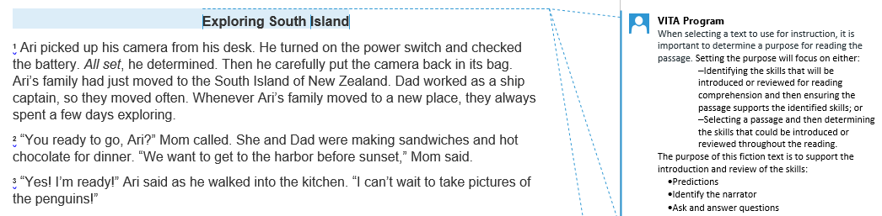
Step 1: Select Authentic Text (5 of 7)
Notes:
The annotations were created by Virginia Department of Education staff from the Office of Humanities and the Office of Student Assessment. VITA Program (Virginia Information Technologies Agency) is the author of the annotations.

Slide 16
Step 1: Select Authentic Text (6 of 7)
Passage: Exploring South Island
This fiction passage example will be used to demonstrate how the selection of authentic text supports the introduction and review of specific skills.
Please see the annotated Word document for additional support.

Slide 17
Step 1: Select Authentic Text (7 of 7)
The selected fiction passage, “Exploring South Island”*, supports the introduction and review of:
  Making, confirming, and revising predictions
  Identifying the narrator
  Asking and answering questions
  *Please see the annotated Word document for additional support.

Slide 18
Step 2: Examine the Content and Progression of Standards for SOL 3.5C
2.7A- Make and confirm predictions.
3.5C- Make, confirm, and revise predictions.
4.5H- Draw conclusions/make inferences about text using the text as support.

Slide 19
Step 2: Examine the Content and Progression of Standards for SOL 3.5F
Grade 2- Introduced in Grade 3
3.5F- Identify the narrator of a story.
4.5E- Identify the narrator of a story and the speaker of a poem.

Slide 20
Step 2: Examine the Content and Progression of Standards for SOL 3.5G
2.7C- Ask and answer questions using the text for support.
3.5G- Ask and answer questions about what is read.
4.5C- Summarize events in the plot.

Slide 21
Step 3: Sample Question Starters for SOL 3.5C
What is a prediction?
Based on the story, what will [insert character(s) name] most likely do next?
In the future, [insert character(s) name] will most likely-
Based on [insert location or title of text], what will most likely happen next?
After reading the passage, what will [insert character(s) name] most likely do the next time [insert detail from passage]? Include specific details from the text to support your answer.

Slide 22
Step 3: Sample Question Starters for SOL 3.5F
What does a narrator do in a story?
Who is telling this story?
Which phrase from [insert location from passage] tells the reader the narrator is one of the characters in the story?
Which detail from the story shows that the narrator is a character in the story? [insert details from passage]
Explain who is the narrator of the story. Include specific details from the text to support your answer.

Slide 23
Step 3: Sample Question Starters for SOL 3.5G
Which question does [insert location from passage] answer?
What question(s) is answered in the story?
Which line from the poem best shows [insert detail from the poem]?
Which paragraph answers the following question: [insert question]. Include specific details from the text to support your answer.

Slide 24
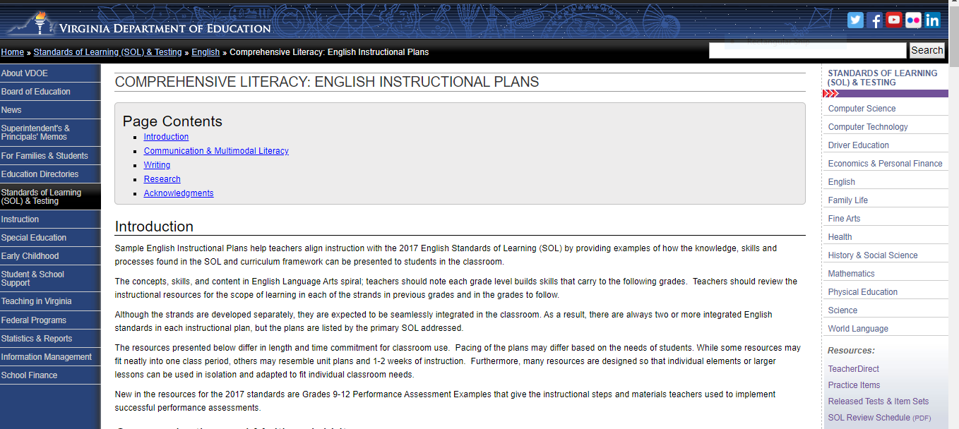
Step 4: Exploring Instructional Resources (1 of 5)
Comprehensive Literacy: English Instructional Plans

Slide 25
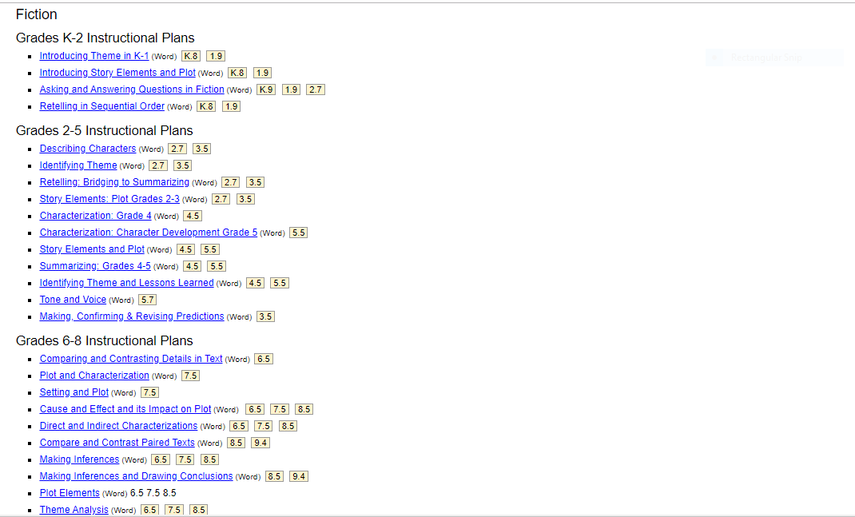
Step 4: Exploring Instructional Resources (2 of 5)

Slide 26
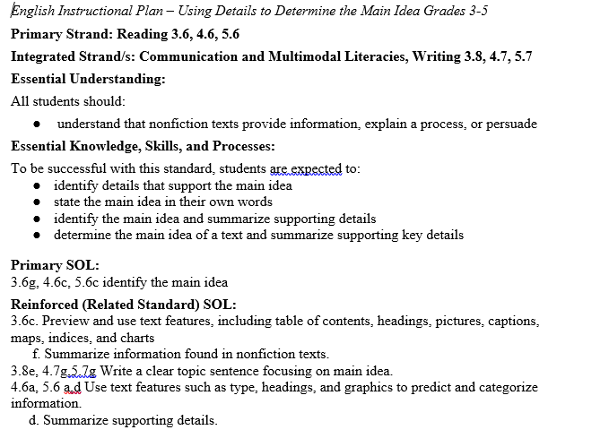
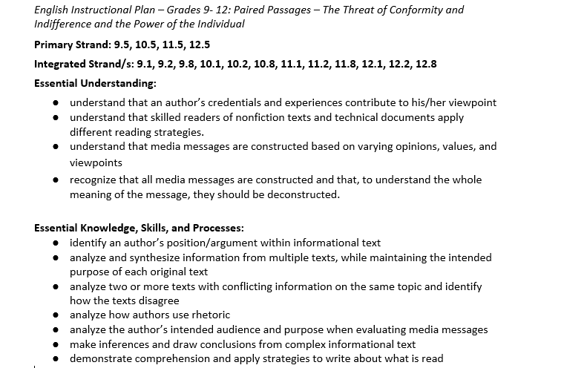
Step 4: Exploring Instructional Resources (3 of 5)

Slide 27
Step 4: Exploring Instructional Resources (4 of 5)
Comprehensive Literacy: English Instructional Plans
  Making, Confirming, and Revising Predictions (3.5C)
This instructional plan was created by Virginia teachers to model how a skill can be introduced or reviewed.
  Please note: text examples within the instructional plans can be changed based on grade level, genre, etc.
  This plan models making, confirming, and revising predictions; however, if the text supports the spiraling of additional skills they should be implemented to support reading comprehension and skill application.

Slide 28
Step 4: Exploring Instructional Resources (5 of 5)
Comprehensive Literacy: English Instructional Plans
  Asking and Answering Questions in Fiction (3.5G)
This instructional plan was created by Virginia teachers to model how a skill can be introduced or reviewed.
  Please note: text examples within the instructional plans can be changed based on grade level, genre, etc.
  This plan models asking and answering questions; however, if the text supports the spiraling of additional skills they should be implemented to support reading comprehension and skill application.

Slide 29
Step 1: Select Authentic Text (1 of 2)
Informational: An Ocean Farm
This nonfiction passage example will be used to demonstrate how the selection of authentic text supports the introduction and review of specific skills.
Please see the annotated Word document for additional support.

Slide 30
Step 1: Select Authentic Text (2 of 2)
The selected article, “An Ocean Farm”*, supports the introduction and review of:
  Text Features
  Inference
  Main Idea
  *Please see the annotated Word document for additional support.

Slide 31
Step 2: Examine the Content and Progression of Standards for SOL 3.6C
2.8A- Preview the selection using text features including table of contents, headings, pictures, captions, and maps.
3.6C- Preview and use text features including table of contents, headings, pictures, captions, maps, indices, and charts.
4.6A- Use text features such as type, headings, and graphics, to predict and categorize information.

Slide 32
Step 2: Examine the Content and Progression of Standards for SOL 3.6E
2.8G- Draw conclusions based on the text.
3.6E- Draw conclusions using the text for support.
4.6E- Draw conclusions and make inferences using textual information as support.

Slide 33
Step 2: Examine the Content and Progression of Standards for SOL 3.6G
2.8F- Identify the main idea.
3.6G- Identify the main idea.
4.6C- Identify the main idea.

Slide 34
Step 3: Sample Question Starters for SOL 3.6C
Identify the text features in the selection.
Why are different text features used in the selection?
Which idea does the [insert text feature] in the article support?
The title [insert title] helps the reader understand that-
The [insert text feature] are included in the article most likely to show-
[Insert inference about name, person, event, etc. from the text]. Explain how the selection supports this inference. Include specific details from the text to support your answer.

Slide 35
Step 3: Sample Question Starters for SOL 3.6E
Which of these is most likely the reason that [insert detail from text]?
Based on the passage, what is the reason for [insert detail from text]?
Based on the passage, what may happen if [insert detail from text]?
[Insert detail from text] happened mostly likely because-
[Insert location or title of text] explains that [insert detail from text] because-
Based on the passage, what can be inferred about [insert name, person, event, etc. from the text]? Include specific details from the text to support your answer.

Slide 36
Step 3: Sample Question Starters for SOL 3.6G
What is a main idea?
[Insert location or title of text] is mainly about-
The main idea of [insert location or title of text] is that-
Which heading best explains the information in [insert location]?
Which sentence from [insert title of text] best describes the main idea?
What is the main idea of [insert location or title of text]? Include specific details from the text to support your answer.

Slide 37
Step 4: Exploring Instructional Resources (1 of 2)
Comprehensive Literacy: English Instructional Plans
  Using Text Features in Nonfiction (3.6C)
This instructional plan was created by Virginia teachers to model how a skill can be introduced or reviewed.
  Please note: text examples within the instructional plans can be changed based on grade level, genre, etc.
  This plan models using text features; however, if the text supports the spiraling of additional skills they should be implemented to support reading comprehension and skill application.

Slide 38
Step 4: Exploring Instructional Resources (2 of 2)
Comprehensive Literacy: English Instructional Plans
  Using Details to Determine Main Idea: Grades 3-5 (3.6G)
This instructional plan was created by Virginia teachers to model how a skill can be introduced or reviewed.
  Please note: text examples within the instructional plans can be changed based on grade level, genre, etc.
  This plan models main idea; however, if the text supports the spiraling of additional skills they should be implemented to support reading comprehension and skill application.

Slide 39
Resources (1 of 3)
Virginia Department of Education: English
  Grade 3 Reading Blueprint
  Grade 4 Reading Blueprint
  Grade 5 Reading Blueprint
  Grade 6 Reading Blueprint
  Grade 7 Reading Blueprint
  Grade 8 Reading Blueprint
  End-of-Course Reading Blueprint

Slide 40
Resources (2 of 3)
Reading Progression Charts
2017 Curriculum Framework
2017 Standards of Learning
Computer Adaptive Testing
Comparison of a Passage-Based CAT and a Traditional Test
Assessment Supports for 2020-2021 Literacy Webinar Series
Recover, Redesign, Restart 2020

Slide 41
Resources (3 of 3)
Frequently Asked Questions about Passage-Based CAT Testing
SOL Practice Items in TestNav 8
2019 English Deeper Learning Conferences
2018 English Standards of Learning (SOL) Institutes
Comprehensive Literary: English Instructional Plans
Superintendent’s Memo 249-20: Update on New Standards of Learning Tests in Reading and History and Social Science

Slide 42
Stay Connected
Office of Student Assessment
  student_assessment@doe.virginia.gov
  (804) 225-2102
Department of Learning and Innovation
  Jill Nogueras, K-12 English Coordinator,
  jill.nogueras@doe.virginia.gov
  Carmen Kurek, Elementary English Specialist,
  carmen.kurek@doe.virginia.gov
  Colleen Cassada, Middle School English Specialist,
  colleen.cassada@doe.virginia.gov

Slide 43
Disclaimer
Reference within this presentation to any specific commercial or non-commercial product, process, or service by trade name, trademark, manufacturer or otherwise does not constitute or imply an endorsement, recommendation, or favoring by the Virginia Department of Education.

Slide 44
Copyright ©2020 by the Commonwealth of Virginia, Department of Education, P.O. Box 2120, Richmond, Virginia 23218-2120. All rights reserved. Except as permitted by law, this material may not be reproduced or used in any form or by any means, electronic or mechanical, including photocopying or recording, or by any information storage or retrieval system, without written permission from the copyright owner. Commonwealth of Virginia public school educators may reproduce any portion of these items for non-commercial educational purposes without requesting permission. All others should direct their written requests to the Virginia Department of Education at the above address or by e-mail to Student_Assessment@doe.virginia.gov.

