Slide 1
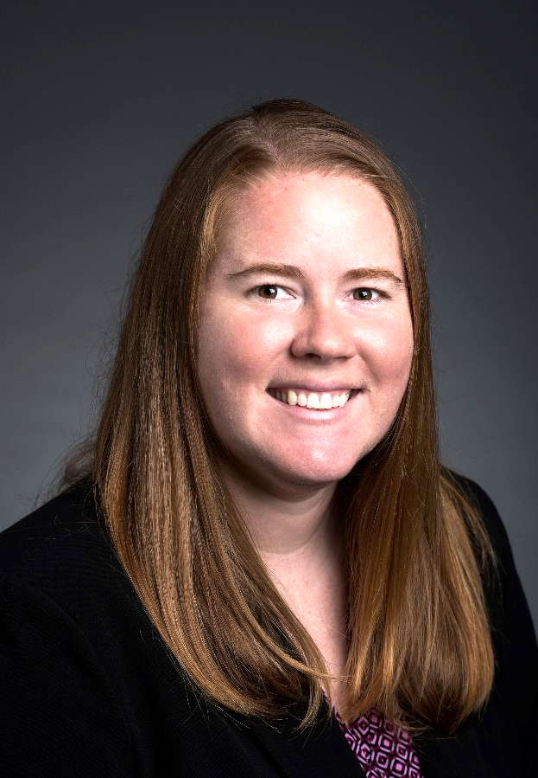




Teaching Math at a Distance
Theresa Wills, PhD, author of Teaching Math at a Distance and Assistant Professor at George Mason University, has taught online for a decade. In that time, Theresa has taught a variety of age groups including K&1, 3, middle school, young adult and and adult learners.
theresawills.com
@theresawills
youtube.com/theresawills

Slide 2
Find all of these templates at:
Find all recordings & slide decks at:
theresawills.com/templates
theresawills.com/mathurdays

Slide 3
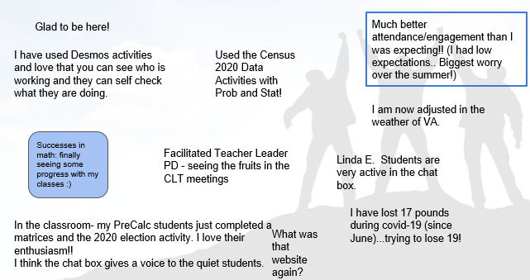
Successes and Celebrations in Math or Personal Lives

Slide 4
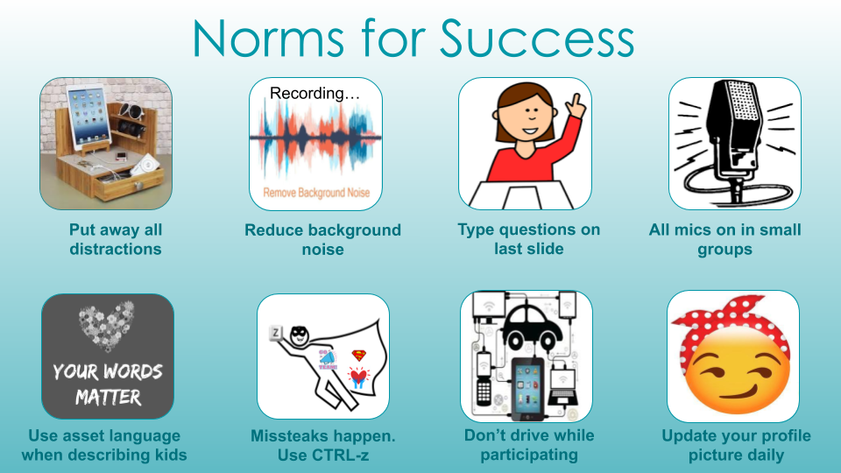

Slide 5
Agenda:
Do the math
Do the discourse
Reimagine the opportunities online
Q&A about the teaching and tech

Slide 6

Notes:
National Council of Teachers of Mathematics. (2015). Principles to Actions: ensuring mathematical success for all. Reston, VA: National Council of Teachers of Mathematics.

Slide 7
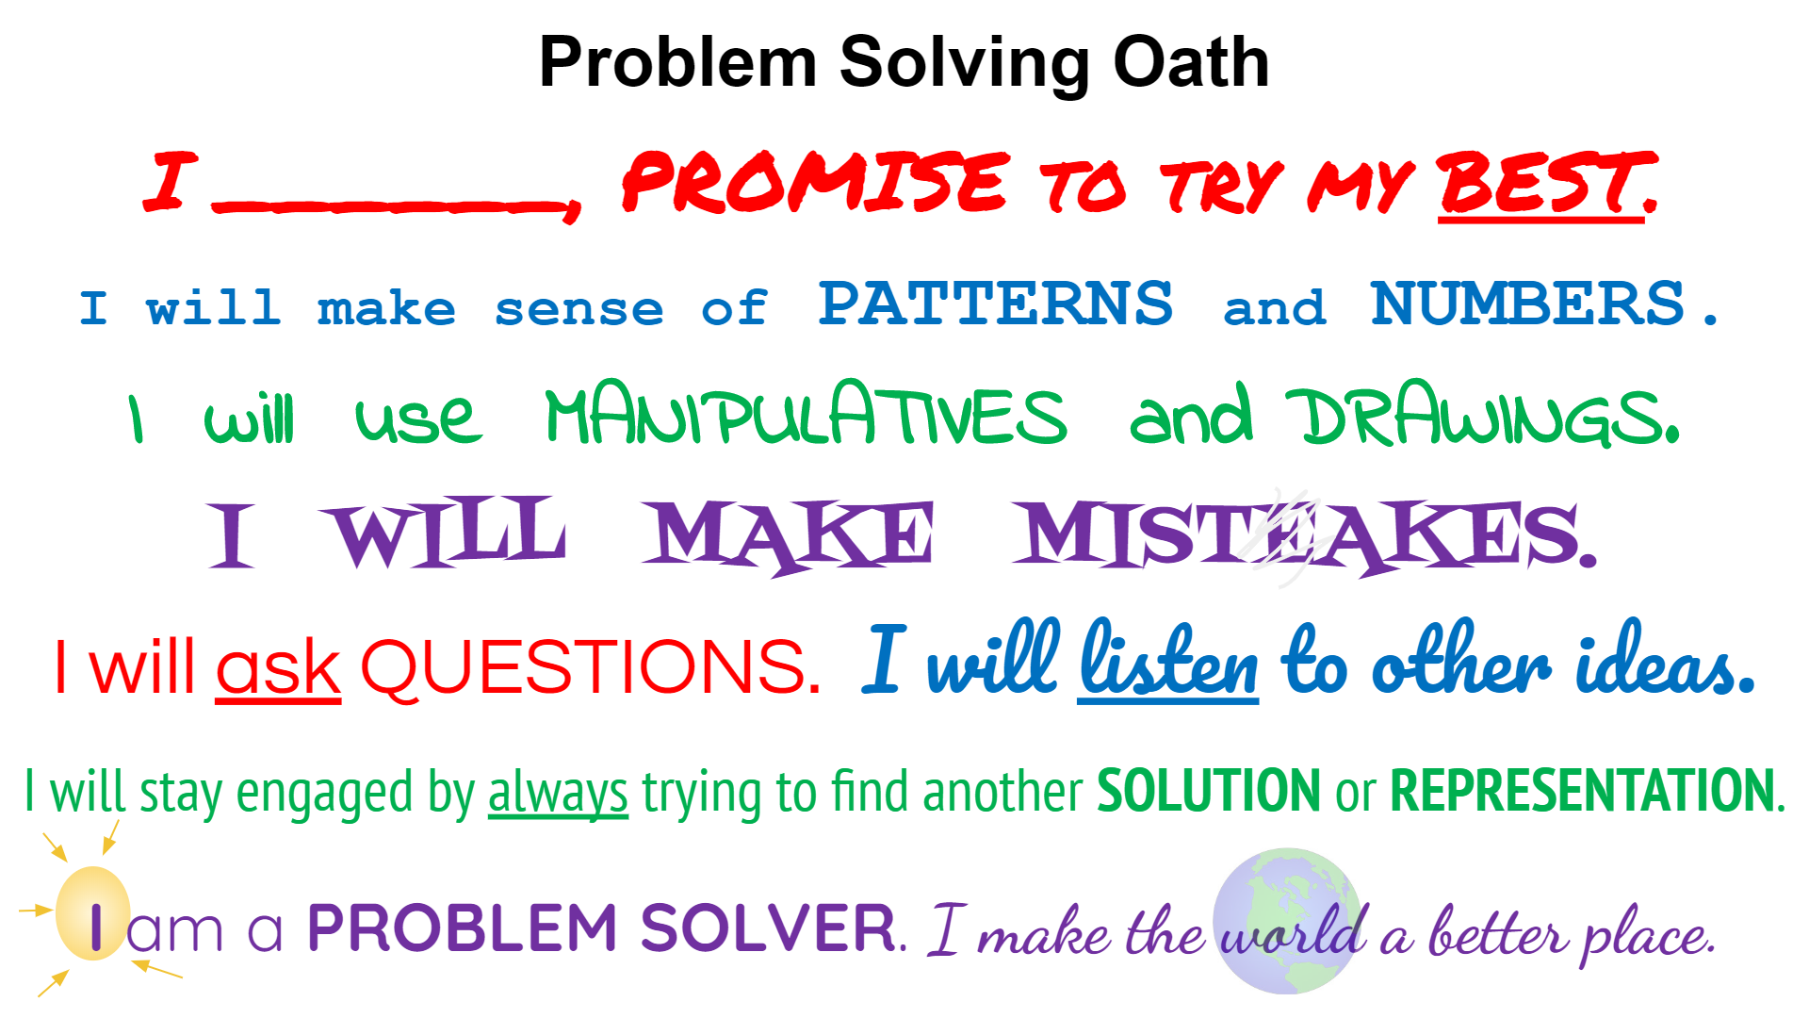

Slide 8

Full Parking Lot
All 20 spaces in my favorite parking lot are filled by vehicles. Some are occupied by two-wheeled motorcycles, and others by cars. Each space has only one vehicle occupying it. To calm myself, I counted wheels and there were exactly 66.
How many cars and how many motorcycles have parked in my lot?

Slide 9

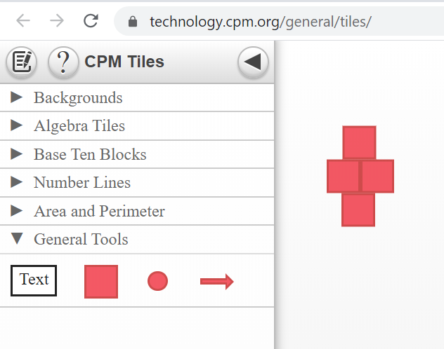
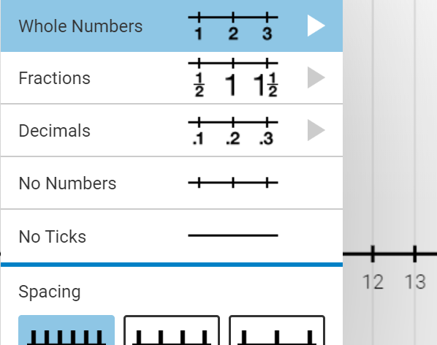
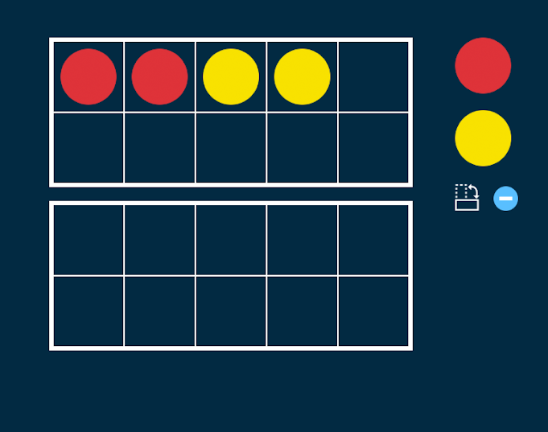
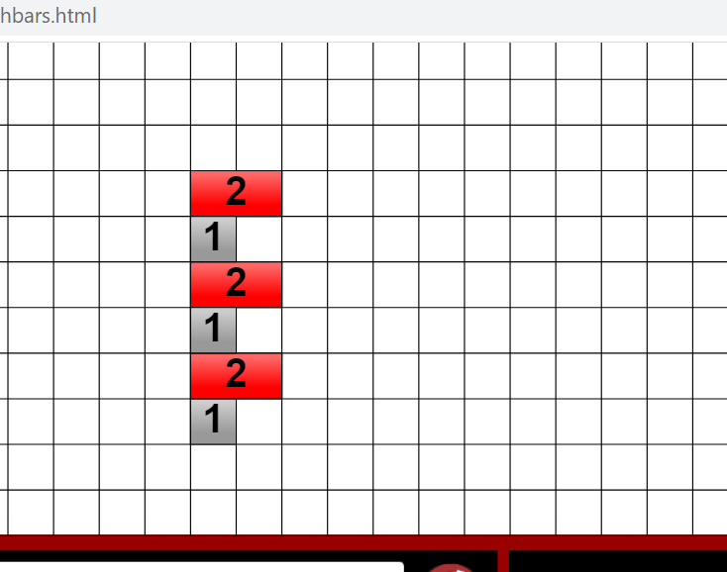
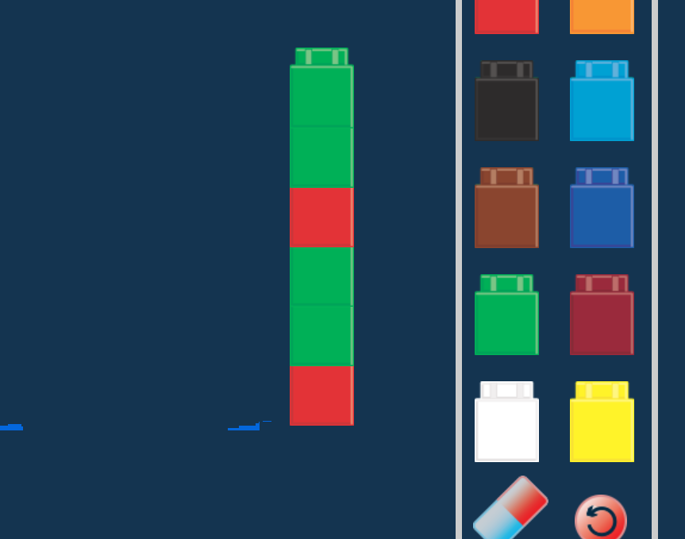
Show your thinking with these virtual manipulatives
CPM Tiles
Model and color code with circles and squares
Interactive Number Line
Model number of feet with “hops” on the numberline.
Ten Frame
Model with two color counters on a Ten Frame.
Cuisenaire Rods
Model different footed animals with cuisenaire rods.
Unifix Cubes
Model solutions with color coded unifix cubes
Notes:
Yes, go ahead and use Desmos, but also consider these :)

Slide 10
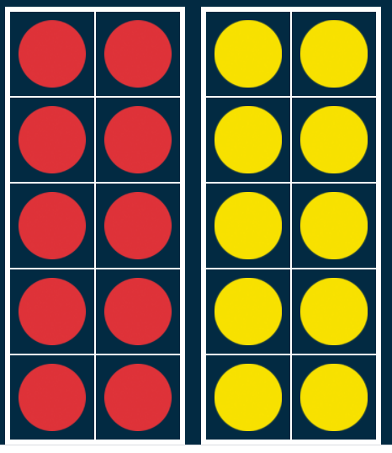
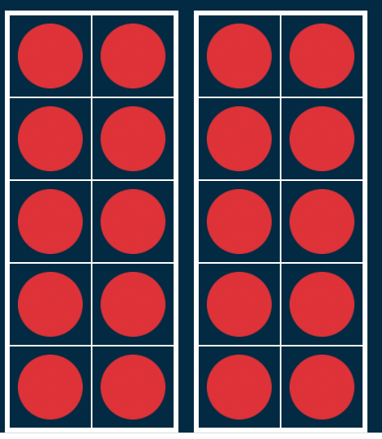
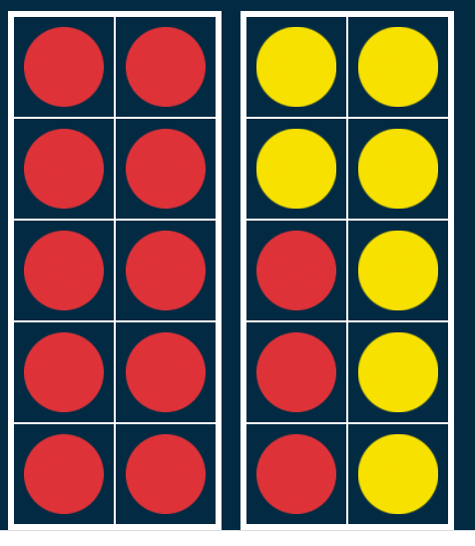
Group 1:
Parking lot with all cars = 20 spots x 4 wheels = 80 wheels -- too many
Parking lot with half cars and half motorcycles 10x4 =40
10x2= 20
60 wheels ---not enough
Cars: 13 spaces x 4 wheels =52
Motorcycles: 7 spaces x 2 wheels = 14 wheels
52 + 14 = 66 wheels

Slide 11
Group 1 Continued:
Let x be the car with 2 wheels (yellow)
Let y be the car with 4 wheels (red)
X+y = 20 space (-2) = -2x - 2y = -40 x + 13 = 20
2x + 4y = 66 wheels 2x + 4y = 66 x = 7 cars with 2 wheels
2y = 26
Y = 13 cars w/ 4 wheels

Slide 12
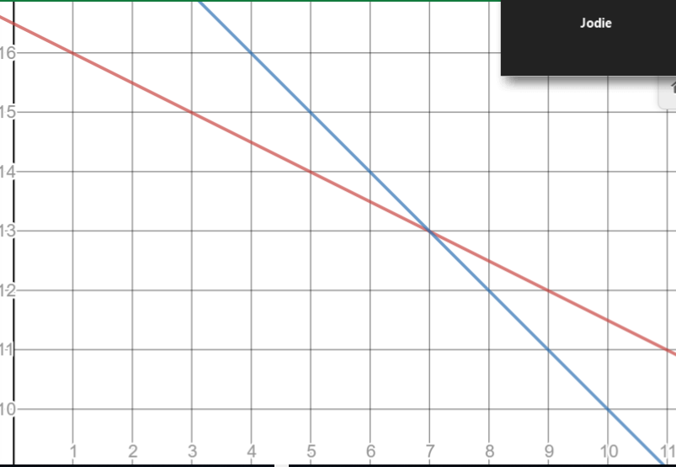
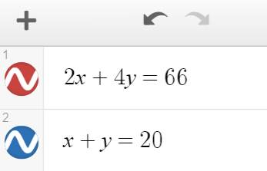
Group 3:
Cars | Motorcycle | Total Wheels
20 | 0 | 80
19 | 1 | 78
18 | 2 | 76
17 | 3 | 74
16 | 4 | 72
15 | 5 | 70
14 | 6 | 68
13 | 7 | 66
12 | 8
11 | 9
C+m=20
4c+2m=66
4(20-m)+2m=66
m=7
C=13

Slide 13
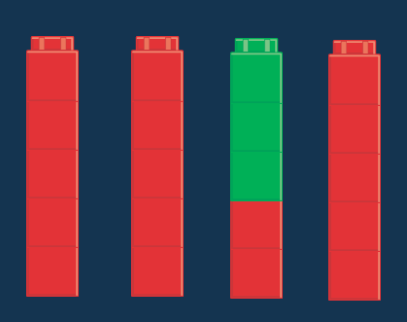
Group 4:
Four wheels
66/4 ~ 16 R 2
16 = max four-wheel vehicles
½(2) = 1 = min two-wheel vehicles
Two wheels

Slide 14
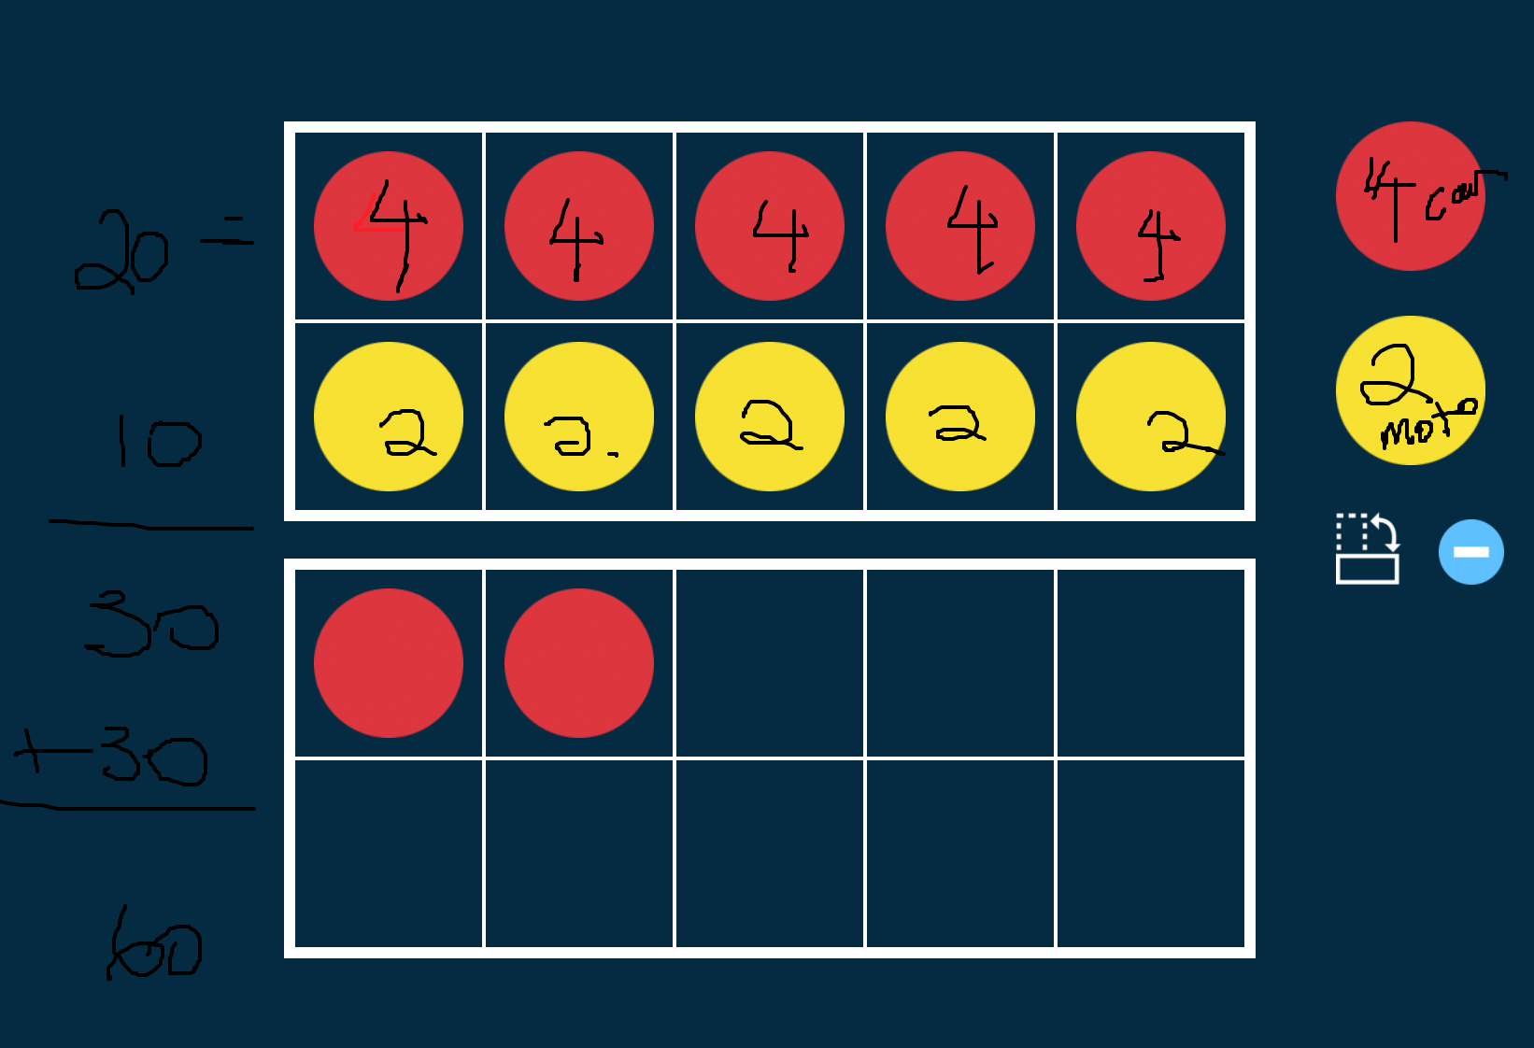
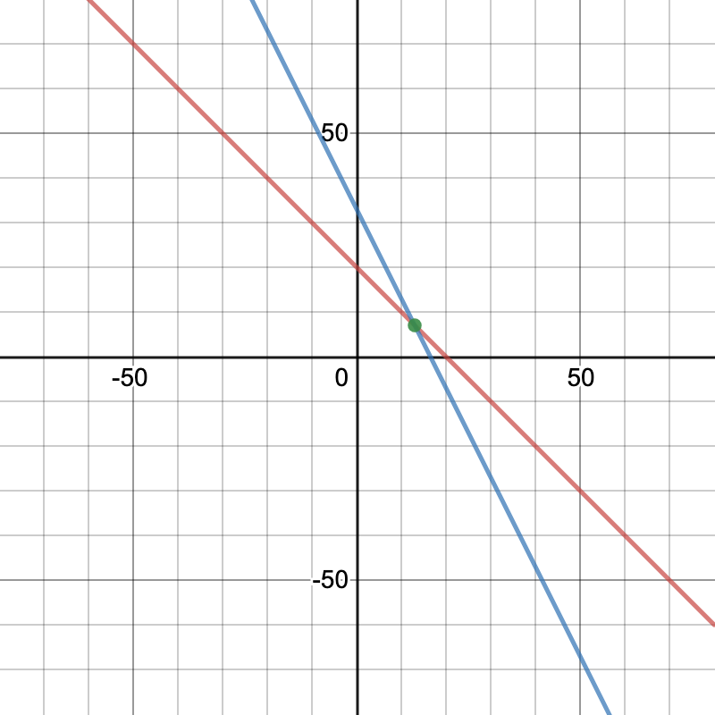
Group 5:
Cars- 4 | Moto- 2 | TTL
10 car - 40 | 10 moto - 20 | 60
11 car - 44 | 9 moto - 18 | 62
12 car - 48 | 8 moto - 16 | 64
13 car- 52 | 7 moto- 14 | 66
(10 cars, 10 moto) =60 | (11,9) | (12,8)

Slide 15
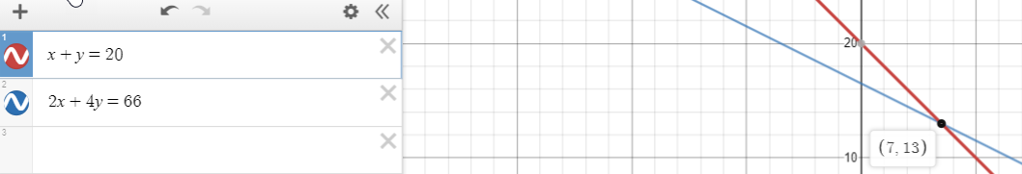
Group 6:
x | motorcycle
y | car
2x + 4y = 66
x+ y = 20
There are 7 motorcycles and 13 cars

Slide 16
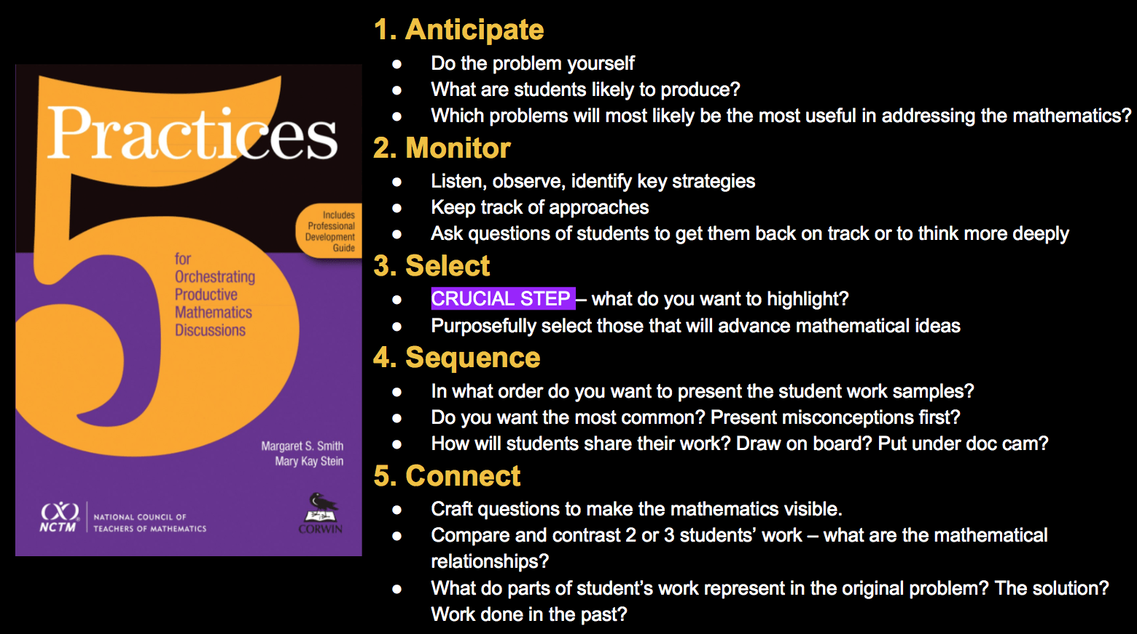
Five Practices

Slide 17
Select, Sequence, and Connect 1
Parking lot with all cars = 20 spots with 80 wheels -- too many
Cars- 4 | Moto- 2 | TTL
10 car - 40 | 10 moto - 20 | 60
11 car - 44 | 9 moto - 18 | 62
12 car - 48 | 8 moto - 16 | 64
13 car- 52 | 7 moto- 14 | 66
(10 cars, 10 moto) =60 | (11,9) | (12,8)
Parking lot with half cars and half motorcycles 10x4 =40
10x2= 20
60 wheels ---not enough

Slide 18
Select, Sequence, and Connect 2
Car | Car | Car 4 wheels | Car r wheels | 4
 | Car 7 | Car 4 wheels | Car 4 wheels
Car/4 wheels | car/ 4 wheels | Car- 4 wheels | Motorcycle 2 wheels | 1 motorcycle
car | Car 4 wheels | Car # 12 | Car-4 wheels | 1 motorcycle (2 wheels)
Four wheels
Two wheels

Slide 19
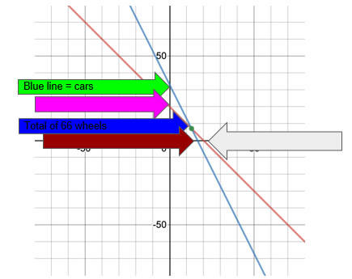
Select, Sequence, and Connect 3
Cars | Motorcycle
20 | 0
19 | 1
18 | 2
17 | 3
16 | 4
15 | 5
14 | 6
13 | 7
12 | 8

Slide 20
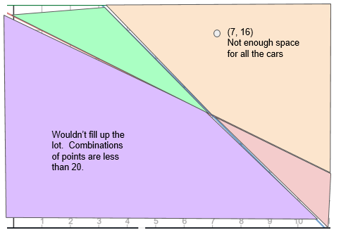
Select, Sequence, and Connect 4
M = motorcycles
C = cars
2m+4c=66
m+c=20
m=7
c= 13
Wouldn’t fill up the lot. Combinations of points are less than 20.

Slide 21
Discussion Prompts
How did you use efficient strategies to split and group wheels?
How could you use tables, graphs and equations to generalize all possibilities?

Slide 22

Teacher Hat
Rich tasks on VDOE website
This task
5 minutes independent think time

Slide 23
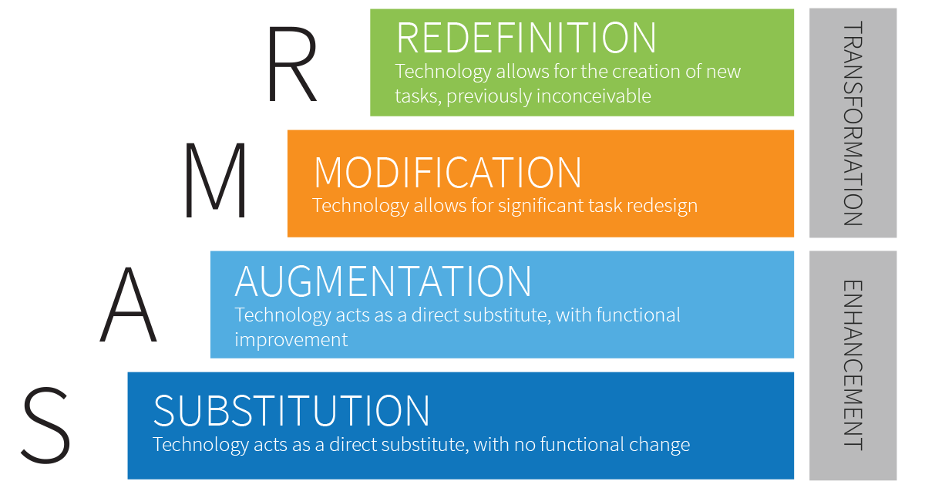
SAMR (1 of 2)

Slide 24
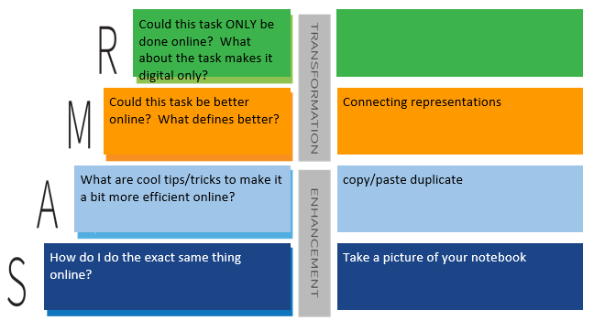
SAMR (2 of 2)

Slide 25
What are your biggest concerns about teaching online?
Ways for kids to do/show work
Unit assessments
Learning cool pedagogy using technology is great. I need more time to practice
Keeping students engaged
Lack of student engagement
Engagement; doing things in order to really learn
Not seeing that they are having trouble with a concept
connecting with the students since they are muted and videos are off
Some students are not engaging; want to use these rich tasks but need help
Getting students to log into the session and participate
Losing kids in links, directions, etc.
Having the right amount of work time for students to learn, but not burn out on screen time
Students engagement
Having time to plan great lessons day to day- is there a “daily” template?
How to know whether or not they are cheating
Formative assessment vs summarize assessment. How do you grade?
Academic honesty with math apps

Slide 26
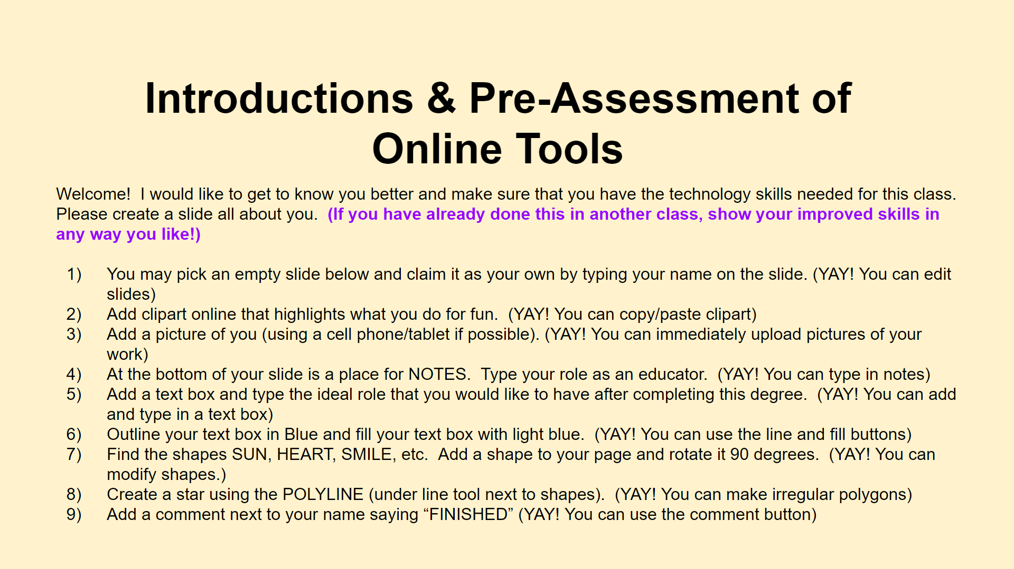

Slide 27
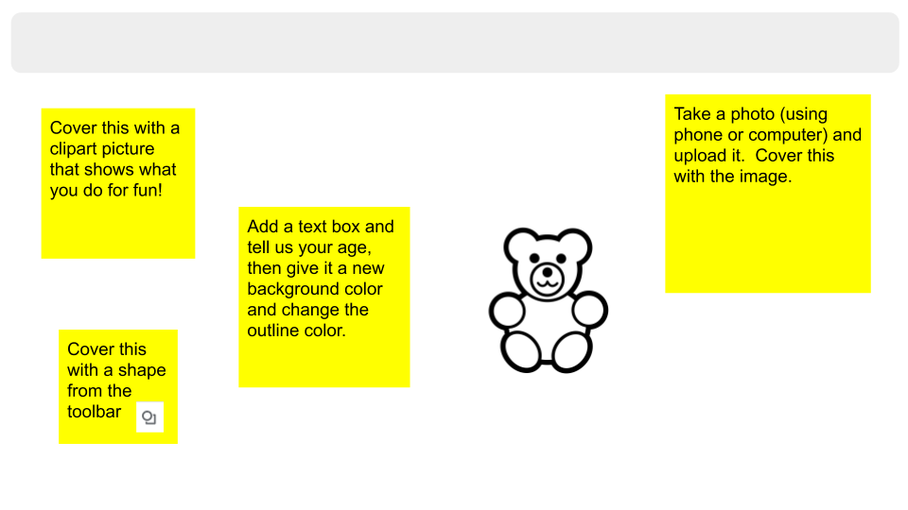
Scavenger Hunt: All About
Type your name
Color the bear using the SCRIBBLE tool under the line tool. Then delete this text box.
Add a comment that says “FINISHED” and turn this box red when you are done.

Slide 28
Frequently Asked Questions
How do I make Drag and Drop slides?
How do I clone objects, stack objects, or make them transparent?
How do I embed google translate to read my directions in english and other languages?
Why is my avatar an anonymous animal and how do I see my students’ names?
How do you teach students to move between zoom/BBcU/Meets/Mteams and googled slides?
I can’t read the small print on the slides. How can I make it bigger?
How do I lock google slides so that students don’t move things?
How do I set up breakout rooms and move between them quickly? BBcU (more platforms to come)
How do I set up safety norms so that students can notify me instantly of problems in breakout rooms?
What if my students have an ipad, phone, or tablet?

Slide 29
Mathurdays- every Saturday at noon Eastern Time
FREE professional development
Engage in best practices for teaching math in remote K-12 classrooms.
Increase student participation
Access templates and lessons that are ready to use immediately.
theresawills.com
@theresawills
youtube.com/theresawills

