Slide 1
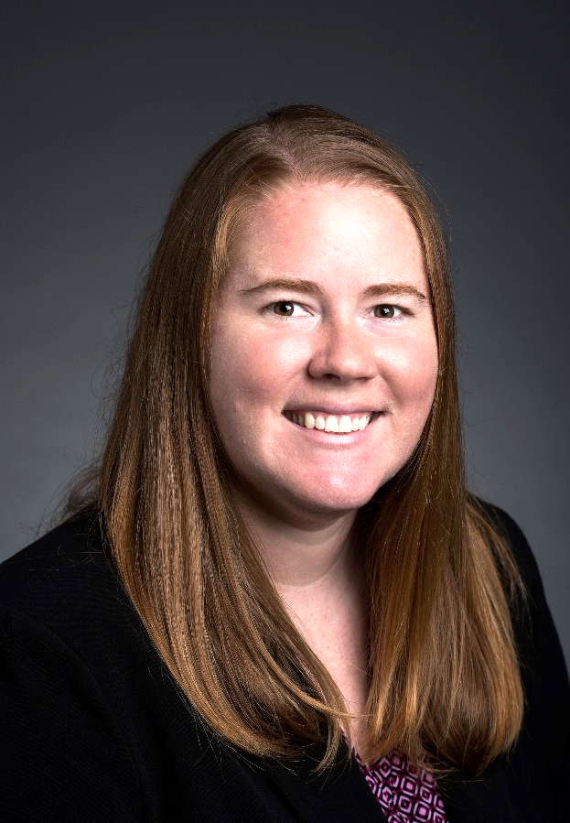
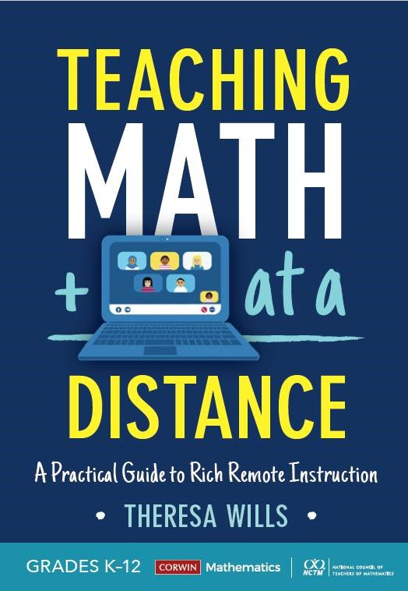



Teaching Math at a Distance
Theresa Wills, PhD, author of Teaching Math at a Distance and Assistant Professor at George Mason University, has taught online for a decade. In that time, Theresa has taught a variety of age groups including K&1, 3, middle school, young adult and and adult learners.
theresawills.com
@theresawills
youtube.com/theresawills

Slide 2
Find all of these templates at:
Find all recordings & slide decks at:
theresawills.com/templates
theresawills.com/mathurdays

Slide 3
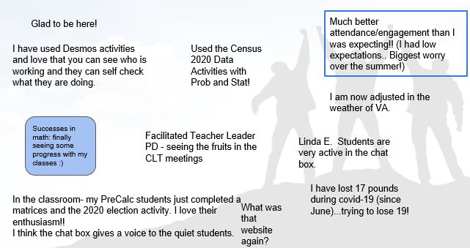
Successes and Celebrations in Math or Personal Lives

Slide 4
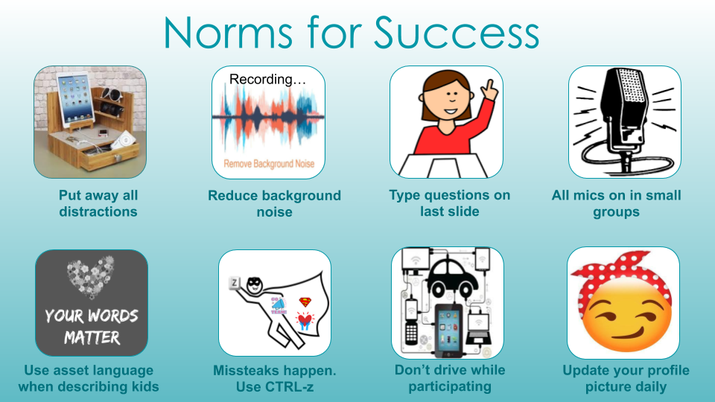

Slide 5
Agenda:
Do the math
Do the discourse
Reimagine the opportunities online
Q&A about the teaching and tech

Slide 6
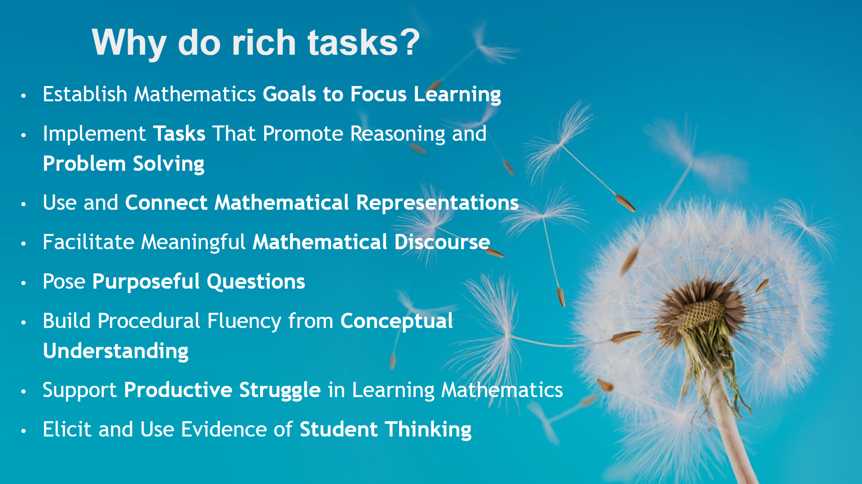
Notes:
National Council of Teachers of Mathematics. (2015). Principles to Actions: ensuring mathematical success for all. Reston, VA: National Council of Teachers of Mathematics.

Slide 7
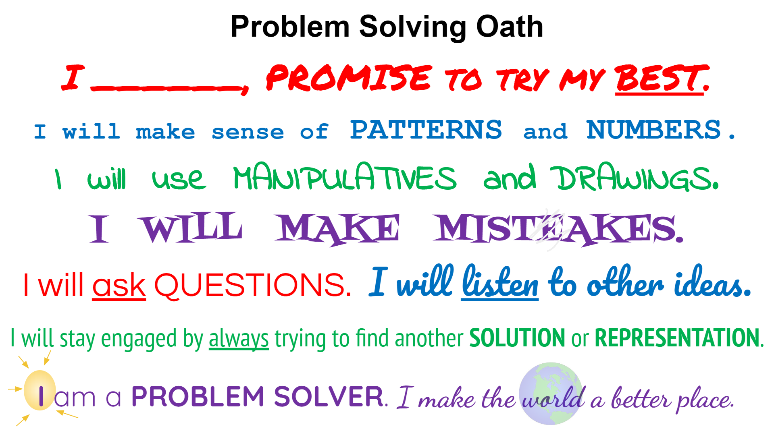

Slide 8
Task: It’s Your Lucky Day (1 of 3)
J. Beans, Inc. produces two different flavor mixes at their jelly bean factory. Their most popular J. Beans are the Original Juicy Beans, but they also sell a surprisingly large quantity of their Junk Beans as well. If you look at flavor guides for these two mixtures, you will see that the Juicy Bean coconut flavor and the Junk Bean soap flavor look identical. Likewise, buttered popcorn and rotten egg look the same.
Ms. Chievous makes two bowls of jelly beans with her own unique mixture of flavors.
The tables show how many jelly beans of each flavor Ms. Chievous placed in the two bowls:
Bowl 1: Bowl 2:
Flavor | Number of Jelly Beans
Coconut | 3
Soap | 2
Flavor | Number of Jelly Beans
Buttered Popcorn | 4
Rotten Egg | 2

Slide 9
Task: It’s Your Lucky Day (2 of 3)
Ms. Chievous explains that she will select the name of one student who can have two of the jelly beans from her bowls. It is your lucky day, Ms. Chievous draws your name and asks if you are willing to choose two jelly beans and eat them in front of the entire class. You accept the challenge, but are really hoping to avoid having your mouth taste like it is filled with soap or a rotten egg.
Three of your best friends give you some advice.
Susan suggests that you pick two jelly beans from bowl 1. | Todd advises you to pick both jelly beans from bowl 2. | Jamie tells you that you should pick one jelly bean from each bowl.

Slide 10
Task: It’s Your Lucky Day (3 of 3)
Susan suggests that you pick two jelly beans from bowl 1. | Todd advises you to pick both jelly beans from bowl 2. | Jamie tells you that you should pick one jelly bean from each bowl.
Think this through carefully! Ms. Chievous will have the camera rolling as you eat each jelly bean. Whose advice should you follow?
Explain your reasoning thoroughly enough to convince us that you are making the best out of your lucky day.

Slide 11


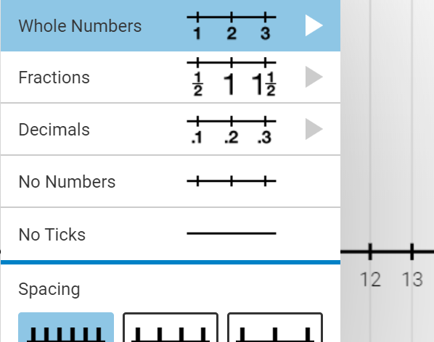
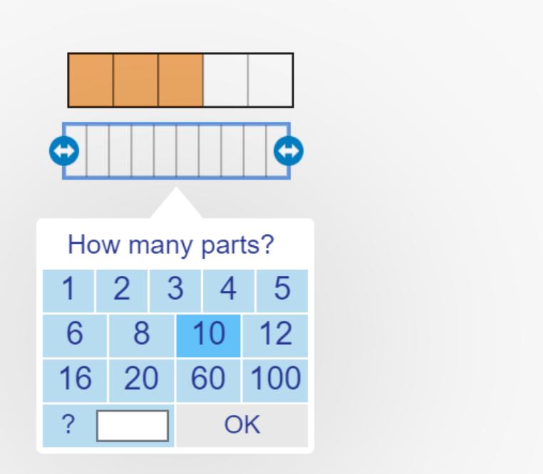
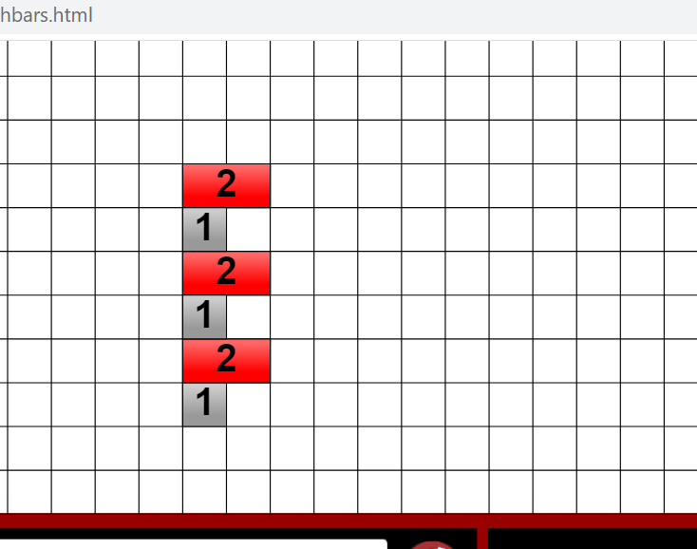
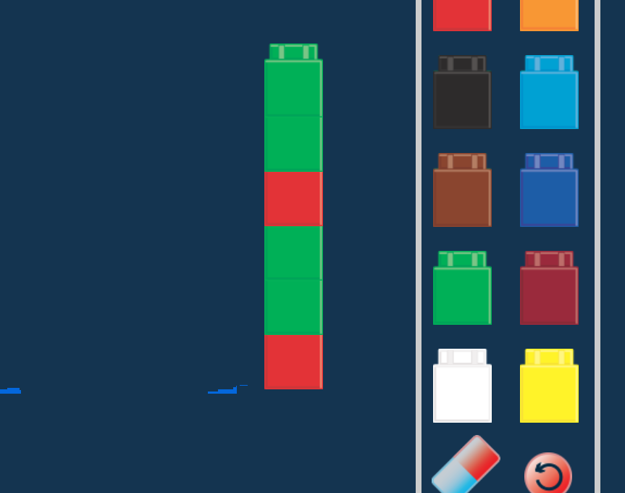
Show your Thinking with these Virtual Manipulatives
Two color counters
Create models to extend ratios and proportions
Interactive Number Line
Ability to “hop” on a linear model
Fraction Models
Create custom bar and circle area models
Cuisenaire Rods
“Locked” sizes for a compare model.
Unifix Cubes
Multi-color stackable cubes for a hybrid linear, set, and area model.
Notes:
Proportions - orange juice

Slide 12

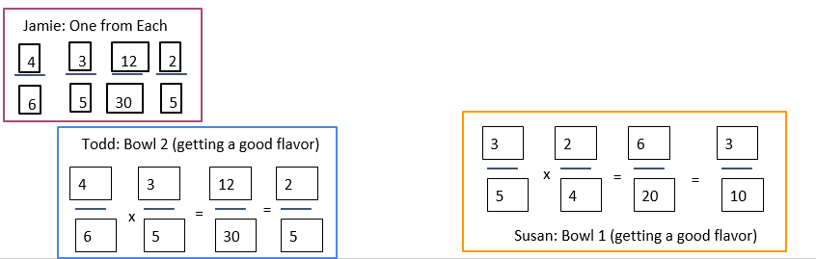
Group 1:
So, follow either Todd’s or Jamie’s advice.

Slide 13
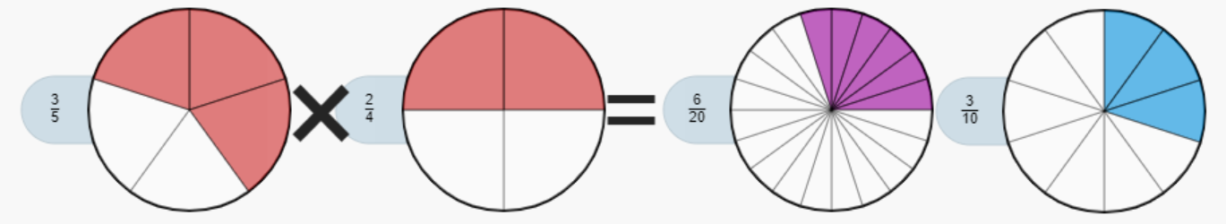
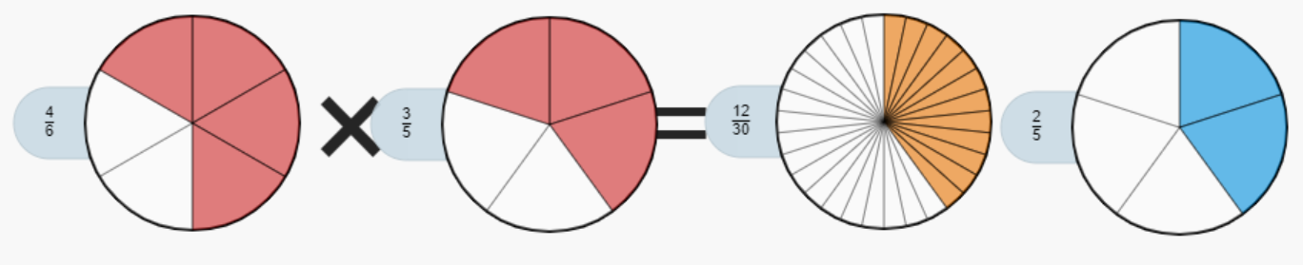
Group 2:
Susan’s suggestion has a 30% chance of a good flavor
Todd’s suggestion has a 40% chance of a good flavor
Jamie was 40% too.
Take Todd’s advice!
Susan - p(f) - .3; p(u) - .2; p(1/1): .5
Todd - p(f) - .4, p(u) - .067; p(1/1): .53
Jamie - p(f) -.38; p(u) - .11; p(1/1): . 5

Slide 14
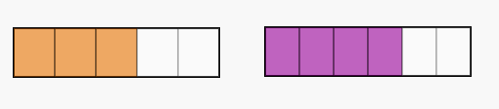
Group 3:
Susan: prob of picking two good from bowl 1:
⅗ x 2/4 = ⅗ x ½ = 3/10 = 30% chance
Todd: prob of picking two good from bowl 2
4/6x ⅗= 2/3x ⅗ =⅖= 40%
Definitely not Susan, choosing either Todd or Jamie would give you the same probability mathematically.
Jamie- prob of picking good from each bowl
⅗ x 4/6 - ⅗ x ⅔ = ⅖ = 40%
Bowl 1 -brown is good jelly beans
Bowl 2: purple is good jelly beans

Slide 15
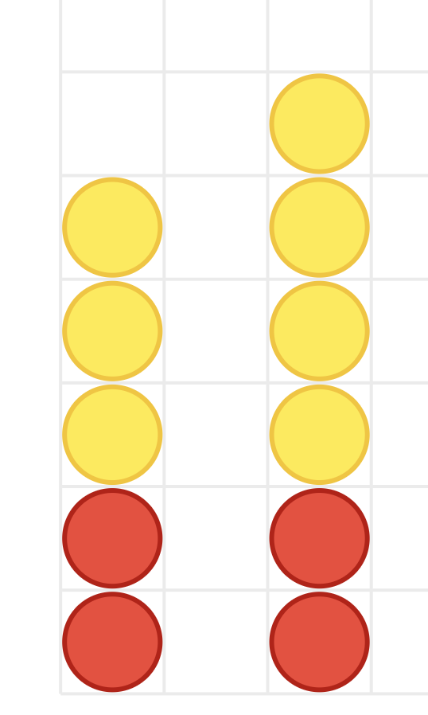
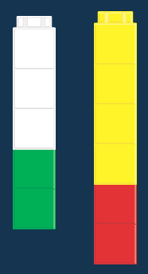
Group 4:
Going with Jamie (because I want a coconut) based on probability. Assuming luck with first pick: Bowl 1: ⅗ & Bowl 2: ⅔ = 40%
However, if first pick is not lucky, then I go with Todd.
Bowl 1
Bowl 2

Slide 16
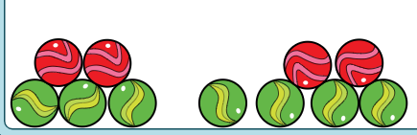
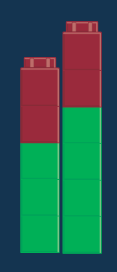
Group 5:
Bowl 2
Bowl 1
Bowl 1
Bowl 2
As a team we determined that we would take Todd’s advice. Together you have a greater chance of getting a good vs bad jelly bean.

Slide 17
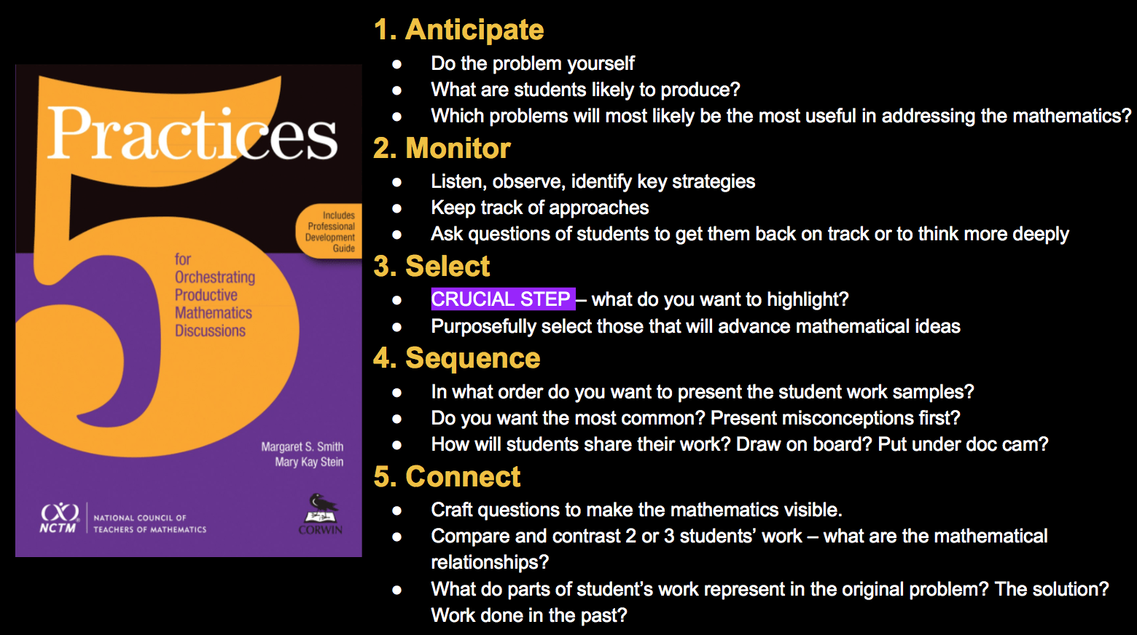
Five Practices

Slide 18
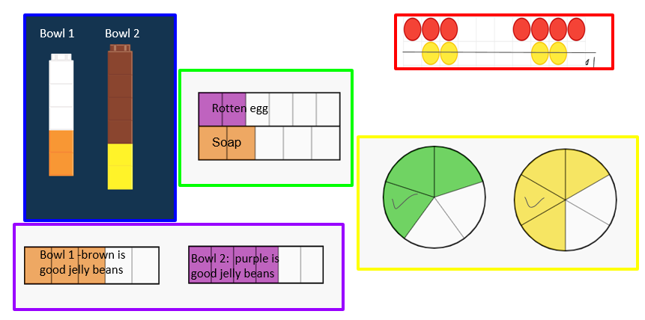
Select, Sequence, Connect 1
What does 2 mean in these representations?

Slide 19
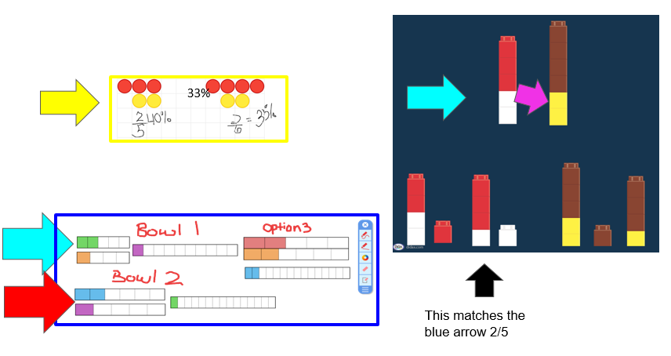
Select, Sequence, Connect 2

Slide 20
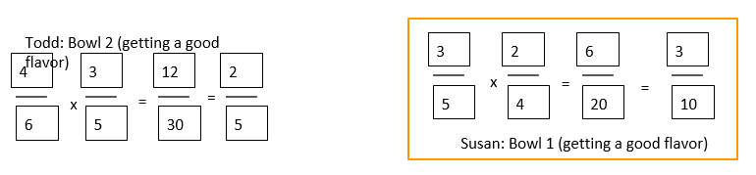
Select, Sequence, Connect 3

Slide 21
Discussion Prompts
How can different representations help us to compare ratios and proportions?
What strategies focus on a part/whole and part/part relationship? How does that help you to understand probability?

Slide 22
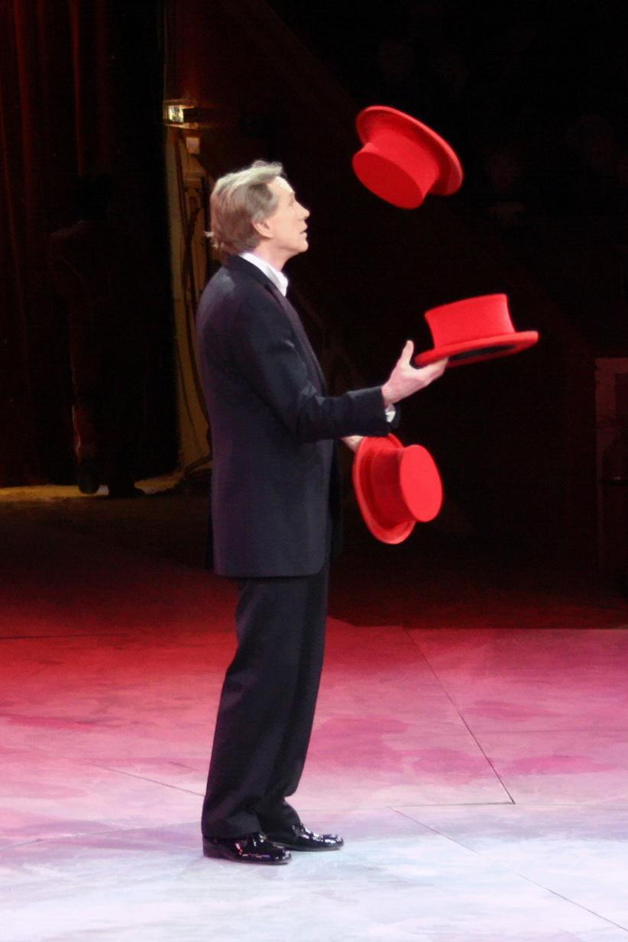
Teacher Hat
Rich tasks on VDOE website
This task
5 minutes independent think time

Slide 23
What opportunities were available because of the technology?
I had the opportunity to work with manipulatives I haven’t used before.
Creating multiple visual representations
To use various manipulatives that showed students’ different ways of thinking about a problem.
Choices to use as models. Time to discuss ideas with others.
To use different manipulatives that I have not used.
All of us were given the opportunity to use manipulates (1 to 1) and we had a choice for which one to use.
Students are able to solve problems as a group virtually with manipulatives.
Small group work in a breakout room that was undisturbed by other groups
Work with others collaboratively
Choice, ability to converse with others
Seeing a variety of manipulatives that I was not familiar with.
Brainstorming/collaborating with colleagues across the state
Notes:
Please list grade level & topic.

Slide 24
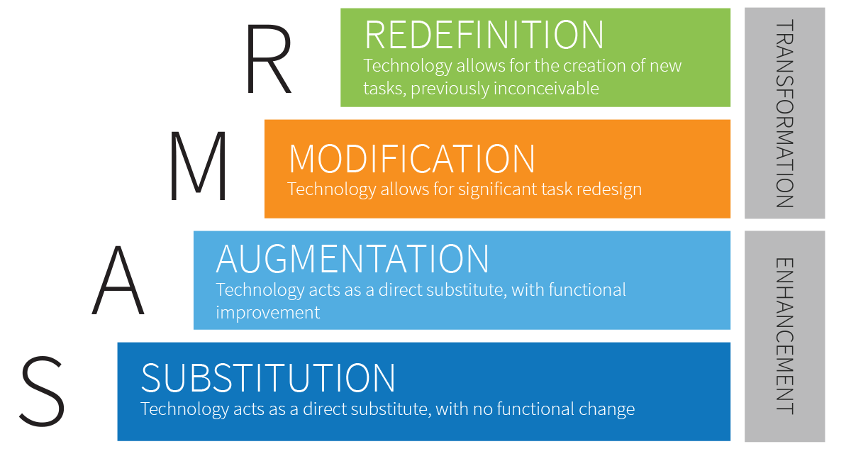
SAMR (1 of 2)

Slide 25
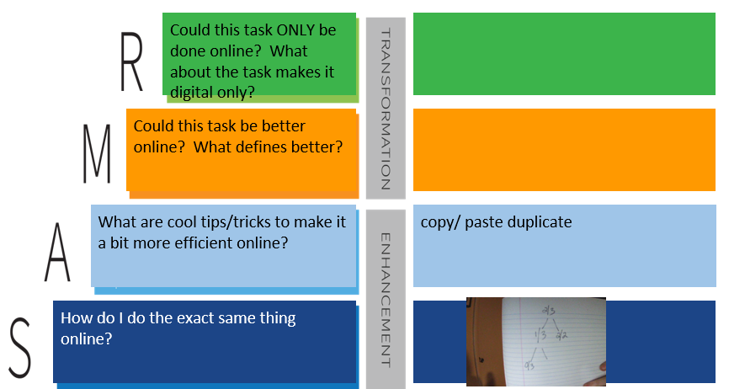
SAMR (2 of 2)

Slide 26
What are your biggest concerns about teaching online?
My concern is my sped students receiving all their accommodations and modifications.
Free resources vs. paid subscriptions
Reliability of technology.
Student engagement, especially when they are working in groups and I am with a different group
Cannot see student work to follow their thinking which is important in math.
Student motivation, especially during asynchronous times
Teaching the students how to use the materials in a timely manner.
How to get students to keep their cameras on and stay engaged
We live in a small county with spotty or no wifi, reaching students who are virtual and getting online.
Reaching all students and student accountability.
Selecting the right kinds of manipulatives so that I am not overwhelming them by sharing too many, while also sharing enough that there are option for diverse thinkers.
7th and 8th grade. Not having their camera on makes it difficult to know if the students are paying attention. Especially students with IEP’s, 504, etc.
Student engagement
Distractions that students have in their houses. Not able to concentrate.
Managing all those moving parts
The overwhelming amount of resources/information presented to us
Notes:
Please list grade level & topic.

Slide 27

Scavenger Hunt: All About
Cover this with a clipart picture that shows what you do for fun.
Type your name
Take a photo (using phone or computer) and upload it. Cover this with the image.
Add a text box and tell us your age, then give it a new background color and change the outline color.
Cover this with a shape from the toolbar.
Color the bear using the SCRIBBLE tool under the line tool. Then delete this text box.
Add a comment that says “FINISHED” and turn this box red when you are done.

Slide 28
Frequently Asked Questions
How do I make Drag and Drop slides?
How do I clone objects, stack objects, or make them transparent?
How do I embed google translate to read my directions in english and other languages?
Why is my avatar an anonymous animal and how do I see my students’ names?
How do you teach students to move between zoom/BBcU/Meets/Mteams and google slides?
I can’t read the small print on the slides. How can I make it bigger?
How do I lock google slides so that students don’t move things?
How do I set up breakout rooms and move between them quickly? BBcU (more platforms to come)
How do I set up safety norms so that students can notify me instantly of problems in breakout rooms?
What if my students have an ipad, phone, or tablet?

Slide 29
Mathurdays- every Saturday at noon Eastern Time
FREE professional development
Engage in best practices for teaching math in remote K-12 classrooms.
Increase student participation
Access templates and lessons that are ready to use immediately.
theresawills.com
@theresawills
youtube.com/theresawills

