Slide 1
Understand Scoring
For Use With Local Alternative Assessments in Grade 5 Writing

Slide 2
About the Webinar
During the webinar, please use the CHAT feature to submit questions to “all panelists and attendees.”
The slides from this presentation and the recorded webinar itself will be posted on the Comprehensive Literacy Webinar Series web page.

Slide 3
Overview
What Is Understand Scoring?
Accessing Understand Scoring
Using Understand Scoring
  Scoring Local Alternative Assessments
  More Uses for Understand Scoring
What Is Coming Next?

Slide 4
What Is Understand Scoring?
Understand Scoring is an online application hosted by the Virginia Department of Education and Pearson.
Understand Scoring was originally created to provide additional information about scoring the short paper component of the Grade 5, Grade 8, and End-of-Course (EOC) Writing Standards of Learning (SOL) assessments.

Slide 5
What Has Changed?
In fall 2020 the Grade 5 Writing tab was updated to provide information about administering and scoring Local Alternative Assessments in writing. Information about the Grade 5 Writing SOL test has been removed.

Slide 6
Accessing Understand Scoring
Locating the Application through the Virginia Department of Education’s Website

Slide 7
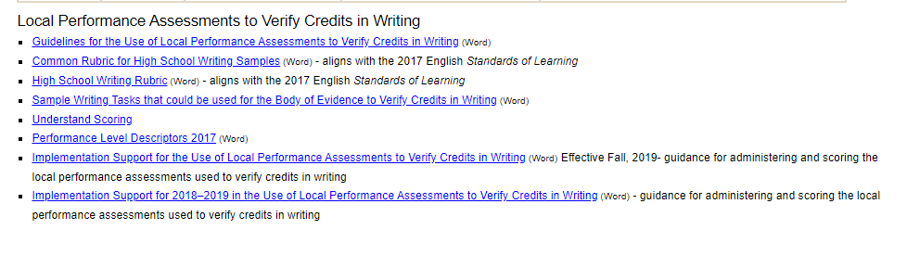
Accessing Understand Scoring (1 of 2)
To access Understand Scoring, follow the link provided in one of two places on the Virginia Department of Education’s website.
Notes:
A screenshot of the Local Performance Assessments to Verify Credits in Writing section of the VDOE English Standards of Learning web page. A red arrow points to the hyperlink for Understand Scoring.

Slide 8
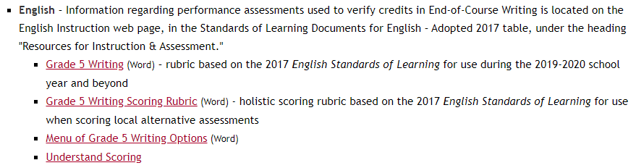
Accessing Understand Scoring (2 of 2)
Performance Assessments & Local Alternative Assessments
Notes:
A screenshot of the table for the 2010 English SOL resources on the VDOE English Standards of Learning web page. A red arrow points to the hyperlink for Understand Scoring.

Slide 9
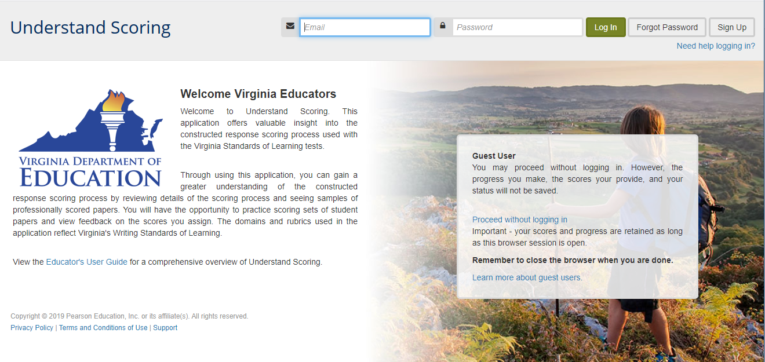
Getting Started
Clicking either link takes a user to the sign-in page for Understand Scoring.
Notes:
A screenshot of the Understand Scoring web page. A red arrow points to the Sign Up button in the top right corner.

Slide 10
Getting Started: Sign Up
Choose “Sign Up” in the upper right corner of the web page to create an account.
Users may access Understand Scoring as a guest, but work will not be saved.
Note: All accounts were reset summer 2020 to accommodate users needing to requalify for EOC Performance Assessment scoring.

Slide 11
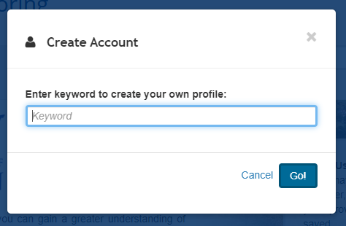
Getting Started: Keyword
A keyword is required in order to create an account.
The keyword is Virginia. Please refer to Superintendent’s Memo #194-20 dated July 31, 2020.
Notes:
Say it’s Virginia and refer to sup memo

Slide 12
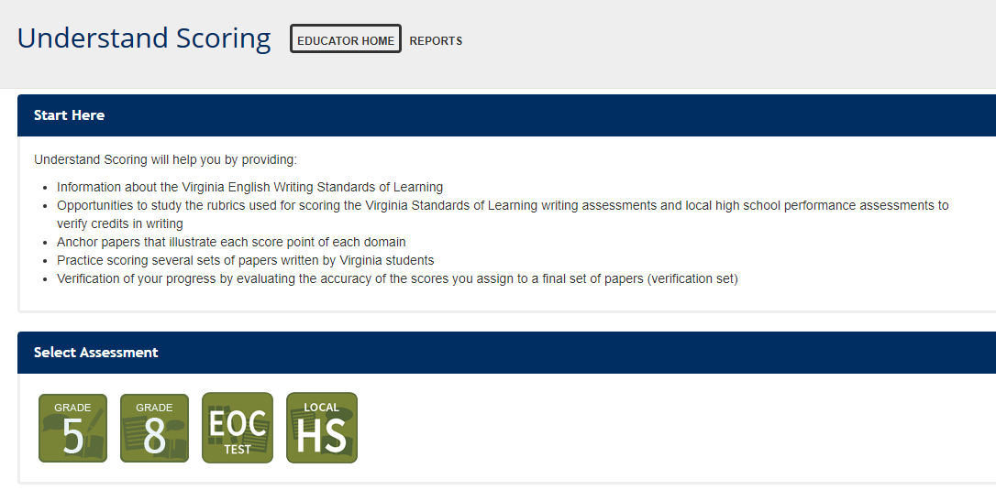
Grade 5 Writing
Notes:
A screenshot of the Understand Scoring home page. A red arrow points to the Grade 5 button.

Slide 13
Materials Available (1 of 2)
Rubrics used for scoring local alternative assessment for Grade 5 Writing
Anchor papers that illustrate each score point of each domain
  Annotations for each anchor paper to provide explanations for score points
  Overlays that highlight information from the annotations

Slide 14
Materials Available (2 of 2)
Practice sets to provide Virginia educators experience with scoring papers written by Virginia students
  Annotations for each practice paper, available after educators have completed each set
Verification sets used to ensure that scores assigned are consistent with performance expectations established by the scoring rubrics
  Divisions may choose to use the Verification Set scores to qualify readers for scoring local alternative assessment for Grade 5 Writing

Slide 15
Best Practice for Scoring (1 of 2)
Divisions may choose how to train and qualify scorers for the Local Alternative Assessment in Grade 5 Writing.
Consider the information provided in the Procedures for Training Scorers and Scoring section of the local high school landing page in Understand Scoring.

Slide 16
Best Practice for Scoring (2 of 2)
Scorers should read and understand:
  All information in the Grade 5 tab within Understand Scoring.
  The scoring rubric for the Composing/Written Expression domain and each of the Composing/Written Expression anchor papers and annotations.
  The scoring rubric for the Usage and Mechanics domain and each of the Usage and Mechanics anchor papers and annotations.

Slide 17
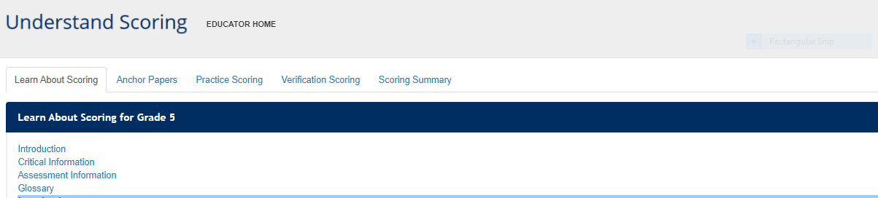
Learn About Scoring
Before viewing the Anchor Papers or attempting the Practice Sets, it is important to read and understand the information included in the Learn About Scoring section.
Notes:
A screenshot of the Learn About Scoring tab. The sections within Learn About Scoring are Introduction, Critical Information, Assessment Information, and Glossary.

Slide 18
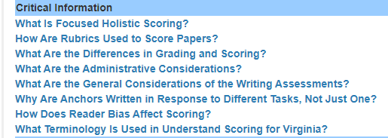
Critical Information: Overview
The Critical Information section provides a closer look at some details related to administering and scoring the local alternative assessment in writing.

Slide 19
Focused Holistic Scoring
Papers for the local alternative assessment are scored, not graded.
The information included in the Focused Holistic Scoring section begins to differentiate scoring and grading.

Slide 20
Focused Holistic Scoring: Definition
Focused holistic scoring is the evaluation of writing proficiency based on specific elements or domains of writing.
  Each domain is scored holistically, independently of the other, and the score reflects the reader’s overall impression according to the rubric’s features.
  The scorers weigh the student’s relative strengths or weaknesses and then assign a score point for each domain that most accurately describes the attributes of the paper.

Slide 21
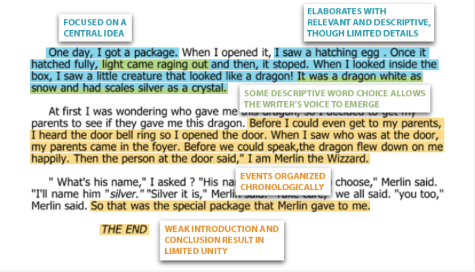
Overall Impression Example
A paper assigned a score of 3 in composing and written expression, for example, might have some characteristics of a 2-level paper and some characteristics of a 4-level paper, but overall, its 3-level characteristics predominate.
Notes:
At right, a screenshot of a 3-level anchor paper with overlays.

Slide 22
Understand Scoring- Learn About Scoring
Nonscorable Papers
All papers, no matter how brief, must be scored, unless they are off-topic, incoherent, or in a language other than English. Papers that express a student’s refusal to respond to the assessment are also considered nonscorable.
Readers should only score what was written by the student. Written here includes appropriately attempting to embed and cite research from outside sources. Before, during, and after scoring student samples, it is a local division’s decision how to handle intentional and unintentional plagiarism. Based on guidance from the Virginia Department of Education when assigning a score point, the reader should evaluate only the student’s work and not information that has been plagiarized. Please see 5th Grade Practice Set 5, Paper 3 and its annotation for an example of plagiarized information that should not be considered when scoring.

Slide 23
Questions About Scoring (1 of 2)
Should a writing sample lose a point if:
It includes a digression?
It does not have five paragraphs?
No. The score should reflect the reader’s overall impression, based on the rubric.
The rubric, even for score point 4, states “few, if any, digressions.”
The rubric does not mention formulaic writing.

Slide 24
Questions About Scoring (2 of 2)
Should a writing sample gain a point if:
There are quotation marks, one question mark, and one exclamation point, regardless of appropriate use?
There are five paragraphs?
No. The score should reflect the reader’s overall impression, based on the rubric.
The rubric does not mention tallying the variety of punctuation marks to award a higher score.
The rubric does not mention formulaic writing.

Slide 25
Preferences Vs. Rubrics
Papers must be scored holistically, not graded. An educator’s classroom preferences and rules for writing, if not included in the Virginia writing rubrics, are not features to score.
Example: “Uses highly specific word choice, descriptive language, and selected information, creating an appropriate tone and enhancing the writer's voice.” (Composing/Written Expression)
  Does not say “No second-person pronouns.”

Slide 26
Focused Holistic Scoring: Range of Papers
It is important for local scorers to understand the criteria used in assigning a score and not to expect papers at a certain score point always to look the same or have the same attributes.
Papers receiving the same score point may look very different from each other.
Within each score point, a range of papers representing the lower, middle, and upper ends will be evident, as it is in any scoring.
Notes:
This is analogous to the range when grading. For example, the range in many school divisions for an A is 91 to 100, but every score within this range would be considered an A. While scoring and grading are not the same, this is one way in which they are similar.

Slide 27
How Are Rubrics Used to Score Papers?
Scorers for the Grade 5 writing assessment must use rubrics in conjunction with anchor papers to appropriately assign scores to student writing samples.

Slide 28
Using Rubrics and Anchor Paper Sets
Generally, rubrics for writing assessments are fairly generic and provide the general description of a score point, while anchor papers provide examples of student writing that illustrate the rubric descriptions.
It is only in conjunction with anchor papers that the criteria at each score point of the rubric begin to be clarified.

Slide 29
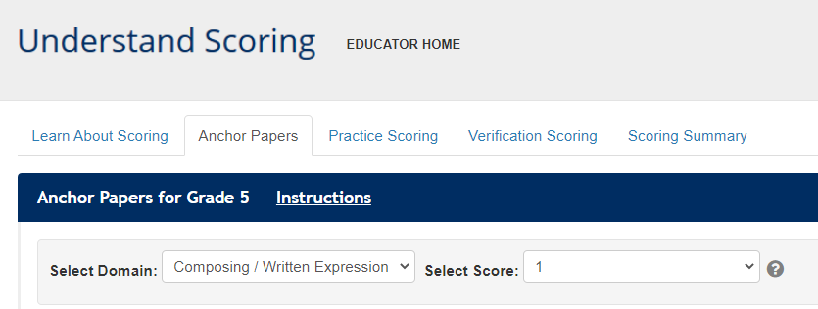
Anchor Papers
Revisiting anchor papers, even after qualifying to become a scorer, helps ensure that the scorer remains tied to the performance expectations in each domain.
Notes:
Revisiting anchor papers, even after qualifying to become a scorer, helps ensure that scorers remain tied to the performance expectations in each domain.

Slide 30
Anchor Set Annotations
Each anchor paper is accompanied by an annotation that describes how a paper meets the expectation outlined in the rubric for the specific score point. Annotations were developed using feedback from Virginia teachers and other educators serving on the 2012 and 2020 rangefinding committees.
Notes:
A screenshot of the Anchor Papers tab. On the right side of the page, an arrow points to the Annotation/Overlay option.

Slide 31
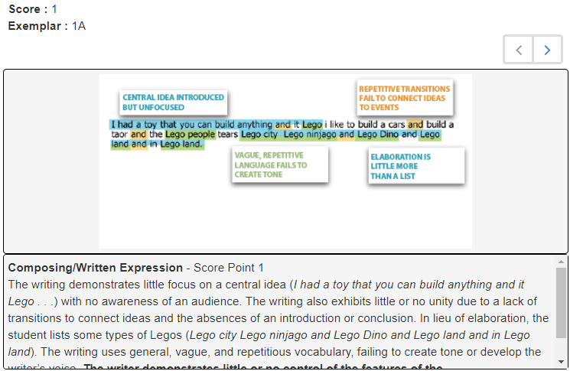
Anchor Sets: Annotation/Overlay
While viewing each anchor paper, educators have the option of selecting the annotation and a highlighted overlay.
This example shows the annotation and overlay for Composing/Written Expression.

Slide 32
Rangefinding in Writing
Rangefinding in writing involves a committee of Virginia educators with experience in teaching and scoring student writing.
Committee members:
  Review and discuss the writing rubrics and previous anchor papers.
  Read and assign scores to new writing samples completed by Virginia students.
  Evaluate scored papers: high 3, low 3, etc.

Slide 33
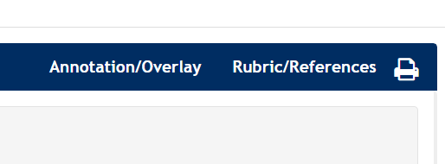
Print Option
The print option is available for all anchor, practice, and verification papers for scorers who wish to have hard copies available while scoring student writing samples.
Notes:
A screenshot of the Anchor Papers tab. On the right side of the page, an arrow points to the Annotation/Overlay option.

Slide 34
Practice Scoring
After training, prospective scorers should independently score the papers within the four available practice sets.
For each paper in a practice set, prospective scorers assign one score for Composing/Written Expression and one score for Usage and Mechanics.

Slide 35
Adjacent and Non-Adjacent Scores
Adjacent scores are within one point of each other.
  For a practice set paper with a score point 3 in Usage and Mechanics, a low adjacent score would be 2, and a high adjacent score would be 4.
Non-adjacent scores are more than one point off.
  For a practice set paper with a score point 3 in Usage and Mechanics, a non-adjacent score would be 1.

Slide 36
Using the Scoring Summary (1 of 3)
After all papers in the practice set have been scored, results will be shown in the Scoring Summary tab.
Scorers might use these results to adjust their practice, as necessary.
Notes:
The scoring summary serves as formative feedback that will assist the scorer in becoming more aligned to the scoring rubrics, which is necessary to meet qualifying in verification sets.

Slide 37
Using the Scoring Summary (2 of 3)
The Exact column shows the percentage of scores assigned that matched the practice papers’ actual scores.
The Adjacent column shows the percentage of scores assigned that were within one score point of the practice papers’ actual scores.
Notes:
A screenshot of the scoring summary information from Practice Set 1. The table has ten columns, labeled: Paper Set, Status, Domain, Exact, Adjacent, Non-Adjacent, High Adjacent, Low Adjacent, Pass ?, and Has Been Reset ?

Slide 38
Using the Scoring Summary (3 of 3)
In this example, 50% of the scores were non-adjacent, which means the score assigned was more than 1 point away from the paper’s actual score, and the adjacent scores are low. This scorer should:
Review the practice set annotations for Practice Set 1 to gain a better understanding of why each score point was assigned.
Review the anchor sets and annotations again with these results in mind before attempting the next practice set.
Notes:
A screenshot of the scoring summary information from Practice Set 1. The table has ten columns, labeled: Paper Set, Status, Domain, Exact, Adjacent, Non-Adjacent, High Adjacent, Low Adjacent, Pass ?, and Has Been Reset ?

Slide 39
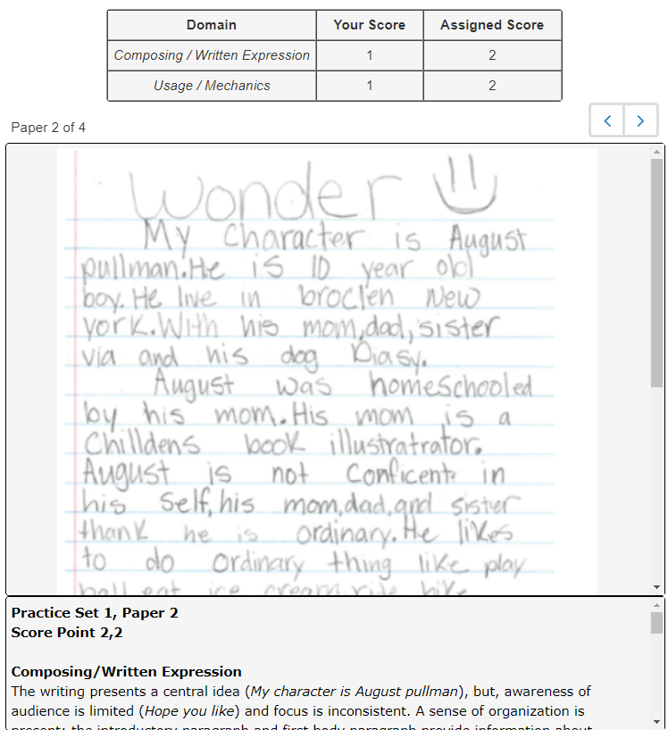
Reviewing the Practice Sets
After a practice set is submitted, a prospective scorer may then again select the set from the drop-down menu to review the assigned scores and annotations.

Slide 40
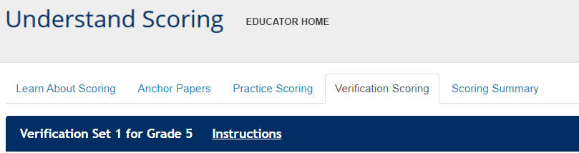
Verification Scoring
Divisions may choose to have prospective scorers use the Verification Sets within Understand Scoring to qualify for scoring student writing samples.

Slide 41
Best Practice for Qualifying (1 of 2)
Scorers should have 70% or better exact agreement with the actual scores on each domain in one of the verification sets to qualify as a scorer.
  Exact agreement means the scores must match. Adjacent scores do not count as exact agreement.
Scorers having 10% or more non-adjacent scores in more than one domain should not qualify for scoring student writing samples.
Notes:
The second verification set is provided for scorers unable to meet the 70% or better requirement on the first attempt. After additional practice, prospective scorers have the option of a second try with the second set.

Slide 42
Best Practice for Qualifying (2 of 2)
Divisions may consider asking scorers to qualify through Understand Scoring annually.
Even after qualifying , scorers should continue to revisit the anchor sets and annotations, along with any other resources available in Understand Scoring, to recalibrate.
Notes:
The second verification set is provided for scorers unable to meet the 70% or better requirement on the first attempt. After additional practice, prospective scorers have the option of a second try with the second set.

Slide 43
Locally Scoring Student Writing Samples
It is best practice that all papers are read by two readers, with the student’s score for each domain being the total of the score assigned by both readers.
  Divisions should establish protocols for resolving non-adjacent scores.
    It is recommended that a third qualified scorer rescore the domain on which the scores are non-adjacent, with the highest two of the three scores accepted.

Slide 44
Calculating a Student’s Total Score (1 of 2)
If a division chooses to calculate a student’s total score:
  The Composing/Written Expression score is counted twice and the Usage/Mechanics score is counted once.
  The Composing/Written Expression score counts 2/3 and the Usage/Mechanics score counts 1/3.

Slide 45
Calculating a Student’s Total Score (2 of 2)
Individual student writing samples do not pass or fail the local alternative assessment.
There is no numerical score that correlates to a passing or failing score for an individual writing sample.

Slide 46
Scoring Protocol (1 of 2)
Divisions should develop a scoring protocol that includes:
  How to resolve non-adjacent scores.
  When and how often training and qualifying will occur.
  When and how often calibration of scorers will occur.
  When and how often writing tasks will be scored using the Grade 5 Writing Scoring Rubric(2017).

Slide 47
Scoring Protocol (2 of 2)
It is best practice to:
  Incorporate quality control activities throughout the scoring window.
  Train and qualify scorers at a time near the scoring window.
  Include a way to requalify and/or recalibrate scorers immediately before scoring student samples or during an extended scoring window.

Slide 48
Additional Uses for Understand Scoring

Slide 49
More Uses for Understand Scoring (1 of 2)
Information in Understand Scoring may be helpful to anyone producing, teaching, or scoring student writing.
  Model for what teachers will be looking for in student writing
  Model for providing peer feedback, self assessment (5 C’s)
  Writing to show thinking, across courses – can give feedback about not only the subject (ex. history) but also their writing
  Convenient way to get VA specific student samples to show to students sample essays – current and aligned to the 2017 Standards of Learning.

Slide 50
More Uses for Understand Scoring (2 of 2)
  In addition to using Understand Scoring to train and qualify scorers of local alternative assessment writing samples, educators may:
  Use examples and annotations to help identify strengths and weaknesses in students’ writing and make a plan for how students may improve their writing.
  Share exemplars with students during instruction to enhance students’ understanding of how the rubrics will be applied to their writing.

Slide 51
More About 5th Grade Writing
From the 2019 Deeper Learning Conference:
3-5 Writing: Moving in the “Write” Direction for the SOLs (PPT)
Grade 5 Writing Rubric 2017 (Word)

Slide 52
What Has NOT Changed? Grade 8
At this time, there have been no changes to the Grade 8 Writing SOL test blueprint or test items.
The Grade 8 Writing SOL test continues to be a required Virginia assessment, and the Grade 8 training materials remain available for Virginia educators.
The Grade 8 Writing SOL test continues to be aligned with the 2010 English SOL.

Slide 53
What Has NOT Changed? EOC
At this time, there have been no changes to the EOC Writing SOL test blueprint or test items.
Students can earn their verified credit in writing through the EOC writing test, the local high school performance assessment, or from one of the substitute tests.
The EOC Writing SOL test continues to be an available Virginia assessment, and the EOC Writing training materials remain available for Virginia educators.
The EOC Writing SOL test continues to be aligned with the 2010 English SOL.

Slide 54
Resources
VDOE English Standards of Learning (SOL) & Testing
Comprehensive Literacy Instructional Plans
Performance Assessments & Local Alternative Assessments

Slide 55
What Is Coming Next?

Slide 56
What Is Coming Next? EOC
Additional information will be provided for using Performance Level Descriptors (2017 English SOL) to evaluate collections of evidence used to award a verified credit.
School divisions will be notified later this fall when this information becomes available.

Slide 57
Stay Connected
Office of Student Assessment
  student_assessment@doe.virginia.gov
  (804) 225-2102
Department of Learning and Innovation
  Jill Nogueras, K-12 English Coordinator, jill.nogueras@doe.virginia.gov

Slide 58
Copyright Notice
Copyright ©2020 by the Commonwealth of Virginia, Department of Education, P.O. Box 2120, Richmond, Virginia 23218-2120. All rights reserved. Except as permitted by law, this material may not be reproduced or used in any form or by any means, electronic or mechanical, including photocopying or recording, or by any information storage or retrieval system, without written permission from the copyright owner. Commonwealth of Virginia public school educators may reproduce any portion of these items for non-commercial educational purposes without requesting permission. All others should direct their written requests to the Virginia Department of Education at the above address or by e-mail to Student_Assessment@doe.virginia.gov.

