Slide 1
Routines and Structures for
Learning in Place
September 3, 2020

Slide 2
Agenda
Welcome
Available Resources
Learning Spaces at Home
Routines and Habits
Structures for Success
Next Steps
Stay connected

Slide 3
Welcome!
This webinar is intended to provide support and resources to students, families, and local school division communities.

Slide 4
Starting the 2020-2021 School Year
Social Distancing
Health and Safety
Student Success
& Growth
Communication
Social and Emotional Needs
Learning (and Working) from Home

Slide 5
Why Are Structures and Rules Important?
“It’s normal for young children to test the limits. That’s how they learn what is right and wrong. But, it can be frustrating and really test our patience as parents! One way to keep control and help children learn is to create structure. Structure is created by consistent routines and rules” (Center for Disease Control and Prevention)
Three key ingredients to building structure at home:
Consistency
2.Predictability
3.Follow-through
https://www.cdc.gov/parents/essentials/structure/building.html

Slide 6
Why Are Routines Important for Students?
Children thrive on routine.
Routines makes us feel safe and help to reassure expectations.
“With many schools cancelled and people limiting their exposure to others, it’s up to us as parents to make new routines so our children feel safe and cared for. Those routines are probably going to look different than what we’re used to, but that’s okay. We just need to make them consistent” (Dr. Suzanne Bouffard, Developmental Psychologist)
https://www.pbs.org/parents/thrive/schools-closed-how-to-make-a-new-home-routine

Slide 7

What resources and supports are available?
Starting the 2020-2021 School Year

Slide 8
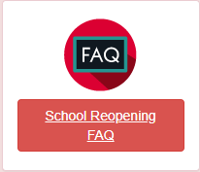
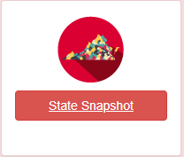
Available Resources from VDOE (1 of 6)

Slide 9
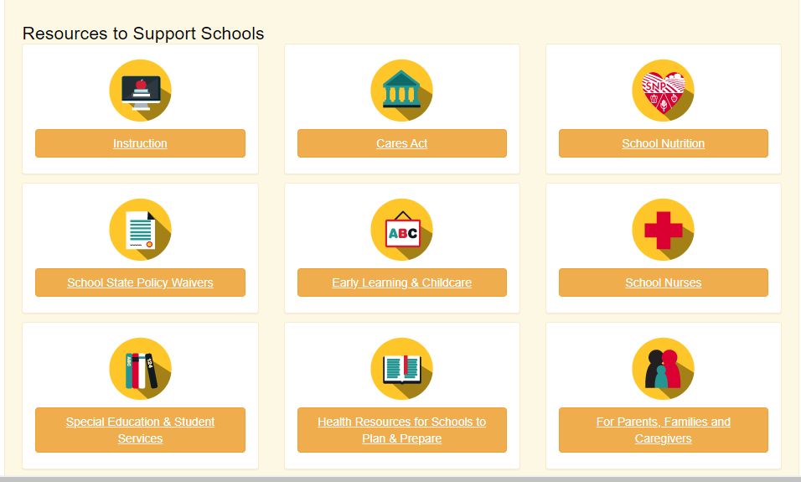
Available Resources from VDOE (2 of 6)

Slide 10
Available Resources from VDOE (3 of 6)
Covid-19 Family Resources: This document provides a “one-stop” resource for parents to access information by bringing all of the COVID-19 resources specific to parents together in one place.
Covid-19 Parent Guide for School-Age Children: The VDOE has created this guide to serve as a resource for parents, families and caregivers on a variety of topics related to COVID-19 and their students.
Youth in Foster Care During School Closure: Joint statement from the VDSS and the VDOE on educational stability for children and youth in foster care during school closures due to COVID-19
Covid-19 Guidelines for Military Families: This document was developed to assist school personnel on how to support military-connected students and their families during the pandemic.

Slide 11
Available Resources from VDOE (4 of 6)
Guidance from the Department of Special Education & Student Services
VDOE Special Education and Student Services Frequently Asked Questions – The goal of this document is to provide school divisions and stakeholders with information and solutions around the provision of services for special education and student services.
VDOE Considerations for COVID Recovery Services for Students with Disabilities (Word) – This document highlights information related to compliance, documentation and progress monitoring, and IEP Team considerations that are necessary in order to make decisions about and address requests for COVID recovery services for students with disabilities.
Special Education Students After COVID-19 Key Considerations (Word) – A document to help support decision making surrounding potential issues regarding school reopening and supports for students, families and staff.
Sustaining Inclusive Practices for Virtual Learning for Students with Disabilities (Word) – This document offers guidance, suggestions, and resources for sustaining inclusionary practices for students with disabilities through continuous learning opportunities using a virtual platform.

Slide 12
Available Resources from VDOE (5 of 6)
CASEL Resources for Parents and Families: Social Emotional Learning (SEL) offers a powerful means to explore and express our emotions, build relationships, and support each other. CASEL provides resources to attend to the social and emotional needs that arise during stressful times like these. This site also provides school resources for K-12 lessons at home.
The Child Mind Institute:Parents may struggle to balance work, child care and self-care while keeping worries — both your children’s and your own — under control. This site offers resources to help children, teenagers, and parents cope with the increased stress of being at home and managing anxiety.

Slide 13

Available Resources from VDOE (6 of 6)
Covid-19 Resources for Parents, Families, and Caregivers: This link will direct you to additional resources and supports.

Slide 14
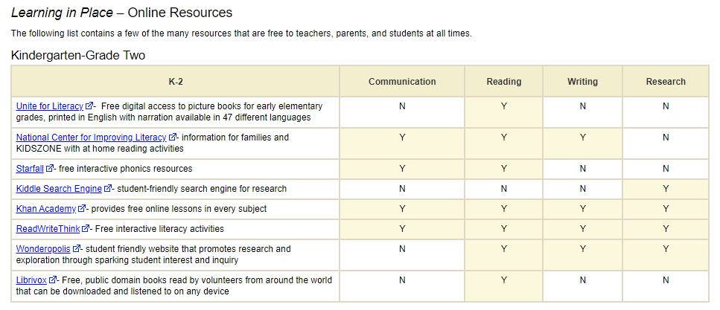
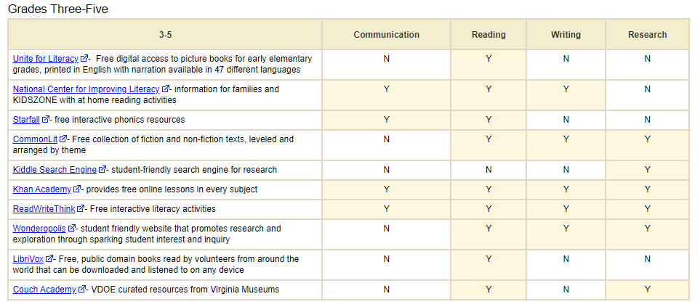
VDOE Resources
Learning in Place Resources from VDOE (1 of 8)
ENGLISH AND READING ELEMENTARY

Slide 15
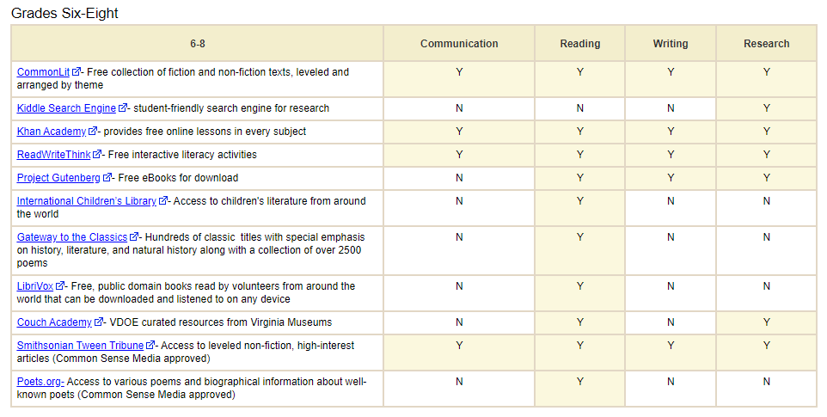
VDOE Resources
Learning in Place Resources from VDOE (2 of 8)
ENGLISH AND READING MIDDLE SCHOOL

Slide 16
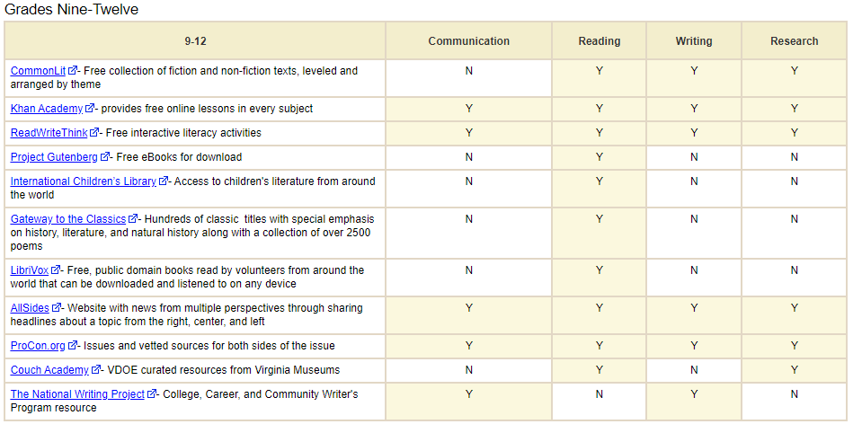
VDOE Resources
Learning in Place Resources from VDOE (3 of 8)
ENGLISH AND READING GRADES 9-12

Slide 17
VDOE Resources
Learning in Place Resources from VDOE (4 of 8)
HISTORY AND SOCIAL SCIENCE ELEMENTARY
An Economy at Work: The Production and Consumption of Goods and Services (PDF) – staff development and teaching module for elementary and middle school teachers on SOL-based economics concepts
Virginia Maps of the Five Geographic Regions (2001)
  Outline Map (PDF)
  Map with Counties (PDF)
  Map without Counties (PDF)
North American Map of Selected Geographic Regions (PDF) – correlates with Standard USI.2b
Documents of American History (PDF) – text of the Constitution of Virginia, Virginia Statute for Religious Freedom, Declaration of Independence, Constitution of the United States of America with Amendments and the Virginia Charters
Virginia Animals and their Habitats – a model comprehensive, cross-curricular second-grade unit that addresses 40 grade-two Virginia Standards of Learning (SOL) in science, mathematics, English, and history and social science.
Civil Rights Education – resources and information from the Brown v. Board of Education Scholarship Committee, as well as the Dr. Martin Luther King Jr. Memorial Commission
Everyday Civics – classroom resources including lesson plans, discussion boards, primary documents, Internet links and media Partnership Resources
Ice Age Discoveries – recent archaeological digs have provided compelling evidence that humans inhabited Virginia at least 18,000 years ago
Mali: Ancient Crossroads of Africa – lesson plans, literature links and online resources on the West African empire of Mali
Virginia's First People Past and Present – guide for teaching the history, geography and economic systems of Virginia Indians, both past and present, with links to Virginia's eleven state-recognized tribes

Slide 18
VDOE Resources
Learning in Place Resources from VDOE (5 of 8)
HISTORY AND SOCIAL SCIENCE MIDDLE SCHOOL
Economics and Financial Literacy – instructional resources to assist in meeting the requirements economics education and financial literacy requirements for all middle and high school students
North American Map of Selected Geographic Regions (2001) (PDF) – correlates to Standard USI.2b
Documents of American History (PDF) – text of the Constitution of Virginia, Virginia Statute for Religious Freedom, Declaration of Independence, Constitution of the United States of America with Amendments and the Virginia Charters
Civil Rights Education – resources and information from the Brown v. Board of Education Scholarship Committee, as well as the Dr. Martin Luther King Jr. Memorial Commission
Everyday Civics – classroom resources including lesson plans, discussion boards, primary documents, Internet links and media Partnership Resources
Ice Age Discoveries – recent archaeological digs have provided compelling evidence that humans inhabited Virginia at least 18,000 years ago
Mali: Ancient Crossroads of Africa – lesson plans, literature links and online resources on the West African empire of Mali
Virginia's First People Past and Present – guide for teaching the history, geography and economic systems of Virginia Indians, both past and present, with links to Virginia's eleven state-recognized tribes

Slide 19
VDOE Resources
Learning in Place Resources from VDOE (6 of 8)
HISTORY AND SOCIAL SCIENCE HIGH SCHOOL
Postwar Germany and the Growth of Democracy – A Resource Guide (PDF) – lessons and resources to assist teachers and students to explore Germany's social, political and economic experiences since 1945
Documents of American History (PDF) – text of the Constitution of Virginia, Virginia Statute for Religious Freedom, Declaration of Independence, Constitution of the United States of America with Amendments and the Virginia Charters
Civil Rights Education – resources and information from the Brown v. Board of Education Scholarship Committee, as well as the Dr. Martin Luther King Jr. Memorial Commission
Everyday Civics – classroom resources including lesson plans, discussion boards, primary documents, Internet links and media Partnership Resources
Ice Age Discoveries – recent archaeological digs have provided compelling evidence that humans inhabited Virginia at least 18,000 years ago
Mali: Ancient Crossroads of Africa – lesson plans, literature links and online resources on the West African empire of Mali
Virginia's First People Past and Present – guide for teaching the history, geography and economic systems of Virginia Indians, both past and present, with links to Virginia's eleven state-recognized tribes

Slide 20
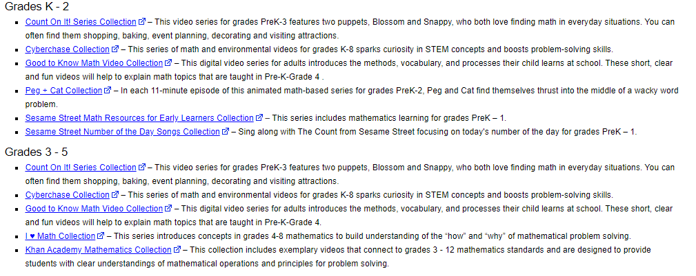
VDOE Resources
Learning in Place Resources from VDOE (7 of 8)
MATHEMATICS ELEMENATARY SCHOOL

Slide 21
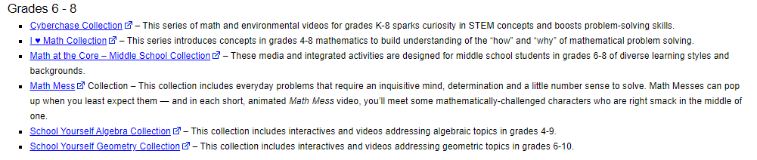
VDOE Resources
Learning in Place Resources from VDOE (8 of 8)
MATHEMATICS GRADES 6-8

Slide 22
VDOE Resources
Additional Resources and Supports
Virginia Learns Anywhere: Learning in Place. The VDOE Department of Learning and Innovation has compiled several Learning in Place Resources to assist teachers, parents, and students
eMediaVA: Free online learning resources
Virtual Virginia

Slide 23
Tips for Creating a Learning Space at Home (1 of 4)
De-clutter and clear a quiet space
Have supplies and organize them
Find age appropriate reading materials to fill the space
Use what you already have!

Slide 24
Tips for Creating a Learning Space at Home (2 of 4)
Younger children should be in a central location
Older students (grades 7-12) should have the option of a more closed-off space for online learning and longer periods of concentrated study.
Think about your child’s learning style-
  Does he or she focus best in quiet or around other people?
A physical reminder of a child’s daily schedule can be helpful.
  whether you have an early learner or a student in high school.
  printed out or on a white board-visible in the learning space for reference
If you have more than one child who’s in school at home,
  color-coded labels or stickers can help everyone manage what belongs to whom, avoiding distractions and conflict when siblings have to share a space.

Slide 25
Tips for Creating a Learning Space at Home (3 of 4)
Encourage students to take pride in their work space.
Teachers can provide support by
  Setting up a mini-lesson about learning spaces
  Sharing a picture or video of his or her at-home learning space
  Allow students to describe or show their learning spaces
Parents and families can provide support by
  Getting their students involved in setup
  Talking about expectations for using the learning space
  Making the experience as fun as possible
It’s important to distinguish the learning space from recreational space so that students can spend downtime in a different area, even just pushing in a chair and leaving the table is helpful for brain breaks.

Slide 26
Tips for Creating a Reading Space at Home (4 of 4)
Reading spaces should be separate from writing activities and virtual meetings.
Designate a special place for reading time
Families can support readers by talking about what kind of space is better for reading versus when he or she writes or meets with the class.
Consider
  Comfort
  Lighting
  Noise level
  Personalized, fun, and inviting

Slide 27

Establishing Routines for Learning
Once a learning space has been created, it’s time to put routines into action!

Slide 28
Establishing Routines and Good Habits (1 of 3)
“In addition to supporting student learning, routines build efficiency in the classroom, both on-site and online” (Judy Zimmy, E.Ed).

Slide 29
Establishing Routines and Good Habits (2 of 3)
Set up at-home expectations:
  Get dressed as if you were going to the actual school building
  Have breakfast
  Prepare lunch or know what you’re having for lunch to avoid additional stress
    VDOE School Nutrition Updates
Create a weekly “to-do” list to stay organized
  Keep track of assignments and due dates
Include time to share highlights and concerns with someone to help with SEL
    VDOE SEL Supports and Updates

Slide 30
Establishing Routines and Good Habits (3 of 3)
Teachers can support routines and good habits by:
Keeping routines that make students feel cared for and valued—always make time for these
Being clear and concise with expectations
Keeping everything in one spot; try to limit where students and families go for information
Providing check-lists for families to use as a guide whenever possible
Think of it this way: “This is the way we turn in papers in our physical classroom… This is how we turn in papers in our distance or online classroom…”
https://blog.nise.institute/online-classroom-routines-making-online-instruction-work-now

Slide 31
Successful Routines from the Classroom to Home (1 of 7)
Introductions Should be a Priority
Teachers can support building normalcy around routines by:
  recording an introduction video
  welcoming students and families and letting them know who you are
  providing a tour of the available resources and virtual work spaces you’ll be using
  taking time to explain schedules and routines
  recording key instructions so that students and families can return to them for support anytime.
  having students create introduction messages or videos
https://blog.nise.institute/online-classroom-routines-making-online-instruction-work-now

Slide 32
Successful Routines from the Classroom to Home (2 of 7)
Build in deadlines, goals, and rewards
  Keep track of long term assignments and quick turn-around assignments
  Make a checklist or “To Do” list so you can physically check off assignments as they are finished.
  Give yourself time to reflect on your hard work
    Take a 10 minute brain break
    Close your eyes for 1 minute
    Share your accomplishment (big or small) with someone- a family member or your teacher
https://blog.nise.institute/online-classroom-routines-making-online-instruction-work-now

Slide 33
Successful Routines from the Classroom to Home (3 of 7)
What times of day do you work best?
  During these times, tackle your most challenging assignments or subjects.
When are you most productive?
  During these times, consider working on longer tasks that require focus.
How do you ask for support or help?
  Ask your teacher(s) when one-on-one time is available; include it in your schedule and routine
  Build time in your at-home routine for support from a family member

Slide 34
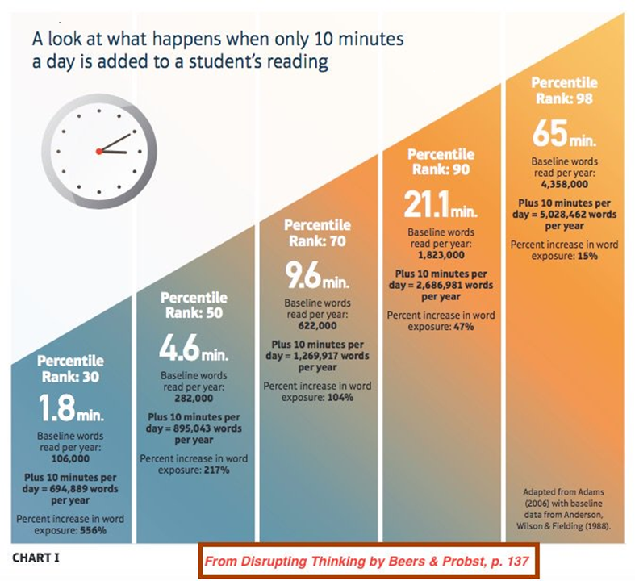
Successful Routines from the Classroom to Home (4 of 7)
Reading Routines are Essential

Slide 35
Successful Routines from the Classroom to Home (5 of 7)
Build time into your day to read
  Every day, students should be reading a self-selected text for a minimum of 20 minutes
    i.e. independent reading
    read aloud
    read with someone
Establish reading habits as early as possible
  Kindergarten: 10 minutes a day
  1st Grade: 15 minutes a day
  2nd Grade: 20 minutes a day
*minutes include time being read to as well as independent reading

Slide 36
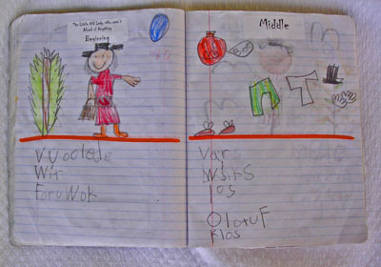
Successful Routines from the Classroom to Home (6 of 7)
Reflect on what you read
  Draw a picture of what you read
  Record new words that you discover
  Track how much you read each day
  Use a choice board or reading BINGO for after-reading activities
Picture Source: https://www.kindergartenkindergarten.com/2010/07/reading-workshop-journals.html

Slide 37
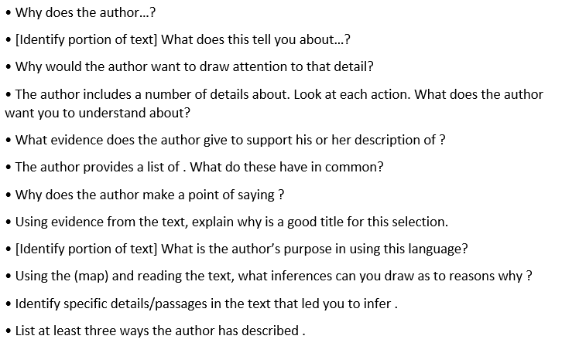
Successful Routines from the Classroom to Home (7 of 7)
Question Stems are a great resource for starting a conversation about reading:
http://www.doe.virginia.gov/testing/sol/standards_docs/english/2017/text-dependent/index.shtml

Slide 38
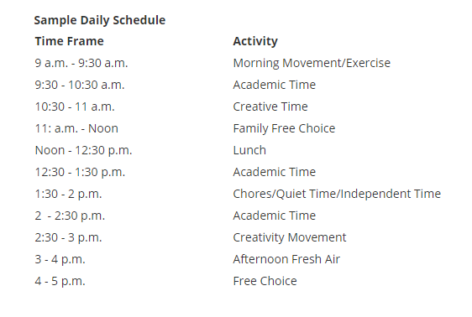
Sample Routine for Elementary
https://www.ohsd.net/Page/7925

Slide 39
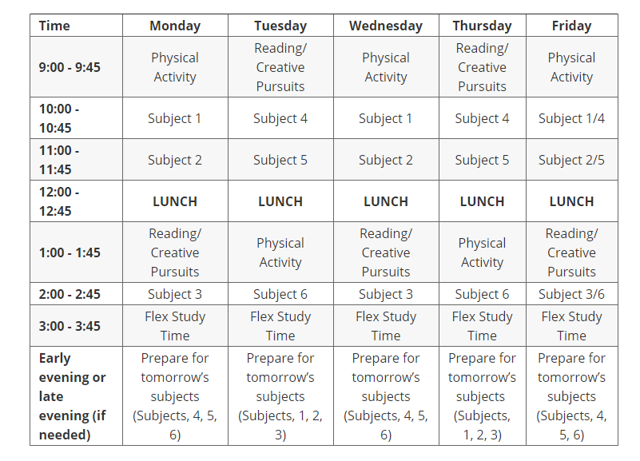
Sample Routine for Secondary
https://blog.prepscholar.com/daily-schedule-distance-learning

Slide 40
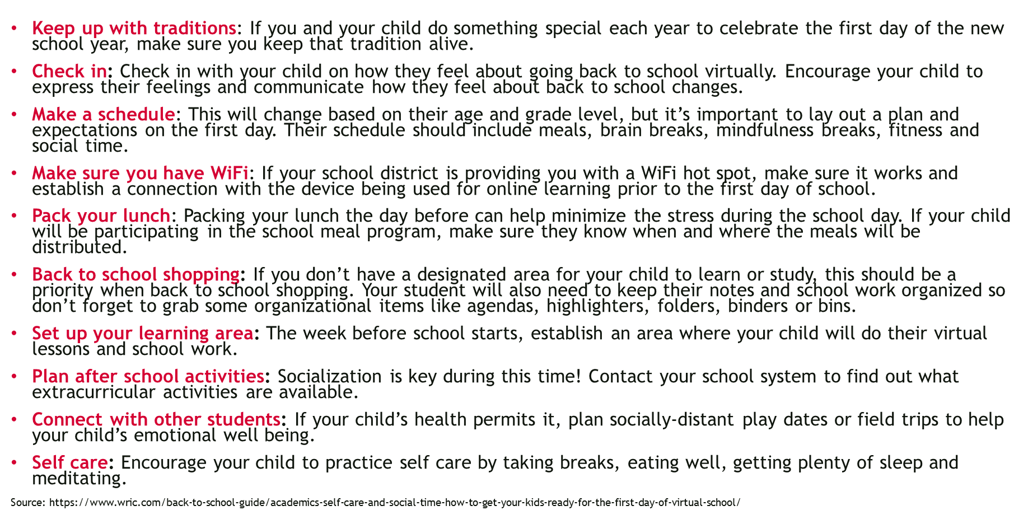
Tips to Prepare for the First Day

Slide 41

Structures for Success

Slide 42
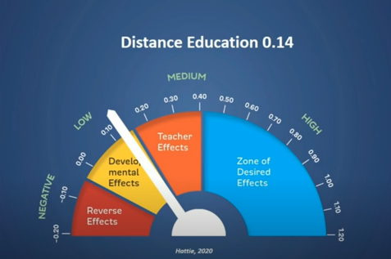
Distance Learning Can be as Effective as In-Person Learning (1 of 3)

Slide 43
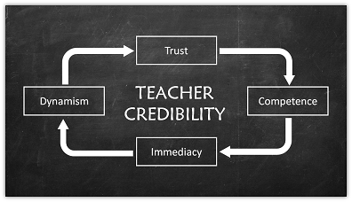
Distance Learning Can be as Effective as In-Person Learning (2 of 3)
It is important to establish credibility in the way that it may have been your very first day in the profession. Your in-person reputation is not the same as your distance-learning reputation

Slide 44

Distance Learning Can be as Effective as In-Person Learning (3 of 3)
We know that good feedback has ALWAYS been one of the most important factors in student academic growth… Consider the opportunities for effective feedback that virtual learning presents

Slide 45
Minor Alterations go a Long Way
In interviews with 40 teachers about their experiences teaching remotely this past spring, the Teaching Systems Lab found that some teachers said students were self-conscious about turning on their video in whole-class settings.
Other teachers had more success in smaller groups—either splitting the class into smaller synchronous meeting times or circulating between simultaneous breakout sessions.
https://www.edweek.org/ew/articles/2020/08/06/classroom-routines-have-to-change-heres-what.html
Notes:
Jill: 1-6, 27-30, 41-47
Carmen: 7-13, 23-26
Colleen: 14-22, 31-40

Slide 46
References
Learnmore.uncg.org: Tips for Setting up your Learning Space
Kariippanon, Katharina & Cliff, Dylan & Lancaster, Sarah & Parrish, Anne-Maree. (2017). Perceived interplay between flexible learning spaces and teaching, learning and student wellbeing. Learning Environments Research. 10.1007/s10984–017–9254–9.
https://www.nytimes.com/wirecutter/blog/remote-learning-space-set-up/
https://www.edutopia.org/article/lessons-summer-teaching-hybrid-classroom?utm_content=linkpos4&utm_source=edu-newsletter&utm_medium=email&utm_campaign=weekly-2020-08-12
https://www.apa.org/topics/covid-19/children-self-regulation
https://www.childrenandscreens.com/media/press-releases/covid-19-and-at-home-learning/
https://www.pbs.org/parents/thrive/schools-closed-how-to-make-a-new-home-routine

Slide 47
2020 Literacy Supply List
Books
Books that teach
Books that help us feel
Books that make us laugh
Books that you love
Love
Books
Students
Families
Yourself
Flexibility
Books/materials
Technology
Students
Families
Leaders
Teams
Yourself

Slide 48
Stay in Touch
Jill Nogueras
K-12 English Coordinator
Jill.Nogueras@doe.virginia.gov
Carmen Kurek
Elementary English/Reading Specialist
Carmen.Kurek@doe.virginia.gov
Colleen Cassada
Middle School English Specialist
Colleen.Cassada@doe.Virginia.gov

