Slide 1
Best Practices for Literacy Learning In Place
Fall 2020

Slide 2
Agenda
Review of Best Practices
Methods and Best Practices For Virtual Learning
Planning for Instruction
Focus Areas for Instruction
Additional Resources
Upcoming Opportunities

Slide 3
Providing New Instruction to All Students
All school divisions must provide new instruction to all students in the 2020-2021 school year regardless of the operational status of a division’s building or the reopening phase the state or locality is in.
Instructional Plan Guidance (Word)
Instructional Plan Submission Link
Preview of Instructional Plan Submission Form (PDF)

Slide 4
Review Best Practices for Literacy Instruction

Slide 5
Elementary

Slide 6
Skills and Knowledge Critical to Comprehension
Word-level skills
2. Vocabulary knowledge and oral language skills
3. Broad Conceptual Knowledge
4. Knowledge and abilities required specifically to comprehend text
5. Thinking and reasoning skills
6. Motivation to understand and work toward academic goals
Shanahan, T., Callison, K., Carriere, C., Duke, N. K., Pearson, P. D., Schatschneider, C., & Torgesen, J. (2010). Improving reading comprehension in kindergarten through 3rd grade: A practice guide (NCEE 2010-4038). Washington, DC: National Center for Education Evaluation and Regional Assistance, Institute of Education Sciences, U.S. Department of Education. Retrieved from whatworks.ed.gov/publications/practiceguides.

Slide 7
What Research Says (1 of 3)
Characteristics of strong phonics instruction:
Explicit and systematic
Readiness Skills
Scope and Sequence
Blending
Dictation
Word Awareness
High-Frequency Words
Reading Connected Text
Building vocabulary and background knowledge
International Literacy Association. (2019). Meeting the challenges of early literacy phonics instruction [Literacy leadership brief]. Newark, DE: Author
Notes:
What does explicit and systematic mean? Explicit phonics instruction means that the letter(s)-sound relationship or skill is directly stated to the students “the /s/ sound is represented by the letter s.” Systematic means that the instruction follows a continuum that moves from easier to more complex skills.
Strong alphabet recognition and phonemic awareness are readiness skills needed for success in reading. Knowing the names and sounds of letters with fluency and being able to orally blend, segment, and manipulate sounds in words from Kindergarten moving up to grade 3 will be the biggest predictor of early reading success.
A strong scope and sequence moves from easier to more complex skills and builds on previous learning.
Blending-We teach students to segment or sounds in order to decode words, but students must be proficient in blending those sounds together in order to sound out words. Students must be proficient with blending orally before using it in text. Blending is used with early readers but should continue as students transition into multisyllabic words.
Dictation-Students must be provided opportunities to “try out” or apply their phonics skills with teacher support, just like the IES Guide discusses practciing phonics skills in connected text.
Word Awareness-Literacy blocks should consist of opportunities for students to analyze and notice patterns in word through tasks that require students to manipulate words to increase students’ ability to notice larger chunks in monosyllabic and multisyllabic words. Word building and word sorting are two examples of these tasks.
High-Frequency Words-Known as the most common words in English. Words that follow regular sound-spellings can be learned and applied during the normal phonics scope and sequence. Word do not, need to be explicitly taught to students.
Reading Connected Text-Students should have opportunities to practice and apply phonics instruction in decodable text.
Building vocabulary and background knowledge-As older elementary students encounter more complex texts and vocabulary, providing a balance of phonics instruction with best practices with vocabulary acquisition and expanding background knowledge is essential.
So as you are reflecting on the practices in your literacy block, continue to think about the implementation of these characteristics. Do you do these daily? Do you see these daily?

Slide 8

What Research Says (2 of 3)
Foundational Skills to Support Reading for Understanding
Recommendation 1- Teach students academic language skills, including the use of inferential and narrative language, and vocabulary knowledge.
Recommendation 2- Develop awareness of the segments of sound in speech and how they link to letters.
Recommendation 3-Teach students to decode words, analyze word parts, and write and recognize words.
Recommendation 4- Ensure that each student reads connected text every day to support reading accuracy, fluency, and comprehension.
Foorman, B., Beyler, N., Borradaile, K., Coyne, M., Denton, C. A., Dimino, J., Furgeson, J., Hayes, L., Henke, J., Justice, L., Keating, B., Lewis, W., Sattar, S., Streke, A., Wagner, R., & Wissel, S. (2016). Foundational skills to support reading for understanding in kindergarten through 3rd grade (NCEE 2016-4008). Washington, DC: National Center for Education Evaluation and Regional Assistance (NCEE), Institute of Education Sciences, U.S. Department of Education. Retrieved from the NCEE website: http://whatworks.ed.gov.
Notes:
These practice guides published by What Works Clearinghouse and the Institute of Education Sciences examine studies and make recommendations based on the evidence of the studies. The recommendations are ranked in order of strongest evidence to minimal.
Recommendation 1-Supporting the development of specific academic, inferential, and narrative language skills will broaden students’ listening comprehension skills which will prepare them for better reading comprehension. It also expands their vocabulary knowledge and syntax within the English language.
Recommendation 2-To effectively decode (convert from print to speech) and encode (convert from speech to print) words, students must be able to identify the individual sounds, or phonemes, that make up the words they hear in speech, name the letters of the alphabet as they appear in print, and identify each letter’s corresponding sound(s). This recommendation presents ways to support these skills such as; 1. Teaching students to recognize and manipulate segments of sound in speech. 2) Teaching students letter–sound relations. And 3. Using word-building and other activities to link students’ knowledge of letter–sound relationships with phonemic awareness.
Recommendation 3-This recommendation presents several ways to implement decoding and analyzing word parts. The first way is blending sounds with spelling patterns from left to right to produce a recognizable word. The next is providing instruction on common sound-spelling patterns. Is it explicit and systematic? Also continuing this instruction even as students move into learning syllables
Recommendation 4-The recommendation states that students should be reading a wide variety of connected text daily, with and without constructive feedback. As students are beginning to apply the alphabetic principal, text should provide examples of recently taught spelling patterns with support and feedback from teachers on applying decoding strategies learned. This recommendation also shares some suggested strategies for supporting students in reading more fluently.

Slide 9

What Research Says (3 of 3)
Comprehension Instruction
Recommendation 1: Teach students how to use reading comprehension strategies
Questioning
Visualization
Monitoring, clarifying, or fix-up
Inference
Retelling
Shanahan, T., Callison, K., Carriere, C., Duke, N. K., Pearson, P. D., Schatschneider, C., & Torgesen, J. (2010). Improving reading comprehension in kindergarten through 3rd grade: A practice guide (NCEE 2010-4038). Washington, DC: National Center for Education Evaluation and Regional Assistance, Institute of Education Sciences, U.S. Department of Education. Retrieved from whatworks.ed.gov/publications/practiceguides.
Notes:
These practice guides published by What Works Clearinghouse and the Institute of Education Sciences examine studies and make recommendations based on the evidence of the studies.
Recommendation 1-
• Teach students how to use several research-based reading comprehension strategies. • Teach reading comprehension strategies individually or in combination. • Teach reading comprehension strategies by using a gradual release of responsibility.
Recommendation 2-• Explain how to identify and connect the parts of narrative texts. • Provide instruction on common structures of informational texts
Recommendation 3-• Structure the discussion to complement the text, the instructional purpose, and the readers’ ability and grade level. • Develop discussion questions that require students to think deeply about text. • Ask follow-up questions to encourage and facilitate discussion. • Have students lead structured small-group discussions.
Recommendation 4-• Teach reading comprehension with multiple genres of text. • Choose texts of high quality with richness and depth of ideas and information. • Choose texts with word recognition and comprehension difficulty appropriate for the students’ reading ability and the instructional activity. • Use texts that support the purpose of instruction.
Recommendation 5-• Help students discover the purpose and benefits of reading. • Create opportunities for students to see themselves as successful readers. • Give students reading choices. • Give students the opportunity to learn by collaborating with their peers.

Slide 10
Recommendation 2- Teach students to identify and use the text’s organizational structure to comprehend, learn, and remember content.
Narrative:
Characters
Setting
Goal
Problem/Conflict
Plot or action
Resolution
Theme(s)
Informational:
Description
Sequence
Problem and Solution
Cause and Effect
Compare and Contrast
Shanahan, T., Callison, K., Carriere, C., Duke, N. K., Pearson, P. D., Schatschneider, C., & Torgesen, J. (2010). Improving reading comprehension in kindergarten through 3rd grade: A practice guide (NCEE 2010-4038). Washington, DC: National Center for Education Evaluation and Regional Assistance, Institute of Education Sciences, U.S. Department of Education. Retrieved from whatworks.ed.gov/publications/practiceguides

Slide 11
Comprehension Instruction
Recommendation 4- Select texts purposefully to support comprehension development.
Recommendation 3- Guide students through focused, high quality discussion on the meaning of text.
Locate and Recall
Integrate and Interpret
Critique and Evaluate
Rich content
Strong organization
Word choice and sentence structure
Support the purpose of instruction
Shanahan, T., Callison, K., Carriere, C., Duke, N. K., Pearson, P. D., Schatschneider, C., & Torgesen, J. (2010). Improving reading comprehension in kindergarten through 3rd grade: A practice guide (NCEE 2010-4038). Washington, DC: National Center for Education Evaluation and Regional Assistance, Institute of Education Sciences, U.S. Department of Education. Retrieved from whatworks.ed.gov/publications/practiceguides
Notes:
Recommendation 3-
Locate and recall-identify the main ideas and supporting details, find elements of a story; focus on small amounts of text
Integrate and interpret-compare and contrast information or actions by characters; examine connections across parts of text; consider alternatives to what is presented in the text; use mental images
Critique and evaluate-assess from numerous perspectives, synthesizing what is read with other texts and other experiences; determine what is most significant in a passage; judge whether and the extent to which certain features in the text accomplish the purpose of the text; judge either the likelihood that an event could actually occur or the adequacy of an explanation in the text
Recommendation 4-
Broad types of literary and informational
Rich content (character development, elaborate detail)
Strong organization
Variation and richness in word choice and sentence structure
Supports the purpose of instruction-text where strategy can easily be applied, well above their reading level but at listening comprehension level, just above their reading level and support though big books, or digitally projecting text

Slide 12
Recommendation 5- Establish an engaging and motivating context in which to teach reading comprehension.
Help students discover the purpose and benefits of reading.
Create opportunities for students to see themselves as successful readers.
Give students reading choices.
Give students the opportunity to learn by collaborating with peers.
Shanahan, T., Callison, K., Carriere, C., Duke, N. K., Pearson, P. D., Schatschneider, C., & Torgesen, J. (2010). Improving reading comprehension in kindergarten through 3rd grade: A practice guide (NCEE 2010-4038). Washington, DC: National Center for Education Evaluation and Regional Assistance, Institute of Education Sciences, U.S. Department of Education. Retrieved from whatworks.ed.gov/publications/practiceguides
Notes:
Recommendation 5- Establish an engaging and motivating context in which to teach reading comprehension.
Help students discover the purpose and benefits of reading.- modeling, choose texts with relevant themes
Create opportunities for students to see themselves as successful readers.-feedback, chunking text, low risk opportunities
Give students reading choices.-activities, order of completion, questions that lead to interesting texts, text response, where they can read, text choice.
Give students the opportunity to learn by collaborating with peers.-partners read the same text and discuss, partners at different levels reading a higher level book alternating pages, sentences, paragraphs, retelling, dramatization, grouping.

Slide 13

Seamless Integration of
English Strands
Reading
Writing
Research
Communication/ Multimodal Literacies

Slide 14
Successful English Instruction
Integrate the Strands
  Reading
      Specific vocabulary from authentic texts
      Both fiction & nonfiction text
      Text-rich environment with variety of text and media
      Student choice whenever possible
  Writing
      Writing as a process for a variety of authentic purposes
      Regular writing conferences
      Use of Writing Portfolios
  Research
      Ongoing and embedded in the learning process (when applicable)
  Communication/Multimodal Literacies

Slide 15
Successful English Instruction
Best Practices
  Use of text-dependent questions
  Use of inference questions
  Use of text-based vocabulary
  Response to reading
  Writing components in every lesson
  Frequent research components

Slide 16
Paired Texts and Text Sets
Paired texts can include books, plays, articles, poems, functional text, graphics, or digital media
Focus on a common theme or topic that fits history and social science or science content
Compare and contrast texts to increase the level of thinking

Slide 17
Integration of Skills
Choose a theme or topic
Choose a variety of text and media options
Incorporate all strands during the unit
Select standards to introduce or review
Think about your students – What will interest them?
Provide opportunities for shared and independent reading
Model the writing process and meet with students for writing conferences

Slide 18
Read! Read! Read!
Students need opportunities to read daily.
Students need to read extended pieces of text and grade level material.
All students need opportunities to read grade level text daily, including nonfiction and fiction pieces.
Schools should provide students with opportunities to read and compare paired passages (fiction and nonfiction) on the same topic as appropriate.
When students are analyzing ideas in two texts and searching for textual evidence to support their conclusions, they are engaging in deeper learning and thinking critically.

Slide 19
Scaffolding Complex Text
Support Vocabulary
Use Deliberate Annotation
Use Questions as Planned Scaffolds
Allow Time for Reflection and Discussion
Provide many hours a week for independent reading
Access to grade level text
Locate complicated sentence structures
Explicit
Notes:
Supporting Vocabulary: re-format the text (visual cues, chunk, print size), student friendly glossaries, picture cues (story, strategy), pre-teach vocabulary,
Annotation: number lines of text, pre-annotating texts with a purpose, Key ideas, providing overviews
Questions: strong series of questions planned systematically, Build from basic comprehension to inferential, hint cards to direct them, using paragraph lines or numbers, or section headings
Reflection: writing in order to prepare for oral, or oral to prepare for writing, talk time with peers (models),
Time for independent reading-hours planned each week to read at their independent level, time to apply what they are learning from higher level texts.
Access to grade level text: planning close reading lessons, short chunks of text,
Sentence structures-identify and incorporate into discussion
Explicit-tell them when a text may be more challenging, teaching-tell them what the pronouns and referring to

Slide 20
The Forgotten “R”
The elimination of the grade 5 Writing SOL assessment threatens writing/research instruction
Writing, like reading, is a life skill and should be included in all curricular areas.
How much writing does your job require?

Slide 21

Additional Research
Teaching Elementary School Students to be Effective Writers
Recommendation 1-Provide daily time for students to write.
Recommendation 2- Teach students to use the writing process for a variety of purposes.
Recommendation 3- Teach students to become fluent with handwriting, spelling, sentence construction, typing, and word processing.
Recommendation 4- Create an engaged community of writers.
Graham, S., Bollinger, A., Booth Olson, C., D’Aoust, C., MacArthur, C., McCutchen, D., & Olinghouse, N.(2012).Teaching elementary school students to be effective writers: A practice guide (NCEE 2012- 4058). Washington, DC: National Center for Education Evaluation and Regional Assistance, Institute of Education Sciences, U.S. Department of Education. Retrieved from http://ies.ed.gov/ncee/ wwc/publications_reviews.aspx#pubsearch
Notes:
These practice guides published by What Works Clearinghouse and the Institute of Education Sciences examine studies and make recommendations based on the evidence of the studies. The recommendations are ranked in order of strongest evidence to minimal.
Recommendation 1-The guide recommends at least 30 minutes a day in Kindergarten for teaching skills, strategies and processes for writing, as well as an hour a day for older elementary students. 30 minutes of that for instruction, and 30 minutes for student writing. It also suggests that some of that student writing time could also occur within other content domains such as writing a lab report for Science.
Recommendation 2-This recommendation shares many strategies for engaging students within the writing process, from picking ideas and organizing all the way to sharing as well as strategies for writing for different purposes.
Recommendation 3-When young students begin to write, they scribble and will tell you a whole story for what that scribble means. They have learned that what I write stands for what I think. As they get older they are working to express their stories and ideas on paper as well as use their developing spelling knowledge to identify the sounds they need to express those ideas. They have two jobs. If students have not developed fluency with their letter formation then the ideas they want to express begin to change and adapt and their print no longer acts as the symbol for those ideas. Handwriting is not only essential for letter learning, but fluency with this is essential for expressing ideas. As students grow and begin to express their ideas in a variety of modes, these practices need to be implemented daily, such as word processing and utilizing technology for communication. It is important that this is intentional and not as time allows.
Recommendation 4-This recommendation shares some ways to create a strong community such as the teacher acting as a writer within the community, providing choices, providing opportunities for students to collaborate as writers, effective ways to publish student writings and providing continuous feedback.

Slide 22
Assigned vs. Taught
Students select their own topic, purpose, and audience
Teacher time is spent in class teaching writing skills and strategies
Students use models and strategies to complete each assignment
Students move through the recursive process
Students write only on teacher selected topic, purpose and audience
Students are given a task without the instruction on how to complete it successfully
Minimal improvement in writing
Students rewrite only to correct errors in usage and mechanics
Because Writing Matters by Carl Nagin
The National Writing Project
Notes:
There is a great difference between assigning writing and teaching writing. Although all students can write, direct instruction by the teacher is needed to develop an awareness of good writing and the skills needed to create it.
Direct instruction of concepts such as audience and purpose and skills such as revision can be followed by student choice and reflection. Then as the writing begins, the instruction continues with teacher modeling.

Slide 23
Secondary

Slide 24
What Research Says- Best Practices for Success (1 of 3)
Incorporation of Disciplinary Literacy Instruction
Integration of Multiple and Social Literacies
Orchestration of Engagement and Motivation
Appreciation of Multicultural Perspectives and Cultures
A Call to Action: What We Know About Adolescent Literacy Instruction. (2018, July 17). Retrieved January 8, 2020, from https://ncte.org/statement/adolescentliteracy/.
Notes:
Academic reading requires specialized reading strategies to access complex texts. Teachers must model and show students how to read within different academic disciplines. When authors write for different audiences and purposes, their structures and styles change. It is important for content area teachers to model for students how to read and analyze text written for different content purposes.
Technology and social media has drastically changed the definition of literacy in the last few decades. “Text” comes in such a variety forms and we need to show students how to interact with all forms, to include bias, validity, credibility and also how to put different texts together to strengthen an argument or point.
Adolescent readers need sustained experiences with diverse texts in a variety of genres and structures. Opportunities for student choice and voice in independent reading and class reading increase motivation and engagement in text. This is something you will hear over and over again during today’s webinar- students need choice and voice in what they read in order to become lifelong readers.
Multicultural literacy is seeing, thinking, reading, writing, listening, and discussing in ways that critically confront and bridge social, cultural, and personal differences. Inclusion of culturally diverse texts allows for students to see themselves in text and embrace the similarities and differences of those around them. It is imperative that we offer students depth and breadth in their literacy development. Many of you have heard of the concept of texts as “mirrors, windows, and sliding glass doors.” How do students see themselves, identify and have empathy with others, and how can these texts act as bridges and doorways to access worlds that are different from our own?

Slide 25
What Research Says- Best Practices for Success (2 of 3)
What adolescent readers need:
Practice thinking critically about how they engage with texts to include
application of metacognitive strategies.
recognition of bias and high-quality sources.
argumentation with evidence.
Critical examination of texts that helps them to
recognize the purpose of text structure and how the writer uses it to create effect.
infer beyond literal interpretations.
question and investigate various social, political, and historical context.
understand multiple meanings and richness of texts and layers of complexity.
A Call to Action: What We Know About Adolescent Literacy Instruction. (2018, July 17). Retrieved January 8, 2020, from https://ncte.org/statement/adolescentliteracy/.
Notes:
Thinking about thinking- how often do we ask students to synthesize and determine which strategies will help them engage with and tackle a piece of text? We will only see this transfer happen when we ask students to think about a text on their own- not when their only experience with text is determined and dictated by the adults.
-To be successful community members, students need the space and time to learn how to recognize bias, credible sources, and how to determine when to believe what they read.
-text structure goes hand in hand with writing instruction. Again- writing instruction impacts reading comprehension.

Slide 26
What Research Says- Best Practices for Success (3 of 3)
Assessment that helps them to focus on
the larger purpose and big ideas of the curriculum, and on metacognitive strategies for thinking during literacy acts (Smith, 1991; Darling-Hammond & Falk, 1997; Langer, 2000).
preparation for assessment (from ongoing classroom measures to high-stakes tests) that should focus on the critical components of multicultural perspectives, motivation, multiple and social literacies, and shifting literacy demands.
Choice and volume of reading
Opportunities to read often from books of their own choosing
Access to a vast library of books and texts that vary in levels and text structures (Miller, 2009)
Dedicated time to read every day (Allington, 2009)
A Call to Action: What We Know About Adolescent Literacy Instruction. (2018, July 17). Retrieved January 8, 2020, from https://ncte.org/statement/adolescentliteracy/.
Notes:
-Access to books- at school, at home, in the community. What does this look like? What opportunities do we have to increase access or get the word out about the importance of access to books?
-Dedicated time to read in school every day. Donalyn Miller reminded us just this weekend that students are not going to go home and suddenly decide to read on their own if it isn’t something they are doing at school. We need to promote time for students to be in text of their choosing daily.

Slide 27
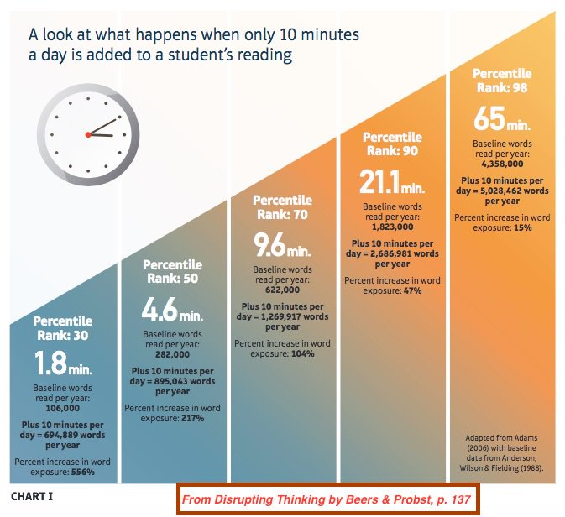
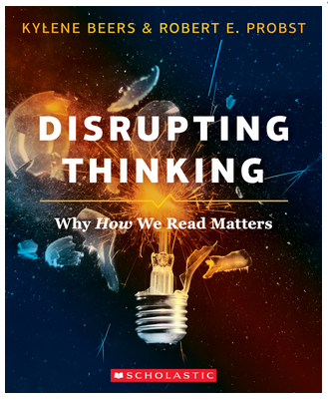
Impact of reading time on student performance

Slide 28
Building Relationships to Build Better Readers
Know your students, know their interests… engagement matters
Cognitive research indicates that the use of highly engaging texts selected to fit students’ interests aids comprehension and increases self-efficacy in reading because students learn more and comprehend better when they have the context that comes with interest in the text (Willingham, 2013).
Create a balance between whole group texts and student-selected
“Students need both content specific reading but also need the exploration of texts beyond the content. If a student enjoys to pleasure read graphic novels we should not dissuade that student from choosing them. Rather, we should support them while still exposing them to content specific passages and texts” (Fisher, Hattie & Frey, 2016).
Notes:
Skills based course- we have the opportunity to build units of study around essential questions that require students to critically think about a topic that resonates with them. They can learn to summarize, draw conclusions, analyze text structure, organization and author’s purpose from any text. Variety is the key- we can always include whole class selections- a poem, an article, a chunk of a book- but what are they in when they read independently in our classes and how can we tap into their natural curiosity to help scaffold and support their learning and independence?

Slide 29
Methods and Best Practices of Virtual Instruction

Slide 30
Face-to-Face vs. Virtual Learning
Hundreds of research studies have compared computer-based learning with face-to-face instruction.
The consistent conclusion is that good instructional methods result in learning whether those methods are delivered virtually or in person.
Good instruction relies on a good teacher, using good instructional methods.

Slide 31
Methods of Virtual Instruction
Synchronous
Asynchronous
Students experience learning activities at the same time. Examples of virtual synchronous learning might include a video conference for a morning meeting, a live science demonstration that all students watch together, or the use of tools where content is presented by a teacher and students can interact during a lesson. The synchronous approach for a student puts the student into direct contact with a teacher and usually other peers. This approach is preferred for working with students who need the support of conversation, direct feedback, and in situations where students can work cooperatively and collaboratively.
The teacher has designed a sequence of activities for students to work independently, and therefore this work may not be completed in tandem with other students. Asynchronous learning is often completed outside of regular class time. Examples of asynchronous assignments might include reading, watching videos, taking assessments, completing projects, completing homework, or answering questions. Students may need extra support in how to structure their time to complete work within the parameters set by the teacher. Students may also be given options to make choices about how they prioritize their time, which can provide practice in time management. Considerations for instructors include the student’s age, maturity, and evidence of prior success in working on asynchronous assignments, as well as the types of support available at home.
Notes:
New virtual learning web page linked here-mention this to participants

Slide 32
Which one to use?
What interaction is needed?
What will feedback look like? Oral/written?
What kind of informal observation and assessments are there?
What is the product/outcome of this learning experience?
What do you want your students to know, understand, and be able to do after this lesson?
Is the content new or review?
What are the student/caregiver needs?

Slide 33
Strategies for Student Success
Create a climate and culture based on trust
Create systems and structures that promote success for all students
Communicate effectively
Make learning targets meaningful
Make learning visible in remote environments

Slide 34
A
Create a climate and culture based on trust.

Slide 35
Empathy is Key
Empathy extends to students and families who may be experiencing a wide variety of challenges.
An empathetic practitioner should assume that all families and students are doing the best they can with what they have in the current situation.
Article: Edutopia - How To Teach With Empathy in Distance Learning

Slide 36
Strategies for Success
How do I create a positive class culture in a remote learning setting? (1 of 2)
Start by getting to know your students. Use surveys, discussion boards, and collaborative tools to get to know students and help them get to know each other.
Make your classroom space a safe place for mistakes. Model how to give and receive constructive feedback and give students a chance to practice with you.
Model how to respond to diverse ideas, opinions, and beliefs in student interactions.
Be prepared to respond to, to promote constructive dialogue about, and to support project themes about race and social justice. Get ideas from the Talking About Race web portal from the African American Museum of History and Culture.
Use a live class session to collaboratively develop community agreements to guide virtual class interaction.
Provide structures for the building of a class community and positive relationships.

Slide 37
B
Create systems and structures that support all students.

Slide 38
Strategies for Success
How do I create a positive class culture in a remote learning setting? (2 of 2)
Clearly communicate your norms, routines, and expectations. Allow students practice them before diving into class content. Check for understanding and assist students who struggle.
Set office hours and be present, visible, and available during those times.
Create a predictable lesson structure to allow students to develop a routine that works for them.

Slide 39
C
Communicate
Effectively

Slide 40
Communication
Communication is key to virtual learning.
Keep instructions clear and concise.
Break complex instructions down into smaller steps.
Communicate exactly what students are being asked to know or be able to do by the end of the lesson.
Communicate the success criteria for the products students will create.

Slide 41
Reduce Text Demands
Keep all written communication as clear and concise as possible.
Provide video directions to accompany text as often as you can.
Offer face-to-face meetings (through applications such as Google Meet or Zoom) to offer verbal explanation and invite questions.
Limit email communication with students, particularly when they’re struggling. Reaching out verbally is paramount at this time.
Decrease quantity and increase quality. Be selective with the content you choose to deliver, and cut out superfluous information.
Proofread all written information to remove teacher jargon and ensure student-friendly language. Remember, our vocabularies are vast compared with those of most of our students.
https://www.edutopia.org/article/focus-empathy-distance-learning

Slide 42
Effective Videos
Research shows that videos created for online courses should be kept short (3 - 4 minutes), informal, and the instructor should show their personality and be enthusiastic.
It is okay for videos not to be perfect! The studies show that informal videos that are imperfect and show your personality can result in better student outcomes then videos with professional production quality.
Keeping videos under 3-4 minutes support students using a variety of technologies and with internet connectivity issues. When videos need to be longer, break them up in to parts that are 4 minutes or less.

Slide 43
D
Make assignments meaningful

Slide 44
Support SEL
Social and emotional learning (SEL) is the process through which children and adults understand and manage emotions, set and achieve positive goals, feel and show empathy for others, establish and maintain positive relationships, and make responsible decisions.
Teach students how to use the arts to manage feelings and emotions, and develop communication skills.
Work with students for the development of personal goals and action plans to achieve them.
Pair analysis of the arts/music with building emotional vocabulary.
CASEL Resources for Social and Emotional Learning

Slide 45
Engage in Culturally Responsive Practices
Culturally responsive teaching (CRT) is a research-based approach that makes meaningful connections between what students learn in school and their cultures, languages, and life experiences. These connections help students access rigorous curriculum, develop higher-level academic skills, and see the relevance between what they learn at school and their lives.
Culturally Responsive Teaching: What You Need to Know

Slide 46
Strategies for Success
How do I plan meaningful experiences for remote learning?
Get to know students, what they care about, and what motivates them to learn.
Communicate and draw connections to the “why” behind the learning goals.
Involve students in setting personal goals and developing strategies to achieve them.
Show students how the learning targets relate to things they care about.
Incorporate student voice, choice, and agency in learning processes and products.

Slide 47
E
Make Learning Visible

Slide 48

Visible Learning for Teachers
Set meaningful learning intentions.
Develop and communicate success criteria.
Provide ongoing, meaningful feedback.

Slide 49
Backwards Planning
What do students need to know or be able to do by the end of the lesson?
How will I know if the student knows it or can do it
(What will they show me?)
3. How will I communicate the success criteria?
Design a lesson that will result in student’s ability to deliver a product that shows you the success criteria.

Slide 50
Check for Understanding Early and Often
Put structures in to place to check for understanding early and often.
Feedback can come from you and/or peers during the process of creating their work.

Slide 51
Strategies for Success
How do I make learning visible in a remote setting?
Provide ongoing feedback, both teacher to student and student to student.
Engage in backwards planning. After setting the learning target, decide how students will show you they have met it. Set the success criteria for the learning outcome, then design a lesson that allows students to successfully show you they have met the learning target.

Slide 52
Planning for Instruction

Slide 53

Six Principles for Supporting Students with Unfinished Learning
Stick to grade-level content and instructional rigor.
Focus on the depth of instruction, not on the pace.
Prioritize content and learning.
Ensure inclusion for each and every learner.
Identify and address gaps in learning through instruction, avoiding the misuse of standardized testing.
Capitalize on commonalities, not differences.
Addressing Unfinished Learning After COVID-19 School Closures | Council of the Great City Schools

Slide 54
Considerations for Planning (1 of 2)
Beginning the Year
  Building student/family relationships
  Daily Schedules/task cues
  Student responses
  Live communication routines
  Other communication routines
  Access to anchor charts, student resources and other visual scaffolds
Plan for scaffolding and modifications
  English Learners
  Students with special needs

Slide 55
Considerations for Planning (2 of 2)
Use assessments
  Prior year
  VDOE English Tracking Log
  Screening assessments
  Informal observations
  Families
  Recording information
Standards and Pacing
  2017 English Standards of Learning Curriculum Framework
  Division pacing or scope and sequence
  Any modifications to division pacing
  Planning for missed content
Teacher talk
  Pre plan
  Concise
  Consistency

Slide 56
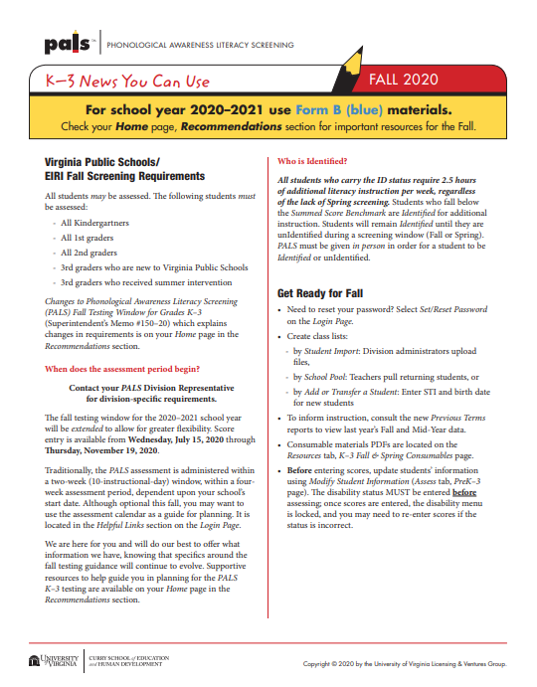

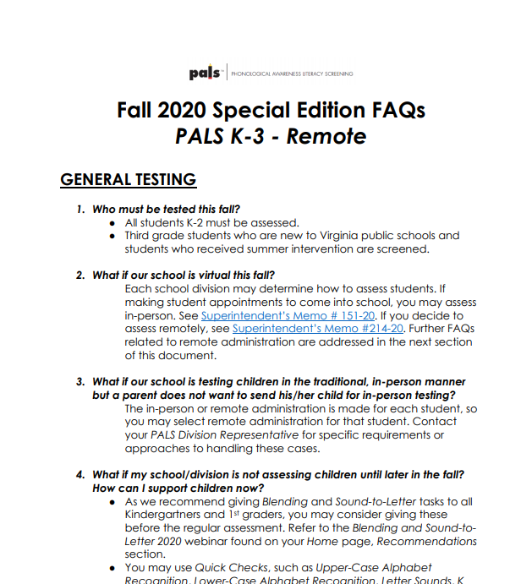
PALS Support

Slide 57
Areas of Focus for A Variety of Learning Environments

Slide 58
8VAC20-131-80. Instructional Program in Elementary Schools.
“C. To provide students with sufficient opportunity to learn, local school divisions shall provide a minimum of 680 hours of the required 990 hours of instructional time to students in elementary school in the four academic disciplines of English, mathematics, science, and history and social science.”
“B. In kindergarten through grade 3, reading, writing, spelling, and mathematics shall be the focus of the instructional program.”
Notes:
Code of Virginia-Standards of Accreditation
For a 6 hour school day, this is about 3.8 hours per day across the 4 disciplines

Slide 59
§ 22.1-253.13:1. Standard 1. Instructional programs supporting the Standards of Learning and other educational objectives.
“The Board shall seek to ensure that the Standards of Learning are consistent with a high-quality foundation educational program. The Standards of Learning shall include, but not be limited to, the basic skills of communication (listening, speaking, reading, and writing); computation and critical reasoning, including problem solving and decision making; proficiency in the use of computers and related technology; computer science and computational thinking, including computer coding; and the skills to manage personal finances and to make sound financial decisions.”
“The English Standards of Learning for reading in kindergarten through grade three shall be based on components of effective reading instruction, to include, at a minimum, phonemic awareness, phonics, fluency, vocabulary development, and text comprehension.”
Notes:
Code of Virginia-Standards of Quality
As you listen today, you may hear practices that sound familiar and are not entirely new. The action step after this webinar is to reflect on the implementation of these practices. What does daily implementation look like? Is it explicit? Is it systematic? Is it daily?

Slide 60
What Research Says About Phonics
Phonics Instruction
“Phonics instruction is an essential part of early reading and writing instruction. Students need to learn how to efficiently decode words to increase their word recognition skills. The more words students recognize automatically, the better their reading fluency, which has a powerful effect on their comprehension of text. And that’s the point. Phonics instruction is designed to increase students’ ability to read and make meaning from text.”
“Students progress at a much faster rate in phonics when the bulk of instructional time is spent on applying the skills to authentic reading and writing experiences, rather than isolated skill-and-drill work. At least half of a phonics lesson should be devoted to application exercises. For students who are below level, the amount of reading during phonics instruction must be even greater.”
International Literacy Association. (2019). Meeting the challenges of early literacy phonics instruction [Literacy leadership brief]. Newark, DE: Author

Slide 61
Effective Literacy Instruction
Explicit
Systematic
is telling students specifically what we want them to know
phonics instruction means that the letter(s)-sound relationship or skill is directly stated to the students “the /s/ sound is represented by the letter s.”
means that the instruction follows a continuum that moves from easier to more complex skills
Means building on prior knowledge

Slide 62
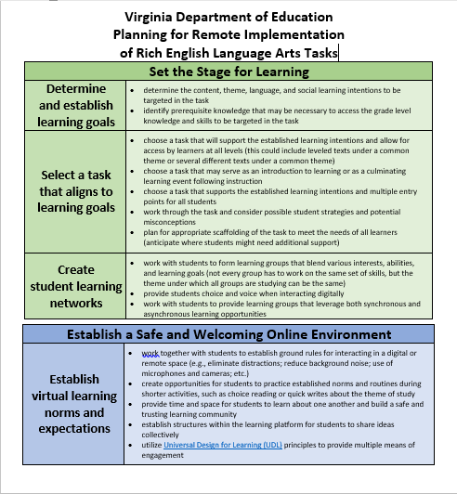
Considerations:

Slide 63
Areas of Focus for All Learners
Building relationships
Accessing grade level content and text
Developing rich English tasks
Including ALL learners
Creating predictable reading/writing routines
Emphasizing foundational skills in K-3

Slide 64
Upcoming Webinars
Elementary: Social & Emotional Learning and Reading- Sept 17
Secondary: Social & Emotional Learning and Reading-Sept 24
Assessment Supports for 2020-2021-Oct 1
Integrating the Four Strands in a Hybrid Model-Oct 8

Slide 65
Additional Resources
Supporting Virtual Teaching
English Learning In Place Resources
Comprehensive Literacy: English Instructional Plans
2020 Comprehensive Literacy Webinar Series
VDOE English Standards of Learning webpage
VDOE English Instruction webpage
VDOE HSS Instruction webpage

Slide 66
Stay in Touch
Jill Nogueras
K-12 English Coordinator
Jill.Nogueras@doe.virginia.gov
Carmen Kurek
Elementary English/Reading Specialist
Carmen.Kurek@doe.virginia.gov
Colleen Cassada
Middle School English Specialist
Colleen.Cassada@doe.Virginia.gov
Assessment Office
Student_Assessment@doe.virginia.gov

