Slide 1
Integrating the Four Strands in a Hybrid Model
Fall 2020

Slide 2
Agenda-
What is blended learning/hybrid learning?
Available Resources
Challenges of teaching the strands in a Hybrid Model
Integrating the Strands of English
Integrating HSS into ELA instruction
What works best synchronously, asynchronously, in person?
Assessing the four strands
Strategies for success
Instructional Resource Example
Upcoming webinars
Stay in touch

Slide 3
What is Blended Learning?
Blended learning is-
a formal education program in which a student learns at least in part through online delivery of content and instruction with some element of student control over time, place, path, and/or pace
and
at least in part at a supervised brick-and-mortar location away from home.
https://www.christenseninstitute.org/wp-content/uploads/2013/04/Classifying-K-12-blended-learning.pdf

Slide 4

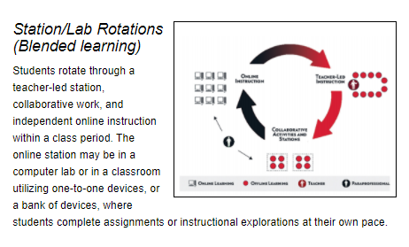
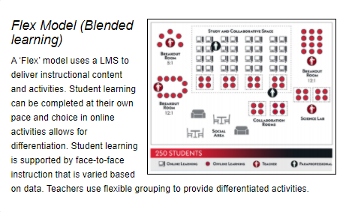
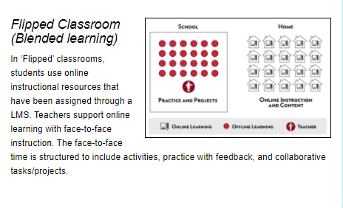
Models of Blended Learning
Images used with permission from the Christensen Institute. Staker, H., & Horn, M. B. (2012). Classifying K-12 blended learning. Christensen Institute.

Slide 5
Available Resources
VDOE Virtual Learning Hub
VDOE Supporting Virtual Learning
VDOE Planning for Virtual Teaching and Learning
K-5 Instruction Core Models
English Instructional Models
History and Social Science Instructional Models

Slide 6
Challenges of the Hybrid Model
The goal of blended learning is to leverage the specific positive attributes of each environment to ensure the optimum use of resources to attain the instructional goal and learning objectives. (Holden & Westfall, 2006)
What are the instructional road blocks for English/Reading within a blended model?

Slide 7
Seamless Integration of
English Strands
Reading
Writing
CONNECTION
AND UNDERSTANDING
Literacies
Communication/
Multimodal Literacy
Research

Slide 8
Integrate the Strands
Reading:
Allow for student choice
Focus on specific vocabulary from authentic texts
Use both fiction and nonfiction texts
Provide variety of texts and media
Writing:
It’s a process!
Write for a variety of authentic purposes
Provide feedback
  Conferencing
  Written
Use a writing portfolio
CONNECTION
AND UNDERSTANDING
Research:
Embed it in the learning process
Make it authentic and meaningful to students
Allow for student choice when possible
Communication & Multimodal Literacies:
Allow students to share
Introduce a variety of media that fits within the topic or theme.

Slide 9
Best Practices in any Learning Environment
  Use text-dependent questions
  Use inference questions
  Use text-based vocabulary
  Response to reading
  Writing components in every lesson
  Frequent research components

Slide 10
Paired Texts and Text Sets
Paired texts can include books, plays, articles, poems, functional text, graphics, or digital media
Focus on a common theme or topic that fits history and social science or science content
Compare and contrast texts to increase the level of thinking
Student choice whenever possible
Theme or Topic
Digital Media
Technical Texts
Graphics
Plays
Informational Texts
Historical Texts
Poems
Interviews
Analyze,
Compare, Contrast

Slide 11
Texts: Use What You Have!
Think about students – What will interest them?
Texts might look different these days- consider what students can access at home.
Make learning authentic by working with what students have.
Provide opportunities for shared and independent reading

Slide 12
Reading Promotes
Deeper Learning & Critical Thinking
Students need:
  opportunities to read daily.
  to read extended pieces of text and grade level material.
  opportunities to read grade level text daily, including nonfiction and fiction pieces.
Teachers support students:
  by providing opportunities to read and compare paired passages (fiction and nonfiction) on the same topic as appropriate.
  by modeling how to analyze ideas in two texts and search for evidence to support their conclusions.

Slide 13

Scaffold Complex Text
Incorporate Time Every day for Independent Reading
Provide Access to Grade Level Text
Highlight and Focus on Complicated Text Structure
Be Explicit
Support Vocabulary
Use Deliberate Annotations
Use Questions as Planned Scaffolds
Allow Time for Reflection and Discussion

Slide 14
Reading and Writing Together
Introduce varied texts to show students different writing styles.
Model the writing process and meet with students for writing conferences.
Use other content material for texts and allow students to demonstrate understanding through writing.

Slide 15
Integrating History and Social Science (1 of 7)
Students Need to Read and Write in EVERY Class
"BUT THE REALLY BIG INVESTMENT IN READING TIME IN SCHOOL SHOULD
NOT BE FILLING LOST MINUTES. IT SHOULD BE A PROMINENT PART OF
INSTRUCTION. KIDS SHOULD BE READING THROUGHOUT THEIR SCHOOL
DAY—DURING LITERACY INSTRUCTION, DURING SCIENCE, SOCIAL STUDIES,
MATHEMATICS, HEALTH, AND THE ARTS, TOO."
TIMOTHY SHANAHAN
“KIDS NEED TO READ WITHIN INSTRUCTION"

Slide 16

Integrating History and Social Science (2 of 7)
I don’t want to ask my colleagues to take on more work by integrating Reading, Writing or “my” content into their lessons.
How can I possibly make it happen in my current teaching environment?
Where am I going to find the time to locate resources?
In times of great challenge, it can be easy to fall into old habits:
English
History
Math
Science

Slide 17
Integrating History and Social Science (3 of 7)
Integrating historical content offers thoughtful experiences that support the use of information sources, asking questions, application of both the social science and English skills, and allows students to share both verbal and written communication supported with evidence.

Slide 18
Seamless Integration of
History and Social Science in English Instruction
Non-fiction
text
Persuasive
Writing
CONNECTION
AND UNDERSTANDING
Literacies
Communication/
Multimodal Literacy
Research using
Primary Sources

Slide 19
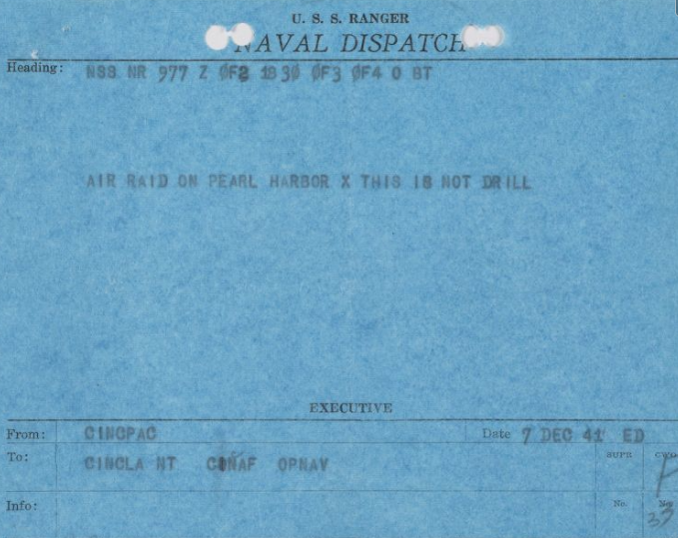


Integrating History and Social Science (4 of 7)

Slide 20

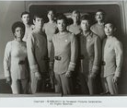


Integrating History and Social Science (5 of 7)

Slide 21


Integrating History and Social Science (6 of 7)

Slide 22
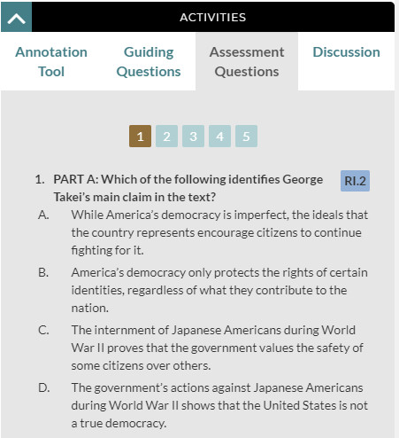


Integrating History and Social Science (7 of 7)

Slide 23
What Works?
Always look for ways to maximize student engagement, check for understanding, & build relationships.
Synchronous Activities
Engaging Tasks to Spark Interest
Small Group
Direct Instruction
Guided Reading and Thinking
Questioning
Feedback and Conferring
Asynchronous Activities
Pre-recorded Modeling
Partner Work
  Discussion Boards
  Shared Google Docs
  Shared Google Slides
Reflective Writing
Multi-modal Literacies

Slide 24
Assessing the 4 Strands (1 of 2)
Provide expectations and guidelines for assessing students.
Describe criteria broadly so that it can be demonstrated in multiple ways.
Give feedback in a timely manner.
Use flexible structures and rubrics that allow for a huge variety of experiences and resources. Place student reflection and self-assessment at the center of feedback.

Slide 25
Assessing the 4 Strands (2 of 2)
Consider exploring the following innovative reflection opportunities and assessment formats for students:
  activities that require student reflection;
  authentic learning experiences;
  career exploration;
  creativity in learning;
  critical thinking exercises;
  inquiry-based learning;
  outside investigations/explorations;
  play-based learning;
  project-based learning;
  problem-solving activities;
  technology-based direct instruction;
  voice and choice for students (choice boards);
  workplace readiness preparation; and
  writing for a variety of purpose

Slide 26
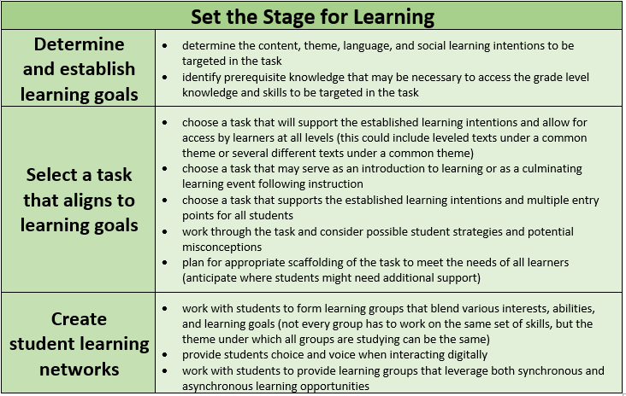
Create Rich Assessment Tasks (1of3)
Opportunities to Integrate the Strands
When planning for assessment, check to be sure each strand is represented throughout the process.
Collaboration & Communication
http://www.doe.virginia.gov/instruction/english/literacy-webinars/2020-2021/remote-implementation-tasks-aug-2020.docx

Slide 27
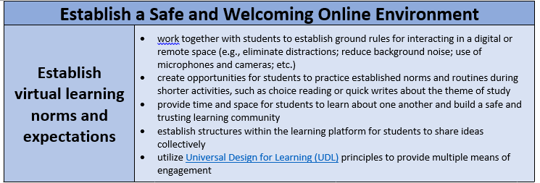
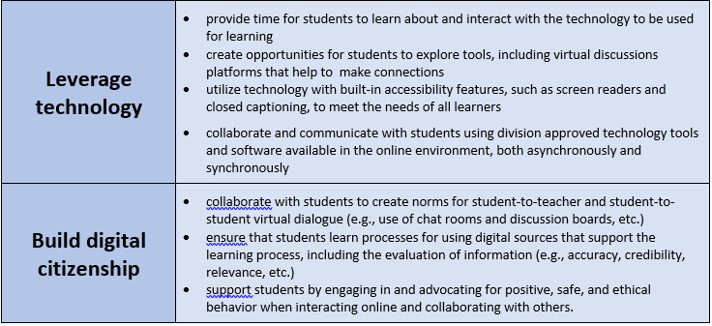
Create Rich Assessment Tasks (2 of 3)
Research & Communication
Communication, Multimodal Literacy, Reading, & Writing

Slide 28
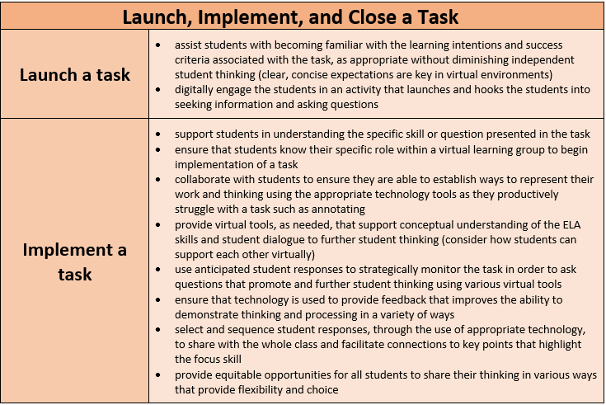
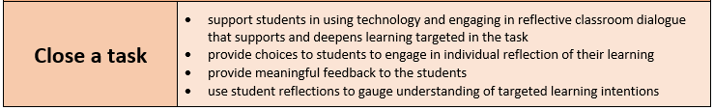
Create Rich Assessment Tasks (3 of 3)
When creating the assessment, build in opportunities to use the strands:
Reflective Writing
Reading & Analyzing
Communicating using Multimodal Media
Evaluating Information and Resources

Slide 29
Strategies for Success (1 of 4)
Engagement – quality virtual instruction
Provides a creative way for students to master content using a variety of instructional strategies.
Personalize instruction and give students the power to “own” their learning through providing choice.
Be selective and thoughtful with assignments.
Tasks should be manageable based on curriculum.
http://www.doe.virginia.gov/instruction/virtual_learning/virtual-teaching-learning/index.shtml

Slide 30
Strategies for Success (2 of 4)
Engagement – quality virtual instruction
Differentiate based on student needs; coordinate and collaborate with teachers including EL teachers, special education teachers, gifted resource teachers, and others.
Teachers may also integrate a variety of learning experiences that integrate technology into daily instruction including:
  authentic learning experiences;
  inquiry-based learning;
  online coursework;
  online research;
  project-based learning;
  simulations;
  virtual games; and
  virtual learning experiences.
http://www.doe.virginia.gov/instruction/virtual_learning/virtual-teaching-learning/index.shtml

Slide 31
Strategies for Success (3 of 4)
  When possible, use the same materials in both settings, and stick with the same curricular progression.
  Taking a “remote-first” approach to instructional planning could make hybrid schedules (and socially distanced classrooms) run more smoothly.
  When students do have time in person, they should be collaborating with each other, having discussions, and working through problems.
https://www.edweek.org/ew/articles/2020/08/06/how-to-make-lessons-cohesive-when-teaching.html?1599162834626?cmp=eml-enl-ewpce-dis

Slide 32
Strategies for Success (4 of 4)
Routines that create cohesion across learning environments-
Reading Grade Level Text
Responding to Text
Reading Foundations Work
https://ccsso.org/blog/ccsso-releases-restart-recovery-considerations-teaching-learning

Slide 33
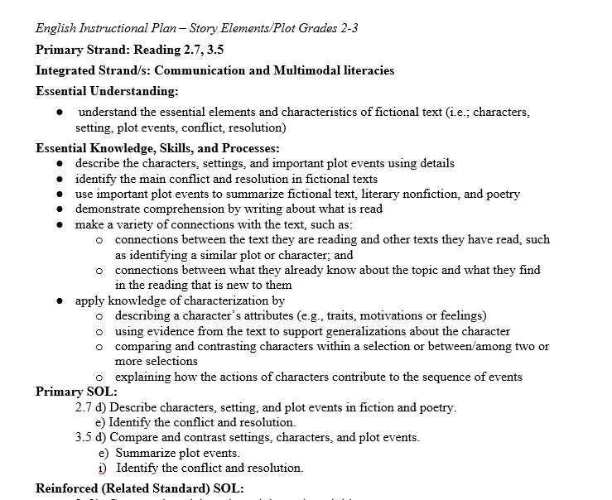
Instructional Examples (Elementary School 1 of 4)
Use what you have!
Consider which activities can be modified for blended learning.
http://www.doe.virginia.gov/testing/sol/standards_docs/english/2017/eng-instruct-plans/index.shtml

Slide 34
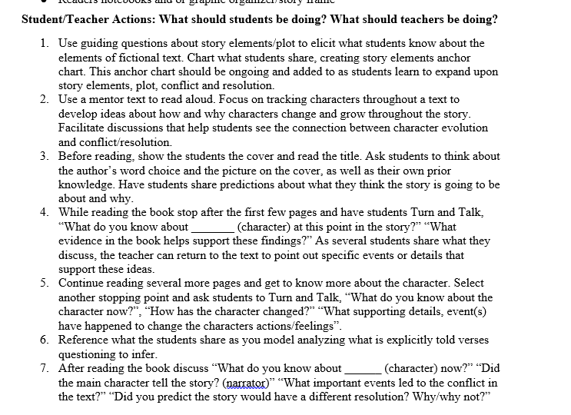
Instructional Examples (Elementary School 2 of 4)
Teacher can use “Academic Background” section to focus pre-teaching of skills and language during face to face time
Teacher PRE-RECORDS direct instruction:
Review story elements
Introduce new concept
Provide explicit instructions on how to practice the skill/concept at.
Use face to face instructional time to support students with complex text and connections to other content.
http://www.doe.virginia.gov/testing/sol/standards_docs/english/2017/eng-instruct-plans/index.shtml

Slide 35
Instructional Examples (Elementary School 3 of 4)
Hybrid Learning Plan Sample
Face to face or Synchronous Day 1 | Teacher works with a small group of students to pre-teach or review some of the academic background information such as character traits. Have students practice with a short text identifying character traits with text evidence. Work with groups or class of students to pre-teach and understand some vocabulary in preparation for upcoming texts
Virtual or Asynchronous Day 2 | Have a pre-recorded video available for students describing how characters change throughout the story, ideas to build the concept might include comic strips, a short video clip along with some teacher talk to discuss and plant some language/sentence frames for students to use. Give students a short snippet of text to practice this concept with and have them respond through writing.

Slide 36
Instructional Examples (Elementary School 4 of 4)
Hybrid Learning Plan Sample
Face to face or Synchronous Day 3 | Review previous day’s concepts and place students in pairs to read/share their written reflections. Teacher listening in on student conversations to collect anecdotal or formative data on student understanding Support students with further development of this concept by conferring, meeting with small groups, and scaffolding through complex text, graphic organizers, etc. Connect learning back to thematic unit on friendship by discussing and charting the impacts to the community of being a good citizen and encouraging others to be good citizens. Make connections to the stories that have been read and the character’s traits and how it can impact a community. Create a list or T-chart of traits/actions and impacts. (HSS 3.1f)
Virtual or Asynchronous Day 4 | Provide students with photographs, primary sources, or short videos illustrating ways people serving their community. Have students observe, and reflect on observations in writing. Choose a way to help your community. Create a pamphlet, or poster advertising this. Use on of the traits you discussed from text earlier in the week (example: Are you responsible? Then go out and vote!)

Slide 37
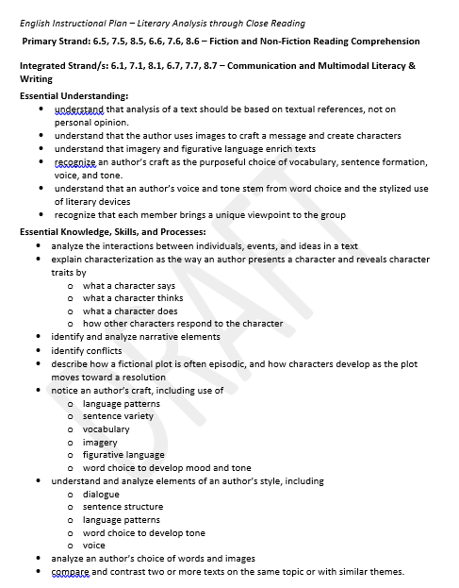
Instructional Examples (Secondary 1 of 4)
Use what you have!
Consider which activities can be modified for blended learning
http://www.doe.virginia.gov/testing/sol/standards_docs/english/2017/eng-instruct-plans/index.shtml

Slide 38

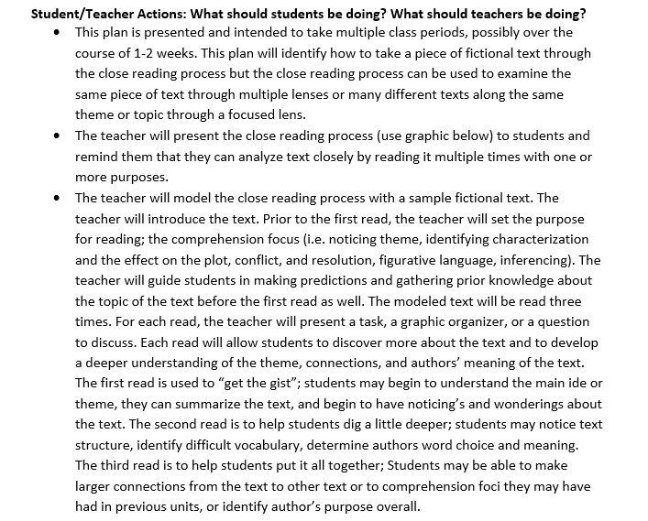
Instructional Examples (Secondary 2 of 4)
Pre-record direct instruction of the skill and process for learning. (ex. Close reading protocols)
Post additional supports such as graphics or charts
Explain intended goals and outcomes for the lesson.
Record a model example of the activity for students to refer back to.
http://www.doe.virginia.gov/testing/sol/standards_docs/english/2017/eng-instruct-plans/index.shtml

Slide 39
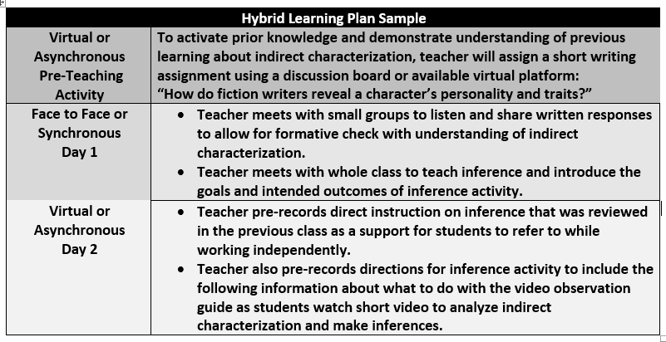
Instructional Examples (Secondary 3 of 4)

Slide 40
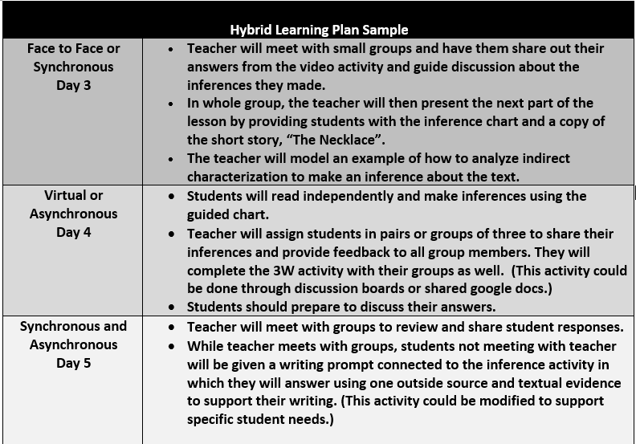
Instructional Examples (Secondary 4 of 4)

Slide 41
Upcoming Webinars
Assessment Supports: Grade Three Reading-October 13 at 3:00pm
Assessment Supports: Grade Four Reading-October 15 at 3:00pm
Assessment Supports: Grade Five Reading-October 16 at 3:00pm
Assessment Supports: Grade Six Reading-October 19 at 3:00pm
Assessment Supports: Grade Seven Reading-October 20 at 3:00pm
Assessment Supports: Grade Eight Reading-October 21 at 3:00pm
Assessment Supports: End Of Course Reading-October 22 at 3:00pm

Slide 42
Additional Resources
Supporting Virtual Teaching
English Learning In Place Resources
Comprehensive Literacy: English Instructional Plans
2020 Comprehensive Literacy Webinar Series
VDOE English Standards of Learning webpage
VDOE English Instruction webpage
VDOE HSS Instruction webpage

Slide 43
Integrating History and Social Science
History and Social Science Resources:
Library of Congress-Teaching with Primary Sources Virginia Partnership
Library of Virginia-Document Bank
Virginia Museum of Fine Arts
Virginia History & Culture Museum
New American History
emediava
Building a Community of Learners Professional Development Series
Weekly virtual Professional Development offerings along with recordings of recently offered webinars in the series, like:
Library of Congress-Teaching with Primary Sources (Session 1)
New American History-Teaching Students to Think for Themselves (Session 1)

Slide 44
Stay in Touch
Jill Nogueras
K-12 English Coordinator
Jill.Nogueras@doe.virginia.gov
Carmen Kurek
Elementary English/Reading Specialist
Carmen.Kurek@doe.virginia.gov
Colleen Cassada
Middle School English Specialist
Colleen.Cassada@doe.Virginia.gov
Brandi McCracken
Elementary HSS Specialist
Brandi.McCraken@doe.Virginia.gov
Assessment Office
Student_Assessment@doe.virginia.gov

