Slide 1
Interdisciplinary Collaboration
Integrating the English standards across content areas

Slide 2
What do we want to accomplish today?
Essential Questions
How can teachers outside of English/Language arts support literacy effectively?
How should lessons and experiences be designed to meet those expectations? What will instruction and learning look and sound like?
What instructional supports do teachers in my division need to meet the expectations?
Agenda
Overview of the value of integration to support literacy: Focus on disciplinary vocabulary development
Teaching writing vs. assigning writing
Local Topics as a Panacea for Interdisciplinary Learning

Slide 3
Vocabulary Development

Slide 4
Vocabulary is learned dynamically
“Vocabulary instruction should provide students with opportunities to encounter words repeatedly and in a variety of contexts” (Stahl, 2005)
“When children ‘know’ a word, they not only know the word’s definition and its logical relationship with other words, they also know how the word functions in different contexts” (Stahl & Kapinus, 2001)
Vocabulary is learned contextually
Using a contextual approach to instruction produced greater vocabulary gains than lessons that emphasized learning word definitions (Nash & Snowling, 2006).

Slide 5
Encountering text and words dynamically
What effect does this have on instruction?
Consider what “The Vocabulary List” implies
  A hierarchy of meanings that is static
  Context isn’t important
  Meaning transcends content area
Consider the power of tackling vocabulary organically
  Models vocabulary strategies for students
  Stresses the importance of context
  Emphasizes content-specific information

Slide 6
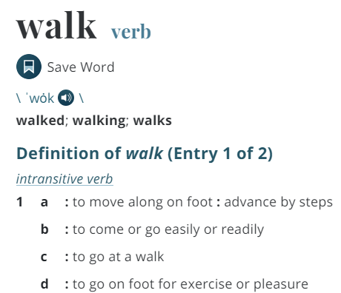

Vocabulary may or may not be intuitive in the content area

Slide 7
The problem (and missed opportunity) of vocabulary work devoid of context
Culture - the beliefs, behaviors, objects, and other characteristics common to the members of a particular group or society.
Culture - A growth of microorganisms, viruses, or tissue cells in a specially prepared nutrient medium under supervised conditions
QUESTIONS YOU MAY ASK: How have you seen the word used before? Would you add any characteristics to the definition? What do you think is meant by “beliefs” and “behaviors”? How does the meaning you learned in history relate to the meaning in science?

Slide 8
Teaching Writing vs. Assigning Writing

Slide 9
Assigned vs. Taught
Assigned
Students write using teacher selected topics and sources and take a position that is determined for them
Students are given a task without instruction on how to complete it successfully
Students rewrite only to correct errors in usage and mechanics
Taught
Students use research and reading to chart their own path and formulate their own position
Teacher time is spent in class teaching writing skills and strategies
Students use models and strategies to complete each assignment and adjust based on teacher and peer feedback
Because Writing Matters by Carl Nagin
The National Writing Project
Notes:
There is a great difference between assigning writing and teaching writing. Although all students can write, direct instruction by the teacher is needed to develop an awareness of good writing and the skills needed to create it.
Direct instruction of concepts such as audience and purpose and skills such as revision can be followed by student choice and reflection. Then as the writing begins, the instruction continues with teacher modeling.

Slide 10
When writing is taught…
Teachers model by
  Writing with the students
  Revealing the hard work of writing
  Thinking aloud through revision of their writing
  Editing only after revision is complete
Notes:
Modeling is one of the most effective instructional strategies and that is true in writing as well as other areas. Teachers should write as students are writing and then model the steps in the writing process, fine tuning the modeling to meet the students’ needs. If composing is the weakest area then the teacher might conduct a think aloud through the process of selecting main ideas and developing organization and elaboration. If first drafts are generally solid but revision is lacking, then the teacher can model strategies such as developing sentence variety or replacing bland language for more vivid vocabulary.

Slide 11
The best writing instruction is integrated with content, not divorced from it
Writing as a replacement for multiple choice assessment
Writing to generate analytical responses to course content
Integrates all of the English SOL strands
Increases the amount of time students spend writing AND analyzing information, effectively doubling instructional time with no impact on your content
Is a transferrable skill that improves literacy and analysis across all content areas
This type of writing must be TAUGHT
As a replacement for multiple choice assessment, writing may happen in a vacuum with no links to reading.
This type of writing can often just be ASSIGNED
Notes:
Emphasize that while short answer responses and fill-in-the-blanks may be good, it misses its ceiling because it lacks authenticity. It’s only authentic to that test and isn’t a transferrable skill. But writing that is integrated with reading is far more effective.

Slide 12
Effective writing instruction means writing is embedded across all contents
… as a content-specific set of skills
Think about what it means to write for YOUR content area
How can students learn to write like a historian… a scientist… a mathematician?
How can student writing be generated as a response to the kind of information and text that students encounter in your content… from laboratory data to primary sources.
These are all skills that must be TAUGHT
Notes:
This is about history today but really it’s all content areas. Emphasize that disciplinary writing is as important to each content as any other skill. Students taking your course without learning to write in your course is like learning to drive a car but never learning how to make left turns.

Slide 13
History and Social Science Essential Understandings:
All students should:
Analyze and interpret primary and secondary sources
Interpret charts, graphs, and pictures
Use evidence to draw conclusions and make generalizations
Compare and contrast historical and political perspectives
Assess cause and effect
Explain connections across time and place
Exercise citizenship skills
Conduct historical investigations
Notes:
In history and social science we have expanded the way we present and emphasize skills. From the first page that you tear off on your way to SOL 2a to the foundation for the entire course. What do all of these have in common? You can’t do these without the kind of authentic writing we’ve been discussing today.

Slide 14
Science Standards of Learning Goals:
Use scientific processes to safely investigate the natural world;
Develop the scientific knowledge, skills, and attributes to be successful in college, explore science-related careers and interests, and be work-force ready ;
Develop scientific dispositions and habits of mind (collaboration, curiosity, creativity, demand for verification, open-mindedness, respect for logical and rational thinking, objectivity, learning from mistakes, patience, and persistence);
Possess significant knowledge of science to be informed consumers with the ability to communicate and use science in their everyday lives and engage in public discussions;
Make informed decisions regarding contemporary civic, environmental, and economic issues;
Apply knowledge of mathematics and science in an authentic way using the engineering design process to solve societal problems; and
Develop an understanding of the interrelationship of science with technology, engineering and mathematics (STEM).
Notes:
In history and social science we have expanded the way we present and emphasize skills. From the first page that you tear off on your way to SOL 2a to the foundation for the entire course. What do all of these have in common? You can’t do these without the kind of authentic writing we’ve been discussing today.

Slide 15
Math Essential Understandings:
Mathematical Communication
Students will communicate thinking and reasoning using the language of mathematics, including specialized vocabulary and symbolic notation, to express mathematical ideas with precision. Representing, discussing, justifying, conjecturing, reading, writing, presenting, and listening to mathematics will help students clarify their thinking and deepen their understanding of the mathematics being studied. Mathematical communication becomes visible where learning involves participation in mathematical discussions
Notes:
In history and social science we have expanded the way we present and emphasize skills. From the first page that you tear off on your way to SOL 2a to the foundation for the entire course. What do all of these have in common? You can’t do these without the kind of authentic writing we’ve been discussing today.

Slide 16
English Essential Understandings
All students should:
understand that writers communicate ideas for a variety of purposes
understand that writers plan, write, revise, and share their writing with others
understand that writers use the writing process including planning, drafting, revising, editing, and publishing
understand that written communication should be well-planned and clear to the reader.
Notes:
Here are our English understandings in regards to writing. There’s no opposition here… asking history teachers to be purposeful about teaching writing is not, “just one more thing.” It’s something that should have been happening all along.

Slide 17
Using Local Topics to Support Literacy

Slide 18
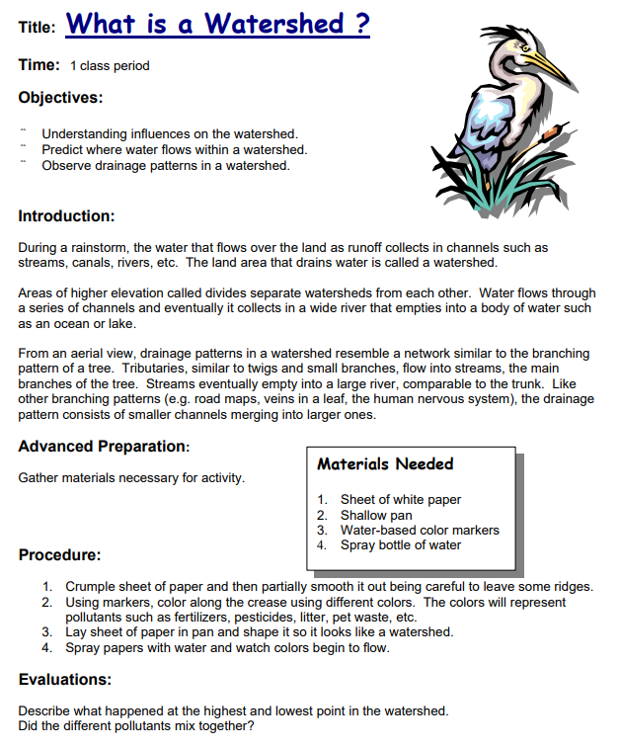
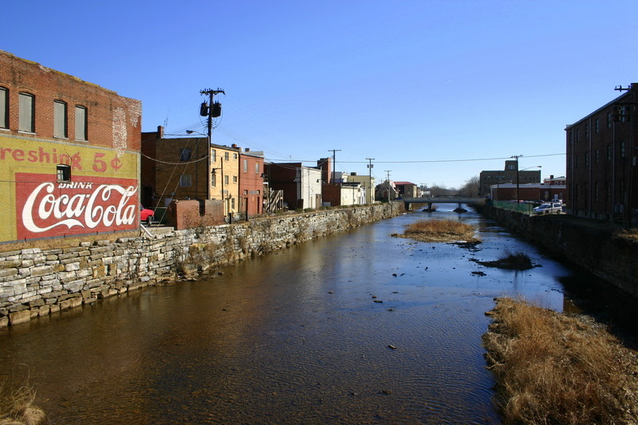
Assessing Environmental Impact
Students develop essential understandings and processes (and vocabulary)
Then they apply it to their locality

Slide 19
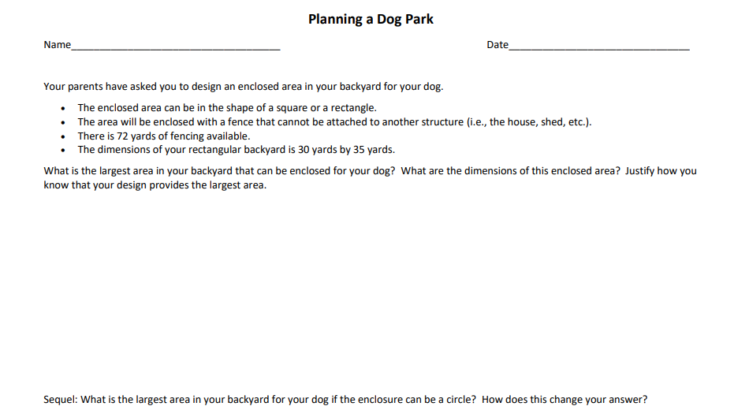
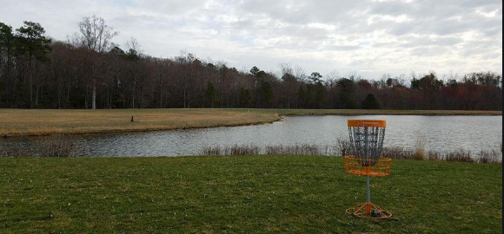
Rich Mathematical Tasks
Students develop essential understandings and processes (and vocabulary)…
Then devise and pitch their own design challenge…

Slide 20
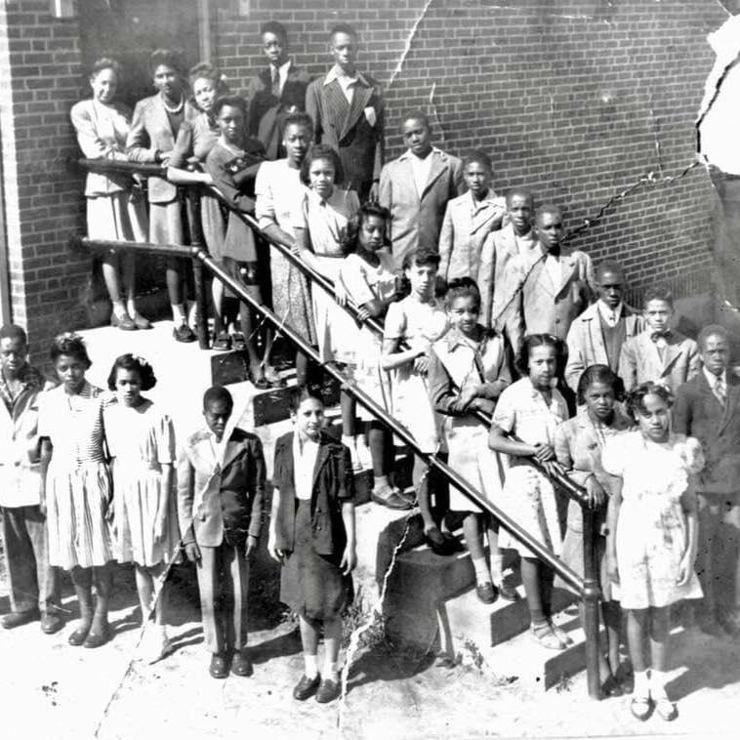
Teaching Hard History
Students develop essential understandings of national or world historical events…
Local history helps students better understand their community, as well as the inequities they see around them every day…It’s hard to find real local history in textbooks, and it takes courage to teach these hidden, hard histories. But it’s not hard to help students uncover this history. They can start with the origins of the names of streets, schools and government buildings in their city. Or they can consider how the hard history of our nation played out in their community.
- from TeachingTolerance.org
Then investigate to uncover this history in their counties, cities, and towns.
“I had no idea because I was told what I was supposed to hear. And the fact that, that was the groundbreaking thing that started the process for Brown vs the Board of Education, happened right here in my town.”
- David Clark, Mayor, Town of Pulaski

Slide 21
BOE Guidelines – Local Alternative Assessments
Superintendent’s Memo 025-19, Attachment A
“1. incorporate options for age-appropriate, authentic performance assessments and portfolios … 2. permit and encourage integrated assessments that include multiple subject areas
The legislation encourages integrated assessments that include multiple subject areas. For example, a local assessment might address content from both U.S. History I and 6th Grade English.

Slide 22
Resources for this work

Slide 23


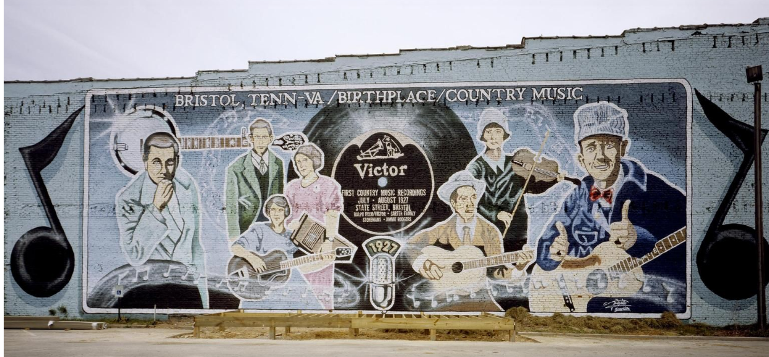
Local History Investigation
Encyclopedia Virginia
.

Slide 24

Searching for Poetry and Prose by Theme
Common Lit
.

Slide 25

The Geo-Inquiry Model

Slide 26
Stay Connected
Jill Nogueras
K-12 English Coordinator
Jill.Nogueras@doe.virginia.gov
Carmen Kurek
Elementary English/Reading Specialist
Carmen.Kurek@doe.virginia.gov
Taylor Snow
English/History & Social Science Specialist
Taylor.Snow@doe.Virginia.gov
Assessment Office
Student_Assessment@doe.virginia.gov
Christonya Brown
Coordinator of History and Social Science
Christonya.Brown@doe.virginia.gov
Dr. Anne Peterson
K-12 Science Coordinator
Anne.Peterson@doe.virginia.gov
Tina Mazzacane
K-12 Mathematics Coordinator
Tina.Mazzacane@doe.virginia.gov

