Slide 1
Virginia Department of Education
Comprehensive Literacy: Best Practices for Elementary Reading Blocks
Webinar
Fall 2019

Slide 2
Agenda
Welcome and Introductions
What Research Says
2017 English Standards of Learning and VDOE Updates
Panel Discussion
Dr. Tammy Milby, University of Richmond Director of Reading
Lori Wall, Director of Elementary Curriculum, Newport News Public Schools

Slide 3
Questions from the Field
Chat Feature
Use the chat feature to pose any questions to the group.
We will collect these and add additional information as necessary to the presentation before slides are mailed out.

Slide 4
8VAC20-131-80. Instructional Program in Elementary Schools.
“C. To provide students with sufficient opportunity to learn, local school divisions shall provide a minimum of 680 hours of the required 990 hours of instructional time to students in elementary school in the four academic disciplines of English, mathematics, science, and history and social science.”
“B. In kindergarten through grade 3, reading, writing, spelling, and mathematics shall be the focus of the instructional program.”
Notes:
Code of Virginia-Standards of Accreditation
For a 6 hour school day, this is about 3.8 hours per day across the 4 disciplines

Slide 5
§ 22.1-253.13:1. Standard 1. Instructional programs supporting the Standards of Learning and other educational objectives.
“The Board shall seek to ensure that the Standards of Learning are consistent with a high-quality foundation educational program. The Standards of Learning shall include, but not be limited to, the basic skills of communication (listening, speaking, reading, and writing); computation and critical reasoning, including problem solving and decision making; proficiency in the use of computers and related technology; computer science and computational thinking, including computer coding; and the skills to manage personal finances and to make sound financial decisions.”
“The English Standards of Learning for reading in kindergarten through grade three shall be based on components of effective reading instruction, to include, at a minimum, phonemic awareness, phonics, fluency, vocabulary development, and text comprehension.”
Notes:
Code of Virginia-Standards of Quality
As you listen today, you may hear practices that sound familiar and are not entirely new. The action step after this webinar is to reflect on the implementation of these practices. What does daily implementation look like? Is it explicit? Is it systematic? Is it daily?

Slide 6

What Research Says (1 of 4)
Foundational Skills to Support Reading for Understanding in Kindergarten Through 3rd Grade Practice Guide:
Recommendation 1- Teach students academic language skills, including the use of inferential and narrative language, and vocabulary knowledge.
Recommendation 2- Develop awareness of the segments of sound in speech and how they link to letters.
Recommendation 3- Teach students to decode words, analyze word parts, and write and recognize words.
Recommendation 4- Ensure that each student reads connected text every day to support reading accuracy, fluency, and comprehension.
Foorman, B., Beyler, N., Borradaile, K., Coyne, M., Denton, C. A., Dimino, J., Furgeson, J., Hayes, L., Henke, J., Justice, L., Keating, B., Lewis, W., Sattar, S., Streke, A., Wagner, R., & Wissel, S. (2016). Foundational skills to support reading for understanding in kindergarten through 3rd grade (NCEE 2016-4008). Washington, DC: National Center for Education Evaluation and Regional Assistance (NCEE), Institute of Education Sciences, U.S. Department of Education. Retrieved from the NCEE website: http://whatworks.ed.gov.
Notes:
These practice guides published by What Works Clearinghouse and the Institute of Education Sciences examine studies and make recommendations based on the evidence of the studies. The recommendations are ranked in order of strongest evidence to minimal.
Recommendation 1-Supporting the development of specific academic, inferential, and narrative language skills will broaden students’ listening comprehension skills which will prepare them for better reading comprehension. It also expands their vocabulary knowledge and syntax within the English language.
Recommendation 2-To effectively decode (convert from print to speech) and encode (convert from speech to print) words, students must be able to identify the individual sounds, or phonemes, that make up the words they hear in speech, name the letters of the alphabet as they appear in print, and identify each letter’s corresponding sound(s). This recommendation presents ways to support these skills such as; 1. Teaching students to recognize and manipulate segments of sound in speech. 2) Teaching students letter–sound relations. And 3. Using word-building and other activities to link students’ knowledge of letter–sound relationships with phonemic awareness.
Recommendation 3-This recommendation presents several ways to implement decoding and analyzing word parts. The first way is blending sounds with spelling patterns from left to right to produce a recognizable word. The next is providing instruction on common sound-spelling patterns. Is it explicit and systematic? Also continuing this instruction even as students move into learning syllables
Recommendation 4-The recommendation states that students should be reading a wide variety of connected text daily, with and without constructive feedback. As students are beginning to apply the alphabetic principal, text should provide examples of recently taught spelling patterns with support and feedback from teachers on applying decoding strategies learned. This recommendation also shares some suggested strategies for supporting students in reading more fluently.

Slide 7

What Research Says (2 of 4)
Teaching Elementary School Students to be Effective Writers Practice Guide:
Recommendation 1-Provide daily time for students to write.
Recommendation 2- Teach students to use the writing process for a variety of purposes.
Recommendation 3- Teach students to become fluent with handwriting, spelling, sentence construction, typing, and word processing.
Recommendation 4- Create an engaged community of writers.
Graham, S., Bollinger, A., Booth Olson, C., D’Aoust, C., MacArthur, C., McCutchen, D., & Olinghouse, N.(2012).Teaching elementary school students to be effective writers: A practice guide (NCEE 2012- 4058). Washington, DC: National Center for Education Evaluation and Regional Assistance, Institute of Education Sciences, U.S. Department of Education. Retrieved from http://ies.ed.gov/ncee/ wwc/publications_reviews.aspx#pubsearch.
Notes:
Recommendation 1-The guide recommends at least 30 minutes a day in Kindergarten for teaching skills, strategies and processes for writing, as well as an hour a day for older elementary students. 30 minutes of that for instruction, and 30 minutes for student writing. It also suggests that some of that student writing time could also occur within other content domains such as writing a lab report for Science.
Recommendation 2-This recommendation shares many strategies for engaging students within the writing process, from picking ideas and organizing all the way to sharing as well as strategies for writing for different purposes.
Recommendation 3-When young students begin to write, they scribble and will tell you a whole story for what that scribble means. They have learned that what I write stands for what I think. As they get older they are working to express their stories and ideas on paper as well as use their developing spelling knowledge to identify the sounds they need to express those ideas. They have two jobs. If students have not developed fluency with their letter formation then the ideas they want to express begin to change and adapt and their print no longer acts as the symbol for those ideas. Handwriting is not only essential for letter learning, but fluency with this is essential for expressing ideas. As students grow and begin to express their ideas in a variety of modes, these practices need to be implemented daily, such as word processing and utilizing technology for communication. It is important that this is intentional and not as time allows.
Recommendation 4-This recommendation shares some ways to create a strong community such as the teacher acting as a writer within the community, providing choices, providing opportunities for students to collaborate as writers, effective ways to publish student writings and providing continuous feedback.

Slide 8
What Research Says (3 of 4)
“Phonics instruction is an essential part of early reading and writing instruction. Students need to learn how to efficiently decode words to increase their word recognition skills. The more words students recognize automatically, the better their reading fluency, which has a powerful effect on their comprehension of text. And that’s the point. Phonics instruction is designed to increase students’ ability to read and make meaning from text.”
“Students progress at a much faster rate in phonics when the bulk of instructional time is spent on applying the skills to authentic reading and writing experiences, rather than isolated skill-and-drill work. At least half of a phonics lesson should be devoted to application exercises. For students who are below level, the amount of reading during phonics instruction must be even greater.”
International Literacy Association. (2019). Meeting the challenges of early literacy phonics instruction [Literacy leadership brief]. Newark, DE: Author

Slide 9
What Research Says (4 of 4)
Characteristics of strong phonics instruction:
Explicit and systematic
Readiness Skills
Scope and Sequence
Blending
Dictation
Word Awareness
High-Frequency Words
Reading Connected Text
Building vocabulary and background knowledge
International Literacy Association. (2019). Meeting the challenges of early literacy phonics instruction [Literacy leadership brief]. Newark, DE: Author
Notes:
What does explicit and systematic mean? Explicit phonics instruction means that the letter(s)-sound relationship or skill is directly stated to the students “the /s/ sound is represented by the letter s.” Systematic means that the instruction follows a continuum that moves from easier to more complex skills.
Strong alphabet recognition and phonemic awareness are readiness skills needed for success in reading. Knowing the names and sounds of letters with fluency and being able to orally blend, segment, and manipulate sounds in words from Kindergarten moving up to grade 3 will be the biggest predictor of early reading success.
A strong scope and sequence moves from easier to more complex skills and builds on previous learning.
Blending-We teach students to segment or sounds in order to decode words, but students must be proficient in blending those sounds together in order to sound out words. Students must be proficient with blending orally before using it in text. Blending is used with early readers but should continue as students transition into multisyllabic words.
Dictation-Students must be provided opportunities to “try out” or apply their phonics skills with teacher support, just like the IES Guide discusses practciing phonics skills in connected text.
Word Awareness-Literacy blocks should consist of opportunities for students to analyze and notice patterns in word through tasks that require students to manipulate words to increase students’ ability to notice larger chunks in monosyllabic and multisyllabic words. Word building and word sorting are two examples of these tasks.
High-Frequency Words-Known as the most common words in English. Words that follow regular sound-spellings can be learned and applied during the normal phonics scope and sequence. Word do not, need to be explicitly taught to students.
Reading Connected Text-Students should have opportunities to practice and apply phonics instruction in decodable text.
Building vocabulary and background knowledge-As older elementary students encounter more complex texts and vocabulary, providing a balance of phonics instruction with best practices with vocabulary acquisition and expanding background knowledge is essential.
So as you are reflecting on the practices in your literacy block, continue to think about the implementation of these characteristics. Do you do these daily? Do you see these daily?

Slide 10
Virginia Department of Education 2017 Standards (1 of 3)
New Communication Strand- Grades K-3 Formerly Oral Language
New Communication and Multimodal Literacies strand focuses on:
  Building communication skills
    Ask questions; collaborate with partners or groups
  Strengthening early oral literacy skills
    Retell stories; participate in creative dramatics
  Developing presentation skills
    Speak clearly; organize ideas; create a simple presentation using multimodal tools
Notes:
Now we will look at the new 2017 English Standards of Learning changes and updates as well as the teacher notes that are provided that suggest important components to include in literacy blocks.
In K-3 former Oral Language strand is now named Communication and Multimodal Literacies to align with grades 4 and 5. An effective literacy block should be integrating these skills such as retelling, asking questions, and collaborating throughout the literacy block as modes to communicate about reading and writing, unless specific intervention is needed.

Slide 11
Virginia Department of Education 2017 Standards (2 of 3)
Now called Communication & Multimodal Literacies
Integrates multiple modes of communication and expression, digital citizenship, and current best practices
Encourages options such as podcasts, presentations with visuals and media, blogs, etc
Expands collaboration, consensus-building, team-building, and working toward common goals

Slide 12
Virginia Department of Education 2017 Standards (3 of 3)
Reorganization of important phonological and phonemic awareness skills formerly under an Oral Language Strand (K-2)
These skills provide the foundation for literacy and must be included in classroom instruction
  Moved to Reading Strand:
    Identify and produce rhymes; manipulate syllables; blend and segment phonemes
Notes:
One important change to note is that several oral early literacy skills were also moved from this strand into the reading strand. As many communication skills often get integrated into other areas, and often explicit instruction in these oral early literacy skills is not present. This change would allow more time for explicit instruction in these critical areas.

Slide 13
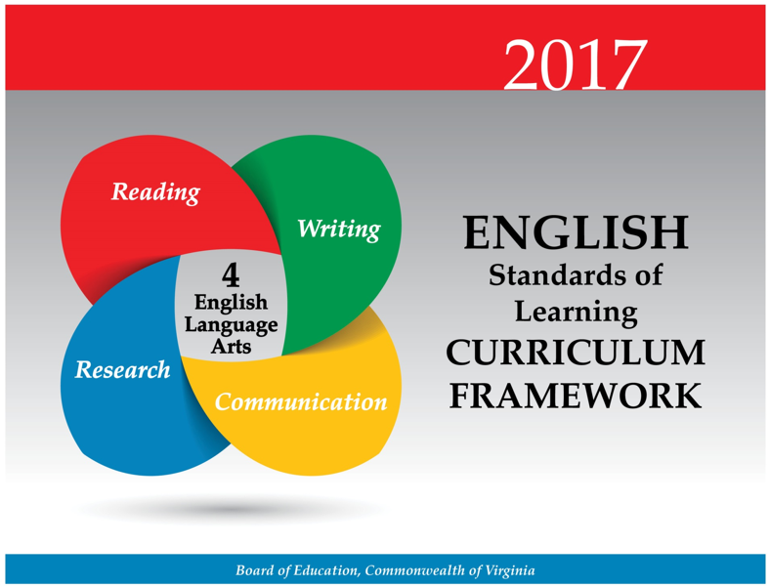
Virginia Department of Education Curriculum Framework
Notes:
We will look at some suggested practices that are already included in the new 2017 English Curriculum Frameworks.

Slide 14
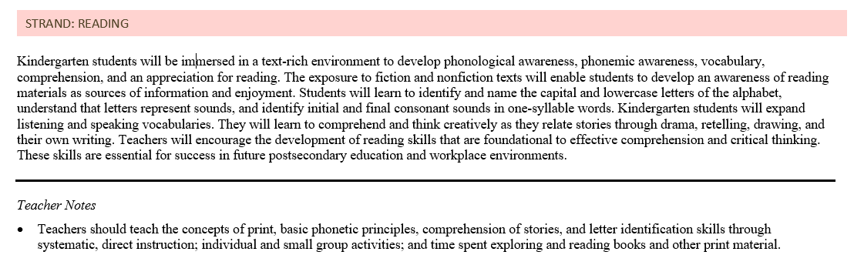
Virginia Department of Education CF Kindergarten Reading
Notes:
The overview page for each strand within each grade level also has teacher notes provided with some best practices to use when structuring a literacy block and providing instruction on the standards.
On this Kindergarten example notice that it states some specific skills that should be taught through systematic, direct instruction within small group, and independent tasks.

Slide 15
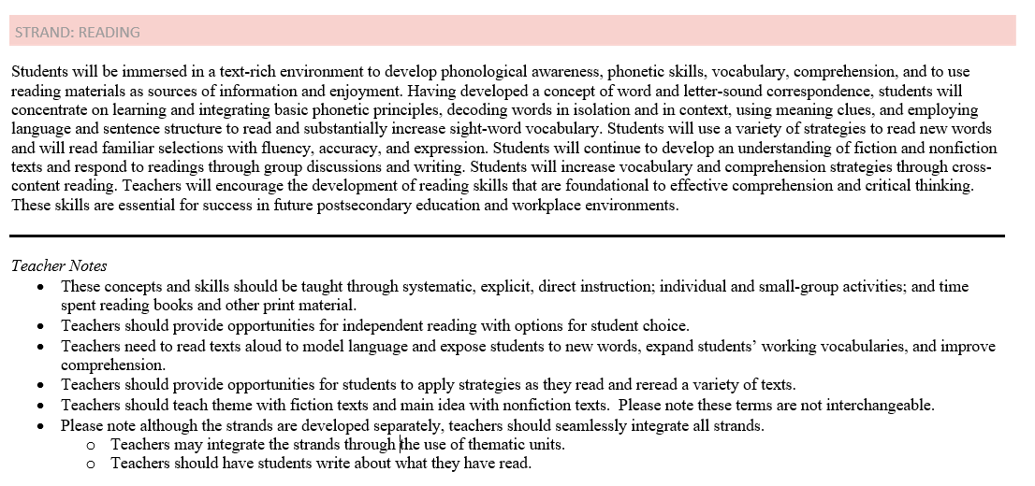
Virginia Department of Education CF First Grade Reading
Notes:
In the first grade teacher notes for reading, some recommendations to be included in a literacy block are systematic, explicit, and direct instruction during small group time, including time for independent reading and student choice within the literacy block, reading aloud to model strategies, and time for students to apply strategies in texts.
Grades 4-5 also contain recommendations such as reading longer and more complex texts along with student choice. So this would be something to consider when structuring a literacy block as well.

Slide 16
Panelist Discussion on Structuring a Reading Block
Participants:
Dr. Tammy Milby, University of Richmond Director of Reading
Lori Wall, Director of Elementary Curriculum, Newport News City Schools
Notes:
Hopefully you have been able to hear some patterns and threads that you are thinking about as your reflect on your literacy blocks. Now we will talk to our two panel experts who have been doing some work in these areas. Their perspectives are valuable as they drive this work in their current roles.

Slide 17
Panelist Questions University
Dr. Tammy Milby, University of Richmond

Slide 18
Panelist Questions:
What are the essentials to an elementary literacy block?
Describe what the reading/writing connection should look like within an elementary literacy block?
What one piece advice can you provide for a new teacher who might be structuring a literacy block on their own for the first time?
What does differentiated instruction look like? What are the students/teacher doing?
In what ways have you worked to incorporate the recommendations from the IES practice guides into your work with prospective teachers?

Slide 19
Pathway to Successful Literacy LITERACY
DR. TAMMY M. MILBY, DIRECTOR OF READING, UNIVERSITY OF RICHMOND

Slide 20
ESSENTIALS DURING THE LANGUAGE ARTS BLOCK & READING / WRITING CONNECTIONS
Notes:
1. What are the essentials to an elementary literacy block?
2. Describe what the reading/writing connection should look like within an elementary literacy block?

Slide 21
Time
Spend time on relevant academic tasks
Value opportunities for real reading and writing
Integrate reading and writing across the content areas & SOL strands
Aim for what you desire- more minutes per day focused on literacy!
  Primary- 120 minutes (90 is a minimum)
  Upper Grades- 90 minutes (60 is really a minimum)
Notes:
Sneak in literacy whenever possible (ex. Reading aloud a chapter book during wait times)
Spend time on what you value- do you want your students to be good at worksheets or good with text? Are you promoting inquiry and critical thinking?

Slide 22
Physical Space
How does the classroom arrangement support literacy?
  How meaningful is the print around the room?
  Does the classroom include:
    Literacy focused centers or stations? choices?
    Word wall words at eye level?
    Anchor charts and visuals created with learners?
    Spaces appropriate for lessons and independent work?
    Published student work and writing?

Slide 23
Access to Literature
Select high quality literature
Balance fiction and informational texts
Utilize diverse texts across genres
Include all kinds of print (magazines, newspapers, source documents, pamphlets, references, menus)
Volume (more minutes of reading can help to raise achievement)
Interactive Read Alouds and Think Alouds = promote comprehension

Slide 24
Instruction
Whole Class
  Build Community
  Strategy Focus (Variety)
Small Groups and Independent Reading
  Provide for individual differences & extra help
  Use data to determine specific needs and make groups flexible
Intervention (appropriate level of challenge)
  People are a resource, who is most skilled to support the learner?
Notes:
Data: Grouping, Planning, Coaching

Slide 25
Motivation
Motivation has a significant impact on students’ learning (Pressley, 2001)
Affective factors build engagement:
  Foster a positive & encouraging environment with high expectations
    Is the task worthwhile? Is it interesting?
    Are students challenged?
    Cooperation is encouraged (lively and enthusiastic work space)
    Hands-on learning and manipulatives are used for learning goals
    Well-established routines and procedures

Slide 26

How do you think reading and writing are connected?

Slide 27
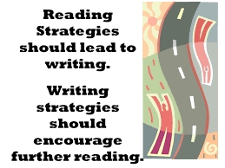
Tips
Notes:
Tips:
Students should write about the texts they are reading
When students write about reading- they think critically about the content they encountered in reading
It is helpful to increase the amount of student generated writing
In writing, teachers should write for learners and explicitly model writing strategies

Slide 28
Advice for ALL…But Especially NEW Teachers!
Think Aloud & Model for Students
Use Literature Whenever Possible
Get to Know Your Learners & Build Relationships

Slide 29
Differentiation
Think about the needs of all learners (including those needing extra help, those on level, and higher achieving readers)
Use a variety of literature and vary groups
Think about an up front/proactive approach to differentiation (UDL)
  Can you engage in a different way? choice, text, authentic task, visuals or hands-on?
  Can you vary the approach to teaching content?
Notes:
Adjust to meet learner needs: Variety of texts and groups, differentiate (1) text, (2) content, or (3) teaching techniques

Slide 30

Research Into Practice
We do lots of work on fluency (including reading with expression) to build confidence & automaticity
  Choral and Echo Reading
  Repeated Text Readings (Voices, Phrases)
  Readers Theatre
Notes:
We do lots of work on fluency and reading with expression. We do choral and echo reading with children with texts on the instructional reading level. We also spend time doing Readers Theater for repeated text reading. Our teachers even have fun reading with different voices and phrases as we reread for confidence and automaticity.
Ensure that each student reads connected text every day to support reading accuracy, fluency, and comprehension. IES Guide, Point 4

Slide 31
Panelist Questions Local
Lori Wall, Director of Elementary Curriculum, Newport News Public Schools

Slide 32
Panelist Question One:
What are the essentials to the elementary literacy block?

Slide 33
Response One from Panelist:
5 components of effective reading instruction (phonemic awareness, phonics, fluency, vocabulary and comprehension)
4 skills of communication (speaking, listening, reading and writing)
Integration Across the Day
Choice and Voice
Application through Real World Experiences

Slide 34
Panelist Question Two:
In what ways have you worked to incorporate the recommendations from the IES practice guides into the elementary literacy block?

Slide 35
Response Two from Panelist:
Switch to a Code-Based Approach to literacy instruction in grades K-2
  Implementation of Daily PPAC in Kindergarten and First Grade
  Explicit phonemic awareness instruction in small group instruction for Emergent and Beginning Learners
  Systematic and explicit handwriting instruction
  Explicit and systematic phonics and spelling instruction
  Use of decodable text to apply decoding strategies learned
Writer’s Workshop Model

Slide 36
Panelist Question Three:
What does differentiated instruction look like? Describe students’ daily routines?

Slide 37
Response Three from Panelist:
Understanding and Using:
  Balanced assessment approach (diagnostic, formative, and summative)
  Developmental Reading Continuum
  Explicit instruction to address skill areas, like phonemic awareness,
  phonics and vocabulary
  Grade level material with the appropriate scaffolds

Slide 38
Panelist Question Four:
Describe how the reading/writing connection has been incorporated into students’ daily experiences.

Slide 39
Response Four from Panelist:
Reciprocity between our Reading and Writing units of study
Use of Reader Response Journal
  Studied the work of Jennifer Serravallo, Understanding Texts and Readers and Reading Conferences
Literature Circles/Book Clubs
Celebrations/Presentations at the end of each writing unit
Performance-Based Assessments
Use of technology: Nearpod, FlipGrid and Seesaw to name just a few

Slide 40
Panelist Question Five:
What suggestions can you offer for divisions who are reworking their elementary literacy blocks to be efficient and effective?

Slide 41
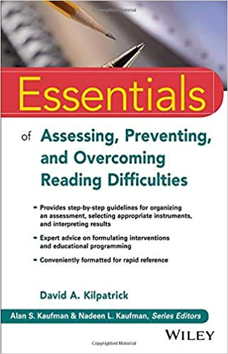
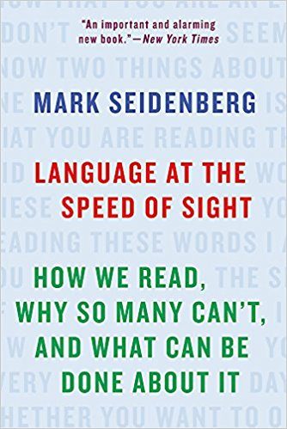
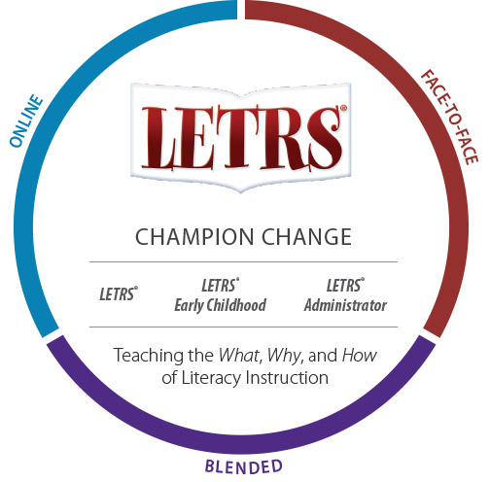
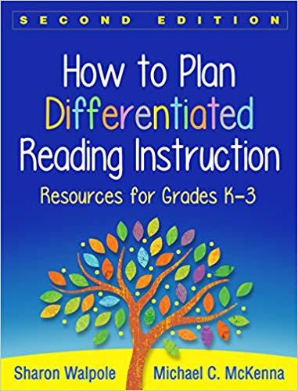
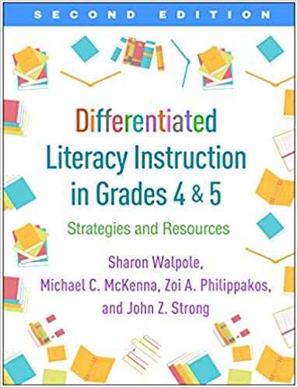
Response Five from Panelist:
Do Your Research
Audit Your Practices
Analyze Your Data

Slide 42
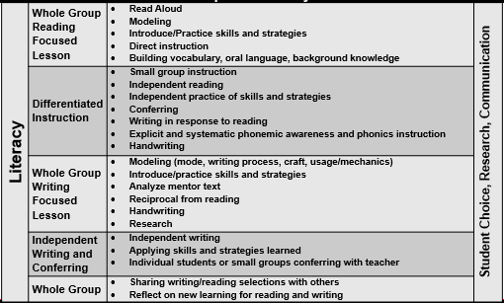
Sample Literacy Block
Notes:
This is a sample literacy block with some of the actions that might be happening at that time. Literacy blocks may look different based on the time built into daily schedules, but the components within the block are critical.
Literacy blocks may not look the same K-5 depending on the age group/needs of the students.
Some literacy blocks for younger students may have the whole group time split into two sessions, one at the beginning of the literacy block and one during differentiated instruction in order to support tasks in smaller chunks of time.
Literacy blocks for older students may have a differentiated instruction time, and an additional independent reading time as students begin to read longer and more complex text and a teacher would need an additional chunk of time to confer with students. This would not be equal to a D.E.A.R. time or S.S.R time. At this age, on some occasions, differentiated instruction may be a reading comprehension task that follows the whole group lesson, that would require students to independently or as a small group read, think, and communicate on a task. The differentiation would be as the teacher moves between groups and or students to scaffold and support the learning.
Note that student choice, research, communication, reading, and writing should be ongoing and integrated throughout daily opportunities in the literacy block, in addition to some intentional times when teacher may provide explicit instruction on choosing a book, how to find sources for research, presentations etc.

Slide 43
Professional Research
Meeting the Challenges of Early Literacy Phonics Instruction
Foundational Skills to Support Reading for Understanding in Kindergarten Through 3rd Grade
Teaching Elementary School Students to Be Effective Writers

Slide 44
VDOE Disclaimer
Reference within this presentation to any specific commercial or non-commercial product, process, or service by trade name, trademark, manufacturer or otherwise does not constitute or imply an endorsement, recommendation, or favoring by the Virginia Department of Education.
Reference within this presentation to any specific commercial or non-commercial product, process, or service by trade name, trademark, manufacturer or otherwise does not constitute or imply an endorsement, recommendation, or favoring by the Virginia Department of Education.

Slide 45
Stay Connected
Jill Nogueras
K-12 English Coordinator
Jill.Nogueras@doe.virginia.gov
Carmen Kurek
Elementary English/Reading Specialist
Carmen.Kurek@doe.virginia.gov
Taylor Snow
English/History & Social Science Specialist
Taylor.Snow@doe.Virginia.gov
Assessment Office
Student_Assessment@doe.virginia.gov

