Slide 1
Virginia Department of Education
Balanced Assessment: Middle School Writing in the History Classroom
Comprehensive Literacy Webinar Series
January 28, 2020

Slide 2
Agenda
Agenda
    Balanced Assessment Plans
    What is authentic writing and why does it matter?
    History Paired Passages
    Resources for this work and bringing it all together

Slide 3
Local Alternative Assessments and Balanced Assessment Plans

Slide 4
Institutionalize & Innovate
“Alternative assessments are incorporated within a balanced assessment system at the classroom level by teachers and at the school/ division level by educational leaders; alternative assessment practices prompt innovative instruction and deeper learning.”
Framework for Local Alternative Assessment Implementation
Notes:
The entire premise around legislation removing SOL tests in 2014 was to encourage flexibility and with that innovation.

Slide 5
Balanced Assessment System
(1 of 2)
A balanced assessment system includes:
a combination of assessments that form a comprehensive measure of student learning
a variety of assessment types that are matched to the content being assessed and the purpose of the assessment data (including the need to meet accountability measures)
Adapted from:
VDOE assessment literacy glossary
Notes:
The most important thing is that first bullet. It’s important to understand all dimensions of student learning: NFL combine analogy.

Slide 6
Balanced Assessment System
(2 of 2)
A balanced assessment system:
allows opportunities to measure student achievement and growth based on content standards, specific learning goals, and the 5 C’s (critical thinking, creative thinking, collaboration, communication, and citizenship)
provides meaningful information that supports and guides classroom instruction.
Adapted from:
VDOE assessment literacy glossary
Notes:
The biggest take away divisions seem to have is that the discussion surrounding the completion of the document and the reflection that comes with it is powerful PD

Slide 7
BOE Guidelines – Local Alternative Assessments (1 of 3)
2018-2019 through 2019-2020
  School divisions are expected to continue to use the Virginia Quality Criteria Tool to ensure that students have access to quality tasks.
  School divisions will continue using the common rubrics developed by VDOE with performance assessment in classrooms where an SOL test has been replaced (Grade 3 Science, Grade 3 History, Grade 5 Writing, United States History to 1865, and United States History: 1865 to the Present).
Notes:
Nuts and bolts expectations

Slide 8
BOE Guidelines – Local Alternative Assessments (2 of 3)
2018-2019 through 2019-2020
  School divisions are expected to prepare Balanced Assessment Plans for each of the five replaced SOL assessments. These plans are expected to
    indicate types of assessments used to measure the content and skills addressed in the grade level/course; and
    may include a variety of assessment types but must include some performance assessments.
Notes:
More nuts and bolts but what’s important to note is that they must include some PAs

Slide 9
BOE Guidelines – Local Alternative Assessments (3 of 3)
Superintendent’s Memo 025-19, Attachment A
“1. incorporate options for age-appropriate, authentic performance assessments and portfolios … 2. permit and encourage integrated assessments that include multiple subject areas
The legislation encourages integrated assessments that include multiple subject areas. For example, a local assessment might address content from both U.S. History I and 6th Grade English.

Slide 10
The imperative…

Slide 11
The Forgotten “R”
The elimination of the grade 5 Writing SOL assessment has likely resulted in less direct writing/research instruction which may be one cause of declining 8th grade scores
The gap can and should be closed across all content areas because writing is a life skill that is authentic to all post-graduation paths and all content areas
How much writing does your job require?
Notes:
In addition to the guidelines and policies, divisions are seeing the impact of writing taking a back seat.

Slide 12
2018-2019 Writing SOL Pass Rates
Test | 2016-2017 Pass Rate | 2017-2018 Pass Rate | 2018-2019 Pass Rate
Grade 8 Writing | 73 | 73 | 70
End of Course Writing | 84 | 84 | 81
Notes:
We see that in Grade 8 Writing

Slide 13
2018-2019 Reading SOL Pass Rates
Test | 2016-2017 Pass Rate | 2017-2018 Pass Rate | 2018-2019 Pass Rate
Grade 3 English Reading | 75 | 72 | 71
Grade 4 English Reading | 79 | 76 | 75
Grade 5 English Reading | 81 | 80 | 78
Grade 6 English Reading | 78 | 80 | 77
Grade 7 English Reading | 82 | 81 | 79
Grade 8 English Reading | 76 | 77 | 76
End of Course English Reading | 87 | 87 | 86
Notes:
Also seeing declines in reading scores so it’s quite likely that divisions are renewing their push for literacy and implementing new literacy initiatives.

Slide 14
Read! Read! Read!
Students need opportunities to read daily.
Students need to read extended pieces of text and grade level material.
All students need opportunities to read grade level text daily, including nonfiction and fiction pieces.
Schools should provide students with opportunities to read and compare paired passages (fiction and nonfiction) on the same topic as appropriate.
When students are analyzing ideas in two texts and searching for textual evidence to support their conclusions, they are engaging in deeper learning and thinking critically.

Slide 15
What role should writing play?

Slide 16

A Successful Virginia Graduate Will
Achieve and apply academic
and technical knowledge;
Demonstrate workplace skills,
qualities, & behaviors;
Build connections and value
interactions with others as a
responsible & responsive citizen;
and align knowledge, skills & personal
interests with career opportunities.
Notes:
Writing is at the essence of the 5Cs. A graduate who leaves K-12 as an effective writer across multiple modes is situated for success in all 5Cs

Slide 17
The best writing instruction is integrated with reading, not divorced from it
Writing as a replacement for multiple choice assessment
Writing to generate analytical responses to reading
Integrates all of the English SOL strands
Increases the amount of time students spend writing AND reading… research indicates that the point of diminishing returns is somewhere beyond 150 minutes per day
Is a transferrable skill that improves literacy across all content areas
This type of writing must be TAUGHT
As a replacement for multiple choice assessment, writing may happen in a vacuum with no links to reading.
This type of writing can often just be ASSIGNED
Notes:
Emphasize that while short answer responses and fill-in-the-blanks may be good, it misses its ceiling because it lacks authenticity. It’s only authentic to that test and isn’t a transferrable skill. But writing that is integrated with reading is far more effective.

Slide 18
Effective writing instruction means writing is embedded across all contents
… as a content-specific set of skills
Think about what it means to write for YOUR content area
How can students learn to write like a historian… a scientist… a mathematician?
How can student writing be generated as a response to the kind of information and text that students encounter in your content… from laboratory data to primary sources.
These are all skills that must be TAUGHT
Notes:
This is about history today but really it’s all content areas. Emphasize that disciplinary writing is as important to each content as any other skill. Students taking your course without learning to write in your course is like learning to drive a car but never learning how to make left turns.

Slide 19
History and Social Science Essential Understandings:
All students should:
Analyze and interpret primary and secondary sources
Interpret charts, graphs, and pictures
Use evidence to draw conclusions and make generalizations
Compare and contrast historical and political perspectives
Assess cause and effect
Explain connections across time and place
Exercise citizenship skills
Conduct historical investigations
Notes:
In history and social science we have expanded the way we present and emphasize skills. From the first page that you tear off on your way to SOL 2a to the foundation for the entire course. What do all of these have in common? You can’t do these without the kind of authentic writing we’ve been discussing today.

Slide 20
English Essential Understandings
All students should:
understand that writers communicate ideas for a variety of purposes
understand that writers plan, write, revise, and share their writing with others
understand that writers use the writing process including planning, drafting, revising, editing, and publishing
understand that written communication should be well-planned and clear to the reader.
Notes:
Here are our English understandings in regards to writing. There’s no opposition here… asking history teachers to be purposeful about teaching writing is not, “just one more thing.” It’s something that should have been happening all along.

Slide 21
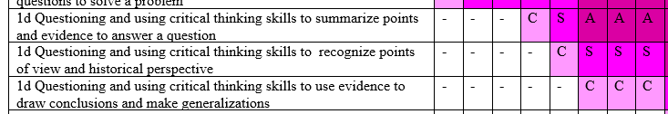
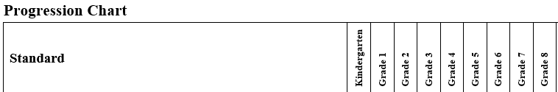
Thinking and writing like a historian is embedded in the SOL
Notes:
Not only are the essential understandings the same but the way the skills get introduced are the same. This is purposeful, not accidental.

Slide 22
Assigned vs. Taught
Assigned
Students write using teacher selected topics and sources and take a position that is determined for them
Students are given a task without instruction on how to complete it successfully
Students rewrite only to correct errors in usage and mechanics
Taught
Students use research and reading to chart their own path and formulate their own position
Teacher time is spent in class teaching writing skills and strategies
Students use models and strategies to complete each assignment and adjust based on teacher and peer feedback
Because Writing Matters by Carl Nagin
The National Writing Project
Notes:
There is a great difference between assigning writing and teaching writing. Although all students can write, direct instruction by the teacher is needed to develop an awareness of good writing and the skills needed to create it.
Direct instruction of concepts such as audience and purpose and skills such as revision can be followed by student choice and reflection. Then as the writing begins, the instruction continues with teacher modeling.

Slide 23
When writing is taught…
Teachers model by
  Writing with the students
  Revealing the hard work of writing
  Thinking aloud through revision of their writing
  Editing only after revision is complete
Notes:
Modeling is one of the most effective instructional strategies and that is true in writing as well as other areas. Teachers should write as students are writing and then model the steps in the writing process, fine tuning the modeling to meet the students’ needs. If composing is the weakest area then the teacher might conduct a think aloud through the process of selecting main ideas and developing organization and elaboration. If first drafts are generally solid but revision is lacking, then the teacher can model strategies such as developing sentence variety or replacing bland language for more vivid vocabulary.

Slide 24
Writing Modes in the Virginia Standards of Learning
Writing process increases in complexity and rigor as students progress through K-12
  Kindergarten = narrative and descriptive
  Grade 1 = narrative, descriptive, and opinion
  Grade 2 = narrative, descriptive, opinion, and expository
  Grade 3 = narrative, descriptive, opinion, and expository
  Grade 4 = narrative, descriptive, opinion, and expository
  Grade 5 = narrative, descriptive, expository, and persuasive
Notes:
Let’s talk about background information.

Slide 25
Writing Modes in the Virginia Standards of Learning
Instructional focus narrows toward specific modes of writing
  6th- narrative & reflective
  7th & 8th – expository & persuasive
  9th & 10th – persuasive & analytical
  11th & 12th – persuasive & argumentative

Slide 26
Authentic Writing
Use mentor texts and engaging sources to provide authentic stimuli for writing
  Select documents that encourage to students to write to demonstrate historical thinking skills… assessing arguments, evaluating sources for bias, etc.
  Incorporate daily writing
  A warm-up prior to beginning a unit of study
  Ask students to evaluate news items and historic documents for bias
  To consolidate thoughts or findings after independent reading, class discussion, or class experiment
  Summative Assessment
  Use authentic writing to assess skill development and content knowledge
Notes:
Writing can and should be integrated in all reading and all contents.

Slide 27
Using Paired Texts for Authentic Writing in the History Classroom
Notes:
We’ve said that the best writing is integrated with reading so how do we build effective, engaging reading so that students can generate effective writing.

Slide 28
What Research Says- Best Practices for Success
What adolescent readers need:
Practice thinking critically about how they engage with texts to include
application of metacognitive strategies.
recognition of bias and high-quality sources.
argumentation with evidence.
Critical examination of texts that helps them to
recognize the purpose of text structure and how the writer uses it to create effect.
infer beyond literal interpretations.
question and investigate various social, political, and historical context.
understand multiple meanings and richness of texts and layers of complexity.
A Call to Action: What We Know About Adolescent Literacy Instruction. (2018, July 17). Retrieved January 8, 2020, from https://ncte.org/statement/adolescentliteracy/.
Notes:
Thinking about thinking- how often do we ask students to synthesize and determine which strategies will help them engage with and tackle a piece of text? We will only see this transfer happen when we ask students to think about a text on their own- not when their only experience with text is determined and dictated by the adults.
-To be successful community members, students need the space and time to learn how to recognize bias, credible sources, and how to determine when to believe what they read.
-text structure goes hand in hand with writing instruction. Again- writing instruction impacts reading comprehension.

Slide 29
Building Relationships to Build Better Readers
Know your students, know their interests… engagement matters
Cognitive research indicates that the use of highly engaging texts selected to fit students’ interests aids comprehension and increases self-efficacy in reading because students learn more and comprehend better when they have the context that comes with interest in the text (Willingham, 2013).
Create a balance between whole group texts and student-selected
“Students need both content specific reading [and] the exploration of texts beyond the content. If a student enjoys to pleasure read graphic novels we should not dissuade that student from choosing them. Rather, we should support them while still exposing them to content specific passages and texts” (Fisher, Hattie & Frey, 2016).
Notes:
Skills based course- we have the opportunity to build units of study around essential questions that require students to critically think about a topic that resonates with them. They can learn to summarize, draw conclusions, analyze text structure, organization and author’s purpose from any text. Variety is the key- we can always include whole class selections- a poem, an article, a chunk of a book- but what are they in when they read independently in our classes and how can we tap into their natural curiosity to help scaffold and support their learning and independence?

Slide 30
What are paired texts…
Can include books, plays, articles, poems, functional text, graphics, maps, or digital media
Focus on a common theme or topic that fits history and social science content
Can be compared and contrasted to demonstrate deeper understanding and historical thinking skills
Are included on the 2017 6-8 Reading SOL tests

Slide 31
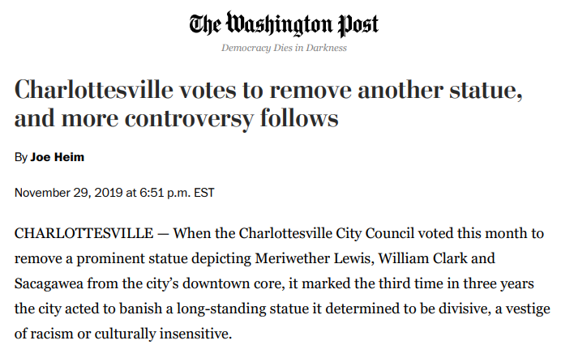
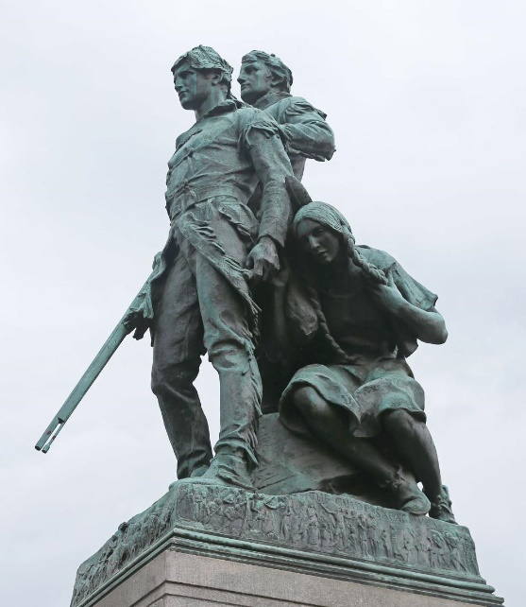
Paired Texts: U.S. History to 1865
Excerpts from the Journals of Lewis and Clark on Sacagawea source: Lewis and Clark Bicentennial Exhibition
The Corps was several days upriver from Fort Mandan. “When we halted for dinner the squaw busied herself in serching for the wild artichokes which the mice collect and deposit in large hoards. this operation she performed by penetrating the earth with a sharp stick about some small collections of drift wood. her labour soon proved successful, and she procured a good quantity of these roots.” —Meriwether Lewis, April 9, 1805
A sudden wind squall had caught the crew of the pirogue by surprise and water filled the boat. “By 4 oClock in the evening our Instruments, Medicine, merchandize provision &c, were perfectly dryed, repacked and put on board the perogue. the loss we sustained was not so great as we had at first apprehended… the Indian woman to whom I ascribe equal fortitude and resolution, with any person onboard at the time of the accedent, caught and preserved most of the light articles which were washed overboard” —Meriwether Lewis, May 16, 1805

Slide 32
Writing Applications
Short writing ideas
Analyze only the journal entries to describe the role Sacagawea played in the expedition
Look at the statue and describe what it shows and how you know
Read the article, examine the statue, take a position on its removal
Lengthier writing ideas
Synthesize all three sources to create a persuasive letter to the editor citing the journals
Write a plan for either an updated monument to the Lewis & Clark expedition that accurately portrays Sacagawea or a historic marker that provides the proper context.

Slide 33
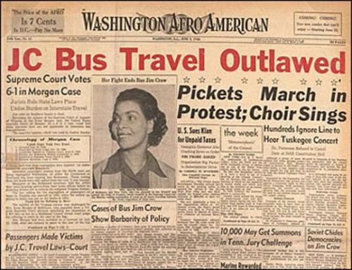
Paired Texts: U.S. History 1865 - Present
“What Everybody Knows Now” by Jacqueline Woodson
Even though the laws have changed
my grandmother still takes us
to the back of the bus when we go downtown
in the rain. It's easier, my grandmother says,
than having white folks look at me like I'm dirt…
I look around and see the ones
who walk straight to the back. See
the ones who take a seat up front, daring
anyone to make them move. And know
this is who I want to be. Not scared
like that. Brave
like that.
Still, my grandmother takes my hand downtown
pulls me right past the restaurants that have to let us sit
wherever we want now. No need in making trouble,
she says. You all go back to New York City but
I have to live here.
Source: PoetryFoundation.org
On July 16, after visiting her mother, Ethel Amos, in Hayes Store, Gloucester County, Morgan boarded a Greyhound bus en route to Baltimore.
Near Saluda, in Middlesex County, about twenty-six miles northwest of Hayes Store, two white passengers boarded the already crowded bus, and the driver asked Morgan and an African American woman with an infant to give up their seats. According to later court documents, "There were two vacant spaces upon the long rear seat, and six white passengers were standing. The bus driver requested [Morgan] and her seatmate … to change their seats and occupy the two vacant spaces on the rear seat." When Morgan refused, and even attempted to prevent the other woman from complying, the bus driver drove to the jail in Saluda.
Source: Encyclopedia Virginia

Slide 34
Writing Applications
Short writing ideas
Write to explain why the texts are paired
Compare and contrast the feelings on Jim Crow laws of Irene Morgan to the grandmother and granddaughter in the poem
Connect the texts to Reconstruction and Civil Rights Movement SOL
Lengthier writing ideas
Conduct additional research on the Morgan case. Use that research, this poem, and others to construct and deliver a Supreme Court opening argument.
Construct a creative writing assignment incorporating USII content in the style of the poet
Writing Applications

Slide 35

Additional Paired Text Ideas in History and Social Science
Using Fiction
Collaborate with colleagues and use online sources like Commonlit.org to identify unconventional texts that tackle important historic and civic themes
“Harrison Bergeron” by Kurt Vonnegut
Use popular music related to historical eras and themes as a chance for students to read lyrical work
“Fortunate Son” by Creedence Clearwater Revival
“A Change is Gonna Come” by Sam Cooke

Slide 36
Resources and Wrap-up

Slide 37
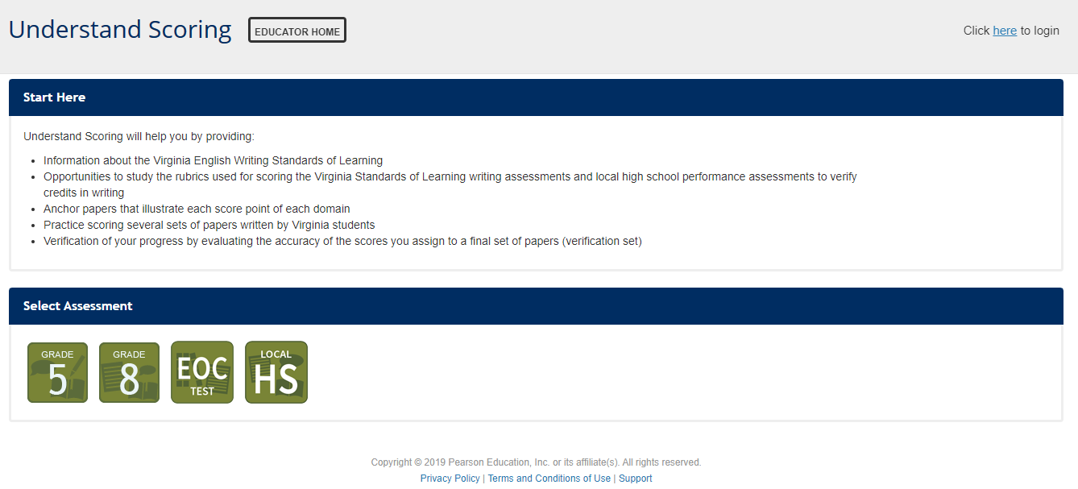
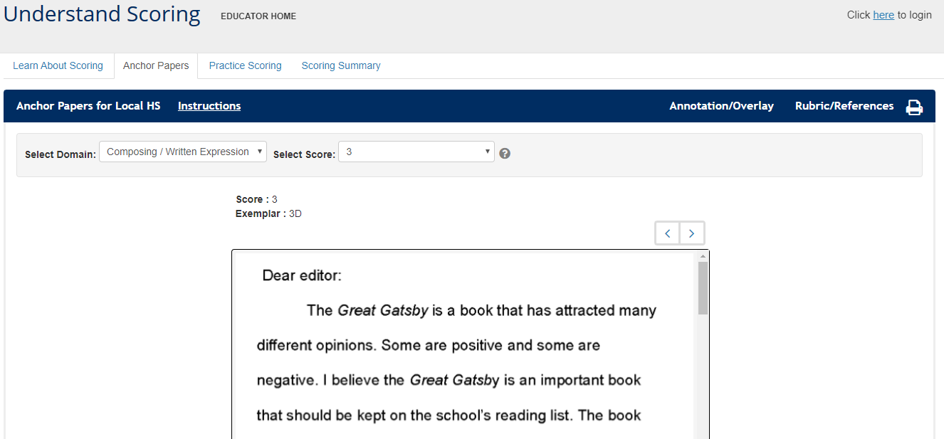
Professional Learning Resources for Writing
Understand Scoring
.

Slide 38

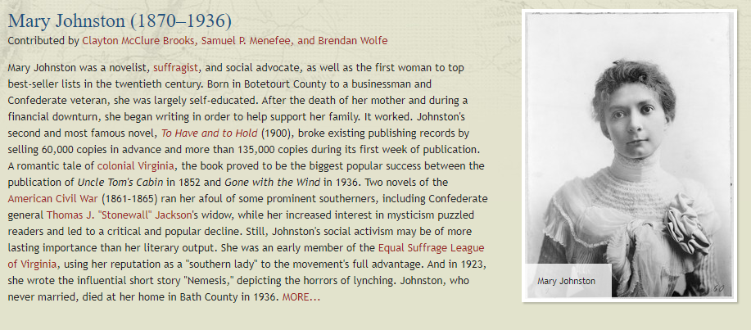
Resources for Building Paired Passages
Encyclopedia Virginia
.

Slide 39
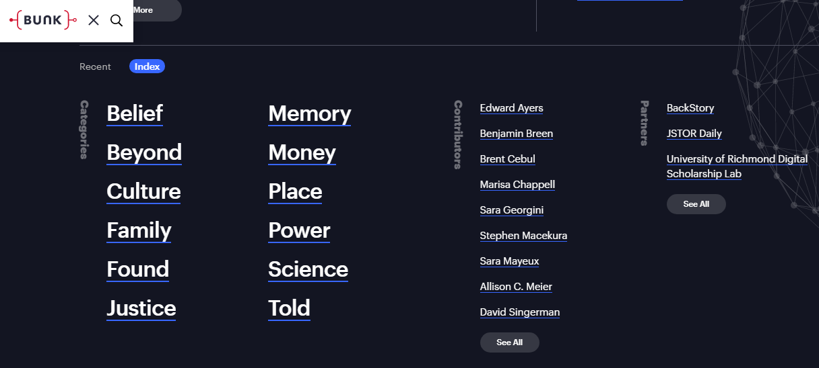
Resources for Building Paired Passages
Bunk History
.

Slide 40
Resources for Building Paired Passages
Common Lit
.

Slide 41

Resources for Building Paired Passages
Document Bank of Virginia
.

Slide 42
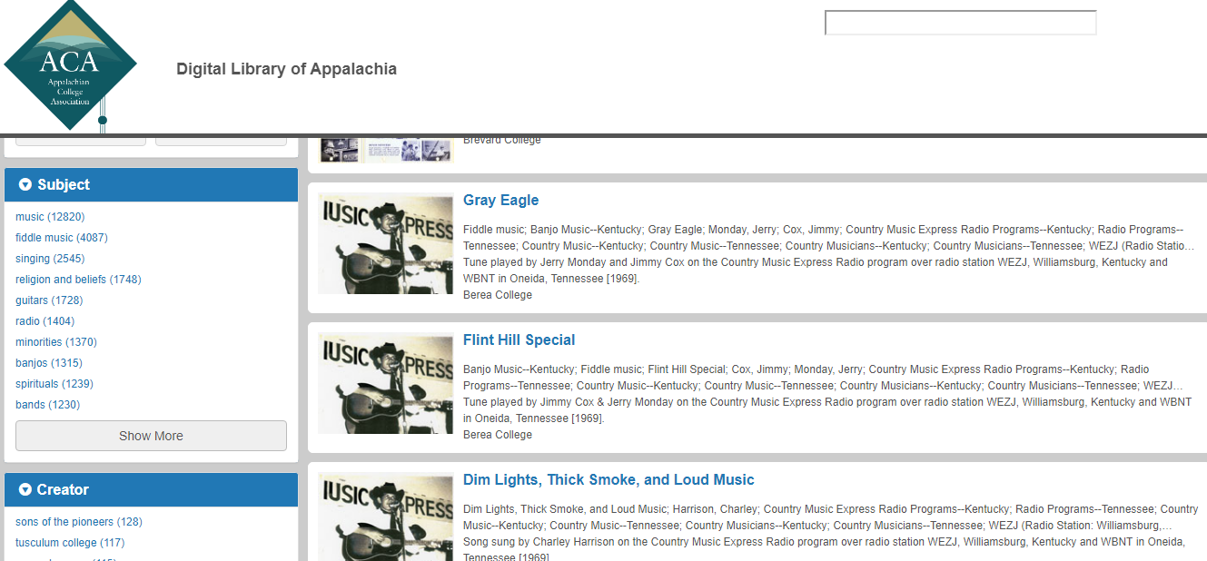
Resources for Building Paired Passages
Digital Library of Appalachia
.

Slide 43
VDOE Disclaimer
Reference within this presentation to any specific commercial or non-commercial product, process, or service by trade name, trademark, manufacturer or otherwise does not constitute or imply an endorsement, recommendation, or favoring by the Virginia Department of Education.
Reference within this presentation to any specific commercial or non-commercial product, process, or service by trade name, trademark, manufacturer or otherwise does not constitute or imply an endorsement, recommendation, or favoring by the Virginia Department of Education.

Slide 44
Stay Connected
Jill Nogueras
K-12 English Coordinator
Jill.Nogueras@doe.virginia.gov
Carmen Kurek
Elementary English/Reading Specialist
Carmen.Kurek@doe.virginia.gov
Taylor Snow
English/History & Social Science Specialist
Taylor.Snow@doe.Virginia.gov
Assessment Office
Student_Assessment@doe.virginia.gov
Christonya Brown
Coordinator of History and Social Science
Christonya.Brown@doe.virginia.gov
Brandi McCracken
Elementary History and Social Science Specialist
Brandi.McCracken@doe.virginia.gov

