Slide 1
Understand Scoring
For Use With the End-of-Course Local Performance Assessment to Verify Credits in Writing

Slide 2
About the Webinar
During the webinar, please use the CHAT feature to submit questions to “all panelists.”
The slides from this presentation, a one-page summary of the information presented, and the recorded webinar itself will be emailed to those registered and posted soon on the Comprehensive Literacy Webinar Series web page.

Slide 3
Overview
What is Understand Scoring?
Accessing Understand Scoring
Using Understand Scoring
  When Verifying Credits Using Local Performance Assessments
  More Uses for Understand Scoring
What is coming next?

Slide 4
What Is Understand Scoring?
Understand Scoring is an online application hosted by the Virginia Department of Education and Pearson.
Understand Scoring was originally created to provide additional information about scoring the short paper component of the Grade 5, Grade 8, and End-of-Course (EOC) Writing Standards of Learning (SOL) assessments.

Slide 5
What Has Changed? EOC
On September 20, 2018, the Virginia Board of Education adopted the Guidelines for the Use of Local Performance Assessments to Verify Credits in Writing.
In Fall 2019, a new tab was added to Understand Scoring to provide information about administering and scoring the End-of-Course Local Performance Assessments to Verify Credits in Writing.

Slide 6
Accessing Understand Scoring

Slide 7
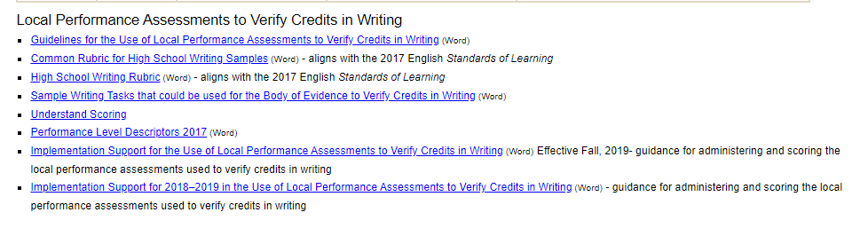
Accessing Understand Scoring
To access Understand Scoring, follow the link provided on the Virginia Department of Education’s website.
Notes:
A screenshot of the Local Performance Assessments to Verify Credits in Writing section of the VDOE English Standards of Learning web page. A red arrow points to the hyperlink for Understand Scoring.

Slide 8
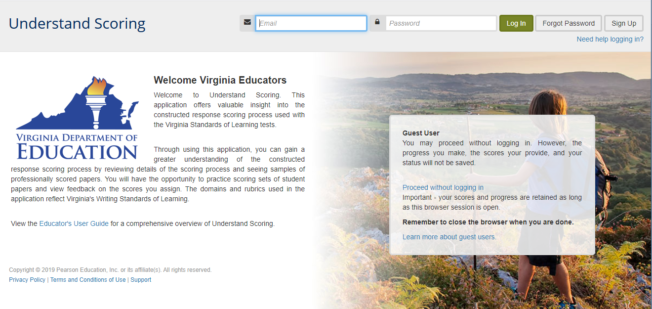
Getting Started
The provided link takes a user to the sign in page for Understand Scoring.
Notes:
A screenshot of the Understand Scoring web page. A red arrow points to the Sign Up button in the top right corner.

Slide 9
Getting Started: Sign Up
Choose “Sign Up” in the upper right corner of the web page to create an account.
Users may access Understand Scoring as a guest, but work will not be saved and Verification Sets (for qualifying scorers) will not be available.

Slide 10
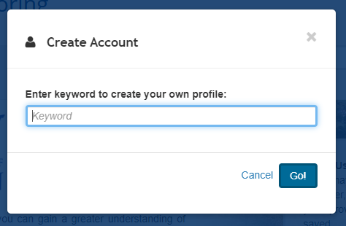
Getting Started: Keyword
A keyword is required in order to create an account.
Please see the Implementation Support for the keyword.

Slide 11
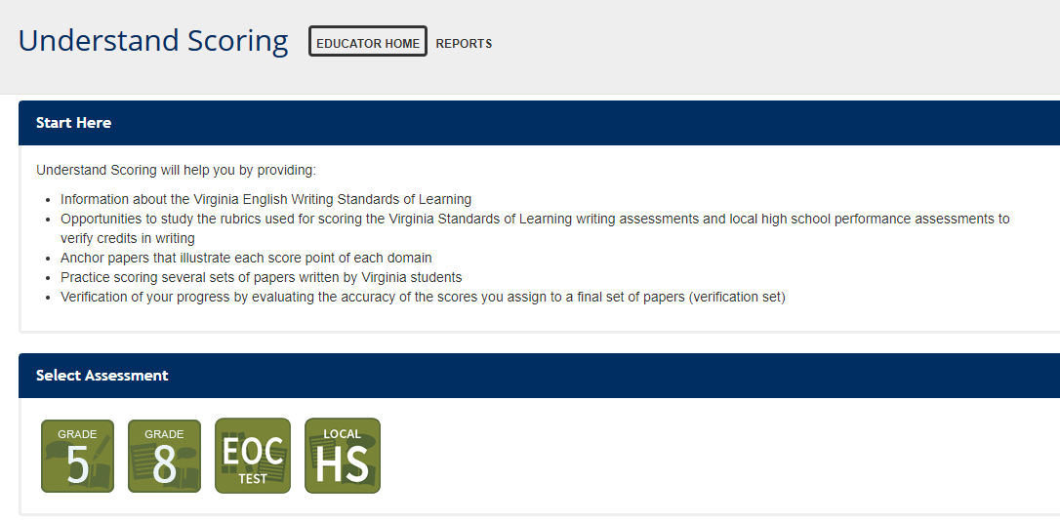
Local HS Button
Notes:
A screenshot of the Understand Scoring home page. A red arrow points to the Local HS button.

Slide 12
Materials Available in Understand Scoring (1 of 2)
Rubrics used for scoring the short paper component of Virginia writing assessments and the local performance assessment for verifying credits in writing
Annotated anchor papers that illustrate each score point of each domain

Slide 13
Materials Available in Understand Scoring (2 of 2)
Practice sets to provide Virginia educators experience with scoring papers written by Virginia students
  Annotations for each practice set to provide explanations after educators have practiced scoring
Verification sets used to qualify readers and to ensure that scores assigned are consistent with performance expectations established by the scoring rubrics

Slide 14
Using Understand Scoring
When Verifying Credits Using Local Performance Assessments

Slide 15
Procedures for Training Scorers (1 of 2)
To score the Local Performance Assessment to Verify Credits in Writing, a scorer must first be trained, and then qualify, with Virginia materials provided in Understand Scoring.
Prospective scorers should also be familiar with the 2017 English Standards of Learning, the Guidelines for the Use of Local Performance Assessments to Verify Credits in Writing, and any additional support documents to ensure that they have a clear understanding of the local performance assessment requirements and suggestions.

Slide 16
Procedures for Training Scorers (2 of 2)
Scorers should read and understand:
  All information in the Local High School (HS) tab within Understand Scoring.
  The scoring rubric for the Composing/Written Expression domain and each of the Composing/Written Expression anchor papers and annotations.
  The scoring rubric for the Usage and Mechanics domain and each of the Usage and Mechanics anchor papers and annotations.

Slide 17
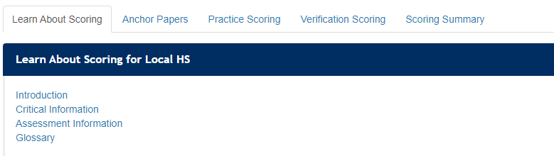
Learn About Scoring
Before viewing the Anchor Papers or attempting the Practice Sets, it is important to read and understand the information included in the Learn About Scoring section.
Notes:
A screenshot of the Learn About Scoring tab. The sections within Learn About Scoring are Introduction, Critical Information, Assessment Information, and Glossary.

Slide 18
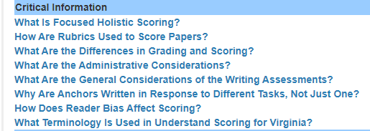
Critical Information: Overview
The Critical Information section provides a closer look at some details related to administering and scoring the local performance assessment to verify credits in writing.

Slide 19
Focused Holistic Scoring
The information included in the Focused Holistic Scoring section begins to differentiate scoring and grading.
Papers for the Local Performance Assessment are scored, not graded.

Slide 20
Focused Holistic Scoring: Definition
Focused holistic scoring is the evaluation of writing proficiency based on specific elements or domains of writing.
  Each domain is scored holistically, independently of the other, and the score reflects the reader’s overall impression according to the rubric’s features.
  The scorers weigh the student’s relative strengths or weaknesses and then assign a score point for each domain that most accurately describes the attributes of the paper.

Slide 21
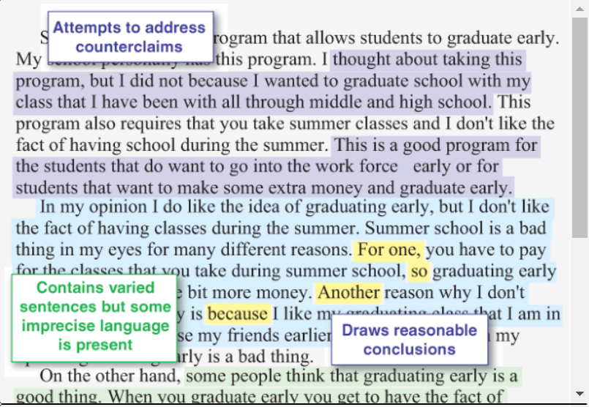
Overall Impression Example
A paper assigned a score of 3 in composing and written expression, for example, might have some characteristics of a 2-level paper and some characteristics of a 4-level paper, but overall, its 3-level characteristics predominate.

Slide 22
Questions Answered About Scoring (1 of 2)
Should a writing sample lose a point if:
There is no counterclaim?
It does not have five paragraphs?
No. The score should reflect the reader’s overall impression, based on the rubric.
The rubric mentions including counterclaims when appropriate.
The rubric does not mention formulaic writing.

Slide 23
Questions Answered About Scoring (2 of 2)
Should a writing sample gain a point if:
There are quotation marks, one question mark, and one exclamation point, regardless of appropriate use?
There is a thesis statement at the end of the introductory paragraph?
No. The score should reflect the reader’s overall impression, based on the rubric.
The rubric does not mention tallying the variety of punctuation marks to award a higher score.
The rubric does not mention formulaic writing.

Slide 24
Preferences Vs. Rubrics
Papers must be scored holistically, not graded. An educator’s classroom preferences and rules for writing, if not included in the Virginia writing rubrics, are not features to score for the local high school assessment.
Example: “Contains specific word choice, descriptive language, and purposeful information, enhancing the writer’s voice and creating a tone appropriate for the intended audience.” (Composing/Written Expression)
  Does not say “No second-person pronouns.”

Slide 25
Focused Holistic Scoring: Range of Papers
It is important for local scorers to understand the criteria used in assigning a score and not to expect papers at a certain score point always to look the same or have the same attributes.
Papers receiving the same score point may look very different from each other.
Within each score point, a range of papers representing the lower, middle, and upper ends will be evident, as it is in any scoring.
Notes:
This is analogous to the range when grading. For example, the range in many school divisions for an A is 91 to 100, but every score within this range would be considered an A. While scoring and grading are not the same, this is one way in which they are similar.

Slide 26
How Are Rubrics Used to Score Papers?
Scorers for the EOC writing assessment must use rubrics in conjunction with anchor papers to appropriately assign scores to student writing samples.

Slide 27
Using Rubrics and Anchor Paper Sets
Generally, rubrics for writing assessments are fairly generic and provide the general description of a score point, while anchor papers provide examples of student writing that illustrate the rubric descriptions.
It is only in conjunction with anchor papers that the criteria at each score point of the rubric begin to be clarified.

Slide 28
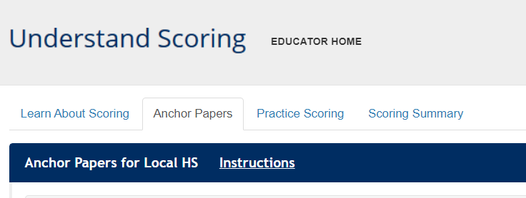
Anchor Papers
Educators using Understand Scoring to train and qualify to score student writing samples should become familiar with and continuously revisit the anchor paper sets for Composing/Written Expression and Usage and Mechanics.
Notes:
Revisiting anchor papers, even after qualifying to become a scorer, helps ensure that scorers remain tied to the performance expectations in each domain.

Slide 29
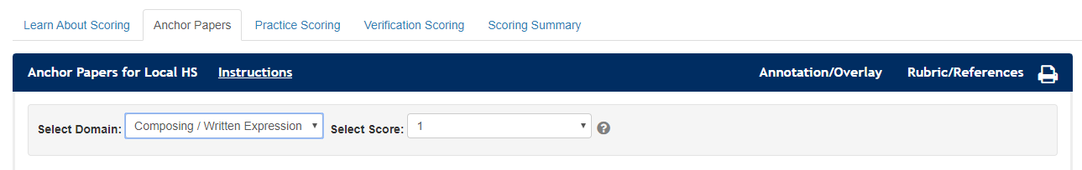
Anchor Set Annotations
Each anchor paper is accompanied by an annotation that describes how a paper meets the expectation outlined in the rubric for the specific score point. Annotations were developed using feedback from Virginia teachers and other educators serving on the 2012 and 2019 rangefinding committees.
Notes:
A screenshot of the Anchor Papers tab. On the right side of the page, an arrow points to the Annotation/Overlay option.

Slide 30
Rangefinding in Writing
Rangefinding in writing involves a committee of Virginia educators with experience in teaching and scoring student writing.
Committee members:
  Review and discuss the writing rubrics and previous anchor papers.
  Read and assign scores to new writing samples completed by Virginia students.
  Evaluate scored papers: high 3, low 3, etc.

Slide 31
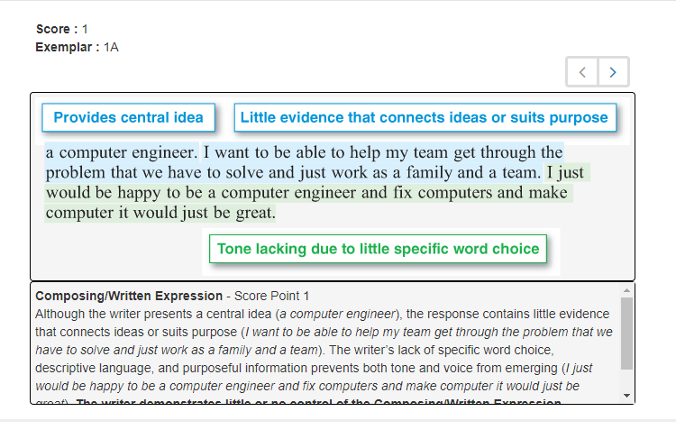
Anchor Sets: Annotation/Overlay
While viewing each anchor paper, educators have the option of selecting the annotation and a highlighted overlay.
This example shows the annotation and overlay for Composing/Written Expression.

Slide 32
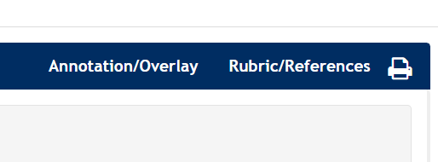
Print Option
The print option is available for all anchor papers and practice papers for scorers who wish to have hard copies available while scoring student writing samples.
Notes:
A screenshot of the Anchor Papers tab. On the right side of the page, an arrow points to the Annotation/Overlay option.

Slide 33
Practice Scoring
After training, prospective scorers should independently score the papers within the four available practice sets.
For each paper in a practice set, prospective scorers assign one score for Composing/Written Expression and one score for Usage and Mechanics.

Slide 34
Using the Scoring Summary (1 of 3)
After all papers in the practice set have been scored, results will be shown in the Scoring Summary tab.
Scorers might use these results to adjust their practice, as necessary.
Notes:
The scoring summary serves as formative feedback that will assist the scorer in becoming more aligned to the scoring rubrics, which is necessary to meet qualifying in verification sets.

Slide 35
Using the Scoring Summary (2 of 3)
The Exact column shows the percentage of scores assigned that matched the practice papers’ actual scores.
The Adjacent column shows the percentage of scores assigned that were within one score point of the practice papers’ actual scores.
Notes:
A screenshot of the scoring summary information from Practice Set 1. The table has ten columns, labeled: Paper Set, Status, Domain, Exact, Adjacent, Non-Adjacent, High Adjacent, Low Adjacent, Pass ?, and Has Been Reset ?

Slide 36
Using the Scoring Summary (3 of 3)
In this example, the adjacent scores are mostly high. This scorer should:
Review the practice set annotations for Practice Set 1 to gain a better understanding of why each score point was assigned.
Review the anchor sets and annotations again with these results in mind before attempting the next practice set.
Notes:
A screenshot of the scoring summary information from Practice Set 1. The table has ten columns, labeled: Paper Set, Status, Domain, Exact, Adjacent, Non-Adjacent, High Adjacent, Low Adjacent, Pass ?, and Has Been Reset ?

Slide 37
Adjacent and Non-Adjacent Scores
Adjacent scores are within one point of each other.
  For a practice set paper with a score point 3 in Usage and Mechanics, a low adjacent score would be 2, and a high adjacent score would be 4.
Non-adjacent scores are more than one point off.
  For a practice set paper with a score point 3 in Usage and Mechanics, a non-adjacent score would be 1.

Slide 38
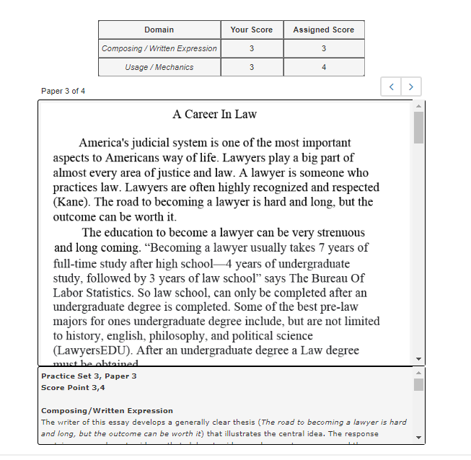
Reviewing the Practice Sets
After a practice set is submitted, a prospective scorer may then again select the set from the drop-down menu to review the assigned scores and annotations.

Slide 39
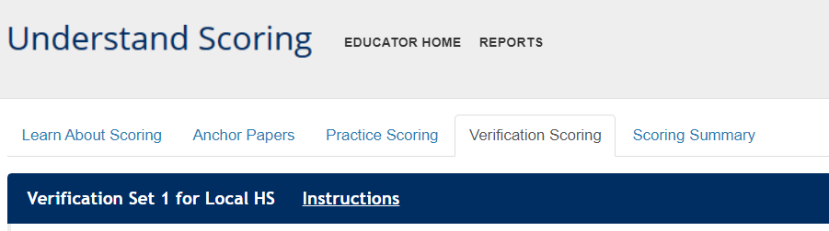
Verification Scoring
Prospective scorers must be logged in to Understand Scoring to view the Verification Sets.
Prospective scorers must use the Verification Sets within Understand Scoring to qualify for scoring student writing samples.

Slide 40
Qualifying to Score Student Writing (1 of 2)
Scorers must have 70% or better exact agreement with the actual scores on each domain in one of the verification sets to pass.
  Exact agreement means the scores must match. Adjacent scores do not count as exact agreement.
Scorers having 10% or more non-adjacent scores in more than one domain will not qualify for scoring student writing samples.
Notes:
The second verification set is provided for scorers unable to meet the 70% or better requirement on the first attempt. After additional practice, prospective scorers have the option of a second try with the second set.

Slide 41
Qualifying to Score Student Writing (2 of 2)
Scorers must qualify through Understand Scoring annually.
Readers should have the dated certificate from Understand Scoring, displaying their verification set results.
  It is recommend these certificates be maintained locally, in one location, as part of the documentation for the local Verified Credit Plan.
Notes:
The second verification set is provided for scorers unable to meet the 70% or better requirement on the first attempt. After additional practice, prospective scorers have the option of a second try with the second set.

Slide 42
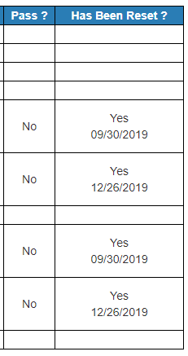
Resetting Verification Sets
Verification Sets may be reset; however, this information is recorded and displayed on the Scoring Summary tab.

Slide 43
Locally Scoring Student Writing Samples
It is best practice that all papers are read by two readers, with the student’s score for each domain being the total of the score assigned by both readers.
  Divisions should establish protocols for resolving non-adjacent scores.
    It is recommended that a third qualified scorer rescore the domain on which the scores are non-adjacent, with the highest two of the three scores accepted.

Slide 44
Calculating a Student’s Total Score (1 of 2)
If a division chooses to calculate a student’s total score:
  The Composing/Written Expression score is counted twice and the Usage/Mechanics score is counted once in calculating the total score.
  The Composing/Written Expression score counts 2/3 and the Usage/Mechanics score counts 1/3.

Slide 45
Calculating a Student’s Total Score (2 of 2)
Individual student writing samples do not pass or fail the local performance assessment.
There is no numerical score that correlates to a passing or failing score for an individual writing sample.

Slide 46
Scoring Protocol (1 of 2)
Divisions should develop a scoring protocol that includes:
  How to resolve non-adjacent scores.
  When and how often training and qualifying will occur.
  When and how often calibration of scorers will occur.
  When and how often writing tasks will be scored using the High School Writing Scoring Rubrics (2017).

Slide 47
Scoring Protocol (2 of 2)
It is best practice to:
  Incorporate quality control activities throughout the scoring window.
  Train and qualify scorers at a time near the scoring window.
  Include a way to requalify and/or recalibrate scorers immediately before scoring student samples or during an extended scoring window.

Slide 48
More Uses for Understand Scoring

Slide 49
More Uses for Understand Scoring (1 of 2)
Information in Understand Scoring may be helpful to anyone producing, teaching, or scoring high school writing, regardless of the method used by the division to verify credits in writing.
  Staff and students in divisions verifying credits in writing through the EOC SOL Writing test would benefit from using the anchor papers, rubrics, and annotations available via the EOC Test button.

Slide 50
More Uses for Understand Scoring (2 of 2)
  In addition to using Understand Scoring to train and qualify scorers of local performance assessment writing samples, educators may:
  Use examples and annotations to help identify strengths and weaknesses in students’ writing and make a plan for how students may improve their writing.
  Share exemplars with students during instruction to enhance students’ understanding of how the rubrics will be applied to their writing.

Slide 51
What Has NOT Changed? Grade 8
At this time, there have been no changes to the Grade 8 Writing SOL test blueprint or test items.
The Grade 8 Writing SOL test continues to be a required Virginia assessment, and the Grade 8 training materials remain available for Virginia educators.
The Grade 8 Writing SOL test continues to be aligned with the 2010 English SOL.

Slide 52
More About Understand Scoring
For an in-depth look at the information within Understand Scoring (including rubrics, domains, explanations of score points, and more), see the Secondary Writing presentation from the 2019 Deeper Learning Conferences.

Slide 53
Resources
These and additional resources for divisions using performance assessment to verify credits in writing are available on the English SOL page of the VDOE website.

Slide 54
What is coming next?

Slide 55
What is Coming Next? Grade 5
The VDOE will host rangefinding for Grade 5 in April 2020.
  Grade 5 Understand Scoring materials specific to the SOL test will be replaced with information specific to performance assessment.
  Grade 5 training materials for the Writing SOL test, aligned to the 2010 English SOL, remain available in Understand Scoring until this replacement occurs.

Slide 56
What is Coming Next? EOC
Additional information will be provided for using Performance Level Descriptors (2017 English SOL) to evaluate bodies of evidence used to award a verified credit.
School divisions will be notified when this information becomes available.

Slide 57
Stay Connected
Office of Student Assessment
  student_assessment@doe.virginia.gov
  (804) 225-2102
Department of Learning and Innovation
  Jill Nogueras, K-12 English Coordinator, jill.nogueras@doe.virginia.gov

