Slide 1
Virginia Department of Education
Enhancing Literacy Instruction for ELs:
Engaging English Learners (EL) in Language Arts
Webinar
February 2020

Slide 2
Agenda
Introduction and Connections
Variety of Supports
Academic Language within SOL
Additional Resources

Slide 3
Webinar Objectives
Teachers will be able to:
Describe various supports for ELs
Identify language (functions and frames) connected to grade-level SOL

Slide 4
Questions from the Field
Chat Feature
Use the chat feature to pose any questions to the group.
We will collect these and add additional information as necessary to the presentation before slides are mailed out or posted.

Slide 5
Think About It…
“There are no native speakers of academic language.”
All students are academic language learners.
There are no “low-incidence” academic language learner schools.
NCELA Webinar (2013)
Notes:
Each content area has its own language students need to understand to be successful
Car shop example
Apprentice analogy: sound like an expert takes explicit instruction

Slide 6
Academic Language: Key to Literacy
•To achieve higher levels of learning, students must be able to understand academic language—the formalized language of instruction found in classrooms, textbooks, and standardized tests. Teachers need to provide explicit academic language instruction for all students, especially English learners or those struggling with reading (Johnson, 2009).
•Research allows us to state with a fair degree of confidence that English learners best acquire English when language forms are explicitly taught and when they have many opportunities to use the language in meaningful contexts (Goldenberg, 2008).
Notes:
Academic Language is not simply a focus on vocabulary.
SOL and assessments require analytical skills, application of vocabulary knowledge to navigate complex texts dense with academic language.
Instruction for ELs prepares them for that challenge.

Slide 7
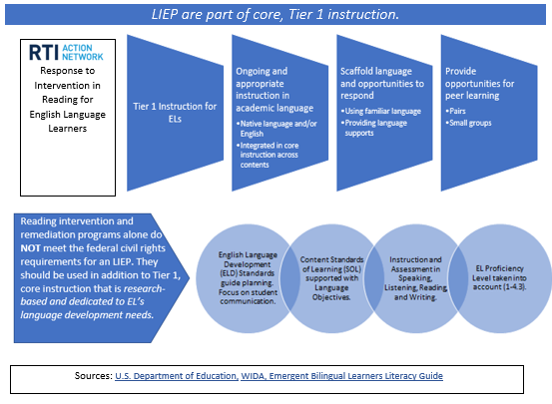
EL Instruction is Tier 1 Instruction
ELs spend much of their school day with general education or content area teachers.
Best possible outcome a result of teacher collaboration to implement effective, Tier 1 instruction for ELs.
Screenshot is from VDOE Resource: ELs who Need Additional Reading Support
Notes:
Screenshot is hyperlinked
ELs need focus on academic language to build literacy as part of core instruction
Equity for ELs in a collaborative effort between EL specialist and content
EL Specialist might have 40 minutes every other day, if that (some places have dually certified teachers to help with this)

Slide 8
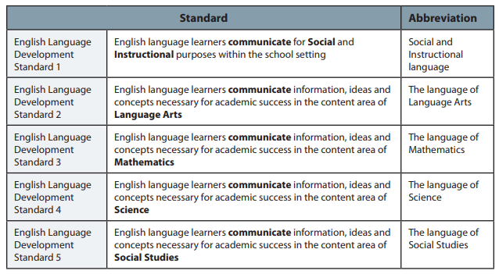
ELD Standards: Communicate
Language Domains
Listening
Reading
Speaking
Writing
Receptive
.
Productive
Notes:
ELD standards that support SOL
New materials expected Fall 2020, standards are the same. Refreshed framework based on feedback from the field, research from University of Wisconsin-Madison, consulting with other national organizations.
Focus on meaning-making and key purposes for language and communication within content areas, e.g. craft arguments, explain processes. Will include some example language expectations.

Slide 9
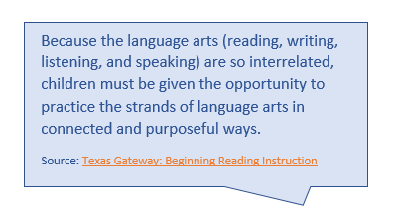

Integrated Lessons
Language Domains
Listening
Reading
Speaking
Writing
Receptive
Reading
Writing
Research
Communication/ Multimodal Literacies
.
Productive
Notes:
Messages from all ELA webinars is integration of skills
When building in all language domains into each lesson, students have the opportunity to use their domains of strength to develop them all simultaneously and connect and retain the content and learning at deeper levels.

Slide 10
Webinar Objective # 1
Teachers will be able to:
Describe various supports for ELs

Slide 11
Enhancing Lessons for Equity
To make ELA lessons more accessible and inclusive:
Use a variety of
Identify the language needed (unpack the SOL)
Supports
Language
Sentence Frames &
Anchor Charts
Cooperative Structures & Peer Interaction
Visuals & Graphic Organizers
Content
Primary Language & Language Adjustments
Teacher Modeling & Think Alouds

Slide 12

Support: Peer Interaction
Cooperative Structures & Peer Interaction
Students need opportunities to:
  share their ideas and how they apply reading strategies and skills and
  hear from their peers.
  “According to the cognitive approach, language has the power to shape the human mind…” (Diana Tihan)
Notes:
Language development, part of the work ELs do everyday in classes, requires language models.
By hearing about the strategies their peers are using, ELs learn more language needed for comprehension and classroom participation in a meaningful way.

Slide 13

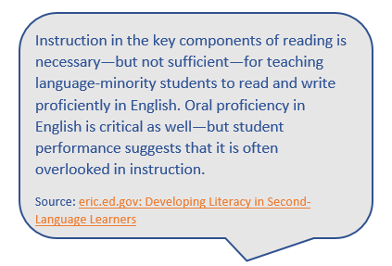
Peer Interaction for
Oral Language Development
Cooperative Structures & Peer Interaction
Screenshot is from VDOE Resource: ELs who Need Additional Reading Support
Notes:
Cooperative Learning is a great strategy to use in every classroom. It doesn’t matter the age or ability of the students, cooperative learning can be used. Cooperative learning gives students a way to learn and use communication skills. It allows more students to talk and engage in the subject at once, rather than the traditional one student answers the teacher’s question.
Structures are very specific strategies that can be used to organize interactions between students who are working in cooperative learning teams.
Most structures can be used with almost any academic content, but some structures are better than others for certain tasks. For example, some structures regulate interaction between pairs, some are best for team work, and others involve the entire class.

Slide 14

Support: Cooperative Structures
Cooperative Structures & Peer Interaction
Literature Circles or Socratic Seminars
Academic Discussions
Reciprocal Teaching
Information Gap Activities or Jigsaws
Structured Think-Pair-Shares
Numbered Heads
These are only examples.
Notes:
Considerations: grouping by language, proficiency level, etc.
Add other types of supports as needed.

Slide 15
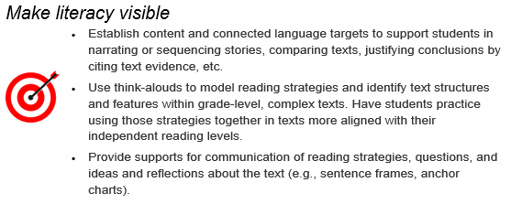
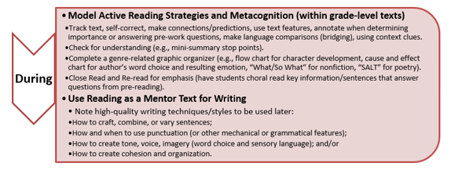
Support: Think Alouds and Models
Teacher Modeling & Think Alouds
Grade-Level Texts
Screenshots from VDOE Resource: Planning and Preparing Literacy Instruction
Notes:
Language is developmental.
Apprentice analogy.
Marzano: When students know expectations, do are more likely to meet them.
Models and think alouds progress students towards both language and content objectives (language objectives to be covered in later slides).
Expose and practice with grade-level and rigorous texts as to ensure equitable opportunity

Slide 16

Support: Relevant Readings
Teacher Modeling & Think Alouds
How does this (story/text) relate to your life? How do you see yourself?
What can you learn from the character’s experience?
How can we make connections between these different experiences (that honors everyone’s perspective)?
Reflects one’s own culture
Helps make connections
Sims Bishop, R. (1990). Mirrors, windows, and sliding glass doors.
Notes:
Mentioned as a best practice with other ELA webinars, specifically grades 6-8
Connections to peers, related to social learning and social-emotional learning theories

Slide 17
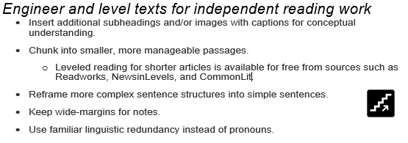
Support: Tailored Texts
Primary Language and Language Adjustments
Screenshot from VDOE Resource: Planning and Preparing Literacy Instruction
Notes:
For students to develop and practice new reading strategies and skills independently and successfully, they will need texts close to their current reading level.

Slide 18

Support: Primary Language
Primary Language and Language Adjustments
ELs can be encouraged to use their primary language when making meaning of new texts and topics.
ELs are still held accountable for English output using supports (even from the beginning levels of English proficiency).
Notes:
Virginia is proud to provide dual language instruction as a language instruction education program (LIEP)
Even if not involved in a Dual Language LIEP, research shows inclusion of an EL’s primary language makes a difference.
Affective filter theory
Teachers can allow primary language use for a specific purpose. Teachers can find key words in the EL’s primary language and provide those. Teachers can point out language connections and cognates (words that look or sound the same between languages).

Slide 19



Support: Visuals
Visuals & Graphic Organizers
Photos or Images
Videos
Artifacts*
Diagrams or Charts
Maps or Globes
TPR (physical movements)
*Students may want to bring in their own cultural artifacts
Notes:
Reduces anxiety
Builds background, text may have unfamiliar concepts (e.g. snow)
Act out character emotions, certain adverbs, etc. to help students learn new words in context
Example: Adults and Directions

Slide 20
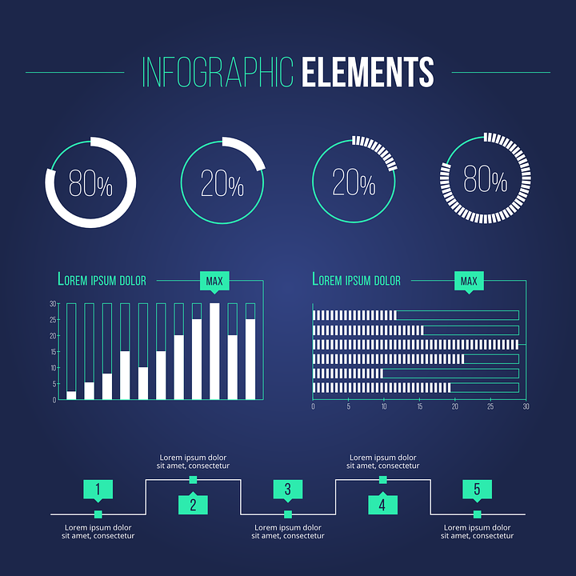
Support: Anchor Charts with Visuals
Visuals & Graphic Organizers
Anchor charts that combine visuals with language*
Infographics
*Students may want create their own culturally relevant analogies and metaphors for anchor charts.
Notes:
Older ideas for anchor charts: the hamburger model which has lost some popularity, as an example of a visual anchor chart combined with language.

Slide 21
Support: Graphic Organizers
Visuals & Graphic Organizers
Topic 1
Topic 2
Topic
Idea
Idea
Idea
Idea
Beginning
Middle
End
Notes:
Helps visually
Models organization of ideas related to text structures
Supports explicit instruction and visible thinking

Slide 22
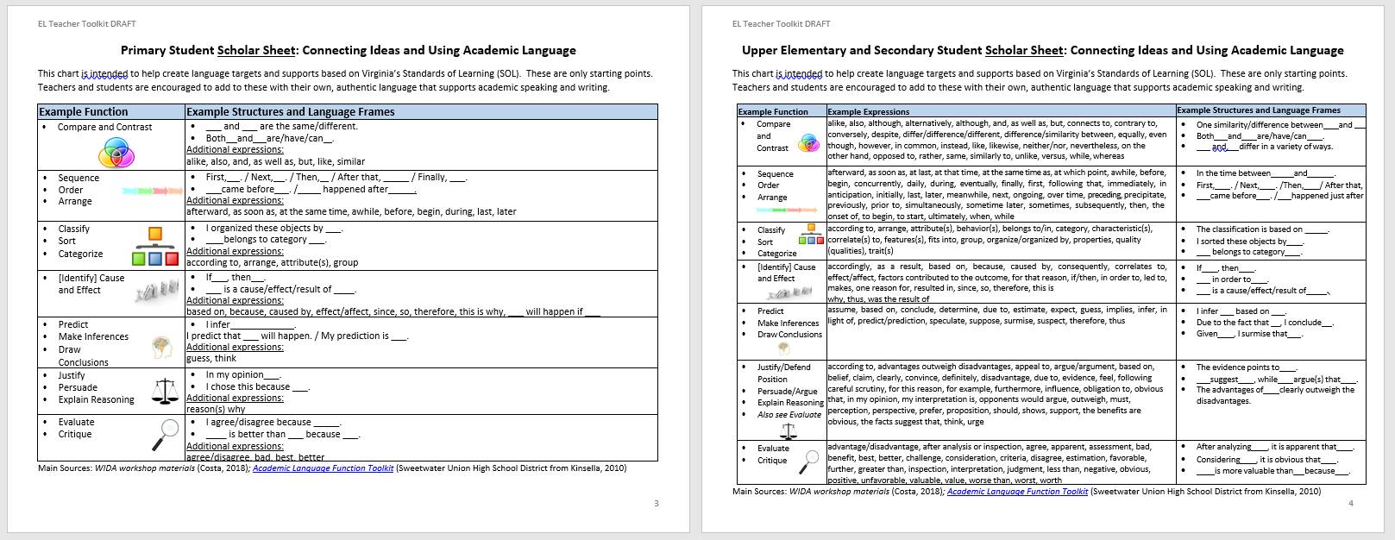
Support: Sentence Frames
Sentence Frames &
Anchor Charts
Screenshot for VDOE Resource: EL Teacher Toolkit
Notes:
From EL Teacher Toolkit Online VDOE Resource
Hyperlinked
These are only examples. Will cover more in the next section of the webinar.

Slide 23

Support: Sentence Frames and Anchor Charts
Co-create with students
Create your own
Collaborate with peers
Sentence Frames &
Anchor charts

Slide 24
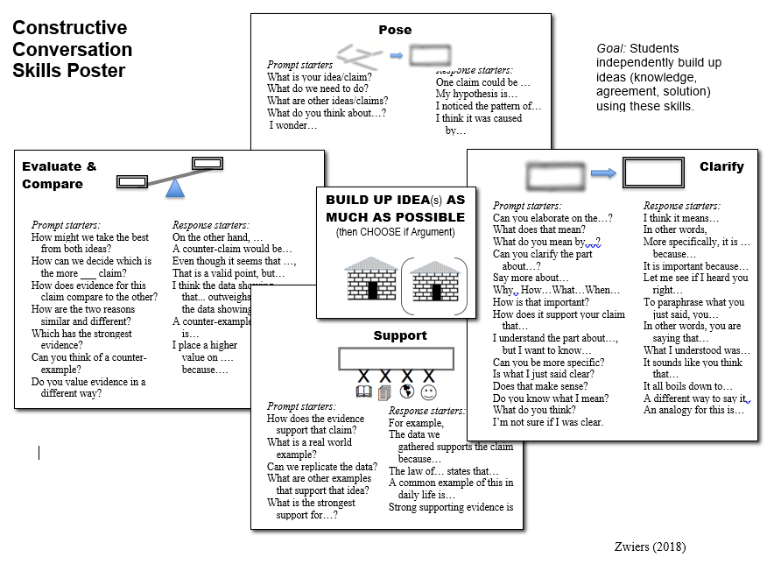
Supporting Supports
Cooperative Structures & Peer Interaction
Sentence Frames &
Anchor Charts
Visuals & Graphic Organizers
Poster screenshot from jeffzwiers.org
Notes:
Image is hyperlinked
Jeff Zwiers same recently to present to K-12 ELA teachers on academic conversations and building ideas.

Slide 25
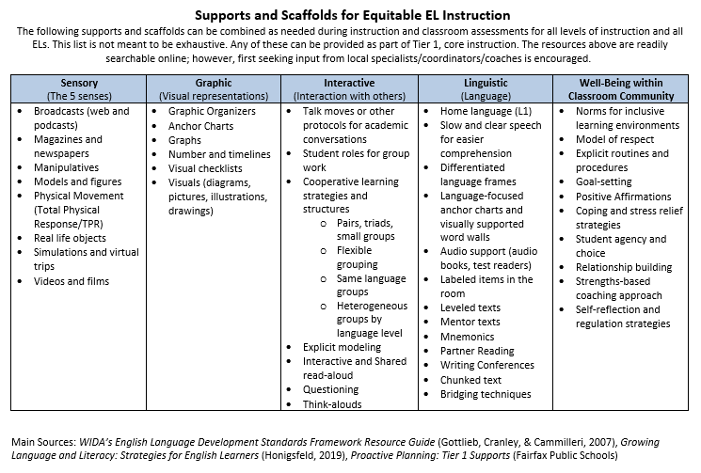
Variety of Supports
Screenshot for VDOE Resource: EL Teacher Toolkit
Notes:
Screenshot is hyperlinked
Only dug into some of the possible supports
In EL Teacher Toolkit, chart lists others

Slide 26
Webinar Objective #2
Teachers will be able to:
Identify language (functions and frames) connected to grade-level SOL

Slide 27
Explicit Academic Language Instruction: Language Objectives
Language of ELA
Compare and Contrast
Sequence
Describe
Justify
Classify
Predict
Identify Cause and Effect
Language Objectives should support student EL communication about SOL.
These are examples. This list is not exhaustive.
Notes:
Language objectives tied to SOL
Use Scholar Sheet as a support

Slide 28
Example: Predict
Reading 1.9d TSW make and confirm predictions
Language | Content
Language Frames or Banks Inference/predict language Justify Language I think ___ will happen. ____ might happen. If ____, then ___. | Visually-supported texts Texts in primary language Graphic organizer (flow chart) With a partner (in primary language)

Slide 29
Example: Compare
Reading 4.5 TSW read and demonstrate comprehension of fictional texts
(i) compare/contrast details…
Language | Content
Language Frames or Banks Comparative language __ differs from___. _____, however, ______. While ___, ____. | Visually-supported texts Texts in primary language Graphic organizer (Venn Diagram) With a partner (in primary language)
Notes:
Helps teach punctuation in context, as it connects to purpose of communication.
As grade levels increase, as does academic language demand, may want to include more frames that use different transitions/signal terms, that start differently, etc.

Slide 30
Example: Identify Cause and Effect
Reading 7.5c TSW Identify Cause and Effect Relationships and their impact on plot
Producing Language | Understanding Texts and Instruction
Language Frames or Banks Cause and Effect language ____ because ____. The impact of ___ was ___. ___ was caused by ___. | Visually-supported texts Texts in primary language Graphic organizer (flow chart) With a partner (in primary language)

Slide 31
Example: Evaluate
Communication and Multimodal Literacies: 8.2 g TSW evaluate presentations
Producing Language | Understanding Texts and Instruction
Language Frames or Banks Evaluative language Justification language According to the criteria,___. ___ presentation was quality/not quality because ___. | Reasons bank or anchor chart; e.g. What makes a presentation quality? How do we define a clear and supported argument? Presentation in primary language

Slide 32
Example: Justify
Writing 10.6: g) TSW clearly state and defend a position using reasons and sufficient evidence from credible sources as support.
Producing Language | Understanding Texts and Instruction
Language Frames or Banks Justification language Additive language (adding support) Evaluative Language It is undeniable that ___. Additional evidence includes___. | Mentor Text(s) Criteria for “credible source” (examples and reasons)

Slide 33
The Language of …
SOL?
Which language function is connected to this SOL?
What are examples of language that students need to understand and use to meet the SOL?
Language of ELA
Compare and Contrast
Sequence
Describe
Justify
Classify
Predict
Identify Cause and Effect
Notes:
If time, people can type in some examples

Slide 34
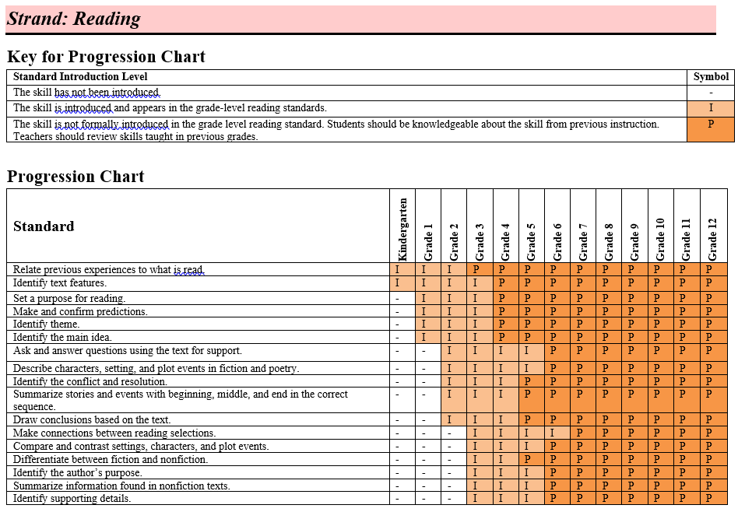
Skill and Language Progression
Language of ELA
Compare and Contrast
Sequence
Describe
Justify
Classify
Predict
Identify Cause and Effect
Notes:
Language is developmental as are reading and analytical skills.
With explicit instruction and modeling, teachers move students along the continuum of depth and complexity.
Language functions are found in SOL across grade levels and content areas
Collaborative opportunity with content or grade level peers to create language objectives and frames

Slide 35
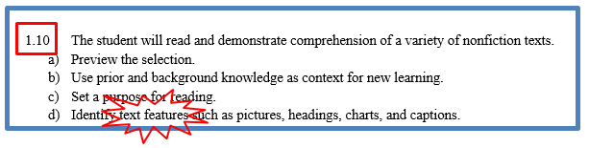
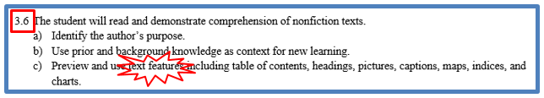




Vertical Articulation of the Standards
This is a caption.
I used the text feature of the headings to know where to find information on reptile adaptations.
Based on the graphics, I predict I will learn about geographic features.
Since___,I can infer ___.
Notes:
Example frames based on the SOL skill as it progresses.
Teachers can use their specific texts to create appropriate frames for their respective contexts. Teachers can think, “ What is an acceptable answer?” and use that to model one of the possible answer frames for students to use.

Slide 36
Enhancing Lessons for Equity: Review
To make ELA lessons more accessible and inclusive:
Use a variety of
Identify the language needed (unpack the SOL)
Supports
Language
Sentence Frames &
Anchor Charts
Cooperative Structures & Peer Interaction
Visuals & Graphic Organizers
Content
Primary Language & Language Adjustments
Teacher Modeling & Think Alouds

Slide 37
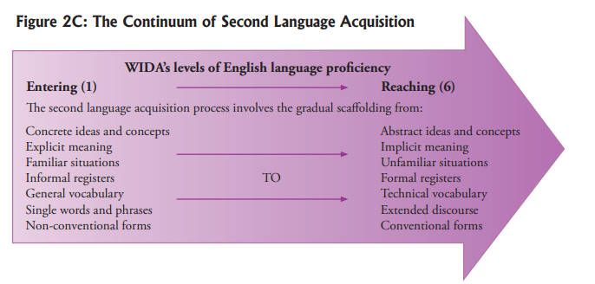
Support Language Progression
How do your supports support academic language development? How are supports differentiated for language level?
Example:
Simple Sentence→
Compound Sentence→
Multiple Sentences (some compound, some complex)
Source: 2007 WIDA ELP Standards and Resource Guide
Notes:
Opportunity for 13% of ELs identified as LTELs

Slide 38

Language, not Content, Differentiation
Screenshot for VDOE Resource: EL Teacher Toolkit
Notes:
Use for creating frames, student goal setting, progress monitoring

Slide 39
Webinar Objectives: Reflect
Are you able to:
List various supports for ELs
Identify language (functions and frames) connected to grade-level SOL
?

Slide 40
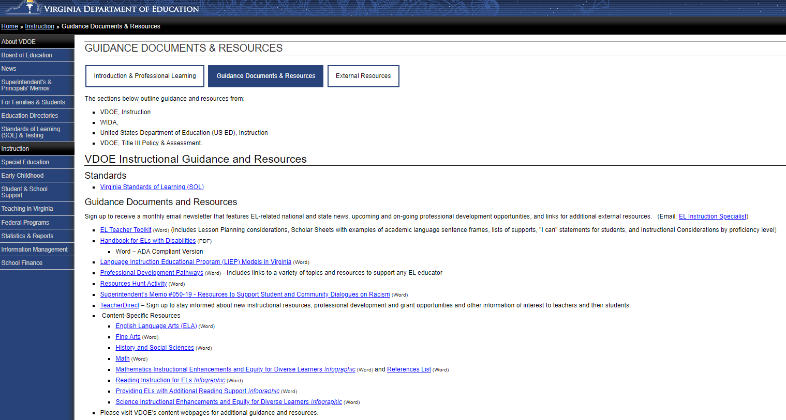
Learn More…
Handbooks and guidance documents
ELA-specific resource list
Links to eLearning

Slide 41

Independent Learning Opportunities Online
Contact your division’s Title III Coordinator for secure portal access.
Start, save, resume until August 2020.

Slide 42
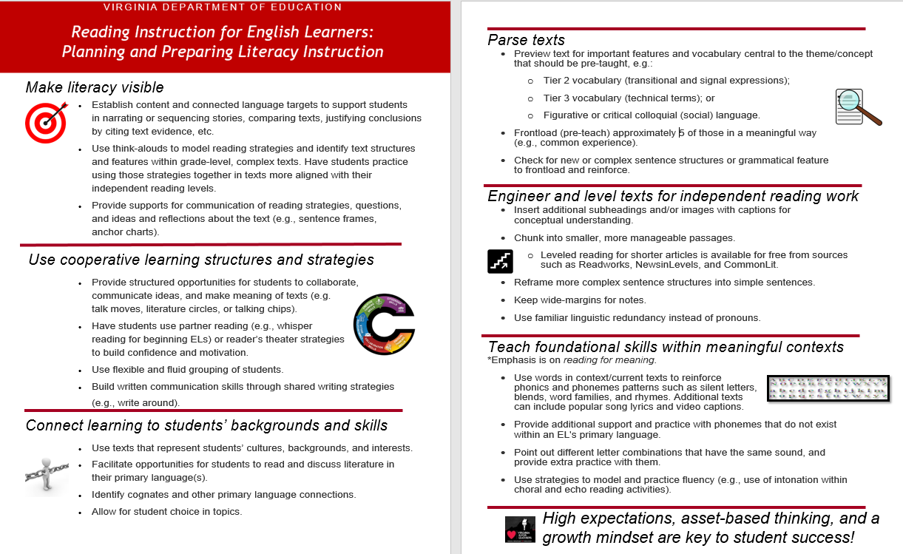
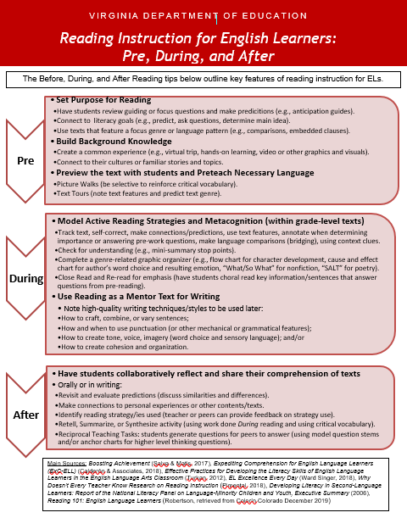
Planning and Preparing Literacy Instruction
Screenshots from VDOE Resource: Planning and Preparing Literacy Instruction
Notes:
Images are hyperlinked

Slide 43

Providing ELs with Additional Reading Support
Screenshot is from VDOE Resource: ELs who Need Additional Reading Support
Notes:
Image is hyperlinked

Slide 44

Stay up to date
News and Updates
Professional Development
Promising Practices
Email:
jessica.costa@ doe.virginia.gov
Notes:
Tool for collaboration; discuss content with an EL specialist or ELA colleague
Possible surveys for FAQs or input on new resources

Slide 45
VDOE Disclaimer
Reference within this presentation to any specific commercial or non-commercial product, process, or service by trade name, trademark, manufacturer or otherwise does not constitute or imply an endorsement, recommendation, or favoring by the Virginia Department of Education.

Slide 46
Stay Connected
Dr. Jessica Costa
English Learner Instruction Specialist
Jessica.costa@doe.Virginia.gov
Jill Nogueras
K-12 English Coordinator
Jill.Nogueras@doe.virginia.gov
Carmen Kurek
Elementary English/Reading Specialist
Carmen.Kurek@doe.virginia.gov
Taylor Snow
English/History & Social Science Specialist
Taylor.Snow@doe.Virginia.gov

