Slide 1
Annual October Count of Children in
Neglected or Delinquent Institutions, and in Adult Correctional Institutions
Virginia Department of Education
Office of ESEA Programs
Gueringe’ Richardson, Title I Specialist
October 2022

Slide 2
Disclaimer
This presentation was planned under a grant from the U.S. Department of Education (USED). However, the content does not necessarily represent the policy of the USED, and you should not assume endorsement by the federal government.

Slide 3
Agenda
Purpose of the Annual October Count for Neglected and Delinquent Students
Procedures for conducting the count
Types of facilities and students served with funding
Method for submitting the Annual October Count

Slide 4
2022 Annual October Count Submission
The Superintendent’s Memo that was released on September 30, 2022, includes directions for submitting the Annual October Count.
The information that is collected is the same as in previous years.
All school divisions will submit data through the SSWS Annual October Count of Neglected or Delinquent Students application data even if no students are reported.
The deadline for entering data is Wednesday, November 16, 2022.

Slide 5
Annual Count Purpose
Provide one data point to USED that is used to determine Title I, Part A, and Title I, Part D, allocations.
USED requires that school divisions and state agencies submit data in two categories:
  the number of delinquent children; and
  the number of neglected children.

Slide 6
Allocations to States
The number of delinquent students counted in the October Count is used to determine the amount of funding for the Title I, Part D, Subpart 2, grant to support delinquent students and at-risk students.
The number of neglected students counted in the October Count is used to determine the amount of funding for the Title I, Part A, grant to support neglected and at-risk students.

Slide 7
Allocations to States cont.
If funding is available after the local facilities are served then
  at-risk students may be served with the remaining Title I, Part D, funds; and
  the remaining neglected set aside funds can go back to Title I, Part A, schools.

Slide 8
Who is Counted?
Children ages 5–17, who reside in an eligible neglected or delinquent institution for at least one day within the 30 consecutive day window, one day of which must be in October.
All children who reside in the facility regardless of the child’s or youth’s state of origin should be included in the October Count.

Slide 9
Who Cannot Be Counted?
Children in homeless shelters cannot be counted. They can receive support through the Title I, Part A, Homeless Set Aside or through the McKinney-Vento Grant.
Children cannot be counted in the enrollment data submitted by a state correction or state detention facility (State Agency).
  Virginia’s two state agencies report those students and receive Title I, Part D, Subpart 1, funds.

Slide 10
Who is Served?
Children that are counted may be different from students served.
Students that can be served with Title I, Part D, funds are students:
  ages 5-21;
  living in local neglected and delinquent facilities;
  adult correctional facilities;
  community day schools for neglected or delinquent children/youth;
  at-risk youth in LEA.

Slide 11
Who is Served? cont.
Students can be served if they are 21 years or younger and have not earned a high school diploma.
Students living in local neglected or delinquent facilities and adult correctional facilities receive first priority for funding because they generate the funds.

Slide 12
Facility Eligibility
  School divisions must report data to the State for locally operated facilities. The facilities must meet the definition of an institution for:
  children who are neglected;
  children who are delinquent; or
  youth 21 years or younger in locally operated adult correctional institutions that have not obtained a high school diploma.

Slide 13
How to Find Facilities
Who to contact to find facilities in your area:
  Student Services Office
  Guidance Departments
  Social Services Agencies
Only contact facilities within your school division boundaries.

Slide 14
Resources
If a facility is eligible, and would like to receive funds through the Title I, Part D, grant or the Title I, Part A, Neglected Set Aside, there are consultation resources on VDOE’s Title I, Part D, webpage:
  Sample Cover Letter
  Sample Intent to Participate Form

Slide 15
Facility Type
  Facilities can be publicly or privately operated.
  Facilities included in the count must be residential. Non-residential facilities, such as community day programs, cannot be counted but can be served after priority is given to the residential facilities.

Slide 16
Definition: Neglected Institution
  “Institution for neglected children and youth” means a public or private residential facility, other than a foster home, that is operated primarily for the care of children and youth who:
    (a) have been committed to the institution or voluntarily placed in the institution under applicable state law due to abandonment, neglect, or death of their parents or guardians; (Section 1432(4)(A) of the ESEA, as amended)

Slide 17
Definition: Delinquent Institution
“Institution for delinquent children and youth” means a public or private residential facility that is operated for the care of children and youth other than a foster home who:
  (a) have been adjudicated to be delinquent or in need of supervision; and
  (b) includes facilities for detention, juvenile corrections and adult corrections (youth 21 years or younger).
  (Section 1432(4)(A) of the ESEA, as amended), (Title I, Part D, Nonregulatory Guidance, N-3)

Slide 18
Delinquent Institution
The definition on the previous slide indicates that only students that have been assigned by the courts are named as delinquent.
The non-regulatory guidance clarifies that a delinquent youth may be placed in a delinquent institution voluntarily or by a state or local agency other than by the juvenile justice system if that is the best placement for the child.

Slide 19
Facility Reporting
The annual October counts are submitted according to the type of facility.
The type of facility must be consistently reported each year unless the charter, constitution, by-laws, or mission statement changes.

Slide 20
Acceptable Facility Types
  Residential facilities that can be included in the count include:
      Religious facilities specifically for neglected or delinquent youth.
      Group homes for neglected or delinquent youth.
      County jails not operated by the state that provide educational services.

Slide 21
Facility Designation
Facilities must be designated as either neglected or delinquent institutions. They cannot be both.
All students in a facility share the same designation. They are either all neglected students or all delinquent students.
One facility cannot report both neglected and delinquent students, but both type of students can be served.

Slide 22
Type of Facility
Facility type is determined by a governing document such as
  charter,
  constitution,
  by-laws,
  mission statement; or
Any documentation that describes the reason students are admitted such as a
    website
    brochure
    admission criteria

Slide 23
No Documentation Provided
If there is no documentation to identify the facility as neglected or delinquent, and the coordinator is confident that the students are eligible to be included in the October Count, then the majority type of students served is used to classify the facility.
For example, if most the of students living in the facility have been placed there because they are a part of the juvenile justice system, then the facility is declared a delinquent facility.

Slide 24
Evidence of Facility Type
The annual October Counts are submitted according to the type of facility.
  For October 2022, a facility’s governing document does not need to be submitted to VDOE, but a copy must be kept on file with the LEA.
  If the documentation has been collected by the LEA in previous years, new documentation does not need to be collected.

Slide 25
Delinquent Facility Example
This slide contains an example of language that describes a delinquent facility.
The “example” facility provides short-term emergency shelter care services for residents pending disposition. Residents may be placed via a Shelter Care Order, either by the court or Intake Officer, Department of Social Services, or through Community Policy and Management Team approval. Residents can remain in Shelter Care for a maximum of 59 days. Parents of referred residents must participate in service provision and may be required to attend group services at the center.

Slide 26
Delinquent Facility Example cont.
This slide contains another example of a description of a delinquent facility.
The “example” program is a three, six, or nine month program for youth who require a less restrictive placement than secure detention, but are unable to remain in their homes due to their behaviors or criminal involvement.

Slide 27
Neglected Facility Example
This is an example of language from a governing document for a neglected facility for girls.
The “example” facility is able to serve 20 females, ages 4-21 who are not able to live with their families. Residents may have sustained previous abuse or neglect, or may be emotionally disturbed, learning disabled, or experiencing behavioral, social, or educational problems.

Slide 28
Annual Count Example 1
Below is the first example of how to count students for the October Count.
The Stellar Behavioral Health Center serves nine students whose parents have either died or have been declared unfit and 16 students who have gotten into a little trouble recently. Their by-laws state that they were created to serve delinquent students; therefore, all of their students are categorized as delinquent for the October Count and they report 25 delinquent students.

Slide 29
Annual Count Example 2
Below is a second example of how to count students for the October Count.
The Champion Academy serves six neglected students and six delinquent students. Their constitution states that their purpose is to serve delinquent students; therefore, they are categorized as a delinquent facility and they report 12 delinquent students.

Slide 30
Annual Count Example 3
Below is a third example of how to count students for the October Count.
The Sterling School serves 10 neglected students and 50 delinquent students. Their charter is unclear and it indicates that it may serve both types of students. They should be categorized as a delinquent facility because they serve more delinquent students and they report 60 delinquent students for the Count.

Slide 31
Annual Count Example 4
Below is a fourth example of how to count students for the October Count.
The Ace Center has seven neglected students and 12 delinquent students living in their facility. The charter states that they were created to serve students who have been neglected, abandoned, abused or whose parents are no longer living. Even though they serve more delinquent students, their charter determines their facility type and they must report 19 neglected students.

Slide 32
LEA Responsibility
  The school division will:
  locate the neglected and delinquent residential facilities in your geographic boundaries;
  contact them to inform them of the purpose and their requirement to participate in the Annual October Count;
  choose a 30 day window, of which one day must be in October to conduct the count; and
  provide the institutions with the directions that will be used to record their number of students ages 5-17, living in their facility.

Slide 33
Facility Responsibility
    The facility will:
    count the number of children living in the institution during the window.
      If a student leaves the institution early in the window through a formal exit process, but then returns during the 30 day window, then the student can be counted twice.
      Runaways who leave voluntarily and then re-enter are not counted twice, they only count once.

Slide 34
Facility Responsibility cont.
The facility will:
provide their governing document (if it has not been provided previously) that identifies their facility as a neglected or a delinquent facility, or
provide an explanation of why they cannot specify their facility type, and
provide a rationale for any changes in the number or type of students reported from the previous year.

Slide 35
LEA Final Steps
The school division will:
compile the data, and
submit the data to the Virginia Department of Education through the Annual October Count of Neglected or Delinquent Students application.

Slide 36
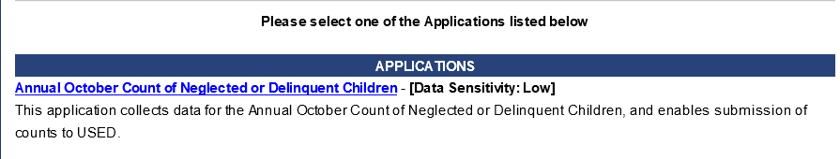
Annual October Count of Neglected or Delinquent Children Application

Slide 37


Choose the Correct Application
The N & D Survey is the application that is used by divisions that receive a Title I, Part D grant. This is not the application to use for the October count.

Slide 38
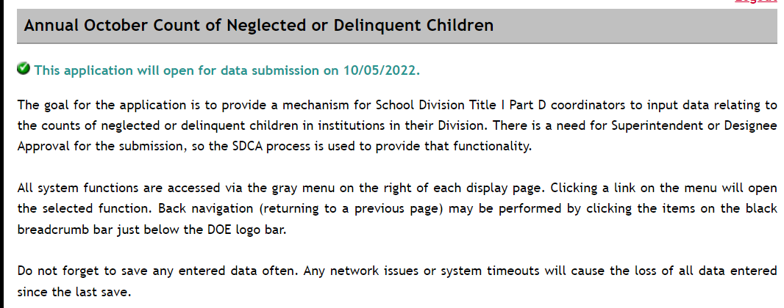
The SSWS Application

Slide 39
How to Get the Application
Coordinators should work with your division’s SSWS administrator to gain access to the application.
This is the same person who gives people permissions in SSWS and OMEGA.

Slide 40
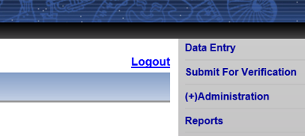
Information Collected
There are two screens to enter data:
Data Entry
Submit for Verification
The links for the screens are on the gray menu.

Slide 41
Entering Information- Reporting Students
All divisions entering data will choose Data Entry on the gray menu on the right side of the screen.
Divisions that have previously reported facilities will have a menu to choose facilities that were previously reported.

Slide 42
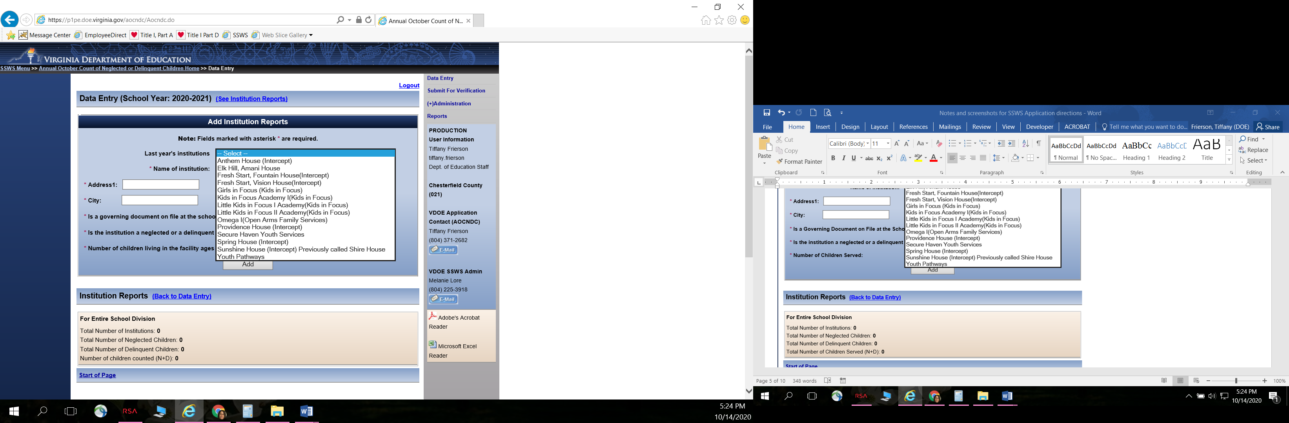
Example of Previously Reports Institutions

Slide 43
Institution Information
Once you choose a previously reported institution, the institution’s contact information will automatically populate in the window.
Double check to make sure that the information is correct. If the institution’s name or address changed, update the information.
Enter the number of children living in the facility ages 5-17 during this year’s October count window.

Slide 44
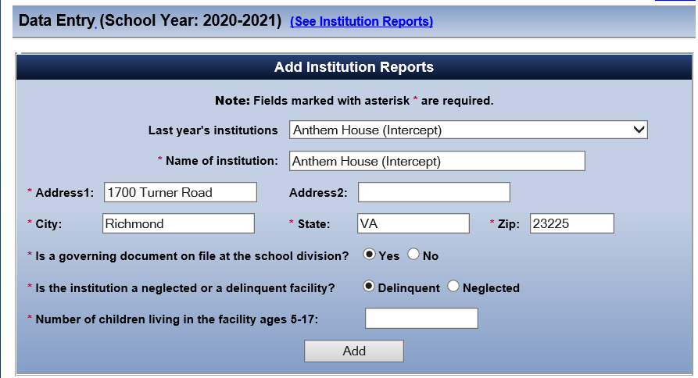
Example of Institution Information
School Year 2022-2023

Slide 45
Application Changes
School Yar 2022-2023
Please note the updated additional wording on the Data Entry page below:
New wording:
Note: Fields marked with asterisk are required if entering facilities. If facilities are not being entered, choose Submit for Verification on the right hand menu.
Number of children living in facilities ages 5-17 (for local education agencies) and children living in state operated detention centers and DJJ ages 5-20 (for State Agencies):
Previous wording is on the screenshot.

Slide 46
Adding Institutions
Once the information entered is correct for that institution, choose Add.
Repeat this process for all institutions that were reported in the past.
If you need to enter the information for a new institution, do not choose from the last year’s institutions’ menu, simply type in the information for the new institution.

Slide 47
Total Number of Institutions and Students
When you add the number of students served, the total at the bottom of the screen will begin to automatically calculate the number of institutions and children served.

Slide 48
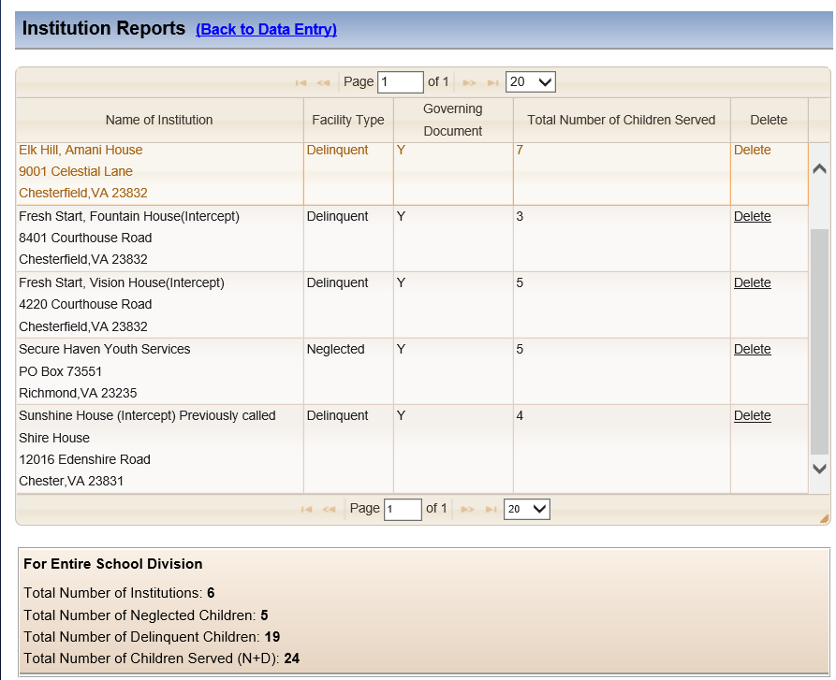
Institution Reports

Slide 49
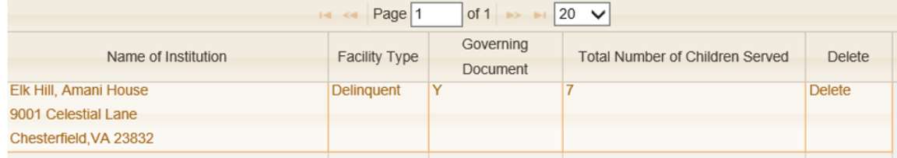
Correcting a Mistake
If you make a mistake, you will have to delete the institution and make revisions by reentering the information in the Add Institution Reports section.

Slide 50
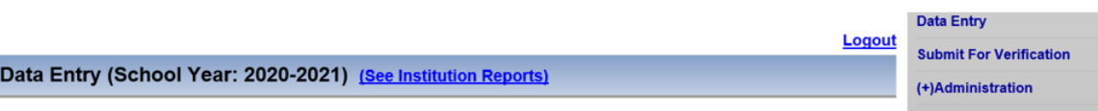
Submit for Verification
Once all of your institutions are entered, then choose Submit for Verification in the gray menu.
School Year 2022-2023

Slide 51
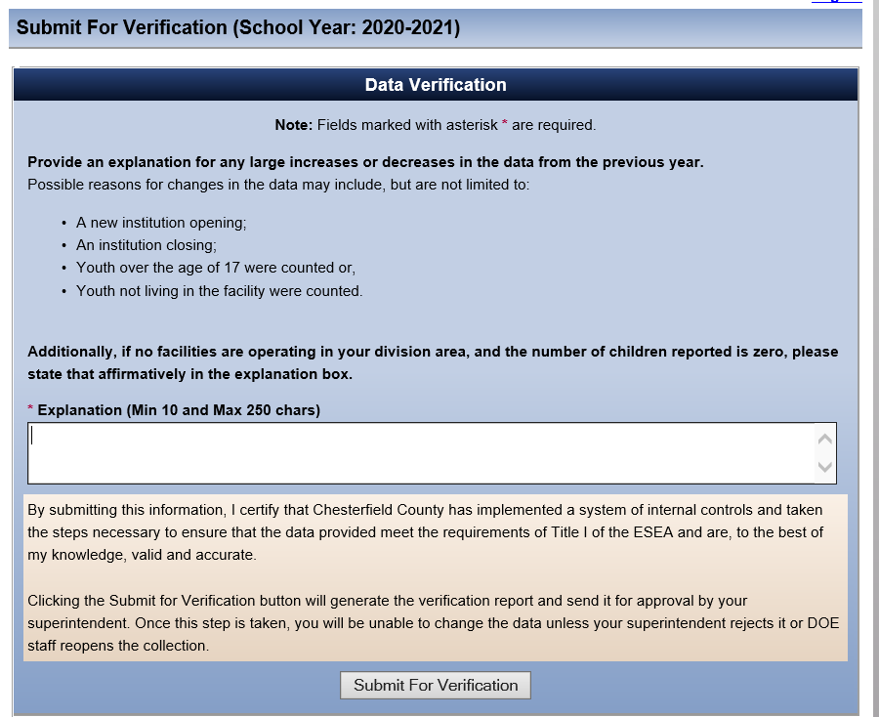
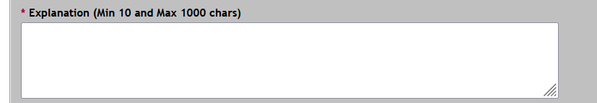
Data
Verification
School Year 2022-2023
If zero students are reported, provide an explanation or reason for zero students, such as there aren’t any facilities in your school division.
If there is a change in the number of students by one student, you will have to enter an explanation for the change.

Slide 52
More Application Changes
School Year 2022-2023
We have made an update to allow additional characters on the Data Verification page. It has been updated to 1000 characters.
New wording:
Additionally, if no facilities are operating in your division area, and the number of children reported is zero, please enter an explanation for reporting zero students in the explanation box

Slide 53
Explanation Box
Possible reasons for changes in the data may include, but are not limited to:
  a new institution opens;
  an institution closes;
  youth over the age of 17 were counted previously;
  youth not living in the facility were counted; or
  not as many students were enrolled to keep enrollment low to accommodate social distancing.

Slide 54
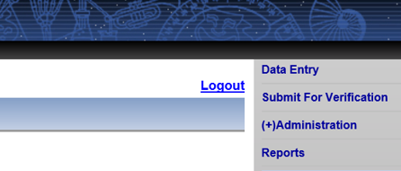
Entering Information for Zero Students
From the entry screen choose Submit for Verification on the gray menu on the right side of the screen.
Do not add zero on the Add Institutions Reports screen.

Slide 55
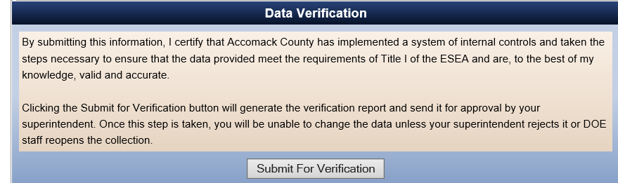
Verifying Zero Students
A certification statement will appear, choose the Submit for Verification at the bottom of the screen.

Slide 56
Data Verification for Zero Students
School Year 2022-2023
A second verification page will appear when you don’t have any students to enter.

Slide 57
Explanation for Zero Students
The application will require a statement confirming that you are not reporting any students.
Example statement: There are no neglected or delinquent institutions located in Accomack County.

Slide 58
Submitting for Superintendent's Approval
Once the explanation is entered, choose the Submit for Verification at the bottom of the screen and the superintendent will receive an email letting them know that the report is ready for their verification.
When the superintendent logs into SSWS, they will be able to approve the report in the same manner as they approve all other verifications in SSWS.

Slide 59
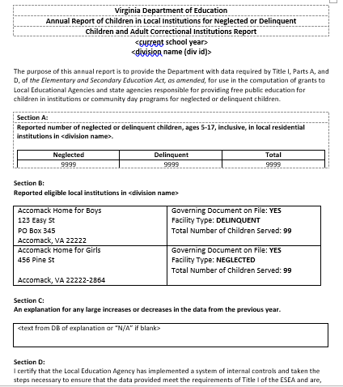
Verification Report
Once the superintendent approves the information submitted, a verification report will be available.
Please note that a certification will appear, but the superintendent’s “signature” will not appear on the report.
Keep a copy for your records. You will not need to submit the report to VDOE.

Slide 60
Contact Information
Gueringe’ Richardson
Title I Specialist
Office of ESEA Programs
Virginia Department of Education
Gueringe.Richardson@doe.virginia.gov
(804) 371-0770

Slide 61
Title I, Part D Resources
Federal Programs, Title I, Part D
Title I, Part D, Legislation and Nonregulatory Guidance

