Slide 1
Unpacking the Guidelines for Locally Awarded Verified Credits
October 28, 2021

Slide 2
Agenda
Superintendent’s Memo #276-21
A Closer Look at the Guidelines for Locally Awarded Verified Credits: Option Two
  Implementation Support for School Divisions Using State-Developed Performance Tasks to Verify Credits in History and Social Science
Questions

Slide 3
Superintendent’s Memo #276-21

Slide 4
Superintendent’s Memo #276-21
“Revisions to the Guidelines for Locally Awarded Verified Credits to Allow for the Use of Performance Assessments to Verify Credits in History and Social Science”
  Guidelines for Locally Awarded Verified Credits (LAVC)
  Implementation Support for School Divisions Using State-Developed Performance Tasks to Verify Credits in History and Social Science

Slide 5
Guidelines for LAVC: Two Options
“A student may be eligible to earn locally-awarded verified credits (LAVC) under two options. Student eligibility and the LAVC process vary between the two options.”
Option One: the previously established LAVC process
Option Two: a new process for LAVC that may be used for history and social science only
Notes:
The Guidelines for Locally Awarded Verified Credits are included in the
Guidance Document Governing Certain Provisions of the Regulations Establishing Standards for Accrediting Public Schools in Virginia meet the requirements of the legislation that now allows for the use of Performance Assessments to Verify Credits in History and Social Science

Slide 6
Associated Revisions to the
SOA Guidance Document
Language was removed from the SOA Guidance Document that prohibited the award of verified credits for performance assessments in history and social science. (This language had been previously added to address legislation enacted by the 2018 Virginia General Assembly.)
LAVC in history and social science earned under Option Two can be used for the Advanced Studies diploma.

Slide 7
LAVC Option One: Eligibility
Option One: To be eligible to earn locally awarded verified credits in reading, writing, mathematics, science, or history/social science, a student must:
Pass the high school course;
Score within a 375-399 scale score range on any administration of the Standards of Learning (SOL) test after taking the test at least twice; and
Demonstrate achievement in the academic content through an appeal process administered at the local level.
Notes:
Eligibility under option one is not new. School divisions already have established procedures for option one eligibility, and the changes to these guidelines do not change those requirements, but moving forward this type of LAVC eligibility will be referenced as “option one.”

Slide 8
LAVC Option One: Local Review Panel
Local school boards must continue to adopt policies that govern procedures to confer LAVC under this option.
For Option One, the requirements for the appointment of a local review panel and the verification process that must be followed have not been revised in the SOA Guidance Document.
Notes:
Again, there is no change to the requirements for this previously established method for determining LAVC.

Slide 9
A Closer Look at the Guidelines for LAVC:
Option Two

Slide 10
LAVC Option Two: Eligibility
Student must meet both criteria:
Pass the course
Demonstrate mastery of the standards/skills/objectives of the entire course, i.e., the course content included in the Standards of Learning

Slide 11
State-Developed Performance Tasks (1 of 2)
State-developed performance tasks will be made available to school divisions exercising Option Two in the Guidelines for LAVC.
Each task will measure student achievement in the core expectations and skills— the “.1” standards from the Standards of Learning (SOL). (Local assessments will measure achievement in the other SOL for the course.)

Slide 12
State-Developed Performance Tasks (2 of 2)
All state-developed performance tasks available for Virginia and U.S. History (and being piloted in World Geography, World History I, and World History II) follow the Inquiry Design Model structure.
  Formative tasks— analyze, interpret resources
  Summative task— respond to the compelling question on which the task is built
A summative task response, completed under appropriate conditions, can become part of a collection of evidence.
Formative task responses are not to be included.

Slide 13
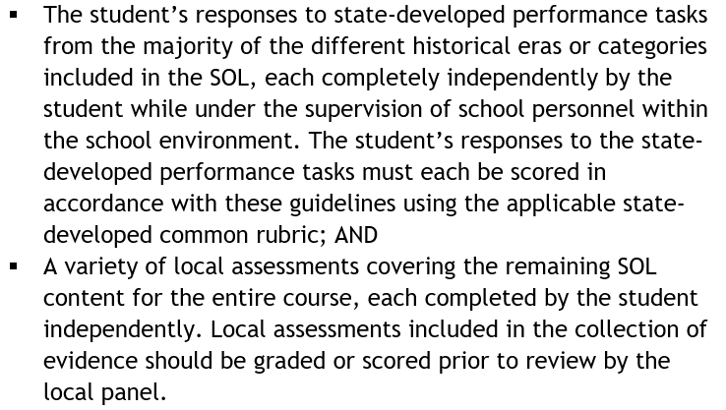
Collection of Evidence: Required Components
A student’s collection of evidence reviewed by the local panel must include:
Notes:
Requirements for the student’s collection of evidence from SOA Guidance Document. These two required components will be discussed in more detail as we review the additional Guidelines for LAVC.

Slide 14
Majority of Different Eras or Categories (1 of 3)
What constitutes a “majority” of the different historical eras/categories included in the SOL for the entire course?
This varies by course and depends on how the SOL are organized.
  World Geography is organized into four categories.
  World History I and Virginia and U.S. History are each organized into four historical eras.
  World History II is organized into three historical eras.

Slide 15
Majority of Different Eras or Categories (2 of 3)
World Geography: The minimum number of responses to state-developed tasks is three, and each of these responses must be from a different category.
World History I and Virginia and U.S. History: The minimum number of responses to state-developed tasks is three, and each of these responses must be from a different historical era.
World History II: The minimum number of responses to state-developed tasks will be two, and both of these responses must be from a different historical era.

Slide 16
Majority of Different Eras or Categories (3 of 3)
Example from Implementation Support for VA/US:
The SOL for Virginia and U.S. History are organized into four historical eras: Early America through the Founding of the New Nation; Expansion, Civil War, and Reconstruction; Industrialization, Emergence of Modern America, and World Conflicts; and the United States since World War II.
Thus, a collection of evidence for Virginia and U.S. History would require a response to a state-developed task from three of these four different eras in order to cover the majority of the eras included in the course.

Slide 17
Local Assessments in the Collection of Evidence
Local assessments are not expected to be performance assessments and may include a variety of item types.
When combined with the state-developed task responses, local assessments will provide evidence for mastery of the standards for the entire course.
Each local assessment included in the collection must be completed independently while adhering to the conditions established for local assessments.
Local assessments should be graded or scored before panel’s review.
Notes:
Pause for questions about what should be included in the collection of evidence

Slide 18
Completion of State-Developed Performance Tasks: “Testing” Conditions (1 of 2)
Any summative task response to be included in the collection of evidence used to verify credit in history and social science must be completed independently by the student while at school and under the supervision of school personnel.
“Responses completed by the student in the remote or virtual learning environment are not to be included.” (Implementation Support, page 1)

Slide 19
Completion of State-Developed Performance Tasks: “Testing” Conditions (2 of 2)
Summative tasks may not be revised to provide a student with additional directions or examples related to the skill being measured.
Examples of supports that are not permitted include but are not limited to: a list of steps to follow when composing a response, a list of information to include in each paragraph, a template that includes sentence stems or paragraph frames for the student to complete.
Notes:
Refer to the Implementation Support for additional examples and for information about accommodations. For

Slide 20
Appropriate Ancillary Materials
A student should have access to the summative task as written, as well as:
the state-developed common rubric for the course (no modifications, additions, or deletions are permitted)
student work generated independently on the formative tasks (scaffolding questions), including the student’s notes and annotations
If in doubt, please reach out!

Slide 21
Inappropriate Ancillary Materials
Materials or resources that provide assistance or prompting for the skills and content being assessed are not permitted and may prevent a student from independently demonstrating their learning.
Examples are provided in the Implementation Support document.
If in doubt, please reach out!
Notes:
Pause for questions about conditions for completing state-developed performance assessments

Slide 22
Scoring Responses to State-Developed Performance Tasks
Use the applicable state-developed common secondary rubric as written.
This requirement applies to all history and social science courses eligible for verified credit, regardless of the grade level in which the course is taught.
At least one response to state-developed performance tasks used to verify credit must be scored by an educator who did not provide the student with instruction.

Slide 23
State-Developed Common Rubrics
HSS State-Developed Common Rubric-Upper Secondary: Use to score responses to state-developed performance tasks completed by students enrolled in Virginia and U.S. History
HSS State-Developed Common Rubric-Early Secondary: Will be used to score responses to state-developed performance tasks completed by students enrolled in World Geography, World History I, and World History II

Slide 24
Focused Holistic Scoring
The state’s common rubrics for history/social science support a focused holistic scoring model for the Core Expectations and, separately, Task Specific Skills that are measured by a state-developed performance task.
Assign one score that best describes the evidence of the student’s achievement in the Core Expectations.
Assign one score that best describes the evidence of achievement in the Task Specific Skills for that task.
Notes:
Assigning one overall score is not required.

Slide 25
Best Practices for Scoring
It is best practice for teachers of record not to score their own student’s responses and for two scorers to score each response, each without knowledge of the score assigned by the other.
Incorporate recalibration activities throughout the locally determined schedule for scoring.
Periodic recalibration activities for scorers help ensure that rubrics are applied fairly and consistently to responses.
Notes:
Questions about scoring

Slide 26
LAVC Option Two: Local Verification Process
The “locally-determined verification process” must include:
Local panel’s evaluation of a student’s collection of evidence, including the student’s responses to state-developed performance tasks scored using the state-developed rubric that corresponds to the course

Slide 27
Verification Process: The Local Panel
At least three educators
Teacher(s) who provided instruction in the course cannot serve on this panel.
Purpose: evaluate a student’s collection of evidence
  Is required evidence included in the collection?
  Does the evidence demonstrate mastery of the entire course?
Document decisions and rationales.
Notes:
Local school board is required to appoint a local panel to carry out a verification process that meets the requirements in the Guidelines for LAVC

Slide 28
Determining if LAVC Is Awarded
The evaluation of a collection of evidence through which the local panel determines if LAVC is awarded is a separate process from scoring responses to state-developed performance tasks.
The Guidelines for LAVC do not allow for a “mass” review and describe this process as an individual determination for each collection of evidence reviewed.

Slide 29
Establishing a Local Process
Develop a protocol for identifying and training members of the local review panel(s).
Compare the evidence collection to the standards, competencies, and objectives of the entire course.
Determine what will be included as documentation of the panel’s decisions and how results of the local review will be communicated to students, families, teachers, student information system managers, etc.
Notes:
Locally determined verification process is what the Guidelines for LAVC reference

Slide 30
Local Panel Decisions
Possible outcomes of the local panel’s review:
LAVC is awarded.
LAVC is denied.
Panel suggests participation in a remedial program and retesting (submitting responses to different state-developed tasks and/or different local assessments).
Panel requests additional academic assignments before making a final decision.

Slide 31
Does the local panel determine a Performance Level?
The Implementation Support states:
“The local panel is not expected to determine a performance level (e.g., Pass/Advanced, Pass/Proficient, etc.) that would result from a SOL test.”
Notes:
Determination of a performance level is not required, not expected to occur, and would entail another, separate process involving the comparison of the collection of evidence against the performance level descriptors for the course, similar to that involved for school divisions using local performance assessments to verify credits in writing.
Pause for questions about the local panel review process

Slide 32
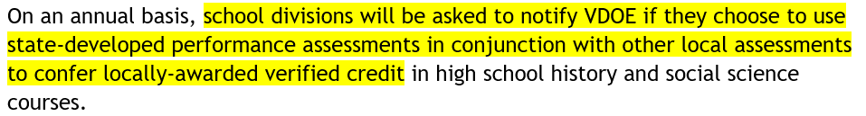
Annual Notification Requirement
All school divisions will submit an online survey to indicate how credit will be verified for students enrolled in each history/social science course eligible for verified credit during the applicable school year.
The DDOT/DDOT2 will be notified each year about the timeline for this requirement.

Slide 33
LAVC Plans for History and Social Science
Use the LAVC Plan for History and Social Science fillable form to document how the school division will meet the requirements each year in each course exercising this option.
The descriptions provided for each section of the form can assist with decision-making and planning ahead for future implementation of this option.
Maintain this annual plan locally.

Slide 34
Desk Reviews (Not Desk Audits)
Each spring, the Office of Student Assessment will select a sample of school divisions exercising this option for desk review.
The DDOT/DDOT2 will be notified via email regarding selection, the process and timeline for desk reviews, and the documents to be provided to VDOE.
VDOE staff will contact the DDOT/DDOT2 to schedule a virtual meeting with school division staff as part of the desk review process.
Notes:
Desk reviews are used to identify technical assistance needs as well as best practices that can be shared with other school divisions.

Slide 35
Questions

Slide 36
Contact Information (1 of 2)
Christonya Brown, History and Social Science Education Coordinator, Christonya.Brown@doe.virginia.gov
Andrea Emerson, History and Social Science Secondary Specialist, Andrea.Emerson@doe.virginia.gov
Brandi McCracken, History and Social Science Elementary Specialist, Brandi.McCracken@doe.virginia.gov

Slide 37
Contact Information (2 of 2)
Office of Student Assessment
student_assessment@doe.virginia.gov
(804) 225-2102
Holli Cook, Assessment Coordinator, Holli.Cook@doe.virginia.gov
Chris Tsitsera, Assessment Specialist, Chris.Tsitsera@doe.virginia.gov

