Slide 1
9-12 VDOE Virtual English SOL Institutes
October 2022
#ReadWriteVA

Slide 2
Agenda
Overview of 9-12 and 6-8 Virtual Sessions
Assessment Results Over Time
Essential Components of Literacy
Research and Evidence-Based Practices for Adolescent Literacy
How Do We Get Students to Work in Grade-Level Material?
Connecting Literacy and Postgraduate Opportunities
Upcoming Opportunities
VDOE Resources

Slide 3
9-12 Virtual English SOL Institutes
Tuesday, October 25th
4:00-4:55 PM: VDOE General Session
5:00-5:55 PM: Building Classroom Communities: Using Voices to Inspire Student Choice
6:00-6:55 PM: Using Communication and Multimodal Literacy Strands to Rebuild and Refresh Your Reading and Writing Communities
Thursday, October 27th
4:00-4:55 PM: Reading and Writing Like a Practitioner- Connecting English and History through Multimodal Presentations
5:00-5:55 PM: READ, RESEARCH, and REACT!
6:00-6:55 PM:Virginia Department of Education Instruction & Assessment

Slide 4
6-8 Virtual English SOL Institutes *Posted*
Tuesday, October 18th
4:00-4:55 PM: VDOE General Session
5:00-5:55 PM: Scientific Reading Research and Disciplinary Literacy at the Middle School Level
6:00-6:55 PM: Building a Word Conscious Classroom in Middle School: Assessment-driven word study and specific vocabulary instruction strategies
Thursday, October 20th
4:00-4:55 PM: Grammar Tools: Using Grammar Instruction to Help Students Read Like Writers and Write Like Readers
5:00-5:55 PM: Project-Based Learning: Access and Integrated Teaching for All
6:00-6:55 PM:Virginia Department of Education Instruction & Assessment

Slide 5
Assessment Results Over Time

Slide 6
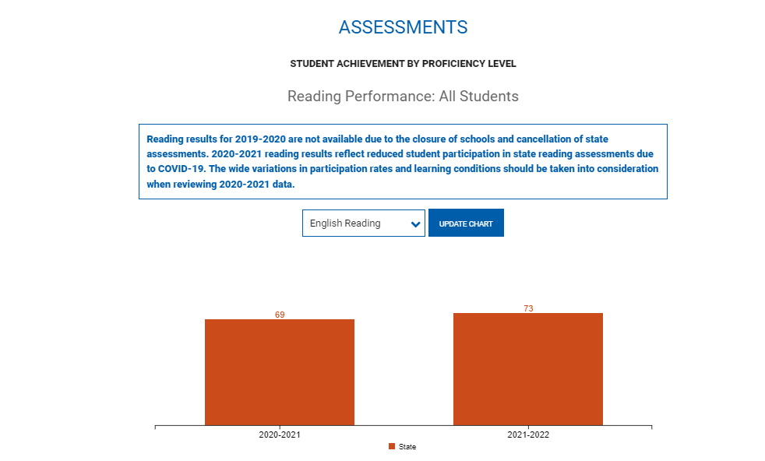
Virginia Department of Education School Quality Profiles

Slide 7
English Reading Performance
Grade Level | 2018-2019 | 2019-2020 | 2020-2021*+ | 2021-2022
Grade Three Reading | 71% | No Data Available | 61% | 68%
Grade Four Reading | 75% |  | 68% | 72%
Grade Five Reading | 78% |  | 66% | 72%
Grade Six Reading | 77% |  | 69% | 70%
Grade Seven Reading | 79% |  | 71% | 72%
Grade Eight Reading | 76% |  | 69% | 72%
End of Course Reading | 86% |  | 81% | 85%
*Pass rates reflect disruptions to instruction caused by the pandemic, decreased participation in state assessment programs, pandemic-related declines in enrollment, fewer retakes, and more flexible “opt-out” provisions for parents concerned about community spread of COVID-19.
+ 2017 English Standards of Learning assessed for the first time.

Slide 8
English Writing Performance
Grade Level | 2018-2019 | 2019-2020 | 2020-2021 | 2021-2022
Grade 8 Writing | 70% | No data available |  | 57%
End of Course Writing | 81% |  |  | 74%

Slide 9
Essential Components of Literacy

Slide 10

Comprehensive Literacy:
Successful English Instruction-Integrates the Strands
Vocabulary Development
Specific vocabulary from authentic text
Content vocabulary from math, science, and social studies
Reading
Both fiction & nonfiction text
Text-rich environment with variety of text and media
Student choice whenever possible
Writing
Writing as a process for a variety of authentic purposes
Regular writing conferences
Use of Writing Portfolios
Research
Ongoing and embedded in the learning process (when applicable)
Communication/Multimodal Literacies
Opportunities to communicate, collaborate and engage critically with peers and a variety of texts.

Slide 11
Essential Components of Literacy (1 of 4)
Commonalities in Reading Behaviors Across Text Types:
Even though there are substantial differences in reading behaviors for different text types, there are also great similarities. Regardless of the type of text, the reader must access the words in the text, recognize and use the structure of the text, make sense of sentences and paragraphs, and comprehend what has been read. Equally, vocabulary is a critical element in comprehending any kind of text.
READING FRAMEWORK FOR THE 2019 NATIONAL ASSESSMENT OF EDUCATIONAL PROGRESS

Slide 12
Essential Components of Literacy (2 of 4)
The association between vocabulary knowledge and comprehension is strong; students who know the meanings of many words and who also can use the context of what they read to figure out the meanings of unfamiliar words are better comprehenders than those who lack these attributes (National Reading Panel 2000a).
READING FRAMEWORK FOR THE 2019 NATIONAL ASSESSMENT OF EDUCATIONAL PROGRESS

Slide 13
Essential Components of Literacy (3 of 4)
Writing is essential to productivity and to personal and social advancement. Corporations in almost all industries and services report that a significant majority of salaried employees—80 percent or more—have some responsibility for writing in their professions.
In K-12 education, good writing instruction empowers students to acquire new knowledge and to develop critical thinking skills.
Writing Framework for the 2017 National Assessment of Educational Progress (NAEP)

Slide 14
Essential Components of Literacy (4 of 4)
The increasing frequency of computer-based writing outside of school or the workplace (for example, emails, instant messaging, blogs) will undoubtedly expand the variety of writing situations in the future to include many new purposes and audiences. Future trends in writing instruction must take into account how computers affect both the writing process and the types of text produced.
Writing Framework for the 2017 National Assessment of Educational Progress (NAEP)

Slide 15
Research and Evidence-Based Practices
Adolescent Literacy

Slide 16
What Research Says (1 of 3)
Adolescent Literacy Instruction
1.Incorporation of Disciplinary Literacy Instruction
2.Integration of Multiple and Social Literacies
3.Orchestration of Engagement and Motivation
4.Appreciation of Multicultural Perspectives and Cultures
A Call to Action: What We Know About Adolescent Literacy Instruction. (2018, July 17). Retrieved January 8, 2020, from https://ncte.org/statement/adolescentliteracy/.

Slide 17
What Research Says (2 of 3)
Adolescent Literacy Instruction:
Practice thinking critically about how they engage with texts to include
application of metacognitive strategies.
recognition of bias and high-quality sources.
argumentation with evidence.
Critical examination of texts that helps them to
recognize the purpose of text structure and how the writer uses it to create effect
infer beyond literal interpretations
question and investigate various social, political, and historical context.
understand multiple meanings and richness of texts and layers of complexity
A Call to Action: What We Know About Adolescent Literacy Instruction. (2018, July 17). Retrieved January 8, 2020, from https://ncte.org/statement/adolescentliteracy/.

Slide 18
What Research Says (3 of 3)
Adolescent Literacy Instruction:
Assessment that helps them to focus on
the larger purpose and big ideas of the curriculum, and on metacognitive strategies for thinking during literacy acts (Smith, 1991; Darling-Hammond & Falk, 1997; Langer, 2000).
preparation for assessment (from ongoing classroom measures to high-stakes tests) that should focus on the critical components of multicultural perspectives, motivation, multiple and social literacies, and shifting literacy demands.
Choice and volume of reading
Opportunities to read often from books of their own choosing
Access to a vast library of books and texts that vary in levels and text structures (Miller, 2009)
Dedicated time to read every day (Allington, 2009)
A Call to Action: What We Know About Adolescent Literacy Instruction. (2018, July 17). Retrieved January 8, 2020, from https://ncte.org/statement/adolescentliteracy/.

Slide 19
What does Evidence-Based Mean?
Definition:
An intervention, tool, or practice that meets one of the four evidence levels in the federal Elementary and Secondary Education Act, as amended by ESSA (strong, moderate, promising, or demonstrates a rationale).
National Center on Improving Literacy (2018). What do we mean by evidence-based?. Washington, DC: U.S. Department of Education, Office of Elementary and Secondary Education, Office of Special Education Programs, National Center on Improving Literacy. Retrieved from http://improvingliteracy.org.

Slide 20
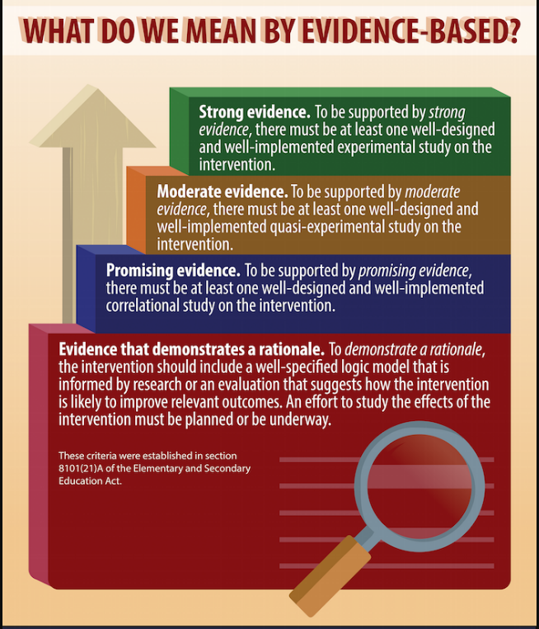
Evidence-Based Instruction
National Center on Improving Literacy (2018). What do we mean by evidence-based?. Washington, DC: U.S. Department of Education, Office of Elementary and Secondary Education, Office of Special Education Programs, National Center on Improving Literacy. Retrieved from http://improvingliteracy.org.

Slide 21
Evidence-Based Practices: Integrate Reading and Writing

Slide 22
“Students spend more time reading than writing, so they are more familiar with the skills required to read. Showing them the connection between reading and writing can help them transfer their reading skills to writing and vice versa.”
Institute of Education Sciences: Teaching Secondary Students to Write Effectively

Slide 23
Quote
“Combining reading and writing together in an activity or assignment helps students learn about important text features.
For example, asking students to summarize a text they just read signals that well-written texts have a set of main points, that students should understand main points while they read, and that when students write certain types of compositions they should focus on main points”
Institute of Education Sciences: Teaching Secondary Students to Write Effectively

Slide 24
Evidence-Based Practices for Additional Support in Instruction

Slide 25
“Evidenced-based reading practices are critical for all learners, including English learners and students with disabilities”
CCSSO (2021). A Nation of Readers: How State Chiefs Can Help Every Child Learn To Read. Retrieved from: https://753a0706.flowpaper.com/CCSSOReadingResource/#page=1

Slide 26
What Research Says and Evidence Shows
“In order to move students through grade-level content, schools will need to lean heavily on tiered strategies that include broad-based supports for all students and intensive intervention for students who have felt the pandemic’s impacts most directly”
Ed Research for Recovery (June, 2020)

Slide 27
Evidence-Based Practices for Interventions
Focus on practices to improve students’ ability to read words accurately and automatically
Focus on practices for helping students to understand the text they read
Providing Reading Interventions for Students in Grades 4–9. (2022). Institute of Education Sciences. Retrieved from https://ies.ed.gov/ncee/wwc/Docs/PracticeGuide/WWC-practice-guide-reading-intervention-full-text.pdf.

Slide 28
How Do We Get Our Students to Work in Grade-Level Material?

Slide 29
“The solution is not to "teach again" the material that students haven't learned. Instead, look forward to what those students will need to know to succeed the next day or the next week and focusing solely on those skills—a strategy known as acceleration”
David Steiner, Johns Hopkins University, 2021

Slide 30
What Research Says (1 of 3)
“Accelerating access to grade-level work—with the right supports—is the best way to help students catch up when they’ve fallen behind.”
“Unlock acceleration by operating as if many of your students, especially students in historically and systemically marginalized groups, are not getting enough chances to do high-quality, grade-level work—and set a clear goal to change that.”
TNTP: Unlocking Acceleration (August 2022)

Slide 31
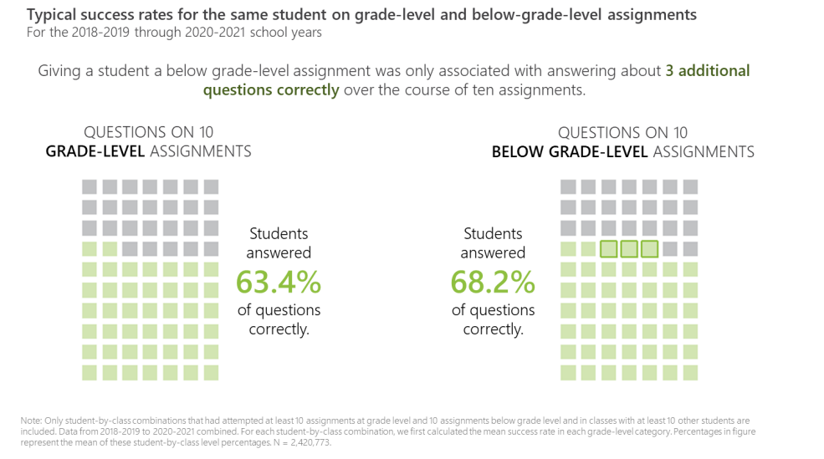
What Research Says (2 of 3)
“Assigning students work below their grade level mainly just denies them important opportunities to engage with material they could master if given the chance”
TNTP: Unlocking Acceleration (August 2022)

Slide 32
What Research Says (3 of 3)
“To make up for what’s been lost, we need to focus on acceleration, not remediation. That means devoting the bulk of classroom time to challenging instruction at grade-level or higher, and giving all students access to a rich, high-quality curriculum in English language arts, mathematics, social studies, science, the arts, and more”
The Acceleration Imperative: A Plan to Address Elementary Students’ Unfinished Learning in the Wake of Covid-19 (2021)

Slide 33
English Standards of Learning Spiral
K.8c Use pictures to make predictions
1.9 d and 2.7a Make and Confirm Predictions
3.5c Make, Confirm and Revise Predictions
4.5h Draw conclusions/Make inferences about the text using text as support
6.5f Draw conclusions and make inferences using the text for support.
8.5e Make inferences and draw conclusions based on explicit and implied information using references to the text for support.
10.5f Draw conclusions and make inferences on explicit and implied information, using textual support as evidence.
12.4h Use critical thinking to generate and respond logically to literal, inferential, and evaluative questions about the text(s).

Slide 34
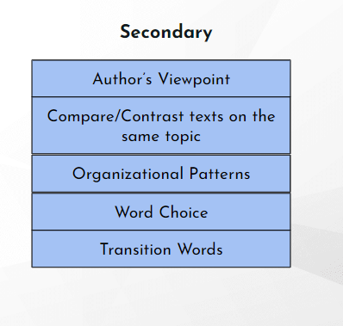

Literacy Skills Stack (Secondary)
Vertical Progression of Skills

Slide 35
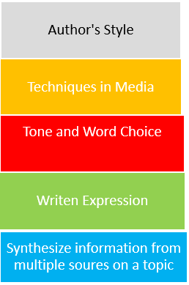
Literacy Skills Work Together (Secondary)

Slide 36
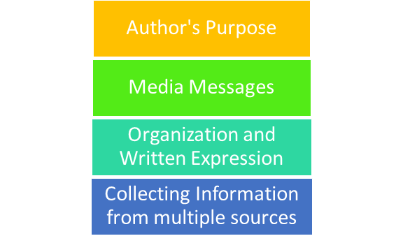
Literacy Strands Work Together
Strand Integration
VDOE Utilizing Data To Maximize Instruction Webinar 2021-2022

Slide 37
Scaffolding Complex Text
•Support vocabulary
•Use deliberate annotation
•Use questions as planned scaffolds
•Allow time for reflection and discussion
Provide opportunities for independent reading
Access to grade level text

Slide 38
Evidence-based Practices
1. Begin lessons with short reviews of previous learning.
2. Present new material in small amounts; assist students as they practice the material.
3. Ask many questions and observe student responses; questions allow students to connect new material to prior learning.
4. Provide models such as step-by-step demonstrations or think alouds to work out the problem.
5. Guide student practice by asking good questions and providing feedback.
6. Check that students understand the material; doing so can help students learn with fewer errors.
7. Obtain a high success rate (~80%) through teaching in small steps, guiding practice, and employing mastery learning techniques.
8. Provide scaffolds, or temporary supports, for difficult material.
9. Prepare students for and monitor independent practice; ample independent practice is necessary for skills and knowledge to become automatic.
10. Engage students in weekly and monthly reviews of past material.
Institute of Educational Sciences: Evidence-based Teaching Practices Infographic

Slide 39
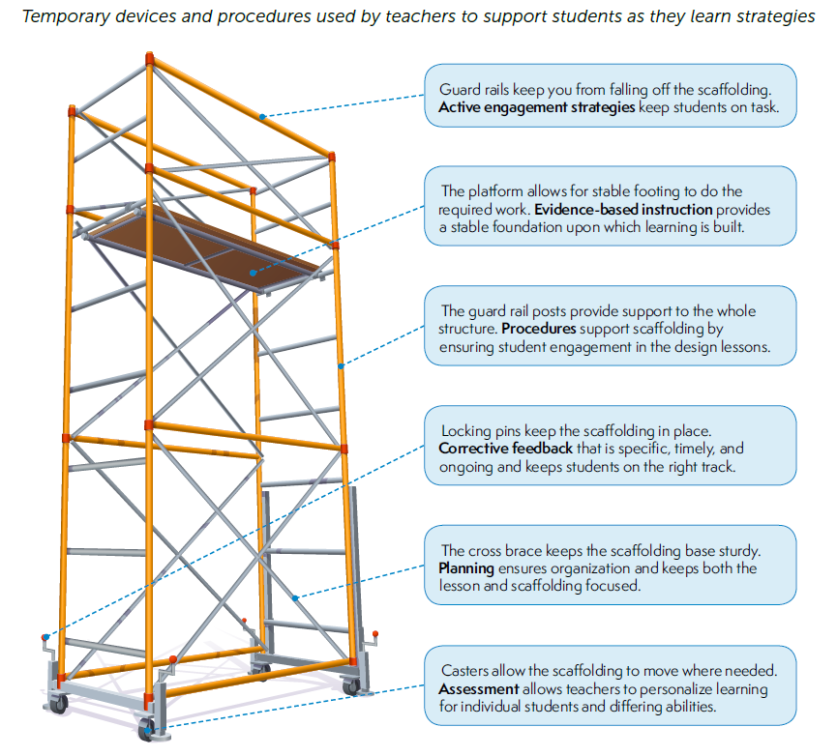
Scaffolding
Institute of Educational Sciences: Evidence-based Teaching Practices Infographic

Slide 40
Evidence-based Practices in Literacy Instruction (1 of 2)
Evidence-based Practices | Literacy Connections & Instructional Focus
Reviews of previous learning (weekly, monthly, opening) Connect new material to prior learning Present new material in small amounts Assist students as they practice the material Think alouds Asking good questions Providing feedback Check that students understand the material Teach in small steps Provide scaffolds Provide model Guide practice Provide independent practice | Explicit, Systematic Direct Instruction Gradual Release (I do, We do, You do) Small group differentiated instruction Conferences Whole group learning | Intentional Focus on: Writing about what was read Explicit vocabulary instruction Academic Vocabulary Before, During, & After Reading Strategies: summarizing self-questioning story structure instruction graphic and semantic organizers comprehension monitoring Engaging students in grade level text Discussion-oriented strategies Collaborative Strategic Reading Integrating strands of English Standards Communication & Multimodal Literacies Reading Writing Research
Collaboration for Effective Educator, Development, Accountability, and Reform Center Evidence-based Reading Instruction for Adolescence, Grades 6-12

Slide 41
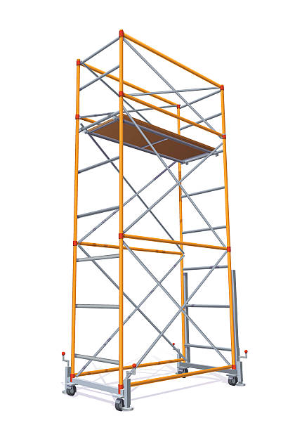
Evidence-based Practices in Literacy Instruction (2 of 2)
Chunking text, read alouds as models
Discussion
Small group
Students are engaged
Explicit expectations while reading
Direct Instruction
Students have a purpose for
learning
Gradual Release (I do, We do, You do)
Small group differentiated instruction
Whole group discussion
Students know what to
expect
Conferences and written feedback
Students show what they
understand and where they need support
Consider the level of rigor in skills of the standards when designing, selecting tasks and activities or learning experiences
Students practice grade-level
skills using appropriate texts
Use formative data to gauge student understanding and inform pacing
Track learning progression, diagnose, go back
Students focus on skills that
they need to strengthen
Institute of Educational Sciences: Evidence-based Teaching Practices Infographic
Adapted from Achieve the Core

Slide 42
What Research Shows
Routines that create cohesion across learning environments-
Reading Grade Level Text
  Teach students how to comprehend complex texts
  Teach students to monitor and adjust how they are reading and notice when comprehension breaks down
Responding to Text
  Teach students to think while reading, asking themselves questions, annotating text, paraphrasing chunks of text
  Provide opportunities for students to respond to text using various modalities
Foundational Skills Work
  Include word study
  Teach vocabulary and provide repeated exposures in multiple contexts
  Work on fluency by having student read a wide range of texts multiple times as a class, with a partner, independently
  Utilize before, during, and after reading strategies
https://ccsso.org/blog/ccsso-releases-restart-recovery-considerations-teaching-learning
Collaboration for Effective Educator, Development, Accountability, and Reform Center Evidence-based Reading Instruction for Adolescence, Grades 6-12

Slide 43
Food for Thought
“It’s not always the text; it’s what you do with it.”
~Jennifer Serravallo

Slide 44
Connecting Literacy
and
Postgraduate Opportunities

Slide 45
What Evidence Shows
Programs and curricula targeted at increasing the relevance of school, building supportive relationships, and helping students manage challenges can help prevent disengagement.
United States Department of Education. (2017). Preventing Dropout in Secondary Schools. Institute of Education Sciences. https://ies.ed.gov/ncee/wwc/Docs/PracticeGuide/wwc_dropout_092617.pdf

Slide 46
Evidence-based Practices to Support Instruction (1 of 4)
Directly connect schoolwork to students’ options after high school:
Make classes relevant by offering curricula and academic programs that are clearly connected to a career or postsecondary education
Integrating career education and college-focused lessons into core academic classes is one strategy for helping students see how work in academic classes matters for life after high school
United States Department of Education. (2017). Preventing Dropout in Secondary Schools. Institute of Education Sciences. https://ies.ed.gov/ncee/wwc/Docs/PracticeGuide/wwc_dropout_092617.pdf

Slide 47
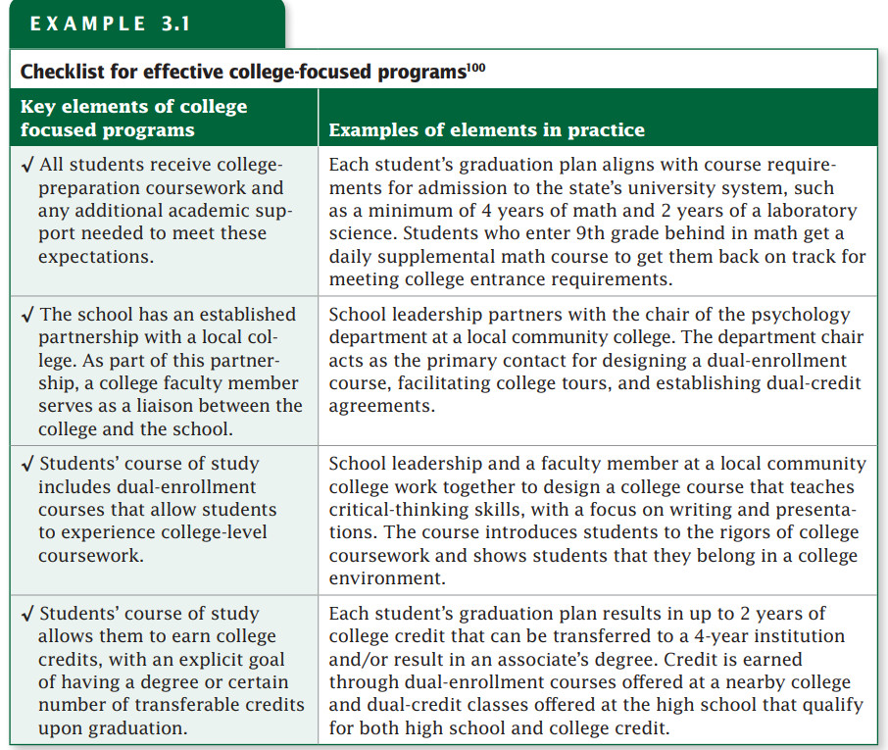
Evidence-based Practices to Support Instruction (2 of 4)
United States Department of Education. (2017). Preventing Dropout in Secondary Schools. Institute of Education Sciences. https://ies.ed.gov/ncee/wwc/Docs/PracticeGuide/wwc_dropout_092617.pdf

Slide 48
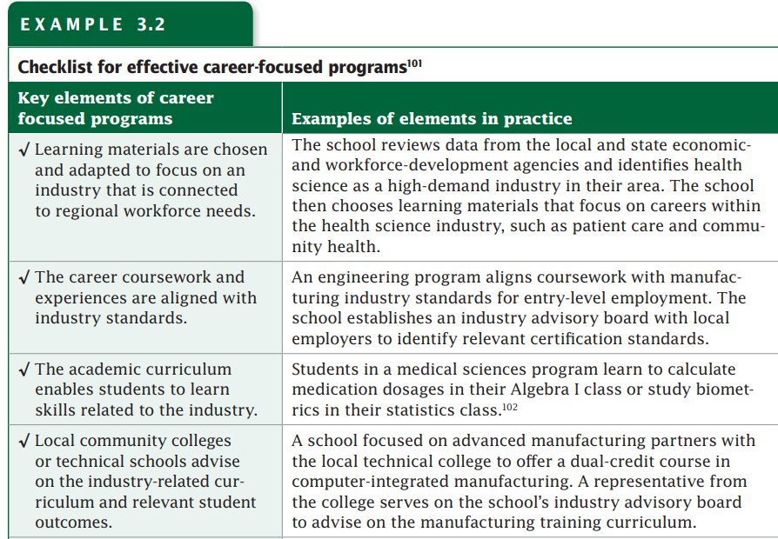
Evidence-based Practices to Support Instruction (3 of 4)
United States Department of Education. (2017). Preventing Dropout in Secondary Schools. Institute of Education Sciences. https://ies.ed.gov/ncee/wwc/Docs/PracticeGuide/wwc_dropout_092617.pdf

Slide 49

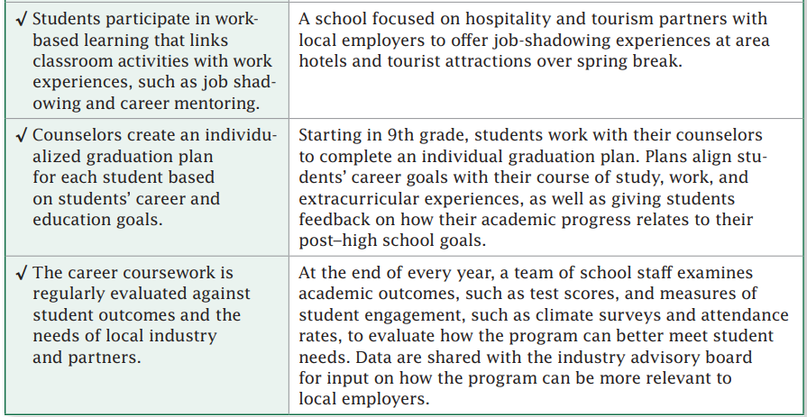
Evidence-based Practices to Support Instruction (4 of 4)
United States Department of Education. (2017). Preventing Dropout in Secondary Schools. Institute of Education Sciences. https://ies.ed.gov/ncee/wwc/Docs/PracticeGuide/wwc_dropout_092617.pdf

Slide 50
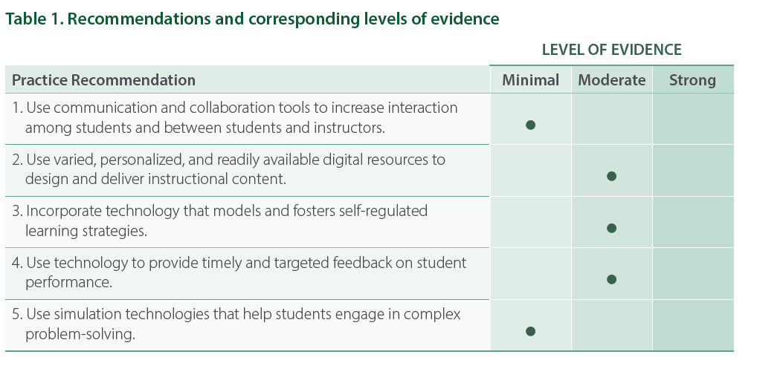
Using Technology to Support Postsecondary Student Learning (1 of 4)
IES Practice Guide: Using Technology to Support Postsecondary Student Learning

Slide 51
Using Technology to Support Postsecondary Student Learning (2 of 4)
Recommendation One: Use communication and collaboration tools to increase interaction among students and between students and instructors.
Select tools that will best support learning objectives
Articulate expectations for when and how the tools should be used
Recommendation Two: Use varied, personalized, and readily available digital resources to design and deliver instructional content.
Plan instruction so that course content is carefully packaged and sequenced, and use technology to scaffold students’ acquisition and application of the content.
Monitor and evaluate the effectiveness of course formats and use of multimedia to deliver content.
IES Practice Guide: Using Technology to Support Postsecondary Student Learning

Slide 52
Using Technology to Support Postsecondary Student Learning (3 of 4)
Recommendation Three: Incorporate technology that models and fosters self-regulated learning strategies.
Select tools and technologies that serve as scaffolds to help students apply self regulated learning strategies.
Model how to use self-regulated learning strategies, and provide students with opportunities to practice self-regulated learning strategies using technology.
Recommendation Four: Use technology to provide timely and targeted feedback on student performance.
Determine the course segments or content for which students would benefit most from timely and targeted feedback.
Strategically incorporate feedback technologies into the course.
Use data to inform instruction, and to help students guide their learning.
IES Practice Guide: Using Technology to Support Postsecondary Student Learning

Slide 53
Using Technology to Support Postsecondary Student Learning (4 of 4)
Recommendation Five: Use simulation technologies that help students engage in complex problem-solving.
Establish the learning objectives first, and then select an activity with the right level of complexity.
Lead students in reflective discussion to help them evaluate their own learning.
IES Practice Guide: Using Technology to Support Postsecondary Student Learning

Slide 54
Virginia Workplace Readiness Skills
& English Standards of Learning
Virginia ELA Standards
Analyze the purpose of information and persuasive techniques used in diverse media formats.
Evaluate the motives (e.g., social, commercial, political) behind media presentation(s).
Use critical thinking to generate and respond logically to literal, inferential, and evaluative questions about the text(s).
Evaluate clarity and accuracy of information.
Analyze, organize, and synthesize information to solve problems, answer questions, complete a task, or create a product.
Identify and synthesize resources to make decisions, complete tasks, and solve specific problems.
Write and revise to a standard acceptable both in the workplace and in postsecondary education.
Write to clearly describe personal qualifications for potential occupational or educational opportunities
Work Ready Standards
READING AND WRITING: Reads and interprets workplace documents and writes effectively
LISTENING AND SPEAKING: Listens attentively and asks questions to clarify meaning; articulates ideas clearly in a manner appropriate for the setting and audience
INFORMATION LITERACY: Locates information efficiently, evaluates the credibility and relevance of sources and facts, and uses information effectively to accomplish work-related tasks
CRITICAL THINKING AND PROBLEM-SOLVING: Uses sound reasoning to analyze problems, evaluate potential solutions, and implement effective courses of action
21st Century Workplace Readiness Skills for the Commonwealth

Slide 55
Upcoming Opportunities

Slide 56
November Learning Labs
For participants interested in workshopping and applying ideas presented at the virtual institutes, three in-person K-12 English SOL Learning Labs will be offered around the state. Educators will attend one full-day learning lab facilitated by presenters from the virtual English SOL Institutes. These full-day sessions will allow for teachers to connect within grade-band groups to workshop ideas presented at the institutes, examine student work samples, dialogue with educators from around the Commonwealth, and plan next steps for instruction based on the virtual session topics.
● Fredericksburg Learning Lab: Monday, November 7, 2022
● Newport News Learning Lab: Wednesday, November 9, 2022
● Roanoke Learning Lab: Thursday, November 17, 2022

Slide 57

Virginia State Literacy Association Conference
Call for Proposals

Slide 58
Additional VDOE Resources

Slide 59
VDOE Resources
VDOE English Comprehensive Instructional Plans
VDOE Webinar: Utilizing Data to Maximize Literacy Instruction in the 2021-2022 Academic Year
2021 VDOE K-12 SOL Conferences In English Language Arts
2022 VDOE K-12 Virtual SOL English Institutes
VDOE English Comprehensive Literacy Webinars
VDOE Professional Development on Demand

Slide 60

Stay Connected!
Jill Nogueras
K-12 English Coordinator
Jill.Nogueras@doe.virginia.gov
Carmen Kurek
Elementary English/Reading Specialist
Carmen.Kurek@doe.virginia.gov
Colleen Cassada
Middle School English Specialist
Colleen.Cassada@doe.Virginia.gov
Assessment Office
Student_Assessment@doe.virginia.gov

Slide 61
References
Hougen, M. (2014). Evidence-based reading instruction for adolescents, grades 6-12 (Document No. IC-13). Retrieved from University of Florida, Collaboration for Effective Educator, Development, Accountability, and Reform Center website:http://ceedar.education.ufl.edu/tools/innovation-configurations/
Meyers, A. (2021). To catch students up, don’t remediate. accelerate. Johns Hopkins University Magazine. Retrieved August 28, 2021, from https://hub.jhu.edu/2021/05/06/accelerate-learning-to-bridge-covid-19-education-gaps/.
Rosenshine, B. (2012). Principles of instruction: Research-based strategies that all teachers should know. American Educator, 36(1), 12-39. Retrieved from https://www.aft.org/sites/default/files/ periodicals/Rosenshine.pdf
Council of Chief State School Officers (2021). A Nation of Readers: How State Chiefs Can Help Every Child Learn To Read. Retrieved from: https://753a0706.flowpaper.com/CCSSOReadingResource/#page=1
The New Teacher Project. (2022, August 9). Unlocking acceleration: how below grade-level work Is holding students back in literacy. Retrieved September 2, 2022, from https://tntp.org/assets/documents/Unlocking_Acceleration_8.16.22.pdf T
Dabbagh, N., Bass, R., Bishop, M., Costelloe, S., Cummings, K., Freeman, B., Frye, M., Picciano, A. G., Porowski, A., Sparrow, J., & Wilson, S. J. (2019). Using technology to support postsecondary student learning: A practice guide for college and university administrators, advisors, and faculty. Washington, DC: Institute of Education Sciences, What Works Clearinghouse. (WWC 20090001) Washington, DC: National Center for Education Evaluation and Regional Assistance (NCEE), Institute of Education Sciences, U.S. Department of Education. https://whatworks.ed.gov.

Slide 62
Disclaimer
Reference within this presentation to any specific commercial or non-commercial product, process, or service by trade name, trademark, manufacturer or otherwise does not constitute or imply an endorsement, recommendation, or favoring by the Virginia Department of Education.

