Slide 1
Office of Student Assessment Updates
2022 K-12 SOL Institutes in English
Language Arts: Grades 9-12 Session
October 27, 2022

Slide 2
Topics
Resources for Teachers
Virginia’s Parent Portal and Student Detail by Question (SDBQ) Reports
Spring 2023 - New Item Type Field Testing

Slide 3
Assessment Supports Literacy Webinars
The Assessment Supports Literacy Webinar Series provided in 2020-2021 suggests a planning process that may be used for reading and literacy instruction.
This series provided a recorded presentation for each grade level which can then be scaffolded and expanded across grade bands.
Information in this series included different ways skills and content may be assessed on state tests and how assessment items may be worded.

Slide 4
Using Assessment Data:
Recordings for Teachers
Recorded presentations related to Standards of Learning tests are provided to assist teachers.
Using Standards of Learning Assessment Data to Inform Instruction in Reading
Using the Student Detail by Question Extract File for Teachers
The methodology modeled in these presentations can be applied to data from Reading and Writing SOL tests to plan for small group or individualized remediation or intervention.

Slide 5
Virginia’s Parent Portal and Student Detail by Question (SDBQ) Reports

Slide 6
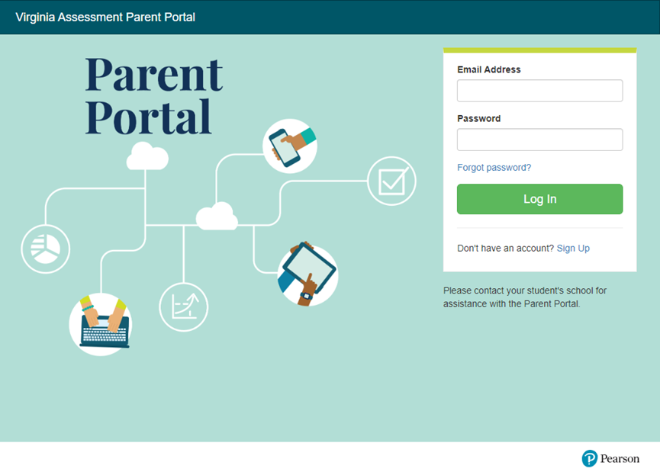
Virginia Assessment Parent Portal

Slide 7
What Is the Parent Portal? (1 of 2)
The Parent Portal is a web-based system that allows parents to access their child’s grades 3-8 reading and mathematics growth assessment and SOL assessment data.
Beginning in Spring 2023, all Non-Writing SOL tests, to include End of Course, will be included in the Parent Portal.
Parents must create an account in the parent portal. Then, using specific student information provided by the school/division, parents can view their child’s assessment data.

Slide 8
What Is the Parent Portal? (2 of 2)
Parents will be able to access their child’s SDBQ Report, and most families will be able to review a personalized video that explains parts of their child’s SDBQ Report.
Parents are encouraged to work with their child’s teacher(s) to further understand what the SDBQ Report indicates about their child’s performance and to discuss strategies to assist their child.

Slide 9
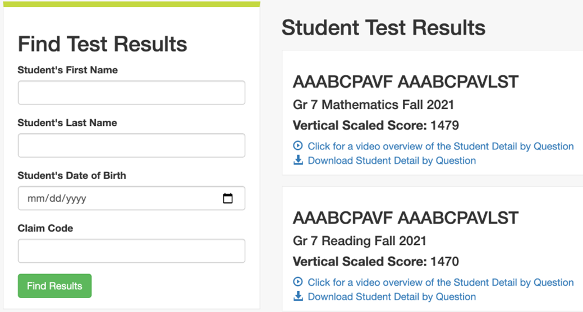
Parent Portal After Claiming a Student
Tests are listed chronologically from most recent to oldest test completed, by test administration.
Student Test Results include:
Student Name
Name of the test
Overall test scaled score
Performance Level
A video explaining the SDBQ Report
Access to the SDBQ Report

Slide 10
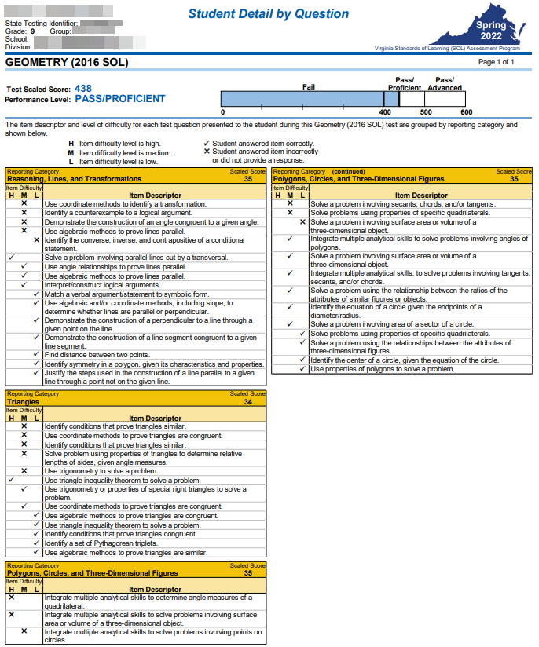
Spring SOL SDBQ Report
This SDBQ Report as it will appear for End of Course SOL tests.
Test Scaled Score, Performance Level, and performance bar graph are displayed.
The report will be broken down by reporting category, then by level of difficulty by items answered incorrectly, then correctly.

Slide 11
Resources to Support Parents
A Virginia Parent & Caregiver Resource Page has been developed to provide:
information about grades 3-8 reading and mathematics growth assessments and SOL tests.
appropriate resources for parents to use when assisting their child in reading and/or mathematics.
As the remaining grades 3-8 Non-Writing SOL tests and EOC SOL tests are added to the Parent Portal, additional resources will be added to this page to support those assessments.
This page may be accessed at: tinyurl.com/VAparentpage

Slide 12
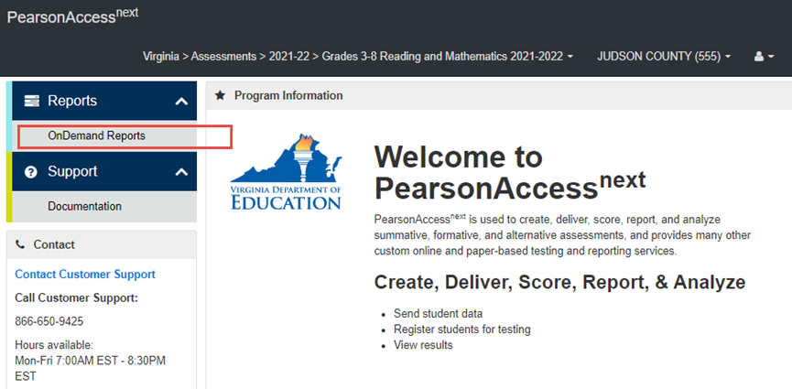
Teacher Access in PearsonAccess^{next}
Teachers who have been given access to student data through Reporting Groups in PearsonAccess^{next} can find the SDBQ Extract in OnDemand Reports.

Slide 13
What are Reporting Groups
A reporting group is a group of students assigned to one or more specified teachers. A reporting group is created to allow specified teacher(s) access to student-level data for students in that reporting group.
Teachers can be assigned students they are instructing in 2022-2023.
Reporting groups will be available in Spring 2023 for all non-writing SOL tests.
This functionality may be utilized for other staff members (counselors, tutors, coaches) with a need to access student level data.
The use of reporting groups is optional.

Slide 14
The Value of Reporting Groups
Provides teachers with access to Student Detail By Question (SDBQ) data in both report and extract file formats
Removes the burden of providing data to teachers from the School Test Coordinator, data coach, building administrator, etc
Increases the amount of time that teachers will have to work with SDBQ data since they can access it themselves
Offers opportunities for teachers to analyze and use student growth assessment data as they are planning for instruction throughout the year
Provides ownership of the data for teachers that exceeds handing them paper copies of students’ results

Slide 15
OnDemand Reports Available for the Teacher – Student Report Viewer Role
The following OnDemand Reports will be available for the Teacher – Student Report Viewer role:
Student Detail By Question (SDBQ) Report (available as a PDF)
Student Detail By Question Extract (available as an Excel file)
This report and data file have size limitations:
SDBQ Report limit is 1,500 records
SDBQ Extract limit is 20,000 test records
The Teacher - Student Report Viewer Role will not have access to any Published Reports.

Slide 16
Spring 2023 Field Testing
New Integrated Reading and Writing Assessment Item Type

Slide 17
Testing Memo No. 1548 (1 of 2)
Testing Memo No. 1548 (September 26, 2022) notifies school divisions of resources to assist school divisions in preparation for the spring 2023 statewide field test of the new integrated reading and writing assessment item type for grade 5, grade 8, and end of course (EOC).
Resources are provided at the bottom of the Standards of Learning (SOL) Practice Items page and toward the middle of the English SOL page on the Virginia Department of Education website.

Slide 18
Testing Memo No. 1548 (2 of 2)
The field test will occur during the school division’s Spring 2023 Writing Test Administration window. This window precedes the Spring 2023 Non-Writing Test Administration window that will include the administration of Reading SOL Tests.

Slide 19
Field Test Participation
Students who will take the EOC Reading SOL Test in spring 2023 will participate in the field test.
Students who completed the EOC Reading SOL Test in fall 2022 are not expected to participate in the field test.

Slide 20
Practice Item Sets
Two practice sets are available for each grade level field testing the new integrated reading and writing item type (5, 8, and EOC).
Each practice set contains multiple-choice items, technology-enhanced items (TEI), and a writing prompt.
The same passage is used with each practice item set for each of the three grade levels.

Slide 21
Checklists for Writers
A Checklist for Writers is available for each of the three grade levels.
The Checklist for Writers will be provided as an Exhibit in the online test delivery system on the item that presents a writing prompt based on the accompanying nonfiction passage.

Slide 22
Rubrics for Instruction and for Scoring
Two distinct rubrics are available for each grade level (5, 8, EOC):
The instructional rubrics are aligned to the 2017 English Standards of Learning and provide more detail within each domain. These are for use in the classroom, especially when focusing on specific features of student writing.
The scoring rubrics are aligned to the 2017 English Standards of Learning and will be used to score the response to the field-test item that presents a prompt or “invitation to write.”

Slide 23
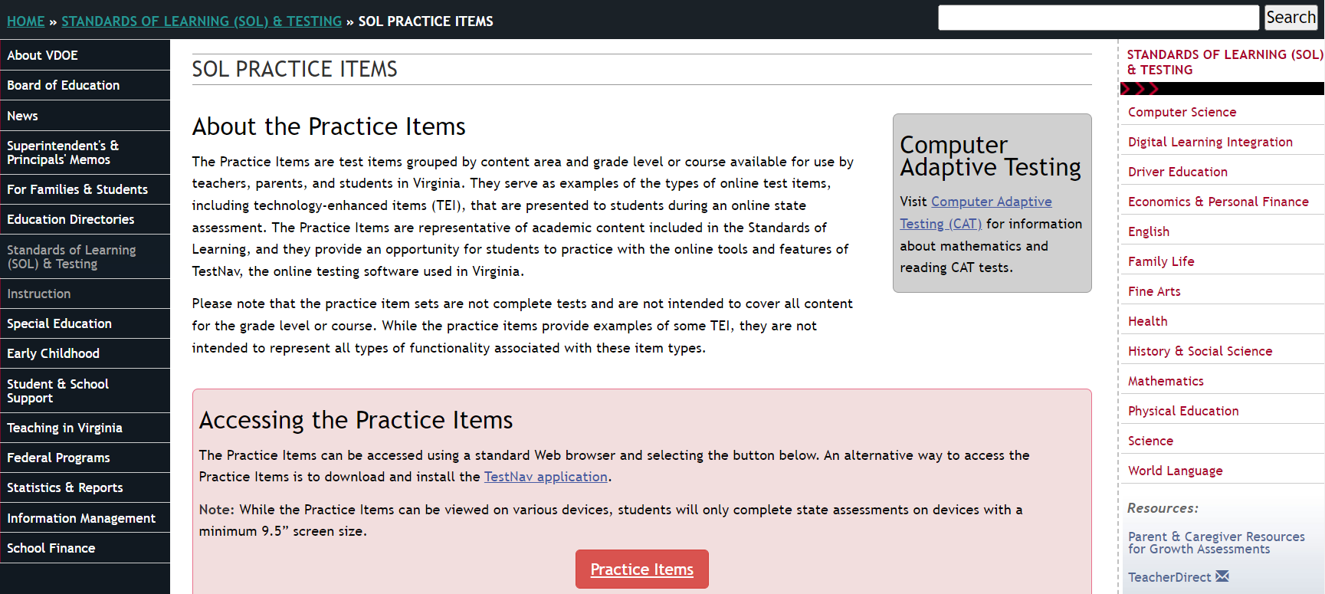
Practice Item Sets (1 of 3)

Slide 24
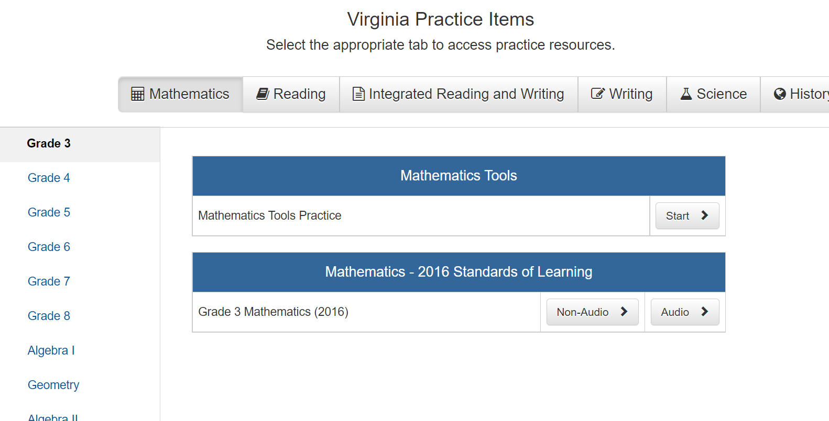
Practice Item Sets (2 of 3)

Slide 25
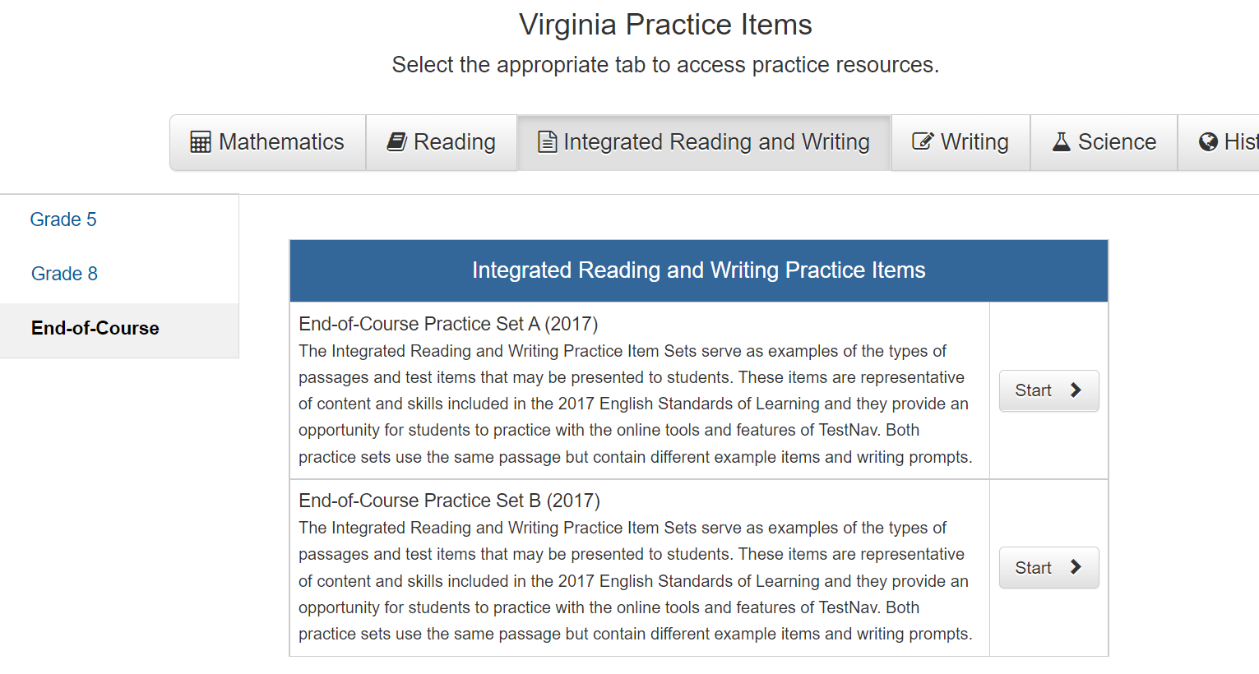
Practice Item Sets (3 of 3)

Slide 26
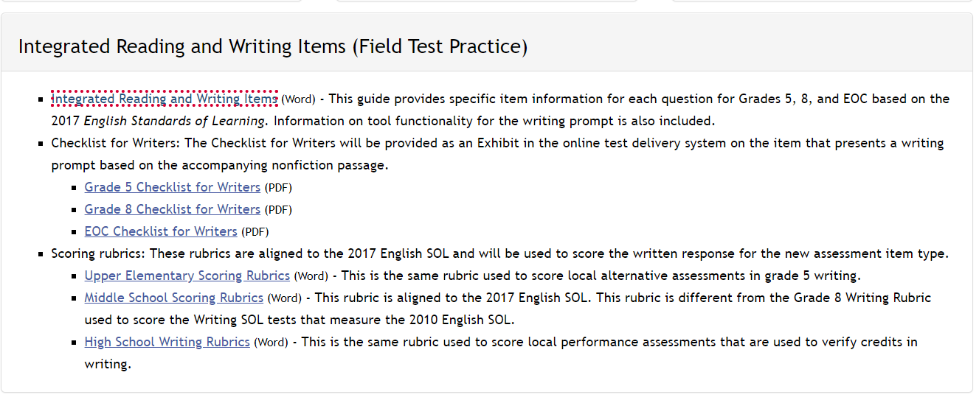
Practice Item Suggestions

Slide 27
EOC Writing SOL Assessments
What does the new integrated reading and writing item type mean for the future of the EOC Writing SOL assessments and/or local performance assessments used to verify credits in writing?
Currently, either of these options is available for verifying the writing credit needed for graduation
Additionally, divisions may elect to use substitute tests approved by the Board for verifying credit in writing.
Changes to any of these options or requirements would require action by the Board or Virginia General Assembly.

Slide 28
EOC Writing in 2022-2023
The EOC Writing SOL tests that will be administered in 2022-2023 are aligned to the 2010 English SOL.
The EOC Writing Scoring Rubrics in the EOC section in Understand Scoring are used to score responses to the short-paper component of this test.
The High School Writing Rubrics aligned to the 2017 English SOL will be used to score responses to the field-test item that presents a prompt. (No scores are provided on field-test items being tried out with students.)
These rubrics and associated training are provided in the Local HS section in Understand Scoring.

Slide 29
Understand Scoring (1 of 3)
Understand Scoring provides information about the SOL writing assessments and local performance assessments used to verify credits in writing, including the rubrics and anchor papers that illustrate each score point on the composing/written expression and usage/mechanics domains used in scoring.

Slide 30
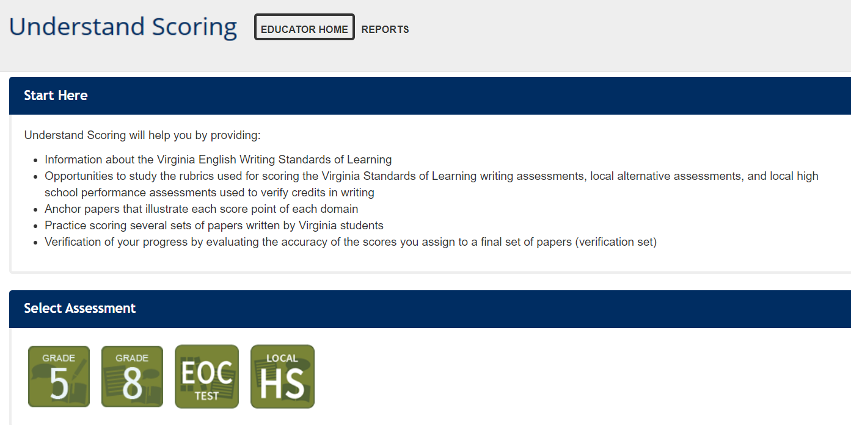
Understand Scoring (2of 3)

Slide 31
Understand Scoring (3 of 3)
Understand Scoring provides information about the SOL writing assessments and local performance assessments used to verify credits in writing, including the rubrics and anchor papers that illustrate each score point on the composing/written expression and usage/mechanics domains used in scoring.
Grade 5: training for scoring local alternative assessments (2017 English Standards of Learning)
Grade 8: training for scoring when preparing for the Grade 8 Writing SOL test (2010 English Standards of Learning)
EOC: training for scoring when preparing for the EOC Writing SOL test (2010 English Standards of Learning)
Local HS: training for scoring local performance assessments to verify credits in writing (2017 English Standards of Learning)

Slide 32
Coming Soon
Additional information about the integrated reading and writing field test and resources will be shared in a future webinar.
Registration information for this future webinar will be provided to Division Directors of Testing and division-level English Language Arts instructional leaders.

Slide 33
Questions
If you have questions about the SOL Assessments, SDBQ reports, the Parent Portal, Understand Scoring, or using local performance assessments to verify credits in writing, please contact the Office of Student Assessment:
Student_Assessment@doe.virginia.gov

