Slide 1
Reading and Writing Like a Practitioner- Connecting English and History through Multimodal Presentations
Elizabeth Knight- History Teacher/ Department Chair
eknight@nelson.k12.va.us
@EknightG
Jennifer Campbell- Secondary Literacy Specialist
jennifercampbell@nelson.k12.va.us
@campbellNCHS

Slide 2
Overview and Learning Target:
I can encourage students to engage in cross curricular learning in history through reading, writing and multimodal presentations in order to broaden their lenses and deepen their understanding of literacy through authentic, real- world connections.

Slide 3
Today’s Agenda
Our agenda for today has been created to help English teachers see how history and English work closely together as a gateway to personal engagement with multiple, cross-curricular texts. This will aid them in their pursuit of both history and literary truth and allow them to produce multimodal presentations as a way of showcasing their understanding of the past, the present, and the future.
We will look at:
How to Access Content Vocabulary
Using Paired Sources
How to use Different Modalities

Slide 4
Research and Evidence Based Practices for Adolescent Literacy (1 of 3)
Adolescent Literacy Instruction:
Incorporates Disciplinary Literacy Instruction
Integrates Multiple and Social Literacies
Has Orchestration of Engagement and Motivation
Shows Appreciation of Multicultural Perspectives and Cultures
Practices thinking critically about how they engage with texts to include:
application of metacognitive strategies.
recognition of bias and high -quality sources.
argumentation with evidence.
A Call to Action: What We Know About Adolescent Literacy Instruction. (2018, July 17). Retrieved
January 8, 2020, from https://ncte.org/statement/adolescentliteracy/.

Slide 5
Research and Evidence Based Practices for Adolescent Literacy (2 of 3)
Critical examination of texts that helps them to:
Recognize the purpose of text structure and how the writer uses it to create effect.
Infer beyond literal interpretations.
Question and investigate various social, political, and historical context.
Understand multiple meanings and richness of texts and layers of complexity
A Call to Action: What We Know About Adolescent Literacy Instruction. (2018, July 17). Retrieved
January 8, 2020, from https://ncte.org/statement/adolescentliteracy/.

Slide 6
Research and Evidence Based Practices for Adolescent Literacy (3 of 3)
Assessment that helps them to focus on:
the larger purpose and big ideas of the curriculum, and on metacognitive strategies for thinking during literacy acts (Smith, 1991; Darling-Hammond & Falk, 1997; Langer, 2000).
preparation for assessment (from ongoing classroom measures to high -stakes tests) that should focus on the critical components of multicultural perspectives, motivation, multiple and social literacies, and shifting literacy demands.
A Call to Action: What We Know About Adolescent Literacy Instruction. (2018, July 17). Retrieved
January 8, 2020, from https://ncte.org/statement/adolescentliteracy/.

Slide 7
Virginia Learning Standards Overview (1 of 3)
English
Communication and Multimodal Literacies and Reading
11.1 The student will make planned informative and persuasive multimodal, interactive presentations collaboratively and individually.
11.4 The student will read, comprehend, and analyze relationships among American literature, history, and culture.
11.5 The student will read, interpret, analyze, and evaluate a variety of nonfiction texts including employment documents and technical writing.

Slide 8
Virginia Learning Standards Overview, continued. (2 of 3)
Writing and Research
11.6 The student will write in a variety of forms, to include persuasive/argumentative, reflective, interpretive, and analytic with an emphasis on persuasion/argumentation.
11.8 The student will analyze, evaluate, synthesize, and organize information from a variety of credible resources to produce a research product.

Slide 9
Virginia Learning Standards Overview, continued. (3 of 3)
History
VUS.1a The student will demonstrate skills for historical thinking, geographical analysis, economic decision making, and responsible citizenship
(Depending on the learning goals and the specific focus of the primary sources and literary pieces chosen, additional history standards may be taught over the course of the unit.)

Slide 10
Essential Questions:
How do I do this in my classroom?
How do I get this started?
What do the students need to know or understand in order to be successful?

Slide 11
Instructional Practices
Access/ Teach Academic/ Content vocabulary
Pairing Primary Historical Sources with Literature
Using Modalities to engage students in self directed learning through reading, writing, and cross curricular connections.

Slide 12
Terms and definitions: (1 of 3)
Authentic text:
intended for “real world” consumption
it can be entertaining, informative, or persuasive
can be in a variety of forms (articles, blogs, journals, etc.)
helps students connect to and use “real world” language

Slide 13
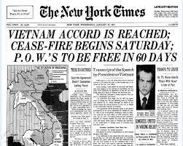
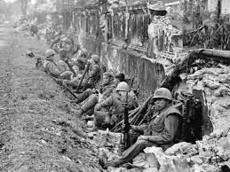
Terms and definitions: (2 of 3)
Paired Sources:
same concept as paired passages
text, images, videos, etc. are matched by a common theme, topic, or idea

Slide 14
Terms and definitions: (3 of 3)
Multimodal:
uses text combined with visual and/or auditory elements to convey meaning
can be static or active content

Slide 15
Practice 1: How do we access content vocabulary?
Intentional vocabulary instruction for specific texts:
Preview the text and scan for unfamiliar words.
Close Reading
Multiple exposures to the words

Slide 16
Reading for vocabulary (Preview and Scan):
Read the following passage
It was inevitable that we would have to eventually part ways. The differences between us were irreconcilable, and the myriad problems we had to overcome became insurmountable. I appreciate all of our experiences as business partners, but neither of us could continue as things had been. Her lackadaisical attitude toward deadlines and my obsessive need to have every detail accounted for led to conflict after conflict. The stresses of the business were bad enough without us undermining each other’s decisions on a regular basis. I was overwhelmed, as was she.
Rate this passage on how many words you didn’t know: 5- Easy (I know them all) 3- I know most 1- There were at least 5 words I don’t know

Slide 17
Reading for vocabulary (Close Reading):
Read the following passage and highlight all the words you don’t know/understand. If you have an idea of what it means but you are unsure, circle it.
It was inevitable that we would have to eventually part ways. The differences between us were irreconcilable, and the myriad problems we had to overcome became insurmountable. I appreciate all of our experiences as business partners, but neither of us could continue as things had been. Her lackadaisical attitude toward deadlines and my obsessive need to have every detail accounted for led to conflict after conflict. The stresses of the business were bad enough without us undermining each other’s decisions on a regular basis. I was overwhelmed, as was she.

Slide 18
Reading for vocabulary (Multiple Exposures to Words):
Words:
Inevitable
Irreconcilable
Insurmountable
lackadaisical
obsessive
undermining
Provide small readings with words in a variety of contexts to build familiarity.

Slide 19
Practice 2: Pairing Sources (1 of 5)
Read one more more texts, analyze, and pair with primary source.
Authentic texts: primary and secondary- text that was written and published for the public
Analyze multiple texts addressing the same topic to determine how authors reach similar or different conclusions
Interpret the social or cultural function of American literature (blogs, film, music, art, etc).
Synthesize, and explore critical thinking questions about the text(s).

Slide 20
Practice 2: Pairing Sources (2 of 5)
Strategies for selecting and teaching the reading of historical documents:
Word Picture- Read for expressive words and examine how they describe the topic

Slide 21
Practice 2: Pairing Sources (3 of 5)
Strategies for selecting and teaching the reading of historical documents:
Perspective, Point of View, Cite Evidence-This is an opportunity for scaffolding as necessary. Students will gauge the perspective of the author and provide evidence from the text to support their findings.

Slide 22
Practice 2: Pairing Sources (4 of 5)
Strategies for selecting and teaching the reading of historical documents:
Questions to ask: What is the purpose of this text selection? What should students get out of the reading?
Notes:
Jennifer

Slide 23
Practice 2: Pairing Sources (5 of 5)
Paired Sources: Examples
Literary- | Primary or Secondary Sources-
Poetry Short Stories Essays Excerpts Novels | Interviews Photographs Legal documents Bills of Sale Political Cartoons Newspaper Articles

Slide 24
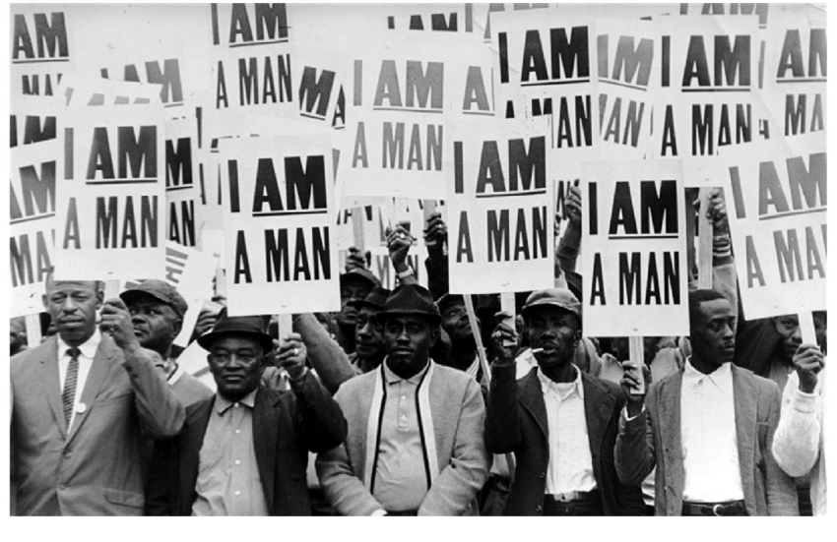
Strategies for analyzing--Images:
What do you see? (List only things you can know. Don’t infer or assume.)
What text is there?
Does the text help you understand the picture?
What do you think the men are doing?
Richard Copley, "Memphis Sanitation Workers Strike," NBC News Photo Blog, March 28, 1968, http://nbcnews.to/1ZJX0Jq

Slide 25
Strategies for analyzing--Text:
As you read over the text, highlight any words that stand out to you.
Why did you choose those words? Are they angry? Powerful? Sad?
What do you picture when you read this?
That man over there says that women need to be helped into carriages, and lifted over ditches, and to have the best place everywhere. Nobody ever helps me into carriages, or over mud-puddles, or gives me any best place! And ain’t I a woman? Look at me! Look at my arm! I have ploughed and planted, and gathered into barns, and no man could head me! And ain’t I a woman? I could work as much and eat as much as a man – when I could get it – and bear the lash as well! And ain’t I a woman?
“Ain’t I a Woman?” by Sojourner Truth Delivered at the 1851 Women’s Convention in Akron, Ohio

Slide 26
Strategies--Examine both together: (1 of 2)
That man over there says that women need to be helped into carriages, and lifted over ditches, and to have the best place everywhere. Nobody ever helps me into carriages, or over mud-puddles, or gives me any best place! And ain’t I a woman? Look at me! Look at my arm! I have ploughed and planted, and gathered into barns, and no man could head me! And ain’t I a woman? I could work as much and eat as much as a man – when I could get it – and bear the lash as well! And ain’t I a woman?
Richard Copley, "Memphis Sanitation Workers Strike," NBC News Photo Blog, March 28, 1968, http://nbcnews.to/1ZJX0Jq
“Ain’t I a Woman?” by Sojourner Truth Delivered at the 1851 Women’s Convention in Akron, Ohio

Slide 27
Strategies--Examine both together: (2 of 2)
How do you think the image and the text are connected? (There are different possible answers, so don’t worry about right or wrong)
How does the image affect how you think about the text?
How does the text affect how you think about the image?

Slide 28
Examples of Paired Sources: (1 of 3)
Historical Connection: FDR and the New Deal
Place Based Connection: The CCC Camp and the building of Campbell’s Mountain Road and Sherando Lake in Nelson and Augusta Counties.

Slide 29
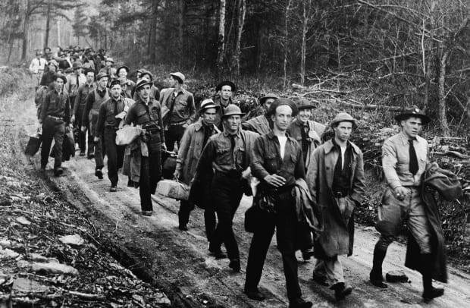
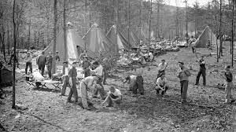
Examples of Paired Sources 1 (2 of 3)
Historical Connection: FDR and the New Deal
Literary Source 1, Informational Text:
Civilian Conservation Corps

Slide 30
Examples of Paired Sources 1 (3 of 3)
Historical Connection: FDR and the New Deal
Literary Sources 2- Let’s look at the following two photographs.
View and Respond to:
What do you see? What feeling does this photograph give the reader or viewer?

Slide 31
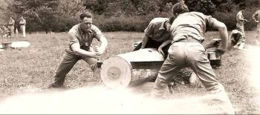

Slide 32
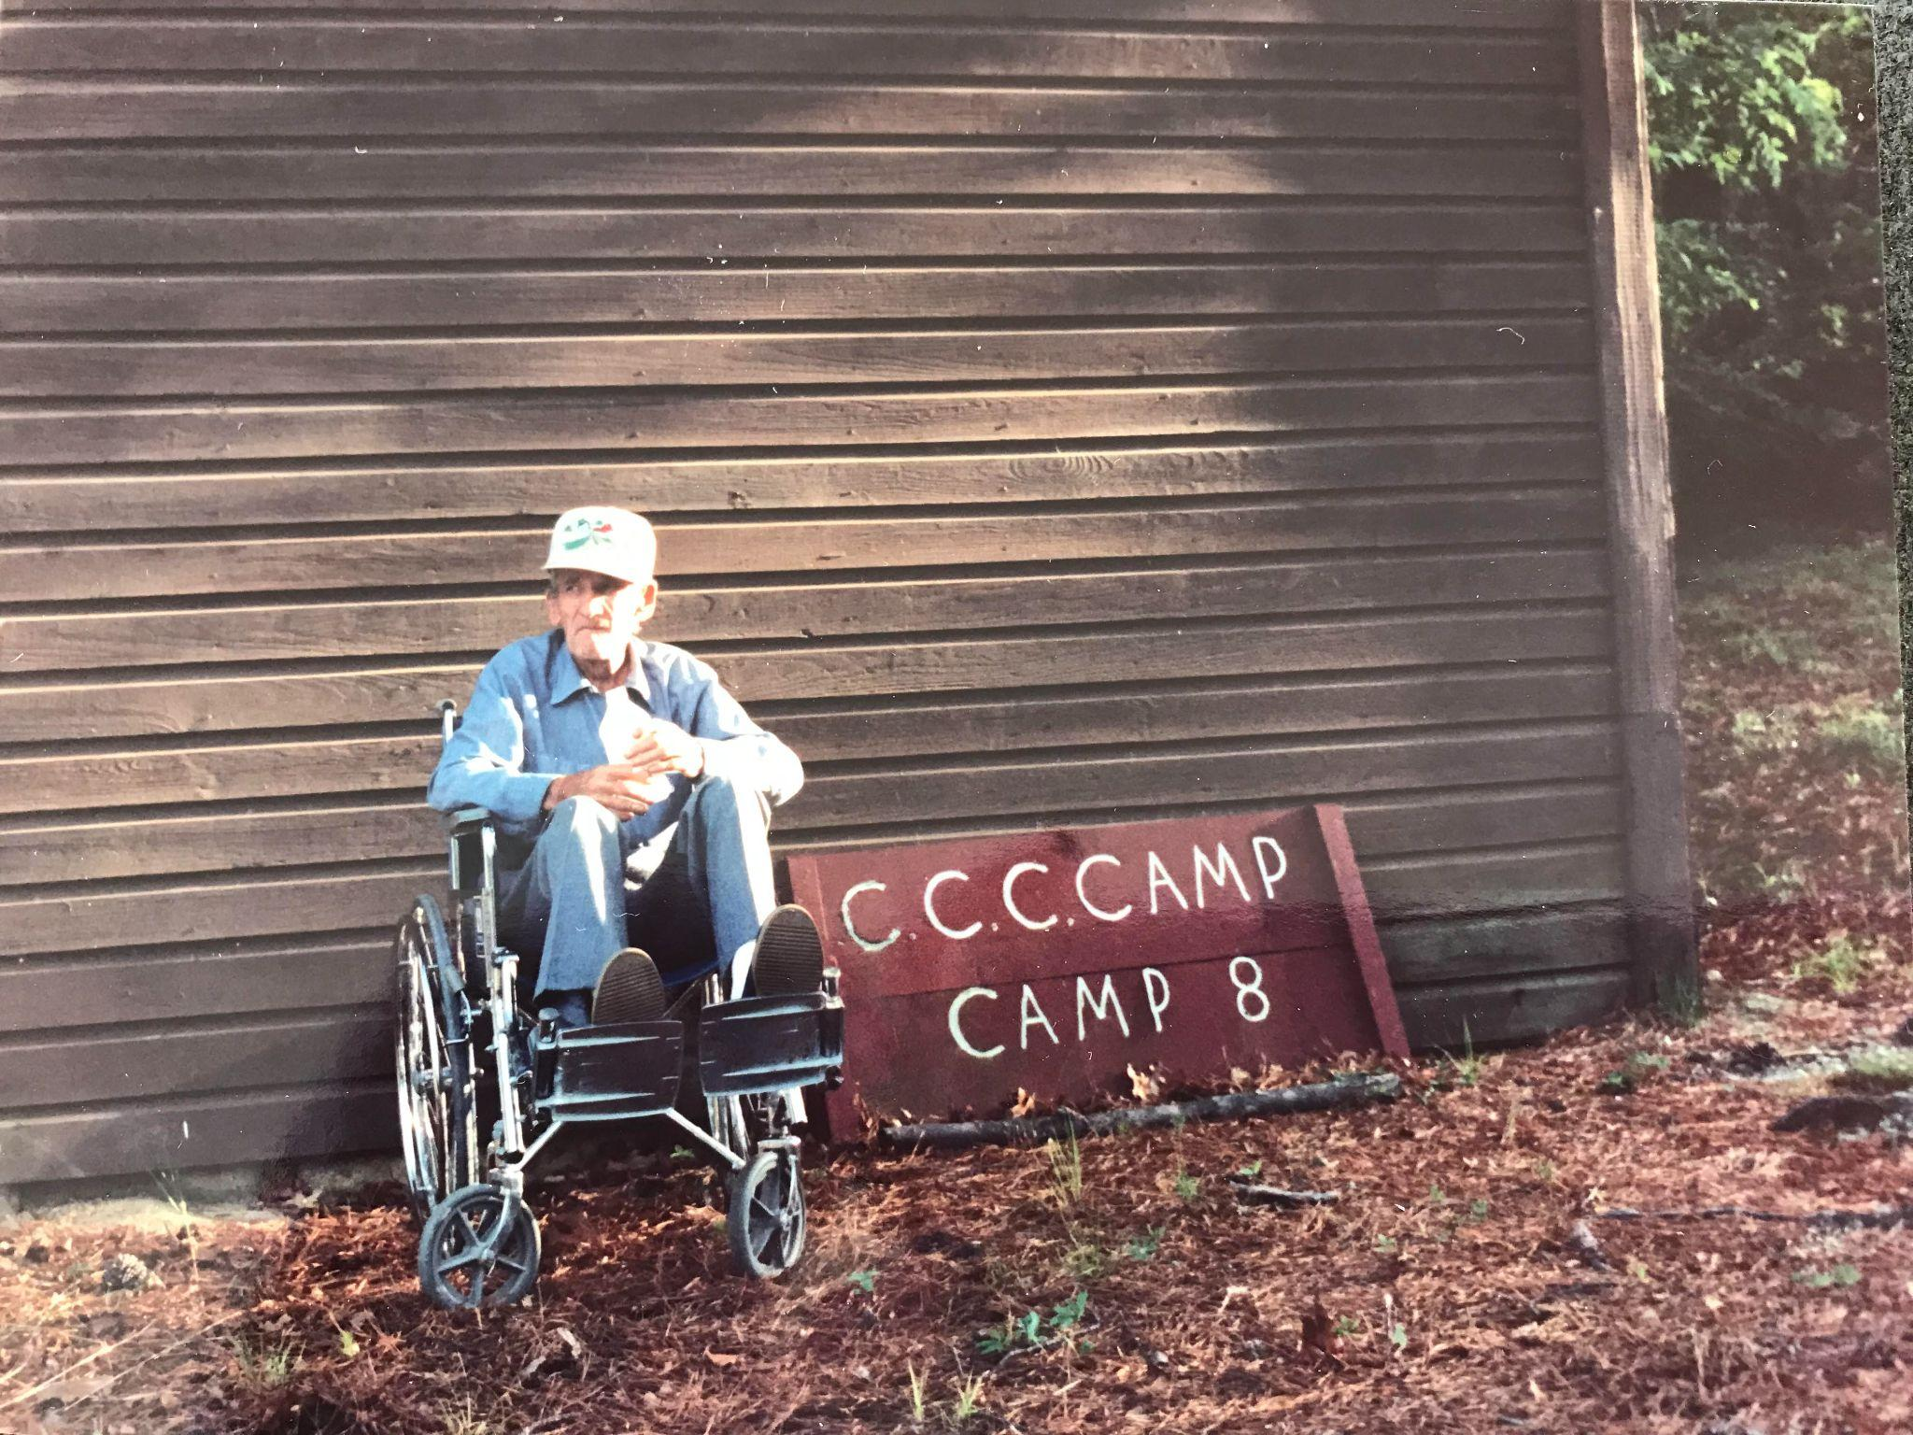

Slide 33
Examples of Paired Sources
Historical Connection: FDR and the New Deal
Literary Source 3, Current Travel Brochure:

Slide 34
Practice 3: Modalities
Multimodal Means:
Allowing students to choose their mode of writing:
can include persuasive/argumentative, reflective, interpretive, and analytic with an emphasis on persuasion/argumentation.
2. Synthesizing: Imagery and text to create compelling message
How does this relate to the problem and solution?
What could this look like? book trailers, brochures, podcasts, posters, public displays (Smithsonian museum on mainstreet)
3. Examination: Look at or inspecting our product and its intentions.
Examining Multimodal Media

Slide 35
Practice 3: Modalities
Multimodal Does:
Addresses a specific audience and purpose.
Promotes student choice and creativity.
Incorporates a variety of forms of literature, writing, and the arts.
Includes a thesis that demonstrates knowledgeable judgments, addresses counterclaims, and provides effective conclusions.
Adheres to conventional uses and demonstrate mastery appropriate for secondary and post-secondary use.

Slide 36
Practice 3: Modalities
Multimodal Asks:
Students to evaluation of content:
What is the cause and effect relationship between mass media and public opinion trends?
How does this relate to our national history?
What are the alternative or opposing perspectives or counter claims?
What are media channels: written (both digital and printed), visual?
What is the influence of media on us? Our topic? Our school? Our lives?

Slide 37
Practice 3: Modalities
Multimodal Allows:
Cross Curricular Engagement
Teacher Guided practice individually or small groups with content teachers:
Virtual conferencing
Classroom questioning
Journals and writing
b. Analysis and Synthesis (using research paired with media)

Slide 38
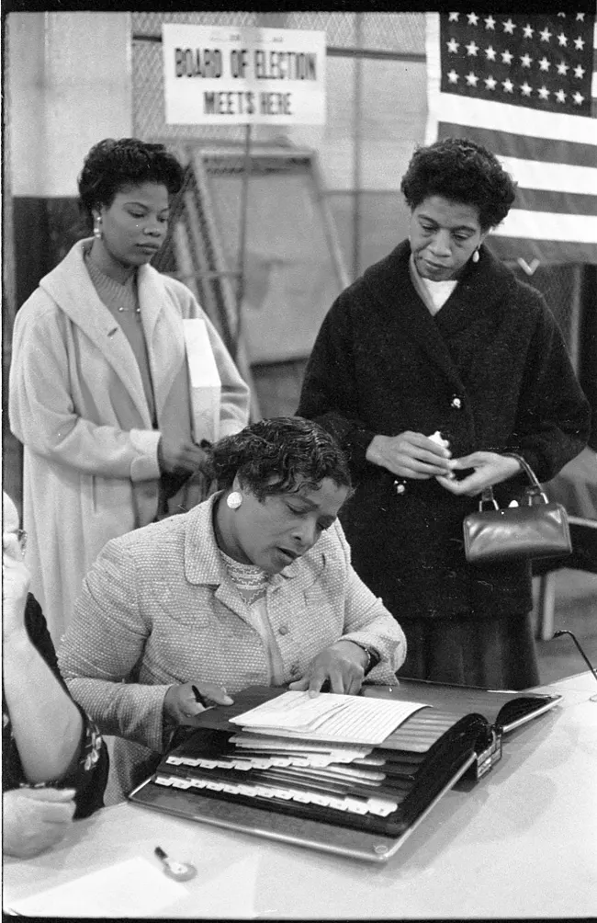
Practice 3: Modalities (1 of 4)
Strategy 1: Teacher Guided Small Group Practice
Teacher led discussion to connect sources to new ideas
Possible questions to lead class discussion:
How could we use Sojourner Truth’s words with this image?
What parts of her speech will have the most power when paired with this image?
Three women at a polling place, on November 5, 1957, in New York City or Newark, New Jersey.
Library of Congress, https://www.loc.gov/item/2015651653/.

Slide 39
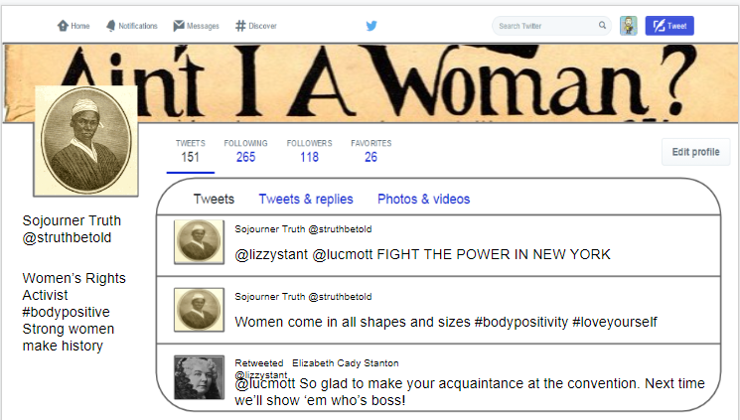
Practice 3: Modalities (2 of 4)
Strategy 2: Independent work with a Template (scaffolding)
Create (or find) a template of a social media source and have students create posts that reflect ideas from both passages.
This post paired “Ain’t I a Woman” with the Seneca Falls Declaration of Women’s Rights.

Slide 40
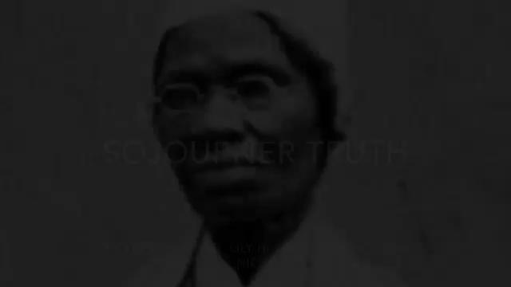
Practice 3: Modalities (3 of 4)
Strategy 3: Student generated synthesis product
Independent student-created video on Sojourner Truth. Used with permission.

Slide 41
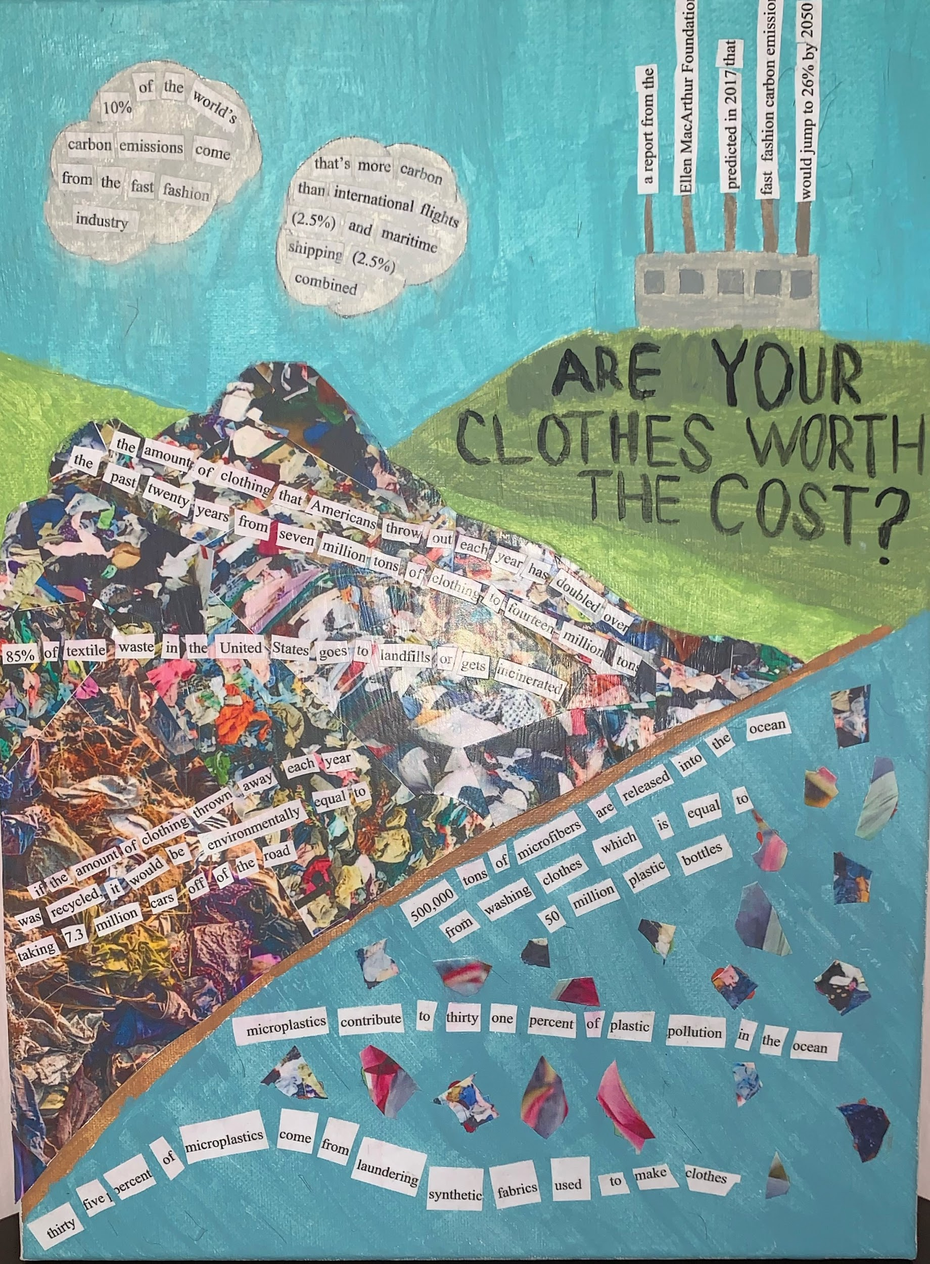
Practice 3: Modalities (4 of 4)
Strategy 3: Student generated synthesis product
This was created by a student as a synthesis of information on labor issues (using The Jungle as a literary source) and environmentalism (article on “Fast Fashion”).
It is a collage made from tempera paint and fashion magazines.
Student work. Used with permission.

Slide 42
Resources for use:
Multimodal Resources:
Supporting Multimodal Literacy-University of Michigan
https://www.dogonews.com/
History Resources:
https://www.loc.gov/
https://www.nationalgeographic.org/education/
https://www.virginiahistory.org/collections-and-resources/virginia-history-explorer
Paired Passage Resources:
https://www.commonlit.org/
https://newsela.com/
Research Resource:
Student Citation (MLA or APA): Resource

Slide 43
Examination of the Presentation
Teacher Discussion (across content areas): How do we evaluate student work to ensure they’ve mastered the learning objectives and state standards?
Teacher/ Student Discussion: How would you evaluate your presentation? What did you enjoy? What did you do well at? What area do you think you could improve or grow in?
Scoring/ Grading Rubrics:
VDOE Understand Scoring
VDOE Page with HS Social Studies Rubric
Example of Teacher-made Rubric
Single Point Rubric (blank)

Slide 44
Next Steps
Select at least one of the evidence-based practices we highlighted today: content vocabulary, paired texts, and modalities.
Select at least one of the lesson strategies from the practice to try or strengthen in your classroom before the learning lab.
See the table below
Join us for the learning lab!
 | Strategy #1 | Strategy #2 | Strategy #3
Content Vocabulary | Preview and scan | Close reading | Multiple exposures to words
Paired Sources | Word picture | Perspective | Guiding questions
Modalities | Teacher guided practice | Individual student work with a template | Student generated synthesis

Slide 45
Works Cited (1 of 5)
“[Three African American Women at a Polling Place, One Looking at a Book of Registered Voters on November 5, 1957, in New York City or Newark, New Jersey] / TOH.” Library of Congress, Washington, D.C. 20540 USA, www.loc.gov/item/2015651653/. Accessed 15 Aug. 2022.
A Call to Action: What We Know About Adolescent Literacy Instruction.
(2018, July 17). Retrieved January 8, 2020, from https://ncte.org/statement/adolescentliteracy/.

Slide 46
Works Cited (2 of 5)
Bowman, Tom. “NPR Choice Page.” Npr.org, 2019, www.npr.org/2018/01/29/580811124/military-victory-but-political-defeat-the-tet-offensive-50-years-later.
“Civilian Conservation Corps - HISTORY.” Www.history.com, www.history.com/topics/great-depression/civilian-conservation-corps#:~:text=Roosevelt%20established%20the%20Civilian%20Conservation.

Slide 47
Works Cited (3 of 5)
Miss EAP. Authentic Materials. 24 Mar. 2014, www.slideshare.net/pokray/authentic-materials-32659115.
“Photo: Latest Compelling Image Galleries. Photos & More.” NBC News, nbcnews.to/1ZJX0Jq. Accessed 15 Aug. 2022.
Sakshi. What to Do to Get out of Reading Slump? - GoBookMart. 25 Feb. 2022, gobookmart.com/what-to-do-to-get-out-of-reading-slump/.

Slide 48
Works Cited (4 of 5)
Strawbridge, Jackie. “5 Authentic Materials for Teaching Reading in a Foreign Language without Books.” General Educator Blog, 25 Jan. 2016, www.fluentu.com/blog/educator/teaching-reading-in-a-foreign-language/.
“Using Evidence and Primary Analysis Worksheets.” History Tech, 27 Mar. 2014, historytech.wordpress.com/2014/03/27/using-evidence-and-primary-analysis-worksheets/.

Slide 49
Works Cited (5 of 5)
“Vietnam Accord Is Reached; Cease-Fire Begins Saturday; P.O.W.'S to Be Free in 60 Days.” Archive.nytimes.com, archive.nytimes.com/www.nytimes.com/learning/general/onthisday/big/0123.html. Accessed 15 Aug. 2022.

Slide 50
Disclaimer
Reference within this presentation to any specific commercial or non-commercial product, process, or service by trade name, trademark, manufacturer or otherwise does not constitute or imply an endorsement, recommendation, or favoring by the Virginia Department of Education.

