Slide 1
Office of Student Assessment Updates
2022 K-12 SOL Institutes in English
Language Arts: Grades 6-8 Session
October 20, 2022

Slide 2
Topics
Growth Assessments: 2022-2023 and Beyond
Spring 2023 Standards of Learning (SOL) Test Updates
Virginia’s Parent Portal and Student Detail by Question (SDBQ) Reports
Spring 2023 - New Item Type Field Testing

Slide 3
Growth Assessments: 2022-2023 and Beyond

Slide 4
2022-23 (and beyond) Growth Assessments
(1 of 2)
As communicated in Superintendent’s Memo #221-21, legislation passed in the 2021 Virginia General Assembly (HB2027 and SB1357) required the implementation of “through-year” or “growth” assessments in reading and mathematics in grades 3-8.
The second year of implementation (2022-2023) and beyond requires that the grades 3-8 reading and mathematics growth assessments be administered to students once in the fall and once in the winter (mid-year) during the school year.

Slide 5
2022-23 (and beyond) Growth Assessments
(2 of 2)
In addition, the normally occurring spring SOL tests for grades 3-8 reading and mathematics will continue to be administered, serve as the test for determining proficiency, and be used to determine growth.

Slide 6
2022-2023 Growth Assessment Content
(1 of 2)
The fall and winter growth assessments will focus primarily on content from the student’s current grade level.
Example: A student taking grade 7 reading in 2022-2023 will be administered a fall and winter (mid-year) growth assessment that focuses on grade 7 reading standards.

Slide 7
2022-2023 Growth Assessment Content
(2 of 2)
To comply with the 2021 legislation, the CAT algorithm has been configured so that a student might be administered a passage and items from below or above grade level, depending on the student’s responses to on-grade-level passages and test items.
Example: The grade 7 reading student may receive a grade 6 passage and test items or a grade 8 passage and test items, depending on their responses to the on-grade-level passages and test items.

Slide 8
Growth Assessments: Grade 3
There are currently no test items that assess grade 2 SOL content available to be administered in the grade 3 reading and mathematics growth assessments.
Field-test passages and items that assess grade 2 SOL are being tried out at random with students in fall 2022, but these items will not count toward a student’s score.
Items measuring grade 2 content will be available for administration to students taking the grade 3 tests beginning in fall 2023.

Slide 9
Growth Assessments: Off-Grade-Level Items
Grade 8 reading and mathematics growth assessments will deliver items at or below grade level only.
Students in grades 3-8 reading and mathematics who meet the criteria for a paper test will only receive test items that assess SOL content aligned with the student’s current grade level.

Slide 10
Growth Assessment Blueprints
New test blueprints for growth assessments in grades 3-8 reading and mathematics have been developed and are available online on the Growth Assessments webpage.

Slide 11
Using Growth Assessment Data:
Recommendation (1 of 2)
Beginning in 2022-2023, growth assessments are designed to provide information on content and skills that may not yet have been taught.
  Growth assessment data should be used to inform instruction.
  Consider other assessment data (formative data and summative SOL test data) in conjunction with the Student Detail by Question (SDBQ) data.
  Use these data alongside the English Tracking Logs from the English, Reading, & Literacy page of the VDOE website for intentional planning for on-grade-level instruction as well as planning for remediation and intervention.

Slide 12
Using Growth Assessment Data:
Recommendation (2 of 2)
The Assessment Supports Literacy Webinar Series provided in 2020-2021 suggests a planning process that may be used for reading and literacy instruction.
  This series provided a recorded presentation for each grade level which can then be scaffolded and expanded across grade bands.
  Information in this series included different ways skills and content may be assessed on state tests and how assessment items may be worded.

Slide 13
Using Assessment Data:
Resources for Teachers
Recorded presentations related to Standards of Learning tests and Grades 3-8 Reading and Mathematics Growth Assessments are provided to assist teachers.
  Using Standards of Learning Assessment Data to Inform Instruction in Reading
  Using the Student Detail by Question Extract File for Teachers
The methodology modeled in these presentations can be applied to data from growth assessments as well as SOL tests.

Slide 14
Office of Student Assessment: Resources for Teachers
Using Standards of Learning Assessment Data to Inform Instruction in Reading
Using the Student Detail by Question Extract File for Teachers
Overview for Teachers: Grades 3-8 Reading and Mathematics Growth Assessments in the 2022-2023 School Year and Beyond
VDOE Growth Assessments Webpage
Department of Student Assessment, Accountability, and ESEA Programs
Office of Student Assessment
Notes:
Presentations on Using SOL Test Data to Inform Instruction- one presentation for Reading teachers, and one for Mathematics teachers- have been provided to assist teachers in determining how last year’s SOL test SDBQ Reports can be used to plan for this year’s instruction.
The presentation titled “Using the Student Detail by Question Extract File for Teachers” is intended to provide an introduction to the SDBQ Extract file and give some examples as to how the file can be manipulated using Microsoft Excel. The demonstration within this video will contain data from the Spring 2022 Standards of Learning Mathematics tests in grades 3, 4, and 5. However, the process that will be shown can be used with any SOL test results as well as Growth Assessment results.

Slide 15
Grades 3-8 Reading and Mathematics SOL Tests (1 of 2)
Beginning in spring 2023, grades 3-8 reading and mathematics computer adaptive SOL tests may also include off-grade-level content.
Tests will primarily include passages and test items that assess content at the student’s grade level.
Based upon a student’s responses to on-grade-level passages and test items, they may also be administered a passage and test items that assess content that is one grade level below or one grade level above their grade level.
Notes:
Example: The grade7 reading student may receive a grade 6 passage and test items or a grade 8 passage and test items, depending on their responses to the on-grade-level passages and test items.

Slide 16
Grades 3-8 Reading and Mathematics SOL Tests (2 of 2)
A student’s proficiency level and pass/fail status on the SOL tests will be determined by their responses to on-grade-level passages and items only.
If off-grade-level passages and items are administered, the student’s responses to those items will be reflected in the vertical scaled score used to determine the student’s growth.

Slide 17
Spring 2023 SOL Tests
Grade 2 SOL content will not be administered in the grade 3 reading or mathematics SOL tests in spring 2023.
Grade 3 CAT SOL tests administered in spring 2023 will only deliver items at or above grade level.
Grade 8 CAT SOL tests will only deliver items at or below grade level.
Students meeting the criteria for a paper test will only be administered test items that assess SOL content aligned with the grade level of the test.
Additional information regarding spring 2023 SOL tests, including test blueprints, will be provided at a later date.

Slide 18
Virginia’s Parent Portal and Student Detail by Question (SDBQ) Reports

Slide 19
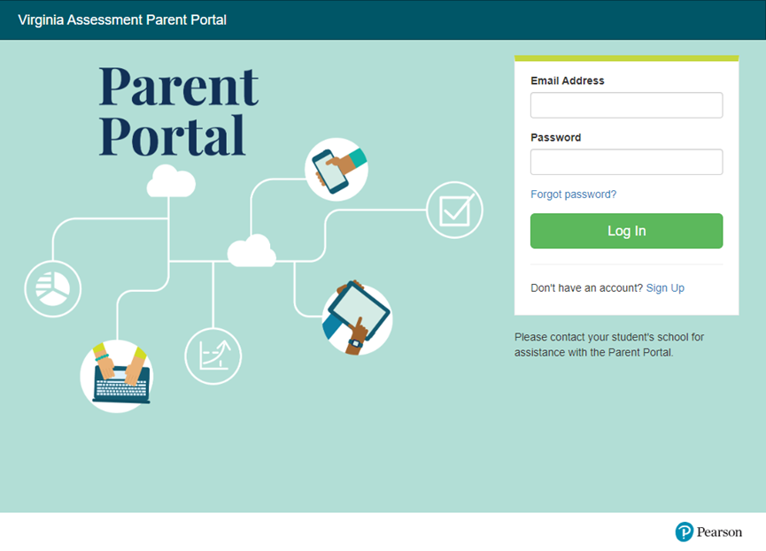
Virginia Assessment Parent Portal
Notes:
You may be curious about the information the parents of your students will receive and how they will be able to access that information.

Slide 20
What Is the Parent Portal? (1 of 2)
The Parent Portal is a web-based system that allows parents to access their child’s grades 3-8 reading and mathematics growth assessment and SOL assessment data.
Parents must create an account in the parent portal. Then, using specific student information provided by the school/division, parents can view their child’s assessment data.
Notes:
The Virginia Parent Portal is a web-based system that was made available to school divisions in Virginia in fall 2021. This portal was specifically designed for the purpose of sharing the results from state assessments administered in grades 3-8 reading and mathematics with parents. Through the Parent Portal, parents will be able to access information about their child’s performance on the growth assessments administered in 2022-2023. Results from Spring 2023 SOL Tests will also be available after they are administered. The same account and Claim Code will be used to access fall and winter growth assessment results. Parents will be provided with a different Claim Code to access their child’s spring 2023 SOL test results.
Parents will be able to access their child's Student Detail by Question report for each assessment completed.
Once the parent has created their account and claimed their child’s test results with the information provided by their child’s school, they will have access to a PDF version of the SDBQ report. This report in the portal is identical to the version that you have access to in your school division.
Most families will be able to access a personalized video via the Parent Portal that will describe the parts of their child’s SDBQ Report. This video is intended to highlight different portions of the report and will provide examples of the types of information that families will want to look for and think about as they review the report. This video also includes a statement that encourages parents to meet with their child’s teacher if they have questions about the information in the SDBQ Report.
Teachers should be aware that in some instances, this video will not be available. In the event that a parent has questions about why a video is not available for their child, please follow the directions provided by your school division.
We want the parents to use the video as a point of conversation with the teacher as an opportunity to discuss student performance.
If a parent has questions about the parent portal, contact your School Test Coordinator for information about your school division’s process.

Slide 21
What Is the Parent Portal? (2 of 2)
Parents will be able to access their child’s SDBQ Report, and most families will be able to review a personalized video that explains parts of their child’s SDBQ Report.
Parents are encouraged to work with their child’s teacher(s) to further understand what the SDBQ Report indicates about their child’s performance and to discuss strategies to assist their child.
Notes:
The Virginia Parent Portal is a web-based system that was made available to school divisions in Virginia in fall 2021. This portal was specifically designed for the purpose of sharing the results from state assessments administered in grades 3-8 reading and mathematics with parents. Through the Parent Portal, parents will be able to access information about their child’s performance on the growth assessments administered in 2022-2023. Results from Spring 2023 SOL Tests will also be available after they are administered. The same account and Claim Code will be used to access fall and winter growth assessment results. Parents will be provided with a different Claim Code to access their child’s spring 2023 SOL test results.
Parents will be able to access their child's Student Detail by Question report for each assessment completed.
Once the parent has created their account and claimed their child’s test results with the information provided by their child’s school, they will have access to a PDF version of the SDBQ report. This report in the portal is identical to the version that you have access to in your school division.
Most families will be able to access a personalized video via the Parent Portal that will describe the parts of their child’s SDBQ Report. This video is intended to highlight different portions of the report and will provide examples of the types of information that families will want to look for and think about as they review the report. This video also includes a statement that encourages parents to meet with their child’s teacher if they have questions about the information in the SDBQ Report.
Teachers should be aware that in some instances, this video will not be available. In the event that a parent has questions about why a video is not available for their child, please follow the directions provided by your school division.
We want the parents to use the video as a point of conversation with the teacher as an opportunity to discuss student performance.
If a parent has questions about the parent portal, contact your School Test Coordinator for information about your school division’s process.

Slide 22
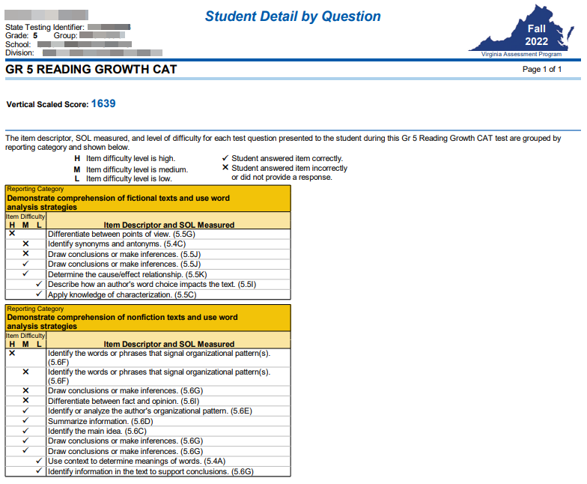
Fall & Winter Growth Assessment Report
The SDBQ Report for grades 3-8 reading and math growth assessments will:
Provide only a Vertical Scaled Score.
Be broken down by reporting category, then by level of difficulty showing items answered incorrectly, then those answered correctly.
Item descriptors will include the SOL number.
Notes:
The SDBQ Report is the only student-level report available for the growth assessments administered to students in grades 3-8 reading and mathematics.There is one report for each test completed by a student, so if a student took a reading and mathematics growth assessment, there would be two reports for that student. Each SDBQ Report will print on a single page. The growth assessment version of the SDBQ report contains student demographic information, the test name and vertical scaled score, and the item descriptors in each reporting category representing the test items answered by the student. SDBQ Reports provide teachers- and parents- with the most detailed information available on the test questions that students answered and this can be a helpful tool for instructional planning.
Vertical scaled scores will be used to determine growth.
Additional information on vertical scaled scores and how growth will be calculated in 2022-2023 will be provided to schools in future presentations.
The fall and winter growth assessment SDBQ report will be broken down by reporting category as indicated by the Growth Assessment blueprints. The items will be ordered by level of difficulty with items answered incorrectly listed first followed by items answered correctly. Item descriptors will contain the associated SOL number. This will be the indicator if a student received an above or below grade level item.
The SDBQ Report for the spring SOL test will include additional information that is not a part of the SDBQ report for the fall and winter growth assessments. Additional information provided in these reports includes an Overall Test Scaled Score, reported on a scale from zero to 600 and the Performance Level that corresponds to that Overall Test Scaled Score (Pass/ Advanced, Pass/ Proficient, Fail/Basic, or Fail/ Below Basic). Also, since the spring SOL test is a summative assessment that comprehensively covers grade level content, it will include more questions than the fall and winter growth assessments. As a result, information on a greater number of test items will appear in each Reporting Category on the spring SOL test SDBQ reports when compared to the fall growth assessment SDBQ report.

Slide 23
Resources to Support Parents
A Virginia Parent & Caregiver Resource Page has been developed to provide:
information about growth assessments.
appropriate resources for parents to use when assisting their child in reading and/or mathematics.
This page may be accessed at: tinyurl.com/VAparentpage
Notes:
The Virginia Department of Education has developed a Virginia Parent and Caregiver Resource Page located at the web address shown on the screen. This is the same webpage that parents are encouraged to visit near the conclusion of their SDBQ video. Those who visit the page will find information about the growth assessments as well as descriptions and links of resources for parents to consider when assisting their children in reading and mathematics.

Slide 24
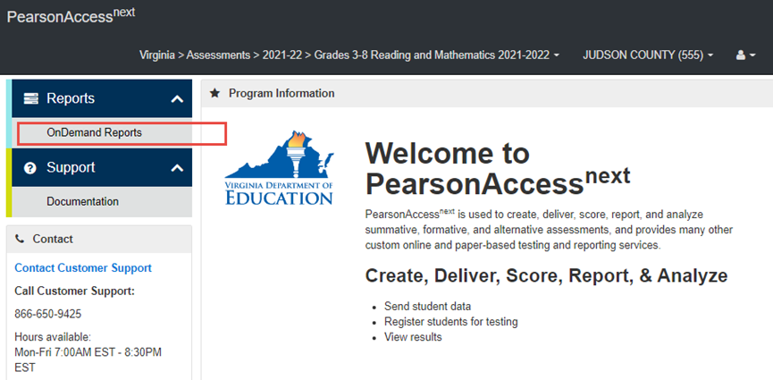
Teacher Access in PearsonAccessnext
Teachers who have been given access to student data through Reporting Groups in PearsonAccessnext can find the SDBQ Extract in OnDemand Reports.
Notes:
In order to access the SDBQ extract file, teachers must be granted this level of access. Last year, an additional function called Reporting Groups was added to the online test administration system that allowed divisions and schools to create user accounts for teachers and then align those user accounts with reporting groups that contain the students they teach or taught. Additionally, that function will allow schools to assign this year’s teacher to the data from last year’s Growth Assessments and SOL tests administered in the 2021-2022 school year. Teachers that have been given this type of user access will find the SDBQ extract in OnDemand Reports on their home screen. Thus, teachers now have access to their students spring 2022 test results.

Slide 25
Spring 2023 Field Testing
New Integrated Reading and Writing Assessment Item Type

Slide 26
Testing Memo No. 1548 (1 of 2)
Testing Memo No. 1548 (September 26, 2022) notifies school divisions of resources to assist school divisions in preparation for the spring 2023 statewide field test of the new integrated reading and writing assessment item type for grade 5, grade 8, and end of course (EOC).
Resources are provided at the bottom of the Standards of Learning (SOL) Practice Items page and toward the middle of the English SOL page on the Virginia Department of Education website.

Slide 27
Testing Memo No. 1548 (2 of 2)
The field test will occur during the school division’s Spring 2023 Writing Test Administration window. This window precedes the Spring 2023 Non-Writing Test Administration window that will include the administration of Reading SOL Tests.

Slide 28
Practice Item Sets
Two practice sets are available for each grade level field testing the new integrated reading and writing item type (5, 8, and EOC).
Each practice set contains multiple-choice items, technology-enhanced items (TEI), and a writing prompt.
The same passage is used with each practice item set for each of the three grade levels.

Slide 29
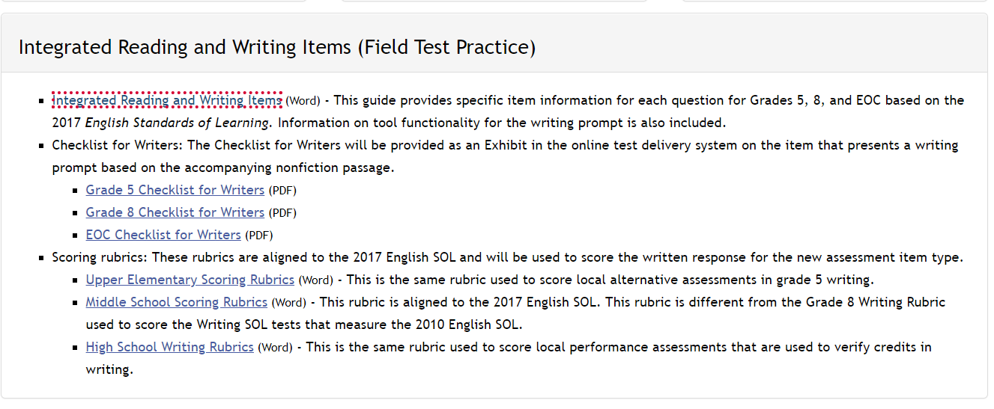
Practice Item Suggestions
Notes:
A document has been created to provide specific item information for each question in the Integrated Reading and Writing Items Field Test Practice Set. Grade 5 Integrated Reading and Writing items will not included paired passages. The Grade 8 Integrated Reading and Writing Item set includes an example of the type of paired nonfiction passages being tried out with students during the field test.
Information on tool functionality for the writing prompt is also included. This document is posted on the SOL Practice Items Page of the VDOE website.

Slide 30
Checklists for Writers
A Checklist for Writers is available for each of the three grade levels.
  The Checklist for Writers will be provided as an Exhibit in the online test delivery system on the item that presents a writing prompt based on the accompanying nonfiction passage.

Slide 31
Rubrics for Instruction and for Scoring
Two distinct rubrics are available for each grade level (5, 8, EOC):
The instructional rubrics are aligned to the 2017 English Standards of Learning and provide more detail within each domain. These are for use in the classroom, especially when focusing on specific features of student writing.
The scoring rubrics are aligned to the 2017 English Standards of Learning and will be used to score the response to the field-test item that presents a prompt or “invitation to write.”
Notes:
Finally, the scoring rubrics and instructional rubrics that are aligned to the 2017 English SOL. The Middle School Scoring Rubrics will be used to score responses for grade 8. We will provide a link to that rubric in a few slides for your convenience.

Slide 32
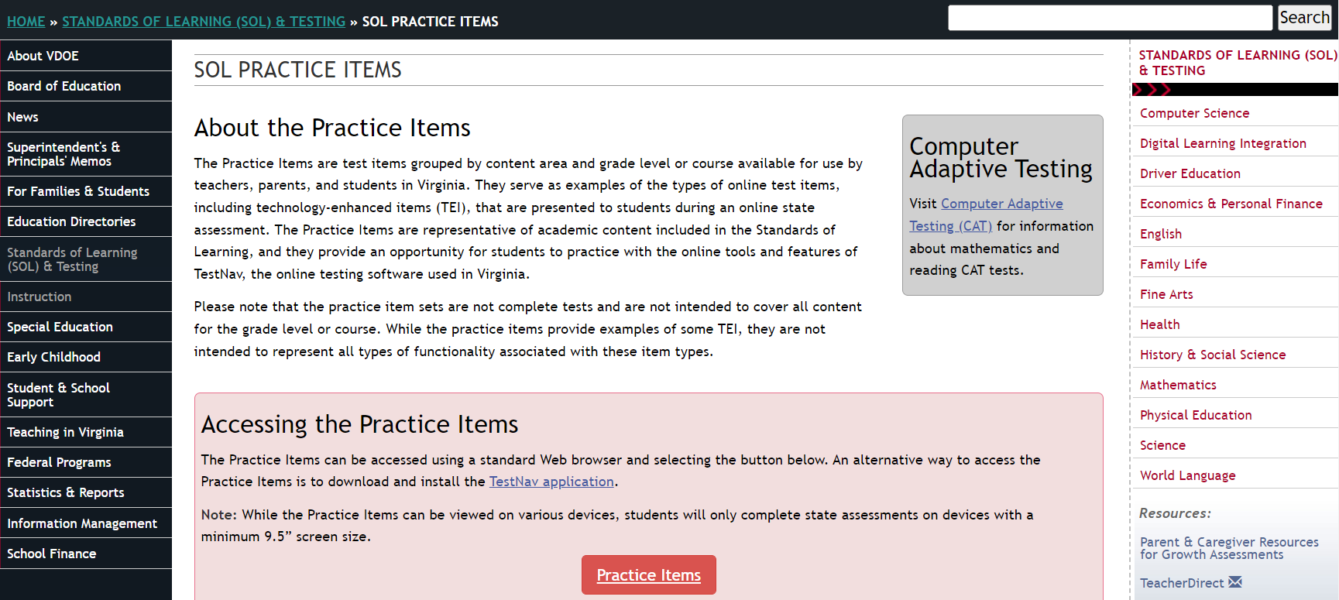
Practice Item Sets (1 of 3)
Notes:
This image of the SOL Practice Items page probably looks familiar to you. The Practice Item Sets for the Integrated Reading and Writing Item Type are included within the regular SOL Practice Items. On this webpage, you would select the red Practice Items link to open the Practice Items in TestNav.

Slide 33
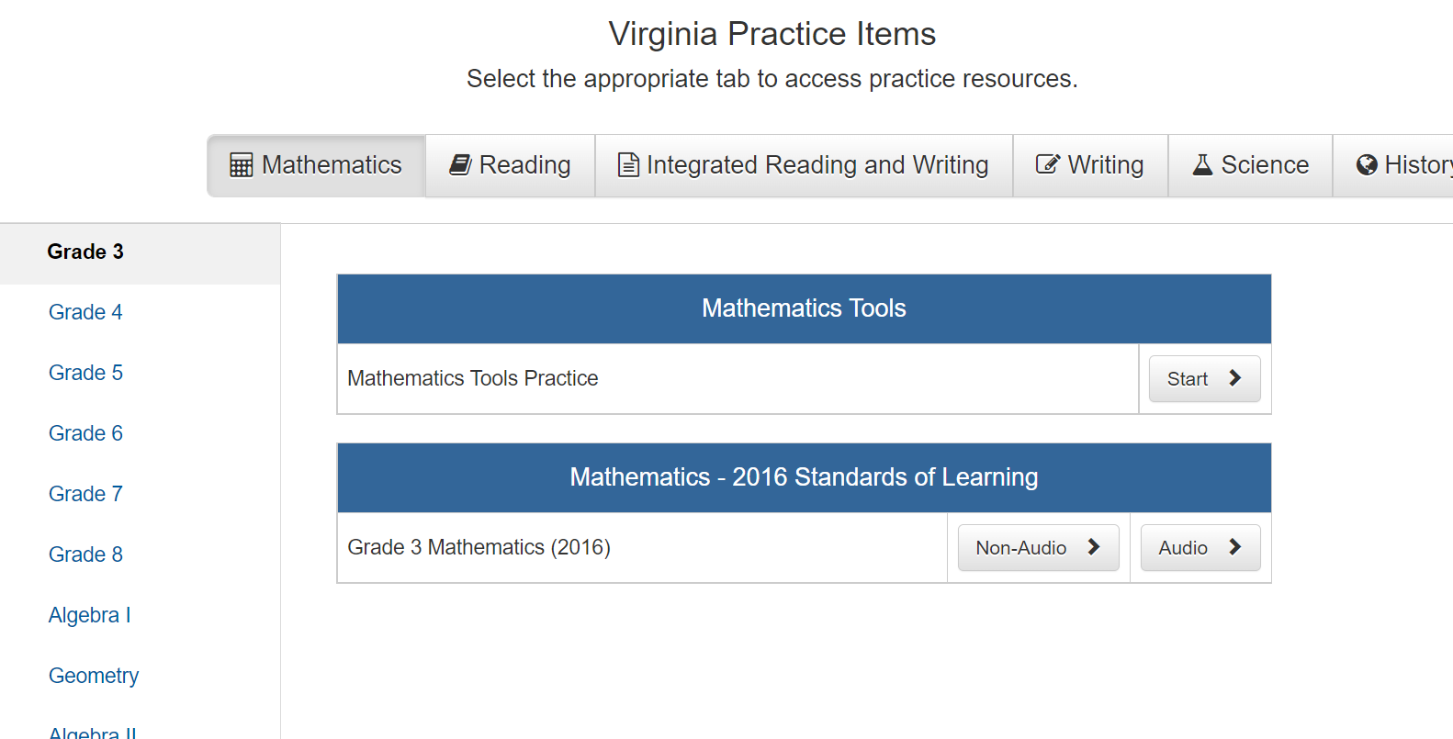
Practice Item Sets (2 of 3)
Notes:
When opening the Virginia Practice Items, the set defaults to the first tab, which is Mathematics.

Slide 34
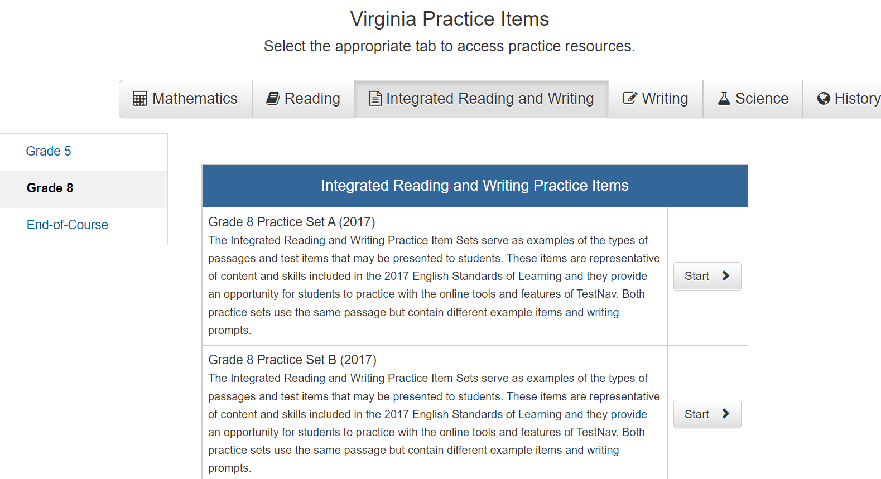
Practice Item Sets (3 of 3)

Slide 35
Grade 8 Writing SOL Assessments
What does the new integrated reading and writing item type mean for the future of the Grade 8 Writing SOL assessments?
Currently, school divisions are required to administer the Grade 8 Writing SOL tests to students.
VDOE does not have the authority to eliminate or remove this requirement.
Removal or elimination of this test requires action by the Virginia Board of Education or Virginia General Assembly.
Neither the Board nor the General Assembly has removed this requirement.

Slide 36
Grade 8 Writing in 2022-2023
The Grade 8 Writing SOL tests that will be administered in 2022-2023 are aligned to the 2010 English SOL.
  The Grade 8 Writing Scoring Rubrics in Understand Scoring are used to score responses to the short-paper component of this test.
The Middle School Scoring Rubrics aligned to the 2017 English SOL will be used to score responses to the field-test item that presents a prompt or “invitation to write.” (No scores are provided on field-test items being tried out with students.)
Notes:
Understand Scoring is used for training scorers using the scoring rubrics in a manner

Slide 37
Coming Soon
Additional information about the integrated reading and writing field test and resources will be shared in a future webinar.
Registration information for this future webinar will be provided to Division Directors of Testing and division-level English Language Arts instructional leaders.
Notes:
We know that you have questions about what this new item type might mean for the future of the local alternative assessments in grade 5 writing and the Standards of Learning Writing tests in grade 8 and EOC. We cannot anticipate the actions of the Board or the General Assembly but we will always do our best to notify you as soon as we have information about proposals or discussions or decisions related to this new item type. Division Directors of Testing and division-level instructional leaders will then provide this information to teachers.

Slide 38
Questions
If you have questions about the Grades 3-8 Reading Growth Assessments, SOL Assessments, SDBQ reports, the Parent Portal, or local alternative assessments, please contact the Office of Student Assessment:
Student_Assessment@doe.virginia.gov

