Slide 1
6-8 VDOE Virtual English SOL Institutes
October 2022
#ReadWriteVA

Slide 2
Agenda
Overview of 6-8 and 9-12 Virtual Sessions
Assessment Results Over Time
Essential Components of Literacy
Research and Evidence-Based Practices: Adolescent Literacy
Evidence-Based Practices and Strategies for Literacy Instruction
How Do We Get Students to Work in Grade-Level Material?
Upcoming Opportunities
VDOE Resources

Slide 3
6-8 Virtual English SOL Institutes
Tuesday, October 18th
4:00-4:55 PM: VDOE General Session
5:00-5:55 PM: Scientific Reading Research and Disciplinary Literacy at the Middle School Level
6:00-6:55 PM: Building a Word Conscious Classroom in Middle School: Assessment-driven word study and specific vocabulary instruction strategies
Thursday, October 20th
4:00-4:55 PM: Grammar Tools: Using Grammar Instruction to Help Students Read Like Writers and Write Like Readers
5:00-5:55 PM: Project-Based Learning: Access and Integrated Teaching for All
6:00-6:55 PM:Virginia Department of Education Instruction & Assessment

Slide 4
9-12 Virtual English SOL Institutes
Tuesday, October 25th
4:00-4:55 PM: VDOE General Session
5:00-5:55 PM: Building Classroom Communities: Using Voices to Inspire Student Choice
6:00-6:55 PM: Using Communication and Multimodal Literacy Strands to Rebuild and Refresh Your Reading and Writing Communities
Thursday, October 27th
4:00-4:55 PM: Reading and Writing Like a Practitioner- Connecting English and History through Multimodal Presentations
5:00-5:55 PM: READ, RESEARCH, and REACT!
6:00-6:55 PM:Virginia Department of Education Instruction & Assessment

Slide 5
Assessment Results Over Time

Slide 6
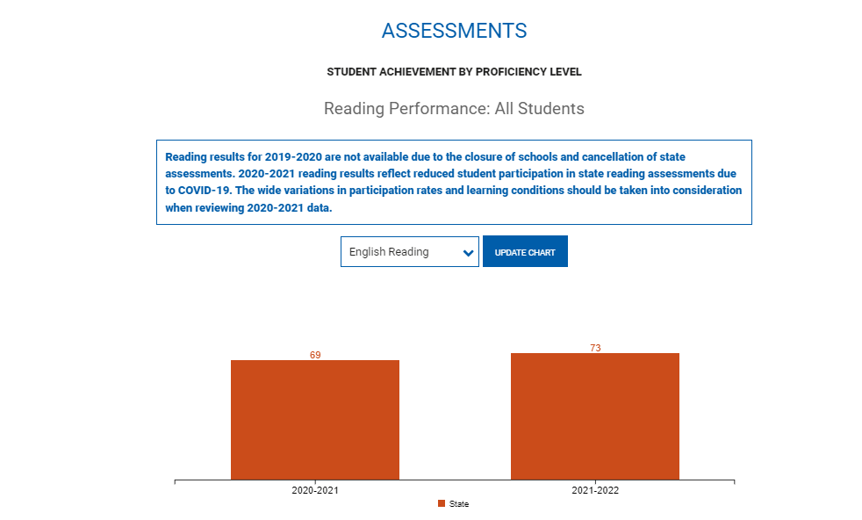
Virginia Department of Education School Quality Profiles

Slide 7
English Reading Performance
Grade Level | 2018-2019 | 2019-2020 | 2020-2021*+ | 2021-2022
Grade Three Reading | 71% | No Data Available | 61% | 68%
Grade Four Reading | 75% |  | 68% | 72%
Grade Five Reading | 78% |  | 66% | 72%
Grade Six Reading | 77% |  | 69% | 70%
Grade Seven Reading | 79% |  | 71% | 72%
Grade Eight Reading | 76% |  | 69% | 72%
End of Course Reading | 86% |  | 81% | 85%
*Pass rates reflect disruptions to instruction caused by the pandemic, decreased participation in state assessment programs, pandemic-related declines in enrollment, fewer retakes, and more flexible “opt-out” provisions for parents concerned about community spread of COVID-19.
+ 2017 English Standards of Learning assessed for the first time.

Slide 8
English Writing Performance
Grade Level | 2018-2019 | 2019-2020 | 2020-2021 | 2021-2022
Grade 8 Writing | 70% | No data available |  | 57%
End of Course Writing | 81% |  |  | 74%

Slide 9
Essential Components of Literacy

Slide 10
Comprehensive Literacy:
Successful English Instruction-Integrates the Strands
Vocabulary Development
Specific vocabulary from authentic text
Content vocabulary from math, science, and social studies
Reading
Both fiction & nonfiction text
Text-rich environment with variety of text and media
Student choice whenever possible
Writing
Writing as a process for a variety of authentic purposes
Regular writing conferences
Use of Writing Portfolios
Research
Ongoing and embedded in the learning process (when applicable)
Communication/Multimodal Literacies
Opportunities to communicate, collaborate and engage critically with peers and a variety of texts.

Slide 11
Essential Components of Literacy (1 of 4)
Commonalities in Reading Behaviors Across Text Types:
Even though there are substantial differences in reading behaviors for different text types, there are also great similarities. Regardless of the type of text, the reader must access the words in the text, recognize and use the structure of the text, make sense of sentences and paragraphs, and comprehend what has been read. Equally, vocabulary is a critical element in comprehending any kind of text.
READING FRAMEWORK FOR THE 2019 NATIONAL ASSESSMENT OF EDUCATIONAL PROGRESS

Slide 12
Essential Components of Literacy (2 of 4)
The association between vocabulary knowledge and comprehension is strong; students who know the meanings of many words and who also can use the context of what they read to figure out the meanings of unfamiliar words are better comprehenders than those who lack these attributes (National Reading Panel 2000a).
READING FRAMEWORK FOR THE 2019 NATIONAL ASSESSMENT OF EDUCATIONAL PROGRESS

Slide 13
Essential Components of Literacy (3 of 4)
Writing is essential to productivity and to personal and social advancement. Corporations in almost all industries and services report that a significant majority of salaried employees—80 percent or more—have some responsibility for writing in their professions.
In K-12 education, good writing instruction empowers students to acquire new knowledge and to develop critical thinking skills.
Writing Framework for the 2017 National Assessment of Educational Progress (NAEP)

Slide 14
Essential Components of Literacy (4 of 4)
The increasing frequency of computer-based writing outside of school or the workplace (for example, emails, instant messaging, blogs) will undoubtedly expand the variety of writing situations in the future to include many new purposes and audiences. Future trends in writing instruction must take into account how computers affect both the writing process and the types of text produced.
Writing Framework for the 2017 National Assessment of Educational Progress (NAEP)

Slide 15
Research and Evidence-Based Practices
Adolescent Literacy

Slide 16
What Research Says (1 of 3)
Adolescent Literacy Instruction
1.Incorporation of Disciplinary Literacy Instruction
2.Integration of Multiple and Social Literacies
3.Orchestration of Engagement and Motivation
4.Appreciation of Multicultural Perspectives and Cultures
A Call to Action: What We Know About Adolescent Literacy Instruction. (2018, July 17). Retrieved January 8, 2020, from https://ncte.org/statement/adolescentliteracy/.

Slide 17
What Research Says (2 of 3)
Adolescent Literacy Instruction:
Practice thinking critically about how they engage with texts to include
application of metacognitive strategies.
recognition of bias and high-quality sources.
argumentation with evidence.
Critical examination of texts that helps them to
recognize the purpose of text structure and how the writer uses it to create effect
infer beyond literal interpretations
question and investigate various social, political, and historical context.
understand multiple meanings and richness of texts and layers of complexity
A Call to Action: What We Know About Adolescent Literacy Instruction. (2018, July 17). Retrieved January 8, 2020, from https://ncte.org/statement/adolescentliteracy/.

Slide 18
What Research Says (3 of 3)
Adolescent Literacy Instruction:
Assessment that helps them to focus on
the larger purpose and big ideas of the curriculum, and on metacognitive strategies for thinking during literacy acts (Smith, 1991; Darling-Hammond & Falk, 1997; Langer, 2000).
preparation for assessment (from ongoing classroom measures to high-stakes tests) that should focus on the critical components of multicultural perspectives, motivation, multiple and social literacies, and shifting literacy demands.
Choice and volume of reading
Opportunities to read often from books of their own choosing
Access to a vast library of books and texts that vary in levels and text structures (Miller, 2009)
Dedicated time to read every day (Allington, 2009)
A Call to Action: What We Know About Adolescent Literacy Instruction. (2018, July 17). Retrieved January 8, 2020, from https://ncte.org/statement/adolescentliteracy/.

Slide 19
What does Evidence-Based Mean?
Definition:
An intervention, tool, or practice that meets one of the four evidence levels in the federal Elementary and Secondary Education Act, as amended by ESSA (strong, moderate, promising, or demonstrates a rationale).
National Center on Improving Literacy (2018). What do we mean by evidence-based?. Washington, DC: U.S. Department of Education, Office of Elementary and Secondary Education, Office of Special Education Programs, National Center on Improving Literacy. Retrieved from http://improvingliteracy.org.

Slide 20
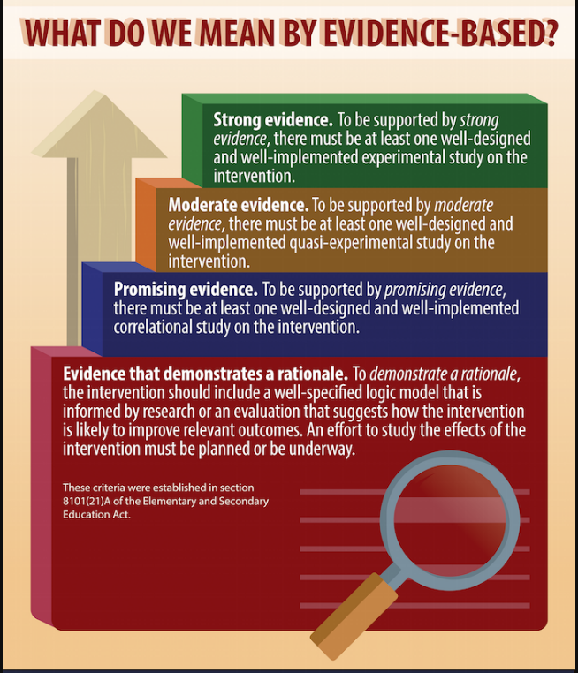
Evidence-Based Instruction
National Center on Improving Literacy (2018). What do we mean by evidence-based?. Washington, DC: U.S. Department of Education, Office of Elementary and Secondary Education, Office of Special Education Programs, National Center on Improving Literacy. Retrieved from http://improvingliteracy.org.

Slide 21
Evidence-Based Practices: Integrate Reading and Writing

Slide 22
“Students spend more time reading than writing, so they are more familiar with the skills required to read. Showing them the connection between reading and writing can help them transfer their reading skills to writing and vice versa.”
Institute of Education Sciences: Teaching Secondary Students to Write Effectively

Slide 23
The Reading/Writing Connection
Use mentor texts to read like a writer and write like a reader
Imitate an author’s style and structure
Appreciate the author’s craft
Incorporate daily writing
A warm-up prior to beginning a unit of study
Incorporate writing into formative assessment
After a thought provoking reading, discussion, or class experiment, students write their thoughts
Find authentic writing opportunities
Blogging or Social media connections
Professional writing
Notes:
Writing can and should be integrated in all reading and all contents.

Slide 24
Assigned Vs. Taught
Students write only on teacher selected topic, purpose and audience
Students are given a task without the instruction on how to complete it successfully
Minimal improvement in writing
Students rewrite only to correct errors in usage and mechanics
Students select their own topic, purpose, and audience
Teacher time is spent in class teaching writing skills and strategies
Students use models and strategies to complete each assignment
Students move through the recursive process
Because Writing Matters by Carl Nagin The National Writing Project
Notes:
There is a great difference between assigning writing and teaching writing. Although all students can write, direct instruction by the teacher is needed to develop an awareness of good writing and the skills needed to create it.
Direct instruction of concepts such as audience and purpose and skills such as revision can be followed by student choice and reflection. Then as the writing begins, the instruction continues with teacher modeling.

Slide 25
When writing is taught…
Teachers model by:
Writing with the students
Revealing the hard work of writing
Thinking aloud through revision of their writing
Editing only after revision is complete
Notes:
Modeling is one of the most effective instructional strategies and that is true in writing as well as other areas. Teachers should write as students are writing and then model the steps in the writing process, fine tuning the modeling to meet the students’ needs. If composing is the weakest area then the teacher might conduct a think aloud through the process of selecting main ideas and developing organization and elaboration. If first drafts are generally solid but revision is lacking, then the teacher can model strategies such as developing sentence variety or replacing bland language for more vivid vocabulary.

Slide 26
Quote
“Combining reading and writing together in an activity or assignment helps students learn about important text features.
For example, asking students to summarize a text they just read signals that well-written texts have a set of main points, that students should understand main points while they read, and that when students write certain types of compositions they should focus on main points”
Institute of Education Sciences: Teaching Secondary Students to Write Effectively

Slide 27
Leverage the Writing Process to Demonstrate Student Thinking

Slide 28
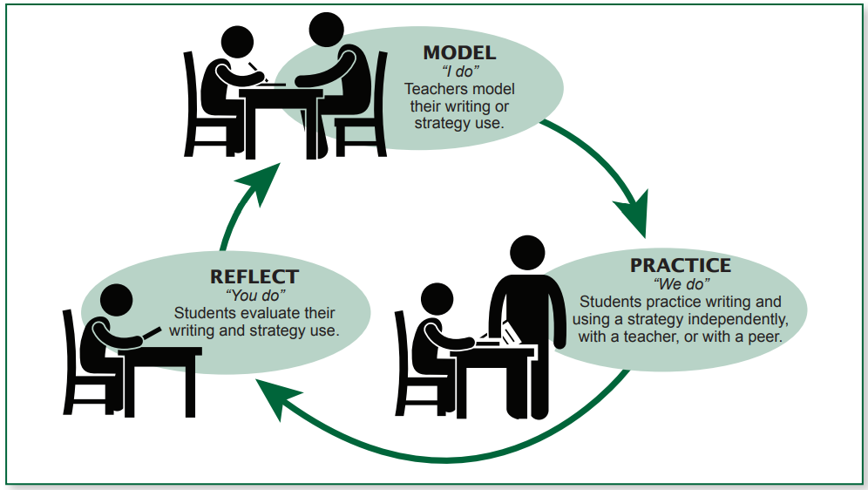
Teach Writing as a Recursive Process
A Model-Practice-Reflect approach allows
students to observe the thinking and actions
of a strong writer, attempt to emulate the
features of effective writing, and then evaluate their writing according to those features.
Institute of Education Sciences: Teaching Secondary Students to Write Effectively

Slide 29
Teaching Writing When Responding to Reading
Institute of Education Sciences: Teaching Secondary Students to Write Effectively

Slide 30
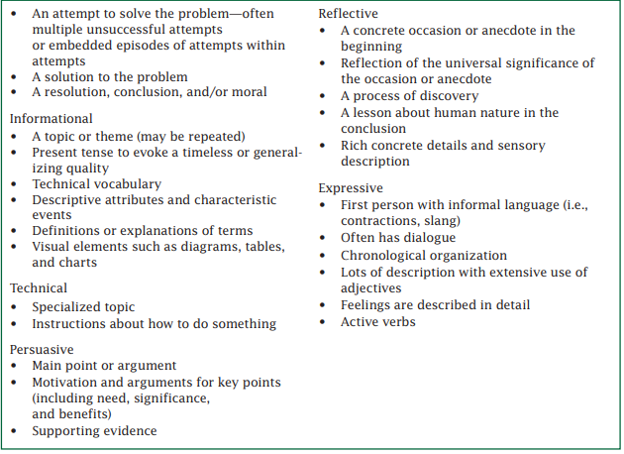
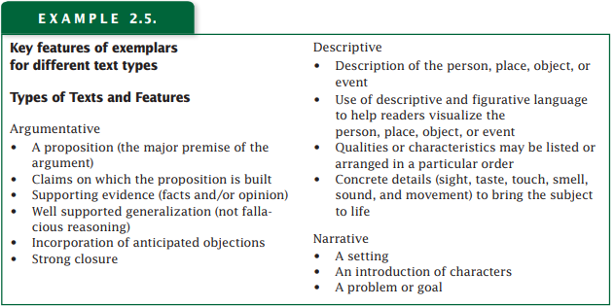
Use Texts as Exemplars for Writing
Institute of Education Sciences: Teaching Secondary Students to Write Effectively

Slide 31
Evidence-Based Practices for Additional Support in Instruction

Slide 32
“Evidenced-based reading practices are critical for all learners, including English learners and students with disabilities”
CCSSO (2021). A Nation of Readers: How State Chiefs Can Help Every Child Learn To Read. Retrieved from: https://753a0706.flowpaper.com/CCSSOReadingResource/#page=1
Notes:
Evidence is showing that there is a larger range

Slide 33
What Research Says and Evidence Shows
“In order to move students through grade-level content, schools will need to lean heavily on tiered strategies that include broad-based supports for all students and intensive intervention for students who have felt the pandemic’s impacts most directly”
Ed Research for Recovery (June, 2020)

Slide 34
Evidence-Based Practices for Interventions
Focus on practices to improve students’ ability to read words accurately and automatically
Focus on practices for helping students to understand the text they read
Providing Reading Interventions for Students in Grades 4–9. (2022). Institute of Education Sciences. Retrieved from https://ies.ed.gov/ncee/wwc/Docs/PracticeGuide/WWC-practice-guide-reading-intervention-full-text.pdf.

Slide 35
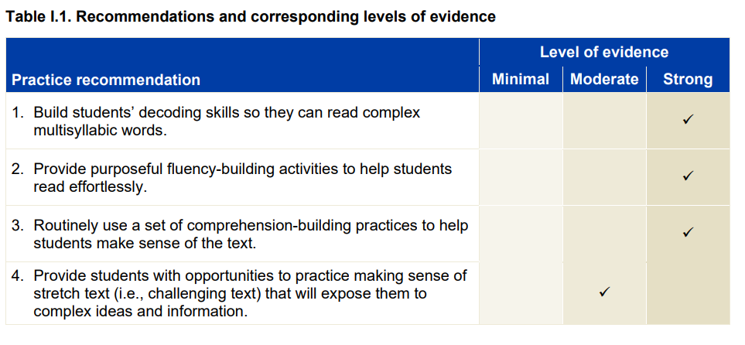
Recommendations
Providing Reading Interventions for Students in Grades 4–9. (2022). Institute of Education Sciences. Retrieved from https://ies.ed.gov/ncee/wwc/Docs/PracticeGuide/WWC-practice-guide-reading-intervention-full-text.pdf.

Slide 36
What Does this Look Like in Pre-Adolescent and Adolescent Learners? (1 of 3)
Decoding:
By upper elementary and middle school grades, texts include more complex multisyllabic words, such as disorganization and equilibrium. Many of these difficult multisyllabic words are essential for understanding the meaning of the texts
Fluency:
The ability to read text accurately, with ease, expression, and appropriate pacing
Providing Reading Interventions for Students in Grades 4–9. (2022). Institute of Education Sciences. Retrieved from https://ies.ed.gov/ncee/wwc/Docs/PracticeGuide/WWC-practice-guide-reading-intervention-full-text.pdf.

Slide 37
What Does this Look Like in Pre-Adolescent and Adolescent Learners? (2 of 3)
Comprehension:
By the time students are in upper-elementary grades, reading material in all subject areas conveys information and ideas that students are expected to learn and understand.
When students are unable to understand these texts, they miss crucial opportunities to learn grade level content.
Providing Reading Interventions for Students in Grades 4–9. (2022). Institute of Education Sciences. Retrieved from https://ies.ed.gov/ncee/wwc/Docs/PracticeGuide/WWC-practice-guide-reading-intervention-full-text.pdf.

Slide 38
What Does this Look Like in Pre-Adolescent and Adolescent Learners? (3 of 3)
Challenging Texts Are Appropriate for All Learners
“Stretch Texts”
often at or just below students’ grade level
utilized with appropriate teacher supports so that students can read and understand challenging texts
practice in small group settings
Provide
the confidence and skill students will need to approach similar texts in subject area classes
exposure to sophisticated vocabulary, more intricate sentence structures, and complex idea
Providing Reading Interventions for Students in Grades 4–9. (2022). Institute of Education Sciences. Retrieved from https://ies.ed.gov/ncee/wwc/Docs/PracticeGuide/WWC-practice-guide-reading-intervention-full-text.pdf.
Notes:
When we look at the design or structure of the secondary literacy classroom, we should be seeing small groups working on complex text with appropriate supports.

Slide 39
Disciplinary Literacy

Slide 40
Disciplinary Literacy (1 of 2)
To understand the content taught in subject-area classes, students need to engage with and gain information from complex texts.
“Stretch texts” allow for discussion of sophisticated ideas and perspectives that contribute to students’ knowledge base for later reading and content classes.
Providing Reading Interventions for Students in Grades 4–9. (2022). Institute of Education Sciences. Retrieved from https://ies.ed.gov/ncee/wwc/Docs/PracticeGuide/WWC-practice-guide-reading-intervention-full-text.pdf.
Notes:
We talked about using stretch texts to enhance exposure and practice with multisyllabic words, but it’s important that we discuss the ideas and perspectives of these texts to enhance background knowledge.

Slide 41
Disciplinary Literacy (2 of 2)
Choosing accessible, yet content-rich material is fundamental to providing deep instruction in academic vocabulary.
Plan writing activities that will allow students to apply their newly learned concepts and skills.
Teaching Academic Content and Literacy to English Learners in Elementary and Middle School

Slide 42
How Do We Get Our Students to Work in Grade-Level Material?

Slide 43
“The solution is not to "teach again" the material that students haven't learned. Instead, look forward to what those students will need to know to succeed the next day or the next week and focusing solely on those skills—a strategy known as acceleration”
David Steiner, Johns Hopkins University, 2021

Slide 44
What Research Says (1 of 3)
“Accelerating access to grade-level work—with the right supports—is the best way to help students catch up when they’ve fallen behind.”
“Unlock acceleration by operating as if many of your students, especially students in historically and systemically marginalized groups, are not getting enough chances to do high-quality, grade-level work—and set a clear goal to change that.”
TNTP: Unlocking Acceleration (August 2022)

Slide 45
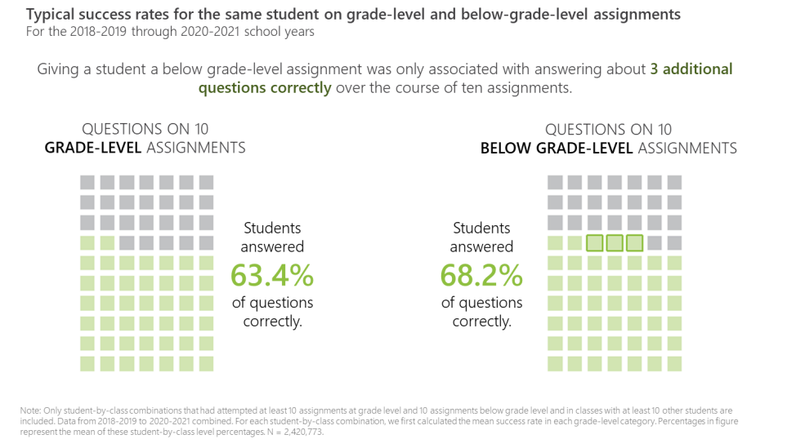
What Research Says (2 of 3)
“Assigning students work below their grade level mainly just denies them important opportunities to engage with material they could master if given the chance”
TNTP: Unlocking Acceleration (August 2022)

Slide 46
What Research Says (3 of 3)
“To make up for what’s been lost, we need to focus on acceleration, not remediation. That means devoting the bulk of classroom time to challenging instruction at grade-level or higher, and giving all students access to a rich, high-quality curriculum in English language arts, mathematics, social studies, science, the arts, and more”
The Acceleration Imperative: A Plan to Address Elementary Students’ Unfinished Learning in the Wake of Covid-19 (2021)

Slide 47
English Standards of Learning Spiral
K.8c Use pictures to make predictions
1.9 d and 2.7a Make and Confirm Predictions
3.5c Make, Confirm and Revise Predictions
4.5h Draw conclusions/Make inferences about the text using text as support
6.5f Draw conclusions and make inferences using the text for support.
8.5e Make inferences and draw conclusions based on explicit and implied information using references to the text for support.
10.5f Draw conclusions and make inferences on explicit and implied information, using textual support as evidence.
12.4h Use critical thinking to generate and respond logically to literal, inferential, and evaluative questions about the text(s).
Notes:
we provide students access to grade level material and balance foundational skills with complex text. The WHY! Because the standards spiral-same speech, each grade level is dependent on the one before it and we have to get students ready for the next step. See this example.

Slide 48
Literacy Skills Stack (Secondary)
Vertical Progression of Skills

Slide 49
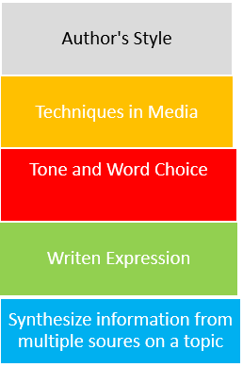
Literacy Skills Work Together (Secondary)
Arrow

Slide 50
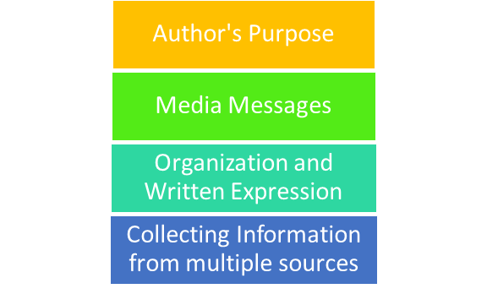
Literacy Strands Work Together
Strand Integration
VDOE Utilizing Data To Maximize Instruction Webinar 2021-2022
Notes:
how-we also must consider that each strand of the standards are dependent on each other as well. So we plan tasks and engage with text in ways that allow us to integrate all of the strands, see the example…

Slide 51
Evidence-based Practices
1. Begin lessons with short reviews of previous learning.
2. Present new material in small amounts; assist students as they practice the material.
3. Ask many questions and observe student responses; questions allow students to connect new material to prior learning.
4. Provide models such as step-by-step demonstrations or think alouds to work out the problem.
5. Guide student practice by asking good questions and providing feedback.
6. Check that students understand the material; doing so can help students learn with fewer errors.
7. Obtain a high success rate (~80%) through teaching in small steps, guiding practice, and employing mastery learning techniques.
8. Provide scaffolds, or temporary supports, for difficult material.
9. Prepare students for and monitor independent practice; ample independent practice is necessary for skills and knowledge to become automatic.
10. Engage students in weekly and monthly reviews of past material.
Institute of Educational Sciences: Evidence-based Teaching Practices Infographic
Notes:
Here are some additional practices to support reading grade level text…

Slide 52
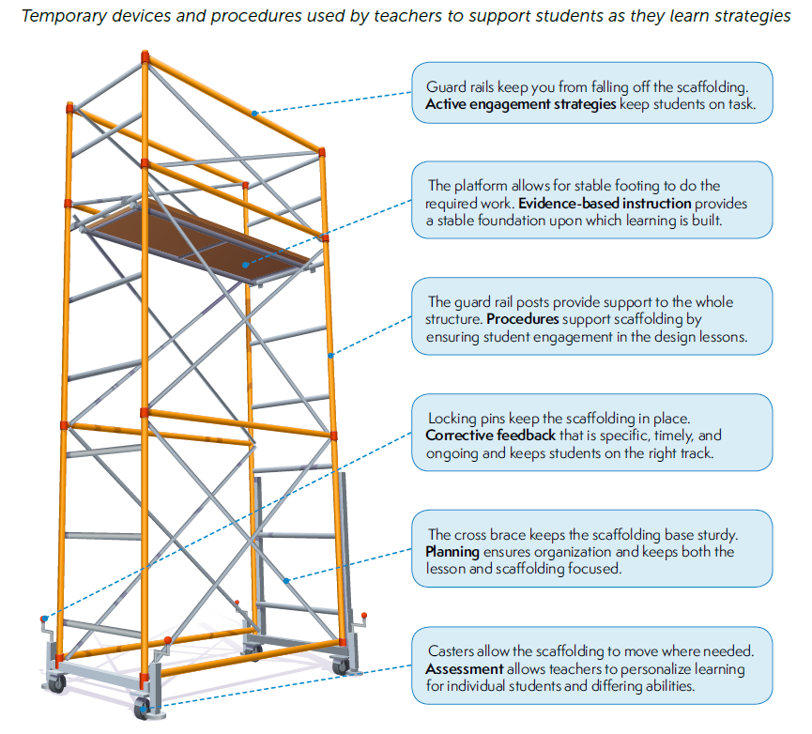
Scaffold
Institute of Educational Sciences: Evidence-based Teaching Practices Infographic
Notes:
we scaffold…

Slide 53
Evidence-based Practices in Literacy Instruction (1 of 2)
Evidence-based Practices | Literacy Connections & Instructional Focus
Reviews of previous learning (weekly, monthly, opening) Connect new material to prior learning Present new material in small amounts Assist students as they practice the material Think alouds Asking good questions Providing feedback Check that students understand the material Teach in small steps Provide scaffolds Provide model Guide practice Provide independent practice | Explicit, Systematic Direct Instruction Gradual Release (I do, We do, You do) Small group differentiated instruction Conferences Whole group learning | Intentional Focus on: Writing about what was read Explicit vocabulary instruction Academic Vocabulary Before, During, & After Reading Strategies: summarizing self-questioning story structure instruction graphic and semantic organizers comprehension monitoring Engaging students in grade level text Discussion-oriented strategies Collaborative Strategic Reading Integrating strands of English Standards Communication & Multimodal Literacies Reading Writing Research
Collaboration for Effective Educator, Development, Accountability, and Reform Center Evidence-based Reading Instruction for Adolescence, Grades 6-12
Notes:
link those to what we have mentioned

Slide 54
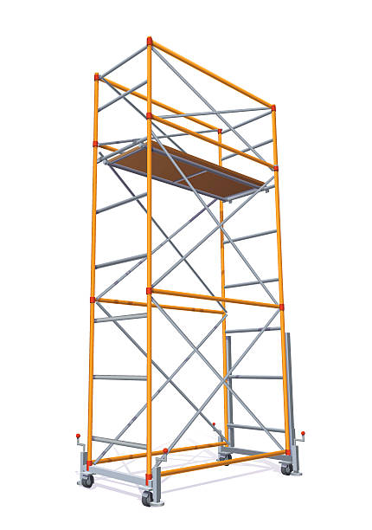
Evidence-based Practices in Literacy Instruction (2 pf 2)
Chunking text, read alouds as models
Discussion
Small group
Students are engaged
Explicit expectations while reading
Direct Instruction
Students have a purpose for
learning
Gradual Release (I do, We do, You do)
Small group differentiated instruction
Whole group discussion
Students know what to
expect
Conferences and written feedback
Students show what they
understand and where they need support
Consider the level of rigor in skills of the standards when designing, selecting tasks and activities or learning experiences
Students practice grade-level
skills using appropriate texts
Use formative data to gauge student understanding and inform pacing
Track learning progression, diagnose, go back
Students focus on skills that
they need to strengthen
Institute of Educational Sciences: Evidence-based Teaching Practices Infographic
Adapted from Achieve the Core

Slide 55
What Research Shows
Routines that create cohesion across learning environments-
Reading Grade Level Text
Teach students how to comprehend complex texts
Teach students to monitor and adjust how they are reading and notice when comprehension breaks down
Responding to Text
Teach students to think while reading, asking themselves questions, annotating text, paraphrasing chunks of text
Provide opportunities for students to respond to text using various modalities
Foundational Skills Work
Include word study
Teach vocabulary and provide repeated exposures in multiple contexts
Work on fluency by having student read a wide range of texts multiple times as a class, with a partner, independently
Utilize before, during, and after reading strategies
https://ccsso.org/blog/ccsso-releases-restart-recovery-considerations-teaching-learning
Collaboration for Effective Educator, Development, Accountability, and Reform Center Evidence-based Reading Instruction for Adolescence, Grades 6-12

Slide 56
Food for Thought
“It’s not always the text; it’s what you do with it.”
~Jennifer Serravallo

Slide 57
Upcoming Opportunities

Slide 58
November Learning Labs
For participants interested in workshopping and applying ideas presented at the virtual institutes, three in-person K-12 English SOL Learning Labs will be offered around the state. Educators will attend one full-day learning lab facilitated by presenters from the virtual English SOL Institutes. These full-day sessions will allow for teachers to connect within grade-band groups to workshop ideas presented at the institutes, examine student work samples, dialogue with educators from around the Commonwealth, and plan next steps for instruction based on the virtual session topics.
● Fredericksburg Learning Lab: Monday, November 7, 2022
● Newport News Learning Lab: Wednesday, November 9, 2022
● Roanoke Learning Lab: Thursday, November 17, 2022

Slide 59
Virginia State Literacy Association Conference
Call for Proposals

Slide 60
Additional VDOE Resources

Slide 61
VDOE Resources
VDOE English Comprehensive Instructional Plans
VDOE Webinar: Utilizing Data to Maximize Literacy Instruction in the 2021-2022 Academic Year
2021 VDOE K-12 SOL Conferences In English Language Arts
2022 VDOE K-12 Virtual SOL English Institutes
VDOE English Comprehensive Literacy Webinars
VDOE Professional Development on Demand

Slide 62
Stay Connected!
Jill Nogueras
K-12 English Coordinator
Jill.Nogueras@doe.virginia.gov
Carmen Kurek
Elementary English/Reading Specialist
Carmen.Kurek@doe.virginia.gov
Colleen Cassada
Middle School English Specialist
Colleen.Cassada@doe.Virginia.gov
Assessment Office
Student_Assessment@doe.virginia.gov

Slide 63
References
Hougen, M. (2014). Evidence-based reading instruction for adolescents, grades 6-12 (Document No. IC-13). Retrieved from University of Florida, Collaboration for Effective Educator, Development, Accountability, and Reform Center website:http://ceedar.education.ufl.edu/tools/innovation-configurations/
Meyers, A. (2021). To catch students up, don’t remediate. accelerate. Johns Hopkins University Magazine. Retrieved August 28, 2021, from https://hub.jhu.edu/2021/05/06/accelerate-learning-to-bridge-covid-19-education-gaps/.
Rosenshine, B. (2012). Principles of instruction: Research-based strategies that all teachers should know. American Educator, 36(1), 12-39. Retrieved from https://www.aft.org/sites/default/files/ periodicals/Rosenshine.pdf
Council of Chief State School Officers (2021). A Nation of Readers: How State Chiefs Can Help Every Child Learn To Read. Retrieved from: https://753a0706.flowpaper.com/CCSSOReadingResource/#page=1
The New Teacher Project. (2022, August 9). Unlocking acceleration: how below grade-level work Is holding students back in literacy. Retrieved September 2, 2022, from https://tntp.org/assets/documents/Unlocking_Acceleration_8.16.22.pdf T

Slide 64
Disclaimer
Reference within this presentation to any specific commercial or non-commercial product, process, or service by trade name, trademark, manufacturer or otherwise does not constitute or imply an endorsement, recommendation, or favoring by the Virginia Department of Education.

