Slide 1
Building a Word Conscious Classroom In Middle School Assessment-driven word study and specific vocabulary instruction strategies
VDOE Conference, Fall 2022

Slide 2
Quote

Slide 3
Session Description
Vocabulary and word knowledge is highly correlated with reading comprehension. In this session, participants will learn practical research and evidence-based instructional practices to develop generative (word parts) and specific vocabulary as outlined in SOLS 6.4. 7.4, and 8.4. Instructors will share the results of integrating explicit instruction in spelling and vocabulary in the middle school to close learning gaps. The implementation focused on explicit instruction, application, and reflection. Teachers built word conscious classrooms exploring how words work in spelling and reading. We will explore different types of words that deepen comprehension such as, homographs, synonyms, antonyms, roots, affixes, among others.

Slide 4
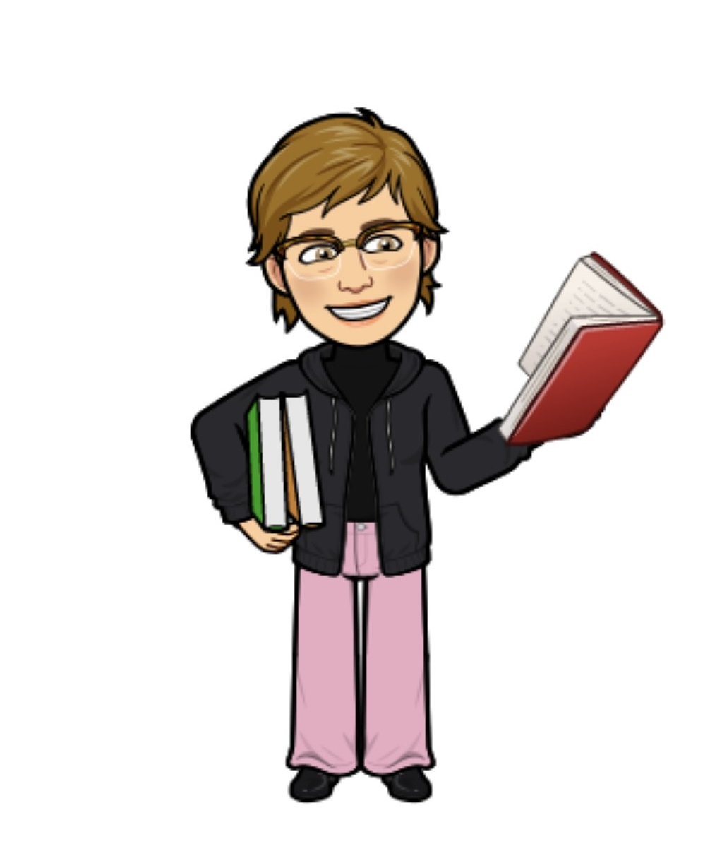
Introductions
Dr. Michelle Picard, Supervisor, Secondary English and Reading
Melissa McQuillan, Instructional Facilitator, Secondary English and Reading
Loudoun County Public Schools

Slide 5
During our time together
Outcomes
To review research and evidence-based practices in spelling and vocabulary
To discuss how spelling and vocabulary are related to reading
To share results of a middle school word study pilot
To share practical evidence-based strategies for generative and specific vocabulary instruction

Slide 6
Research and Evidence-Based Vocabulary Development
Generative and Specific Vocabulary

Slide 7
Vocabulary Development
Generative | Specific
Word Study | Robust and Content Based Vocabulary
Focus on phonology, phonics, orthography, and morphology or sound, pattern, and meaning Focus on underlying generalizations about how spelling features do and do not work in new words Focus on spelling features and word parts | Focus on specific words Recognition that there are levels of understanding Useful to teach words in context and have multiple exposures, uses, and experiences with words

Slide 8
Key Research Findings in Spelling Development
Spelling and reading access similar pathways in the brain
Developmental continuum has been identified and documented
Highly valid and reliable assessments for word knowledge, the continuum of spelling features, across phonology, orthography, and morphology have been designed
Teaching at a student’s instructional level in spelling/word knowledge leads to greater gains, and longer retention
Students that are identified with learning disabilities and English language learners progress along the same developmental continuum
Explicit, systematic instruction promotes growth

Slide 9
Loudoun County Public Schools
Middle School Word Study Initiative

Slide 10
Explicit Instruction in Developmental Spelling Initiative
LCPS piloted explicit, systematic, cumulative, assessment-based word study instruction in five high need middle schools with sixth grade students and teachers including special education and English learners

Slide 11
Question

Slide 12
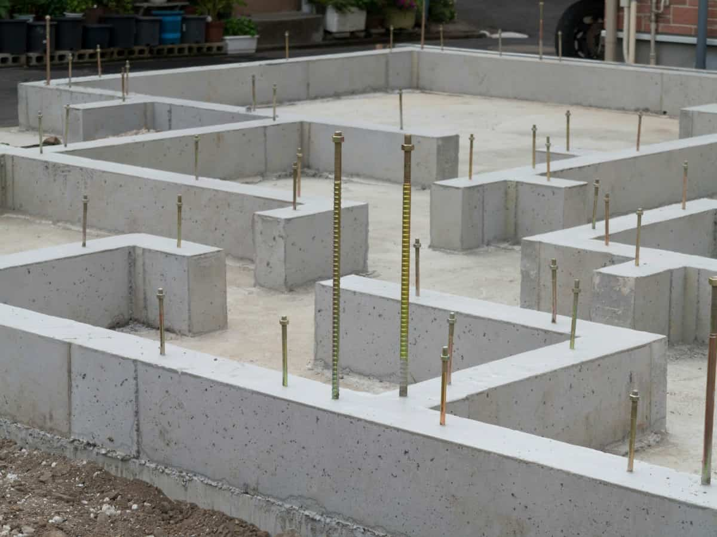
Ensuring a Foundation for Word Recognition, Reading Fluency, Comprehension, Spelling, and Vocabulary

Slide 13
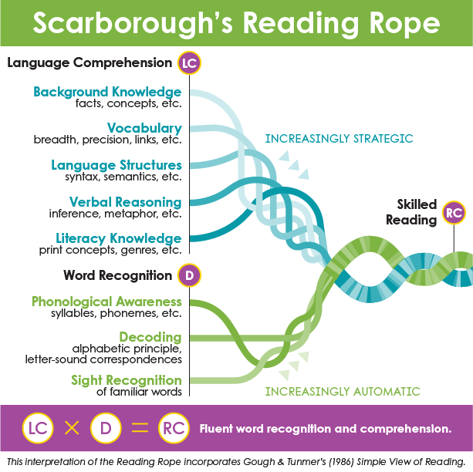
Scarborough Reading Rope, 2001
In both Word Recognition and Language Comprehension
Orthographic Mapping
Morphological Awareness

Slide 14
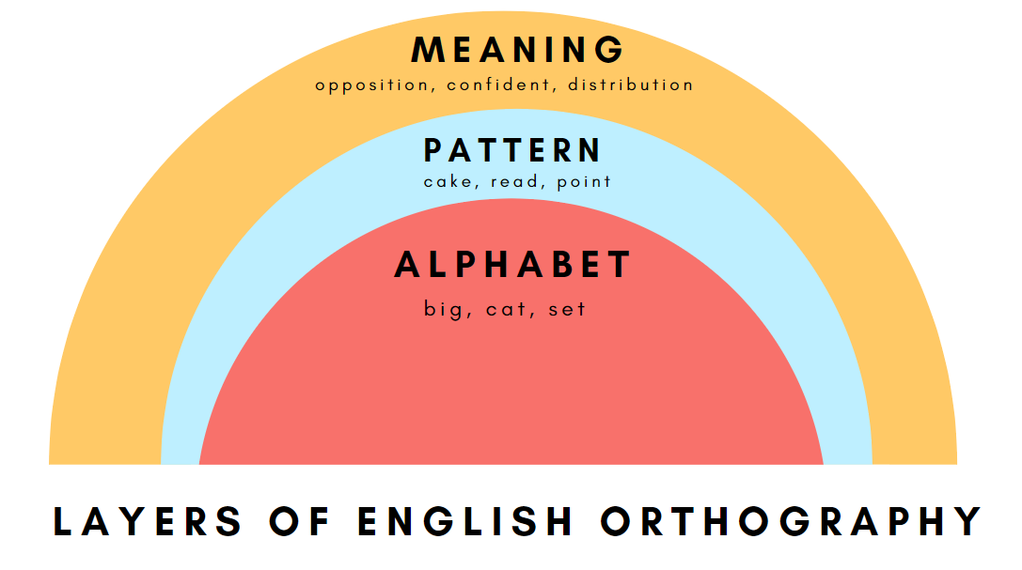
Layers of Meaning

Slide 15
Stages of Spelling Development

Slide 16
Progression of Decoding and Word Recognition
Progression | Example
Readers read letter by letter | M-o-r-p-h-o-l-o-g-y
Readers progress to reading by chunks and syllables | Mor - ph- o - lo - gy
Readers progress to reading by morphemes | Morph - ology
Readers recognize whole words | Morphology

Slide 17
Word Knowledge: Benchmarks
Grade Level | Typical Spelling Stage Ranges Within a Grade | End-of-year Spelling Stage Goal
K | Emergent – Letter name-alphabetic | Middle letter name-alphabetic
1 | Late emergent – Within Word Pattern | Early within word pattern
2 | Late letter name-alphabetic –Early syllables and affixes | Late within word pattern
3 | Within word pattern – Syllables & affixes | Early syllables & affixes
4 | Within word pattern – Syllables & affixes | Middle syllables & affixes
5 | Syllables & affixes – Derivational relations | Late syllables & affixes
6+ | Syllables & affixes – Derivational relations | Derivational relations
Words Their Way: Word Study for Phonics, Spelling and Vocabulary by Bear, Invernizzi, Templeton, & Johnston

Slide 18
Developmental Continuum: Spelling Features
Letter Name | Within Word | Syllables and Affixes | Derivational Relations
Single Syllable, short vowel words Beginning Consonants Ending Consonants Medial Vowels Beginning Blends and Digraphs- ch, sh, th, sp, str Ending Blends and Digraphs Affricates- dr/j/tr | Single Syllable, Long Vowel Patterns Complex Consonants- tch, scr, Long Vowel with Silent E- aCe, iCe, oCe, uCe Long Vowel Patterns- ai, ei, oa, R Controlled Vowels- er, ar, ir, or, ur Abstract Vowels- ew/ui | Multisyllabic Words Adding inflected endings- ed, ing, s, es Doubling, No Change Plurals R- Controlled Vowels in Accented Syllables Open and Closed Syllables Long vowels in Accented Syllables Ambiguous vowels in accented syllables | Multisyllabic words Silent and Sounded Consonants Consonant Changes Vowel Changes Latin Derivatives Assimilated Prefixes

Slide 19
Word Knowledge and Vocabulary Standard 6.4
6.4 The student will read and learn the meanings of unfamiliar words and phrases within authentic texts. a) Identify word origins and derivations. b) Use roots, cognates, affixes, synonyms, and antonyms to expand vocabulary. c) Use context and sentence structure to determine meanings and differentiate among multiple meanings of words. d) Identify and analyze figurative language. e) Use word-reference materials. f) Extend general and specialized vocabulary through speaking, listening, reading, and writing. | To be successful with this standard, students are expected to use common Greek or Latin affixes and roots as clues to the meaning of a word (e.g., aud – hearing, listening, or sound audience, auditory, audible. identify Latin and Greek roots of common English words as clues to the meaning. separate and recombine known word parts to predict the meaning of unfamiliar words, such as separating poly from polygon and phone from telephone to predict the meaning of polyphony. recognize common antonyms and synonyms. notice relationships among inflect

Slide 20
Word Knowledge and Vocabulary Standard 7.4
7. 4 The student will read to determine the meanings and pronunciations of unfamiliar words and phrases within authentic texts. a) Identify word origins and derivations. b) Use roots, cognates, affixes, synonyms, and antonyms to expand vocabulary. c) Identify and analyze figurative language. d) Identify connotations. e) Use context and sentence structure to determine meanings and differentiate among multiple meanings of words. f) Extend general and specialized vocabulary through speaking, listening, reading, and writing. | To be successful with this standard, students are expected to use common Greek or Latin affixes and roots to predict the meaning of unfamiliar words separate and recombine known word parts to predict the meaning of unfamiliar words recognize, understand, use, and explain the impact of figurative language, including simile metaphor personification distinguish among the connotations of words with similar denotations recognize that synonyms may have different connotations (e.g., elderly and mature; youthful and juvenile, inexpensive and cheap) use context as a clue to the meaning of a word or phrase consult word reference materials to find the pronunciation of a word or determine/clarify meanings.

Slide 21
Word Knowledge and Vocabulary Standard 8.4
8.4 The student will apply knowledge of word origins, analogies, and figurative language to extend vocabulary development within authentic texts. a) Identify and analyze an author’s use of figurative language. b) Use context, structure, and connotations to determine meaning and differentiate among multiple meanings of words and phrases. c) Use roots, affixes, cognates, synonyms, and antonyms to determine the meaning of unfamiliar words and technical vocabulary. d) Use dictionaries, thesauruses, and glossaries to determine definition, pronunciation, etymology, spelling, and usage of words. e) Discriminate between connotative and denotative meanings and interpret the connotation. f) Extend general and specialized vocabulary through speaking, listening, reading, and writing. | To be successful with this standard, students are expected to use common roots to determine the meaning of unfamiliar words and make connections with word families (e.g., -phobia, and -ology) recognize the relationships among words related by structure and derivation, such as polygraph and graffiti distinguish among the connotations of words with similar denotations understand, evaluate, and use figurative language, including simile, metaphor, personification, hyperbole, and symbol analyze the impact of specific word choices on meaning and tone consult reference materials to find the pronunciation of a word or determine/clarify meaning recognize that synonyms may have different connotations (e.g., elderly and mature; youthful and juvenile, inexpensive and cheap) and describe the impact on text use context as a clue to the meaning of a word or phrase use both context and reference skills independently to determine the nuances and connotations of words.

Slide 22
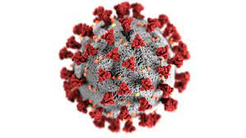
Covid-19

Slide 23
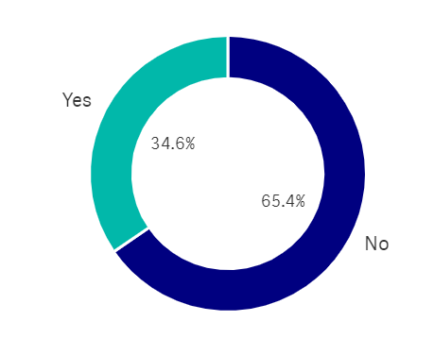
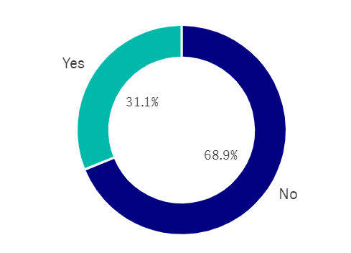
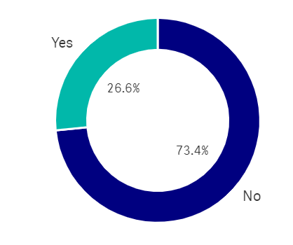
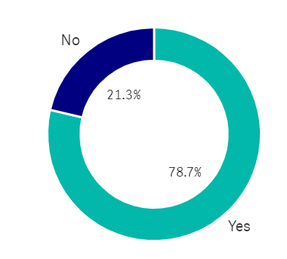
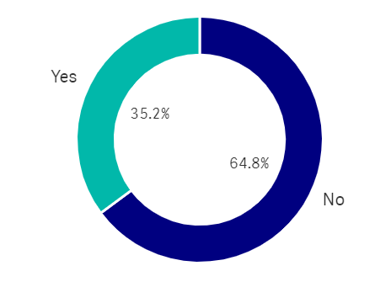
Pilot Middle Schools 2021-22
School #3
School #1
School #2
School #4
School #5

Slide 24
Fall Sixth Grade DSA Scores
 |  | DSA Score 70+ | Total Tested | % on or above Grade 6 with Word Knowledge
School 1 | Fall 2021 | 128 | 293 | 44%
School 2 | Fall 2021 | 119 | 300 | 40%
School 3 | Fall 2021 | 120 | 295 | 41%
School 4 | Fall 2021 | 77 | 250 | 31%
School 5 | Fall 2021 | 82 | 266 | 31%

Slide 25
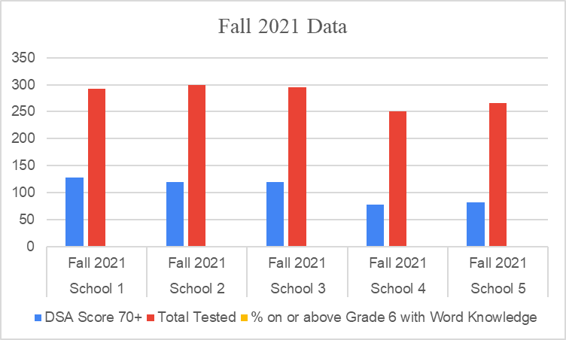
Fall 2021 Data

Slide 26
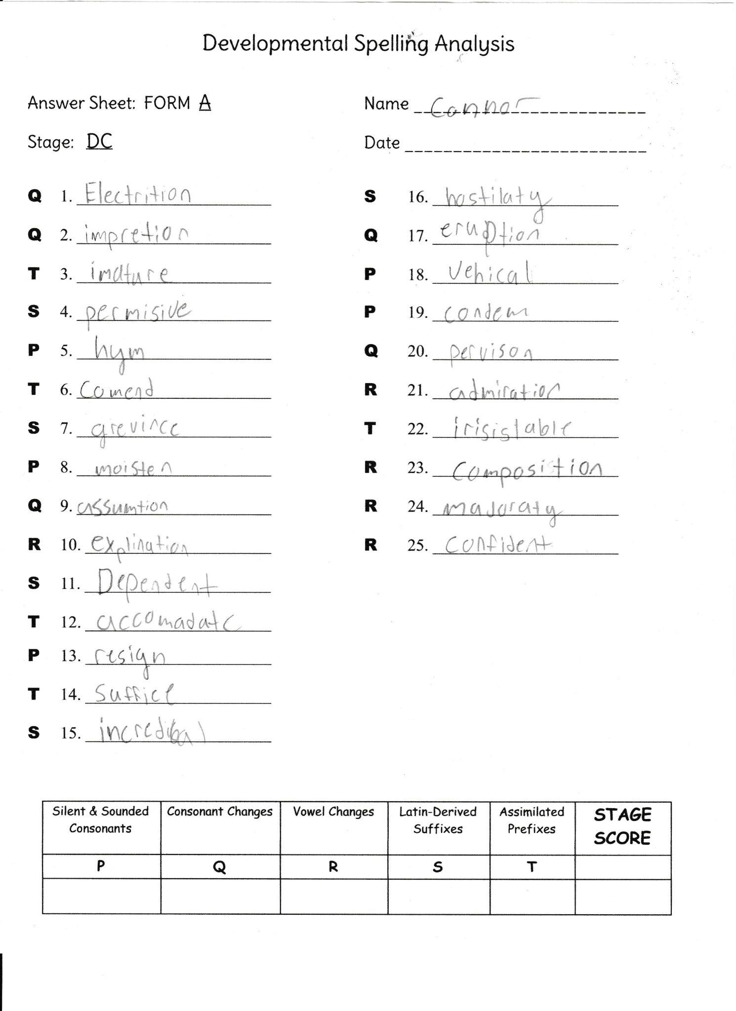
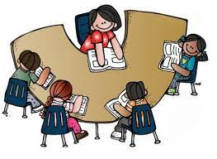
Building Teacher Capacity (1 of 3)

Slide 27
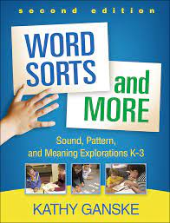
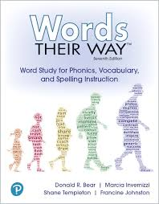
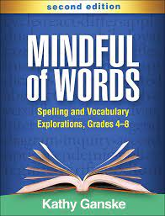
Building Teacher Capacity (2 of 3)

Slide 28
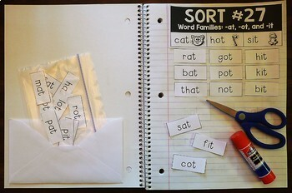
Building Teacher Capacity (3 of 3)
Model Lesson- Explicit Instruction
Word Hunt
Writing Sort
Word Study Notebook
Identify the Big Idea
Facilitated Conversation and Reflection
Classroom Activity Slides

Slide 29
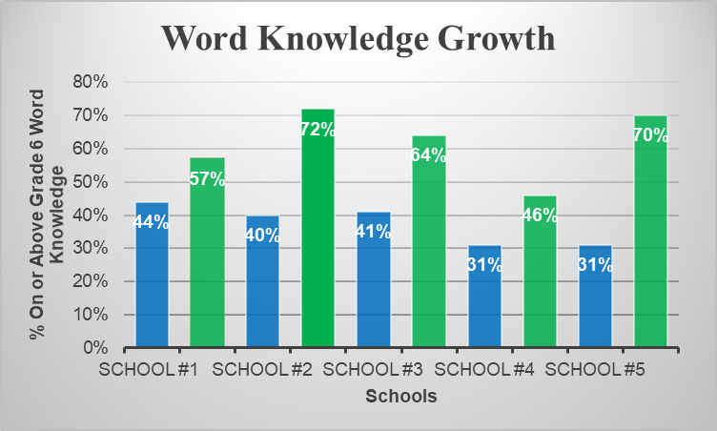
Word Knowledge Growth
Fall
Spring
Notes:
Melissa

Slide 30
Spring Scores Moving Toward Proficiency
Schools |  | 75-100 | 50-74 | 26-49 | 0-25 | Total Tested
School 1 | Spring | 170 (45%) | 102 (32%) | 37 (12%) | 9 (3%) | 318
 | Fall | 73 (20%) | 137 (38%) | 76 (21%) | 4 (1%) | 363
School 2 | Spring | 177 (62%) | 92 (32%) | 17 (6%) | 0 | 286
 | Fall | 29 (10%) | 223 (76%) | 42 (14%) | 0 | 294
School 3 | Spring | 162 (61%) | 73 (27%) | 26 (10%) | 5 (2%) | 266
 | Fall | 70 (24%) | 151 (52%) | 54 (19%) | 14 (5%) | 289
School 4 | Spring | 118 (43%) | 112 (41%) | 35 (13%) | 9 (4%) | 274
 | Fall | 50 (20%) | 133 (54%) | 55 (22%) | 8 (3%) | 246
School 5 | Spring | 142 (54%) | 103 (39%) | 20 (8%) | 0 | 265
 | Fall | 34 (13%) | 128 (49%) | 91 (35%) | 6 (2%) | 259

Slide 31
Comments from Teachers in the Initiative
EL students learned new vocabulary. It was easy to implement when worked into the daily routine.
There were some growths in their spelling, which was great! I loved when they found their words on their own in novels.
Our students made wonderful growth.
Students gained word knowledge and increased comfort with small group and rotation routines.
It gave my ELs a sense of accomplishment. It also was a holdover from elementary, so the familiarity of the routine was comforting for them.
growth in our readers, confidence booster
Increased vocabulary and understanding of patterns in English
We saw great growth!

Slide 32
Vocabulary Strategies
Teach Specific Vocabulary Explicitly

Slide 33
Key Research Findings In Vocabulary Development
Direct instruction of decoding, encoding, comprehension, and wide reading of literature
Systematic, explicit, and intentional instruction on the spoken and written form of the English language (sound, syllable, morpheme, word)
Direct and incidental vocabulary instruction using texts to explore word meanings and sentence structure in wide reading

Slide 34
Types of Words Identified in the VA Standards
Antonyms Synonyms Homophones Homographs Cognates Greek and Latin Roots Prefixes Suffixes Inflections Derivations | 11. Figurative Language 12. Simile 13. Hyperbole 14. Metaphor 15. Onomatopoeia 16. Connotation 17. Denotation 18. Multiple Meaning Words 19. Collective Nouns

Slide 35
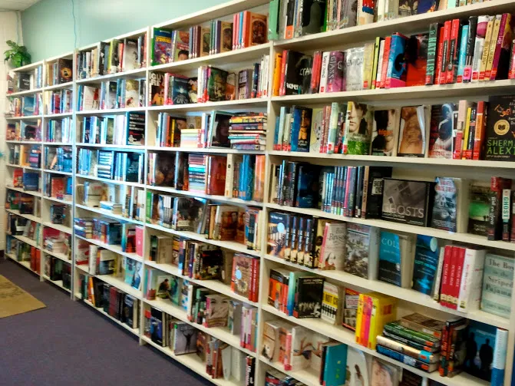
Vocabulary Strategies: Read Widely

Slide 36
Vocabulary Notebooks and Routines (1 of 14)
Collect and Break Apart Words: Prefixes, Suffixes, and Greek and Latin Roots
Collect words with the same word part
Examine the words for meaningful parts—base word, prefixes, or suffixes.
If there is a prefix or suffix, take it off so you can find the base.
Look at the base to see if you know it or if you can think of a related word (a word that has the same base).
Reassemble the word, thinking about the meaning contributed by the base, the suffix, and then the prefix. This should give you a more specific idea of what the word is.
Ask the students to consider and identify the meaning of the suffix, prefix, or root
Record and continue to collect these words over time

Slide 37
Vocabulary Notebooks and Routines (2 of 14)
un - not | re – again | mis – badly, wrongly | dis - opposite, reverse the meaning
unable | rebound | misbehave | disable
unafraid | recall | misconduct | disagreeable
unbeaten | recharge | miscount | disappear
unbroken | recount | misfit | disarm
unclear | recycle | misguide | discharge
uncommon | reflect | misjudge | disclose
uncover | refill | mislead | discomfort
unequal | refresh | mismatch | discover
unfair | reform | misplace | dishonest
unkind | remodel | misprint | disinfect
unpack | reprint | misspell | disloyal
unselfish | research | mistake | disobey
unsteady | rewrite | mistrust | disrespect
Prefixes: A word part affixed to the beginning of a word which changes the meaning of a word.

Slide 38
Vocabulary Notebooks and Routines (3 of 14)
ly - | less - without | ful- | ness -
badly | ageless | careful | awareness
bravely | breathless | cheerful | closeness
closely | careless | fearful | coolness
constantly | ceaseless | graceful | darkness
deadly | endless | harmful | firmness
directly | helpless | hopeful | goodness
eagerly | homeless | peaceful | openness
finally | lawless | playful | ripeness
frequently | painless | powerful | sickness
loudly | powerless | thoughtful | sharpness
loyally | priceless | truthful | stiffness
proudly | reckless | useful | stillness
smoothly | tasteless | wonderful | weakness
Suffixes: A word part affixed to the end of a word or root, which indicates the part of speech.

Slide 39
Vocabulary Notebooks and Routines (4 of 14)
cred- “ to believe” | graph – “ to write” | corp – “body” | cap - “head”
credit | graph | corpse | capital
credible | paragraph | corps | captain
credentials | autograph | corporal | capitol
incredible | diagraph | corporation | capitalize
accredited | graphics | corpus | capitulate
credulous | topography | corpulent | decapitate
 | biography | incorporate | Per capita
 | bibliography | corpuscle | captivity
 | choreographer
 | phonograph
Greek and Latin Roots

Slide 40
Vocabulary Notebooks and Routines (5 of 14)
Root
graph – “ to write”
graph
paragraph
autograph
diagraph
graphics
topography
biography
bibliography
choreographer
phonograph

Slide 41
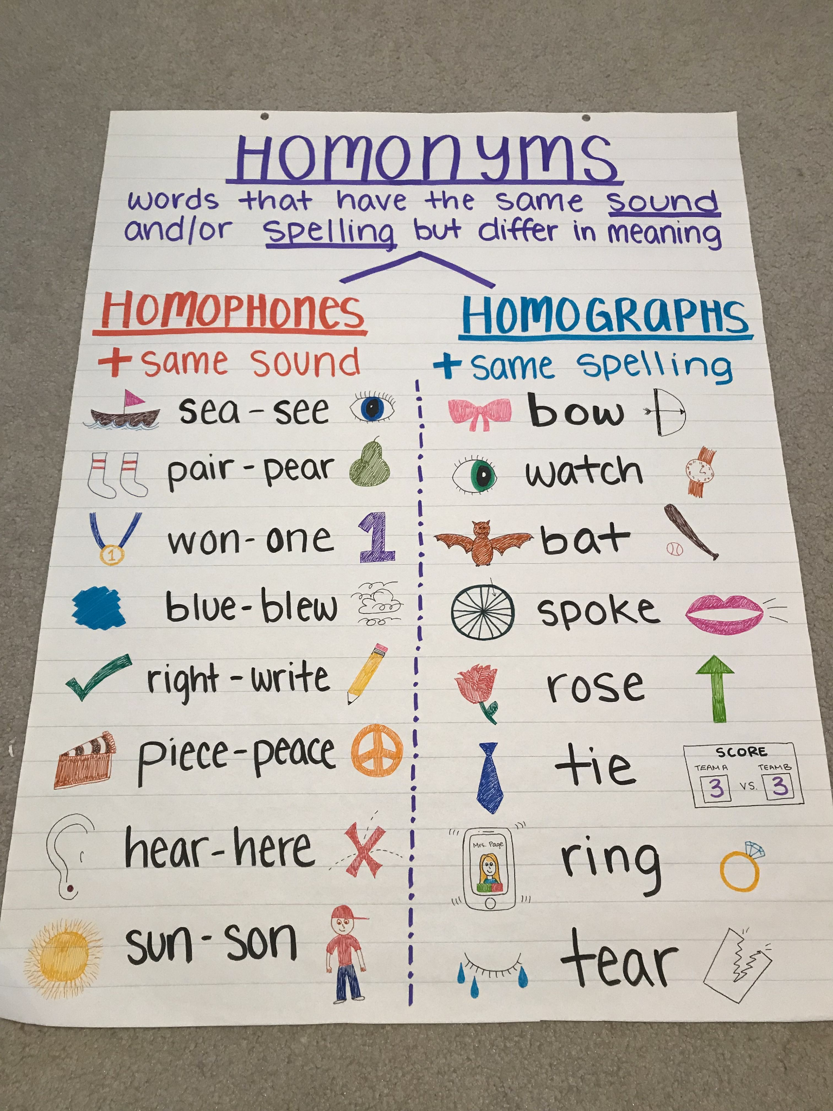
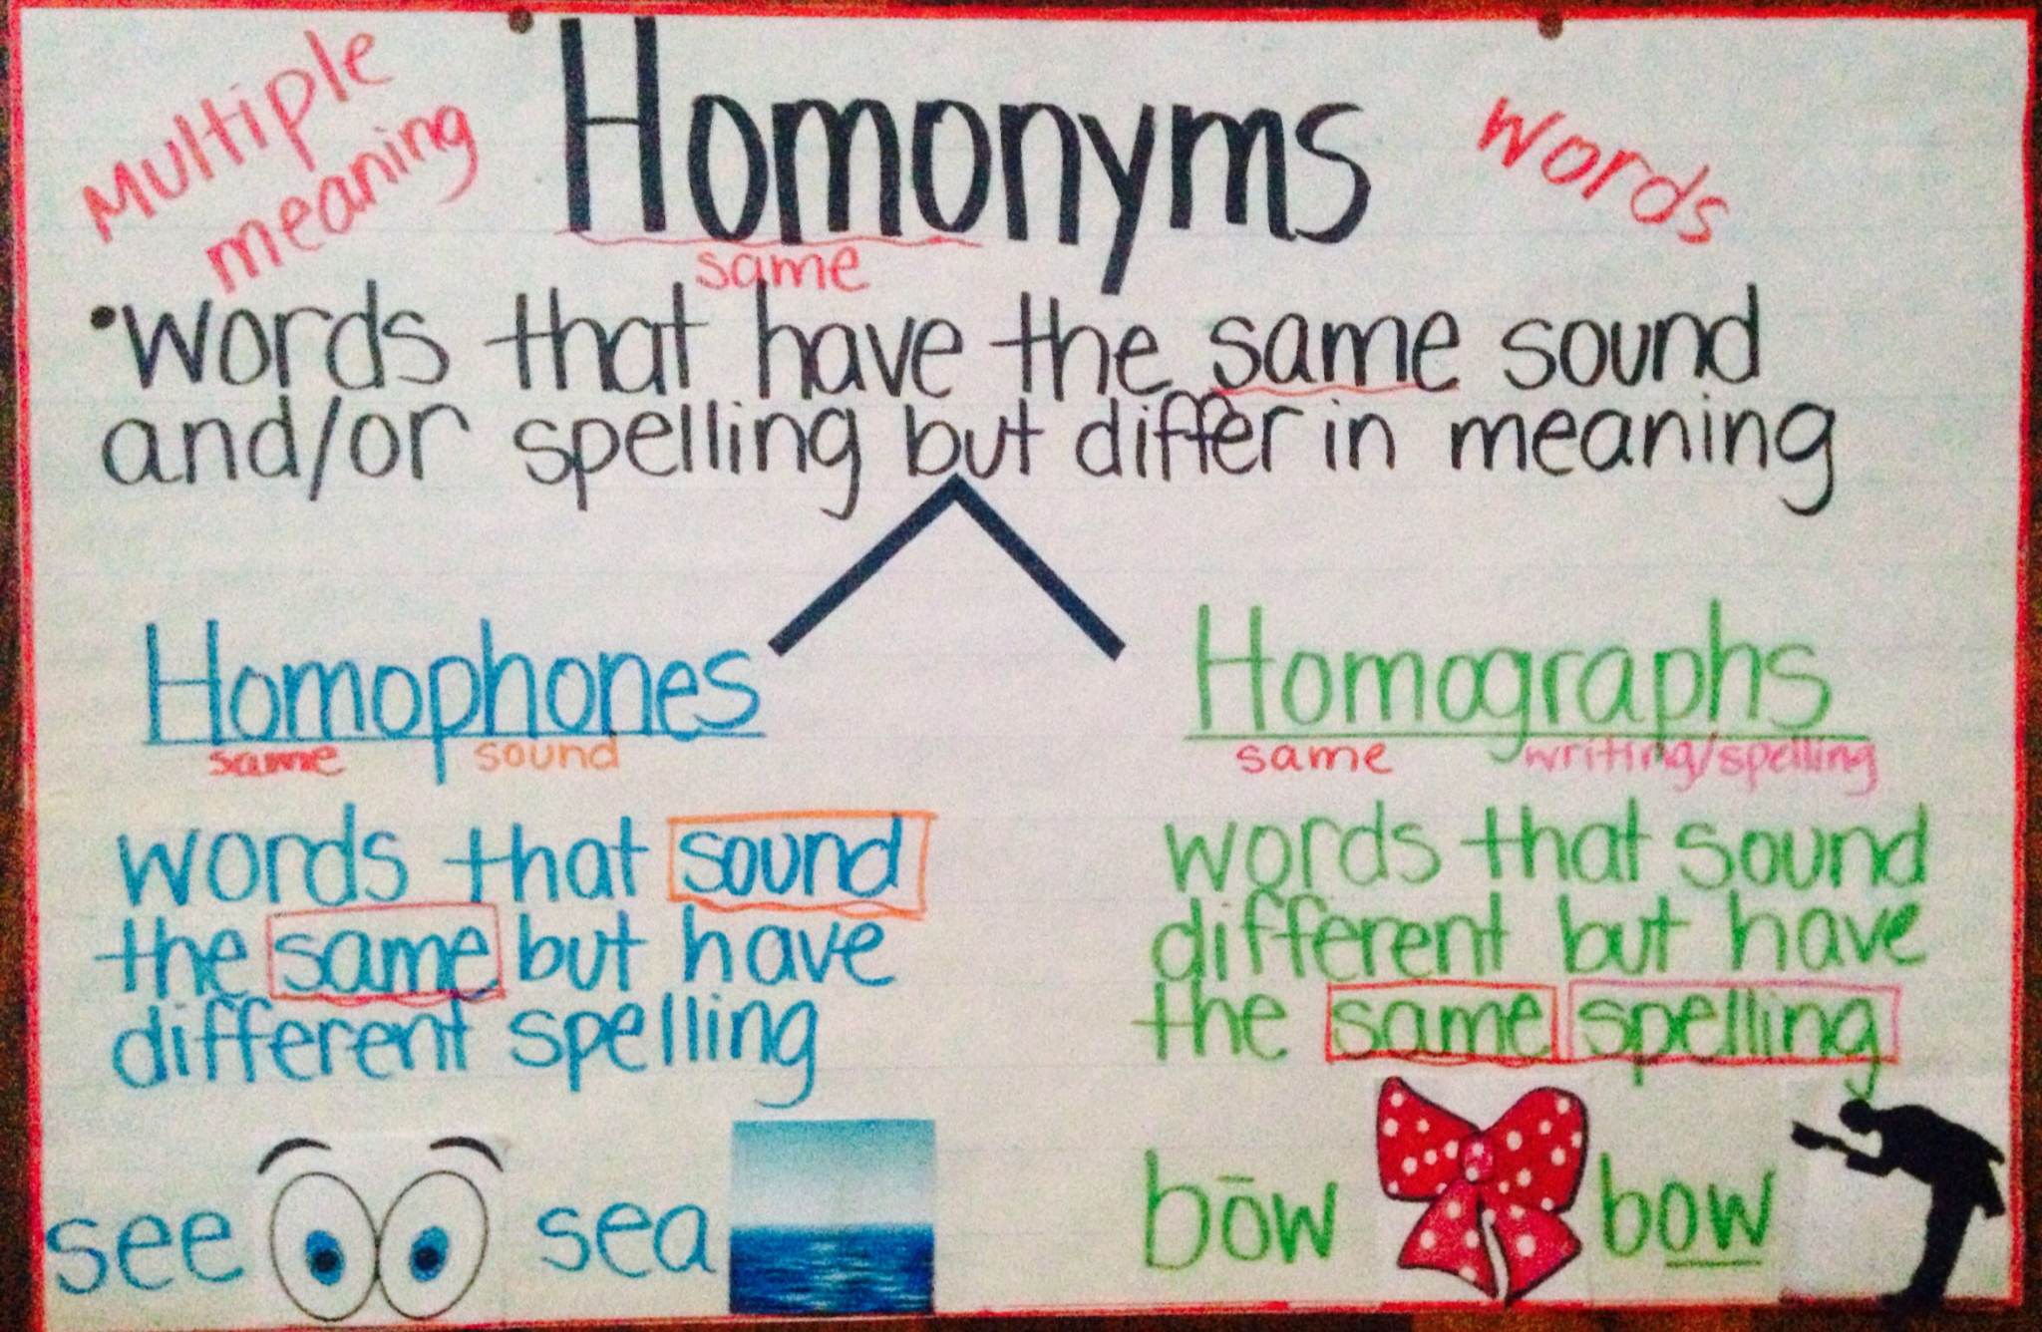
Vocabulary Notebooks and Routines (6 of 14)
Collect words like homophones over time with an illustration and identifying sentence

Slide 42
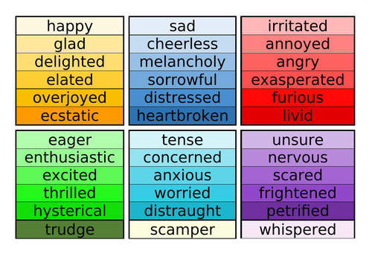
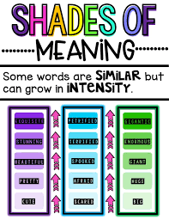
Vocabulary Notebooks and Routines (7 of 14)

Slide 43
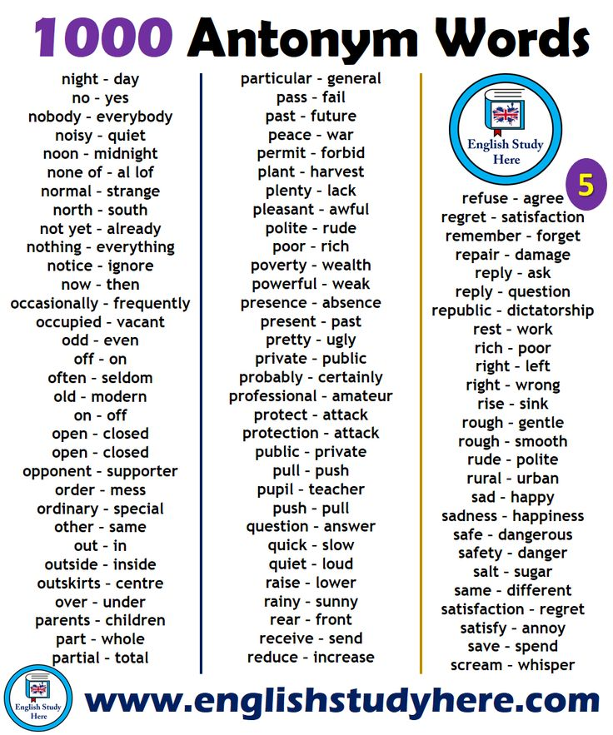
Vocabulary Notebooks and Routines (8 of 14)

Slide 44
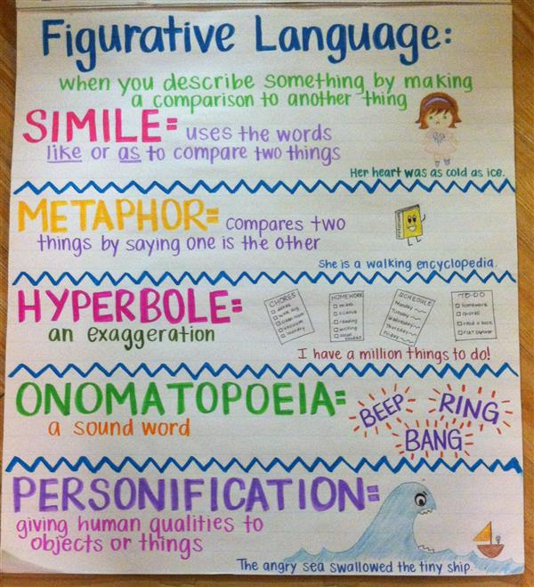
Vocabulary Notebooks and Routines (9 of 14)
Figurative Language: Simile
Metaphor
Hyperbole
Puns
Idioms

Slide 45
Vocabulary Notebooks and Routines (10 of 14)
Sentence Synthesis
Provide 3-5 terms from any related unit of study.
Challenge the student to use as many terms as they can in one sentence which reveals the word meanings correctly.
Share different sentences visually as models.
Example
Terms in English: metaphor, simile, personification, hyperbole
English teachers teach figurative language including similes, comparisons with like or as, metaphors, direct comparisons, hyperbole, the use of exaggeration, and personification, a person, animal, or object representing a concept.

Slide 46
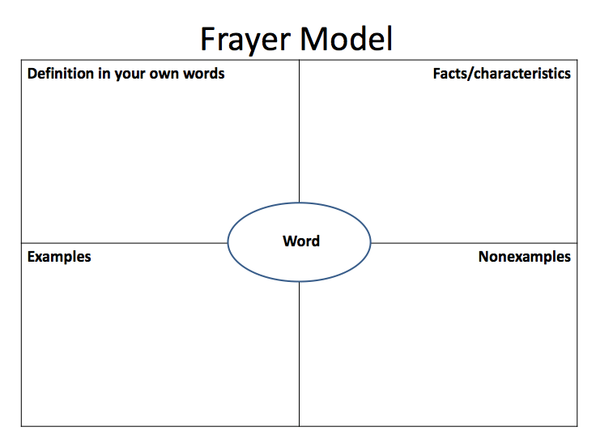
Vocabulary Notebooks and Routines (11 of 14)
The Frayer model provides a graphic organizer that includes a word’s definition, facts and characteristics of the word, examples and non-examples (Frayer, Frederick, & Klausmeier, 1969). It was designed to demonstrate deep understanding about a single word.

Slide 47
Vocabulary Notebooks and Routines (12 of 14)

Slide 48
Vocabulary Notebooks and Routines (13 of 14)
List, Group, Label
List terms and phrases from a single unit of study or topic; often these words are boldfaced in textbooks.
Sort or categorize the terms into groups and discuss thinking for the categorization
Create a title or label for each category that reflects how the words are related.
It can be helpful to create your initial list on cards or sticky notes. The act of categorizing specific vocabulary terms requires discussion and a nuanced understanding of how words are related. List, Group, Label also provides an opportunity for students to revisit words that were challenging or nuanced.

Slide 49
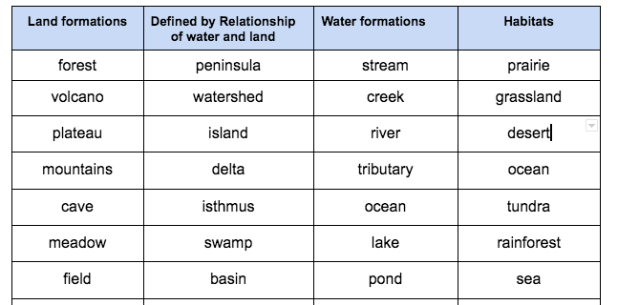
Vocabulary Notebooks and Routines (14 of 14)
List, Group, Label

Slide 50
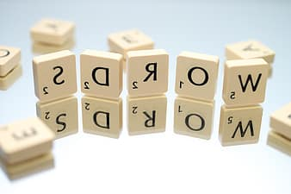
Turn Theory into Practice
Give a spelling inventory to your class/classes.
Analyze the spelling of your students
Determine what gaps there are and what instruction is needed for your students
Be ready to look at your data at an upcoming Learning Lab

Slide 51
Handouts
Words Their Way Spelling Assessment
Really Great Reading Advanced Decoding Survey
Types of Words to Collect, Connect, and Discuss
Developmental Continuum in Spelling Features

Slide 52
Resources
Highlighted References
Bear, D. R., Invernizzi, M., Johnston, F., & Templeton, S. (1996). Words their way: Word study for phonics, vocabulary, and spelling (p. 480). Merrill.
Gough, P. B., & Tunmer, W. E. (1986). Decoding, reading, and reading disability. Remedial and special education, 7(1), 6-10.
National Reading Panel (US), National Institute of Child Health, Human Development (US), National Reading Excellence Initiative, National Institute for Literacy (US), & United States Department of Health. (2000). Report of the National Reading Panel: Teaching children to read: An evidence-based assessment of the scientific research literature on reading and its implications for reading instruction: Reports of the subgroups. National Institute of Child Health and Human Development, National Institutes of Health.
Scarborough, H., & as cited in International Dyslexia Association. (2018). Scarborough’s reading rope: a groundbreaking infographic. International Dyslexia Association, 7(2), 13-18.
Vaughn, S., Kieffer, M. J., McKeown, M., Reed, D. K., Sanchez, M., St Martin, K., ... & Yañez, A. (2022). Providing Reading Interventions for Students in Grades 4-9. Educator's Practice Guide. WWC 2022007. What Works Clearinghouse.

Slide 53
Professional Learning Texts
Professional Learning Texts For Exploration
Words Their Way: Word Study for Phonics, Vocabulary and Spelling Instruction by Bear, Invernizzi, Templeton, and Johnston
Words Their Way with Struggling Readers: Word Study for Reading, Vocabulary, and Spelling Instruction, Grades 4-12 by Francine Johnston, Donald Bear, Marcia Invernizzi, Kevin Flanagan and Tisha Hayes
Words Their Way for Parents, Tutors, and School Volunteers by Michelle Picard, Alison Meadows, Marcia Invernizzi, Donald Bear and Francine Johnston
Vocabulary Their Way Word Study with Middle and High School Students by Shane Templeton, Francine Johnston, Donald Bear, and Marcia Invernizzi
Greek and Latin Roots: Keys to Building Vocabulary by Timothy Rasinski, Nancy Padak, Rick M. Newton, Evangeline Newton
Bringing Words to Life: Robust Vocabulary by Isabel Beck, Linda Kucan, and Margaret McKeown
Creating Robust Vocabulary : Frequently Asked Questions and Extended Examples by Isabel Beck, Linda Kucan, and Margaret McKeown
Vocabulary Book: Learning and Instruction by Michael F. Graves
Teaching Word Meanings by Steven A. Stahl and William E. Nagy
Words, Words, Words by Janet Allen

Slide 54
Thank You!
Dr. Michelle Picard
michelle.picard@lcps.org
Melissa McQuillan
melissa.mcquillan@lcps.org

Slide 55
Resource Websites
Library of Congress | https://www.loc.gov/
National Geographic | https://www.nationalgeographic.org/education/
Read Works | www.readworks.org
Really Great Reading | https://www.reallygreatreading.com/
Library of Virginia | http://www.lva.virginia.gov/
Encyclopedia Virginia | http://encyclopediavirginia.org
VMHC History Explorer | https://www.virginiahistory.org/collections-and-resources/virginia-history-explorer
CommonLit | https://www.commonlit.org/
Read Write Think | http://www.readwritethink.org/
Academy of American Poets | www.poets.org
The Digital Library of Appalachia | https://dla.acaweb.org/digital/collection/Ferrum

Slide 56
Disclaimer
Reference within this presentation to any specific commercial or non-commercial product, process, or service by trade name, trademark, manufacturer or otherwise does not constitute or imply an endorsement, recommendation, or favoring by the Virginia Department of Education.

