Slide 1
scientific reading research and disciplinary literacy at the middle school level

Slide 2
Catalyst
By the time students are in upper-elementary grades, reading material in all subject areas conveys information and ideas that students are expected to learn and understand.
When students are unable to understand these texts, they miss crucial opportunities to learn grade level content.
Question: How can we better prepare all students for the complex demands of reading in middle and high school courses?

Slide 3
Research

Slide 4
Adolescent Reading Research
"WWC | Providing Reading Interventions for Students in Grades 4–9." 13 Apr. 2022, https://ies.ed.gov/ncee/wwc/PracticeGuide/29. Accessed 18 Jul. 2022.
Recommendation #3 Part A Build students’ world and word knowledge so they can make sense of the text. Pages 22-37
Recommendation #3 Part B Consistently provide students with opportunities to ask and answer questions to better understand the text they read. Pages 37-47
Recommendation #3 Part C Teach students a routine for determining the gist of a short section of text. Pages 48- 58
Recommendation #3 Part D Teach students to monitor their comprehension as they read. Pages 59-64

Slide 5
Recommendation #3 Part A: Build students’ world and word knowledge so they can make sense of the text. Pages 22-37
1. Develop world knowledge that is relevant for making sense of the passage.
2. Teach the meaning of a few words that are essential for understanding the passage.
3. Teach students how to derive meanings of unknown words using context.
4. Teach prefixes and suffixes to help students derive meanings of words.
5. Teach the meaning of Latin and Greek roots.

Slide 6
Recommendation #3 Part B: Consistently provide students with opportunities to ask and answer questions to better understand the text they read. Pages 37-47
1. Explicitly teach students how to find and justify answers to different types of questions.
2. Provide ample opportunities for students to collaboratively answer questions.
3. Teach students to ask questions about the text while reading.

Slide 7
Recommendation #3 Part C Teach students a routine for determining the gist of a short section of text. Pages 48- 58
1. Model how to use a routine to generate gist statements.
2. Teach students how to use text structures to generate gist statements.
3. Work collaboratively with students to generate gist statements.

Slide 8
Recommendation #3 Part D Teach students to monitor their comprehension as they read. Pages 59-64
1. Help students determine when they do not understand the text.
2. Teach students to ask themselves questions as they read to check their understanding and figure out what the text is about.
3. Provide opportunities for students to reflect on what they have learned.

Slide 9
Adolescent Reading Research
"WWC | Providing Reading Interventions for Students in Grades 4–9." 13 Apr. 2022, https://ies.ed.gov/ncee/wwc/PracticeGuide/29. Accessed 18 Jul. 2022.
Recommendation #4
Provide students with opportunities to practice making sense of stretch text (challenging text) that will expose them to complex ideas and information. Pages 68-76

Slide 10
Recommendation #4 Provide students with opportunities to practice making sense of stretch text (challenging text) that will expose them to complex ideas and information. Pages 68-76
1. Prepare for the lesson by carefully selecting appropriate stretch texts, choosing points to stop for discussion and clarification, and identifying words to teach.
2. Provide significant support as the group works through a stretch text together.
3. After students demonstrate comfort with reading stretch texts with the group, provide students with electronic supports to use when independently reading stretch text to assist with pronunciation of difficult words and word meanings.

Slide 11
Sources of Disciplinary Literacy Research
Hand, Brian, Carolyn W. Wallace, and Eun‐Mi Yang. "Using a Science Writing Heuristic to enhance learning outcomes from laboratory activities in seventh‐grade science: quantitative and qualitative aspects." International Journal of Science Education 26.2 (2004): 131-149.
Hynd, Cynthia, Jodi Patrick Holschuh, and Betty P. Hubbard. "Thinking like a historian: College students' reading of multiple historical documents." Journal of Literacy Research 36.2 (2004): 141-176.

Slide 12
Sources of Disciplinary Literacy Research
"What is Disciplinary Literacy and Why Does it Matter." https://www.shanahanonliteracy.com/publications/what-is-disciplinary-literacy-and-why-does-it-matter. Accessed 18 Jul. 2022.
This article compares disciplinary literacy with the more widely emphasized approach known as content area literacy and provides an analysis of the growing research base underlying the disciplinary literacy construct. Research studies on disciplinary literacy are drawn from expert–novice comparisons in which think-aloud data are collected, during reading, from experts (i.e., mathematicians, chemists, historians) and students, and from functional linguistics analyses of the features of the grammars in disciplinary texts to identify the purposes and cognitive and communicative approaches that these grammars reveal. Finally, implications for school programs and instruction are considered.

Slide 13
Fair Use
Handouts created by Dawn Baber and Melanie Kennedy are based on
Cynthia and Tim Shanahan's work. Permission from the authors was granted to link this work to our presentation, cite their work in our presentations and to create handouts based on this work.
"Disciplinary Literacy Montana." 1 Oct. 2018, https://www.shanahanonliteracy.com/publications/disciplinary-literacy-montana. Accessed 18 Jul. 2022.
Timothy Shanahan’s Biography

Slide 14
Timothy Shanahan Biography
Timothy Shanahan’s Biography
Timothy Shanahan is Distinguished Professor Emeritus at the University of Illinois at Chi­cago where he was Founding Di­rector of the UIC Center for Literacy. Previously, he was director of reading for the Chicago Public Schools. He is author/editor of more than 200 publications on literacy education. His research emphasizes the connections between reading and writing, literacy in the disciplines, and improvement of reading achievement.
Tim is past president of the International Literacy Association. He served as a member of the Advisory Board of the National Institute for Literacy under Presidents George W. Bush and Barack Obama, and he helped lead the National Reading Panel, convened at the request of Congress to evaluate research on the teaching reading, a major influence on reading education. He chaired two other federal research review panels: the National Literacy Panel for Language Minority Children and Youth, and the National Early Literacy Panel, and helped write the Common Core State Standards.
He was inducted to the Reading Hall of Fame in 2007, and is a former first-grade teacher.

Slide 15
Reading through the eyes of scientists and historians

Slide 16
Overview
Using narrative nonfiction to build disciplinary literacy through the lens of a historian or scientist; incorporating strands of literacy for all Tier 1-3 students; providing differentiated scaffolding; centered around problem-based learning and a Socratic Seminar. Methods can be reproduced using different texts either as a whole thematic unit or in parts.

Slide 17
Based on work by
Timothy and Cynthia Shanahan

Slide 18
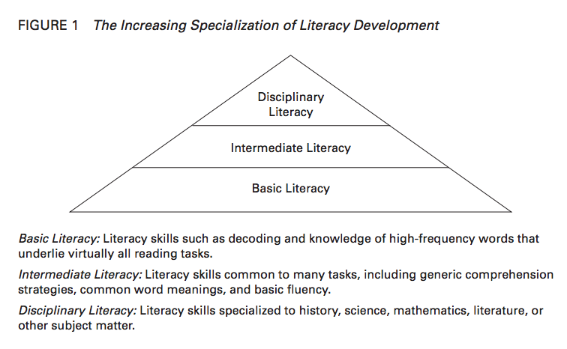
Literacy Pyramid

Slide 19
The What (Part 1 of 2)
What is content area reading?
Content area reading is the teaching of a generalizable set of study skills across content areas for the use in subject matter classes.
In content area reading students use ELA skills such as comprehension skills, study skills, prediction, summarizing
Reading to gain an understanding of history, math, and science by utilizing ELA strategies to master content
Strategies such as the SQ3R, summarizing, questioning, monitoring, and visualizing, paraphrasing
This is more for the novice of the subject.

Slide 20
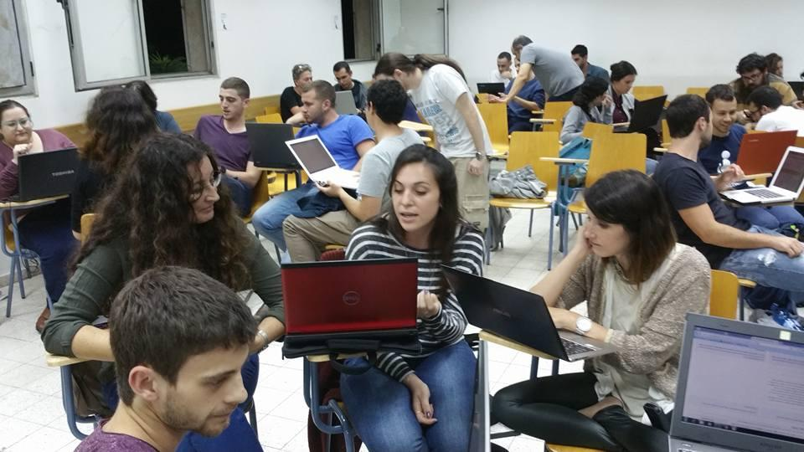
The What (Part 2 of 2)
What is disciplinary literacy?
Disciplinary Literacy is reading and writing that is tailored to the specific characteristics and demands of each discipline.
Emphasizes the description of unique uses and implications of literacy use within the various disciplines.
They have different purposes and approaches to knowledge
In disciplinary literacy, students are acting in the role of historians, scientists, mathematicians and writers.
Disciplinary literacy helps students understand how to use the tools of the discipline. They are acting as historians, scientists, and mathematicians. They are learning the tools of those particular disciplines which may help them in the future.

Slide 21
How is disciplinary literacy different from content area reading?
Disciplinary Literacy is different from content area reading because it emphasizes the unique tools that the experts in a discipline used to engage in the work of that discipline
So, you will read like a scientist, a historian, a mathematician, or a literary agent/writer

Slide 22
Content Area Reading VS Disciplinary Literacy
CONTENT AREA READING
DISCIPLINARY LITERACY
All teachers are reading teachers
Emphasis ELA skills in all reading
Focuses on reading comprehension & study skills
Goal of making better students
Asks “ What is the same across the disciplines?”
Reading & writing are highly generalizable skills
Literacy can be taught with any text/content
Strategies can be applied across disciplines
Can develop “toolbox” of strategies
VOCABULARY
Students need to learn terminology in all fields
Same study techniques for all terms
Realizes not all teachers know how to teach reading
Emphasizes subject area reading skills
Focuses using discipline knowledge to approach texts
Has the goal of making better apprentices of discipline
Asks “ What is different across the disciplines?”
Reading & writing becomes more and more specialized
Specialized approaches to literacy need to be taught
Strategies that are for all disciplines are to generalized
Specific approaches come out of the demands of the text and the purpose of the discipline.
Terminology is specific to field
Different ways to identify and learn

Slide 23
WHY is disciplinary literacy important?
The disciplines represent different cultures
Have different purposes and approaches to knowledge
To prepare students for the real world
Use different methods to gain information
Depend on different kinds of evidence
Write different kinds of texts
READ WITH THOSE DIFFERENCES IN MIND

Slide 24
HOW do we do this? (Part 1 of 2)
Find real world texts
In social studies
Primary sources/secondary- recounts explanations and arguments
Reliability of author
May have conflicting evidence
May have alternative points of view
In science
Scientists wonder about the natural world through observation and experiments.
Look for texts that try to prove something or support a hypothesis.
Textbooks may be used in addition to periodicals and research papers.

Slide 25
HOW do we do this? (Part 2 of 2)
In Math
Mixture of prose, formulae, and graphics
Precision- in definitions and the way the text is read
Need to look for errors
Concepts are described in relation to each other
Reading order changes ( not always left to right)
Abstraction and generalization (intense reading needed)

Slide 26
THE FOUR LENSES (Part 1 of 11)
Reading Like a Historian
Things to consider as you read
Primary/Secondary Sources
Reliability of author
May have conflicting evidence
May have alternative points of view
Think about how this fits with your knowledge of big events in history

Slide 27
THE FOUR LENSES (Part 2 of 11)
Reading Like a Historian
Things to look for:
Names
Dates
Chronological Order
Maps
Charts
Graphs
Recounts, explanations, arguments
Cause and Effect signal words (because, since, consequently, this leads to, if…then…, nevertheless, accordingly, because of, as a result of, in order to, may be due to, yet, for this reason)

Slide 28
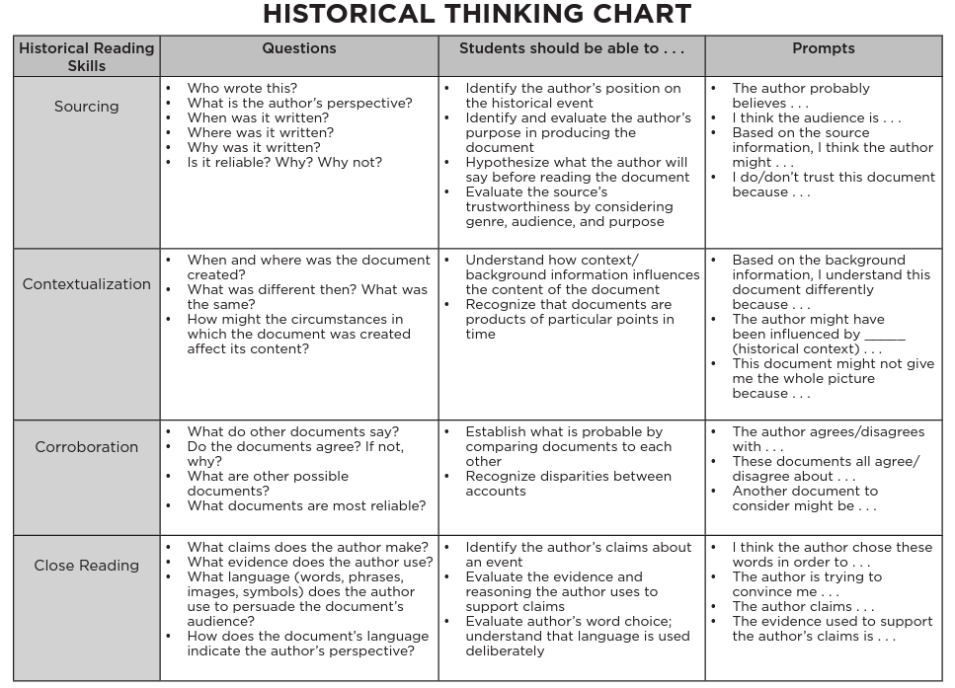
THE FOUR LENSES (Part 3 of 11)

Slide 29
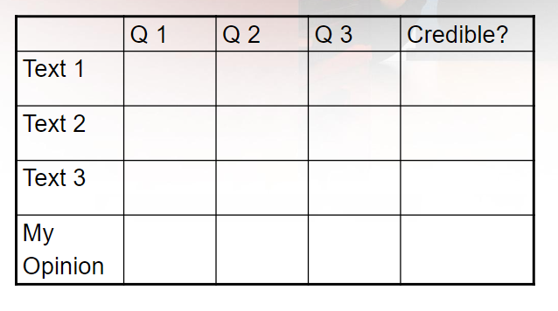
THE FOUR LENSES (Part 4 of 11)
Inquiry Chart

Slide 30
THE FOUR LENSES (Part 5 of 11)
Reading Like a Scientist
Scientists wonder about the natural world
It is learning about the natural world through observation and experiments
What is the text trying to prove (claim/hypothesis)
Does it support the hypothesis (textual evidence)

Slide 31
THE FOUR LENSES (Part 6 of 11)
Reading Like a Scientist
Precision is KEY
Numbers
Units of Measure
Percentiles
Charts
Graphs
Diagrams
Data Tables
Steps/Processes/Procedures
Evidence (explanation is important because language does not lead to exactness)
Recognize Scientific Terms (Problem, Hypothesis, Experimentation, Observation, Conclusion, Contrast, Variable)

Slide 32
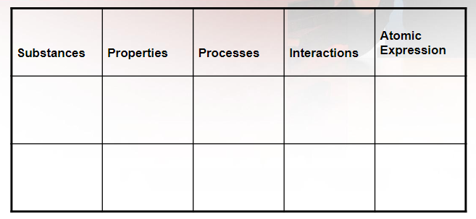
THE FOUR LENSES (Part 7 of 11)
Chemistry Note Taking Chart

Slide 33
THE FOUR LENSES (Part 8 of 11)
Reading Like a Writer
To create artificial worlds that provide insight into the human condition.
Truth is irrelevant.
Use of story and poetry to interpret the human condition.
Is an interpretation of meaning based on textual clues/evidence?
Poems, short stories, novels, plays: critiques: most emphasizing character, plot, rising action, climax, theme … ( missing)
Read in accordance with a particular literary tradition ( close reading, reader response scholarly reading, using a particular interpretive lens/poststructural)

Slide 34
THE FOUR LENSES (Part 9 of 11)
Things to Look for as a Writer
Who is the audience?
Theme-Life Lesson
Mood- General Feeling- (Emoji)
Tone
Characterization (static or dynamic)
Style
Literary Lens
Imagery (description, metaphor, simile
Figuration (symbolism, irony, satire)
Syntax

Slide 35
THE FOUR LENSES (Part 10 of 11)
Reading Like a Mathematician
Things to consider as you read
To find the answer to a problem, the abstract truth
Logical, accurate solutions produce truth to answers
Every word should be read carefully and texts should be reread
Reading order changes (not always left to right)

Slide 36
THE FOUR LENSES (Part 11 of 11)
Reading Like a Mathematician
Things to look for as you read
Numbers
Formulas
Units of Measure
Percentiles
Charts
Graphs
Diagrams
Data Tables
Steps/Processes/Procedures

Slide 37
Tier 1 Instruction
Build Background Knowledge
Vocabulary/Morphology
Reciprocal Teaching
DRTA
Close Reading/Rereading
GIST Statements
Challenging/Complex Text
Text Sets/Quad Texts (Dr. Sarah Lupo-JMU)
Writing & Talking About Reading

Slide 38
Tier 2 Interventions
KWL
Vocabulary Work
Anticipation Guide
Story Walk
Reading Guides
Chunking
DRTA
Reciprocal Teaching
Talking About Reading
Writing/Reflecting About Reading

Slide 39
Tier 3 Interventions
Include Tier 2 Interventions
Modeled Fluent Reading- (Introduction)
Choral Reading
Close Reading
Paired Reading
Save questions to end of 1st or 2nd read
Sentence frames for academic discussions

Slide 40
Now that you have read through the lens of a historian, scientist, mathematician, or writer…
Complete a problem-based learning activity
Write a reflection.
Participate in a discussion or Socratic Seminar

Slide 41
Problem-Based Learning Example
In order to promote tourism, a group of Virginia Beach hotel owners
wants to create a program to eliminate sharks from the coastal waters.
Marine biologists and shark lovers are outraged. Because of your skills
as a public relations expert, you have been recruited by both sides to
create a public service message to get support from the public. What
side do you choose? How will you convince people to support your side?
What evidence will you choose to support your client's opinions?
Your message will go to the public (your classmates).

Slide 42
Problem-Based Learning Example
Afterward, the best project will decide the fate of the sharks.
You have one hour, your devices, and each other to create your
message. Unleash your creativity.
Attach all work to this assignment. Share all files with your group members.

Slide 43
Socratic Seminar
Explain to students that they will get to participate in a student-centered discussion.
Create a set of norms.
Use Socratic Seminar Sentence Starters to guide responses.
Use generic questions to help create text specific questions.
Use a checklist to help students observe discussion group members.
Have students complete a self-reflection.

Slide 44
https://whatschoolcouldbe.org/socratic-seminar/

Slide 45
Give students advance notice that they’ll have the opportunity to debate each other, along with the topic/question (e.g., a student-generated topic, a question from Curiosity Time). Set aside a class period for this student discussion and debate. This video explores a more formal Socratic Seminar. But you can accomplish a lot with occasional short blocks of discussion/debate time (10-20 minutes) among smaller groups of students. These can be done in person or virtually.
Give Socratic Seminars A Try

Slide 46
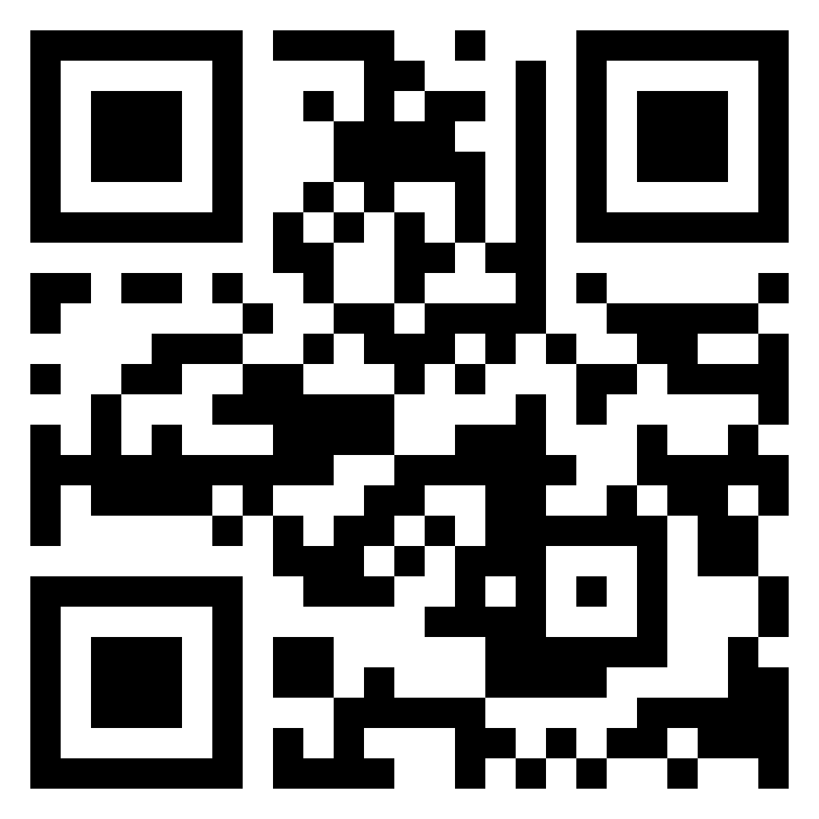
Resources:
Presentation Documents
Contact Information:
Dawn Baber dbaber@apps.fluco.org @Dawn_Baber1
Melanie Kennedy mkennedy@apps.fluco.org @MelanieCKennedy

Slide 47
Further Reading
What Is Disciplinary Literacy and Why Does It Matter?
Timothy Shanahan and Cynthia Shanahan
Texts, Texts, Texts: A Guide to Analyze Texts for Elementary Students
D. Ray Reutzel, Parker C. Fawson

Slide 48
References
"WWC | Providing Reading Interventions for Students in Grades 4–9." 13 Apr. 2022, https://ies.ed.gov/ncee/wwc/PracticeGuide/29. Accessed 18 Jul. 2022.
"Disciplinary Literacy Montana." https://www.shanahanonliteracy.com/publications/disciplinary-literacy-montana. Accessed 24 Jun. 2022.
"What is Disciplinary Literacy and Why Does it Matter." https://www.shanahanonliteracy.com/publications/what-is-disciplinary-literacy-and-why-does-it-matter. Accessed 24 Jun. 2022.
Dr. Sarah Lupo: Assistant Professor - James Madison University.
"Building Background Knowledge Through Reading: Rethinking Text ...." 5 Jul. 2022, https://www.researchgate.net/publication/319904463_Building_Background_Knowledge_Through_Reading_Rethinking_Text_Sets. Accessed 18 Jul. 2022.
"Struggle Is Not a Bad Word: Misconceptions and Recommendations ...." 4 Nov. 2018, https://ila.onlinelibrary.wiley.com/doi/abs/10.1002/jaal.926. Accessed 18 Jul. 2022.

Slide 49
Disclaimer
Reference within this presentation to any specific commercial or non-commercial product, process, or service by trade name, trademark, manufacturer or otherwise does not constitute or imply an endorsement, recommendation, or favoring by the Virginia Department of Education.

