Slide 1
Project-Based Learning
Access and integrated teaching for all.

Slide 2


Presenter Slide
Presenters
Christie Day
Dr. Meg Mascelli

Slide 3
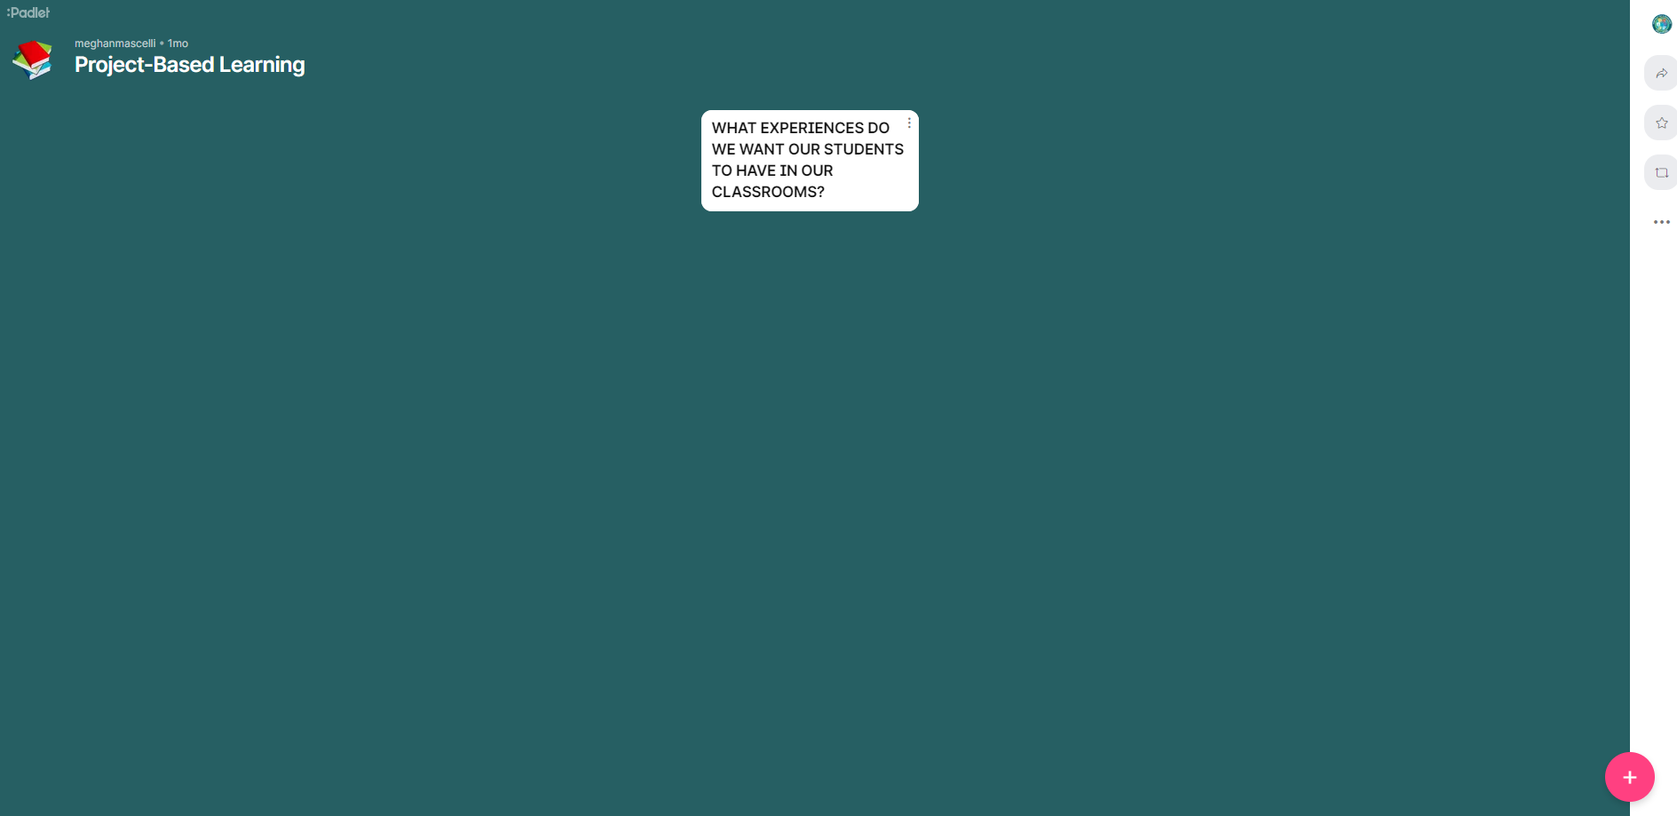
What experiences do we want for ALL students?
(1 of 2)
Click on the + to add your ideas
Add your ideas to this Padlet
https://tinyurl.com/vdoepbl22

Slide 4


What experiences do we want for ALL students? (2 of 2)
…TO MAKE MAKE AN IMPACT ON THEIR SCHOOL, WORLD, HOME, OR COMMUNITY.
…TO BE ENGAGED.
…TO DO RELEVANT WORK THAT MATTERS TO THEM.
…TO COLLABORATE WITH PEERS.
…TO DISCUSS AND SHARE THE WHY OF WHAT THEY LEARNED.
…TO DEVELOP TRANSFERABLE SKILLS FOR SUCCESS.
…TO RECOGNIZE STRENGTHS AND SUCCESSES.
…TO THINK DEEPLY ABOUT WHAT THEY ARE LEARNING.

Slide 5
Supported by Research
Adolescent Literacy Instruction
1.Incorporation of Disciplinary Literacy Instruction
2.Integration of Multiple and Social Literacies
3.Orchestration of Engagement and Motivation
4.Appreciation of Multicultural Perspectives and Cultures
Programs and curricula targeted at increasing the relevance of
school, building supportive relationships, and helping students
manage challenges can help prevent disengagement.

Slide 6
We know we want students to have meaningful experiences… and we know teachers have a lot going on.
PBL can help!

Slide 7

Picture of Boy Graduating

Slide 8
Intended Outcomes
Build a foundational understanding of Project Based Learning (PBL)
Learn about how PBL provides a structure for integrating evidence-based literacy instructional practices
Consider opportunities to bring this learning into our own classrooms

Slide 9
THE FOUNDATIONS FOR PROJECT-BASED LEARNING
What’s at the heart of this work?

Slide 10
How do you solve challenges?
Challenge | Need to Know? | Find Information? | Create/Revise/ Refine | Share Information!
How do I decide which book to read next? | New release? Exploring a new author? What books are in my TBR pile… | Talk to colleagues; consult best seller lists; observe student choices; read reviews | Borrow/buy a book (or 5), dedicate time for reading, realize you’re too busy and rent the audio book… | Post a review on Goodreads

Slide 11
The process stays the same! (1 of 2)
Challenge | Need to Know? | Find Information? | Create/Revise/ Refine | Share Information!
How do I decide which book to read next? | New release? Exploring a new author? What books are in my TBR pile… | Talk to colleagues; consult best seller lists; observe student choices; read reviews | Borrow/buy a book (or 5), dedicate time for reading, realize you’re too busy and rent the audio book… | Post a review on Goodreads
How do I apply and get into the best college for me? | Budget? Grades? Professional goals? How far, etc. | Look at bank statements, visit potential schools, talk to advisors, etc. | Write letters, fill in applications, send, wait! | Celebrate with family and peers!
How do I buy my first house? | Budget? Needs? Location? Amenities? Location? Rooms? Location….? | Redfin, drive around, Craigslist, talk to realtor, etc. | Put in bid, write revisions based on inspections, etc. | Have a housewarming party!
How can I create and manage a garden in my yard? | Where? What tools? What plants? Structure? Soil? Care? Schedule? | TV, videos, library, talking to experts, watching videos | Trial and error, daily measurement, adapting water, nutrients, etc. | Grow and share!

Slide 12




The process stays the same! (2 of 2)
Challenge | Need to Know? | Find Information? | Create/Revise/ Refine | Share Information!
How do I decide which book to read next? | New release? Exploring a new author? What books are in my TBR pile… | Talk to colleagues; consult best seller lists; observe student choices; read reviews | Borrow/buy a book (or 5), dedicate time for reading, realize you’re too busy and rent the audio book… | Post a review on Goodreads
How do I apply and get into the best college for me? | Budget? Grades? Professional goals? How far, etc. | Look at bank statements, visit potential schools, talk to advisors, etc. | Write letters, fill in applications, send, wait! | Celebrate with family and peers!
How do I buy my first house? | Budget? Needs? Location? Amenities? Location? Rooms? Location….? | Redfin, drive around, Craigslist, talk to realtor, etc. | Put in bid, write revisions based on inspections, etc. | Have a housewarming party!
How can I create and manage a garden in my yard? | Where? What tools? What plants? Structure? Soil? Care? Schedule? | TV, videos, library, talking to experts, watching videos | Trial and error, daily measurement, adapting water, nutrients, etc. | Grow and share!

Slide 13
PBL Process: 4 Main Parts

Slide 14
PBL Project
Projects
PBL

Slide 15
Traditional Project Timeline
Teach
Assign Project
Assess

Slide 16
PBL Timeline
Introduce Driving Question
Learn
& apply to original work
Identify Needs to Know

Slide 17
Traditional project examples…
Make a poster to promote recycling
Write a book report
Create a story with an original illustration
Identify Needs to Know

Slide 18
… reframed through PBL
Create a plan for the cafeteria that would reduce waste, and convince school leaders why it should be used.
Develop a book trailer that persuades your classmates to read one of your favorite books.
Publish a children’s book that entertains
the audience while teaching about a nonfiction topic.
Make a poster to promote recycling
Write a book report
Create a story with an original illustration
Identify Needs to Know

Slide 19

PBL
Find the Fact

Slide 20
Which statement is true? (1of 2)
Daily instruction within PBL can take a variety of forms, including direct instruction and teacher modeling.
PBL must be done in groups.
Authentic audiences in PBL should include content-related experts.
Designing PBL means starting from scratch.

Slide 21
Which statement is true? (2 of 2)
Daily instruction within PBL can take a variety of forms, including direct instruction and teacher modeling.
PBL must be done in groups.
Authentic audiences in PBL should include content-related experts.
Designing PBL means starting from scratch.

Slide 22
Designing PBL
A high-level overview to the process

Slide 23
Start with the End in Mind
What content do I want students to learn?
Who in the real world uses this content?
What do they do with it?
What’s something similar that kids can do with it?
Step 1

Slide 24
Content Planning Example
What content do I want students to learn?
Who in the real world uses this content?
What do they do with it?
What’s something similar that kids can do with it?
Identify Needs to Know
Persuasive writing and research
People who want others to agree with their ideas
Influence
Convince someone to make a change they want to see

Slide 25
How do you solve challenges? (1 of 2)
Challenge | Need to Know? | Find Information? | Create/Revise/ Refine | Share Information!
How can I convince a school leader to make a change to make school a better place? | Current regulations? Structures of other middle schools? Existing research on middle school? Etc. | Interview students and staff members; read, watch, and/or listen to experts discuss school change | Determine presentation format, write first draft, share with friends, receive feedback, make changes | Send the communication or present to a school leader, post reflection about experience on social media

Slide 26
How do you solve challenges? (2 of 2)
Challenge | Need to Know? | Find Information? | Create/Revise/ Refine | Share Information!
How can I convince a school leader to make a change to make school a better place? | Current regulations? Structures of other middle schools? Existing research on middle school? Etc. | Interview students and staff members; read, watch, and/or listen to experts discuss school change | Determine presentation format, write first draft, share with friends, receive feedback, make changes | Send the communication or present to a school leader, post reflection about experience on social media

Slide 27
Craft the Driving Question
Align to content
Elevate authenticity, engagement, and purpose
Leads to a strong need to know list
How can you, as a ________, ___________________?
Step 2

Slide 28
Example Driving Questions
PBL Idea: Students provide ideas about how to make their school experience better.
DQ Option 1: How can we improve something about middle school so
that it will be a great experience for all students and
persuade school leaders why they should make a change?
DQ Option 2: How can you, as a student activist, develop a social media
campaign that persuades your followers to do their part in
making the school a more welcoming place for everyone?
DQ Option 3: How can you, as an influencer, convince our principal to
improve something about our school that students dislike?
Identify Needs to Know

Slide 29
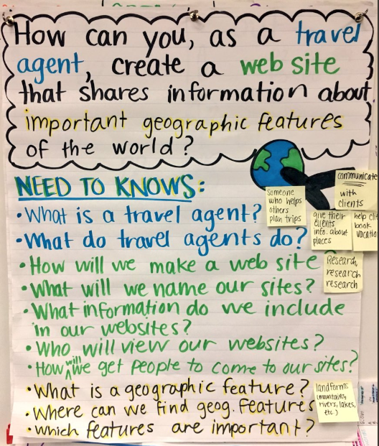
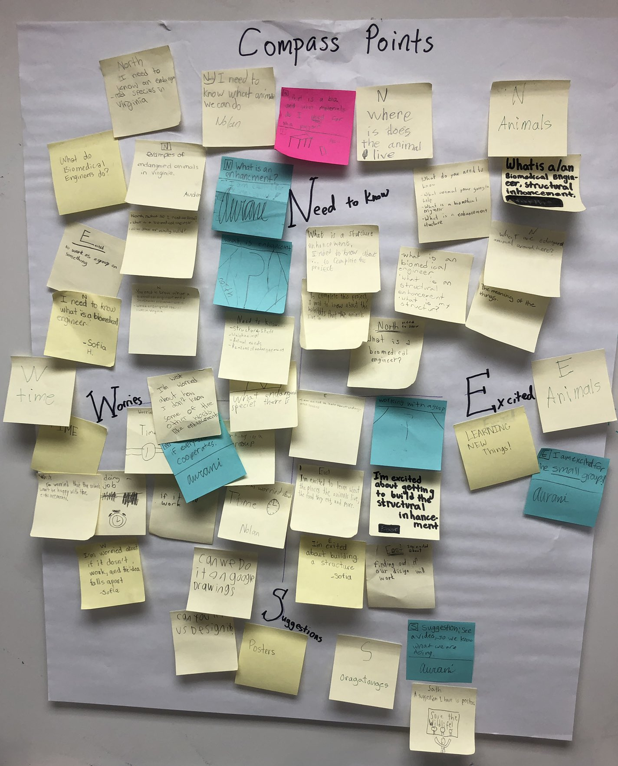
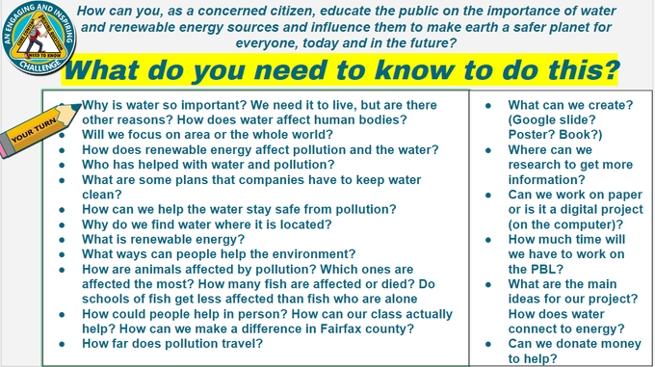
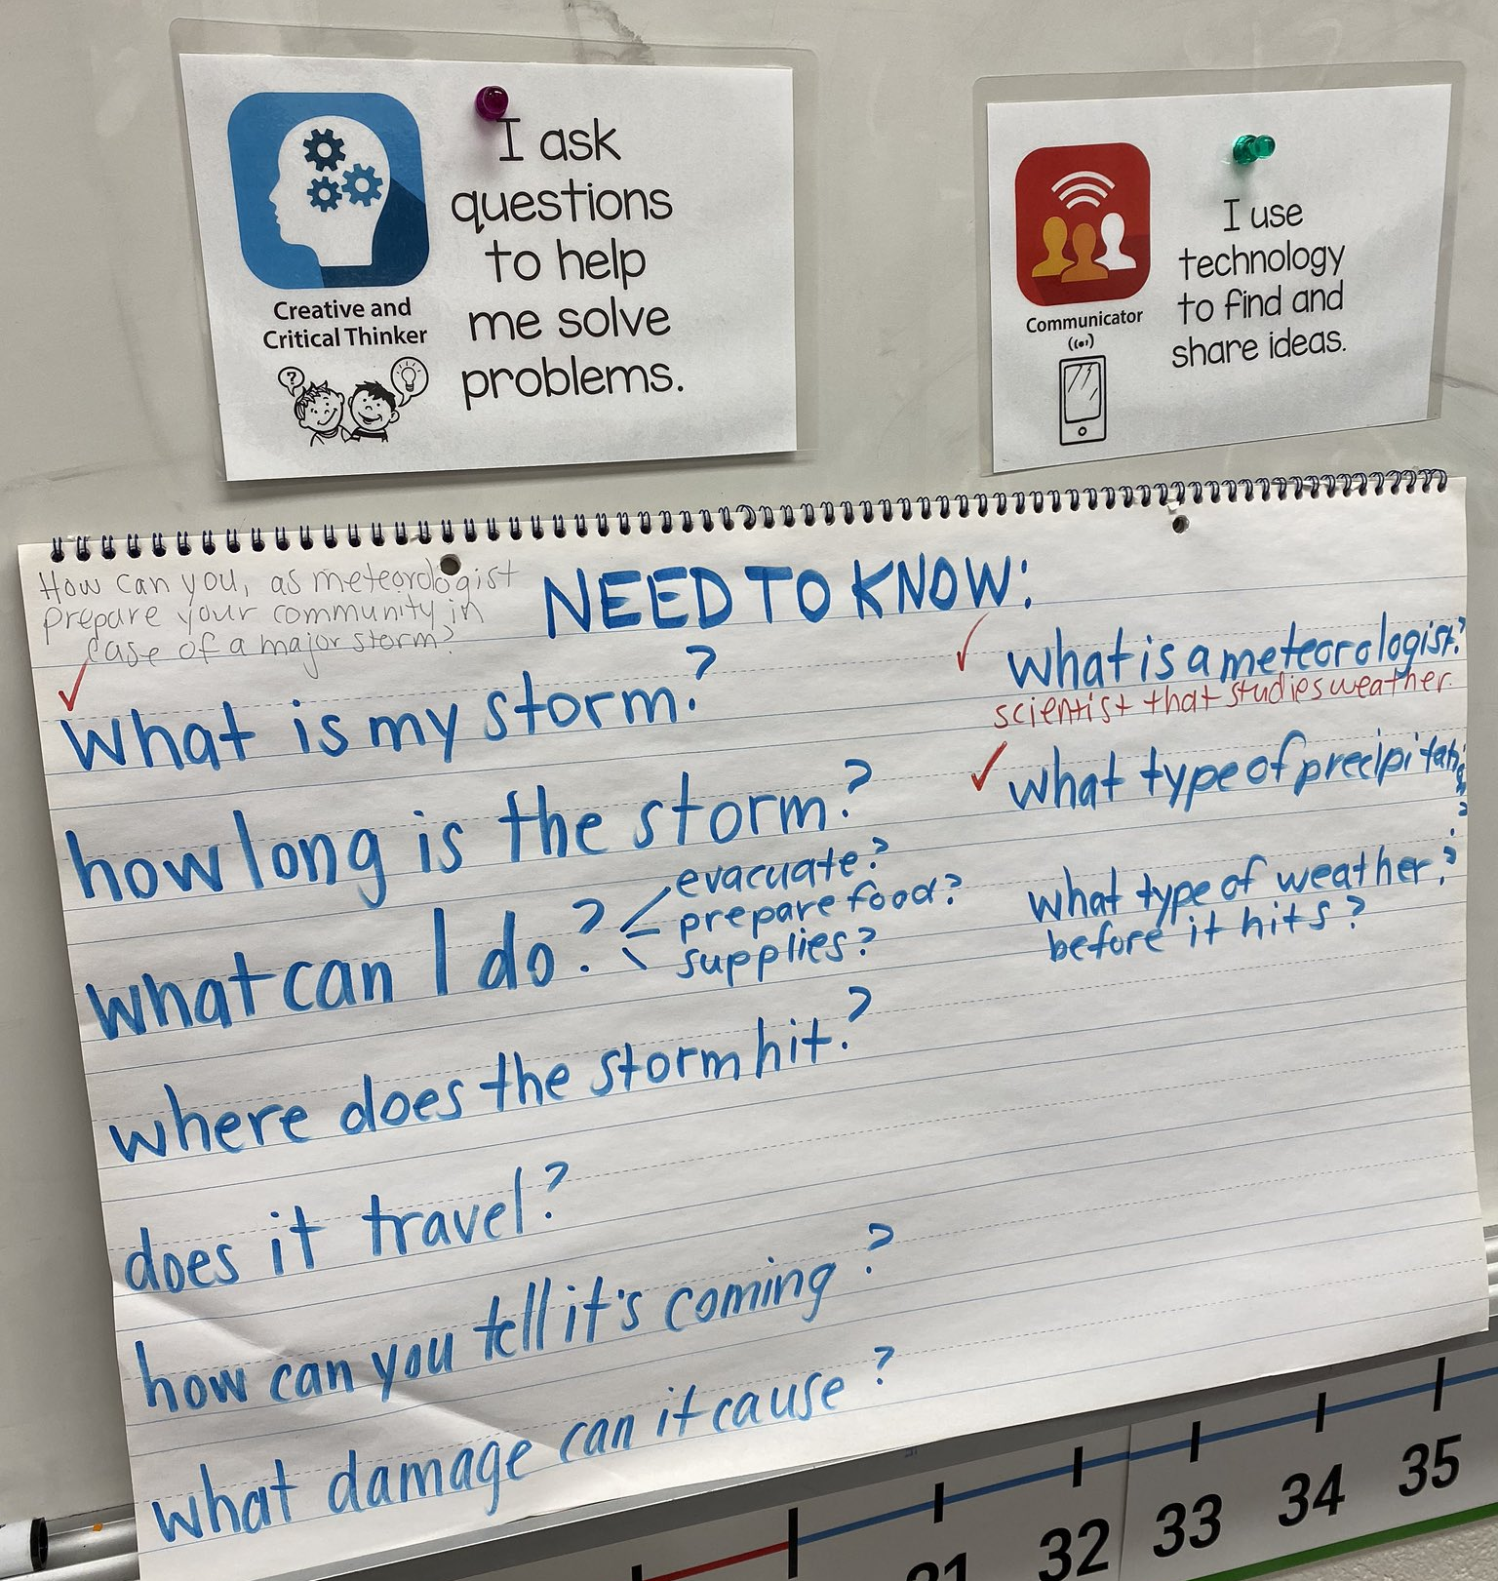
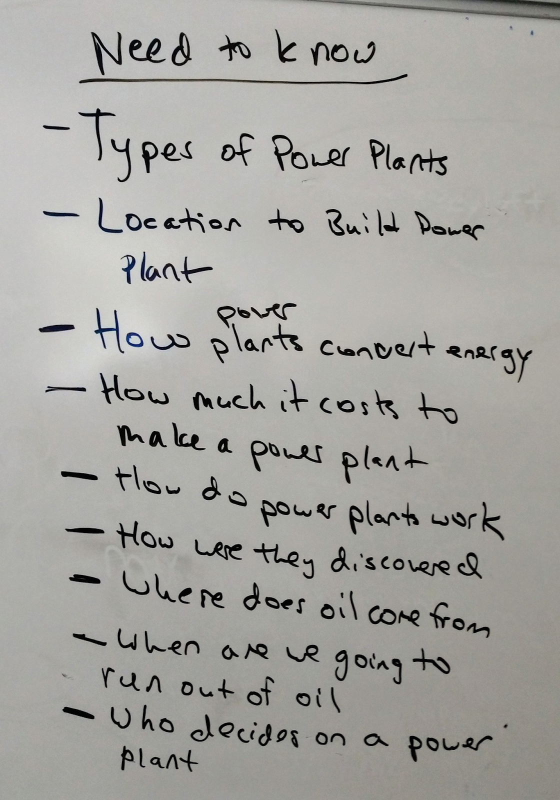
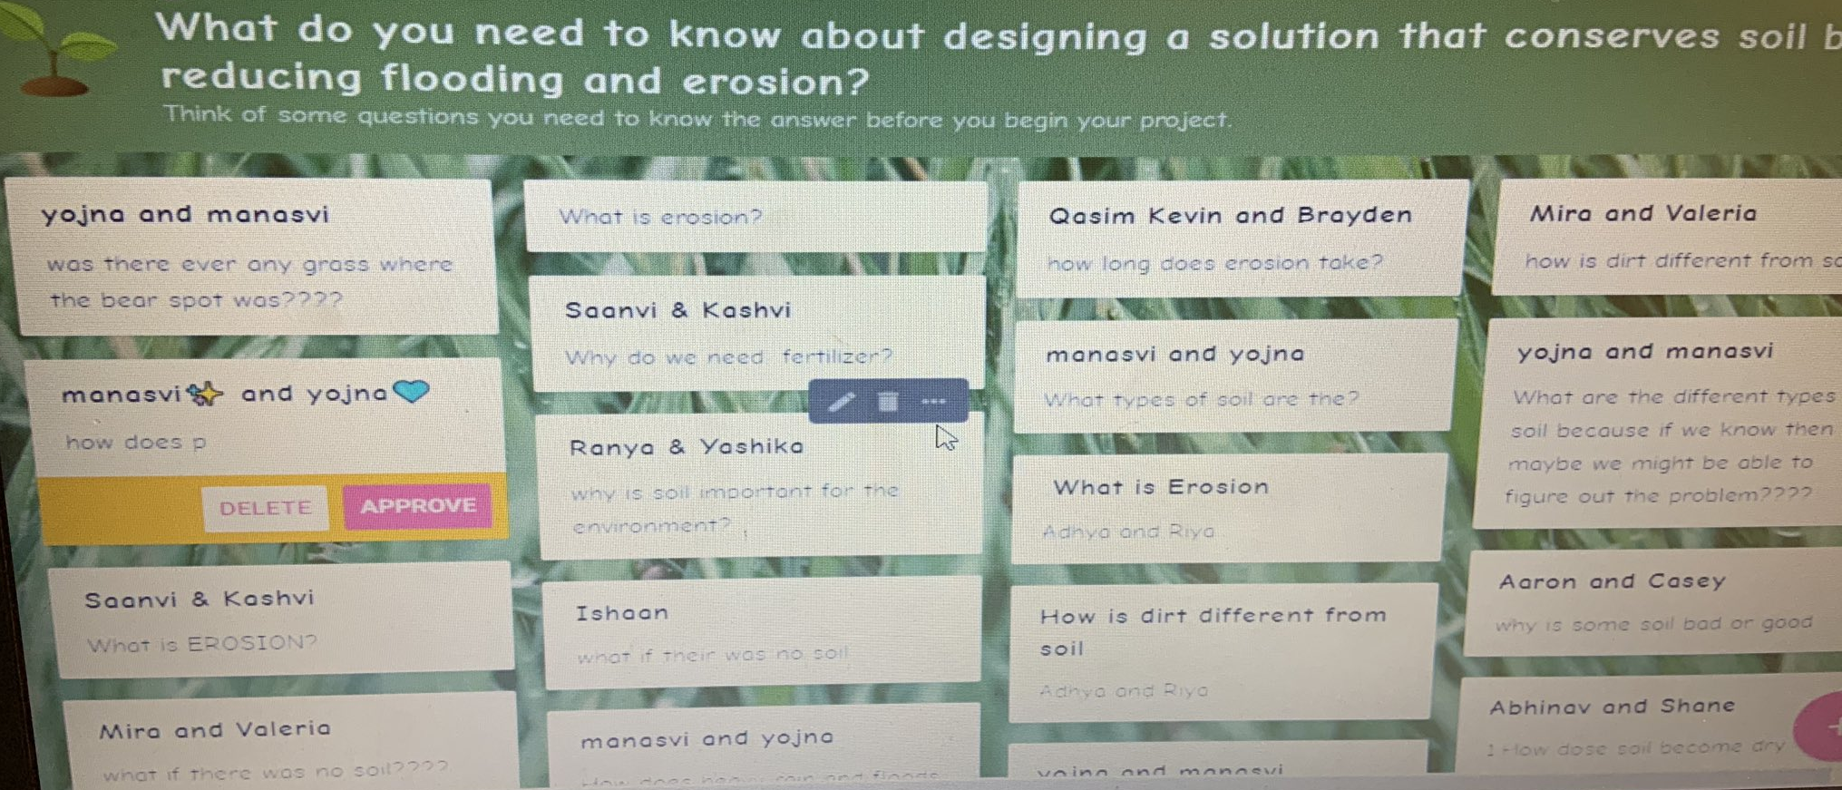
Identify What Students Need to Know
Step 3

Slide 30
Example Need to Know List
How can we improve something about middle school so that it will be a great experience for all students and persuade school leaders why they should make a change?
What will we pick to improve?
What would make middle school better?
How will we persuade school leaders?
What does persuade mean?
What makes someone want to make a change?
How will we get our message to school leaders?

Slide 31
Example Need to Know List
How can we improve something about middle school so that it will be a great experience for all students and persuade school leaders why they should make a change?
What will we pick to improve?
What would make middle school better?
How will we persuade school leaders?
What does persuade mean?
What makes someone want to make a change?
How will we get our message to school leaders?
But what about grammar, vocabulary, and disciplinary reading?

Slide 32
Connecting to Content About Which Students Might Not Ask
“You shared that you need to know _______, so today we are going to …”

Slide 33
Connecting to Content About Which Students Might Not Ask
“You shared that you need to know _______, but before we can understand that, we’ll first need to … so today, we will …”

Slide 34
Connecting to Content About Which Students Might Not Ask
“You shared that you need to know _______. Part of being able to ______ involves ______. Let’s focus on that today.”

Slide 35
Time to Create the Rubric!
Apply best practices for rubric design
Clearly define criteria based on targeted standards
Clarify instructional goals to serve as teaching targets
PBL: Focus on the learning rather than the project
Utilize with students early and often!
Help students focus on the important dimensions
Use as a roadmap → provide specific feedback for learners (and teachers, too!)

Slide 36
Plan the Entry Event
Activate or build background knowledge
Set the stage for learning that is to come
Engage and excite students
Lead to the Driving Question
Often includes texts (visual or written), visible thinking routines, and open-ended questions for student discussion
Step 4

Slide 37
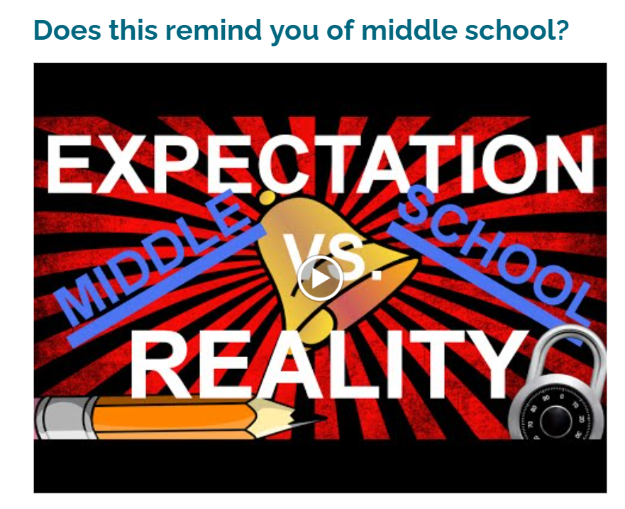
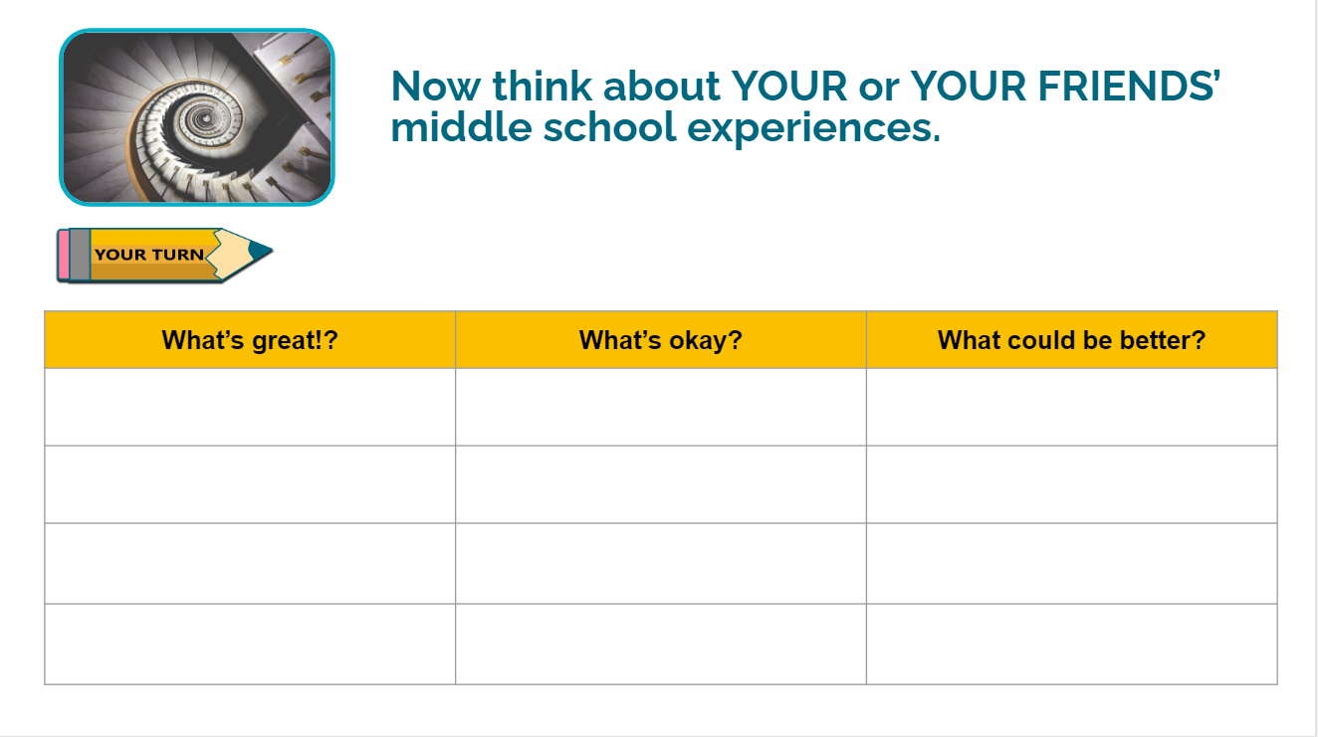
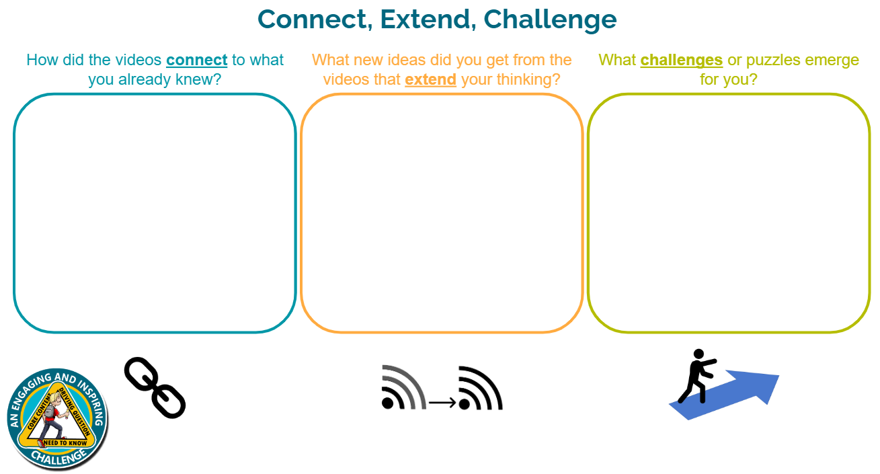
Entry Event Example
How can we improve something about middle school so that it will be a great experience for all students and persuade school leaders why they should make a change?
Step 4

Slide 38
Consider How Students Will
Share Their Learning
With whom can students share their learning?
Classmates
Other adults in the school or outside guests
Professionals in the field
The identified user or audience
Sharing can be in-person or virtual,
synchronous or asynchronous!
Step 5

Slide 39
Student Sharing Example
How can we improve something about middle school so that it will be a great experience for all students and persuade school leaders why they should make a change?
Step 5

Slide 40
INTEGRATION
How Project-Based Learning provides a structure for integrating evidence-based literacy instructional practices.

Slide 41
What specific skills are needed for each part of the process?
Challenge | Need to Know? | Find Information? | Create/Revise/ Refine | Share Information!
How can I convince a school leader to make a change to make school a better place? | Current regulations? Structures of other middle schools? Existing research on middle school? Etc. | Interview students and staff members; read, watch, and/or listen to experts discuss school change | Determine presentation format, write first draft, share with friends, receive feedback, make changes | Send the communication or present to a school leader, post reflection about experience on social media
Comprehension, interdisciplinary literacy, etc.
Research, analysis, synthesis, word choice, tone, etc.
Grammar, mechanics, syntax, word choice, etc.
Multimodal presentations, collaboration, etc.

Slide 42

WHAT DOES THIS LOOK LIKE?
What do these research-based practices look like in Project-Based Learning?

Slide 43










Disciplinary Reading
Launch Texts that help to activate or build
background knowledge during the
entry event
Source Texts that support students learning
about content that is essential to the
topic of their projects
Mentor Texts that serve as examples of how
real-world practitioners convey
their ideas

Slide 44
Disciplinary Reading: Improving School Example
Launch Texts that help to activate or build
background knowledge during the
entry event
Source Texts that support students learning
about content that is essential to the
topic of their projects
Mentor Texts that serve as examples of how
real-world practitioners convey
their ideas
Expectation vs. Reality video
Ted Talk
Student interview transcripts
Articles about middle school
Paired passages
Ted Talk transcripts
Short documentary
User experience guides

Slide 45






Authentic Writing Opportunities
In PBL, students have a reason to write!
You can require different forms of writing based on how you craft the Driving Question.

Slide 46
Authentic Writing: Improving School Example
In order to persuade a leader, students might:
brainstorm ideas to share
consider how they can best share their ideas
write a draft
give and receive feedback
finalize their written ideas
…all before they do anything with media!

Slide 47




Grammar Context
Invitation to Notice: Invite students to notice craft moves that an author is making. Have them search for additional examples.
Invitation to Imitate: After teaching students the grammatical concept, invite them to imitate the author’s style. Can they create something similar?
Building the WHY: Help students make connections between grammatical rules and why we use them in our writing. How do they help us convey our message?

Slide 48
Grammar Context: Improving School Example
Invitation to Notice: Read articles about middle school. Watch persuasive Ted Talks. What are some grammatical structures we notice? Ex: short sentences for impact; commas in a series
Invitation to Imitate: Ask students to try and imitate the move. Can they follow the rule in the writing for their persuasive piece?
Building the WHY: Help students understand why the author is using this craft move. How can they use it to convince their own audience?

Slide 49



Word Study
Morphology Structure and construction of words.
Word Choice Purposeful, technical vocabulary.
Tone Author’s word choice, author’s purpose.

Slide 50
Word Study: Improving School Example
Morphology What are some common roots and affixes we see in the
vocabulary of the articles we are reading or the language people
use in our interviews? How can we use that knowledge to help
us gain deeper comprehension?
Word Choice Why did the authors of the texts you read include certain words?
Which ones should you include in your persuasive piece? Why?
Tone What is the tone of the texts you are reading? How did the authors
convey that? What tone should your writing have? Why?

Slide 51

g
Planning the Daily Learning
Entry Event
Driving Question
Need to Know List
NEED TO KNOW
NEED TO KNOW
NEED TO KNOW
Students share their learning
“You said you need to know___ to be successful,
so our learning target will be______.”
Consider the need to knows
Step 6

Slide 52
WHERE AND WHEN?
What opportunities do we have to utilize these authentic learning opportunities in our own classrooms?

Slide 53


Anytime and Anywhere

Slide 54
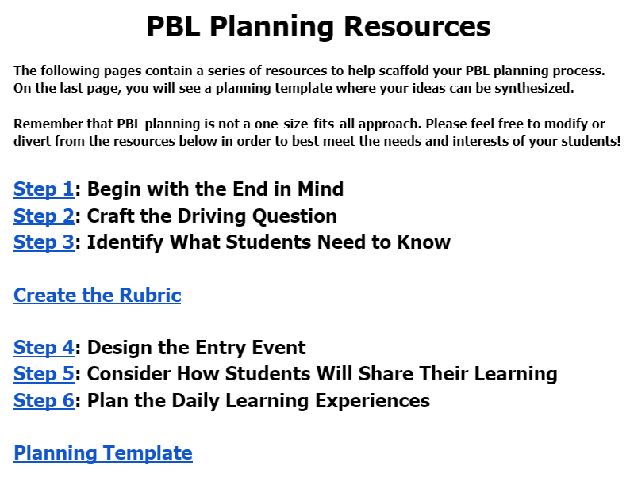
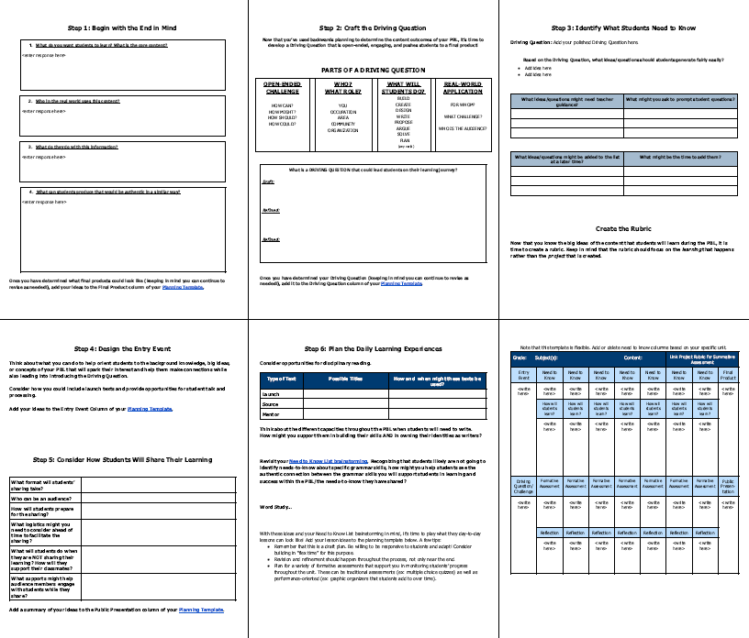
PBL Planning Resources - make a copy!
tinyurl.com/PBLplanningresources

Slide 55
Additional Resources
Resource | Description
Project Zero Thinking Routines | A set of questions or a brief sequence of steps used to scaffold and support student thinking.
The Buck Institute for Education/ PBL Works | A national organization focused on helping teachers use Project-Based Learning.
PBL: Student Thinking at a Deeper Level | A high-level overview of PBL linked to research-based evidence of success.
Introducing Peer Review | Teaching students how to provide meaningful feedback. For Grades K-5 but could easily be modified for older students.
Inquiry Based Learning | An eduotpia blog about how to help students become active questioners.
PBL Rubrics | Examples of rubrics that might provide inspiration for your PBL rubrics.

Slide 56
NEXT STEPS
Where do we go from here?

Slide 57
Learning Lab
Date: Monday 11/7 8:00am-4:00pm Fredericksburg
Bring: Your content, your ideas, and your wonderings
Goal: To network, share, and plan together

Slide 58


Thank You
cpday@fcps.edu
msmascelli@fcps.edu
Add Your Questions to this Padlet
https://tinyurl.com/vdoepbl22
@christiepday
@meghanmascelli

Slide 59
REFERENCES
SOL Connections and Supporting Research

Slide 60
SOL Alignment (1of 2)
6.1 The student will use effective oral communication skills in a variety of settings. | 7.1 The student will participate in and contribute to conversations, group discussions, and oral presentations | 8.1 The student will participate in, collaborate in, and report on small-group learning activities.
6.2. The student will create multimodal presentations that effectively communicate ideas. | 7.2 The student will create multimodal presentations both individually and in a group that effectively communicate ideas. | 8.2 The student will develop and deliver multimodal, interactive presentations collaboratively and individually.
6.3 The student will determine the purpose of media messages and examine how they are constructed. | 7.3 The student will examine the elements of media literacy. | 8.3 The student will analyze, develop, and produce creative or informational media messages.
6.4 The student will read and determine the meanings of unfamiliar words and phrases within authentic texts. | 7.4 The student will read and determine the meanings of unfamiliar words and phrases within authentic texts. | 8.4 The student will apply knowledge of word origins, and figurative language to extend vocabulary development within authentic texts.
6.5 The student will read and demonstrate comprehension of a variety of fictional texts, literary nonfiction, and poetry. | 7.5 The student will read and demonstrate comprehension of a variety of fictional texts, literary nonfiction, poetry, and drama. | 8.5 The student will read and analyze a variety of fictional texts, literary nonfiction, poetry, and drama.

Slide 61
SOL Alignment (2of2)
6.6 The student will read and demonstrate comprehension of a variety of nonfiction texts. | 7.6 The student will read and demonstrate comprehension of a variety of nonfiction texts. | 8.6 The student will read, comprehend, and analyze a variety of nonfiction texts.
6.7 The student will write in a variety of forms to include narrative, expository, persuasive, and reflective with an emphasis on narrative and reflective writing. | 7.7 The student will write in a variety of forms to include narrative, expository, persuasive, and reflective with an emphasis on expository and persuasive writing. | 8.7 The student will write in a variety of forms to include narrative, expository, persuasive, and reflective with an emphasis on expository and persuasive writing.
6.8 The student will self- and peer-edit writing for capitalization, punctuation, spelling, sentence structure, paragraphing, and Standard English. | 7.8 The student will self- and peer-edit writing for capitalization, punctuation, spelling, sentence structure, paragraphing, and Standard English. | 8.8 The student will self- and peer-edit writing for capitalization, punctuation, spelling, sentence structure, paragraphing, and Standard English.
6.9 The student will find, evaluate, and select appropriate resources to create a research product. Added “to create” and removed “for” | 7.9 The student will find, evaluate, and select appropriate resources to create a research product. | 8.9 The student will find, evaluate, select, and synthesize appropriate resources to produce a research product.

Slide 62
Research about PBL’s Effectiveness
Condliffe, B., Quint, J., Visher, M.G., Bangser, M. R., Drohojowska, S. Saco, L., and Nelson, E. (2017). Project Based Learning: A Literature Review, 1-78. New York, NY: MDRC.
Kingston, S. (2018). Project Based Learning & Student Achievement: What Does the Research Tell Us? PBL Evidence Matters. 1(1), 1-11.
Kingston, S., deMonsabert, J., and Wagner, K. (2022). Project Based Learning and Every Student Succeeds Act (ESSA) Evidence Levels: Is PBL and evidence-based practice? PBL Evidence Matters 2(1). The Buck Institute for Education.
Mergendoller, J. R. (2016). What Can We Learn from John Hattie about Project Based Learning? Novato, CA: PBLWorks.

Slide 63
Disclaimer
Reference within this presentation to any specific commercial or non-commercial product, process, or service by trade name, trademark, manufacturer or otherwise does not constitute or imply an endorsement, recommendation, or favoring by the Virginia Department of Education.

