Slide 1
Grammar Tools:
Using Grammar Instruction to Help Students Read Like Writers and Write Like Readers
Sean Ruday

Slide 2
Big Questions
Why are grammatical concepts important tools for effective communication?
How do published authors use these concepts?
How can educators use grammar instruction to help students engage in purposeful reading and writing experiences?

Slide 3
Agenda
Fast write
Concerns with grammar instruction
Connections to literature and metacognition
The toolkit metaphor
Grammar in Hamilton!
Five key recommendations
Mentor text activities
Reflection question
Closing points

Slide 4
Fast Write: Teaching Grammar
Share your ideas here:
https://docs.google.com/document/d/1GS5_B5OaaF3engCEvvd3FUXEZ_qteciBJSy2zoJGQ7c/edit?usp=sharing

Slide 5
Teachers’ Concerns
“Sure, I know some ways to teach grammar, but I definitely don’t know the best way. I can use textbooks and workbooks, but that doesn’t get any kind of results with my students.”
“I need help with coming up with grammar activities that will actually help my students and not make them so bored that they either goof off or act like they’ll fall asleep.”

Slide 6
Research-Based Issues in Grammar Instruction
  “Traditional” grammar instruction often leads to student disengagement (Woltjer, 1998) and has very little impact on student learning (Weaver, 1998).

Slide 7
Literature
The entryway to effective grammar instruction
NCTE Professional Knowledge for the Teaching of Writing (2016): We “need to understand how writers read for the purposes of writing–with an eye toward not just what the text says but also how it is put together”

Slide 8
A Mentor-Text-Based (Culham, 2016) Approach to Grammar Instruction
Metacognitive literacy experiences
Writing as readers
Reading as writers

Slide 9
Grammar is a Tool for Writing
A tool for reading
A tool for writing
A tool for thinking
Grammar

Slide 10
Metacognition
Knowledge of cognitive phenomena (Flavell, 1979), often thought of as thinking about thinking (Garner, 1987).
Related to grammar (Cook, 2020):
  Understanding why a writer chose to use a certain grammatical concept
  Considering what effect that concept might have on a piece of writing

Slide 11
The Toolkit Metaphor
Specific tools for specific uses
“What do a chainsaw and an adverb have in common?”

Slide 12
Knowing about grammar tools helps readers and writers
Make purposeful choices when we write
Comprehend what we read
Think metacognitively about literacy

Slide 13
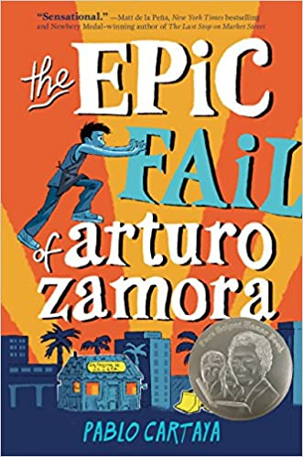
Prepositional Phrases in The Epic Fail of Arturo Zamora

Slide 14
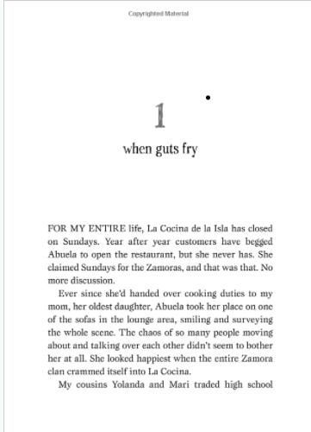
Book

Slide 15
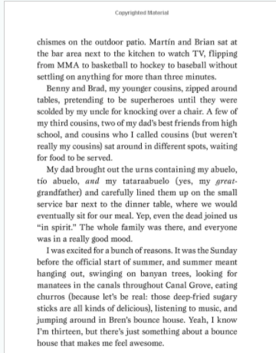
Book

Slide 16
Reflection Questions
What does this passage show us about the importance of prepositional phrases?
How do the prepositional phrases in this passage help us understand it?

Slide 17
Relative clauses as tools—a student’s insights
“I had never heard of relative clauses before, but now I know how writers use them and that they add important information. In my story, I said, ‘Boris, who was the scariest man I ever met, came to my door.’ The relative clause, ‘who was the scariest man I ever met,’ shows a lot about Boris and adds important details. I liked reading books with relative clauses because that showed me how to use them.”

Slide 18
Why Metacognition Matters
Ownership
Comprehension
Application
Success

Slide 19
Don’t Throw Away Your Shot!
Metacognition of Grammar Meets Hamilton!

Slide 20
Strong verb: “scream”
With: “I scream in the face of this mass mutiny…”
Without: I say in the face of this mass mutiny…

Slide 21
Prepositional phrase:
“in this century”
With: “There will be a revolution in this century.”
Without: There will be a revolution.

Slide 22
Specific noun:
“rabble”
With: “Heed not the rabble who scream revolution.”
Without: Heed not the people who scream revolution.

Slide 23
Relative clause:
“who might let some things slide”
With: “We’ll need…some King’s men who might let some things slide.”
Without: We’ll need…some King’s men.

Slide 24
A packed example!
“Why you slumming in the city in your fancy heels? You searching for an urchin who can give you ideals?”

Slide 25
Key Grammatical Concepts
Some Key Concepts for Grades 6-8 From VDOE SOL Grammar and Writing Progression Charts (2017)
Interjections Prepositional phrases Coordinating conjunctions Use commas to indicate interrupters, items in a series, and direct address Structure and coordinate sentences with intervening clauses and phrases Use precise and descriptive language Use clauses and phrases for sentence variety Use modifiers, coordination, and subordination in complete sentences

Slide 26
Connections to Purposeful Reading
Key Reading Concepts for Grades 6-8 From VDOE SOL Reading Progression Charts (2017)
Compare and contrast the authors’ use of word choice, dialogue, form, rhyme, rhythm, and voice in different texts Compare and contrast authors’ styles Describe how word choice and imagery contribute to the meaning of a text Explain how the author’s choice of vocabulary contributes to the author’s style

Slide 27
Foundational Grammatical Concept Mini-Lesson
Introduce key features
Accessible and engaging examples
Post on anchor charts for reference

Slide 28
Five Key Recommendations
1
2
3
4
5
1) Show students examples of grammatical concepts used in literature.
2) Discuss how the authors of those literary works use grammatical concepts as “tools” to enhance their writing.
3) Discuss how the literary works would look if those grammatical concepts were not used.
4) Ask students to use specific grammatical concepts in their own writing.
5) Ask students to reflect on how knowing about grammatical concepts enhances reading and writing.

Slide 29
Recommendation One
Recommendation | Benefits | Put in Practice
Show students examples of grammatical concepts used in literature. | Students see grammatical concepts used authentically. Students learn how they can apply concepts to their own works | Example of strong verb use in It’s Trevor Noah: Born a Crime. Stories from a South African Childhood. Adapted for Young Readers by Trevor Noah “When the colonial armies invaded, the Zulu charged into battle with nothing but spears and shields against men with guns.”

Slide 30
Recommendation Two
Recommendation | Benefits | Put in Practice
Discuss how the authors of those literary works use grammatical concepts as “tools” to enhance their writing. | Increased metacognition Discussion of the purposeful use of grammar | Activity: Ask students to reflect on what information the grammatical concept provides and why the author may have chosen to use it Example of a subordinate clause from The City of Ember by Jeanne DuPrau: “When Lina went to work the next morning, the street was oddly silent.”

Slide 31
Recommendation Three
Recommendation | Benefits | Put in Practice
Discuss how the literary works would look if those grammatical concepts were not used. | Further illustrates the importance of these concepts to the texts in which they’re used Helps students see grammatical concepts as important tools rather than terms to memorize | “She played it salsa for her mother and father, who had left their homeland..” from Refugee by Alan Gratz vs “She played it salsa for her mother and father…” Follow up-question: What did the relative clause add to the original sentence?

Slide 32
Recommendation Four
Recommendation | Benefits | Put in Practice
Ask students to use specific grammatical concepts in their own writing. | Requires students to take ownership Relates to gradual release of responsibility (Pearson & Gallagher, 1983) | Student work example in the following slide

Slide 33
Student Example Using Prepositional Phrases
Tyrone ran to the window. He decided he had to get out of there past that huge gate. Through the window, Tyrone climbed. He knew the bad guys were still there behind him. Into the night, Tyrone kept running.

Slide 34
Recommendation Five
Recommendation | Benefits | Put in Practice
Ask students to reflect on how knowing about grammatical concepts enhances reading and writing. | Students look at their own grammar use with a critical eye Further improves students’ metacognitive awareness of grammatical concepts | Student reflection questions: Why is a particular grammatical concept important to effective writing? How can knowing about this concept help you understand what you read?

Slide 35
Student response:
Why are prepositional phrases important to effective writing?
“Prepositional phrases add a lot more information to writing. In my story, the prepositional phrases tell you a lot more information about the way Tyrone escaped.”

Slide 36
Student response:
How can knowing about prepositional phrases help you understand what you read?
“Prepositional phrases can help me understand what I read because I can see the way authors use them to add information and figure out what information they’re adding.”

Slide 37
Activity—Prepositional Phrases:
Connections to Literature
https://docs.google.com/document/d/1zJjVzSz8I3lEAOMzjzumHM1lptQA57wdIyVNjYWsiUs/edit?usp=sharing
Go to the link to complete the activity!

Slide 38
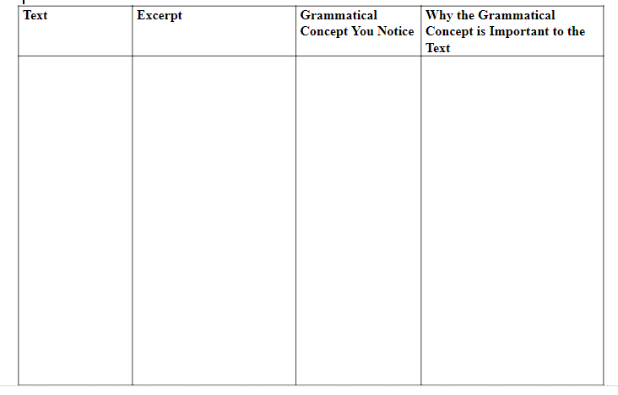
Mentor Text Activity

Slide 39
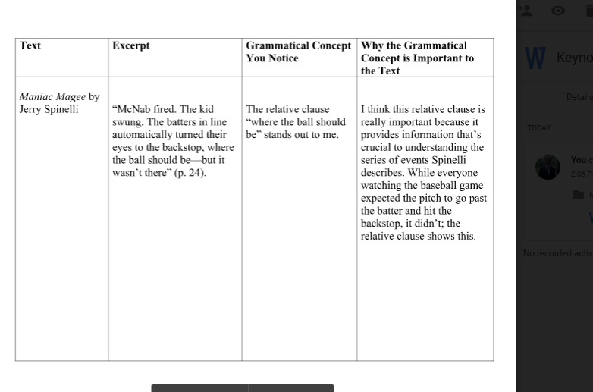
Mentor Text Activity Example (1 of 2)

Slide 40
Mentor Text Activity (2 of 2)
Share the following information on this Google Doc: https://docs.google.com/document/d/1OzuXZECWDk112PZsNq7WkEpFjknUkymDBpndF5jrPkc/edit?usp=sharing
The text you used
An excerpt from it
A grammatical concept you notice in the text
Why you think the grammatical concept is important to the text
Note: “Text” can take a wide range of forms for this activity

Slide 41
Final Thoughts
Look for “mentor examples” of grammatical concepts in texts your students enjoy
Talk with students about the importance of those concepts to the texts and how the concepts help us understand the piece
Help students apply these concepts to their own works and reflect on their uses

Slide 42
Reflection Question
Why are grammatical concepts like tools for effective writing?

Slide 43
Grammar: A tool for…
Empowerment
Expression
Understanding

Slide 44
Keep in touch!
www.seanruday.weebly.com
sean.ruday@gmail.com
Twitter: @SeanRuday
Instagram: seanrudayliteracy

Slide 45
References
Cook, L.S. (2020). Students as their own best critics: A metacognitive approach to teaching grammar in
context. ATEG Journal, 29, 13-25.
Culham, R. (2016). The writing thief: Using mentor texts to teach the craft of writing. Stenhouse.
Flavell, J. H. (1979). Metacognition and cognitive monitoring. American Psychologist, 34, 906–911.
Garner, R. (1987). Metacognition and reading comprehension. Norwood, NJ: Ablex.
National Council of Teachers of English (2016). Professional knowledge for the teaching of writing.
https://ncte.org/statement/teaching-writing/
Weaver, C. (1998). Teaching grammar in the context of writing. In C. Weaver (Ed.), Lessons to share on
teaching grammar in context (pp.18–38). Portsmouth, NH: Boynton/Cook.
Woltjer, S. (1998). Facilitating the use of description—and grammar. In C. Weaver (Ed.), Lessons to share on
teaching grammar in context (pp.95–99). Portsmouth, NH: Boynton/Cook.

Slide 46
Disclaimer
Reference within this presentation to any specific commercial or non-commercial product, process, or service by trade name, trademark, manufacturer or otherwise does not constitute or imply an endorsement, recommendation, or favoring by the Virginia Department of Education.

