Slide 1
3-5 VDOE Virtual English SOL Institutes
General Session

Slide 2
Agenda
Overview of 3-5 and 6-8 Virtual Sessions
Assessment Results Over Time
Overview of the Virginia Literacy Act (VLA)
Essential Components of Literacy
The Science of Reading
Evidence-Based Practices and Strategies for Literacy Instruction
How Do We Get Students to Work in Grade-Level Material?
Upcoming Opportunities
VDOE Resources

Slide 3
3-5 Virtual English SOL Institutes
Tuesday, October 11th
4:00-4:55 PM: VDOE General Session
5:00-5:55 PM: Guided Reading to Reading Guides- Supporting All Students with Grade Level Texts
6:00-6:55 PM: Advanced Phonics: Everything You Need to Know About Syllables and Morphology
Thursday, October 13th
4:00-4:55 PM: Reading + Writing= Skilled Readers and Writers
5:00-5:55 PM: World and Word Knowledge
6:00-6:55 PM: Virginia Department of Education Instruction & Assessment

Slide 4
6-8 Virtual English SOL Institutes
Tuesday, October 18th
4:00-4:55 PM: VDOE General Session
5:00-5:55 PM: Scientific Reading Research and Disciplinary Literacy at the Middle School Level
6:00-6:55 PM: Building a Word Conscious Classroom in Middle School: Assessment-driven word study and specific vocabulary instruction strategies
Thursday, October 20th
4:00-4:55 PM: Grammar Tools: Using Grammar Instruction to Help Students Read Like Writers and Write Like Readers
5:00-5:55 PM: Project-Based Learning: Access and Integrated Teaching for All
6:00-6:55 PM:Virginia Department of Education Instruction & Assessment

Slide 5
Assessment Results Over Time

Slide 6
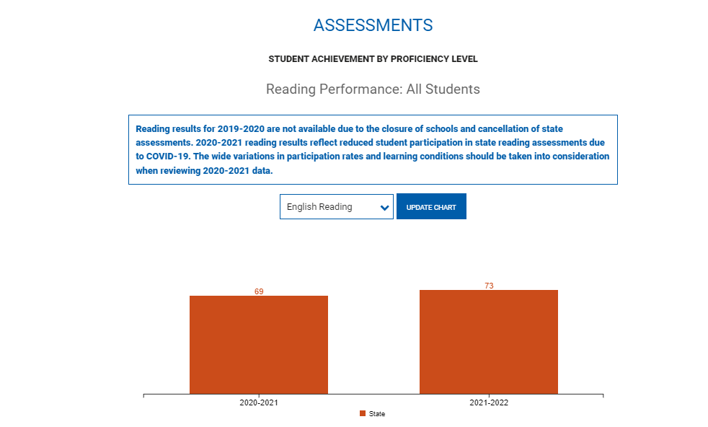
Virginia Department of Education School Quality Profiles

Slide 7
English Reading Performance
Grade Level | 2018-2019 | 2019-2020 | 2020-2021*+ | 2021-2022
Grade Three Reading | 71% | No Data Available | 61% | 68%
Grade Four Reading | 75% |  | 68% | 72%
Grade Five Reading | 78% |  | 66% | 72%
Grade Six Reading | 77% |  | 69% | 70%
Grade Seven Reading | 79% |  | 71% | 72%
Grade Eight Reading | 76% |  | 69% | 72%
End of Course Reading | 86% |  | 81% | 85%
*Pass rates reflect disruptions to instruction caused by the pandemic, decreased participation in state assessment programs, pandemic-related declines in enrollment, fewer retakes, and more flexible “opt-out” provisions for parents concerned about community spread of COVID-19.
+ 2017 English Standards of Learning assessed for the first time.

Slide 8
English Writing Performance
Grade Level | 2018-2019 | 2019-2020 | 2020-2021 | 2021-2022
Grade 8 Writing | 70% | No data available |  | 57%
End of Course Writing | 81% |  |  | 74%

Slide 9
The Virginia Literacy Act

Slide 10
How the VLA Will Improve Literacy
Virginia is taking the lead nationwide to reverse these trends and improve early literacy outcomes for the Commonwealth’s youngest learners.
Prepare Teachers
Align Curricula, Screening & Intervention Methods
Science Based Reading Research
Evidence-
based
Literacy
Instruction
Science Based Reading Research
The Virginia Literacy Act
Partner with Families
Require Continuing Professional Development
Notes:
Speaker: Leslie Sale
Now that we know the need is clear, let's move on to what the VLA does. One of the primary goals of the VLA is alignment. Aligning teacher knowledge, training, and preparation with strong core curricula rooted in reading research. Implementing effective instruction for students and using screening to identify students who need additional evidence-based intervention. Families become partners in this process providing extra support in literacy skills at home.
First, it will focus on Preparing Teachers:
Educator Preparation Programs will provide K-3 teachers with instruction in evidence-based practices for the teaching of reading;
K-3 teacher candidates will pass a revised reading assessment to demonstrate proficiency in evidence-based practices for the teaching of reading
Next, it will Align Curricula, Screening & Intervention Methods:
School divisions will align K-3 core early reading instruction with evidence-based practices;
We will provide guidance to school divisions on early reading interventions that are aligned with evidence-based practices;
School divisions will align K-3 literacy screening and progress monitoring with evidence-based practices;
School divisions will develop and implement division-wide literacy plans that align professional development, curriculum, and instruction with evidence-based practices
It will also require continuing professional development:
K-3 teachers will participate in professional development coursework focused on evidence-based practices for the teaching of reading
School divisions, with support from VDOE, will develop and implement literacy professional development plans
And lastly, it will ensure that we Partner with Parents:
We will develop data collection and transparent reporting plans on key literacy measures
We will provide families with at-home resources that enable them to help their students to become proficient readers

Slide 11
VLA - Key Components (1 of 2)
Defines Key Terms
Establishes the definition of evidence-based literacy instruction and science-based reading instruction.
Aligns Curricula, Screening and Intervention Methods
Requires both the instructional and intervention programs in grades K-3 be aligned with science-based reading research, as set out in a division-wide literacy plan.
Maintains the current screening model to identify students in need of intervention, and requires the development of reading plans for students below the benchmark.
Adds a division-wide staffing ratio of one reading specialist per 550 students in K-3.
Requires Continuing Professional Development and Training
Requires principals and certain teachers be provided with professional development in science-based reading research and evidence-based literacy instruction.
Notes:
Speaker: Leslie Sale

Slide 12
VLA - Key Components (2 of 2)
Partners with Families
Ensures parents are engaged in the development of student reading plans and have access to resources to support literacy development at home.
Aligns Educator Preparation and Licensure
Requires certain educator preparation programs to ensure candidates have a program of coursework and demonstrate mastery in science-based reading research and evidence-based literacy instruction.
Stipulates that the literacy assessment for licensure or alternate route to licensure with certain endorsements include a test of science-based reading research and evidence-based literacy instruction.
Requires every person seeking initial licensure with certain endorsements complete study in science-based reading research and evidence-based literacy instruction.
Establishes a microcredential program for earning an add-on reading specialist endorsement (when needed).
Notes:
Speaker: Leslie Sale

Slide 13
Every K-3 Student…
 | Receives core literacy instruction from an evidence-based literacy curriculum for the entire literacy block Receives additional evidence-based instruction and intervention, as outlined in a student reading plan, if they do not meet literacy benchmarks
Notes:
Speaker: Jenna Conway

Slide 14
Every K-3 Teacher…
 | Uses evidence-based literacy curriculum for the entire literacy block Assesses student learning using approved literacy screeners routinely throughout the year Uses student-level data to inform both whole group instruction and individualized instruction and intervention Participates in pre-service preparation and/or in-service training in evidence-based literacy instruction
Notes:
Speaker: Jenna Conway

Slide 15
Every K-3 Reading Specialist…
 | Coordinates intervention services for students not meeting literacy benchmarks Develops, oversees implementation of, and monitors student progress on student reading plans, in collaboration with teachers and families
Notes:
Speaker: Jenna Conway

Slide 16
Every School Division…
 | Develops a division-wide literacy plan Ensures all kindergarten through grade 3 teachers have and use evidence-based literacy curriculum Staffs at least one reading specialist for every 550 students in kindergarten through grade 3 Provides professional development in evidence-based literacy instruction to teachers, reading specialists and principals Receives coaching and support from regional literacy coaches
Notes:
Speaker: Jenna Conway

Slide 17
Every Family of a K-3 Student…
 | Has access to free online evidence-based literacy instruction resources to support their child’s literacy development at home Can participate in the development of their child’s student reading plan, if they do not meet literacy benchmarks
Notes:
Speaker: Jenna Conway

Slide 18
Every K-3 Educator Preparation Program …
 | Requires aspiring teachers and reading specialists to complete coursework in and demonstrate a mastery of evidence-based literacy instruction
Notes:
Speaker: Jenna Conway

Slide 19
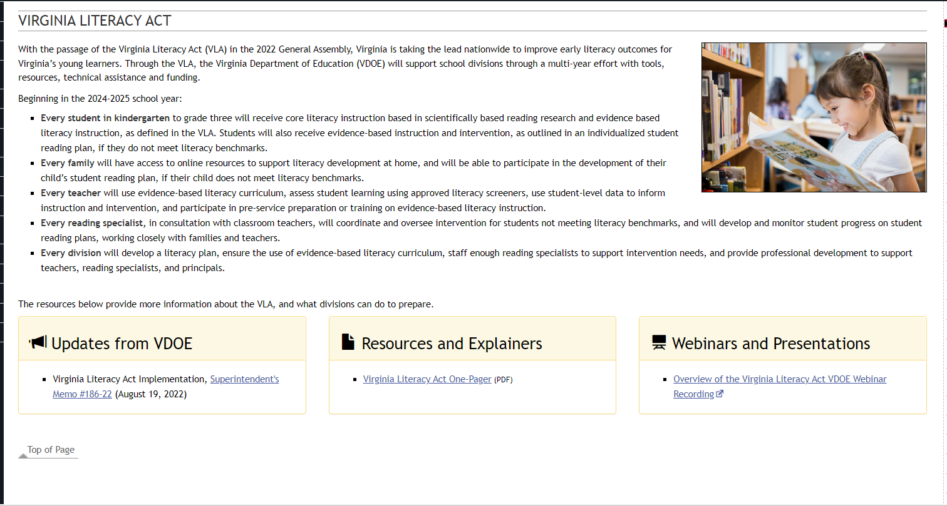
Visit the VDOE VLA Webpage

Slide 20
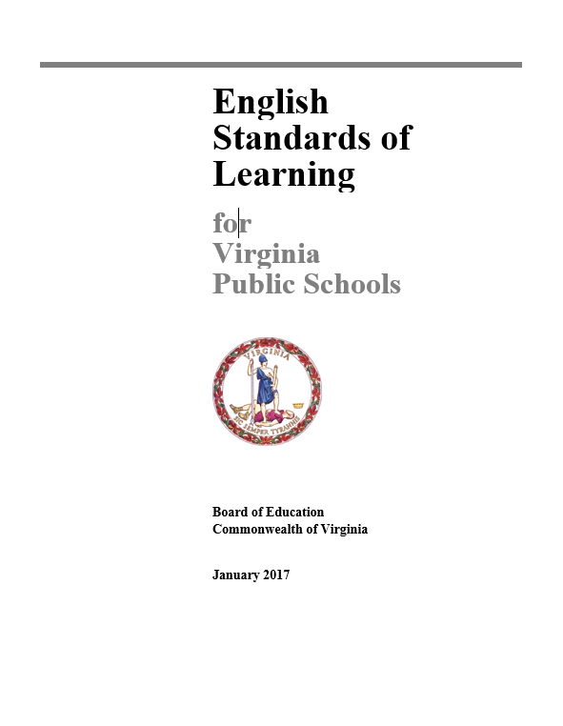
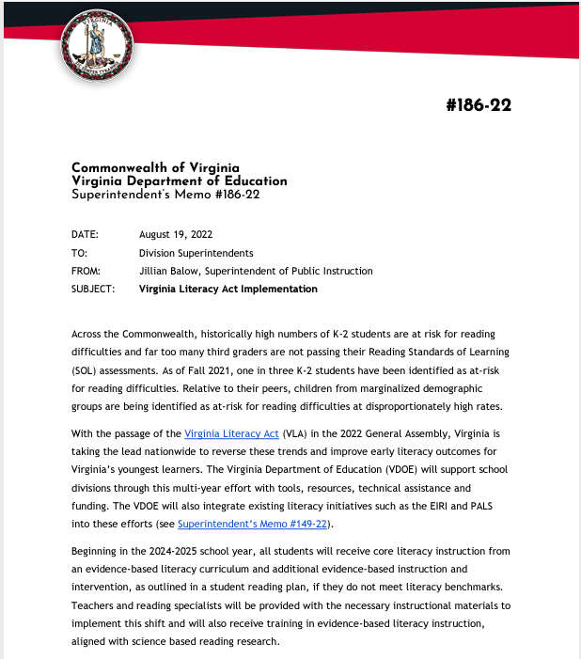
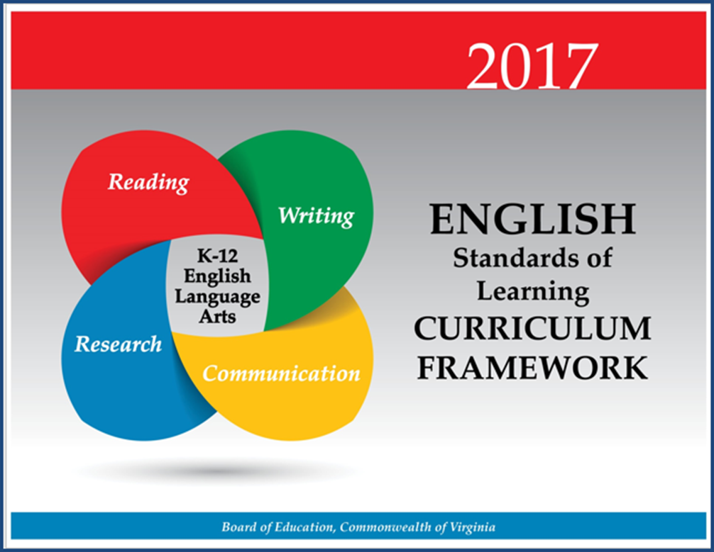
Working Together to Improve Literacy

Slide 21
Essential Components of Literacy

Slide 22
Essential Components of Literacy
Text comprehension is influenced by readers’ ability to apply the essential components of reading: phonemic awareness, phonics knowledge, fluency, and understanding of word meanings or vocabulary.
Without these foundational skills, comprehension will not occur.
READING FRAMEWORK FOR THE 2019 NATIONAL ASSESSMENT OF EDUCATIONAL PROGRESS

Slide 23
Essential Components of Literacy
By grade 4, when the NAEP Reading Assessment is first administered, students should have a well-developed understanding of how sounds are represented alphabetically and should have had sufficient practice in reading to achieve fluency with different kinds of texts (National Research Council 1998).
Because NAEP tests at grades 4, 8, and 12, the assessment focuses on students’ reading comprehension, not their foundational skills related to alphabetic knowledge.1
READING FRAMEWORK FOR THE 2019 NATIONAL ASSESSMENT OF EDUCATIONAL PROGRESS

Slide 24
Comprehensive Literacy:
Successful English Instruction-Integrates the Strands
Vocabulary Development
Specific vocabulary from authentic text
Content vocabulary from math, science, and social studies
Reading
Both fiction & nonfiction text
Text-rich environment with variety of text and media
Student choice whenever possible
Writing
Writing as a process for a variety of authentic purposes
Regular writing conferences
Use of Writing Portfolios
Research
Ongoing and embedded in the learning process (when applicable)
Communication/Multimodal Literacies
Opportunities to communicate, collaborate and engage critically with peers and a variety of texts.

Slide 25
Essential Components of Teaching Reading
As reported in the National Reading Panel and later recognized in CCSSO’s A Nation of Readers report, additional research has shown the significant impact of instruction that explicitly addresses all five pillars of reading.
Phonemic Awareness
Phonics
Fluency
Vocabulary
Comprehension

Slide 26
The Five Pillars of Reading in the Standards of Learning
Phonemic Awareness | Phonics Instruction | Fluency Instruction | Vocabulary Instruction | Comprehension Instruction
K.3- The student will orally identify, segment and blend various phonemes to develop phonological and phonemic awareness 1.3- The student will orally identify, produce, and manipulate various phonemes within words to develop phonological and phonemic awareness. 2.3- The student will orally identify, produce, and manipulate various phonemes within words to develop phonemic awareness. | K.6- The student will develop an understanding of basic phonetic principles. 1.5- The student will apply phonetic principles to read and spell. 2.4- The student will use phonetic strategies when reading and spelling. 3.3 The student will use knowledge of regular and irregular vowel patterns and decode regular multisyllabic words. | 1.9 i) Read and reread familiar stories and poems with fluency, accuracy and meaningful expression. 1.10 h) Read and reread familiar texts with fluency, accuracy and meaningful expression 2.7 i) Read and reread familiar stories and poems with fluency, accuracy, and meaningful expression. 2.8 h) Read and reread familiar texts with fluency, accuracy, and meaningful expression. 3.5 m) Read with fluency, accuracy, and meaningful expression. 3.6 m) Read with fluency, accuracy, and meaningful expression. | K.7- The student will expand vocabulary and use of word meanings. 1.7- The student will expand vocabulary and use of word meanings. 2.5-The student will use semantic clues and syntax to expand vocabulary when reading. 2.6- The student will expand vocabulary and use of word meanings. 3.4 The student will expand vocabulary when reading | K.8-The student will demonstrate comprehension of fictional text. K.9- The student will demonstrate comprehension of nonfiction text. 1.9, 2.7, 3.6- The student will read and demonstrate comprehension of a variety of fictional texts. 1.10, 2.8, 3.7- The student will read and demonstrate comprehension of a variety of nonfiction texts.
Here are some examples of where science based reading is evident in the 2017 English Standards of Learning. School divisions are required to teach the comprehensive set of standards as outlined in 8VAC20-131-80.

Slide 27
The Science of Reading

Slide 28
What is the Science of Reading?
There is over 50 years of research from a variety of career fields that support how the brain learns to read and speak and how we should be taught. More recently the connection between these fields of research has become more apparent and talked about in educational settings.
Science of reading. A term that refers to a corpus of objective investigation and accumulation of reliable evidence about how humans learn to read and how reading should be taught.
(International Literacy Association)

Slide 29
The Simple View
The Science of Reading
Decoding
Language Comprehension
Reading Comprehension
0 X 1 = 0
1 X 0 = 0
.5 X 1 = .5
Grough & Tunmer, 1986

Slide 30
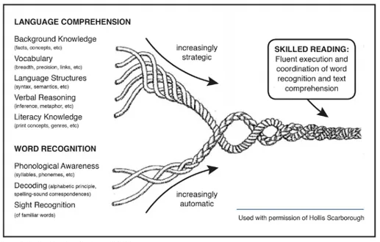
Scarborough’s Reading Rope
Scarborough, 2001
Language Comprehension
The Science of Reading
Reading Comprehension
Decoding

Slide 31
Science of Reading and Instructional Practices
Key practices that demonstrate research and evidence-based instruction:
Direct instruction of decoding, encoding, comprehension, and wide reading of literature
Specific focus on phoneme awareness instruction as well as its connection to encoding and decoding
Systematic, explicit, and intentional instruction on the spoken and written form of the English language (sound, syllable, morpheme, word)
Direct and incidental vocabulary instruction using texts to explore word meanings and sentence structure
Emphasis and intention on building background knowledge and listening comprehension through texts, multimedia, and other print resources that will lead to independent reading comprehension (Moats, 2020).

Slide 32
Evidence-Based Literacy Instruction
Virginia Literacy Act
"Evidence-based literacy instruction" means structured instructional practices, including sequential, systematic, explicit, and cumulative teaching, that (i) are based on reliable, trustworthy, and valid evidence consistent with science-based reading research; (ii) are used in core or general instruction, supplemental instruction, intervention services, and intensive intervention services; (iii) have a demonstrated record of success in adequately increasing students' reading competency, vocabulary, oral language, and comprehension and in building mastery of the foundational reading skills of phonological and phonemic awareness, alphabetic principle, phonics, spelling, and text reading fluency; and (iv) are able to be differentiated in order to meet the individual needs of students.

Slide 33
What does Evidence-Based Mean?
Definition:
An intervention, tool, or practice that meets one of the four evidence levels in the federal Elementary and Secondary Education Act, as amended by ESSA (strong, moderate, promising, or demonstrates a rationale).
National Center on Improving Literacy (2018). What do we mean by evidence-based?. Washington, DC: U.S. Department of Education, Office of Elementary and Secondary Education, Office of Special Education Programs, National Center on Improving Literacy. Retrieved from http://improvingliteracy.org.

Slide 34
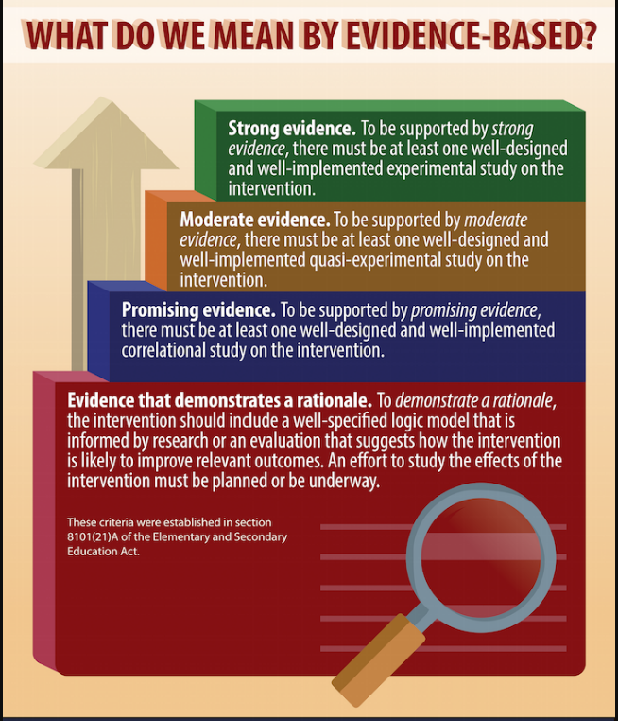
Evidence-Based Instruction
National Center on Improving Literacy (2018). What do we mean by evidence-based?. Washington, DC: U.S. Department of Education, Office of Elementary and Secondary Education, Office of Special Education Programs, National Center on Improving Literacy. Retrieved from http://improvingliteracy.org.

Slide 35
Literacy Research and Evidence-Based Practices For Grades K-3

Slide 36
What Research Says
Kindergarten through Grade 3
Teach students academic language skills, including the use of inferential and narrative language, and vocabulary knowledge.
Develop awareness of the segments of sounds in speech and how they link to letters.
Teach students to decode words, analyze word parts, and write and recognize words.
Ensure that each student reads connected text everyday to support reading accuracy, fluency, and comprehension.
https://ies.ed.gov/ncee/wwc/PracticeGuide/21

Slide 37
Science-Based Phonics Instruction
Effective Phonics Instruction
Explicit and systematic
Readiness Skills
Scope and Sequence
Blending
Dictation
Word Awareness
High-Frequency Words
Reading Connected Text
Building vocabulary and background knowledge
ILA Literacy Leadership Brief

Slide 38
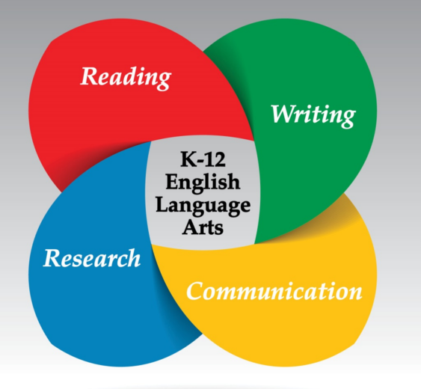
Extending Comprehension Beyond Early Literacy
“In addition to teaching explicit word-reading skills, literacy instruction requires the teaching of text analysis, discussion, and writing about reading” (Duke, et al. 2021).
School divisions are required to teach the comprehensive set of standards as outlined in 8VAC20-131-80.

Slide 39
Literacy Research and Evidence-Based Practices For Grades 4-5

Slide 40
Evidence-Based Practices for Interventions
Focus on practices to improve students’ ability to read words accurately and automatically
Focus on practices for helping students to understand the text they read
Providing Reading Interventions for Students in Grades 4–9. (2022). Institute of Education Sciences. Retrieved from https://ies.ed.gov/ncee/wwc/Docs/PracticeGuide/WWC-practice-guide-reading-intervention-full-text.pdf.

Slide 41
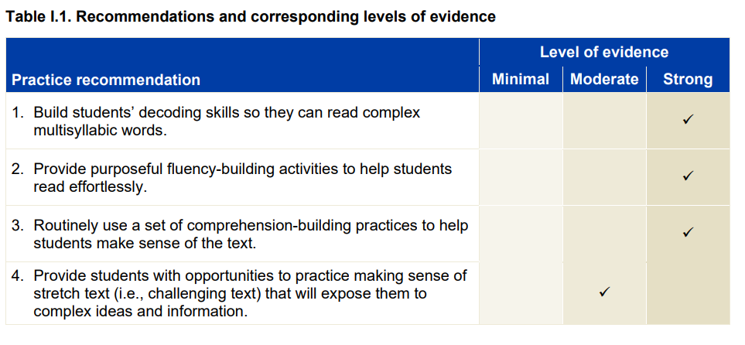
Recommendations
Providing Reading Interventions for Students in Grades 4–9. (2022). Institute of Education Sciences. Retrieved from https://ies.ed.gov/ncee/wwc/Docs/PracticeGuide/WWC-practice-guide-reading-intervention-full-text.pdf.

Slide 42
What Does this Look Like in Pre-Adolescent and Adolescent Learners? (1 of 3)
Decoding:
By upper elementary and middle school grades, texts include more complex multisyllabic words, such as disorganization and equilibrium. Many of these difficult multisyllabic words are essential for understanding the meaning of the texts
Fluency:
The ability to read text accurately, with ease, expression, and appropriate pacing
Providing Reading Interventions for Students in Grades 4–9. (2022). Institute of Education Sciences. Retrieved from https://ies.ed.gov/ncee/wwc/Docs/PracticeGuide/WWC-practice-guide-reading-intervention-full-text.pdf.

Slide 43
What Does this Look Like in Pre-Adolescent and Adolescent Learners? (2 of 3)
Comprehension:
By the time students are in upper-elementary grades, reading material in all subject areas conveys information and ideas that students are expected to learn and understand.
When students are unable to understand these texts, they miss crucial opportunities to learn grade level content.
Providing Reading Interventions for Students in Grades 4–9. (2022). Institute of Education Sciences. Retrieved from https://ies.ed.gov/ncee/wwc/Docs/PracticeGuide/WWC-practice-guide-reading-intervention-full-text.pdf.

Slide 44
What Does this Look Like in Pre-Adolescent and Adolescent Learners? (3 of 3)
Challenging Texts Are Appropriate for All Learners
“Stretch Texts”
often at or just below students’ grade level
utilized with appropriate teacher supports so that students can read and understand challenging texts
practice in small group settings
Provide
the confidence and skill students will need to approach similar texts in subject area classes
exposure to sophisticated vocabulary, more intricate sentence structures, and complex idea
Providing Reading Interventions for Students in Grades 4–9. (2022). Institute of Education Sciences. Retrieved from https://ies.ed.gov/ncee/wwc/Docs/PracticeGuide/WWC-practice-guide-reading-intervention-full-text.pdf.
Notes:
When we look at the design or structure of the secondary literacy classroom, we should be seeing small groups working on complex text with appropriate supports.

Slide 45
Literacy Research and Evidence-Based Practices and Strategies for Literacy Instruction

Slide 46
“The solution is not to "teach again" the material that students haven't learned. Instead, look forward to what those students will need to know to succeed the next day or the next week and focusing solely on those skills—a strategy known as acceleration”
David Steiner, Johns Hopkins University, 2021

Slide 47
What Research Says
“Accelerating access to grade-level work—with the right supports—is the best way to help students catch up when they’ve fallen behind.”
“Unlock acceleration by operating as if many of your students, especially students in historically and systemically marginalized groups, are not getting enough chances to do high-quality, grade-level work—and set a clear goal to change that.”
TNTP: Unlocking Acceleration (August 2022)

Slide 48
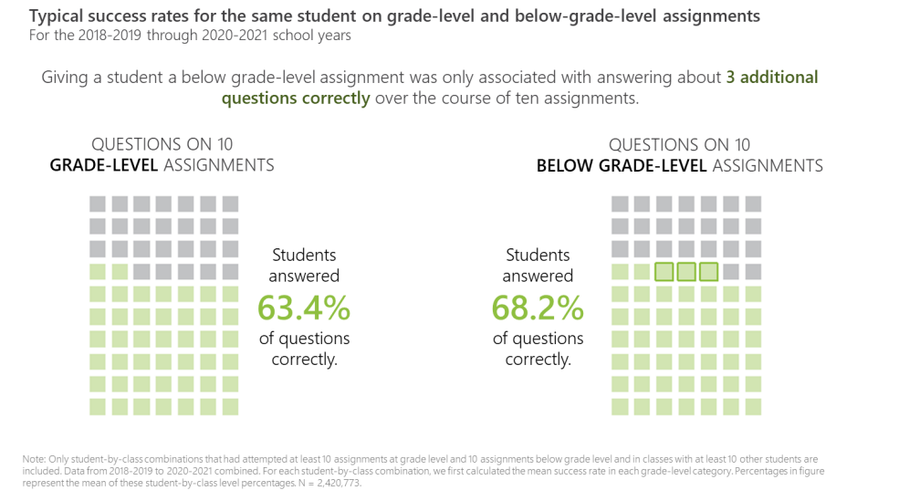
What Research Says
“Assigning students work below their grade level mainly just denies them important opportunities to engage with material they could master if given the chance”
TNTP: Unlocking Acceleration (August 2022)

Slide 49
What Research Says
“To make up for what’s been lost, we need to focus on acceleration, not remediation. That means devoting the bulk of classroom time to challenging instruction at grade-level or higher, and giving all students access to a rich, high-quality curriculum in English language arts, mathematics, social studies, science, the arts, and more”
The Acceleration Imperative: A Plan to Address Elementary Students’ Unfinished Learning in the Wake of Covid-19 (2021)

Slide 50
How Do We Get Our Students to Work in Grade-Level Material?

Slide 51
English Standards of Learning Spiral
K.8c Use pictures to make predictions
1.9 d and 2.7a Make and Confirm Predictions
3.5c Make, Confirm and Revise Predictions
4.5h Draw conclusions/Make inferences about the text using text as support
6.5f Draw conclusions and make inferences using the text for support.
8.5e Make inferences and draw conclusions based on explicit and implied information using references to the text for support.
10.5f Draw conclusions and make inferences on explicit and implied information, using textual support as evidence.
12.4h Use critical thinking to generate and respond logically to literal, inferential, and evaluative questions about the text(s).
Notes:
we provide students access to grade level material and balance foundational skills with complex text. The WHY! Because the standards spiral-same speech, each grade level is dependent on the one before it and we have to get students ready for the next step. See this example.

Slide 52
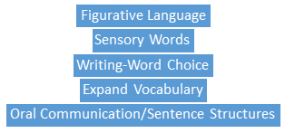
Literacy Skills Stack
Vertical Progression of Skills
VDOE Utilizing Data To Maximize Instruction Webinar 2021-2022
Notes:
How to we get them in grade level work? Well the standards spiral but each literacy skill is also interdependent on other skills also. So its misleading to say there’s a “main idea” issue. There was a lot that happened along the way with the reader, and the text that couldve led to someone not understanding the main idea. We have to intentionally plan text and tasks that support this stacking of skills to support the reader through the text. See the example on this slide, planning questions, knowing the reader, and the text.

Slide 53
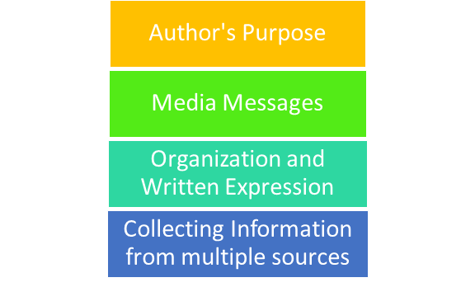
Literacy Strands Work Together in 3-5
Strand Integration
VDOE Utilizing Data To Maximize Instruction Webinar 2021-2022
Notes:
how-we also must consider that each strand of the standards are dependent on each other as well. So we plan tasks and engage with text in ways that allow us to integrate all of the strands, see the example…

Slide 54
Scaffolding Complex Text
•Support Vocabulary
•Use Deliberate Annotation
•Use Questions as Planned Scaffolds
•Allow Time for Reflection and Discussion
•Provide many hours a week for independent reading
•Access to grade level text
•Locate complicated sentence structures
•Explicit
Notes:
Supporting Vocabulary: re-format the text (visual cues, chunk, print size), student friendly glossaries, picture cues (story, strategy), pre-teach vocabulary,
Annotation: number lines of text, pre-annotating texts with a purpose, Key ideas, providing overviews
Questions: strong series of questions planned systematically, Build from basic comprehension to inferential, hint cards to direct them, using paragraph lines or numbers, or section headings
Reflection: writing in order to prepare for oral, or oral to prepare for writing, talk time with peers (models),
Time for independent reading-hours planned each week to read at their independent level, time to apply what they are learning from higher level texts.
Access to grade level text: planning close reading lessons, short chunks of text,
Sentence structures-identify and incorporate into discussion
Explicit-tell them when a text may be more challenging, teaching-tell them what the pronouns and referring to

Slide 55
Evidence-based Practices
1. Begin lessons with short reviews of previous learning.
2. Present new material in small amounts; assist students as they practice the material.
3. Ask many questions and observe student responses; questions allow students to connect new material to prior learning.
4. Provide models such as step-by-step demonstrations or think alouds to work out the problem.
5. Guide student practice by asking good questions and providing feedback.
6. Check that students understand the material; doing so can help students learn with fewer errors.
7. Obtain a high success rate (~80%) through teaching in small steps, guiding practice, and employing mastery learning techniques.
8. Provide scaffolds, or temporary supports, for difficult material.
9. Prepare students for and monitor independent practice; ample independent practice is necessary for skills and knowledge to become automatic.
10. Engage students in weekly and monthly reviews of past material.
Institute of Educational Sciences: Evidence-based Teaching Practices Infographic
Notes:
Here are some additional practices to support reading grade level text…

Slide 56
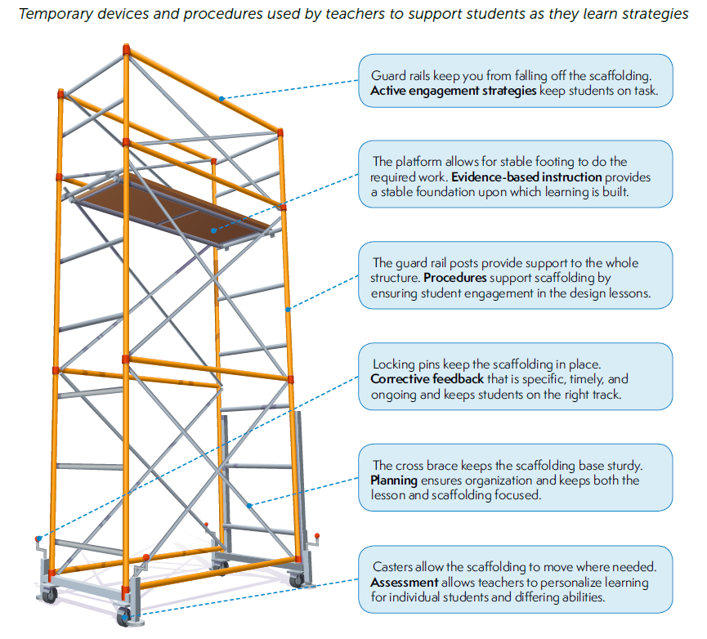
Scaffolds
Institute of Educational Sciences: Evidence-based Teaching Practices Infographic
Notes:
we scaffold…

Slide 57
Evidence-based Practices in Literacy Instruction
Evidence-based Practices | Literacy Connections & Instructional Focus
Reviews of previous learning (weekly, monthly, opening) Connect new material to prior learning Present new material in small amounts Assist students as they practice the material Observe student responses Think alouds Asking good questions Providing feedback Check that students understand the material Teach in small steps Provide scaffolds Provide model Guide practice Provide independent practice | Explicit, Systematic Direct Instruction Gradual Release (I do, We do, You do) Small group differentiated instruction Conferences Whole group learning | Intentional Focus on: Building language skills (oral, academic, inferential, etc) Listening and language comprehension Writing about what was read Handwriting Engaging students in grade level text Decoding Speech sounds and their connection to print Balancing fiction and nonfiction Reading connected text daily Integrating strands of English Standards Communication & Multimodal Literacies Reading Writing Research
Notes:
link those to what we have mentioned

Slide 58
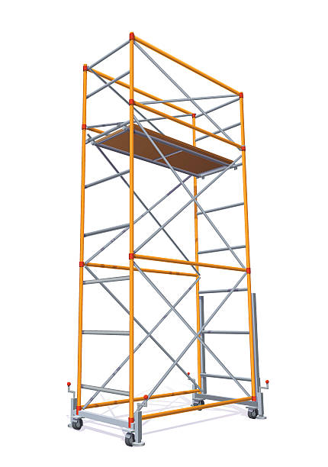
Evidence-based Practices in Literacy Instruction
Chunking text, read alouds
Discussion
Small group
Students are engaged
Explicit and systematic
Direct Instruction
Students have a purpose for
learning
Gradual Release (I do, We do, You do)
Small group differentiated instruction
Whole group learning
Students know what to
expect
Conferences and written feedback
Students show what they
understand and where they need support
Consider the level of rigor in skills of the standards when designing, selecting tasks and activities or learning experiences
Students practice grade-level
skills using appropriate texts
Use formative data to gauge student understanding and inform pacing
Track learning progression, diagnose, go back
Students focus on skills that
they need to strengthen
Institute of Educational Sciences: Evidence-based Teaching Practices Infographic
Adapted from Achieve the Core

Slide 59
Food for Thought
“It’s not always the text; it’s what you do with it.”
~Jennifer Serravallo

Slide 60
Upcoming Opportunities

Slide 61
November Learning Labs
For participants interested in workshopping and applying ideas presented at the virtual institutes, three in-person K-12 English SOL Learning Labs will be offered around the state. Educators will attend one full-day learning lab facilitated by presenters from the virtual English SOL Institutes. These full-day sessions will allow for teachers to connect within grade-band groups to workshop ideas presented at the institutes, examine student work samples, dialogue with educators from around the Commonwealth, and plan next steps for instruction based on the virtual session topics.
● Fredericksburg Learning Lab: Monday, November 7, 2022
● Newport News Learning Lab: Wednesday, November 9, 2022
● Roanoke Learning Lab: Thursday, November 17, 2022

Slide 62
Virginia State Literacy Association Conference
Call for Proposals

Slide 63
Additional VDOE Resources

Slide 64
VDOE Resources
VDOE English Comprehensive Instructional Plans
VDOE Webinar: Utilizing Data to Maximize Literacy Instruction in the 2021-2022 Academic Year
2021 VDOE K-12 SOL Conferences In English Language Arts
2022 VDOE K-12 Virtual SOL English Institutes
VDOE English Comprehensive Literacy Webinars
VDOE Professional Development on Demand

Slide 65
Stay Connected!
Jill Nogueras
K-12 English Coordinator
Jill.Nogueras@doe.virginia.gov
Carmen Kurek
Elementary English/Reading Specialist
Carmen.Kurek@doe.virginia.gov
Colleen Cassada
Middle School English Specialist
Colleen.Cassada@doe.Virginia.gov
Assessment Office
Student_Assessment@doe.virginia.gov

Slide 66
References
Meyers, A. (2021). To catch students up, don’t remediate. accelerate. Johns Hopkins University Magazine. Retrieved August 28, 2021, from https://hub.jhu.edu/2021/05/06/accelerate-learning-to-bridge-covid-19-education-gaps/.
Rosenshine, B. (2012). Principles of instruction: Research-based strategies that all teachers should know. American Educator, 36(1), 12-39. Retrieved from https://www.aft.org/sites/default/files/ periodicals/Rosenshine.pdf
Shanahan, T., Callison, K., Carriere, C., Duke, N. K., Pearson, P. D., Schatschneider, C., & Torgesen, J. (2010). Improving reading comprehension in Kindergarten through 3rd grade. Washington, DC: National Center for Education Evaluation and Regional Assistance, Institute of Education Sciences, U.S. Department of Education. Retrieved from https://ies.ed.gov/ncee/wwc/Docs/PracticeGuide/ readingcomp_pg_092810.pdf
Foundational Skills to Support Reading for Understanding (2019) Institute of Education Sciences Retrieved from https://ies.ed.gov/ncee/wwc/Docs/PracticeGuide/wwc_foundationalreading_040717.pdf
Council of Chief State School Officers (2021). A Nation of Readers: How State Chiefs Can Help Every Child Learn To Read. Retrieved from: https://753a0706.flowpaper.com/CCSSOReadingResource/#page=1
The New Teacher Project. (2022, August 9). Unlocking acceleration: how below grade-level work Is holding students back in literacy. Retrieved September 2, 2022, from https://tntp.org/assets/documents/Unlocking_Acceleration_8.16.22.pdf T

Slide 67
Disclaimer
Reference within this presentation to any specific commercial or non-commercial product, process, or service by trade name, trademark, manufacturer or otherwise does not constitute or imply an endorsement, recommendation, or favoring by the Virginia Department of Education.

