Slide 1
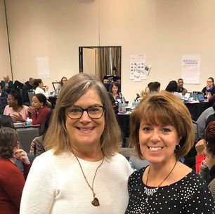
World and Word Knowledge
Unlocking Reading Road Blocks for Evidence-Based Vocabulary Instruction
Annette Conley, Reading Specialist, Thoroughgood Elementary School, Virginia Beach
Jennifer Haws, Principal, Corporate Landing Elementary School, Virginia Beach

Slide 2
Overview
The role of background (WORLD) knowledge in reading
Strategies for developing background knowledge
The role of vocabulary instruction (WORD Knowledge) in reading
Strategies for teaching vocabulary

Slide 3
Let’s Connect!
Our dynamic colleagues have done fantastic sessions!
Add to our Padlet
https://tinyurl.com/vdoe3to5

Slide 4
Why oh why??
Understanding and applying the research on world and word knowledge IES Practice Guide Providing Reading Interventions 4-9

Slide 5
World Knowledge
Providing students with relevant knowledge to comprehend text.

Slide 6
Why bother?
Evidence-Based Practices
What does the research say about world knowledge?
“Students need enough knowledge about a topic to read and understand a text on that topic.”
“Experts estimate between 30%-60% of variance in learning outcomes can be traced to prior knowledge disparities.”
* “What is Prior Knowledge” https://yup.com/blog/importance-building-on-prior-knowledge/

Slide 7
A Review of the Rope

Slide 8
Focus on World Knowledge
Must address the misconceptions that students have
Brain Research- “Constructivism” and Long-term memory
Struggling readers - the roadblocks of working memory
The old method “What do you know about the circus?” took WAY too much time!
Explicit instruction is the way to go!

Slide 9
What do the standards say? (1 of 2)
3.5 The student will read and demonstrate comprehension of fictional texts, literary nonfiction, and poetry.
a) Set a purpose for reading.
b) Make connections between reading selections.
c) Make, confirm, and revise predictions.
d) Compare and contrast settings, characters, and plot events.
e) Draw conclusions using the text for support.
i) Use reading strategies to monitor comprehension throughout the reading process.
3.6 The student will read and demonstrate comprehension of nonfiction texts.
a) Identify the author’s purpose.
b) Use prior and background knowledge as context for new learning.
d) Ask and answer questions about what is read using the text for support.
e) Draw conclusions using the text for support.
i) Use reading strategies to monitor comprehension throughout the reading process.

Slide 10
What do the standards say? (2 of 2)
4.5 Fiction
a) Describe how the choice of language, setting, and characters contributes to the development of plot.
b) Identify the theme(s).
c) Summarize events in the plot.
d) Identify genres.
f) Identify the conflict and resolution.
g) Identify sensory words.
h) Draw conclusions/make inferences about text using the text as support.
4.6 Nonfiction
b) Explain the author’s purpose.
e) Draw conclusions and make inferences using textual information as support.
f) Distinguish between cause and effect.
g) Distinguish between fact and opinion.

Slide 11
Partner Sharing -Identify the Vocabulary in Fifth Grade Standards
5.5 The student will read and demonstrate comprehension of fictional texts, literary nonfiction, and poetry.
a) Summarize plot events using details from text.
b) Discuss the impact of setting on plot development.
c) Describe character development.
d) Identify theme(s).
e) Explain the resolution of conflict(s).
g) Differentiate between first and third person point-of-view.
i) Explain how an author’s choice of vocabulary contributes to the author’s style.
j) Draw conclusions and make inferences with support from the text.
k) Identify cause and effect relationships.
l) Compare/contrast details in literary and informational nonfiction texts.

Slide 12
Strategies for World Knowledge (1 of 4)
Strategies identified as having an evidenced-based impact: (“Provide a clear the path” for word learning)
Student input
Direct instruction
Questions

Slide 13
Strategies for World Knowledge (2 of 4)
Student Input -
Evidenced-Based practice: Assimilation of new knowledge into previous knowledge
Remember:
VERY brief
Turn and talk
Write it on a sticky note
Sketch it on a wipe board
Avoid calling on one student at a time
Caution: Misconceptions can be road blocks

Slide 14
Strategies for World Knowledge (3 of 4)
Explicit Instruction (3 - 5 minutes)
*Teacher Led - Interactive and student-focused
Podcasts
Videos / Virtual Field Trips (https://ditchthattextbook.com/virtual-field-trips/
Image Flood
Teacher summary

Slide 15
Strategies for World Knowledge (4 of 4)
Question Formulation Technique
A Question Focus
Rules for Producing Questions
Producing Questions
Categorizing Questions-Open/Closed
Prioritizing Questions
Next Steps
Reflection
What is the OFT
An Example Volcano QFT

Slide 16
Try It! World Knowledge
Robot Text
Work with a partner
Identify activities or resources to build World Knowledge
Sharing

Slide 17
Word Knowledge
Understanding the meaning of a variety of words supports meaning of the text as a whole

Slide 18
Remember the Reading Rope

Slide 19
Word Knowledge - The Why
“Understanding word meaning has always been essential to reading comprehension. Whether reading the printed page or a computer screen, a strong sense of word meaning provides a basis for greater comprehension in an increasingly fast-paced world.”
What is The Nations Report Card?

Slide 20
Word Knowledge - Our Why
Soaring Seagulls
Words I was SO surprised that students didn’t know:
pebble, grouchy, stoop, carport, basement, kin
Chunk chunk blend and sorts - slope, trot

Slide 21
Word Knowledge: the Standards (1 of 2)
3.4 The student will expand vocabulary when reading.
d) Use context to clarify meaning of unfamiliar words.
e) Discuss meanings of words and develop vocabulary by listening to and reading a variety of texts.
f) Use vocabulary from other content areas.
4.4 The student will expand vocabulary when reading.
d) Use vocabulary from other content areas.
e) Develop and use general and specialized vocabulary through speaking, listening, reading, and writing.
5.4 The student will expand vocabulary when reading.
a) Use context to clarify meaning of unfamiliar words and phrases.
b) Use context & sentence structure to determine meanings & differentiate among multiple meanings
f) Develop + use general/specialized content area vocab through speaking, listening, reading, & writing.

Slide 22
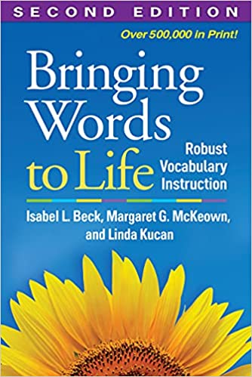
Word Knowledge: The Standards (2 of 2)
In Teacher notes:
Vocabulary words should be culled from student reading instead of using random lists and should not be taught in isolation.
"Tiered” Vocabulary Model
by Beck, McKeown, and Kucan

Slide 23
“Tiered” Vocabulary Model
3
2
1
Tier 1: Everyday words familiar to most students (often learned through conversation)
girl, sad, orange (8,000 word families in English)
Tier 2: High-utility academic vocabulary found in many content texts (cross-curricular)
masterpiece, measure, multiple (7,000 word families in English)
Tier 3: Content specific academic vocabulary (all others)
economics, chlorophyll (remaining 400,000 words in English)

Slide 24
Teaching Word Knowledge Routine (1 of 3)
Display word for students to read and view. “This word is _.”
Decode the word by syllables. Identify roots and affixes
Ask, “What is the word?” Have the students repeat the vocabulary word.
Repeat steps 1 and 2 for difficult to pronounce words. May want students to write the word and highlight phonics.

Slide 25
Teaching Word Knowledge Routine (2 of 3)
5. Display student-friendly definition. “_ means _.” Chorally repeat the student-friendly definition (as you point to the words).
6. Identify the word etymology and any “related” words known by the students and/or teacher.
7. Provide examples of the vocabulary word that will help your students understand the word. Here are some options:
Pictures
Acting out the word
Novel sentences using the word
Sentences from the read-aloud text using the word

Slide 26
Teaching Word Knowledge Routine (3 of 3)
8. Check for understanding by asking students questions where they will have to use the vocabulary word correctly in their answer. Choose one or two of the options listed below. Provide a sentence frame for student responses. For example: Start your answer with [sentence frame].
Ask the students questions that will prompt a complete understanding of the vocabulary word or its meaning.
Ask students to generate examples or nonexamples to show that they understand the correct use of the vocabulary word.
Ask students to say a sentence that uses the vocabulary word.

Slide 27
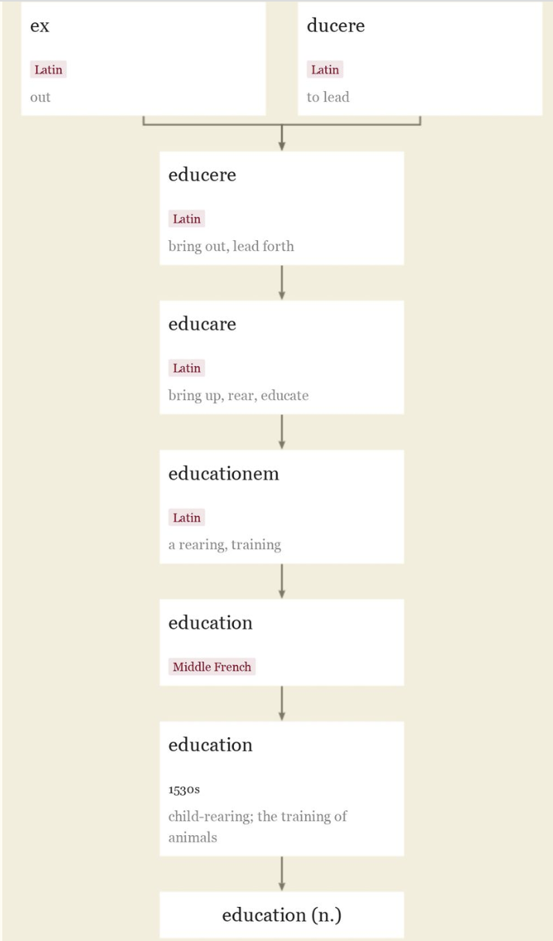
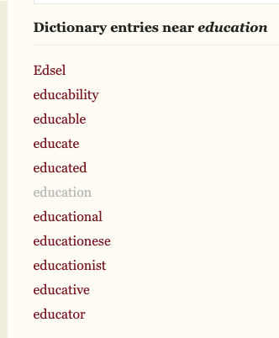
Etymology
Etymologies are not definitions; they're explanations of what our words meant and how they sounded 600 or 2,000 years ago.
Example: education (n.)
1530s, "child-rearing," also "the training of animals," from French education (14c.) and directly from Latin educationem (nominative educatio) "a rearing, training," noun of action from past-participle stem of educare (see educate). Originally of instruction in social codes and manners; meaning "systematic schooling and training for work" is from 1610s.
Resource: ETYM Online

Slide 28
Become a “Word Nerd”
Oxford English Dictionary at OED.com
Miriam Webster Dictionary
Dictionary.com

Slide 29
More Direct Instruction for Word Knowledge
“Giving students information about a word is important to initiate word learning. However, students will need to work with the words and their meanings to remember them. Once or twice a week, provide additional opportunities for students to work with the words and their meanings after reading.”
Strategies to use:
Frayer and layer
Cloze and context clues
Regular vocab building structures
Vhttps://ies.ed.gov/ncee/wwc/Docs/PracticeGuide/WWC-practice-guide-reading-intervention-full-text.pdf

Slide 30
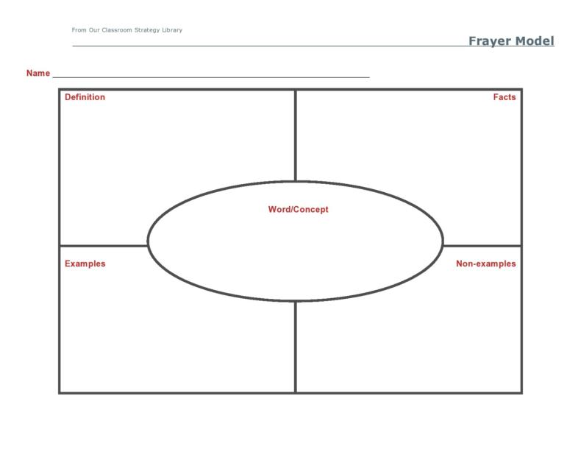
Strategies for Constructing Word Knowledge (1 of 6)
Frayer and Layer
The Frayer is awesome, but it’s not enough. You have to do lots of review and add layers.

Slide 31
Strategies for Constructing Word Knowledge (2 of 6)
The good old CLOZE technique - not for assessment, for instruction

Slide 32
Strategies for Constructing Word Knowledge (3 of 6)
Another example for Cloze - can be used before, during and after reading

Slide 33
Strategies for Constructing Word Knowledge (4 of 6)
Context Clues - using nonsense words
I don’t like going to the foogle with my mom. It takes so long to go through all of the aisles, and our basket gets full so fast. It is so boring to wait until everything is checked out too.

Slide 34
Strategies for Constructing Word Knowledge (5 of 6)
Context Clues Examples:
The sun is so bright today that I will definitely have to wear my foogles. I just bought some the other day thankfully!
Dear Diary,
I overslept this morning. I had to eat my bowl of poof-poofs very quickly, and I almost missed the tramzam. When I got to school, I realized I had forgotten my zilgping . Luckily, Ms. Jutzi is very zoosh, and told me I could bring it tomorrow.

Slide 35
Strategies for Constructing Word Knowledge (6 of 6)
Create ownership around growing vocabulary
Daily practice and usage
Vocabulary Journals/Anchor charts/Vocab Partners
“I’m Thinking of a Word” and other games
Online resources

Slide 36
Applying Word Knowledge
Return to the robot text.
Choose a Tier 3 word to review with a partner.
Try a strategy:
8 step structure
Figure out the etymology
Create a nonsense context clues example

Slide 37
Tying it All Together
We’d love to connect!
Jennifer Haws
Twitter @jehaws
Jennifer.Haws@vbschools.com
Annette Conley –
Twitter: @Amconley49
Annette.Conley@vbschools.com

Slide 38
Reference Page
“Collection of Virtual Field Trips” retrieved at (https://ditchthattextbook.com/virtual-field-trips/
“The Nation’s Report Card on Reading” retrieved at https://nces.ed.gov/nationsreportcard/pdf/main2011/2013452.pdf
“Providing Reading Interventions in Students 4-9: An Educators Praction Guide” retrieved at: https://ies.ed.gov/ncee/wwc/Docs/PracticeGuide/WWC-practice-guide-reading-intervention-full-text.pdf
Question Formulation Technique retrieved at https://rightquestion.org/what-is-the-qft/
Virginia Department of Education ELA Standards of Learning
•“What is Prior Knowledge”retrieved at https://yup.com/blog/importance-building-on-prior-knowledge/

Slide 39
Disclaimer
Reference within this presentation to any specific commercial or non-commercial product, process, or service by trade name, trademark, manufacturer or otherwise does not constitute or imply an endorsement, recommendation, or favoring by the Virginia Department of Education.

