Slide 1
Advanced Phonics: Everything You Need to Know About Syllables and Morphology
Dr. Jennifer McSweeney, K-5 Instructional Literacy Specialist
Anna Yim, Reading Specialist

Slide 2
Presenters
Dr. Jennifer McSweeney
Anna Yim

Slide 3
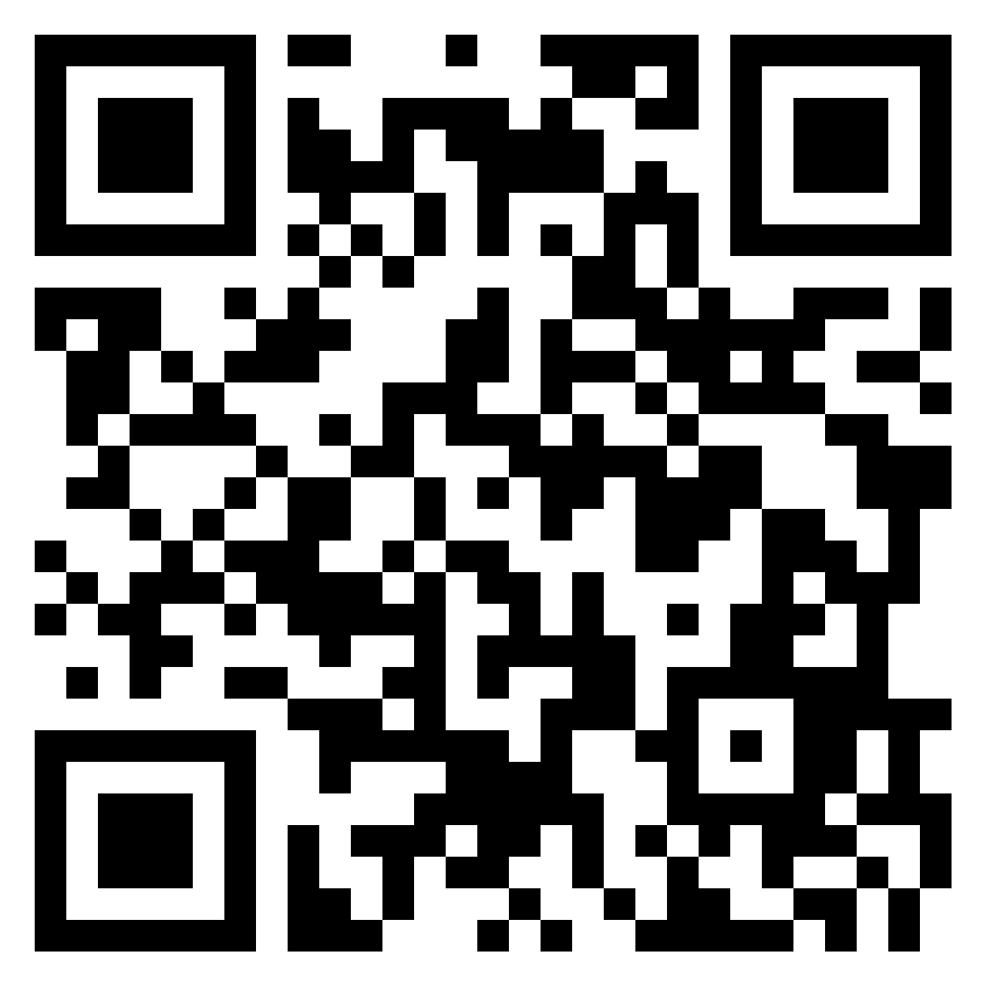
Questions or Ponderings?
We will revisit all questions during the November Learning Labs. Please sign up.
Scan the QR code or click on the link:
https://tinyurl.com/vdoe3to5

Slide 4
Introduction
Understanding Advanced Phonics

Slide 5
Introduction: Learning Intentions
What is Advanced Phonics? Learning about Syllables
To learn about the 6 syllable types
To learn about the 6 syllable division rules for multi-syllable words
To learn strategies to teach students how to break down a hard word
To learn how students can practice working with syllables
What is Morphology? Learning about Meaning
To learn the difference between morphemes, morphology, and morphological awareness.
To learn where to start with prefixes and suffixes.
To learn how students can practice working with morphemes.

Slide 6
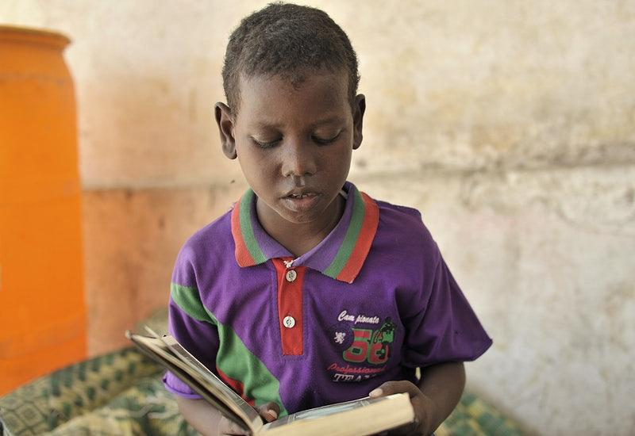
Introduction- Think About This…
“There is no comprehension strategy powerful enough to compensate for the fact that you can’t read the words”
-Archer & Hughes, 2010, Guilford Press.

Slide 7
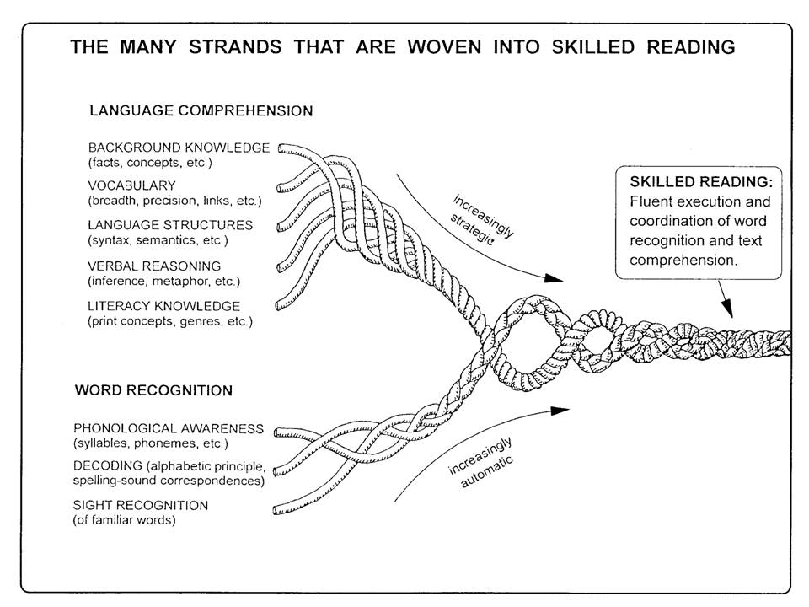
Introduction: Reading Rope
Strands of the reading rope develop over time to develop skilled readers.
We will focus on :
-Decoding
-Vocabulary (Morphology)

Slide 8
Syllables
Understanding the role of syllables in decoding and building fluency

Slide 9
Syllables: Read this passage… Why do students need to know syllables types and syllable division rules?
Jabberwocky
by Lewis Carroll
'Twas brillig, and the slithy toves
Did gyre and gimble in the wabe:
All mimsy were the borogoves,
And the mome raths outgrabe.
'
-What did you need to know to decode this passage?
-Are the /g/ sounds in gyre and gimbal hard or soft?
-What part of speech is the word slithy? How do you know?
-Do you see words with a CVCsilent e pattern?

Slide 10
Syllables: Connecting Science Of Reading to
Standards of Learning (SOL) and Evidence-Based Practices
Reading Rope Strand: Decoding and SOL strands of reading, writing, communication
Grade 3
3.3 The student will use knowledge of regular and irregular vowel patterns and
decode regular multisyllabic words.
3.5 m) Read with
fluency, accuracy, and
meaningful expression.
3.6 j) Read with
fluency, accuracy, and
meaningful expression.
3.9 The student will edit writing for capitalization, punctuation, spelling, and Standard English.
Grade 4
4.4 b) Use knowledge of roots, affixes, synonyms, antonyms, and homophones to determine the meaning of new words.
4.5 l) Read with fluency, accuracy, and meaningful expression.
4.6 i) Read with fluency, accuracy, and meaningful expression.
4.8 The student will self- and peer-edit writing for capitalization, spelling, punctuation, sentence structure, paragraphing, and Standard English.
Grade 5
5.4 c) Use knowledge of roots, affixes, synonyms, antonyms, and homophones to determine the meaning of new words.
5.5 m) Use reading strategies throughout the reading process to monitor comprehension.
5.6 k) Use reading strategies throughout the reading process to monitor comprehension.
5.8 The student will self- and peer-edit writing for capitalization, spelling, punctuation, sentence structure, paragraphing, and Standard English.

Slide 11
Syllables: Connecting Science Of Reading to
Standards of Learning (SOL) and Evidence-Based Practices
Research says:
By upper elementary and middle school grades, texts include more complex multisyllabic words, such as disorganization and equilibrium. Many of these difficult multisyllabic words are essential for understanding the meaning of the texts. Therefore, we need to…
Build students’ decoding skills so they can read multisyllabic words.
Prepare students with the skills needed to break apart and accurately sound out multisyllabic words.
Explicitly teach students the routine to use when they encounter unfamiliar multisyllabic words.
Teach students to decode words, analyze word parts, and write and
recognize words.

Slide 12
Syllables: Orthographic Mapping with BIG words
Flexible
* What are the morphemes, or meaningful parts? flex-ible flex = to bend, ible = adjective
*How many syllables? flex-i-ble
*How many graphemes are in the word? f-l-e-x-i-b-l-e
*How many phonemes are in the word? /f/-/l/-/e/-/k/-/s/-/i/-/b/-/e/-/l/
*What part of speech is the word? ible = an adjective

Slide 13
Syllables: Orthographic Mapping: Syllables vs. Morphemes
Word
Syllable
Morpheme
prevent pre-vent pre=before, vent = come
quietly qui-et-ly quiet = with little noise, ly = adverb
disable dis-a-ble dis = not, able = having the skill to do something

Slide 14
Syllables: 6 Syllable Types
Closed syllables, simple and complex (e.g., pet, cats)
Vowel Consonant-e (VCe, magic e, or silent e) syllables (e.g., slide, scare, cute)
Open syllables (e.g., ri – pen)
Vowel team syllables (e.g., teeth)
Vowel-r syllables (e.g., car, bird, her)
Consonant-le (Cle) syllables (e.g., ap – ple)

Slide 15
Syllables: 6 Syllable Division Rules
Rabbit: Divide between 2 consonants VC/CV
Tiger: Divide between long vowel and consonant V/CV
Camel: Divide between consonant and vowel VC/V
Turtle: See -le, count back 3 /Cle
Lion: Divide between 2 vowels V/V
*Remember:
Divide after prefixes pre/view
Divide before suffixes work/ing
Divide between compound words Cat/fish
Divide before final stable syllables
lo/tion, vi/sion

Slide 16
Syllables: Strategy #1 to break down BIG words using prefixes and suffixes
Box any familiar suffixes (e.g., -ing, -ous, -ful).
Circle any familiar prefixes (e.g., re-, un-, sub-).
Locate and put a line under each vowel grapheme in the word.
Use knowledge of syllables to decode the vowel sounds. Scoop a pencil under each syllable, blending left to right.
Say the whole word and see if it makes sense. Flex the vowel sound, and try it different ways if it doesn’t sound right.
If necessary, check the context for clarification

Slide 17
Syllables: Strategy #2 to break down BIG words using vowels and syllables
Underline single vowels and vowel or vowel-consonant combinations.
2. Count the number of vowel sounds to determine how many syllables are in the word.
3. Break the word into parts, with every syllable having a vowel sound in it.
4. Blend each part together to form a word you recognize.
unreasonable
un/rea/son/a/ble

Slide 18
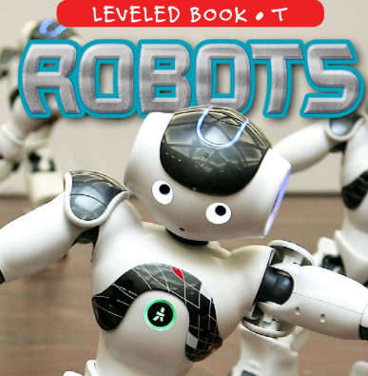
Syllables: Activities for students
Give each student a card that contains a word part. (Add a picture card for words that might be more difficult—or to enhance the activity for EL students.)
Have students walk around until they find another student to complete their word.
Ask questions about the words.
Re-sort, if appropriate.

Slide 19
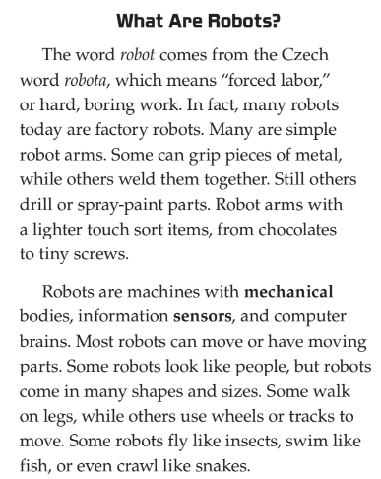
Syllables: An activity with Robots
ro-bot la-bor
fac-tor-y me-chan-i-cal
bor-ing in-for-ma-tion
sen-sors com-pu-ter
peo-ple in-sects
Questions:

Slide 20
Morphology
Understanding the Role of Morphology in Word Recognition and Comprehension

Slide 21
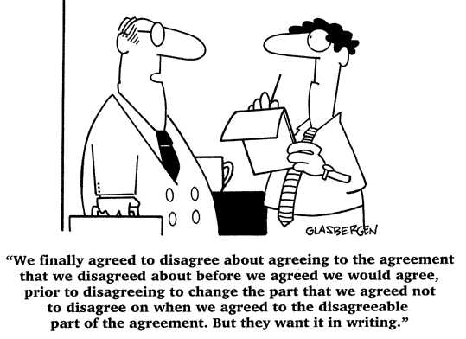
Morphology

Slide 22
Morphology: Connecting Science Of Reading to
Standards of Learning (SOL) and Evidence-Based Practices Part 1
Reading Rope Strand: Decoding and SOL strands of reading, writing, communication
Grade 3
3.3 The student will and
decode regular multisyllabic words.
3.4 b) Use knowledge of roots, affixes, synonyms, and antonyms to determine the meaning of new words.
3.4 c) Discuss meanings of words and develop vocabulary by listening to and reading a variety of texts.
3.4d) Use vocabulary from other content areas
Grade 4
4.4 b) Use knowledge of roots, affixes, synonyms, antonyms, and homophones to determine the meaning of new words.
4.4 d) Use vocabulary from other content areas.
4.4 e) Develop and use general and specialized vocabulary through speaking, listening, reading, and writing.
Grade 5
5.4 c) Use knowledge of roots, affixes, synonyms, antonyms, and homophones to determine the meaning of new words.
5.4 f) Develop and use general and specialized content area vocabulary through speaking, listening, reading, and writing.

Slide 23
Morphology: Connecting Science Of Reading to
Standards of Learning (SOL) and Evidence-Based Practices Part 2
Research Says: Evidenced-Based Practices:
Teach students academic language skills, including vocabulary knowledge.
Teach student to decode words, analyze word parts, and write and recognize words
Focus on practices to improve students’ ability to read words accurately and automatically
Focus on practices for helping students to understand the text they read.
Systematic, explicit and intentional instruction on the spoken and written form of the English language (sound, syllable, morpheme, word)

Slide 24
Morphology: Word Division by Syllable vs. by Morpheme
Word Division by Syllable
For example, the word contradiction may be divided by syllable (con-tra-dic-tion)
Syllables are units of sound organized around a vowel, and they do not necessarily convey meaning.
Word Division by Morpheme
For example, the word contradiction may be divided by morpheme (contra-dict-ion).
Morphemes are the smallest unit of meaning in a word, and enables readers to directly get at the meaning of words.

Slide 25
Morphology: Terminology
morpheme: smallest unit of meaning in a word.
morphology: the study of morphemes.
morphological awareness: the ability to understand, analyze, and manipulate morphemes within words.

Slide 26
Morphology: Root Words and Base Words
Root and base word are two different concepts.
Base word refers to a word stripped of its affixes.
For example, spell is the base word in spelling and misspell;
Root word refers to a word part from an original language, such as Latin or Greek.
For example, cred is the root in incredible and credit.
Unlike a base word, a root cannot stand alone but is used to form a family of words with related meanings.

Slide 27
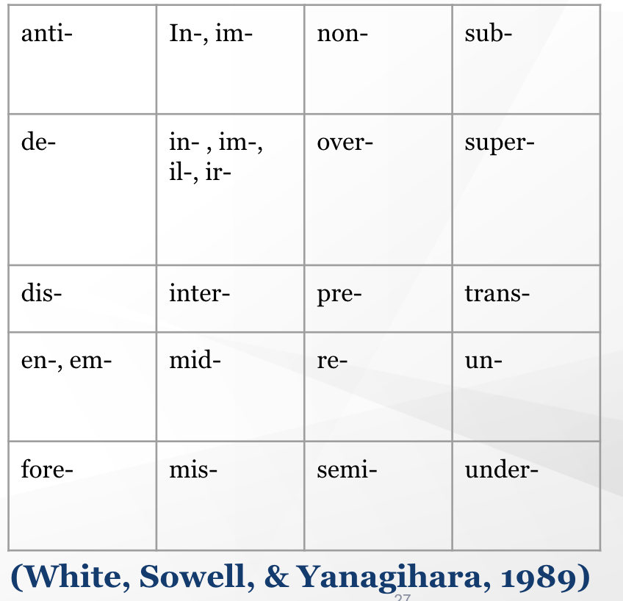
Morphology: Prefixes
20 prefixes accounted for 97% of prefixed words
Un-, re-, dis-, and in- (im-, ir-, il-) accounted for 58% of these

Slide 28
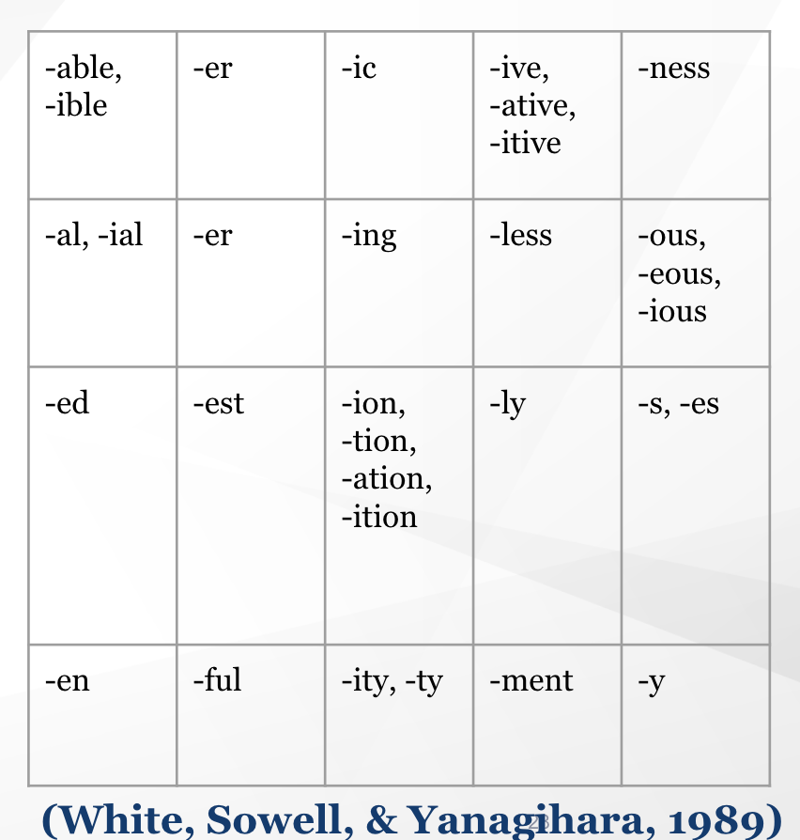
Morphology: Suffixes
12 types of suffixes accounted for 87% of suffixed words
-s/es, -ed, and -ing accounted for 65% of suffixed words

Slide 29
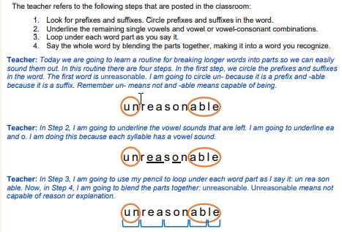
Morphology: Teach students a routine they can use to decode multisyllabic words Part 1
There are numerous routines that can be used to break down and decode multisyllabic words.
Choose one routine to teach students to read a multisyllabic word.

Slide 30
Morphology: Teach students a routine they can use to decode multisyllabic words Part 2
Look for prefixes and suffixes. Circle prefixes and suffixes in the word.
disagreement

Slide 31
Morphology: Teach students a routine they can use to decode multisyllabic words. Part 3
Look for prefixes and suffixes. Circle prefixes and suffixes in the word.
disagreement

Slide 32
Morphology: Teach students a routine they can use to decode multisyllabic words Part 4
2. Underline the remaining single vowels and vowel or vowel-consonant combinations.
disagreement

Slide 33
Morphology: Teach students a routine they can use to decode multisyllabic words Part 5
2. Underline the remaining single vowels and vowel or vowel-consonant combinations.
disagreement

Slide 34
Morphology: Teach students a routine they can use to decode multisyllabic words Part 6
3. Loop under each word part as you say it.
disagreement

Slide 35
Morphology: Teach students a routine they can use to decode multisyllabic words Part 7
3. Loop under each word part as you say it.
disagreement

Slide 36
Morphology: Have students practice building and manipulating words.
In addition to teaching students about suffixes, prefixes, and basic roots, give students opportunities to practice combining them to create new words.

Slide 37
Morphology: Have students practice building and manipulating words
disagreement
disapproval
disengage
disappointment
disobey
dishonest
disconnect
disagreement
disagree
disagrees
disagreed
agreement
agreeable
agreeably
disagreement
abandonment
entertainment
treatment
government
employment

Slide 38
Morphology: Use Cognates as a bridge to English language development
Cognates are words in two or more languages that share a common origin and help English learners link English words to their primary languages.
For example, in Spanish, electricidad means electricity and organismo means organism.

Slide 39
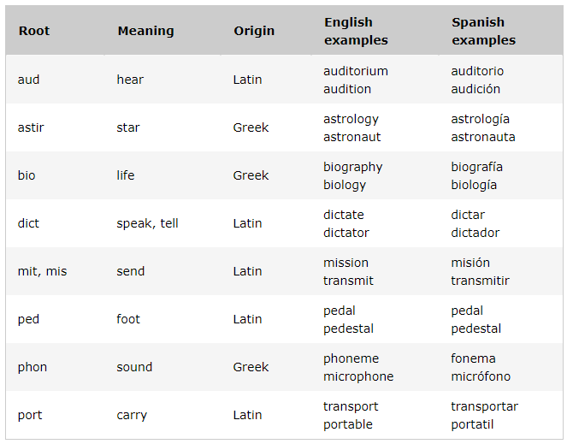
Morphology: Common Greek and Latin roots that are cognates in English and Spanish

Slide 40
Morphology: Choose a small set of vocabulary words for in-depth instruction
It is beneficial to provide intensive instruction on a few select words across several days using a variety of instructional activities
When students are taught a large number of words in a day, they often develop only a shallow understanding of a word’s meaning that is rarely retained later.
Six Criteria When Choosing Words to Teach
Words central to understanding the text.
Words frequently used in the text.
Words that might appear in other content areas.
Words with multiple meanings.
Words with affixes.

Slide 41
Morphology: Teach academic vocabulary in-depth using multiple modalities (writing, speaking, and listening) Part 1
Provide student-friendly definitions of the target academic words and apply these definitions to the context of the text.
Explicitly clarify and reinforce the definitions using examples, non-examples, and concrete representations
Facilitate structured discussions to increase opportunities to talk about academic words
Provide opportunities for students to respond to questions where they have to show their understanding of subtle differences in usage and meaning.
Require students to use the target academic words in their writing activities
Engage student in activities that will increase exposure to and experiences with the word

Slide 42
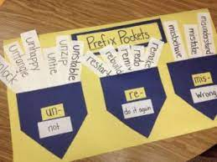
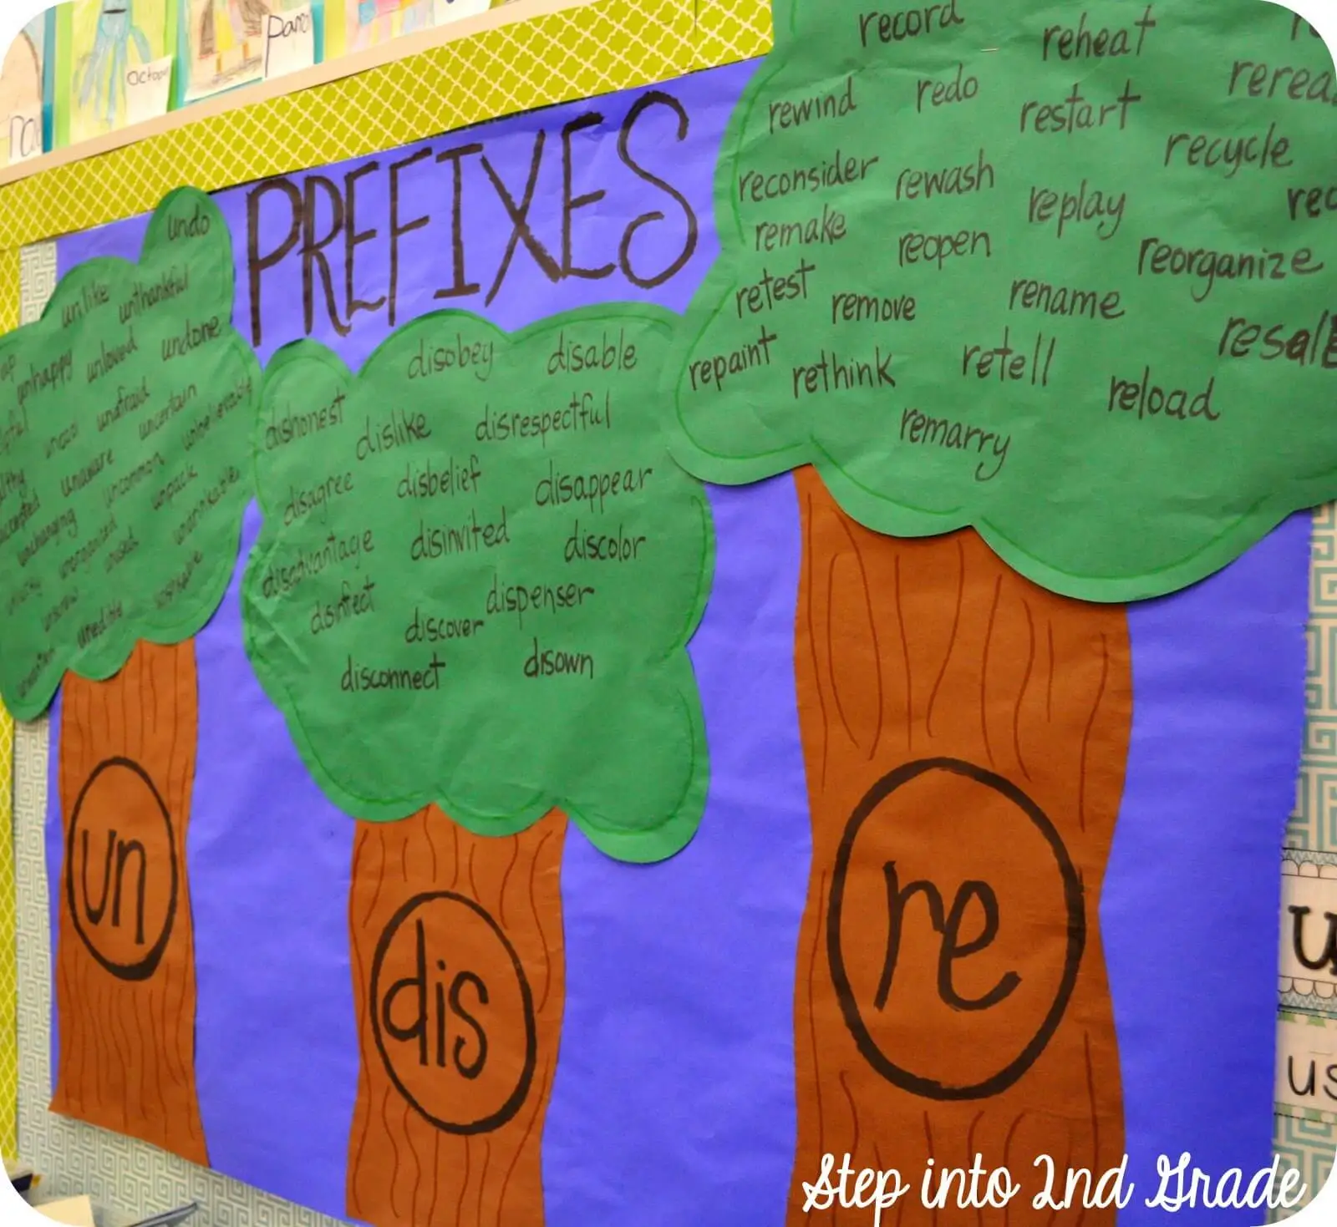
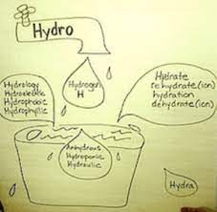
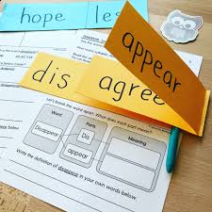
Morphology: Teach academic vocabulary in-depth using multiple modalities (writing, speaking, and listening) Part 2
Speaking/Listening (facilitate discussions where students have to respond to questions where they have to show their understanding of the word) complete a graphic organizer or task together
Other activities (crosswords, charades, sketching, and drawing to represent word meanings can help increase exposure and experience with target academic words.

Slide 43
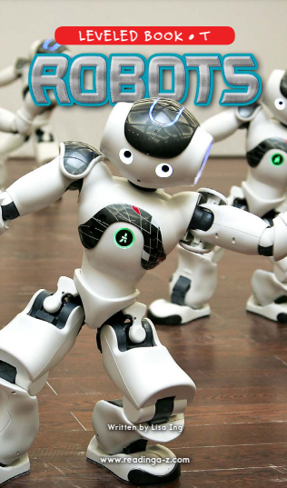
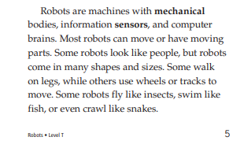
Morphology: Teach the Meanings of Morphemes within the Context of a Sentence
Attention can be given to the word’s internal structure and meaning within the context of a sentence.
Instruction should include not only the spelling, but also the role the morpheme has in changing the meaning of the word.
It is very common for students to make grammatical errors with the endings on words.

Slide 44
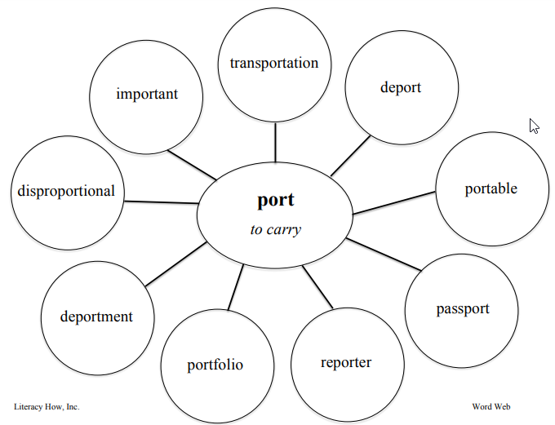
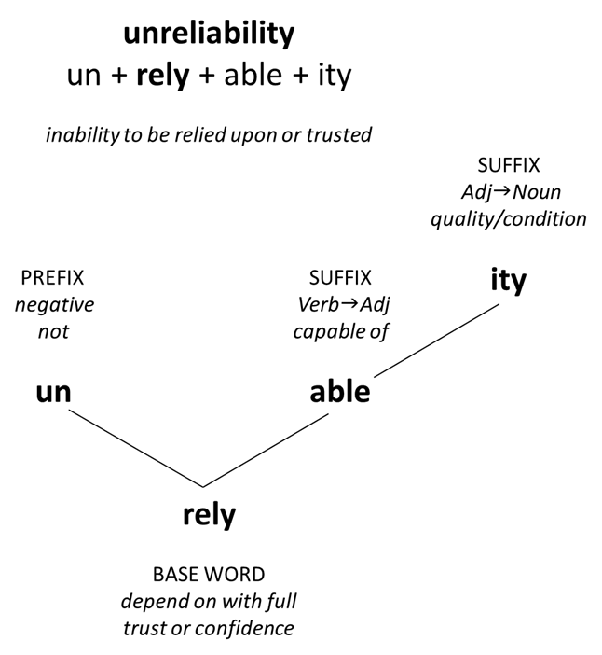
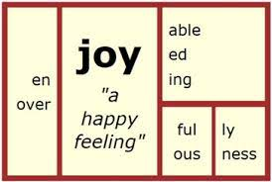
Morphology: Use Visuals to Teach a Root or Base word and its Derivative Forms

Slide 45
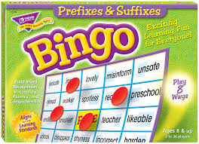
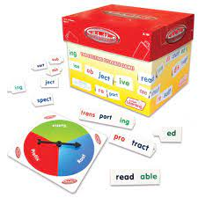
Morphology: Playing Around with Words
flashcards
concentration games
dice-like morpheme cubes
morpheme linking sticks
morpheme bingo games
matching cards games
memory card concentration

Slide 46
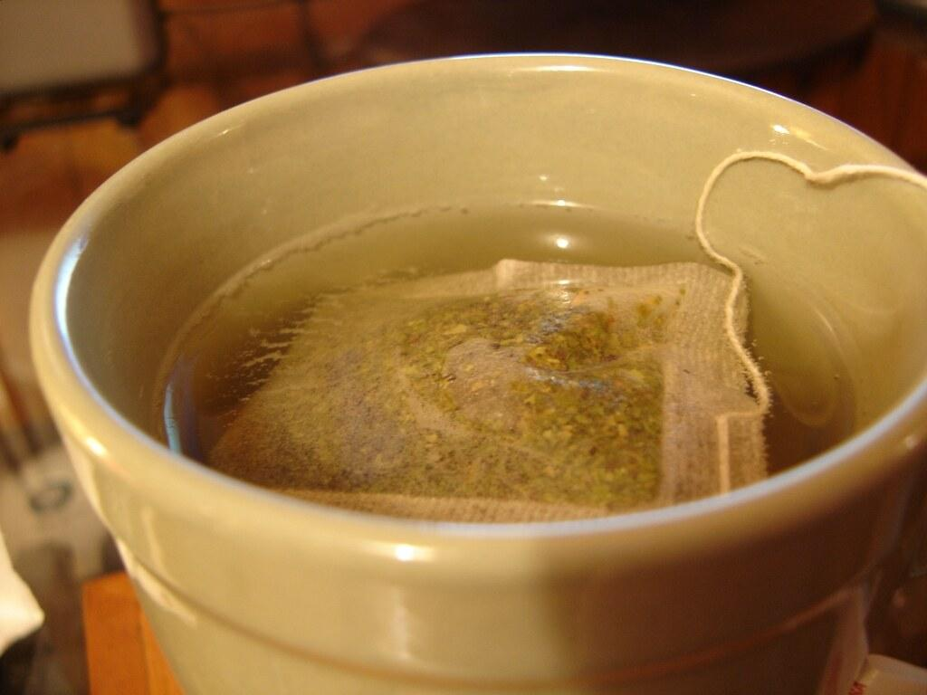
Morphology: Steep Students in Words
“The vocabulary-rich classroom resounds with language, including morphological word play.”
- Susan M. Ebbers

Slide 47
Stay Tuned!
Thursday, October 13, 2022
4:00-5:00 p.m. Reading and Writing = Skilled Readers/Writers (Susan Hoch and Jessica Kidd)
5:00-6:00 p.m. Building Vocabulary and Background Knowledge (Annette Conley and Jennifer Haws)
6:00-7:00 p.m. VDOE Assessment and Data

Slide 48
Questions and Ponderings?
We will revisit all questions during the November Learning Labs.
Scan the QR code or click on the link:
https://tinyurl.com/vdoe3to5

Slide 49
Conclusion & Final Thoughts
“English is not crazy; it is dense, rich, complex, challenging, but it is not crazy.”
-VanCleave, 2021
VanCleave, 2021

Slide 50
References Part 1
Archer, A.; Hughes, C.A. (2010). Explicit instruction: Effective and efficient teaching. New York: Guilford Press.
Carlisle, J. F. (2000). Awareness of the structure and meaning of morphologically complex words: Impact on reading. Reading and Writing, 12(3), 169-190.
Colorin Colorado. (2018, August 15). Using cognates to develop comprehension. Reading Rockets. Retrieved August 11, 2022, from https://www.readingrockets.org/article/using-cognates-develop-comprehension

Slide 51
References Part 2
Ebbers, S. M. (2017). Morphological awareness strategies for the general and special education classroom: A vehicle for vocabulary enhancement. Perspectives on Language and Literacy, 42(2), 29-34.
Foundational Skills to Support Reading for Understanding in Kindergarten Through 3rd Grade. (2016). Institute of Education Sciences. Retrieved from https://ies.edu.gov/ncee/wwc/PracticeGuide/21
Mann, V. & Singson, M. (2003). Linking morphological knowledge to English decoding ability: Large effects of little suffixes. In E. Assink & D. Sandra (Eds.), Reading complex words: Cross-language studies (1-25). New York: Plenum Publishers

Slide 52
References Part 3
Providing Reading Interventions for Students in Grades 4–9. (2022). Institute of Education Sciences. Retrieved from https://ies.edu.gov/ncee/wwc/Docs/PracticeGuide/WWC-practice-guide-reading-intervention-full-text.pdf
Teaching Academic Content and Literacy to English Learners in Elementary and Middle School. (2014). Institute of Education Sciences. Retrieved from https://ies.ed.gov/ncee/wwc/Docs/PracticeGuide/english_learners_pg_040114.pdf#page=20
White, Thomas, Joanne Sowell, and Alice Yanagihara. “Teaching Elementary Students to Use Word-Part Clues.” The Reading Teacher 42 (1989): 302-308.

Slide 53
Contact Information
Dr. Jennifer McSweeney: jmcsweeney@gc.k12.va.us
Jennifer is the K-5 Instructional Literacy Specialist for Gloucester County Public Schools. She was a teacher for 20 years and has experience as a special education teacher, a 2nd grade teacher, 3rd grade teacher, 6th-8th teacher, and a reading specialist. She holds a master’s degree in reading and an Ed. D in Educational Policy, Planning, and Leadership. Jennifer is a Local LETRS Facilitator for her county. Her mission is to make a difference in the reading lives of children, families, and all teachers within their school buildings.
Anna Yim: agyim@fcps.edu
Anna is the reading specialist at Westlawn Elementary School in Fairfax County Public Schools. She has been a teacher for 14 years and started her educational career as a special education teacher. She holds educational specialist degree in reading and master’s degree in special education. She holds endorsements in ESOL and AAP and is currently pursuing her certification in Educational Leadership. She believes that learning to read is not a privilege and all students are entitled to the right to read.

Slide 54
Disclaimer
Reference within this presentation to any specific commercial or non-commercial product, process, or service by trade name, trademark, manufacturer or otherwise does not constitute or imply an endorsement, recommendation, or favoring by the Virginia Department of Education.

