Slide 1
K-2 VDOE Virtual English SOL Institutes
General Session

Slide 2
Agenda
Overview of K-2 and 3-5 Virtual Sessions
Overview of the Virginia Literacy Act (VLA)
Essential Components of Literacy
The Science of Reading
Literacy Research and Evidence-Based Practices for Grades K-3
Changing the Trajectory
Evidence-Based Practices and Strategies for Literacy Instruction
Upcoming Opportunities
VDOE Resources

Slide 3
K-2 Virtual English SOL Institutes
Tuesday, October 4th
4:00-4:55 PM: VDOE General Session
5:00-5:55 PM: Enhancing Background Knowledge to Propel Vocabulary, Comprehension, and Writing
6:00-6:55 PM: Skilled Reading Through Shared Reading in K-2: Strengthen the Fibers of Literacy Through the Intentional Integration of Standards
Thursday, October 6th
4:00-4:55 PM:Orthographic Mapping: Every Word Wants to Be a Sight Word
5:00-5:55 PM: Primary Writing Instruction for All: What? So What? Now What?
6:00-6:55 PM: Early Literacy- Virginia Department of Education and Virginia Literacy Partnerships (formerly the PALS Office)

Slide 4
3-5 Virtual English SOL Institutes
Tuesday, October 11th
4:00-4:55 PM: VDOE General Session
5:00-5:55 PM:Guided Reading to Reading Guides- Supporting All Students with Grade Level Texts
6:00-6:55 PM: Advanced Phonics: Everything You Need to Know About Syllables and Morphology
Thursday, October 13th
4:00-4:55 PM: Reading + Writing= Skilled Readers and Writers
5:00-5:55 PM: World and Word Knowledge
6:00-6:55 PM:Virginia Department of Education Instruction & Assessment

Slide 5
The Virginia Literacy Act

Slide 6
How the VLA Will Improve Literacy
Virginia is taking the lead nationwide to reverse these trends and improve early literacy outcomes for the Commonwealth’s youngest learners.
Prepare Teachers
Align Curricula, Screening & Intervention Methods
Science Based Reading Research
Evidence-
based
Literacy
Instruction
Science Based Reading Research
The Virginia Literacy Act
Partner with Families
Require Continuing Professional Development

Slide 7
VLA - Key Components (1 of 2)
Defines Key Terms
Establishes the definition of evidence-based literacy instruction and science-based reading instruction.
Aligns Curricula, Screening and Intervention Methods
Requires both the instructional and intervention programs in grades K-3 be aligned with science-based reading research, as set out in a division-wide literacy plan.
Maintains the current screening model to identify students in need of intervention, and requires the development of reading plans for students below the benchmark.
Adds a division-wide staffing ratio of one reading specialist per 550 students in K-3.
Requires Continuing Professional Development and Training
Requires principals and certain teachers be provided with professional development in science-based reading research and evidence-based literacy instruction.

Slide 8
VLA - Key Components (2 of 2)
Partners with Families
Ensures parents are engaged in the development of student reading plans and have access to resources to support literacy development at home.
Aligns Educator Preparation and Licensure
Requires certain educator preparation programs to ensure candidates have a program of coursework and demonstrate mastery in science-based reading research and evidence-based literacy instruction.
Stipulates that the literacy assessment for licensure or alternate route to licensure with certain endorsements include a test of science-based reading research and evidence-based literacy instruction.
Requires every person seeking initial licensure with certain endorsements complete study in science-based reading research and evidence-based literacy instruction.
Establishes a microcredential program for earning an add-on reading specialist endorsement (when needed).

Slide 9
Every K-3 Student…
 | Receives core literacy instruction from an evidence-based literacy curriculum for the entire literacy block Receives additional evidence-based instruction and intervention, as outlined in a student reading plan, if they do not meet literacy benchmarks

Slide 10
Every K-3 Teacher…
 | Uses evidence-based literacy curriculum for the entire literacy block Assesses student learning using approved literacy screeners routinely throughout the year Uses student-level data to inform both whole group instruction and individualized instruction and intervention Participates in pre-service preparation and/or in-service training in evidence-based literacy instruction

Slide 11
Every K-3 Reading Specialist…
 | Coordinates intervention services for students not meeting literacy benchmarks Develops, oversees implementation of, and monitors student progress on student reading plans, in collaboration with teachers and families

Slide 12
Every School Division…
 | Develops a division-wide literacy plan Ensures all kindergarten through grade 3 teachers have and use evidence-based literacy curriculum Staffs at least one reading specialist for every 550 students in kindergarten through grade 3 Provides professional development in evidence-based literacy instruction to teachers, reading specialists and principals Receives coaching and support from regional literacy coaches

Slide 13
Every Family of a K-3 Student…
 | Has access to free online evidence-based literacy instruction resources to support their child’s literacy development at home Can participate in the development of their child’s student reading plan, if they do not meet literacy benchmarks

Slide 14
Every K-3 Educator Preparation Program …
 | Requires aspiring teachers and reading specialists to complete coursework in and demonstrate a mastery of evidence-based literacy instruction

Slide 15
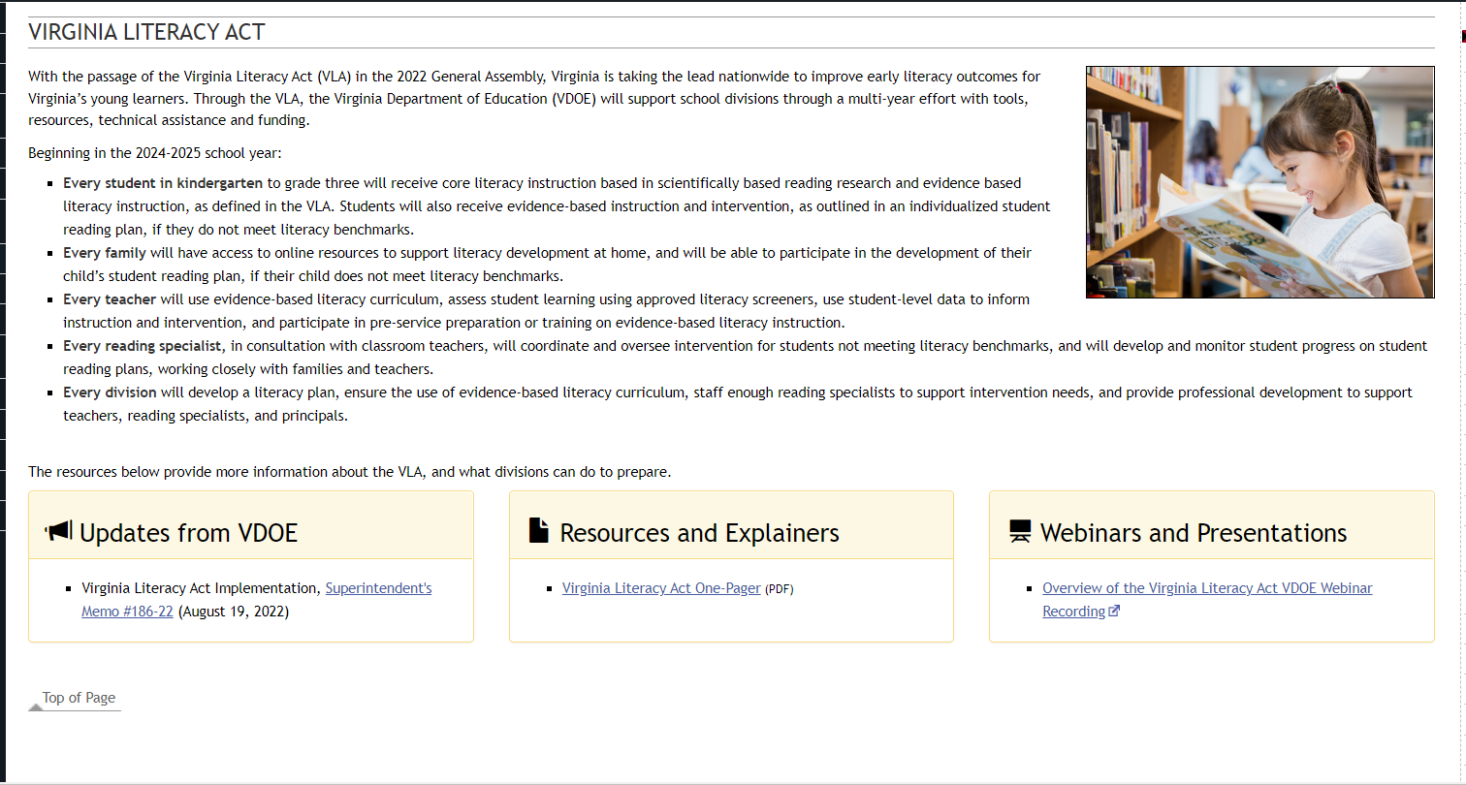
Visit the VDOE VLA Webpage

Slide 16
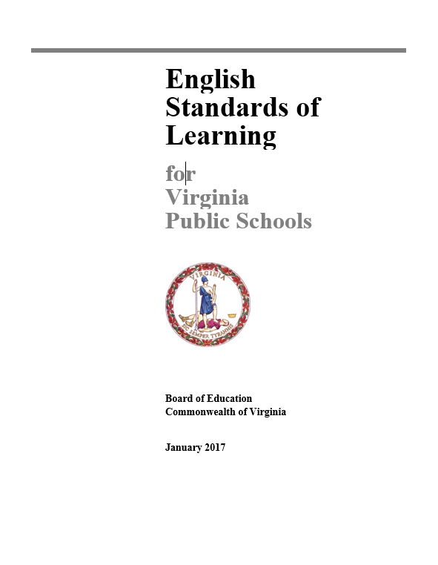
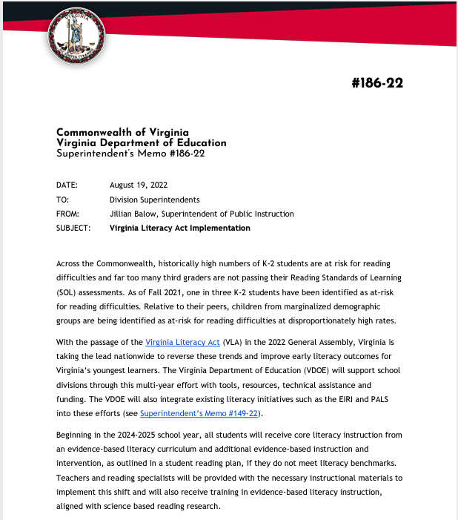
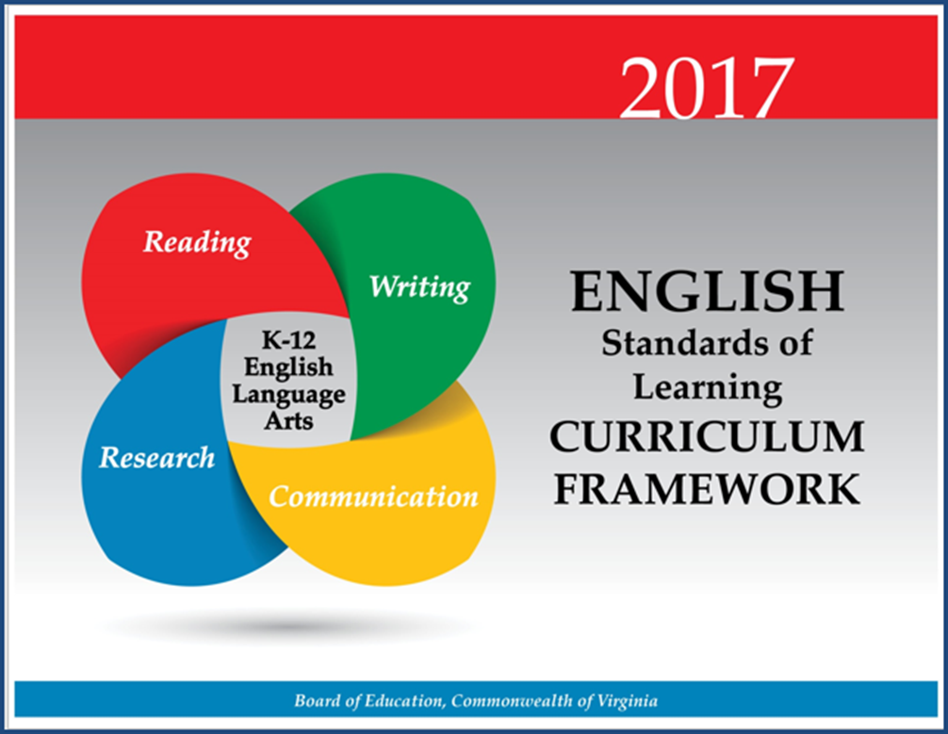
Working Together to Improve Literacy

Slide 17
Essential Components of Literacy

Slide 18
Essential Components of Literacy
Text comprehension is influenced by readers’ ability to apply the essential components of reading: phonemic awareness, phonics knowledge, fluency, and understanding of word meanings or vocabulary.
Without these foundational skills, comprehension will not occur.
READING FRAMEWORK FOR THE 2019 NATIONAL ASSESSMENT OF EDUCATIONAL PROGRESS

Slide 19
Essential Components of Literacy
By grade 4, when the NAEP Reading Assessment is first administered, students should have a well-developed understanding of how sounds are represented alphabetically and should have had sufficient practice in reading to achieve fluency with different kinds of texts (National Research Council 1998).
Because NAEP tests at grades 4, 8, and 12, the assessment focuses on students’ reading comprehension, not their foundational skills related to alphabetic knowledge.1
READING FRAMEWORK FOR THE 2019 NATIONAL ASSESSMENT OF EDUCATIONAL PROGRESS

Slide 20
Comprehensive Literacy:
Successful English Instruction-Integrates the Strands
Vocabulary Development
Specific vocabulary from authentic text
Content vocabulary from math, science, and social studies
Reading
Both fiction & nonfiction text
Text-rich environment with variety of text and media
Student choice whenever possible
Writing
Writing as a process for a variety of authentic purposes
Regular writing conferences
Use of Writing Portfolios
Research
Ongoing and embedded in the learning process (when applicable)
Communication/Multimodal Literacies
Opportunities to communicate, collaborate and engage critically with peers and a variety of texts.

Slide 21
Essential Components of Teaching Reading
As reported in the National Reading Panel and later recognized in CCSSO’s A Nation of Readers report, additional research has shown the significant impact of instruction that explicitly addresses all five pillars of reading.
Phonemic Awareness
Phonics
Fluency
Vocabulary
Comprehension

Slide 22
The Five Pillars of Reading in the Standards of Learning
Phonemic Awareness | Phonics Instruction | Fluency Instruction | Vocabulary Instruction | Comprehension Instruction
K.3- The student will orally identify, segment and blend various phonemes to develop phonological and phonemic awareness 1.3- The student will orally identify, produce, and manipulate various phonemes within words to develop phonological and phonemic awareness. 2.3- The student will orally identify, produce, and manipulate various phonemes within words to develop phonemic awareness. | K.6- The student will develop an understanding of basic phonetic principles. 1.5- The student will apply phonetic principles to read and spell. 2.4- The student will use phonetic strategies when reading and spelling. 3.3 The student will use knowledge of regular and irregular vowel patterns and decode regular multisyllabic words. | 1.9 i) Read and reread familiar stories and poems with fluency, accuracy and meaningful expression. 1.10 h) Read and reread familiar texts with fluency, accuracy and meaningful expression 2.7 i) Read and reread familiar stories and poems with fluency, accuracy, and meaningful expression. 2.8 h) Read and reread familiar texts with fluency, accuracy, and meaningful expression. 3.5 m) Read with fluency, accuracy, and meaningful expression. 3.6 m) Read with fluency, accuracy, and meaningful expression. | K.7- The student will expand vocabulary and use of word meanings. 1.7- The student will expand vocabulary and use of word meanings. 2.5-The student will use semantic clues and syntax to expand vocabulary when reading. 2.6- The student will expand vocabulary and use of word meanings. 3.4 The student will expand vocabulary when reading | K.8-The student will demonstrate comprehension of fictional text. K.9- The student will demonstrate comprehension of nonfiction text. 1.9, 2.7, 3.6- The student will read and demonstrate comprehension of a variety of fictional texts. 1.10, 2.8, 3.7- The student will read and demonstrate comprehension of a variety of nonfiction texts.
Here are some examples of where science based reading is evident in the 2017 English Standards of Learning. School divisions are required to teach the comprehensive set of standards as outlined in 8VAC20-131-80.

Slide 23
The Science of Reading

Slide 24
What is the Science of Reading?
There is over 50 years of research from a variety of career fields that support how the brain learns to read and speak and how we should be taught. More recently the connection between these fields of research has become more apparent and talked about in educational settings.
Science of reading. A term that refers to a corpus of objective investigation and accumulation of reliable evidence about how humans learn to read and how reading should be taught.
(International Literacy Association)

Slide 25
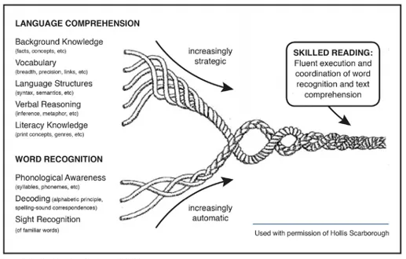
Scarborough’s Reading Rope
Scarborough, 2001
The Science of Reading

Slide 26
Science of Reading and Instructional Practices
Key practices that demonstrate research and evidence-based instruction:
Direct instruction of decoding, encoding, comprehension, and wide reading of literature
Specific focus on phoneme awareness instruction as well as its connection to encoding and decoding
Systematic, explicit, and intentional instruction on the spoken and written form of the English language (sound, syllable, morpheme, word)
Direct and incidental vocabulary instruction using texts to explore word meanings and sentence structure
Emphasis and intention on building background knowledge and listening comprehension through texts, multimedia, and other print resources that will lead to independent reading comprehension (Moats, 2020).

Slide 27
Evidence-Based Literacy Instruction
Virginia Literacy Act
"Evidence-based literacy instruction" means structured instructional practices, including sequential, systematic, explicit, and cumulative teaching, that (i) are based on reliable, trustworthy, and valid evidence consistent with science-based reading research; (ii) are used in core or general instruction, supplemental instruction, intervention services, and intensive intervention services; (iii) have a demonstrated record of success in adequately increasing students' reading competency, vocabulary, oral language, and comprehension and in building mastery of the foundational reading skills of phonological and phonemic awareness, alphabetic principle, phonics, spelling, and text reading fluency; and (iv) are able to be differentiated in order to meet the individual needs of students.

Slide 28
What does Evidence-Based Mean?
Definition:
An intervention, tool, or practice that meets one of the four evidence levels in the federal Elementary and Secondary Education Act, as amended by ESSA (strong, moderate, promising, or demonstrates a rationale).
National Center on Improving Literacy (2018). What do we mean by evidence-based?. Washington, DC: U.S. Department of Education, Office of Elementary and Secondary Education, Office of Special Education Programs, National Center on Improving Literacy. Retrieved from http://improvingliteracy.org.

Slide 29
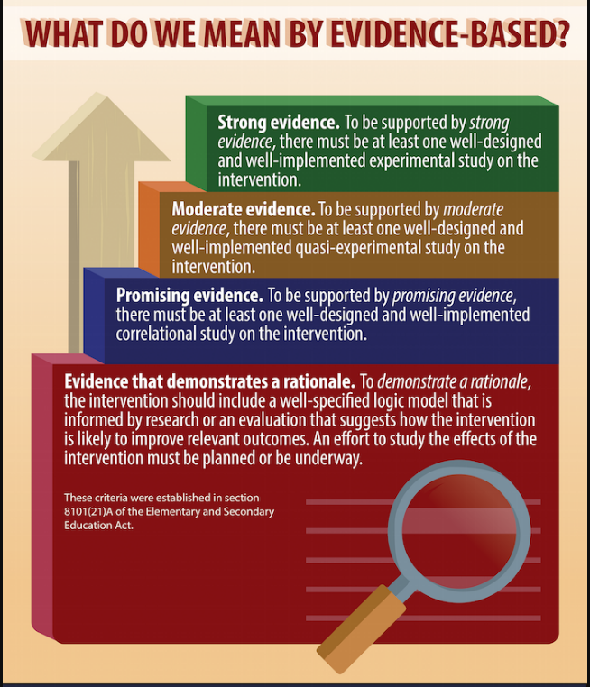
Evidence-Based Instruction
National Center on Improving Literacy (2018). What do we mean by evidence-based?. Washington, DC: U.S. Department of Education, Office of Elementary and Secondary Education, Office of Special Education Programs, National Center on Improving Literacy. Retrieved from http://improvingliteracy.org.

Slide 30
Literacy Research and Evidence-Based Practices For Grades K-3

Slide 31
What Research Says
Kindergarten through Grade 3
Teach students academic language skills, including the use of inferential and narrative language, and vocabulary knowledge.
Develop awareness of the segments of sounds in speech and how they link to letters.
Teach students to decode words, analyze word parts, and write and recognize words.
Ensure that each student reads connected text everyday to support reading accuracy, fluency, and comprehension.
https://ies.ed.gov/ncee/wwc/PracticeGuide/21

Slide 32
Science-Based Phonics Instruction
Effective Phonics Instruction
Explicit and systematic
Readiness Skills
Scope and Sequence
Blending
Dictation
Word Awareness
High-Frequency Words
Reading Connected Text
Building vocabulary and background knowledge
ILA Literacy Leadership Brief

Slide 33
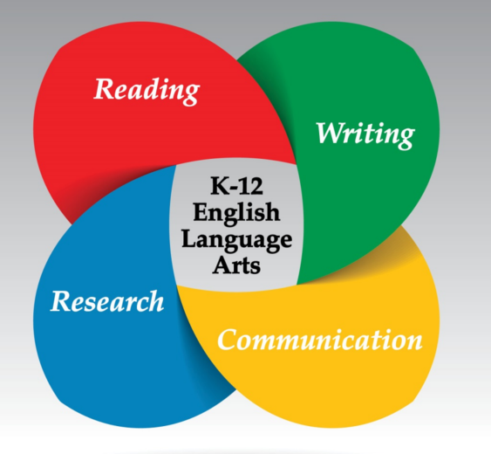
Building Language and Comprehension
“In addition to teaching explicit word-reading skills, literacy instruction requires the teaching of text analysis, discussion, and writing about reading” (Duke, et al. 2021).
School divisions are required to teach the comprehensive set of standards as outlined in 8VAC20-131-80.

Slide 34
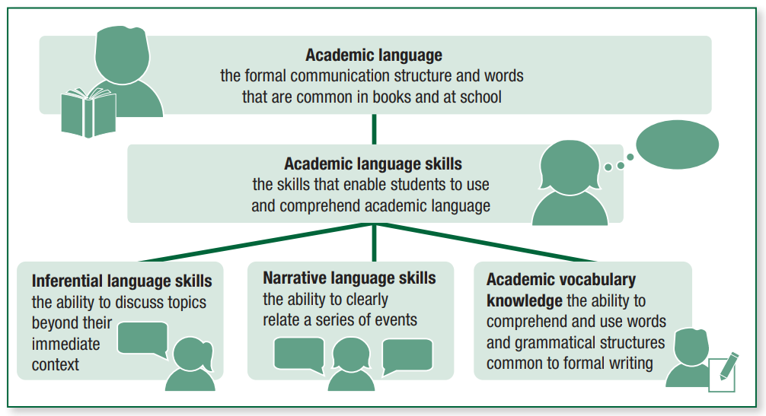
Early Elementary Instructional Practices
Foundational Skills to Support Reading for Understanding (2019) Institute of Education Sciences Retrieved from https://ies.ed.gov/ncee/wwc/Docs/PracticeGuide/wwc_foundationalreading_040717.pdf

Slide 35
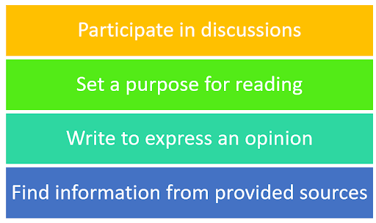
Literacy Strands Work Together
Strand Integration
VDOE Utilizing Data To Maximize Instruction Webinar 2021-2022

Slide 36
Changing the Trajectory
in
Literacy Instruction
Showing Work
versus
Demonstrating Thinking

Slide 37
How Students “Show Work” in Elementary English
Identifying letters and sounds
Sort spelling patterns in words
Discussion
Writing/drawing
Highlighting evidence in texts

Slide 38
Demonstrating Thinking in English: K-2 Examples
Having students look in mirrors and describe what their mouth is doing when making sounds.
Think alouds and engaging in conversations about text
Pushing manipulatives or a concrete object to segment sounds in words
Conferencing about student thinking of a text
Application of phonics through reading and writing experiences
Using new words learned in discussions
Reading is a metacognitive process.
Teaching Reading is Rocket Science
IES Practice Guides

Slide 39
What Research Shows
Routines that create cohesion across learning environments-
Reading Grade Level Text
Responding to Text
Foundational Skills Work
https://ccsso.org/blog/ccsso-releases-restart-recovery-considerations-teaching-learning

Slide 40
Evidence from the Field
Reading is a metacognitive process.
Get books and texts in the hands of kids.
Provide daily opportunities for students to read.
Prioritize literacy across contents.
Teaching skills in isolation is not authentic to real reading experiences.
From: Educator to Educator: Sharing Lessons Learned from School Divisions on Best Practices (Winter, 2019).

Slide 41
Evidence-Based Practices and Strategies For Literacy Instruction

Slide 42
Evidence-based Practices
1. Begin lessons with short reviews of previous learning.
2. Present new material in small amounts; assist students as they practice the material.
3. Ask many questions and observe student responses; questions allow students to connect new material to prior learning.
4. Provide models such as step-by-step demonstrations or think alouds to work out the problem.
5. Guide student practice by asking good questions and providing feedback.
6. Check that students understand the material; doing so can help students learn with fewer errors.
7. Obtain a high success rate (~80%) through teaching in small steps, guiding practice, and employing mastery learning techniques.
8. Provide scaffolds, or temporary supports, for difficult material.
9. Prepare students for and monitor independent practice; ample independent practice is necessary for skills and knowledge to become automatic.
10. Engage students in weekly and monthly reviews of past material.
Institute of Educational Sciences: Evidence-based Teaching Practices Infographic

Slide 43
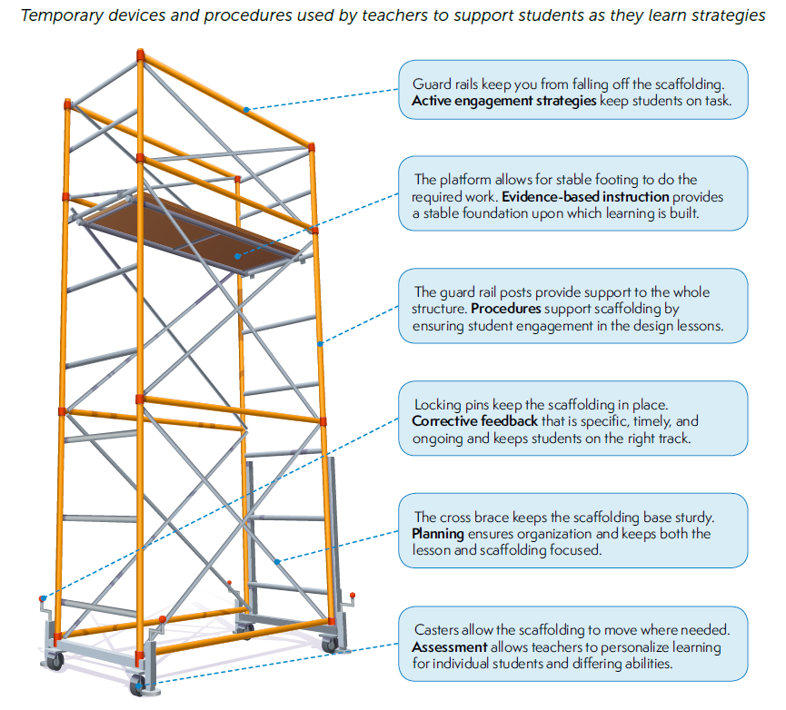
Institute of Educational Sciences: Evidence-based Teaching Practices Infographic

Slide 44
Evidence-based Practices in Literacy Instruction
Evidence-based Practices | Literacy Connections & Instructional Focus
Reviews of previous learning (weekly, monthly, opening) Connect new material to prior learning Present new material in small amounts Assist students as they practice the material Observe student responses Think alouds Asking good questions Providing feedback Check that students understand the material Teach in small steps Provide scaffolds Provide model Guide practice Provide independent practice | Explicit, Systematic Direct Instruction Gradual Release (I do, We do, You do) Small group differentiated instruction Conferences Whole group learning | Intentional Focus on: Building language skills (oral, academic, inferential, etc) Listening and language comprehension Writing about what was read Handwriting Engaging students in grade level text Decoding Speech sounds and their connection to print Balancing fiction and nonfiction Reading connected text daily Integrating strands of English Standards Communication & Multimodal Literacies Reading Writing Research

Slide 45
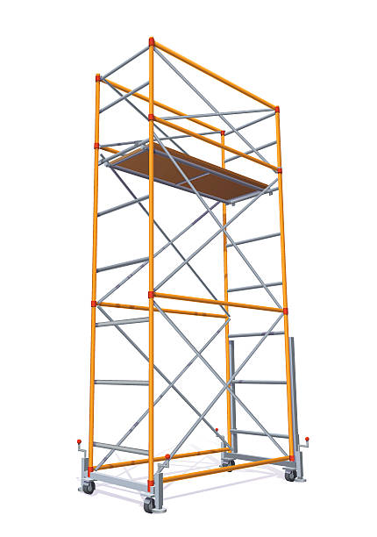
Evidence-based Practices in Literacy Instruction
Chunking text, read alouds
Discussion
Small group
Students are engaged
Explicit and systematic
Direct Instruction
Students have a purpose for
learning
Gradual Release (I do, We do, You do)
Small group differentiated instruction
Whole group learning
Students know what to
expect
Conferences and written feedback
Students show what they
understand and where they need support
Consider the level of rigor in skills of the standards when designing, selecting tasks and activities or learning experiences
Students practice grade-level
skills using appropriate texts
Use formative data to gauge student understanding and inform pacing
Track learning progression, diagnose, go back
Students focus on skills that
they need to strengthen
Institute of Educational Sciences: Evidence-based Teaching Practices Infographic
Adapted from Achieve the Core

Slide 46
Upcoming Opportunities

Slide 47
November Learning Labs
For participants interested in workshopping and applying ideas presented at the virtual institutes, three in-person K-12 English SOL Learning Labs will be offered around the state. Educators will attend one full-day learning lab facilitated by presenters from the virtual English SOL Institutes. These full-day sessions will allow for teachers to connect within grade-band groups to workshop ideas presented at the institutes, examine student work samples, dialogue with educators from around the Commonwealth, and plan next steps for instruction based on the virtual session topics.
● Fredericksburg Learning Lab: Monday, November 7, 2022
● Newport News Learning Lab: Wednesday, November 9, 2022
● Roanoke Learning Lab: Thursday, November 17, 2022

Slide 48
Virginia State Literacy Association Conference
Call for Proposals

Slide 49
VDOE Resources

Slide 50
VDOE Resources
VDOE English Comprehensive Instructional Plans
VDOE Webinar: Utilizing Data to Maximize Literacy Instruction in the 2021-2022 Academic Year
2021 VDOE K-12 SOL Conferences In English Language Arts
2022 VDOE K-12 Virtual SOL English Institutes
VDOE English Comprehensive Literacy Webinars
VDOE Professional Development on Demand

Slide 51
Stay Connected!
Jill Nogueras
K-12 English Coordinator
Jill.Nogueras@doe.virginia.gov
Carmen Kurek
Elementary English/Reading Specialist
Carmen.Kurek@doe.virginia.gov
Colleen Cassada
Middle School English Specialist
Colleen.Cassada@doe.Virginia.gov
Assessment Office
Student_Assessment@doe.virginia.gov

Slide 52
References
Meyers, A. (2021). To catch students up, don’t remediate. accelerate. Johns Hopkins University Magazine. Retrieved August 28, 2021, from https://hub.jhu.edu/2021/05/06/accelerate-learning-to-bridge-covid-19-education-gaps/.
Rosenshine, B. (2012). Principles of instruction: Research-based strategies that all teachers should know. American Educator, 36(1), 12-39. Retrieved from https://www.aft.org/sites/default/files/ periodicals/Rosenshine.pdf
Shanahan, T., Callison, K., Carriere, C., Duke, N. K., Pearson, P. D., Schatschneider, C., & Torgesen, J. (2010). Improving reading comprehension in Kindergarten through 3rd grade. Washington, DC: National Center for Education Evaluation and Regional Assistance, Institute of Education Sciences, U.S. Department of Education. Retrieved from https://ies.ed.gov/ncee/wwc/Docs/PracticeGuide/ readingcomp_pg_092810.pdf
Foundational Skills to Support Reading for Understanding (2019) Institute of Education Sciences Retrieved from https://ies.ed.gov/ncee/wwc/Docs/PracticeGuide/wwc_foundationalreading_040717.pdf
Council of Chief State School Officers (2021). A Nation of Readers: How State Chiefs Can Help Every Child Learn To Read. Retrieved from: https://753a0706.flowpaper.com/CCSSOReadingResource/#page=1

Slide 53
Disclaimer
Reference within this presentation to any specific commercial or non-commercial product, process, or service by trade name, trademark, manufacturer or otherwise does not constitute or imply an endorsement, recommendation, or favoring by the Virginia Department of Education.

