Slide 1
Skilled Reading Through Shared Reading
Strengthen the Fibers of Literacy Through the Intentional Integration of Standards

Slide 2
Stay In Touch!
Jennifer Sanders
Literacy Coach
Hanover County Public Schools
jsanders@hcps.us
Katelyn Wilkerson
Literacy Coach
Hanover County Public Schools
kwilkerson@hcps.us

Slide 3
Share Your Thinking! (1 of 2)
https://tinyurl.com/VDOEK-2

Slide 4
Learning Intentions
I am learning to identify the alignment of science-based reading research and evidence-based instruction in our ELA Standards of Learning.
I am learning to utilize shared reading as an instructional context in which to intentionally integrate standards.

Slide 5
ELA Standards of Learning
Science-Based Reading Research & Evidence- Based instruction

Slide 6
Science-Based Reading Research
"Science-based reading research" Direct instruction of decoding, encoding, comprehension, and wide reading of literature specific focus on phoneme awareness instruction as well as its connection to encoding and decoding systematic, explicit, and intentional instruction on the spoken and written form of the English language (sound, syllable, morpheme, word) Direct and incidental vocabulary instruction using texts to explore word meaning and sentence structure. Emphasis and intention on building background knowledge and listening comprehension through texts, multimedia, and other print resources that will lead to independent reading comprehension.”
Virginia Literacy Act

Slide 7
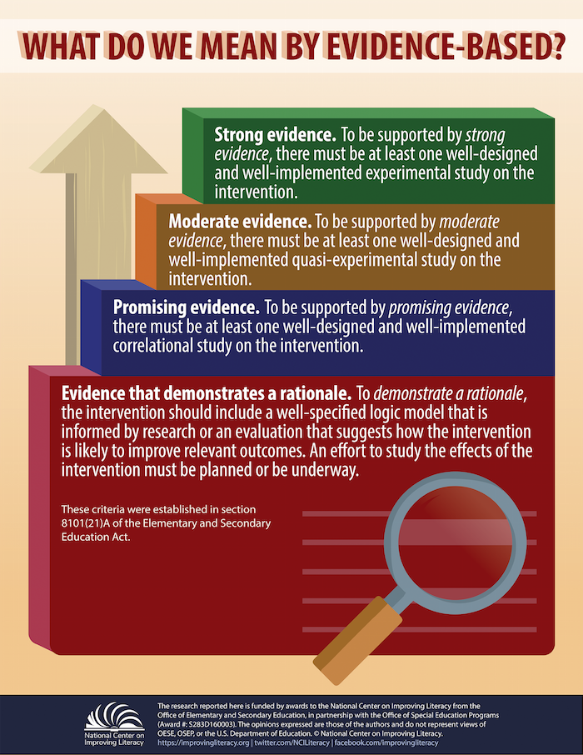
Evidence-Based Instruction
"Evidence-based literacy instruction" means structured instructional practices, including sequential, systematic, explicit, and cumulative teaching, that (i) are based on reliable, trustworthy, and valid evidence consistent with science-based reading research; (ii) are used in core or general instruction, supplemental instruction, intervention services, and intensive intervention services; (iii) have a demonstrated record of success in adequately increasing students' reading competency, vocabulary, oral language, and comprehension and in building mastery of the foundational reading skills of phonological and phonemic awareness, alphabetic principle, phonics, spelling, and text reading fluency; and (iv) are able to be differentiated in order to meet the individual needs of students.”
Virginia Literacy Act

Slide 8
ELA Standards of Learning (1 of 3)
Line
Line
VDOE ELA Standards of Learning

Slide 9
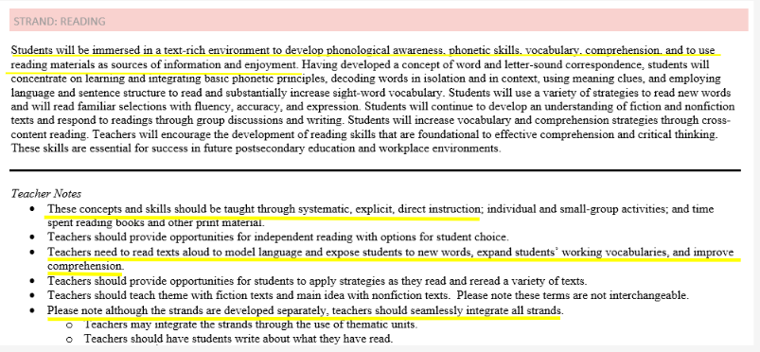
ELA Standards of Learning (2 of 3)
VDOE ELA Standards of Learning

Slide 10
ELA Standards of Learning (3 of 3)
VDOE ELA Standards of Learning

Slide 11
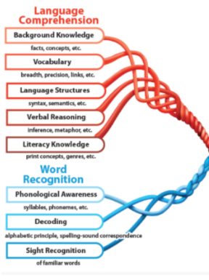
Strengthen the Fibers of Literacy

Slide 12
Intentional Integration of Standards
K.8b, 1.9c, 2.7b
K.7a-h, 1.7a-h, 2.6a-f
1.6a-e, 2.5a-b
K.8c-e, K.9a-c, 1.9a-i, 1.10 a-h 2.7a-i, 2.8a-h
K.4a-e, K.5a-c, K.8a, 1.4a-c
K.3a-g, 1.3a-f, 2.3a-c
K.6a-e, 1.5a-g, 2.4a-d
K.5d, 1.5h

Slide 13
Shared Reading:
Instructional Context that supports the integration of standards

Slide 14
Shared Reading
The goal of literacy instruction is to create independent, strategic readers, writers, thinkers, and communicators. Shared reading provides an opportunity for students to develop their understanding of language, and to enhance their ability to communicate effectively in a text-rich environment. Students will develop phonological awareness, phonemic awareness, vocabulary, comprehension, and develop a connection between oral and written language.

Slide 15
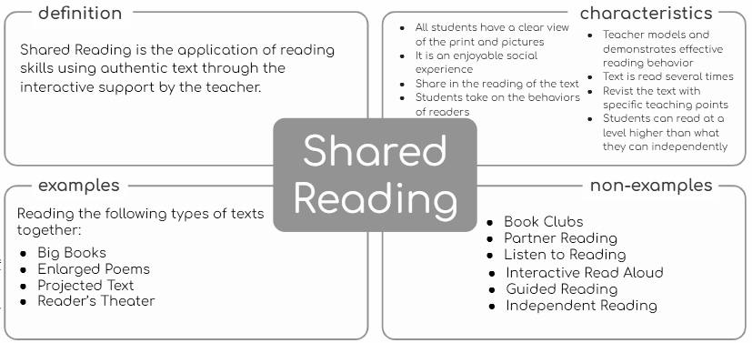
Instructional Context: Shared Reading

Slide 16
Gradual Release: Shared Reading
low high
Teacher Support
Student Control

Slide 17
Shared Reading Lesson: Components
First Read:
Model Reading of the Text
Read to the children interpreting the text with your voice. Make a few brief comments that enable children to think about and enjoy the text.
Additional Reads:
Read the Text Together
Have students read the whole text or selected parts with you. Revisit the text with an intentional teaching point.
Engage readers in discussion of the whole text. Encourage children to share their thinking.
Introduce
the Text
Discuss
the Text
The goal is to engage the children’s interest in the text before you begin reading it.

Slide 18
Planning Standard Integration
Blank Template: Shared Reading
Sample:Shared Reading Lesson Plan for the Week

Slide 19
Standard Integration:
Standards Explicitly Taught
K.3 The student will orally identify, segment, and blend various phonemes to develop phonological and phonemic awareness.
d) Blend and segment one-syllable words into phonemes including onset and rime.
K.5 The student will demonstrate an understanding that print conveys meaning.
d) Read his/her name and commonly used high-frequency words.
K.6 The student will develop an understanding of basic phonetic principles.
d) Identify initial consonant sounds in one-syllable words
K.7 The student will expand vocabulary and use of word meanings.
a) Discuss meanings of words
K.8 The student will demonstrate comprehension of fictional texts.
a) Identify the role of an author and an illustrator.
understand that authors tell stories through words and illustrators tell stories with pictures.
K.9 The student will demonstrate comprehension of nonfiction texts.
a) Use pictures to identify topic and make predictions
b) Identify text features specific to the topic, such as titles, headings, and pictures.
Understand that nonfiction texts provide information
understand that text features serve a purpose
K.11 The student will write in a variety of forms to include narrative and descriptive.
f) Begin each sentence with a capital letter and use ending punctuation

Slide 20
Standard Integration:
Standards Practiced
K.1 The student will build oral communication skills.
a) Listen actively and speak using agreed-upon rules for discussion.
b) Express ideas in complete sentences and express needs through direct requests.
c) Initiate conversations.
d) Follow implicit rules for conversation, including taking turns and staying on topic.
e) Listen and speak in informal conversations with peers and adults.
f) Discuss various texts and topics collaboratively and with partners.
g) Use voice level, phrasing, and intonation appropriate for various language situations.
h) Follow one- and two-step directions.
K.2 The student will demonstrate growth in oral, early literacy skills.
b) Participate in a variety of oral language activities, including choral and echo speaking and recitation.
d) Participate in creative dramatics.
K.9 The student will demonstrate comprehension of nonfiction texts.
c) Ask and answer questions about what is read.
K.11 The student will write in a variety of forms to include narrative and descriptive.
a) Differentiate pictures from writing.
c) Use letters to phonetically spell words that describe pictures or experiences.
e) compose simple sentences.
f) Begin each sentence with a capital letter and use ending punctuation.

Slide 21
Extension of Shared Reading
Respond to the text | Engage children in additional experiences to enhance their appreciation and interpretation of the text. | Respond to the text through shared or interactive writing. Students can create their own individual books like the shared reading book.\ Students can create a story map with pictures/cutouts using sentences from the book as labels.

Slide 22
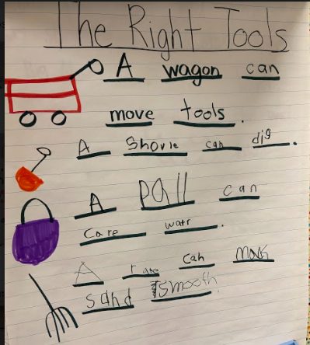
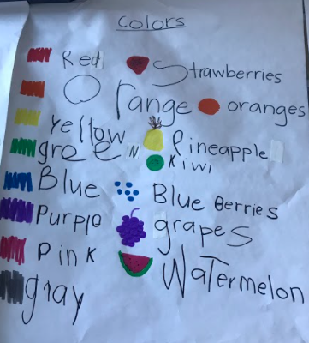
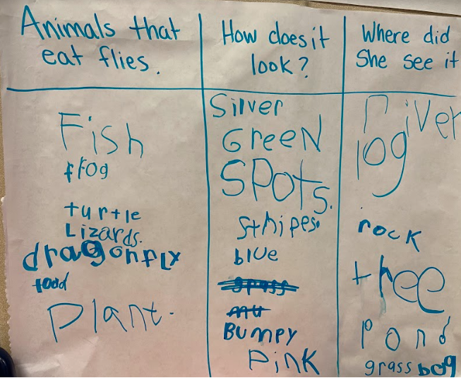
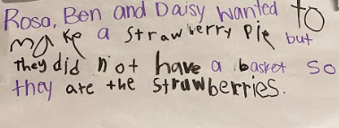
Writing in Response to the Text

Slide 23
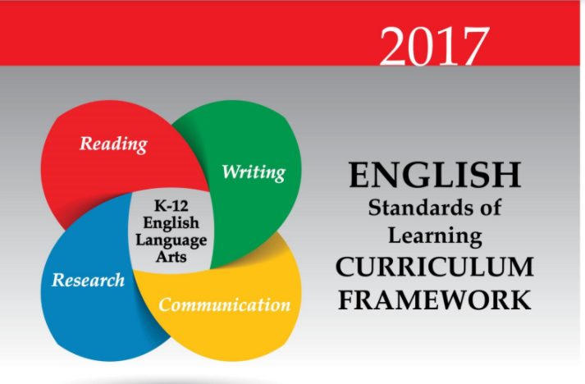
Considerations for Planning (1 of 3)
Standards
Student Data
Anecdotal notes
Accuracy
Fluency
Comprehension
Small Group Observations
Phonics principles/assessments
Writing Samples
Word knowledge
Spelling features
Author’s craft

Slide 24
Considerations for Planning (2 of 3)
Teaching Point | Sample Learning Intention | Sample Success Criteria | Sample Assessment Practices
Phonics & Word Study: Phonics | I am learning that some words have consonant clusters. | I can use consonant clusters to read words. | Analyze anecdotal notes for correct reading of consonant clusters.
Phonics & Word Study: HFW | I am learning that we can read and write words quickly because we see them often. | I can read and write words quickly. | Analyze anecdotal notes for accurate reading of HFW Analyze writing samples for accurate spelling of HFW
Phonics & Word Study: Word Solving & Decoding | I am learning strategies to read unknown words. | I can use known strategies to read words. | Observe students word solving
Fluency | I am learning that my voice can match the meaning of what I read. | I can read the talk the way the character said it. | Anecdotal notes during oral reading
Comprehension | I am learning that fictional stories have a theme. | I can identify the theme of the shared reading fiction book. | Anecdotal notes during text discussion Exit ticket: write theme on a sticky note

Slide 25
Considerations for Planning (3 of 3)
Intentional Text Selection
Select texts that match your standards & learning intentions.
Select texts with topics that provide an opportunity to build background knowledge.
Select texts that are just beyond those that most children can process during small group instruction.
Select texts that are worth reading and rereading.

Slide 26
Share your thinking! (2 of 2)
https://tinyurl.com/VDOEK-2

Slide 27
Thank you!
Skilled Reading Through Shared Reading
Jennifer Sanders
Literacy Coach
Hanover County Public Schools
jsanders@hcps.us
Katelyn Wilkerson
Literacy Coach
Hanover County Public Schools
kwilkerson@hcps.us

Slide 28
Disclaimer
Reference within this presentation to any specific commercial or non-commercial product, process, or service by trade name, trademark, manufacturer or otherwise does not constitute or imply an endorsement, recommendation, or favoring by the Virginia Department of Education.

