Slide 1
Orthographic Mapping:
Every word wants to be a sight word
Carrie Leestma - CSLeestma@fcps.edu
Lauren Surber - ljsurber@fcps.edu
Fairfax County Public Schools

Slide 2
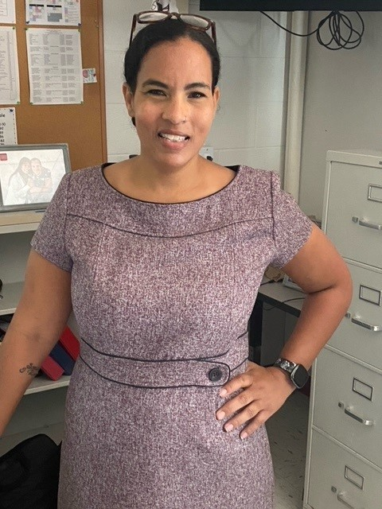
Meet your presenters!
Carrie Leestma
Intervention Specialist K - 12
Former FCPS Dyslexia Specialist
Lauren Surber
1st Grade Teacher
Former Literacy Specialist / Coach
Notes:
Add pictures
Carrie and Lauren will both introduce themselves.

Slide 3
Connect with us!
https://tinyurl.com/VDOEK-2
Notes:
You can scan the URL or type in this Url link to post questions about our session at any time since we are unable to communicate with you directly during today’s presentation.

Slide 4
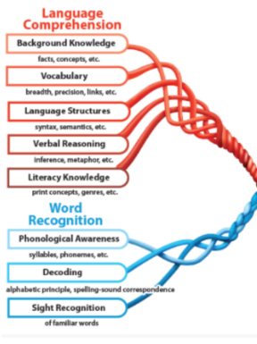
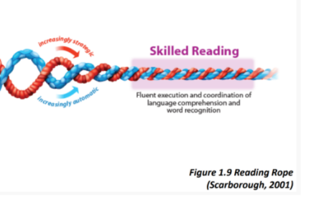
How does this fit into Scarborough’s Rope?

Slide 5
Learning Intentions
To understand the research behind how readers learn to automatically recognize words.
To understand the prerequisite skills needed to support automatic word reading.
To learn how to bring this research into your classroom instruction with evidence-based practices.

Slide 6
How does this align to the Standards of Learning?
K.5 Read his/her name and commonly used high-frequency words.
1.5 Read and spell commonly used sight words.

Slide 7
Sight Words
What is a sight word?

Slide 8
Which words are sight words?
Children who are involved in sports are seen to be more proactive in class activities. Several children take up sports seriously in their children. The physical training classes that are enjoyed in the schools and colleges are to imbibe on the students a love for sports. The outdoors is an extremely important part of our lives. We must embrace it. Sports and games are two ways to express it. Games can be played indoors. Even working with building blocks or legos can be considered as a game. Hide and Seek is also a game. There are several other indoor games.
Type your answer in the chat

Slide 9
So Many Terms…
Term | Definition
Irregular Words | Words that cannot be sounded out because some or all of the word does not follow the rules of English orthography
High Frequency Words Sight Words | Words (spelled regularly or irregularly) words that appear often in printed text. Lists of these words include the Dolch and Fry word lists.
Sight Words | A familiar written word that is recognized instantly, automatically, and effortlessly, without sounding it out or guessing (Kilpatrick, 2022, p. 27).

Slide 10
Reflecting on Sight Words
Did this information confirm your thinking around what a sight word is or change your thinking?
Share your thinking
on the Padlet.

Slide 11
Orthographic Mapping
How does a word become a sight word?

Slide 12
What has brain research shown us about how we read words?
Readers have NOT memorized a word as a whole word visually when they read a word effortlessly and automatically.
When readers read a word effortlessly and automatically they have connected the letters in the word to the sounds in the words and have had a lot of exposure to the word.
(Ehri, 2013)

Slide 13
What is orthographic mapping?
“Orthographic mapping is the process readers use to store written words for immediate, effortless retrieval. It is a means by which readers turn unfamiliar written words into familiar, instantaneously accessible sight words”.
(Kilpatrick, 2015)

Slide 14
Four Part Processor
Context
Meaning
bat
/b/ /ă/ /t/
Phonological
phonics
Orthographic
Seidenberg & McClelland, 1989

Slide 15
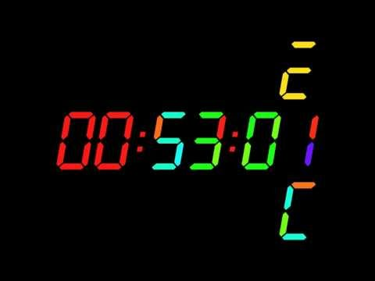
Stroop Test
Blue
Green
Yellow
Brown
Gray
Pink
Black
White
Red
Purple
Orange
Beige
Stroop (1935)

Slide 16
Reflecting on orthographic mapping and current teaching practices
Reflect on the 4 part processor and what the brain does to make a word a sight word.
Think about how you have taught high frequency words in your classroom.
What parts of the brain were you activating or not activating when you taught that way?
Share your thinking
on the Padlet.

Slide 17
Setting Students up for Orthographic Mapping
What prerequisite skills do students need to be able to engage in the process of orthographic mapping?

Slide 18
What are the prerequisite skills for orthographic mapping?
Automatic letter-sound correspondence knowledge
Phonemic awareness proficiency
Ability to accurately and quickly decode
(Kilpatrick, 2022)

Slide 19
Ehri’s Phases of Word Reading Development
Pre-Alphabetic
Early Alphabetic
Later Alphabetic
Consolidated Alphabetic
Increased Automatic Sight Word Recognition (regular and irregular)
Early Sight Word Learning
Letter Knowledge
Orthographic mapping: Phoneme-Grapheme links, phonograms (word families) syllable patterns, morphemes
Phoneme- Grapheme Correspondance
Incidental visual cues
Partial Phoneme Awareness
Complete Phoneme Awareness
Advanced phoneme awareness: Deletion, substitution, reversal of phonemes

Slide 20
Reflecting on Prerequisite Skills for Orthographic Mapping
Are the prerequisite skills needed for orthographic mapping explicitly and systematically taught in your school/classroom?
Share your thinking
on the Padlet.

Slide 21
Teaching Reading in the Classroom
How does our knowledge of orthographic mapping shape our instruction in the classroom?

Slide 22
Evidence-based instructional practices that support orthographic mapping
Introduce words orally first
Use phoneme grapheme mapping to connect speech to print
Application in context (reading and writing)
Don’t leave out meaning

Slide 23
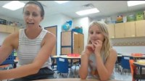
Watch it in action!

Slide 24
Reflecting on the video
What instructional practices did you observe in the video that would support the process of orthographic mapping?
Which processors in the four part processor model were addressed in this video?
Share your thinking
on the Padlet.

Slide 25
So which words do I teach?
Does the word appear with high frequency in early texts?
Is the word easily decodable? Should it be taught with the phonetic concept to which it aligns?
Does the word have one or more irregular sound spellings? Is it temporarily irregular or always irregular?
(Burkins & Yates, 2021)

Slide 26
Reflecting on evidence-based practices that support orthographic mapping
Reflect on what you have learned about orthographic mapping and evidence-based instructional practices that support orthographic mapping.
What do you want to try in your classroom? What do you want to stop doing in your classroom?
Share your thinking
on the Padlet.

Slide 27
Every word wants to be a sight word when it grows up!
The ultimate goal of reading is to comprehend. Automatic recognition of words is necessary so that the reader can focus on making meaning and not decoding words.

Slide 28
Disclaimer
Reference within this presentation to any specific commercial or non-commercial product, process, or service by trade name, trademark, manufacturer or otherwise does not constitute or imply an endorsement, recommendation, or favoring by the Virginia Department of Education.

Slide 29
References
Burkins, J. & Yates, K. (2021).Shifting the Balance: 6 ways to bring the science of reading into the balanced literacy classroom. Stenhouse Publishers.
Ehri, L. C. (2013). Orthographic mapping in the acquisition of sight word reading, spelling memory, and vocabulary learning. Scientific Studies of Reading, 18(1), 5–21. https://doi.org/10.1080/10888438.2013.819356
Kilpatrick, D. A. (2022). Equipped for reading success: A comprehensive, step-by-step program for developing phoneme awareness and fluent word recognition. Casey & Kirsch Publishers.
Seidenberg, M. S., & McClelland, J. L. (1989). A distributed, developmental model of word recognition and naming. Psychological review, 96(4), 523.
Stroop, John Ridley (1935). "Studies of interference in serial verbal reactions". Journal of Experimental Psychology. 18 (6): 643–662.

