Slide 1
Enhancing Background Knowledge to Propel Vocabulary, Comprehension, and Writing
October 4, 2022

Slide 2
Having crumbled to 214 all out, with Jonathan Trott's 84 not out the glue across an otherwise brittle English innings, the tourists were back in the contest when Paul Collingwood's brace had the hosts wobbling at 100 for five at the turn of the 21st over.
(Russ Walsh, 2013)

Slide 3
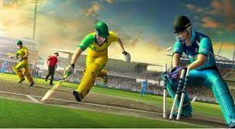
Does background knowledge matter to reading comprehension?

Slide 4
Presenters – Emily McMillen and Lynn Smith
2nd & 3rd grade title 1, classroom teacher
Instructional coach
Associate principal
Memphis City, Richmond City, Henrico County Public Schools
Please stay in touch! emcmillen@henrico.k12.va.us
ELA Teacher
Associate Principal
Reading Specialist/Coach
Collaborative Teacher, K-5
Henrico County, Richmond City, Goochland, Nottoway County Public Schools
Please stay in touch!
lynn.smith@tncs.org

Slide 5
Learning Intentions
I am learning how to plan with content as my focus.
I am learning how to value and expand the background knowledge of my students.
I am learning a structure for teaching vocabulary.
I am learning how to use writing to assess comprehension.

Slide 6
Questions or ponderings
Questions or Ponderings
We will revisit all questions during the November Learning Labs.
Teachers! Be sure to sign up

Slide 7
The Reading Rope

Slide 8
The Baseball Study
The Knowledge Gap, Wexler, p. 204

Slide 9
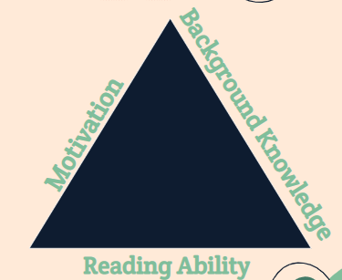
Donalyn Miller’s Reading Triangle
The Reading Triangle - Donalyn Miller

Slide 10
“We can’t focus only on activating background knowledge that children already possess, rather we must systematically augment it.”
- Wexler, 2019

Slide 11
“Knowing stuff makes you a better reader.”
-Wexler, 2019, p. 206

Slide 12
How do we do this?
1. Reframe how we think about content
2. Thematic unit planning
3. Purposeful text selection
4. Developing vocabulary

Slide 13
Reframe how we think about content:
“The best way to improve student comprehension is to build their knowledge base by focusing reading instruction primarily on content” (CORE Teaching Reading Sourcebook 3rd Edition, p 618)
“Comprehension strategies instruction should occur in the context of reading carefully selected texts rather than in isolation.” (CORE Teaching Reading Sourcebook 3rd Edition, p 628)

Slide 14
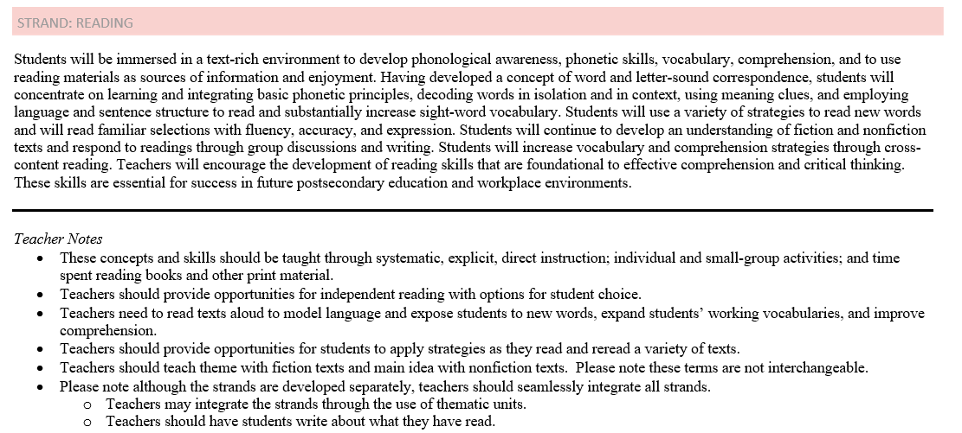
Reframing our thinking about content

Slide 15
Thematic Unit Planning & Text Selection
“Use text sets, multiple texts on the same topic, to maximize vocabulary & background knowledge growth and build comprehension.”
-The Reading League, 2022
The Reading League - Unit Planning and Text Sets

Slide 16
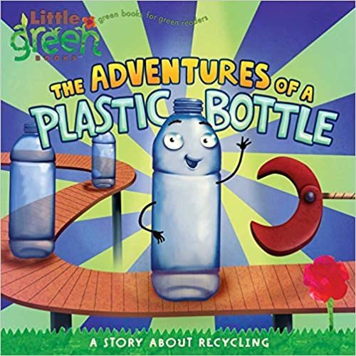
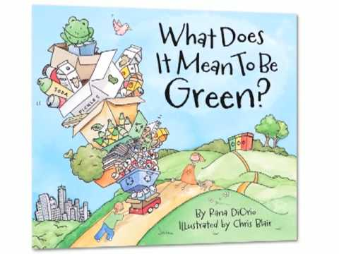
This is done with nonfiction content…

Slide 17
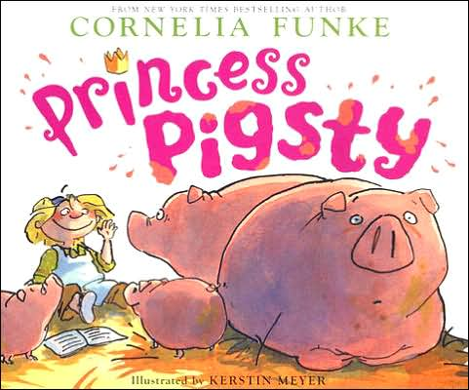
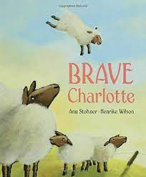
… or fictional themes!

Slide 18
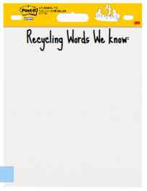
Structuring your Units that Systematically Build Background Knowledge, Nonfiction
K.9 The student will demonstrate comprehension of nonfiction texts. c) Ask and answer questions about what is read. K.11 The student will investigate and understand that materials can be reused, recycled, and conserved. Key concepts include a) materials and objects can be used over and over again; b) everyday materials can be recycled; and c) water and energy conservation at home and in school helps ensure resources are available for future use.

Slide 19
Structuring your Units that Systematically Build Background Knowledge, Fiction
2.7 The student will read and demonstrate comprehension of fictional texts. f) Identify the theme.

Slide 20
Developing Vocabulary

Slide 21
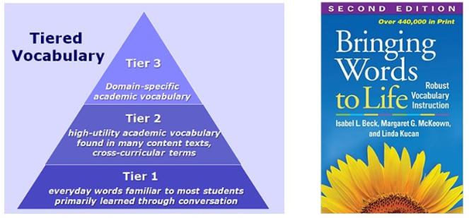
Tiered Vocabulary

Slide 22
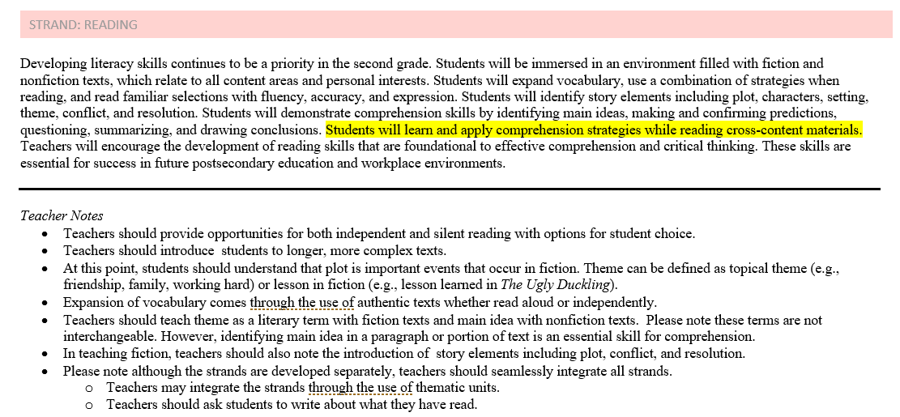
It’s in the VDOE K-Grade 5 standards

Slide 23
Structure for Teaching Vocabulary, Nonfiction
After reading the story…
Contextualize the word
Say the word
Give a student friendly explanation
Provide a different context
Engage actively with the word
Say the word again
(CORE Vocabulary Handbook, 2006, p. 33-34)

Slide 24
Structure for Teaching Vocabulary, Fiction
After reading the story…
Contextualize the word
Say the word
Give a student friendly explanation
Provide a different context
Engage actively with the word
Say the word again
(CORE Vocabulary Handbook, 2006, p. 33-34)

Slide 25
“Keep the focus on constructing the meaning of text rather than on the strategies themselves.”
-CORE Teaching Reading Sourcebook 3rd Edition, p 628

Slide 26
Let’s Review - How do we do this?
1. Reframe how we think about content
2. Thematic unit planning
3. Purposeful text selection
4. Developing vocabulary

Slide 27
The Writing Rope

Slide 28
Writing as a means to measure comprehension
VDOE Logo

Slide 29
Teaching Elementary School Students to Be Effective Writers
1. Provide daily time for students to write.
2. Teach students to use the writing process for a variety of purposes.
3. Teach students to become fluent with handwriting, spelling, sentence construction, typing, and word processing.
4. Create an engaged community of writers.
Teaching Elementary School Students to Be Effective Writers

Slide 30
Quote
“When teachers integrate writing tasks with other content-area lessons, students may think more critically about the content-area material.”
-IES, Teacher Elementary Students to be Effective Writers, 2018

Slide 31
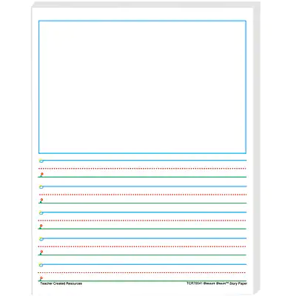
Writing Paper
Plastic waste can be

Slide 32
Being different is

Slide 33
Review - Learning Intentions
Expanding student background knowledge
Enhancing student vocabulary
Impact on comprehension
Writing as a means to measure comprehension

Slide 34
Disclaimer
Reference within this presentation to any specific commercial or non-commercial product, process, or service by trade name, trademark, manufacturer or otherwise does not constitute or imply an endorsement, recommendation, or favoring by the Virginia Department of Education.

Slide 35
Sources:
Core Knowledge Foundation. (2017, December 4). The Baseball Experiment. https://www.coreknowledge.org/blog/baseball-experiment-two-wisconsin-researchers-discovered-comprehension-gap-knowledge-gap/
Filling the Gaps: Text Sets Build Background Knowledge and Improve Comprehension of Informational Texts. (2019, May 7). Iowa Reading Research Center. https://iowareadingresearch.org/blog/text-sets-background-knowledge
Graham, S., Bollinger, A., Booth Olson, C., D’Aoust, C., MacArthur, C., McCutchen, D., & Olinghouse,
N.(2012).Teaching elementary school students to be effective writers: A practice guide (NCEE 2012-
4058). Washington, DC: National Center for Education Evaluation and Regional Assistance, Institute of Education Sciences, U.S. Department of Education. Retrieved from http://ies.ed.gov/ncee/
wwc/publications_reviews.aspx#pubsearch.
Miller, Donalyn (2017, October 16). On the Level by Donalyn Miller. Nerdy Book Club. https://nerdybookclub.wordpress.com/2017/10/15/on-the-level-by-donalyn-miller/
Lawson, B. (2022, June 3). The Reading League - The Science of Reading. The Reading League. https://www.thereadingleague.org
V.D.O.E. (2017b). English Standards of Learning Curriculum Framework. VDOE English Standards of Learning. https://www.doe.virginia.gov/testing/sol/standards_docs/english/2017/cf/english-cf-2017.doc
Walsh, R. (2022, July 6). Does Background Knowledge Matter to Reading Comprehension? Russ on Reading Discussing Sound Literacy Instruction, Supporting Teachers and Defending Public Education. http://russonreading.blogspot.com/2013/05/does-background-knowledge-matter-to.html
Wexler, N. (2020). The knowledge gap: The hidden cause of America's broken education system-- and how to fix it Avery, an imprint of Penguin Random House LLC https://ies.ed.gov/ncee/wwc/Docs/PracticeGuide/WWC_Elem_Writing_PG_Dec182018.pdf#page=18
What are “text sets,” and why use them in the classroom? (2016, September 23). The Thomas B. Fordham Institute. https://fordhaminstitute.org/national/commentary/what-are-text-sets-and-why-use-them-classroom
Worthington, M. (2020, February 18). Joan Sedita's “Writing Rope.” International Dyslexia Association. https://dyslexiaida.org/joan-seditas-writing-rope/#:%7E:text=With%20a%20nod%20to%20Hollis,as%20a%20single%2C%20mo

