Slide 1
Best Practice for Verifying Credits in Writing
Performance Assessment to Verify Credits in Writing
December 2020

Slide 2
Overview
Background Information
Performance Level Descriptors (PLDs)
Awarding Verified Credit
Anchor Sets and Annotations
Additional Resources

Slide 3
Background Information
Verified credit in writing is determined after a body (or collection) of evidence is evaluated during a separate process using the 2017 EOC Writing Performance Level Descriptors (PLDs), which describe levels of achievement in high school writing: advanced, proficient, or does not meet the standard (fails). A body of evidence that is judged to be proficient or advanced according to these descriptors should earn the student a verified credit in writing.
The rubric scores on individual writing samples and the PLD determination are independent of each other, as there is no numerical score on the rubric that correlates with a Pass/Proficient or Pass/Advanced performance level from the PLDs.

Slide 4
Collaboration with the National Center for the Improvement of Educational Assessment, Inc.
In the spring of 2020, the Virginia Department of Education collaborated with members of the Center for Assessment and a panel of Virginia educators to conduct a range finding of collections of evidence to create an anchor set that illustrates the three levels of proficiency in the Performance Level Descriptors (PLD). The collections represent authentic samples of Virginia student work from across the commonwealth.

Slide 5
Range Finding Process
VDOE staff collaborated with the Center for Assessment to conduct the range finding for anchor sets.
The panel included Virginia educators from across the commonwealth with extensive knowledge of expectations for student writing at the end of the course.
During range finding, a process was used to provide exemplars to be used as training materials and anchor sets in order to support local divisions
  A similar process is described as best practice for school divisions when determining verified credit

Slide 6
Anchor Sets and Annotations
The Virginia Department of Education’s Office of Student Assessment and English Office of the Department of Learning and Innovation, with assistance from the Center for Assessment and a committee of Virginia educators, have provided twelve example collections of evidence and accompanying annotations.
  3 Pass/Advanced
  6 Pass/Proficient
  3 Fail/Does Not Meet

Slide 7
To Be Included in the Collection of Evidence (1 of 2)
“School divisions that choose to award verified credits to these students in writing using authentic performance assessments must administer assessments that cover the writing and research standards included in the English SOL for grades 9-11. A list of the applicable SOL is provided below.
  Grade 9 English: SOL 9.6, 9.7, 9.8
  Grade 10 English: SOL 10.6, 10.7, 10.8
  Grade 11 English: SOL 11.6, 11.7, 11.8”

Slide 8
To Be Included in the Collection of Evidence (2 of 2)
Writing samples included in the collection of evidence must include three types of writing covered by the English SOL for grades 9-11: persuasive, analytic, and argumentative.
At least one of the writing samples must include a research component.
  The research process is not evaluated using the PLDs. The use of resources may be implicit in the writing samples, or it may be explicit through the appropriate use of citations.

Slide 9
What Can Be Evaluated?
“A student performing at this level should be able to use resources, prewriting strategies, and revision in order to:”
  Student writing included in the collection of evidence implies the use of resources, prewriting strategies, and revision.
  Only evidence included in the collection should be used to determine if verified credit is to be awarded, and only as it compares to the performance level descriptors.

Slide 10
A Note on Completion of Writing Samples
Any writing sample included in a student’s collection of evidence to be evaluated for a verified credit must have been completed independently by the student, without assistance from any person.
  School divisions must determine the processes and procedures they will use to ensure that the guidelines and expectations for the local performance assessments used to verify credits in writing are followed with fidelity, including that students are not being provided assistance.

Slide 11
Determining if a Verified Credit Should Be Awarded
“The student writing samples and the results of any other assessment used by the school division to determine student proficiency in the writing skills included in the English SOL for grades 9-11 constitute a body of evidence. School divisions will review the body of evidence against the performance level descriptors that describe the student’s level of achievement in high school writing and will determine if the student’s achievement is advanced, proficient, or does not meet the standard (fails). Students who are judged to be proficient or advanced according to these descriptors should be awarded a verified credit.”

Slide 12
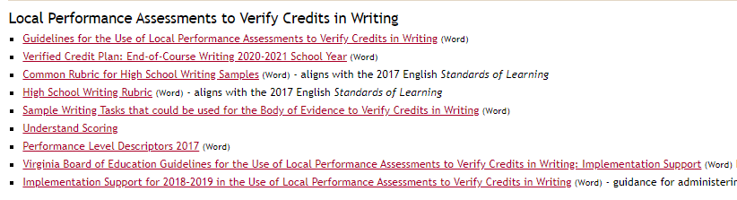
Performance Level Descriptors (EOC Writing)
Performance Level Descriptors are available on the English SOL page of the Virginia Department of Education website.

Slide 13
Language in Performance Level Descriptors
Performance Level Descriptors are written to show what a student can do by the end of the course.
Fail/Does Not Meet
  A student performing at this level should be able to use resources, prewriting strategies, and revision in order to: develop a simple thesis; provide basic information and limited evidence related to the topic; show relationships between or among ideas; arrange sentences in an attempt to exhibit unity; construct a limited variety of sentences; use specific words and relevant vocabulary to write about a topic; compose sentences that maintain standard usage; use mechanics to support writing.

Slide 14
Assembling a Panel of Evaluators
School divisions are responsible for assembling a panel of evaluators for determining if a verified credit is awarded to each collection of evidence.
The local panel should consist of at least two educators who have expertise in the English content standards assessed by the local performance assessments used to verify credit in writing. The current teacher of record for the student who completed the collection should not be included in this panel. The panel may be convened virtually, or the panel may meet in person.
It is best practice that each member of the panel has completed the training, practice, and verification included in Understand Scoring to gain a better understanding of Virginia’s expectations for student writing at the end of the course.
  Note: The panel does not assign individual scores to writing samples included in the collections, nor does it use previously assigned scores to award verified credit.

Slide 15
Evaluation Process (1 of 2)
School divisions are expected to use the anchors and annotations provided by VDOE as part of the local process to train the panel that will evaluate the collections of evidence.
Each panelist should complete an independent review of each collection of evidence without knowledge of the student’s identity. The recommendation by each panelist should be documented, and this documentation should be maintained as part of the collection of evidence.

Slide 16
Evaluation Process (2 of 2)
During review of a completed collection, panelists are expected to consider the achievement demonstrated within writing samples themselves rather than the scores previously assigned to those writing samples.
Each collection of evidence must be evaluated by at least two panelists. If there is not total agreement regarding the level of achievement demonstrated in the collection of evidence, an additional independent evaluation must be conducted by a person who has expertise in the 2017 English SOL and meets the above recommendations and expectations. Divisions are encouraged to designate a person, such as an English supervisor or division-level specialist, to make this final determination.

Slide 17
Best Practice in Awarding Verified Credit (1 of 2)
It is expected that the panel uses a version of the following procedure:
  Read and discuss the twelve anchors and annotations available on the VDOE website, paying close attention to collections “on the line” between each performance level.
  Individually, sort collections into the three performance levels (stacks).
  Compare each collection in each stack to the determined performance level to ensure that student work reflects the description, keeping in mind that the PLDs describe what a student can do at the end of the course.

Slide 18
Best Practice in Awarding Verified Credit (2 of 2)
It is recommended that the panel uses a version of the following procedure (continued):
  Sort collections in each stack from highest to lowest performance.
  Use the anchor sets and annotations throughout the process of determining verified credit in order to recalibrate and maintain consistency with Virginia’s expectations.
  Reconvene the panel to compare the ordered collections, beginning with the highest performance in the Pass/Advanced category.
  Collections that do not have total agreement in performance level should undergo the additional independent evaluation and must be carefully compared to the anchors, annotations, and PLDs.

Slide 19
Using PLDs to Evaluate Holistically
The language included in the Performance Level Descriptors is broad, and it is meant to be applied holistically to an entire collection of evidence.
  Of the three samples, two may demonstrate consistent control of usage and mechanics, while one includes overwhelming errors in capitalization and punctuation.
  Two samples may include a clear, logical thesis that illustrates the central idea, purpose, or position and provides for development of ideas, while one sample lacks a central idea, purpose, or position.
    Verified credit is not determined based on one feature of the performance level description.
    It is the responsibility of the panel to use the PLDs and annotated student collections to determine the overall performance level of each collection of evidence.

Slide 20
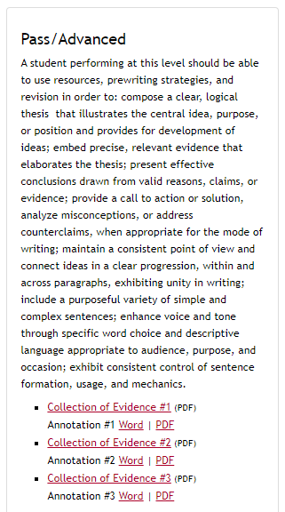
Performance Level: Pass/Advanced
The performance level descriptor is included on the web page, and collections with their annotations are listed from highest to lowest.

Slide 21
Example from Annotations: Pass/Advanced
Collection 3
  “Evidence is precise and relevant, clearly, though not perfectly, elaborating the thesis in each sample. The first and second sample demonstrate effective use of quotations, embedding the information appropriately and drawing conclusions from the source material (Individuals do not realize how precious time is. . . . One day some family members will not be here, and society will wish they would have spent more time with their loved ones and not on a phone.), though some repetition and off-topic claims also appear (Children need to grow up and grow into being a teenager, and part of that is becoming independent. Adolescents will make mistakes and mature from them, and that how is how they grow up, so it is important they are not deterred from being independent.). The third writing sample connects ideas within paragraphs in a clear progression, though unity across paragraphs is weak. Unity is stronger in the first and second samples, as ideas are connected in a clear progression as well as to the overall purpose and position.”

Slide 22
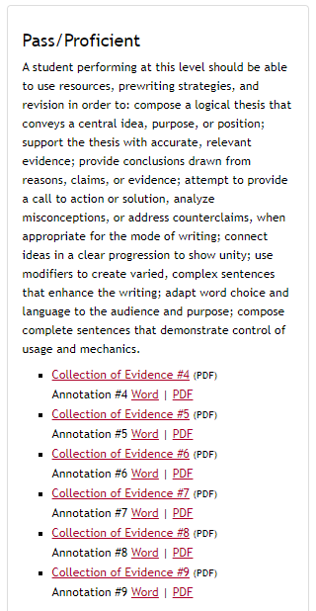
Performance Level: Pass/Proficient
The performance level descriptor is included on the web page, and collections with their annotations are listed from highest to lowest.

Slide 23
Example from Annotations: Pass/Proficient (1 of 2)
Collection 4
  “The writing samples each include a logical thesis that conveys a central idea, position, or purpose, although some evidence diminishes the clarity of the thesis. In the first writing sample, a clear, though formulaic, position is presented (This paper will discuss how people cannot handle spontaneous social interactions because of their reliance on technology.). In the second writing sample, the purpose of analyzing a career choice is clear (Being a social worker is an amazing career choice.), and the third writing sample takes a clear, logical position that provides the central idea and purpose for writing but does not fully provide for the development of ideas (Vaccinations are a huge reason people stay protected….we should still be vaccinating.).”

Slide 24
Example from Annotations: Pass/Proficient (2 of 2)
Collection 9
  “The writing includes attempts to draw conclusions from reasons, claims, or evidence (It made a lot of people lose faith because it was a time where a lot of people were unemployed and were lacking wealth.), though some conclusions are limited (Failing light source is kind of interesting because it’s creepy and mysterious most of the time when it is used.). The first writing sample includes a subtle call to action that supports the position (Unless in the future the taxes go down and the criteria to get a job is the same for all people then that could help make the American Dream reachable again.). Ideas are connected in a clear progression to show unity, with some weakness in the second writing sample when the quotations are explained but not fully connected to the central idea. Although the inclusion of precise evidence and relevant conclusions are areas of weakness that affect the overall quality of the writing, reasonable to consistent control of additional features of the performance level allows this collection to be considered proficient.”

Slide 25
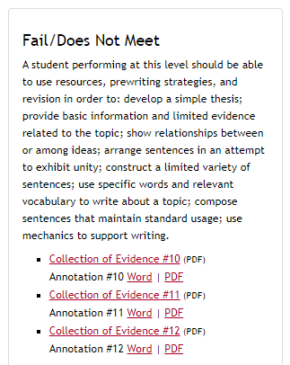
Performance Level: Fail/Does Not Meet
The performance level descriptor is included on the web page, and collections with their annotations are listed from highest to lowest.

Slide 26
Example from Annotations: Fail/Does Not Meet
Collection 10
“Though accurate, relevant evidence is effectively provided in the first sample (In the middle of the movie your phone rings and causes a giant distraction) and third sample (Also the academic performance of middle schoolers worsened at schools that tried restorative justice.Meaning that restorative justice may not work for every grade level or every school the way it does for others), more often the support is basic or limited.”
“Though each writing sample includes sentences that consistently, though not perfectly, maintain standard usage, there are instances when sentence structure and mechanics do not fully support the writing (If students had to stay after school to participate in a yoga class rather then miss recess or sit at silent lunch Im sure they would without a doubt be much happier). While control of usage and mechanics enhances the collection of evidence, overall weakness shown in the features of composing and written expression prevent this collection from reaching a level of Pass/Proficient.”

Slide 27
A Note on Plagiarism
Readers should only score what was written by the student. Written includes appropriately attempting to embed and cite research from outside sources. Before, during, and after scoring student samples, it is a local division’s decision how to handle intentional and unintentional plagiarism. Based on guidance from the Virginia Department of Education, when assigning a performance level, the reader should evaluate only the student’s work and not information that has been plagiarized.
Collection 7: “In the second writing sample, definitions for the three isolated gothic elements (Isolation, Mental illness, and Depression) would show awareness of audience, but because they are not the student’s original work and lack citations, these sentences cannot be considered when evaluating the collection of evidence.”

Slide 28
Local Performance Assessments to Verify Credits in Writing
Note 7/2023: Please reference current guidance: Local Performance Assessments to Verify Credits in Writing
Guidelines for the Use of Local Performance Assessments to Verify Credits in Writing (Word)
Verified Credit Plan: End-of-Course Writing 2020-2021 School Year (Word)
Common Rubric for High School Writing Samples (Word) - for instruction, aligns with the 2017 English Standards of Learning
High School Writing Rubric (Word) - for scoring, aligns with the 2017 English Standards of Learning
Sample Writing Tasks that could be used for the Body of Evidence to Verify Credits in Writing (Word)
Understand Scoring
Performance Level Descriptors 2017 (Word)
Virginia Board of Education Guidelines for the Use of Local Performance Assessments to Verify Credits in Writing: Implementation Support (Word) Effective Fall, 2019- guidance for administering and scoring the local performance assessments used to verify credits in writing
Implementation Support for 2018–2019 in the Use of Local Performance Assessments to Verify Credits in Writing (Word) - guidance for administering and scoring the local performance assessments used to verify credits in writing
Procedures for Determining if Verified Credit is Awarded (effective fall 2020) (Word)
Evaluating Collections of Evidence to Award Verified Credit in Writing

Slide 29
Local Performance Assessments to Verify Credits in Writing in 2020-2021
Note 7/2023: Please reference current guidance: Local Performance Assessments to Verify Credits in Writing
Superintendent’s Memo #311-20 (Word), November 20, 2020 - Emergency Guidelines for the Use of Local Performance Assessments to Verify Credits in Writing for the 2020-2021 School Year
Emergency Guidelines for the Use of Local Performance Assessments to Verify Credits in Writing for the 2020-2021 School Year (Word)
Verified Credit Plan: End-of-Course Writing (under Emergency Guidelines for the Use of Local Performance Assessments to Verify Credits in Writing for the 2020-2021 School Year) (Word)
Procedures for Determining if Verified Credit is Awarded (effective fall 2020) (Word)

Slide 30
Save the Date!
Please join us Monday, December 7, 2020 at 10:00 a.m. for our
Evaluating the Collection of Evidence for Verified Credit in Writing Question & Answer Session Webinar
Registration is required.
Please submit all questions by close of business Friday, December 4th.
The registration link will be sent out via email from Jill Nogueras and the Student_Assessment@doe.Virginia.gov account.

Slide 31
Student Assessment Contact Information
Office of Student Assessment
  Agency Hours: 8:00 a.m. – 5:00 p.m.
    Assessment Phone Coverage: 7:00 a.m. – 5:00 p.m.
    Phone: 804-225-2102
    Email: Student_Assessment@doe.virginia.gov

Slide 32
Stay in Touch!
Jill Nogueras
K-12 English Coordinator
Jill.Nogueras@doe.virginia.gov
Carmen Kurek
Elementary English/Reading Specialist
Carmen.Kurek@doe.virginia.gov
Colleen Cassada
Middle School English Specialist
Colleen.Cassada@doe.Virginia.gov

