Slide 1

2016 Mathematics
Standards of Learning
Kindergarten
Overview of Revisions - 2009 to 2016
Referenced documents available at VDOE Mathematics 2016
Notes:
Welcome to the Kindergarten overview of revisions to the Mathematics Standards of Learning from 2009 to 2016.
It would be helpful to have a copy of the Kindergarten – Crosswalk (Summary of Revisions) and a copy of the 2016 Kindergarten Curriculum Framework to reference during this presentation.

Slide 2
Purpose
Overview of the 2016 Mathematics Standards of Learning and the Curriculum Framework
Highlight information included in the Essential Knowledge and Skills and the Understanding the Standard sections of the Curriculum Framework
Notes:
The purpose of this presentation is to provide an overview of the revisions and to highlight information included in the Essential Knowledge and Skills and Understanding the Standards sections of the Curriculum Framework. This presentation serves as a brief overview and is not a comprehensive list of all revisions. The Curriculum Framework should be referenced for additional information regarding the 2016 standards.

Slide 3
Agenda
Implementation Timeline
Resources Currently Available
  Crosswalk (Summary of Revisions)
  Standards and Curriculum Frameworks
Comparison of 2009 to 2016 Standards
  Number and Number Sense
  Computation and Estimation
  Measurement and Geometry
  Probability and Statistics
  Patterns, Functions, and Algebra
Notes:
The implementation timeline will be shared followed by a brief overview of the Crosswalk and Curriculum Frameworks, and lastly a side by side comparison, by strand, of the 2009 standards to the new 2016 (two thousand sixteen) standards.

Slide 4
Implementation Timeline
2016-2017 School Year – Curriculum Development VDOE staff provides a summary of the revisions to assist school divisions in incorporating the new standards into local written curricula for inclusion in the taught curricula during the 2017-2018 school year.
2017-2018 School Year – Crossover Year 2009 Mathematics Standards of Learning and 2016 Mathematics Standards of Learning are included in the written and taught curricula. Spring 2018 Standards of Learning assessments measure the 2009 Mathematics Standards of Learning and include field test items measuring the 2016 Mathematics Standards of Learning.
2018-2019 School Year – Full-Implementation Year Written and taught curricula reflect the 2016 Mathematics Standards of Learning. Standards of Learning assessments measure the 2016 Mathematics Standards of Learning.
Notes:
During the (two thousand sixteen/two thousand seventeen) 2016-2017 school year – school divisions should begin incorporating the new standards into local curricula to be taught during the 2017-2018 school year.
During the Crossover Year -- both the 2009 and 2016 standards should be taught. During the Spring 2018 assessments will measure the 2009 standards and include field test items measuring the 2016 standards.
Full implementation of the 2016 standards will occur in the 2018-2019 school year.

Slide 5
2016 SOL Revisions –
Improve the vertical progression of mathematics content
Ensure developmental appropriateness of student expectations
Increase support for teachers in mathematics content (including definitions, explanations, examples, and instructional connections)
Clarify expectations for teaching and learning
Improve precision and consistency in mathematical vocabulary and format
Ensure proficiency of elementary students in computational skills
Notes:
The revisions focus on improving vertical progression of the content, ensuring developmental appropriateness, increasing support for teachers (including definitions, explanations, examples, and instructional connections), clarifying expectations both for teaching and for student learning, improving precision and consistency in mathematical vocabulary and format, and better ensuring computational fluency at the elementary level.

Slide 6
Changes to the Curriculum Framework
Reduction of columns from 3 to 2
  Understanding the Standard (US) – information that supports mathematics content knowledge
  Essential Knowledge and Skills (EKS) – information that provides expectations for student learning
Indicators of SOL sub-bullet added to each bullet within the Essential Knowledge and Skills
Notes:
The Curriculum Framework will have a somewhat different look for K-8. The reduction in the number of columns from 3 to 2 was made in order to provide consistency in format to other disciplines and consistency within the mathematics K-12. The Understanding the Standard has information that supports mathematical content knowledge and provides background information for teachers. The Essential Knowledge and Skills column provides the expectations for learning and assessment.
Corresponding EKS bullets and SOL bullets are indicated with the same letter. An example is provided on the next screen.
Teachers are encouraged to read both the Essential Knowledge and Skills and the Understanding the Standard columns.

Slide 7
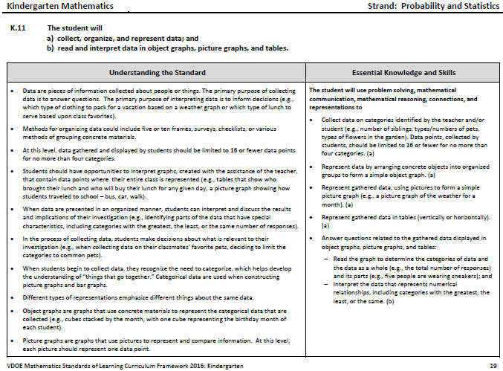
Notes:
This is a page from the kindergarten Curriculum Framework. It is very important that teachers spend time exploring the new Curriculum Frameworks. They contain examples of edits made to the Understanding the Standard section including clarity in definitions and explanations. In some standards, examples have also been included.
In addition, where appropriate, corresponding EKS bullets and SOL bullets are indicated with the same letter. It is important to note that during any given lesson, multiple EKS bullets may be represented.

Slide 8
Overview of Changes in Kindergarten
2009 |  | 2016
Strand | # of Standards | # of Standards | Strand
Number and Number Sense | 5 | 5 | Number and Number Sense
Computation and Estimation | 1 | 1 | Computation and Estimation
Measurement | 4 | 4 | Measurement and Geometry
Geometry | 2
Probability and Statistics | 2 | 1 | Probability and Statistics
Patterns, Functions, and Algebra | 2 | 2 | Patterns, Functions, and Algebra
Total | 16 | 13 | Total
Notes:
In Kindergarten there was a reduction in the number of standards from 16 to 13. This is a result of: consolidation of related concepts and skills, a reduction of repetition, an improvement in the developmental progression, and/or deletion of content.
The revisions made to Kindergarten will be addressed in greater detail later in this presentation. Note that the strands of measurement and geometry have been combined and now represent one strand titled “measurement and geometry.”

Slide 9
Mathematics Process Goals for Students
“The content of the mathematics standards is intended to support the five process goals for students”
- 2009 and 2016 Mathematics Standards of Learning
Mathematical Understanding
Problem Solving
Connections
Communication
Representations
Reasoning
Notes:
In the next several slides, we will take a look at revisions to the Curriculum Framework document.
The mathematical process goals, found listed in the Introduction, continue to play an instrumental role in the teaching and learning of mathematics with understanding.
We encourage all educators to review information included in the introduction of the 2016 Curriculum Frameworks.

Slide 10
Standards of Learning Curriculum Frameworks
Introduction includes:
  Mathematical Process Goals for Students
  Instructional Technology
  Computational Fluency
  Algebra Readiness
  Equity
New
Notes:
Four additional sections have been included in the introduction to the 2016 Curriculum Framework -- Instructional Technology, Computational Fluency, Algebra Readiness, and Equity.
The content of each section addresses the impact on students’ learning and instruction. We encourage educators to review these sections of the introduction.

Slide 11
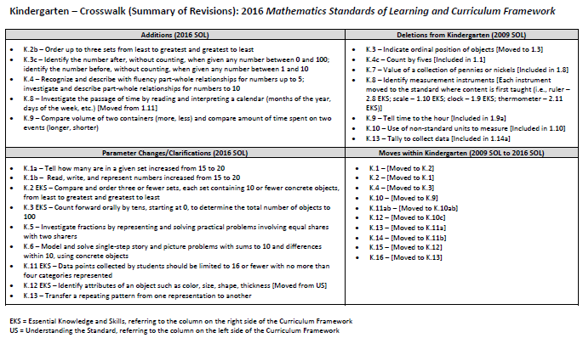
2016
2009
Notes:
This is the snapshot of the Kindergarten Crosswalk and Summary of Revisions page one.
Notice there are four quadrants representing the additions, deletions, parameter changes or clarifications, and any moves within the Kindergarten standards.
The upper left quadrant represents the additions, the standards referenced are the 2016 numbers. Moves from other grade levels are indicated within brackets.
The upper right quadrant identifies deletions from the 2009 standards and indications of where that content was moved.
The bottom left quadrant indicates the parameter changes (for example K.1 increased from 15 to 20) and in K.2 EKS bullet – students are now comparing and ordering up to three sets of objects. In some cases content was moved from the Understanding the Standards section as indicated here.
In the bottom right quadrant, moves within a grade level are indicated with the first number being the 2009 standard number and the number in the brackets representing the 2016.

Slide 12
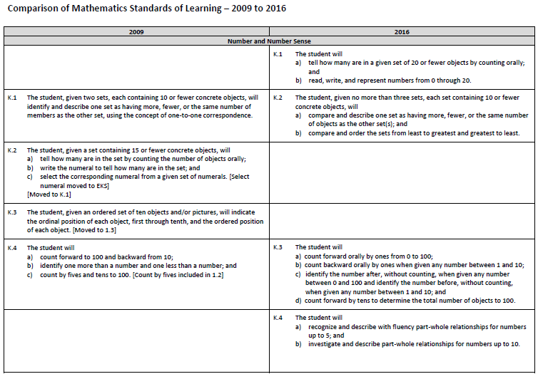
Notes:
On page 2 and the remaining pages of the crosswalk, a side by side comparison of the 2009 and 2016 standards can be found. An attempt was made to keep the standards in numerical order for both columns.
When deleted content was moved or already found in another grade, it is indicated in brackets.
Empty boxes on the right indicate that that content has either been deleted or moved. Empty boxes on the left typically indicate that the 2016 standard is new to that grade level, as you see here in the new K.4 standard.

Slide 13
Number and Number Sense
Notes:
We’ll now dig deeper into the crosswalk by taking a look at the Number and Number Sense strand.

Slide 14
2009 SOL | 2016 SOL
K.2 The student, given a set containing 15 or fewer concrete objects, will a) tell how many are in the set by counting the number of objects orally; b) write the numeral to tell how many are in the set; and select the corresponding numeral from a given set of numerals. [Select corresponding numeral was moved to EKS] [K.2ab Moved to K.1ab] | K.1 The student will tell how many are in a given set of 20 or fewer objects by counting orally; and read, write, and represent numbers from 0 through 20.
Revisions:
K.1a – Tell how many are in a given set of objects increased from 15 to 20
K.1b – Read, write, and represent numbers increased from 15 to 20
K.1b EKS – Clarification provided – construct a set corresponding to a given number, identify numerals in random order, and identify the numeral that corresponds to a given set
Notes:
K.1 represents the former K.2 with the quantity of objects increasing from 15 to 20; Clarity has been provided in EKS section that students will construct a set corresponding to a given number, identify numerals in random order, and identify the numeral that corresponds to a given set.

Slide 15
2009 SOL | 2016 SOL
K.1 The student, given two sets, each containing 10 or fewer concrete objects, will identify and describe one set as having more, fewer, or the same number of members as the other set, using the concept of one-to-one correspondence. | K.2 The student, given no more than three sets, each set containing 10 or fewer concrete objects, will compare and describe one set as having more, fewer, or the same number of objects as the other set(s); and compare and order the sets from least to greatest and greatest to least.
Revisions:
K.2 – Number of sets increased from two to no more than three
K.2b – Order up to three sets from least to greatest and greatest to least
Notes:
The former K.1 is now represented in K.2 with the number of sets that students will compare increasing from two to three sets. In addition, ordering three or fewer sets from greatest to least and least to greatest is a new expectation in kindergarten.

Slide 16
2009 SOL | 2016 SOL
K.3 The student, given an ordered set of ten objects and/or pictures, will indicate the ordinal position of each object, first through tenth, and the ordered position of each object. [Moved to 1.3]
Revisions:
K.3 – Indicate ordinal position of objects moved to 1.3
Notes:
Indicating ordinal positions of objects has been moved to 1.3.

Slide 17
2009 SOL | 2016 SOL
K.4 The student will a) count forward to 100 and backward from 10; b) identify one more than a number and one less than a number; and c) count by fives and tens to 100. [Count by fives included in 1.1] | K.3 The student will count forward orally by ones from 0 to 100; count backward orally by ones when given any number between 1 and 10; identify the number after, without counting, when given any number between 0 and 100 and identify the number before, without counting, when given any number between 1 and 10; and count forward by tens to determine the total number of objects to 100.
Revisions:
Count by fives deleted; remains in grade one
K.3a – Counting forward orally by ones from 0 to 100
K.3b new – Count backward orally when given any number between 1 and 10
K.3c – Identify the number after, without counting, when given any number between 0 and 100; Identify number before, without counting, when given any number between 1 and 10
K.3d EKS – Clarifies counting by tens should be done in conjunction with determining the total number of objects up to 100
Notes:
K.4 is now K.3 with counting by fives being deleted from Kindergarten; counting by fives remains in 1.1.
Clarification has been provided that students should count ‘orally’ to 100 in K.3a.
K.3b is a new expectation – students have previously been expected to count backwards from 10 – this expectation has been changed to ‘ count backward orally by ones when given any number between 1 and 10’.
Identifying one more than a number and one less than a number in K.3c has been clarified – students are to identify the number after, without counting, when given any number between 0 and 100. They will also identify the number before, without counting, when given any number between 1 and 10.
The EKS bullet for K.3d clarifies that counting by tens should be done orally in conjunction with determining the total number of objects up to 100.

Slide 18
2009 SOL | 2016 SOL
 | K.4 The student will a) recognize and describe with fluency part-whole relationships for numbers up to 5; and b) investigate and describe part-whole relationships for numbers up to 10.
New
Revisions:
K.4a – Recognize and describe with fluency part-whole relationships for numbers up to five in a variety of configurations
K.4b – Investigate and describe part-whole relationships for numbers up to 10 using a variety of configurations
Notes:
K.4 is a NEW expectation. Students will recognize and describe with fluency part-whole relationships with number up to five in a variety of configurations. In addition, they will investigate and describe part-whole relationships for numbers up to 10 using a variety of configurations. Fluency with numbers to 10 is part of grade one.
Additional teacher information can be found in the Understanding the Standard section of the Curriculum Framework.

Slide 19
2009 SOL | 2016 SOL
K.5 The student will identify the parts of a set and/or region that represent fractions for halves and fourths. | K.5 The student will investigate fractions by representing and solving practical problems involving equal sharing with two sharers.
Revisions:
Greater emphasis on representing and solving practical problems that involve sharing with two sharers
Represent fair shares concretely
Describe fair shares as equal pieces or parts of a whole
Notes:
In SOL K.5 greater emphasis has been placed on students representing and solving practical problems that involve sharing with two sharers and describing fair shares as equal pieces or parts of a whole. Representing fractions with symbols is not an expectation at this level.

Slide 20
Computation and Estimation
Notes:
Let’s move on to the standards for Computation and Estimation.

Slide 21
2009 SOL | 2016 SOL
K.6 The student will model adding and subtracting whole numbers, using up to 10 concrete objects. | K.6 The student will model and solve single-step story and picture problems with sums to 10 and differences within 10, using concrete objects.
Revisions:
Solve various types of story and picture problems using 10 or fewer concrete objects
See Understanding the Standard section in Curriculum Framework for additional information and examples of problem types
Notes:
Clarification has been provided in K.6 that students should model and SOLVE single-step story and picture problems with sums to 10 and differences within 10, using concrete objects. Types of problems should include joining, separating, and part-part-whole scenarios. Additional information, and examples of problem types, can be found in the Understanding the Standard section of the Curriculum Framework.

Slide 22
MEASUREMENT AND GEOMETRY
Notes:
We’ll move on to measurement and geometry.

Slide 23
2009 SOL | 2016 SOL
K.7 The student will recognize a penny, nickel, dime, and quarter and will determine the value of a collection of pennies and/or nickels whose total value is 10 cents or less. [Value of a collection included in 1.8] | K.7 The student will recognize the attributes of a penny, nickel, dime, and quarter and identify the number of pennies equivalent to a nickel, a dime, and a quarter.
Revisions:
Deleted determining the value of a collection of pennies and/or nickels
EKS – Equivalencies now included in standard
Notes:
In K.7 determining the value of a collection of pennies and/or nickels has been removed – this content remains in grade one. The EKS bullet regarding equivalencies is now located in the standard.

Slide 24
2009 SOL | 2016 SOL
K.8 The student will identify the instruments used to measure length (ruler), weight (scale), time (clock: digital and analog; calendar: day, month, and season), and temperature (thermometer). [Moved each measurement instrument to the grade and standard where the content is first taught (i.e., ruler and scale – 2.8 EKS; clock – 1.9 EKS; thermometer – 2.11 EKS)] | K.8 The student will investigate the passage of time by reading and interpreting a calendar. [Moved from 1.11]
Revisions:
Identification of measurement instruments moved to grade level where the use of the instrument first occurs:
  - ruler and scale moved to 2.8 EKS
clock moved to 1.9 EKS
thermometer moved to 2.11 EKS
Calendar (identification of days and months) remains in K.8
Seasons are included in science curriculum
Notes:
Identification of measurement instruments has been moved to the grade level where the use of the instrument first occurs. For instance:
ruler and scale moved to 2.8 EKS;
the clock was moved to 1.9 EKS; and
thermometer moved to 2.11 EKS.
Identifying days of the week and months of the year remains in Kindergarten. Seasons are included in science curriculum.
Direct comparison of length, height, weight, time, volume, and temperature appears in K.9. See EKS bullets for greater detail.

Slide 25
2009 SOL | 2016 SOL
K.9 The student will tell time to the hour, using analog and digital clocks. [Time to hour included in 1.9a]
Revisions:
Telling time to the hour deleted from Kindergarten
Notes:
Telling time to the hour has been deleted from kindergarten; telling time to the hour and half hour remain in 1.9a.

Slide 26
2009 SOL | 2016 SOL
K.10 The student will compare two objects or events, using direct comparisons or nonstandard units of measure, according to one or more of the following attributes: length (longer, shorter), height (taller, shorter), weight (heavier, lighter), temperature (hotter, colder). Examples of nonstandard units include foot length, hand span, new pencil, paper clip, and block. [Use of non-standard units included in 1.10] | K.9 The student will compare two objects or events, using direct comparisons, according to one or more of the following attributes: length (longer, shorter), height (taller, shorter), weight (heavier, lighter), temperature (hotter, colder), volume (more, less), and time (longer, shorter).
Revisions:
Direct comparisons of volume and time are additions to expectations in measurement
Non-standard units deleted in Kindergarten; remain a part of grade one
Notes:
K.10 is now K.9 with some the following revisions:
Comparing volume of two containers (more or less) and comparing amount of time spent on two events (longer, shorter) have been added to the Kindergarten expectation
Using non-standard units to measure has been deleted from Kindergarten but remains in grade one.

Slide 27
2009 SOL | 2016 SOL
K.11 The student will a) identify, describe, and trace plane geometric figures (circle, triangle, square, and rectangle); and compare the size (larger, smaller) and shape of plane geometric figures (circle, triangle, square, and rectangle). [Moved to K.10ab] K.12 The student will describe the location of one object relative to another (above, below, next to) and identify representations of plane geometric figures (circle, triangle, square, and rectangle) regardless of their positions and orientations in space. [Moved to K.10c] | K.10 The student will a) identify and describe plane figures (circle, triangle, square, and rectangle); b) compare the size (smaller, larger) and shape of plane figures (circle, triangle, square, and rectangle); and c) describe the location of one object relative to another (above, below, next to) and identify representations of plane figures (circle, triangle, square, and rectangle) regardless of their positions and orientations in space.
Revisions:
K.11 and K.12 became new K.10
Deleted tracing of figures in Kindergarten
Notes:
K.11 and K.12 became the new K.10. Note tracing a figure in Kindergarten has been removed.

Slide 28
PROBABILITY AND STATISTICS
Notes:
We will now take a look at the Probability and Statistics strand.

Slide 29
2009 SOL | 2016 SOL
K.13 The student will gather data by counting and tallying. [Tallying included in 1.14a] K.14 The student will display gathered data in object graphs, picture graphs, and tables, and will answer questions related to the data. [Moved to K.11b] | K.11 The student will collect, organize, and represent data; and read and interpret data in object graphs, picture graphs, and tables. [Moved from K.14]
Revisions:
Deleted tallying to collect data; content remains in grade one
K.11b – EKS bullets provide additional clarification – data points collected by students limited 16 or fewer with no more than four categories represented
Notes:
K.13 and K.14 were combined to form K.11. Tallying to collect data has been removed from Kindergarten. It is not an expectation that students master this skill until grade one when counting by fives is included in the curriculum.
The K.11b EKS bullets provide additional clarification – for instance, data points collected by students should be limited 16 or fewer for no more than four categories represented.

Slide 30
PATTERNS, FUNCTIONS, AND ALGEBRA
Notes:
Let’s take a look at the Patterns, Functions and Algebra strand.

Slide 31
2009 SOL | 2016 SOL
K.15 The student will sort and classify objects according to attributes. | K.12 The student will sort and classify objects according to one attribute.
Revisions:
Sorting and classifying limited to one attribute in Kindergarten
Notes:
K.15 is now K.12 - Sorting and classifying has been limited to one attribute in Kindergarten and two attributes in grade one.
Clarification has been provided in the EKS bullets that state that students will identify the attributes of an object such as color, size, shape, or thickness. Examples are included in the Understanding the Standard section of the Curriculum Framework.

Slide 32
2009 SOL | 2016 SOL
K.16 The student will identify, describe, and extend repeating patterns. | K.13 The student will identify, describe, extend, create, and transfer repeating patterns.
Revisions:
Create and transfer added to SOL - creating repeating patterns was included in the 2009 EKS
New – transfer a repeating pattern from one representation to another added to the EKS
Notes:
K.16 is now K.13
Creating and transferring patterns was added to the standard. The creation of repeating patterns was already included in the 2009 EKS bullets.
Transferring a repeating pattern from one representation to another is an addition to Kindergarten. Examples have been included in the US section of the Curriculum Framework.

Slide 33
Questions?
Please contact the
VDOE Mathematics Team
Mathematics@doe.virginia.gov
Notes:
This concludes the presentation on the 2016 Grade K Mathematics Standards of Learning revisions. You are encouraged to refer to the Curriculum Frameworks where additional information can be found.
Should you have any questions, feel free to contact a member of the Mathematics Team at the email shown on the screen.

