Slide 1

2016 Mathematics
Standards of Learning
Grade 8 Mathematics
Overview of Revisions - 2009 to 2016
Referenced documents available at VDOE Mathematics 2016
Notes:
Welcome to the Grade 8 Overview of Revisions to the Mathematics Standards of Learning from 2009 to 2016.
It would be helpful to have a copy of the Grade 8 – Crosswalk (Summary of Revisions) and a copy of the 2016 Grade 8 Curriculum Frameworks to reference during this presentation.
These documents are available electronically on the VDOE Mathematics 2016 webpage under Standards of Learning and Testing.

Slide 2
Purpose
Overview of the 2016 Mathematics Standards of Learning and the Curriculum Framework
Highlight information included in the Essential Knowledge and Skills and the Understanding the Standard sections of the Curriculum Framework
Notes:
Our purpose is to provide an overview of the revisions and to highlight information included in the Essential Knowledge and Skills and Understanding the Standards sections of the curriculum framework.
This presentation is a brief overview of revisions and not a comprehensive list of all revisions. Teachers should reference the curriculum framework if they have questions regarding the 2016 standards.

Slide 3
Agenda
Implementation Timeline
Resources Currently Available
  Crosswalk (Summary of Revisions)
  Standards and Curriculum Frameworks
Comparison of 2009 to 2016 Standards
  Number and Number Sense
  Computation and Estimation
  Measurement and Geometry
  Probability and Statistics
  Patterns, Functions, and Algebra
Notes:
The implementation timeline will be shared followed by a brief overview of the Crosswalk and curriculum frameworks, and lastly a side by side comparison of the 2009 standards to the new 2016 (two thousand sixteen) standards.

Slide 4
Implementation Timeline
2016-2017 School Year – Curriculum Development VDOE staff provides a summary of the revisions to assist school divisions in incorporating the new standards into local written curricula for inclusion in the taught curricula during the 2017-2018 school year.
2017-2018 School Year – Crossover Year 2009 Mathematics Standards of Learning and 2016 Mathematics Standards of Learning are included in the written and taught curricula. Spring 2018 Standards of Learning assessments measure the 2009 Mathematics Standards of Learning and include field test items measuring the 2016 Mathematics Standards of Learning.
2018-2019 School Year – Full-Implementation Year Written and taught curricula reflect the 2016 Mathematics Standards of Learning. Standards of Learning assessments measure the 2016 Mathematics Standards of Learning.
Notes:
During the 2016-2017 school year – school divisions should begin incorporating the new standards into local curricula.
During the 2017-2018 school year – both the 2009 and 2016 standards should be taught. The Spring 2018 assessments will measure the 2009 standards and include field test items measuring the 2016 standards.
Full implementation of the 2016 standards will occur in the 2018-2019 school year.

Slide 5
2016 SOL Revisions –
Improve the vertical progression of mathematics content
Ensure developmental appropriateness of student expectations
Increase support for teachers in mathematics content (including definitions, explanations, examples, and instructional connections)
Clarify expectations for teaching and learning
Improve precision and consistency in mathematical language and format
Ensure proficiency of elementary students in computational skills
Notes:
The revisions focus on improving vertical progression of the content, ensuring developmental appropriateness, increasing support for teachers (including definitions, explanations, examples, and instructional connections), clarifying expectations both for teaching and for student learning, improving precision and consistency in mathematical vocabulary and format, and better ensuring computational fluency at the elementary level.

Slide 6
Changes to the Curriculum Framework
Reduction of columns from 3 to 2
  Understanding the Standard (US) – information that supports mathematical content knowledge
  Essential Knowledge and Skills (EKS) – information that provides expectations for student learning
Indicators of SOL sub-bullet added to each bullet within the Essential Knowledge and Skills
Objectives measured without a calculator on state assessments are indicated with an asterisk *
Notes:
The curriculum framework will have a somewhat different look for K-8. The reduction in the number of columns from 3 to 2 was made in order to provide consistency in format to other disciplines and consistency within the mathematics K-12.
The Understanding the Standard or US column has information that supports mathematical content knowledge and provides background information for teachers.
The Essential Knowledge and Skills or EKS column provides the expectations for learning and assessment.
Corresponding EKS bullets and SOL bullets are indicated with the same letter. An example is provided on the next slide.
SOL with an asterisk indicate objectives that are measured without a calculator on state assessments.

Slide 7
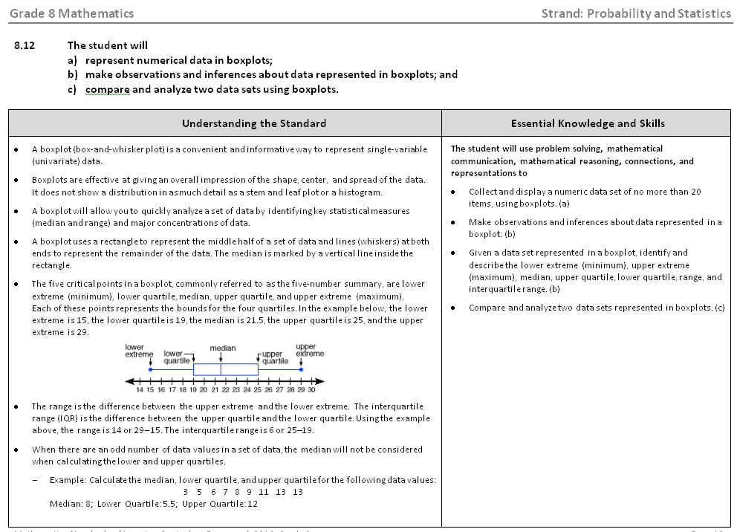
Notes:
This is a page from the math 8 curriculum framework. Notice the 2 column format mentioned on the previous slide – Understanding the Standard and Essential Knowledge and Skills. Teachers are encouraged to read both the Essential Knowledge and Skills and the Understanding the Standard columns.
It is very important that teachers spend time exploring the 2016 curriculum frameworks. They contain examples of edits made to the Understanding the Standard section including clarity in definitions and explanations. In some standards, examples have also been included.
In addition, where appropriate, corresponding EKS and SOL bullets are indicated with the same letter.

Slide 8
Overview – Math 8
2009 |  | 2016
Strand | # of Standards | # of Standards | Strand
Number and Number Sense | 2 | 3 | Number and Number Sense
Computation and Estimation | 3 | 1 | Computation and Estimation
Measurement | 2 | 6 | Measurement and Geometry
Geometry | 4
Probability and Statistics | 2 | 3 | Probability and Statistics
Patterns, Functions, and Algebra | 4 | 5 | Patterns, Functions, and Algebra
Total | 17 | 18 | Total
Notes:
There was an overall reduction in the number of standards in K-12. This was a result of - consolidation of related concepts and skills; a reduction of repetition, an improvement of the developmental progression, and/or deletion of content.
However, in grade 8 there was an increase in the number of standards from 17 to 18.
Note that the strands of measurement and geometry have been combined and now represent one strand titled “measurement and geometry.”

Slide 9
Mathematics Process Goals for Students
“The content of the mathematics standards is intended to support the five process goals for students”
- 2009 and 2016 Mathematics Standards of Learning
Mathematical Understanding
Problem Solving
Connections
Communication
Representations
Reasoning
Notes:
The mathematical process goals continue to play an instrumental role in the teaching and learning of mathematics with understanding.
We encourage educators to review these sections included in the introduction of the 2016 curriculum frameworks.

Slide 10
Standards of Learning Curriculum Frameworks
Introduction includes:
  Mathematical Process Goals for Students
  Instructional Technology
  Computational Fluency
  Algebra Readiness
  Equity
New
Notes:
Four additional sections have been included in the introduction to the 2016 curriculum framework –
Instructional Technology,
Computational Fluency,
Algebra Readiness, and
Equity.
The content of each section addresses the impact on students’ learning and instruction. Educators are encouraged to review these sections included in the introduction.

Slide 11
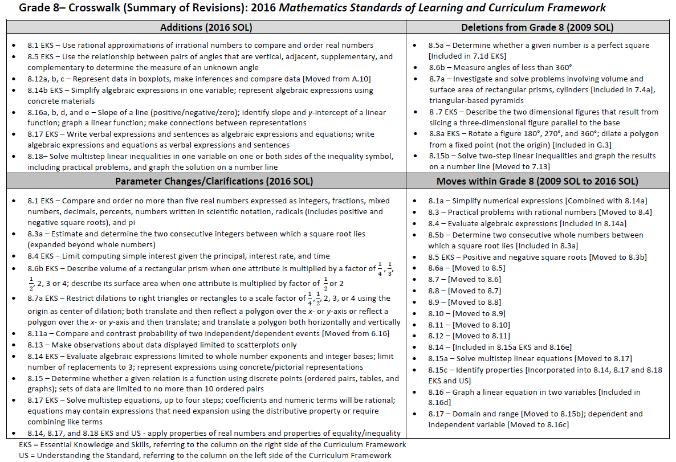
2009
2016
Notes:
This is a snapshot of the Grade 8 Crosswalk (Summary of Revisions) page one. There are four quadrants – additions, deletions, parameter changes or clarifications, and moves within the standards.
The upper left quadrant represents the additions, the standards referenced are the 2016 numbers and include additions to the EKS as well as the standard. Moves from other grade levels are indicated within brackets.
The upper right quadrant identifies deletions from the 2009 standards and indicates where that content was moved.
The bottom left quadrant indicates parameter changes or clarifications. Note the underlines examples on the screen.
The bottom right quadrant indicates moves within a grade level which are indicated with the first number being the 2009 SOL number and the number in the brackets representing the 2016 number.

Slide 12
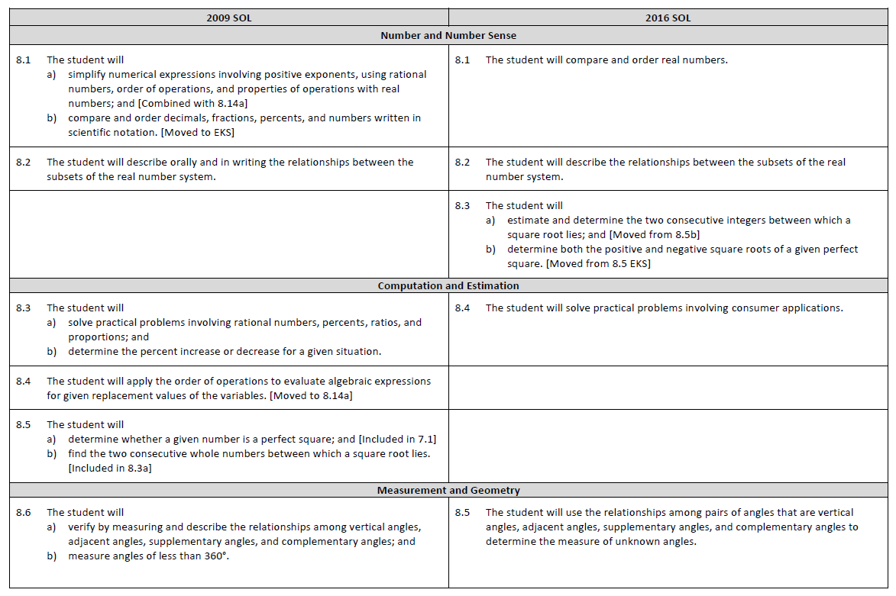
Notes:
On page 2 and the remaining pages of the crosswalk, a side by side comparison of the 2009 and 2016 standards can be found. There was an attempt to keep the standards in numerical order for both columns.
When deleted content was moved or already found in another grade, it is indicated in brackets. See example in 2009 for 8.1, 8.4 and 8.5.
Empty boxes on the right indicate content that was either deleted or moved.
Empty boxes on the left typically indicate that the 2016 standard is new to that grade level or moved from another strand within the grade level, such as 8.3.

Slide 13
Number and Number Sense
Notes:
We’ll begin by taking a look at the Number and Number Sense strand.

Slide 14
2009 SOL | 2016 SOL
8.1 The student will a) simplify numerical expressions involving positive exponents, using rational numbers, order of operations, and properties of operations with real numbers; and [Combined with 8.14a] b) compare and order decimals, fractions, percents, and numbers written in scientific notation. [Moved to EKS] | 8.1 The student will compare and order real numbers.
Revisions:
Simplifying numerical expressions is combined with 8.14a evaluating an algebraic expression for given replacement values of the variables
Compare and order no more than 5 real numbers expressed as integers, fractions, mixed numbers, decimals, percents, numbers written in scientific notation, radicals (includes both positive and negative square roots) and π
Use rational approximations (to nearest hundredth) of irrational numbers to compare and order
Notes:
8.1a simplifying numerical expressions is combined with 8.14a evaluating an algebraic expression for given replacement values of the variables.
The 2016 SOL 8.1 EKS bullet states that students will compare and order real numbers. Real numbers may be expressed as integers, fractions, mixed numbers, decimals, percents, numbers written in scientific notation, radicals (includes both positive and negative square roots) and pi.
The second EKS bullet under 8.1 states that students will use rational approximations (to the nearest hundredth) of irrational numbers to compare and order, locating values on a number line.

Slide 15
2009 SOL | 2016 SOL
8.2 The student will describe orally and in writing the relationships between the subsets of the real number system. | 8.2 The student will describe the relationships between the subsets of the real number system.
Revisions:
No revisions
Notes:
SOL 8.2 has no major revisions.
The US clarifies the definition of real numbers and their subsets.

Slide 16
2009 SOL | 2016 SOL
 | 8.3 The student will a) estimate and determine the two consecutive integers between which a square root lies; and [Moved from 8.5b] b) determine both the positive and negative square roots of a given perfect square. [Moved from 8.5 EKS]
Revisions:
8.3a - Estimate and determine the two consecutive integers between which a positive or negative square root lies (expanded beyond whole numbers)
Notes:
SOL 8.3 was 8.5b and was expanded to determine the two consecutive integers between which a positive or negative square root lies.

Slide 17
Computation and Estimation
Notes:
Now we’ll take a look at the Computation and Estimation strand.

Slide 18
2009 SOL | 2016 SOL
8.3 The student will a) solve practical problems involving rational numbers, percents, ratios, and proportions; and b) determine the percent increase or decrease for a given situation. | 8.4 The student will solve practical problems involving consumer applications.
Revisions:
Solve practical problems involving consumer applications by using proportional reasoning
Reconcile an account balance given a statement with 5 or fewer transactions
Compute sales tax or tip and the total
Compute simple interest and new balance given the principal, interest rate, and time
Compute the percent of increase or decrease in a practical situation
Notes:
2009 SOL 8.3 is now 2016 SOL 8.4.
Students are expected to solve practical problems involving consumer applications by using proportional reasoning and computation procedures for rational numbers.
Examples of consumer applications given in the standard are:
reconcile an account balance given a statement with 5 or fewer transactions,
compute sales tax or tip and the total, and
compute simple interest and new balance.
Students are also expected to compute the percent of increase or decrease in a practical situation.

Slide 19
2009 SOL | 2016 SOL
8.4 The student will apply the order of operations to evaluate algebraic expressions for given replacement values of the variables. [Moved to 8.14a]
Revisions:
Moved to 8.14a in Patterns, Functions, and Algebra strand
Notes:
SOL 8.4 which was in the strand Computation and Estimation has been moved to 8.14a in Patterns, Functions and Algebra.

Slide 20
2009 SOL | 2016 SOL
8.5 The student will a) determine whether a given number is a perfect square; and [Included in 7.1] b) find the two consecutive whole numbers between which a square root lies. [Included in 8.3a]
Revisions:
Removed from Grade 8 and included in 7.1d EKS - Determine whether a given number is a perfect square
Notes:
8.5a - “determining whether a given number is a perfect square” was moved to SOL 7.1.
8.5b is included in 8.3a. See the slide on SOL 8.3.

Slide 21
Measurement and Geometry
Notes:
We will now take a look at the Measurement and Geometry strand. In the 2016 standards, the strands for Measurement and Geometry were combined into one strand.

Slide 22
2009 SOL | 2016 SOL
8.6 The student will a) verify by measuring and describe the relationships among vertical angles, adjacent angles, supplementary angles, and complementary angles; and b) measure angles of less than 360°. | 8.5 The student will use the relationships among pairs of angles that are vertical angles, adjacent angles, supplementary angles, and complementary angles to determine the measure of unknown angles.
Revisions:
Use the relationship between pairs of angles that are vertical, adjacent, supplementary, and complementary to determine the measure of an unknown angle
Measure angles of less than 360° was removed
Notes:
In the 2016 SOL 8.5, just like in 2009 8.6, students are expected to identify and describe relationships between pairs of angles as well as use those relationships to solve practical problems involving the measure of unknown angles.
8.6b “measure angles of less than 360 degrees” was removed from grade 8.

Slide 23
2009 SOL | 2016 SOL
8.7 The student will a) investigate and solve practical problems involving volume and surface area of prisms, cylinders, cones, and pyramids; and b) describe how changing one measured attribute of a figure affects the volume and surface area. | 8.6 The student will a) solve problems, including practical problems, involving volume and surface area of cones and square-based pyramids; and b) describe how changing one measured attribute of a rectangular prism affects the volume and surface area.
Revisions:
Removed from Grade 8 and included in 7.4a – Volume and surface area of rectangular prisms and cylinders
Removed from Grade 8 and included in G.13 – Volume and surface of triangular-based pyramids
Removed from Grade 8 – Describe the two dimensional figures that result from slicing a three-dimensional figure parallel to the base
8.6b EKS – Describe volume of a rectangular prism when one attribute is multiplied by a factor of 1/4 , 1/3, 1/2, 2, 3, or 4
8.6b EKS – Describe surface area of a rectangular prism when one attribute is multiplied by factor of 1/2 or 2
Notes:
SOL 8.7 is now SOL 8.6.
Students are expected to solve problems including practical problems involving volume and surface area of cones and square-based pyramids. Rectangular prisms and cylinders are included in SOL 7.4. Triangular-based pyramids are included in Geometry.
The EKS bullet “describing the 2-dimensional figures that result from slicing a 3-dimensional figure parallel to the base” has been removed.
2 EKS bullets were added where students are describing how the volume or surface area is affected when 1 attribute is changed.
For volume, the attribute may be multiplied by 1/4 , 1/3, 1/2, 2, 3 or 4.
For surface area, the attribute may be multiplied by ½ or 2.
We recommend that teachers reference the US column to provide clarity, explanations, examples, and connections.

Slide 24
2009 SOL | 2016 SOL
8.8 The student will a) apply transformations to plane figures; and b) identify applications of transformations. | 8.7 The student will a) given a polygon, apply transformations, to include translations, reflections, and dilations, in the coordinate plane; and b) identify practical applications of transformations.
Revisions:
Removed from Grade 8 and included in Geometry – Rotate a figure 90°, 180°, 270°, and 360° [Included in G.3]
Removed from Grade 8 and included in Geometry – Dilating a polygon from a fixed point not the origin [Included in G.3]
8.7a EKS – Translate a polygon both horizontally and vertically
8.7a EKS – Restrict dilations to right triangles or rectangles to a scale factor of 1/4, 1/2, 2, 3, or 4 using the origin as center of dilation
8.7a EKS – Both translate and then reflect a polygon over the x- or y-axis or reflect a polygon over the x- or y-axis and then translate
Notes:
SOL 8.8 is SOL 8.7 in the 2016 standards. Many of the revisions in this standard occur in the EKS bullets.
The transformation of rotation was moved to Geometry. Dilating a polygon from a fixed point not the origin was also moved to Geometry. However, dilating a right triangle or rectangle from the origin using a scale factor of 1/4,1/2, 2, 3, or 4 is part of the 8.7 standard.
Students are expected to sketch a polygon that has been translated horizontally or vertically or both and also identify coordinates.
Students are also expected to sketch and identify the coordinates of a polygon that has been translated and reflected over the x- or y-axis or reflected over the x- or y-axis and then translated.
Teachers are encouraged to read the US column for clarity in definitions, explanations, and examples.

Slide 25
2009 SOL | 2016 SOL
8.9 The student will construct a three-dimensional model, given the top or bottom, side, and front views. | 8.8 The student will construct a three-dimensional model, given the top or bottom, side, and front views.
Revisions:
No revisions
Notes:
SOL 8.9 is now SOL 8.8. SOL 8.8 “construct a 3-dimensional model given the top or bottom, side, and front views” has no major revisions.

Slide 26
2009 SOL | 2016 SOL
8.10 The student will a) verify the Pythagorean Theorem; and b) apply the Pythagorean Theorem. | 8.9 The student will a) verify the Pythagorean Theorem; and b) apply the Pythagorean Theorem.
Revisions:
No revisions
Notes:
2009 SOL 8.10 “verify and apply the Pythagorean Theorem” is now 8.9 in the 2016 standards. There were no major revisions to this standard.

Slide 27
2009 SOL | 2016 SOL
8.11 The student will solve practical area and perimeter problems involving composite plane figures. | 8.10 The student will solve area and perimeter problems, including practical problems, involving composite plane figures.
Revisions:
No revisions
Notes:
8.11 is now 8.10 “solve area and perimeter problems involving composite plane figures, including practical problems.”
There are no major revisions to this standard.

Slide 28
Probability and Statistics
Notes:
We will now review the Probability and Statistics strand.

Slide 29
2009 SOL | 2016 SOL
8.12 The student will determine the probability of independent and dependent events with and without replacement. | 8.11 The student will a) compare and contrast the probability of independent and dependent events; and [Moved from 6.16] b) determine probabilities for independent and dependent events.
Revisions:
8.11a – Compare and contrast probability of two independent/dependent events
8.11b EKS – Determine whether 2 events are independent or dependent
Notes:
The 2009 SOL 8.12 is now the 2016 8.11b.
8.11a was moved from grade 6, SOL 6.16 “compare and contrast the probability of independent and dependent events”. Students are expected to determine if events are independent or dependent.
Teachers are encouraged to reference the US column which contains clarifications, definition, explanations, and examples.

Slide 30
2009 SOL | 2016 SOL
 | 8.12 The student will a) represent numerical data in boxplots; b) make observations and inferences about data represented in boxplots; and c) compare and analyze two data sets using boxplots. [Moved from A.10]
New
Revisions:
New content for Grade 8
Collect and display up to 20 data items in a boxplot
Use the five-number summary to describe the data
Compare and analyze two data sets using boxplots
Notes:
SOL 8.12 “the student will represent data in boxplots, make observations and inferences about data represented in boxplots, and compare and analyze two data sets using boxplots” was moved from Algebra A.10.
This is new content in grade 8.
A boxplot or box-and-whisker plot is a convenient and informative way to represent single variable data.
Students will
collect and display up to 20 data items in a boxplot,
use the five-number summary to describe the data, and
compare and analyze two data sets using boxplots.
Teachers are encouraged to read the US column for information pertaining to this new standard.

Slide 31
2009 SOL | 2016 SOL
8.13 The student will a) make comparisons, predictions, and inferences, using information displayed in graphs; and b) construct and analyze scatterplots. | 8.13 The student will a) represent data in scatterplots; b) make observations about data represented in scatterplots; and c) use a drawing to estimate the line of best fit for data represented in a scatterplot.
Revisions:
8.13b - Make observations about data displayed limited to scatterplots only
8.13c EKS – Estimate the line of best fit with a drawing
Notes:
SOL 8.13 is the standard about scatterplots.
8.13a is now 8.13b; make observations about data represented in scatterplots.
8.13b is now 8.13a; represent data in scatterplots.
8.13c was added to address the EKS bullet about the line of best fit. Students will use a drawing to estimate the line of best fit for data represented in a scatterplot.
There were few revisions to this standard. However, teachers are encouraged to read the US column for information about this standard.

Slide 32
Patterns, Functions, and Algebra
Notes:
We are now moving on to the Patterns, Functions and Algebra strand.

Slide 33
2009 SOL | 2016 SOL
 | 8.14 The student will a) evaluate an algebraic expression for given replacement values of the variables; and [Moved from 8.4 Computation and Estimation and 8.1a Number and Number Sense] b) simplify algebraic expressions in one variable.
Revisions:
8.14a - Use the order of operations and apply properties of real numbers to simplify and evaluate algebraic expressions
8.14a - Evaluate algebraic expressions for given replacement values of the variables
  Limited to whole number exponents and integer bases
  Limit number of replacements to three
8.14b - Simplify algebraic expressions in one variable
  May require combining like terms
  Expressions will include only linear and numeric terms
  Coefficients and numeric terms may be rational
Notes:
8.1a and 8.4 were combined and moved to SOL 8.14a.
Students are expected to use the order of operations and apply properties of real numbers to evaluate algebraic expressions for up to 3 replacement values of the variables. Exponents are limited to whole numbers and bases are limited to integers.
Students are also expected to be able to simplify algebraic expressions where combining like terms is possible. Expressions will include only linear and numeric terms where the coefficients and numeric terms may be rational.
Students are also expected to apply the properties of real numbers when simplifying expressions. This is a shift from the 2009 standards in that the focus is not to identify a specific property being used, but correctly apply the properties to simplify expressions. It is appropriate for teachers and students to use the names of the properties when being applied, but this should not be a focus of assessment.
Teachers are encouraged to read the US column for definition, examples, explanations and connections.

Slide 34
2009 SOL | 2016 SOL
 | 8.15 The student will a) determine whether a given relation is a function; and b) determine the domain and range of a function. [Moved from 8.17]
Revisions:
8.15a - Determine whether a given relation is a function using discrete points (ordered pairs, tables, and graphs)
  Sets of data are limited to no more than 10 ordered pairs
8.15b - Identify the domain and range moved from 8.17
Notes:
In SOL 8.15a students are expected to determine whether a given relation represented by a set of no more than 10 ordered pairs, a table or a graph is a function.
Students will also determine the domain and range of a function represented by a set of ordered pairs, a table or a graph.
Teachers are encouraged to review the Understanding the Standard section in the curriculum frameworks for definitions, examples, and explanations regarding the standard and EKS.

Slide 35
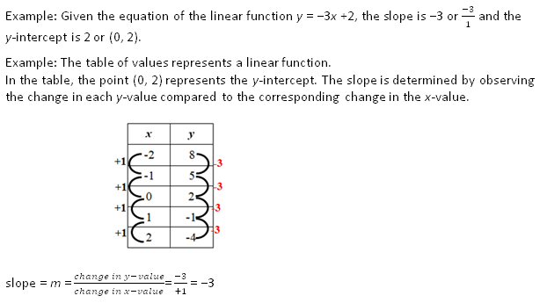
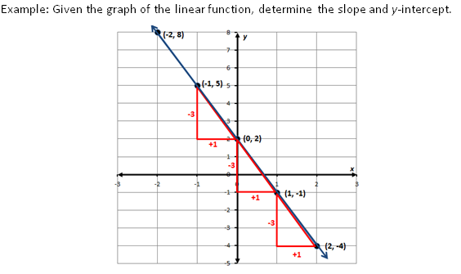
2009 SOL | 2016 SOL
8.14 The student will make connections between any two representations (tables, graphs, words, and rules) of a given relationship. [Included in 8.15a EKS and 8.16e] | 8.16 The student will a) recognize and describe the graph of a linear function with a slope that is positive, negative, or zero; b) identify the slope and y-intercept of a linear function given a table of values, a graph, or an equation in y = mx + b form;
Revisions:
8.16a - Recognize and describe a line with a slope that is positive/negative/zero
8.16b - Identify slope and y-intercept of a linear function given a table, graph, or an equation in the form y = mx + b
  y-intercept limited to integer values
  Coordinates in the graph will be limited to integers
Notes:
The next 2 slides will address SOL 8.16.
8.16 is vertically aligned with 6.12 and 7.10.
In grade 6, students investigated unit rate in proportional relationships.
In grade 7, students defined slope as a unit rate or rate of change and investigated proportional and additive relationships.
In 8.16 students continue to look at slope and describe slope as positive, negative or zero.
They are now looking at a table, an equation in the form y = mx + b, or a graph and identifying the slope and y-intercept. (See the example on the screen from the US column.)
Notice in the table of values as x increases by 1, y decreases by 3 or -3, the slope ,m, is represented by the change in y over the change in x, -3/1 or -3. The y-intercept is the ordered pair where the x value is 0 and the y value is 2. From this information students should be able to write an equation of the linear function.
In this next example, a graph, students use slope triangles drawn from one given ordered pair to the next to determine the change in y and the change in x. Note the red triangles. The slope is -3 (the change in y) over 1 (the change in x) or -3. The y-intercept is the ordered pair where the line crosses the y-axis or (0,2). In this example the y-intercept is 2.

Slide 36
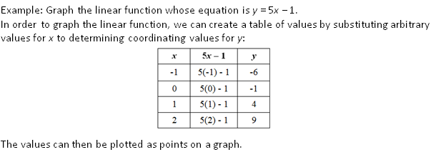
2009 SOL | 2016 SOL
8.14 The student will make connections between any two representations (tables, graphs, words, and rules) of a given relationship. [Included in 8.15a EKS and 8.16e] | 8.16 The student will c) determine the independent and dependent variable, given a practical situation modeled by a linear function; d) graph a linear function given the equation in y = mx + b form; and e) make connections between and among representations of a linear function using verbal descriptions, tables, equations, and graphs.
Revisions:
8.16c - Identify the dependent and independent variable in a practical situation
8.16d - Graph a linear function
    y-intercept limited to integers
8.16e EKS - Write equation of a linear function in the form y = mx + b
  Given the slope and y-intercept
Notes:
In 8.16c, students will identify the independent and dependent variable in a given practical situation.
In bullet d, students are expected to graph a linear function from the equation in the form y = mx + b. See the example on the screen. In one method of graphing, students can create a table of values and then plot the points on a graph.
2009 SOL 8.14 is now 8.16e. Functions can be recognized, described, and examined in a variety of ways, including verbal descriptions, tables, equations and graphs.
Students will benefit from a discussion of how the various representations contribute to their understanding of the function. An important part of the mathematical discussion should involve a comparison of the results from the different representations. Why would one representation of a linear function be more appropriate than another? (A graph is visual and slope can be determined quickly; a table will show a pattern; an equation will show an intercept; a verbal description provides a context.)
Teachers are encouraged to review the US column in the curriculum frameworks for definitions, examples, and explanations regarding the standard and EKS.

Slide 37
2009 SOL | 2016 SOL
8.15 The student will a) solve multistep linear equations in one variable with the variable on one and two sides of the equation; b) solve two-step linear inequalities and graph the results on a number line; and [Moved to 7.13] c) identify properties of operations used to solve an equation. [Incorporated into EKS and US of 8.14, 8.17 and 8.18] | 8.17 The student will solve multistep linear equations in one variable on one or both sides of the equation, including practical problems that require the solution of a multistep linear equation in one variable.
Revisions:
Solve multistep equations with variable on one or both sides including practical problems
  Up to 4 steps
  Coefficients and numeric terms are rational
  May require combining like terms
  Apply properties of real numbers and properties of equality to solve
Write verbal expressions and sentences as algebraic expressions and equations and vice versa
Notes:
8.15a is now 8.17. Students are expected to solve multistep equations up to four steps with the variable on one or both sides of the equation including practical problems. The coefficients and numeric terms are rational. Students may need to combine like terms.
This standard parallels SOL 8.18 where students solve multistep inequalities with the variable on one or both sides of the inequality including practical problems.
Students are expected to apply the properties of real numbers and properties of equality when solving equations. This is a shift from the 2009 standards in that the focus is not to identify a specific property being used, but correctly apply the properties to solve equations. It is appropriate for teachers and students to use the names of the properties when being applied, but this should not be a focus of assessment.
Students are also expected to write verbal expressions and sentences as algebraic expressions and equations and vice versa.

Slide 38
2009 SOL | 2016 SOL
 | 8.18 The student will solve multistep linear inequalities in one variable with the variable on one or both sides of the inequality symbol, including practical problems, and graph the solution on a number line.
New
Revisions:
Solve and graph multistep inequalities with variable on one or both sides of the inequality
  Up to 4 steps
  Includes practical problems
  Coefficients and numeric terms are rational
  Graph solutions on a number line
  Apply properties of real numbers and properties of inequality to solve
  May require combining like terms
  Identify a value that is part of the solution set
Write verbal expressions and sentences as algebraic expressions and inequalities and vice versa
Notes:
In the 2009 SOL8.15b standard, students solved 2-step inequalities and graphed the results on a number line. This was moved to grade 7.
In the 2016 standard 8.18, students are expected to solve multistep inequalities up to four steps with the variable on one or both sides of the inequality including practical problems. The coefficients and numeric terms are rational. Students may need to combine like terms. Students should be able to graph the solution on a number line and identify values that are in the solution.
Students are expected to apply the properties of real numbers and properties of inequalities when solving inequalities. This is a shift from the 2009 standards in that the focus is not to identify a specific property being used, but correctly apply the properties to solve inequalities. It is appropriate for teachers and students to use the names of the properties when being applied, but this should not be a focus of assessment.

Slide 39
2009 SOL | 2016 SOL
8.16 The student will graph a linear equation in two variables. [Incorporated into 8.16d]
Revisions:
This SOL was incorporated into the 2016 SOL 8.16d
Notes:
8.16 “graph a linear equation in two variables” is now “graph a linear function given the equation in y=mx + b form.” Teachers should refer to 2016 SOL 8.16 for revisions regarding this standard.

Slide 40
2009 SOL | 2016 SOL
8.17 The student will identify the domain, range, [Moved to 8.15b] independent variable, or dependent variable [Moved to 8.16c] in a given situation.
Revisions:
Determine the domain and range moved to 8.15b
Determine the independent and dependent variable moved to 8.16c
Notes:
SOL 8.17 was incorporated into 2016 SOL 8.15 and 8.16.
In the 2016 SOL 8.15b, students are expected to determine the domain and range of a function represented as a set of ordered pairs, a table, or a graph of discrete points.
In SOL 8.16c, students are expected to determine the independent and dependent variable, given a practical situation modeled by a linear function.
See the US columns in these SOL for definitions, explanations, and examples.

Slide 41
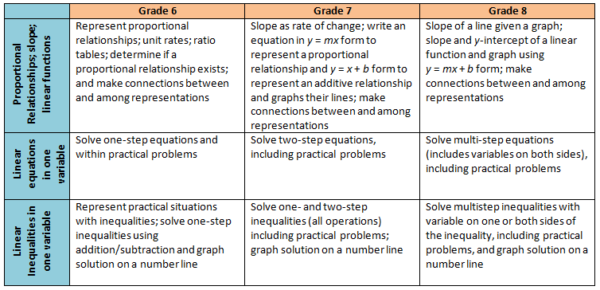
Middle School Revisions Leading to Algebra I
Notes:
The 2016 Mathematics standards include a shift in the development of the concept of linear functions beginning in grade 6. The new standards will recognize the relationship between proportional relationships and linear functions.
In grade 6 students will represent a proportional relationship using tables and identify the unit rate (leading to the concept of slope) in a proportional relationship.
In grade 7 students learn to write the equation of a proportional relationship in y = mx form and contrast that relationship with a simple additive relationship of the form y = x + b and graph each of these types of functions, first as the slope changes in the proportional relationship, and then separately as the y-intercept changes in an additive relationship.
In grade 8, students then put these two transformational approaches together to explore linear functions in y = mx + b form. Students will be expected to build the concepts through graphing and tables and will not be expected to use the slope formula.
In Algebra I, students will then take a deeper dive into slope (including exposure to the slope formula), other forms of linear functions such as point-slope and standard form, and undefined slope. Knowing this progression and the intended development of these concepts in middle school will be helpful for teachers in Algebra I.
The chart on this slide provides a summary of this progression, along with the progression of solving equations and inequalities. The progression for equations and inequalities has very few revisions, thus Algebra I teachers can expect students to have prior knowledge similar to what they are currently exposed to in middle school.

Slide 42
Questions?
Please contact us!
Mathematics@doe.virginia.gov
Notes:
This concludes the presentation on the 2016 Grade 8 Mathematics Standards of Learning revisions. You are encouraged to refer to the curriculum frameworks where additional information can be found.
Should you have any questions, feel free to contact a member of the Mathematics Team at the email shown on the screen.

