Slide 1

2016 Mathematics
Standards of Learning
Grade 7 Mathematics
Overview of Revisions - 2009 to 2016
Referenced documents available at VDOE Mathematics 2016
Notes:
Welcome to the Grade 7 Overview of Revisions to the Mathematics Standards of Learning from 2009 to 2016.
It would be helpful to have a copy of the Grade 7 – Crosswalk (Summary of Revisions) and a copy of the 2016 Grade 7 Curriculum Frameworks to reference during this presentation.
These documents are available electronically on the VDOE Mathematics 2016 webpage under Standards of Learning and Testing.

Slide 2
Purpose
Overview of the 2016 Mathematics Standards of Learning and the Curriculum Framework
Highlight information included in the Essential Knowledge and Skills and the Understanding the Standard sections of the Curriculum Framework
Notes:
Our purpose is to provide an overview of the revisions and to highlight information included in the Essential Knowledge and Skills and Understanding the Standards sections of the curriculum framework.
This presentation is a brief overview of revisions and not a comprehensive list of all revisions. Teachers should reference the curriculum framework if they have questions regarding the 2016 standards.

Slide 3
Agenda
Implementation Timeline
Resources Currently Available
  Crosswalk (Summary of Revisions)
  Standards and Curriculum Frameworks
Comparison of 2009 to 2016 Standards
  Number and Number Sense
  Computation and Estimation
  Measurement and Geometry
  Probability and Statistics
  Patterns, Functions, and Algebra
Notes:
The implementation timeline will be shared followed by a brief overview of the Crosswalk and curriculum frameworks, and lastly a side by side comparison of the 2009 standards to the new 2016 (two thousand sixteen) standards.

Slide 4
Implementation Timeline
2016-2017 School Year – Curriculum Development VDOE staff provides a summary of the revisions to assist school divisions in incorporating the new standards into local written curricula for inclusion in the taught curricula during the 2017-2018 school year.
2017-2018 School Year – Crossover Year 2009 Mathematics Standards of Learning and 2016 Mathematics Standards of Learning are included in the written and taught curricula. Spring 2018 Standards of Learning assessments measure the 2009 Mathematics Standards of Learning and include field test items measuring the 2016 Mathematics Standards of Learning.
2018-2019 School Year – Full-Implementation Year Written and taught curricula reflect the 2016 Mathematics Standards of Learning. Standards of Learning assessments measure the 2016 Mathematics Standards of Learning.
Notes:
During the 2016-2017 school year – school divisions should begin incorporating the new standards into local curricula.
During the 2017-2018 school year – both the 2009 and 2016 standards should be taught. The Spring 2018 assessments will measure the 2009 standards and include field test items measuring the 2016 standards.
Full implementation of the 2016 standards will occur in the 2018-2019 school year.

Slide 5
2016 SOL Revisions –
Improve the vertical progression of mathematics content
Ensure developmental appropriateness of student expectations
Increase support for teachers in mathematics content (including definitions, explanations, examples, and instructional connections)
Clarify expectations for teaching and learning
Improve precision and consistency in mathematical language and format
Ensure proficiency of elementary students in computational skills
Notes:
The revisions focus on improving vertical progression of the content, ensuring developmental appropriateness, increasing support for teachers (including definitions, explanations, examples, and instructional connections), clarifying expectations both for teaching and for student learning, improving precision and consistency in mathematical vocabulary and format, and better ensuring computational fluency at the elementary level.

Slide 6
Changes to the Curriculum Framework
Reduction of columns from 3 to 2
  Understanding the Standard (US) – information that supports mathematical content knowledge
  Essential Knowledge and Skills (EKS) – information that provides expectations for student learning
Indicators of SOL sub-bullet added to each bullet within the Essential Knowledge and Skills
Objectives measured without a calculator on state assessments are indicated with an asterisk *
Notes:
The curriculum framework will have a somewhat different look for K-8. The reduction in the number of columns from 3 to 2 was made in order to provide consistency in format to other disciplines and consistency within the mathematics K-12.
The Understanding the Standard or US column has information that supports mathematical content knowledge and provides background information for teachers.
The Essential Knowledge and Skills or EKS column provides the expectations for learning and assessment.
Corresponding EKS bullets and SOL bullets are indicated with the same letter. An example is provided on the next slide.
SOL with an asterisk indicate objectives that are measured without a calculator on state assessments.

Slide 7
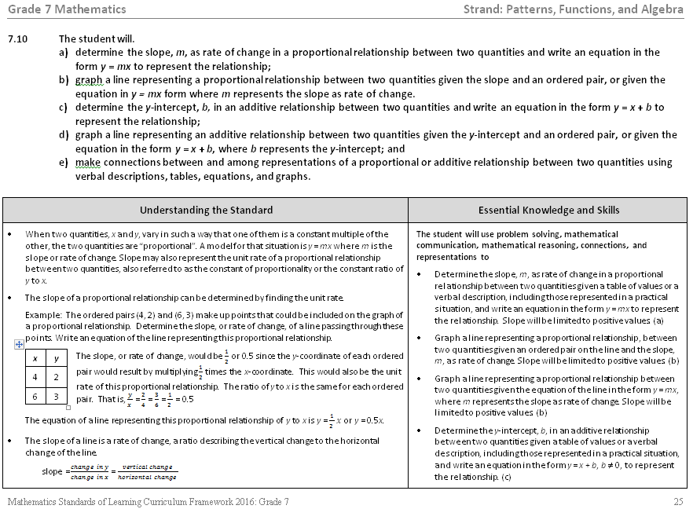
Notes:
This is a page from the math 7 curriculum framework. Notice the two column format mentioned on the previous slide – Understanding the Standard and Essential Knowledge and Skills. Teachers are encouraged to read both the Essential Knowledge and Skills and the Understanding the Standard columns.
It is very important that teachers spend time exploring the 2016 curriculum frameworks. They contain examples of edits made to the Understanding the Standard including clarity in definitions and explanations. And in some standards, examples have also been included.
In addition, where appropriate, corresponding EKS bullets and SOL bullets are indicated with the same letter.

Slide 8
Overview – Math 7
2009 |  | 2016
Strand | # of Standards | # of Standards | Strand
Number and Number Sense | 2 | 1 | Number and Number Sense
Computation and Estimation | 2 | 2 | Computation and Estimation
Measurement | 2 | 4 | Measurement and Geometry
Geometry | 2
Probability and Statistics | 3 | 2 | Probability and Statistics
Patterns, Functions, and Algebra | 5 | 4 | Patterns, Functions, and Algebra
Total | 16 | 13 | Total
Notes:
There was an overall reduction in the number of standards in K-12. This is a result of -- consolidation of related concepts and skills; a reduction of repetition, an improvement of the developmental progression, and/or deletion of content. In grade 7 there was an overall reduction in the number of standards from 16 to 13.
Note that the strands of Measurement and Geometry have been combined and now represent one strand titled “Measurement and Geometry.”

Slide 9
Mathematics Process Goals for Students
“The content of the mathematics standards is intended to support the five process goals for students”
- 2009 and 2016 Mathematics Standards of Learning
Mathematical Understanding
Problem Solving
Connections
Communication
Representations
Reasoning
Notes:
The mathematical process goals continue to play an instrumental role in the teaching and learning of mathematics with understanding.
We encourage educators to review these sections included in the introduction of the 2016 curriculum frameworks.
.

Slide 10
Standards of Learning Curriculum Frameworks
Introduction includes:
  Mathematical Process Goals for Students
  Instructional Technology
  Computational Fluency
  Algebra Readiness
  Equity
New
Notes:
Four additional sections have been included in the introduction to the 2016 curriculum framework –
Instructional Technology,
Computational Fluency,
Algebra Readiness, and
Equity.
The content of each section addresses the impact on students’ learning and instruction. Educators are encouraged to review these sections included in the introduction.

Slide 11
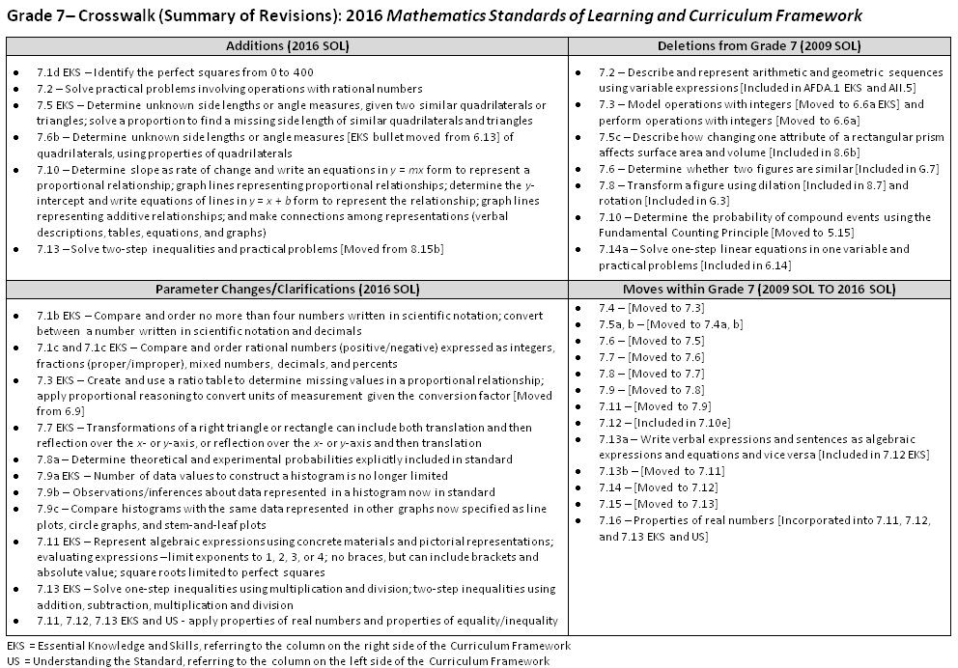
2009
2016
Notes:
This is a snapshot of the Grade 7 Crosswalk (Summary of Revisions) page one. There are four quadrants – additions, deletions, parameter changes or clarifications, and moves within the standards.
The upper left quadrant represents the additions, the standards referenced are the 2016 numbers and include additions to the EKS as well as to the standard. Moves from other grade levels are indicated within brackets.
The upper right quadrant identifies deletions from the 2009 standards and brackets indicate where the content was moved.
The bottom left quadrant indicates parameter changes or clarifications. See underlined examples on the screen.
The bottom right quadrant indicates moves within a grade level which are indicated with the first number being the 2009 SOL and the number in the brackets representing the 2016.

Slide 12
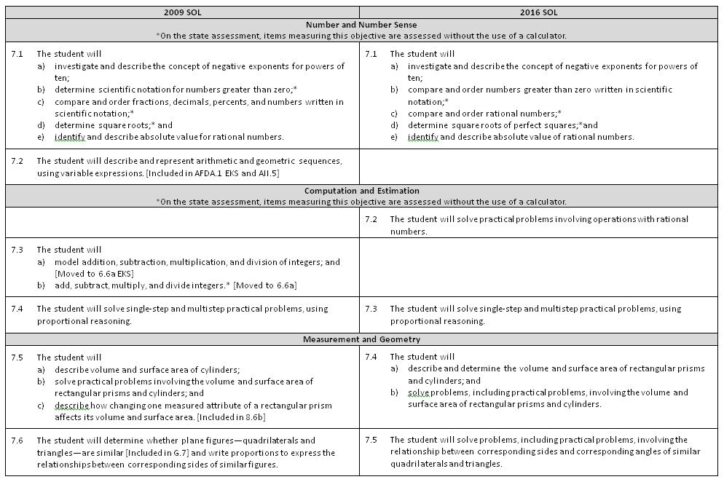
Notes:
On page 2 and the remaining pages of the crosswalk, a side by side comparison of the 2009 and 2016 standards can be found. There was an attempt to keep the standards in numerical order for both columns.
When deleted content was moved or already found in another grade, it is indicated in brackets. See examples in 2009 for 7.2, 7.3, and 7.6.
Empty boxes on the right indicate content that was either deleted or moved.
Empty boxes on the left typically indicate that the 2016 standard is new to that grade level, such as 7.2.

Slide 13
Number and Number Sense
Notes:
We’ll begin by taking a look at the Number and Number Sense strand.

Slide 14
2009 SOL | 2016 SOL
7.1 The student will investigate and describe the concept of negative exponents for powers of ten; determine scientific notation for numbers greater than zero;* compare and order fractions, decimals, percents, and numbers written in scientific notation;* determine square roots;* and identify and describe absolute value for rational numbers. | 7.1 The student will investigate and describe the concept of negative exponents for powers of ten; compare and order numbers greater than zero written in scientific notation;* compare and order rational numbers;* determine square roots of perfect squares;*and identify and describe absolute value of rational numbers.
Revisions:
Compare and order no more than four numbers written in scientific notation; convert between a number written in scientific notation and decimals
Compare and order rational numbers (positive/negative) expressed as integers, fractions (proper/improper), mixed numbers, decimals, and percents
Determine the absolute value of a rational number
*On the state assessment, items measuring this objective are assessed without the use of a calculator.
Notes:
7.1a did not change from 2009 to 2016.
In SOL 7.1b students are expected to convert between scientific notation and decimals and vice versa. Students compare no more than 4 numbers in scientific notation.
In SOL 7.1c students are comparing and ordering no more than 4 rational numbers. Rational numbers may be expressed as integers, fractions (proper and improper), mixed numbers, decimals, and percents. Fractions and mixed numbers may be positive or negative. Decimals may be positive or negative and are limited to the thousandths place.
7.1d and e remained the same.

Slide 15
2009 SOL | 2016 SOL
7.2 The student will describe and represent arithmetic and geometric sequences, using variable expressions. [Included in AFDA.1 EKS and AII.5]
Revisions:
Removed from Grade 7 and included in AFDA.1 EKS and AII.5
Notes:
The content of 7.2 arithmetic and geometric sequences was removed from grade 7 and is included in the high school courses Algebra, Function, and Data Analysis and Algebra II.

Slide 16
Computation and Estimation
Notes:
Now let’s look at the Computation and Estimation strand.

Slide 17
2009 SOL | 2016 SOL
 | 7.2 The student will solve practical problems involving operations with rational numbers.
New
Revisions:
Solve practical problems involving operations with rational numbers
Notes:
The 2016 SOL 7.2 has replaced the old 7.3 operations with integers which was moved to grade 6. In this standard, rational numbers may be expressed as integers, fractions (proper and improper), mixed numbers, decimals and percents. Fractions and decimals may be positive or negative. Decimals are limited to the thousandths place.

Slide 18
2009 SOL | 2016 SOL
7.3 The student will a) model addition, subtraction, multiplication, and division of integers; and [Moved to 6.6a EKS] b) add, subtract, multiply, and divide integers.* [Moved to 6.6a]
Revisions:
Removed from Grade 7 and included in SOL 6.6
Notes:
The 2009 SOL 7.3 was moved to SOL 6.6 in the 2016 standards.

Slide 19
2009 SOL | 2016 SOL
7.4 The student will solve single-step and multistep practical problems, using proportional reasoning. | 7.3 The student will solve single-step and multistep practical problems, using proportional reasoning.
Revisions:
Create and use a ratio table to determine missing values in a proportional relationship
Apply proportional reasoning to convert units of measurement given the conversion factor [Moved from 6.9]
Notes:
The 2009 SOL 7.4 is now the 2016 SOL 7.3. In the EKS, students are expected to create and use a ratio table to determine missing values in a proportional relationship.
Students apply proportional reasoning to convert units of measure within and between U. S. Customary System and the metric system when given the conversion factor. This EKS bullet was moved from 6.9. See the note in red on the slide.
Students should be able to find 10% of a quantity and then use this benchmark to compute 5%, 15% or 20% in practical situations such as tips, tax, and discounts.
For more information regarding this standard, teachers should reference the curriculum framework including the US column. The US column indicates definitions, explanations and examples.

Slide 20
Measurement and Geometry
Notes:
Moving on to the Measurement and Geometry strand. In the 2016 standards, the strands for Measurement and Geometry were combined into one strand.

Slide 21
2009 SOL | 2016 SOL
7.5 The student will a) describe volume and surface area of cylinders; b) solve practical problems involving the volume and surface area of rectangular prisms and cylinders; and c) describe how changing one measured attribute of a rectangular prism affects its volume and surface area. [Included in 8.6b] | 7.4 The student will a) describe and determine the volume and surface area of rectangular prisms and cylinders; and b) solve problems, including practical problems, involving the volume and surface area of rectangular prisms and cylinders.
Revisions:
7.4a – Determine the volume and surface area of a rectangular prism [Removed from Grade 6] and cylinder
7.5c – Removed from Grade 7 and included in SOL 8.6
Notes:
Students no longer find the volume and surface area of a rectangular prism in Grade 6. It is now included in 7.4a.
In 7.4a students will describe and determine the volume and surface area of rectangular prisms and cylinders.
7.4b remains the same as 7.5b
7.5c describing how changing one measured attribute of a rectangular prism affects its volume and surface area is now included in SOL 8.6.

Slide 22
2009 SOL | 2016 SOL
7.6 The student will determine whether plane figures—quadrilaterals and triangles—are similar [Included in G.7] and write proportions to express the relationships between corresponding sides of similar figures. | 7.5 The student will solve problems, including practical problems, involving the relationship between corresponding sides and corresponding angles of similar quadrilaterals and triangles.
Revisions:
Determine unknown side lengths or angle measures, given two similar quadrilaterals or triangles
Solve a proportion to find a missing side length of similar quadrilaterals and triangles
Notes:
In 7.6 determining whether two figures are similar has been moved to Geometry.
In 7.5, given two similar quadrilaterals or triangles, students are expected to: write similarity statements using symbols and solve a proportion to determine a missing side length of similar quadrilaterals or triangles.
Also given angle measures in a quadrilateral or triangle, determine unknown angle measures in a similar quadrilateral or triangle.

Slide 23
2009 SOL | 2016 SOL
7.7 The student will compare and contrast the following quadrilaterals based on properties: parallelogram, rectangle, square, rhombus, and trapezoid. | 7.6 The student will a) compare and contrast quadrilaterals based on their properties; and b) determine unknown side lengths or angle measures of quadrilaterals
Revisions:
Properties of quadrilaterals were removed from grade 6
Determine unknown side lengths or angle measures of quadrilaterals, using properties of quadrilaterals
Notes:
Properties of quadrilaterals were removed from grade 6 and are now included in 7.6.
In this standard, students are expected to compare, contrast, and classify quadrilaterals based on their properties.
Students should also be able to determine unknown sides lengths and angles using the properties of quadrilaterals and given certain information.
Teachers should reference the US column for definitions, properties, explanations, and connections.

Slide 24
2009 SOL | 2016 SOL
7.8 The student, given a polygon in the coordinate plane, will represent transformations (reflections, dilations [Included in 8.7a and G.3], rotations [Included in G.3], and translations) by graphing in the coordinate plane. | 7.7 The student will apply translations and reflections of right triangles or rectangles in the coordinate plane.
Revisions:
Removed from Grade 7 - Transform a figure using dilation [Included in 8.7] and rotation [Included in G.3]
Transformations of a right triangle or rectangle can include both translation and then reflection over the x- or y-axis, or reflection over the x- or y-axis and then translation
Notes:
In the 2016 SOL 7.7, dilation and rotation of a polygon has been removed and is included in Grade 8 and Geometry. See note in red on the screen.
The translations and reflections are limited to right triangles and rectangles in the coordinate plane. Transformations can include combinations of both translation and reflection over the x- or y-axis and vice versa.

Slide 25
Probability and Statistics
Notes:
We will now review the Probability and Statistics strand.

Slide 26
2009 SOL | 2016 SOL
7.9 The student will investigate and describe the difference between the experimental probability and theoretical probability of an event. | 7.8 The student will a) determine the theoretical and experimental probabilities of an event; and b) investigate and describe the difference between the experimental probability and theoretical probability of an event
Revisions:
7.8a -Determine the theoretical and experimental probabilities of an event
Notes:
2009 SOL 7.9 is now 2016 SOL 7.8
There was only one revision to this standard. 7.8a “determine the theoretical and experimental probabilities of an event” was added to address the first two EKS bullets under the standard.

Slide 27
2009 SOL | 2016 SOL
7.10 The student will determine the probability of compound events, using the Fundamental (Basic) Counting Principle. [Moved to 5.15]
Revisions:
Removed from Grade 7 and included in SOL 5.15
Notes:
The Fundamental Counting Principle was moved to grade 5 in SOL 5.15 where students were constructing a sample space and determining the probability of an outcome.

Slide 28
2009 SOL | 2016 SOL
7.11 The student, given data for a practical situation, will a) construct and analyze histograms; and b) compare and contrast histograms with other types of graphs presenting information from the same data set. | 7.9 The student, given data in a practical situation, will a) represent data in a histogram; b) make observations and inferences about data represented in a histogram; and c) compare histograms with the same data represented in stem-and-leaf plots, line plots, and circle graphs.
Revisions:
Number of data values to construct a histogram is no longer limited
Observations/inferences about data represented in a histogram now part of the standard itself
Compare histograms with the same data represented in other graphs now specified as line plots, circle graphs, and stem-and-leaf plots
Notes:
In 2016 SOL 7.9a, the number of data values to construct a histogram is no longer limited. However, teachers should be reasonable about the selection of data values so that the focus is on the analysis of the data. Teachers are encouraged to read the US column for information about histograms.
Students should be able to compare histograms with the same data represented in 3 other graphs – stem and leaf plots, line plots, and circle graphs. Comparing different types of representations of the same data provides students opportunity to learn how different graphs show different things about the same data.

Slide 29
Patterns, Functions, and Algebra
Notes:
We are now moving on to Patterns, Functions and Algebra strand.

Slide 30

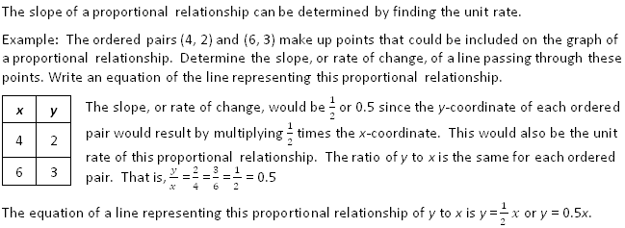
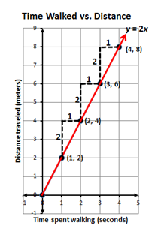
2009 SOL | 2016 SOL
7.12 The student will represent relationships with tables, graphs, rules, and words. [Included in 7.10e] | 7.10 The student will a) determine the slope, m, as a rate of change in a proportional relationship between two quantities and write an equation in the form y = mx to represent the relationship; b) graph a line representing a proportional relationship between two quantities given the slope and an ordered pair, or given the equation in y = mx form, where m represents the slope as rate of change;
New
Revisions:
7.10a - Determine slope as rate of change and write an equations in y = mx form to represent a proportional relationship
7.10b - Graph lines representing proportional relationships given the slope and an ordered pair or the equation y = mx
Examples added in the US
Notes:
7.12 is now 7.10 in the 2016 standards. 7.10 is vertically aligned with 6.12 and 8.16. Students are continuing to look at proportional relationships . Students now have a name for the coefficient of x, the slope. Teachers and students should look at slope as the rate of change or unit rate. Slope is limited to positive values. Students are expected to graph a line given the slope and an ordered pair or given the equation, y = mx. Students should be able to generate a table of values (ratio table) from the given information and then graph the line or use slope triangles (rate of change) to plot points to graph a line.
Teachers should review the US column for clarity, examples, explanations, and connections. Examples on the screen were taken from the curriculum frameworks.
SOL 7.10 c, d, and e are continued on the next slide.

Slide 31
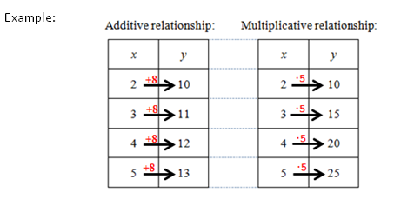
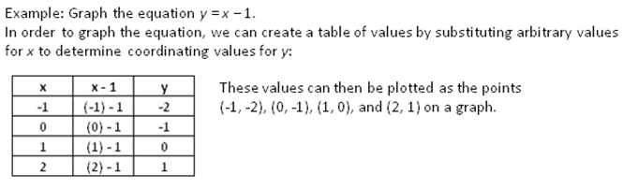
2009 SOL | 2016 SOL
 | c) determine the y-intercept, b, in an additive relationship between two quantities and write an equation in the form y = x + b to represent the relationship; d) graph a line representing an additive relationship between two quantities given the y-intercept and an ordered pair, or given the equation in the form y = x + b, where b represents the y-intercept; and e) make connections between and among representations of a proportional or additive relationship between two quantities using verbal descriptions, tables, equations, and graphs.
New
Revisions:
7.10c - Determine the y-intercept and write equations of lines in y = x + b form to represent the relationship
7.10d - Graph lines representing additive relationships; y-intercept limited to integers and slope is 1
7.10e - Make connections among representations (verbal descriptions, tables, equations, and graphs)
Notes:
In SOL 7.10c students are beginning to look at relationships that are not proportional. Students are expected to recognize and determine if a relationship between 2 quantities is an additive relationship. Students will determine the y-intercept and write an equation in the form y = x + b. See example on the screen from the curriculum framework.
Students are asked to graph additive relationships given the y-intercept and another ordered pair or given the equation in the form y = x + b where the y-intercept is limited to integers and the slope is 1.
In 7.10e students will make connections between and among the representations of both proportional and additive relationships.
Teachers are encouraged to review the US column in the curriculum frameworks for definitions, examples, and explanations regarding this standard and the EKS bullets.

Slide 32
2009 SOL | 2016 SOL
7.13 The student will a) write verbal expressions as algebraic expressions and sentences as equations and vice versa; and [Included in 7.12 EKS] b) evaluate algebraic expressions for given replacement values of the variables. | 7.11 The student will evaluate algebraic expressions for given replacement values of the variables.
Revisions:
Represent algebraic expressions using concrete materials and pictorial representations;
Evaluating expressions – limit exponents to 1, 2, 3, or 4; no braces, but can include brackets and absolute value; square roots limited to perfect squares
Notes:
7.13a has been moved to the EKS in 7.12. See the note in red on the screen.
SOL 7.13b is now 7.11.
In 7.11, students are expected to use the order of operations and properties of real numbers to simplify the resulting numerical expressions for given replacement values of the variables.
Exponents are limited to 1,2,3, or 4 and bases are limited to positive integers.
Expressions may include brackets, and absolute value and square roots (which are limited to perfect squares).

Slide 33
2009 SOL | 2016 SOL
7.14 The student will a) solve one- and two-step linear equations in one variable; and b) solve practical problems requiring the solution of one- and two-step linear equations. [One-step equations included in 6.13] | 7.12 The student will solve two-step linear equations in one variable, including practical problems that require the solution of a two-step linear equation in one variable.
Revisions:
One-step equations are included in 6.13
Coefficients and numeric terms will be rational
Apply properties of real numbers and properties of equality
EKS – Write verbal expressions and sentences as algebraic expressions and equations and vice versa [Moved from 7.13a]
Notes:
7.14 is now 7.12 in the 2016 standards.
Students are expected to represent and solve two-step equations in one variable and to solve practical problems that require the solution to a two-step equation.
Coefficients and numeric terms will be rational numbers.
Students are expected to apply the properties of real numbers when solving equations. This is a shift from the 2009 standards in that the focus is not to identify a specific property being used, but correctly apply the properties to solve equations. It is appropriate for teachers and students to use the names of the properties when being applied, but this should not be a focus of the assessment.
Students are expected to write verbal expressions and sentences as algebraic expressions and equations and vice versa. This was removed from 7.13a to the EKS in 7.12. See note in red on the screen.

Slide 34
2009 SOL | 2016 SOL
7.15 The student will a) solve one-step inequalities in one variable; and b) graph solutions to inequalities on the number line. | 7.13 The student will solve one- and two-step linear inequalities in one variable, including practical problems, involving addition, subtraction, multiplication, and division, and graph the solution on a number line.
Revisions:
Solve two-step inequalities and practical problems [Moved from 8.15b]
Solve one-step and two-step inequalities involving addition, subtraction, multiplication and division including practical problems
Coefficients and numeric terms will be rational
EKS – Write verbal expressions and sentences as algebraic expressions and inequalities and vice versa
EKS – Identify a numerical value that is part of the solution set of a given inequality
Apply properties of real numbers and properties of equality/inequality
Notes:
In grade 6 SOL 6.14, students solve one-step inequalities involving addition and subtraction when the numeric terms are limited to integers.
So in grade 7 SOL 7.13 students are expected to solve 1- and 2-step inequalities including practical problems when coefficients and numeric terms are rational.
Students are expected to identify a value that is part of the solution set of the inequality.
Writing verbal expressions and sentences as algebraic expressions and inequalities and vice versa was added to 7.13 SOL as an EKS bullet.
Note: Students are expected to apply the properties of real numbers and properties of inequality when solving inequalities. This is a shift from the 2009 standards in that the focus is not to identify a specific property being used, but correctly apply the properties to simplify expressions and solve equations and inequalities. It is appropriate for teachers and students to use the names of the properties when being applied, but this should not be a focus of assessment.

Slide 35
2009 SOL | 2016 SOL
7.16 The student will apply the following properties of operations with real numbers: a) the commutative and associative properties for addition and multiplication; b) the distributive property; c) the additive and multiplicative identity properties; d) the additive and multiplicative inverse properties; and e) the multiplicative property of zero. [Included in EKS and US for 7.11, 7.12, and 7.13]
Revisions:
Moved to 7.11, 7.12 and 7.13 Understanding the Standard
The focus is not to identify a specific property being used, but correctly apply the properties.
Notes:
7.16 was included in the new 7.11, 7.12 and 7.13 SOL.
As stated previously in this presentation - Students are expected to apply the properties of real numbers when simplifying expressions and solving equations and inequalities. This is a shift from the 2009 standards in that the focus is not to identify a specific property being used, but correctly apply the properties to simplify expressions and solve equations and inequalities. It is appropriate for teachers and students to use the names of the properties when being applied, but this should not be a focus of assessment.

Slide 36
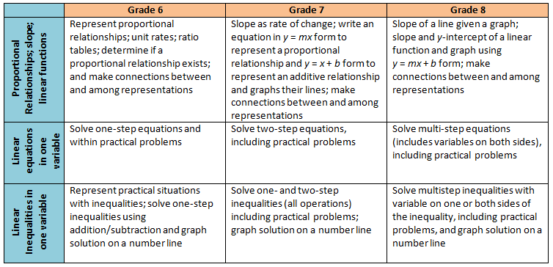
Middle School Revisions Leading to Algebra I
Notes:
The 2016 Mathematics standards include a shift in the development of the concept of linear functions beginning in grade 6. The new standards will recognize the relationship between proportional relationships and linear functions.
In grade 6 students will represent a proportional relationship using tables and identify the unit rate (leading to the concept of slope) in a proportional relationship.
In grade 7 students learn to write the equation of a proportional relationship in y = mx form and contrast that relationship with a simple additive relationship of the form y = x + b and graph each of these types of functions, first as the slope changes in the proportional relationship, and then separately as the y-intercept changes in an additive relationship.
In grade 8, students then put these two transformational approaches together to explore linear functions in y = mx + b form. Students will be expected to build the concepts through graphing and tables and will not be expected to use the slope formula.
In Algebra I, students will then take a deeper dive into slope (including exposure to the slope formula), other forms of linear functions such as point-slope and standard form, and undefined slope. Knowing this progression and the intended development of these concepts in middle school will be helpful for teachers in Algebra I.
The chart on this slide provides a summary of this progression, along with the progression of solving equations and inequalities. The progression for equations and inequalities has very few revisions, thus Algebra I teachers can expect students to have prior knowledge similar to what they are currently exposed to in middle school.

Slide 37
Questions?
Please contact us!
Mathematics@doe.virginia.gov
Notes:
This concludes the presentation on the 2016 Grade 7 Mathematics Standards of Learning revisions. You are encouraged to refer to the curriculum frameworks where additional information can be found.
Should you have any questions, feel free to contact a member of the Mathematics Team at the email address shown on the screen.

