Slide 1

2016 Mathematics
Standards of Learning
Grade 6 Mathematics
Overview of Revisions - 2009 to 2016
Referenced documents available at VDOE Mathematics 2016
Notes:
Welcome to the Grade 6 Overview of Revisions to the Mathematics Standards of Learning from 2009 to 2016.
It would be helpful to have a copy of the Grade 6 – Crosswalk (Summary of Revisions) and a copy of the 2016 Grade 6 Curriculum Frameworks to reference during this presentation.
These documents are available electronically on the VDOE Mathematics 2016 webpage under Standards of Learning and Testing.

Slide 2
Purpose
Overview of the 2016 Mathematics Standards of Learning and the Curriculum Framework
Highlight information included in the Essential Knowledge and Skills and the Understanding the Standard sections of the Curriculum Framework
Notes:
Our purpose is to provide an overview of the revisions and to highlight information included in the Essential Knowledge and Skills and Understanding the Standards sections of the curriculum framework.
This presentation is a brief overview of revisions and not a comprehensive list of all revisions. Teachers should reference the curriculum framework if they have questions regarding the 2016 standards.

Slide 3
Agenda
Implementation Timeline
Resources Currently Available
  Crosswalk (Summary of Revisions)
  Standards and Curriculum Frameworks
Comparison of 2009 to 2016 Standards
  Number and Number Sense
  Computation and Estimation
  Measurement and Geometry
  Probability and Statistics
  Patterns, Functions, and Algebra
Notes:
The implementation timeline will be shared followed by a brief overview of the Crosswalk and curriculum frameworks, and lastly a side by side comparison of the 2009 standards to the new 2016 (two thousand sixteen) standards.

Slide 4
Implementation Timeline
2016-2017 School Year – Curriculum Development VDOE staff provides a summary of the revisions to assist school divisions in incorporating the new standards into local written curricula for inclusion in the taught curricula during the 2017-2018 school year.
2017-2018 School Year – Crossover Year 2009 Mathematics Standards of Learning and 2016 Mathematics Standards of Learning are included in the written and taught curricula. Spring 2018 Standards of Learning assessments measure the 2009 Mathematics Standards of Learning and include field test items measuring the 2016 Mathematics Standards of Learning.
2018-2019 School Year – Full-Implementation Year Written and taught curricula reflect the 2016 Mathematics Standards of Learning. Standards of Learning assessments measure the 2016 Mathematics Standards of Learning.
Notes:
During the 2016-2017 school year – school divisions should begin incorporating the new standards into local curricula.
During the 2017-2018 school year – both the 2009 and the 2016 standards should be taught. The Spring 2018 assessments will measure the 2009 standards and include field test items measuring the 2016 standards.
Full implementation of the 2016 standards will occur in the 2018-2019 school year.

Slide 5
2016 SOL Revisions –
Improve the vertical progression of mathematics content
Ensure developmental appropriateness of student expectations
Increase support for teachers in mathematics content (including definitions, explanations, examples, and instructional connections)
Clarify expectations for teaching and learning
Improve precision and consistency in mathematical language and format
Ensure proficiency of elementary students in computational skills
Notes:
The revisions focus on improving vertical progression of the content, ensuring developmental appropriateness, increasing support for teachers (including definitions, explanations, examples, and instructional connections), clarifying expectations both for teaching and for student learning, improving precision and consistency in mathematical vocabulary and format, and better ensuring computational fluency at the elementary level.

Slide 6
Changes to the Curriculum Framework
Reduction of columns from 3 to 2
  Understanding the Standard (US) – information that supports mathematical content knowledge
  Essential Knowledge and Skills (EKS) – information that provides expectations for student learning
Indicators of SOL sub-bullet added to each bullet within the Essential Knowledge and Skills
Objectives measured without a calculator on state assessments are indicated with an asterisk *
Notes:
The curriculum framework will have a somewhat different look for K-8. The reduction in the number of columns from 3 to 2 was made in order to provide consistency in format to other disciplines and consistency within the mathematics K-12.
The Understanding the Standard or US column has information that supports mathematical content knowledge and provides background information for teachers.
The Essential Knowledge and Skills or EKS column provides the expectations for learning and assessment.
Corresponding EKS bullets and SOL bullets are indicated with the same letter. An example is provided on the next slide.
SOL with an asterisk indicate objectives that are measured without a calculator on state assessments.

Slide 7
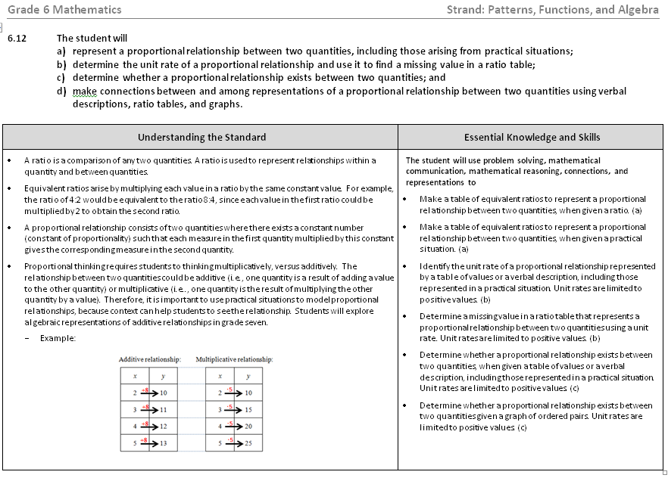
Notes:
This is a page from the grade 6 curriculum framework. Notice the two column format mentioned on the previous slide – Understanding the Standard and Essential Knowledge and Skills.
Teachers are encouraged to read both the Essential Knowledge and Skills and the Understanding the Standard columns.
It is very important that teachers spend time exploring the 2016 curriculum frameworks. They contain examples of edits made to the Understanding the Standard section including clarity in definitions and explanations. In some standards, examples have been added.
In addition, where appropriate, corresponding EKS bullets and SOL bullets are indicated with the same letter.

Slide 8
Overview – Math 6
2009 |  | 2016
Strand | # of Standards | # of Standards | Strand
Number and Number Sense | 5 | 4 | Number and Number Sense
Computation and Estimation | 3 | 2 | Computation and Estimation
Measurement | 2 | 3 | Measurement and Geometry
Geometry | 3
Probability and Statistics | 3 | 2 | Probability and Statistics
Patterns, Functions, and Algebra | 4 | 3 | Patterns, Functions, and Algebra
Total | 20 | 14 | Total
Notes:
There was an overall reduction in the number of standards in K-12. This is a result of -- consolidation of related concepts and skills; a reduction of repetition, an improvement of the developmental progression, and/or deletion of content.
In Grade 6 the number of standards was reduced from 20 to 14.
The revisions occurring in grade 6 will be addressed later in this presentation. Note that the strands of measurement and geometry have been combined and now represent one strand titled “measurement and geometry.”

Slide 9
Mathematics Process Goals for Students
“The content of the mathematics standards is intended to support the five process goals for students”
- 2009 and 2016 Mathematics Standards of Learning
Mathematical Understanding
Problem Solving
Connections
Communication
Representations
Reasoning
Notes:
The mathematical process goals continue to play an instrumental role in the teaching and learning of mathematics with understanding.
We encourage educators to review these sections included in the introduction of the 2016 curriculum frameworks.

Slide 10
Standards of Learning Curriculum Frameworks
Introduction includes:
  Mathematical Process Goals for Students
  Instructional Technology
  Computational Fluency
  Algebra Readiness
  Equity
New
Notes:
Four additional sections have been included in the introduction to the 2016 curriculum framework –
Instructional Technology,
Computational Fluency,
Algebra Readiness, and
Equity.
The content of each section addresses the impact on students’ learning and instruction. Educators are encouraged to review these sections included in the introduction.

Slide 11
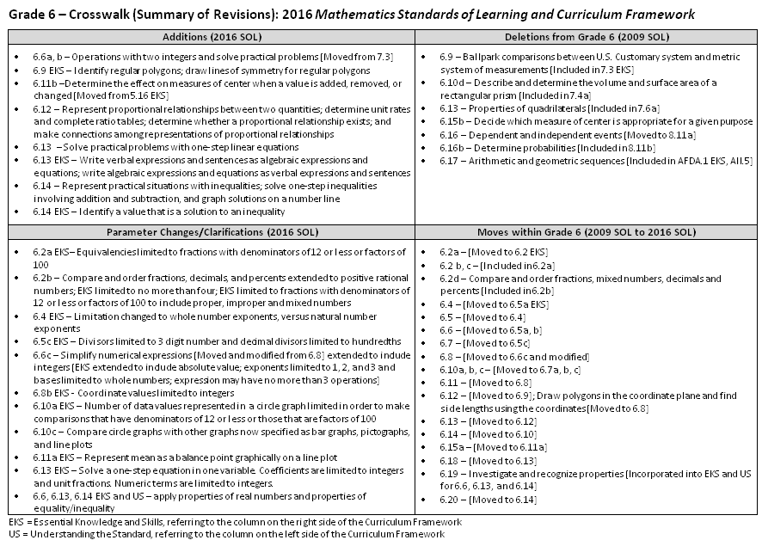
2009
2016
Notes:
This is a snapshot of the Grade 6 Crosswalk (Summary of Revisions) page one. There are four quadrants – additions, deletions, parameter changes or clarifications, and moves within the grade or course.
The upper left quadrant represents the additions, the standards referenced are the 2016 numbers and include additions to the EKS as well as to the standard. Moves from other grade levels are indicated within brackets.
The upper right quadrant identifies deletions from the 2009 standards and brackets indicate where that content was moved.
The bottom left quadrant indicates parameter changes or clarifications. Note the underlined examples on the screen.
The bottom right quadrant indicates moves within a grade level which are indicated with the first number being the 2009 SOL and the number in the brackets representing the 2016 standards.

Slide 12
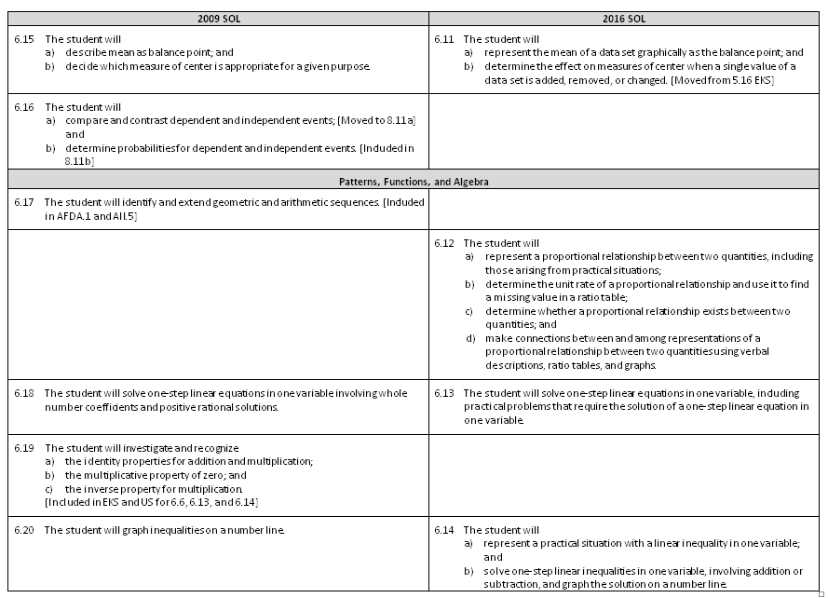
Notes:
On page 2 and the remaining pages of the crosswalk, a side by side comparison of the 2009 and 2016 standards can be found. There was an attempt to keep the standards in numerical order for both columns.
When deleted content was moved or already found in another grade, it is indicated in brackets. See examples in 2009 for 6.16a, 6.17 and 6.19.
Empty boxes on the right indicate content that was either deleted or moved.
Empty boxes on the left typically indicate that the 2016 standard is new to that grade level, such as 6.12.

Slide 13
Number and Number Sense
Notes:
We’ll begin by taking a look at the Number and Number Sense strand.

Slide 14
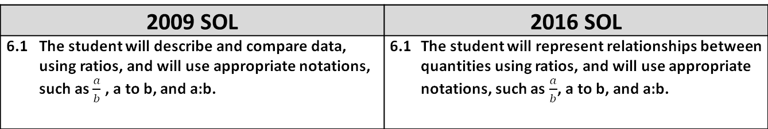
2009 SOL | 2016 SOL
6.1 The student will describe and compare data, using ratios, and will use appropriate notations, such as $\frac{a}{b}$ , a to b, and a:b. | 6.1 The student will represent relationships between quantities using ratios, and will use appropriate notations, such as $\frac{a}{b}$, a to b, and a:b.
Revisions:
Clarifications were added to Understanding the Standard (US)
  A fraction can express more than part-to-whole relationship (from elementary grades). It may express a measurement, an operator (multiplication), a quotient, or a ratio. Examples added.
  Fractions may be used when determining equivalent ratios
  Examples using ratios to represent different comparisons added to the US using a table
Notes:
SOL 6.1 remains the same except “describe and compare data using ratios” was changed to “represent relationships between quantities using ratios”. Revisions were concentrated in the US column.
Added to the US – a fraction can express more than part-to-whole relationship. It may express a measurement, an operator (such as multiplication), a quotient, or a ratio.
Fractions may be used when determining equivalent ratios. For example, the ratio of girls to boys in a class is 3 to 4, this can be interpreted as the number of girls is equal to ¾ of the number of boys. In a class with 16 boys, the number of girls is ¾ of 16 or 12 girls.
Examples using ratios to represent different comparisons is now in a table in the US column.
Again we recommend that you reference the US column to provide clarity, explanations, examples, and connections.

Slide 15
2009 SOL | 2016 SOL
6.2 The student will a) investigate and describe fractions, decimals, and percents as ratios; [Moved to 6.2 EKS] b) identify a given fraction, decimal, or percent from a representation; [Included in 6.2a] c) demonstrate equivalent relationships among fractions, decimals, and percents;* and [Included in 6.2a] compare and order fractions, decimals, and percents.* [Included in 6.2b] | 6.2 The student will a) represent and determine equivalencies among fractions, mixed numbers, decimals, and percents; and * compare and order positive rational numbers.*
Revisions:
6.2a - Equivalencies limited to fractions with denominators of 12 or less or factors of 100
6.2b - Positive rational numbers include fractions, mixed numbers, decimals and percents with fractions limited to denominators of 12 or less or factors of 100
6.2b - Order up to 4 positive rational numbers
*On the state assessment, items measuring this objective are assessed without the use of a calculator.
Notes:
In SOL 6.2, a has moved to the Essential Knowledge and Skills column. Bullets b and c were combined to become the new 6.2a. Bullet d became the new 6.2b.
In the new 6.2a, fractions include both proper and improper fractions. Fraction denominators may be 12 or less or factors of 100.
In the new 6.2b, “positive rational numbers” include fractions (proper and improper), mixed numbers, decimals and percents.
Ordering positive rational numbers has been increased from 3 to no more than 4.
Fractions, decimals and percents may be represented using an area model, a set model, or a measurement model. Examples are shown in the US.
An asterisk after a standard or a standard bullet denotes “on the state assessment, items measuring this objective are assessed without the use of a calculator”.

Slide 16
2009 SOL | 2016 SOL
6.3 The student will a) identify and represent integers; b) order and compare integers; and c) identify and describe absolute value of integers. | 6.3 The student will a) identify and represent integers; b) compare and order integers; and c) identify and describe absolute value of integers.
Revisions:
No revisions
Notes:
SOL 6.3 has no major revisions.
The US clarifies the definition of integer. Integers should be explored by modeling on a number line and using manipulatives and used in practical situations.
Teachers should note that students in grade 6 are not expected to know the names of the subsets of the real number system.

Slide 17
2009 SOL | 2016 SOL
6.4 The student will demonstrate multiple representations of multiplication and division of fractions. [Moved to 6.5 EKS]
Revisions:
See 6.5 EKS, Computation and Estimation strand
Notes:
SOL 6.4 was moved to an EKS bullet in SOL 6.5 in the 2016 standards.

Slide 18
2009 SOL | 2016 SOL
6.5 The student will investigate and describe concepts of positive exponents and perfect squares. | 6.4 The student will recognize and represent patterns with whole number exponents and perfect squares.
Revisions:
Exponents may be whole numbers
Notes:
SOL 6.5 has become SOL 6.4 in the 2016 standards. In the new SOL 6.4, exponents include whole numbers specifically including the number 0.
The US states, any real number other than zero raised to the zero power is 1; except 0 to the 0 power is undefined.

Slide 19
Computation and Estimation
Notes:
Now we’ll take a look at Computation and Estimation.

Slide 20
2009 SOL | 2016 SOL
6.6 The student will a) multiply and divide fractions and mixed numbers;* and [Moved to 6.5a] b) estimate solutions and then solve single-step and multistep practical problems involving addition, subtraction, multiplication, and division of fractions. [Moved to 6.5b] | 6.5 The student will a) multiply and divide fractions and mixed numbers;* b) solve single-step and multistep practical problems involving addition, subtraction, multiplication, and division of fractions and mixed numbers; and c) solve multistep practical problems involving addition, subtraction, multiplication, and division of decimals. [Moved from 6.7]
Revisions:
6.5a & b - Fractions are defined as proper or improper and mixed numbers
6.5c - Divisors limited to 3–digit number and decimal divisors limited to hundredths
6.5c - Solve multistep practical problems with decimals included
*On the state assessment, items measuring this objective are assessed without the use of a calculator.
Notes:
6.6 and 6.7 have become the new 6.5 in the 2016 standards.
The new 6.5a EKS bullet includes the old 6.4 standard where students demonstrate/model multiplication and division of fractions (including proper and improper fractions and mixed numbers) using multiple representations.
6.5b expressly includes fractions and mixed numbers.
6.5c was the old 6.7 Students will solve multistep practical problems with decimals. However, divisors are limited to 3 digits with decimal divisors limited to hundredths.

Slide 21
2009 SOL | 2016 SOL
6.7 The student will solve single-step and multistep practical problems involving addition, subtraction, multiplication, and division of decimals. [Moved to 6.5c]
Revisions:
See 6.5c in the 2016 standards
Notes:
6.7 was moved to 6.5c. See the previous slide.

Slide 22
2009 SOL | 2016 SOL
6.8 The student will evaluate whole number numerical expressions, using the order of operations.* [Combined with 6.6c] | 6.6 The student will a) add, subtract, multiply, and divide integers;* [Moved from 7.3] b) solve practical problems involving operations with integers; and [Moved from 7.3 EKS] c) simplify numerical expressions involving integers.*[Moved and modified from 6.8]
New
Revisions:
6.6a - Moved from 7.3 and 6.8
Emphasis on formulating rules for operations of integers through concrete experiences
6.6b - Operations with two integers and solve practical problems
6.6c - Use order of operations and apply properties of real numbers to simplify expressions involving more than 2 integers including absolute value, exponents limited to 1, 2, and 3 and bases limited to whole numbers
6.6c - Expressions may have no more than 3 operations
*On the state assessment, items measuring this objective are assessed without the use of a calculator.
Notes:
6.6a and b are new to grade 6 in the 2016 standards.
6.6a was moved from 7.3, this bullet addresses operations with 2 integers. The emphasis is on formulating rules for operations of integers through concrete experiences.
6.6b “solving practical problems involving operations with integers” was an EKS bullet under 7.3
6.6c was moved and modified from the old 6.8. The emphasis here is to use the order of operations and apply properties of real numbers to simplify expressions involving more than 2 integers. Teachers may reference the US section for a list of the properties. Exponents are limited to 1,2, or 3 and bases are limited to whole numbers. Expressions may have no more than 3 operations.
Note: In the EKS related to 6.6c, students are expected to apply the properties of real numbers. This is a shift from the 2009 standards. The focus is not to identify a specific property being used, but correctly apply the properties to simplify expressions. It is appropriate for teachers and students to use the names of the properties when being applied, but this should not be a focus of assessment.

Slide 23
Measurement and Geometry
Notes:
We will now take a look at the Measurement and Geometry strand. In the 2016 standards, the strands for Measurement and Geometry were combined into one strand.

Slide 24
2009 SOL | 2016 SOL
6.9 The student will make ballpark comparisons between measurements in the U.S. Customary System of measurement and measurements in the metric system. [Included in 7.3 EKS]
Revisions:
Removed from Grade 6 and included in 7.3 EKS
Notes:
SOL 6.9 was removed from Grade 6 and is now an EKS bullet in SOL 7.3.

Slide 25
2009 SOL | 2016 SOL
6.10 The student will a) define π (pi) as the ratio of the circumference of a circle to its diameter; b) solve practical problems involving circumference and area of a circle, given the diameter or radius; c) solve practical problems involving area and perimeter; and d) describe and determine the volume and surface area of a rectangular prism. [Included in 7.4a] | 6.7 The student will a) derive π (pi); b) solve problems, including practical problems, involving circumference and area of a circle; and c) solve problems, including practical problems, involving area and perimeter of triangles and rectangles.
Revisions:
See 7.4 - Volume and surface area of a rectangular prism
Notes:
SOL 6.10 a, b, and c correspond to 6.7 a, b, and c in the 2016 standards.
6.10d has been removed and is included in 7.4a.
When determining the area or circumference of a circle, teachers and students should be aware that pi may be approximated using 3.14, 22/7 or by using the pi button on the calculator.
Review the US column for definitions and other teacher information.

Slide 26
2009 SOL | 2016 SOL
6.11 The student will a) identify the coordinates of a point in a coordinate plane; and [Included in 6.8b] b) graph ordered pairs in a coordinate plane. | 6.8 The student will a) identify the components of the coordinate plane; and [Moved from 6.11 EKS bullet] b) identify the coordinates of a point and graph ordered pairs in a coordinate plane.
Revisions:
6.8a - Coordinate values limited to integers
6.8b EKS - Draw polygons in the coordinate plane given coordinates and determine the length of a side joining points with the same first or second coordinate [Moved from 6.12]
Notes:
2016 SOL 6.8a was moved from an EKS bullet under 6.11.
6.11a and b is now combined in 6.8b. Identify the coordinates and graph ordered pairs. Coordinate values are limited to integers.
6.8b encompasses an EKS bullet moved from 6.12. Note red bracket in the second bullet under revisions on the screen.
Teachers are encouraged to review the Understanding the Standard section in the curriculum frameworks for definitions, examples, and explanations regarding the standard and EKS.

Slide 27
2009 SOL | 2016 SOL
6.12 The student will determine congruence of segments, angles, and polygons. | 6.9 The student will determine congruence of segments, angles, and polygons.
Revisions:
Identify regular polygons
Draw lines of symmetry to divide regular polygons into two congruent parts
Notes:
2016 SOL 6.9 includes 6.12. Additionally, students are expected to identify regular polygons and draw lines of symmetry.
Students should be familiar with geometric markings in figures to indicate congruence and parallelism.

Slide 28
2009 SOL | 2016 SOL
6.13 The student will describe and identify properties of quadrilaterals. [Included in 7.6]
Revisions:
Removed from Grade 6 and included in 7.6
Notes:
6.13 describing and identifying properties of quadrilaterals was removed from grade 6 and is now included in SOL 7.6

Slide 29
Probability and Statistics
Notes:
We will now review the Probability and Statistics strand.

Slide 30
2009 SOL | 2016 SOL
6.14 The student, given a problem situation, will a) construct circle graphs; b) draw conclusions and make predictions, using circle graphs; and c) compare and contrast graphs that present information from the same data set. | 6.10 The student, given a practical situation, will a) represent data in a circle graph; b) make observations and inferences about data represented in a circle graph; and c) compare circle graphs with the same data represented in bar graphs, pictographs, and line plots.
Revisions:
6.10a - Data values limited to allow for comparisons that have denominators of 12 or less or those that are factors of 100
6.10c - Compare circle graphs with bar graphs, pictographs, and line plots
Notes:
6.14 is now 6.10 in the 2016 standards.
In 6.10a, data values should be limited to allow for comparisons that have denominators of 12 or less or factors of 100. For example, in a class of 20, 7 students choose apples as a favorite fruit, so the comparison is 7 out of 20, 7/20 or 35%. Teachers should be reasonable about the selection of data values. The number of data values can effect how a circle graph is constructed. Students are not expected to construct circle graphs using central angles.
In 6.10c, students are now comparing data represented in circle graphs to the same data represented in 3 other graphs; bar graphs, pictographs, and line plots.
Teachers are encouraged to review the US column in the curriculum frameworks for definitions, examples, and explanations regarding the standard and the EKS.

Slide 31
2009 SOL | 2016 SOL
6.15 The student will a) describe mean as balance point; and b) decide which measure of center is appropriate for a given purpose. | 6.11 The student will a) represent the mean of a data set graphically as the balance point; and b) determine the effect on measures of center when a single value of a data set is added, removed, or changed. [Moved from 5.16 EKS]
Revisions:
6.15b - removed
6.11a - Represent mean as a balance point graphically on a line plot
6.11b - New
New
Notes:
6.15a “describe mean as balance point” is now 6.11a “represent the mean of a data set graphically as the balance point”
6.15b was removed from grade 6.
The new 6.11b was moved from 5.16 EKS – “Determine the effect on measures of center when a single value of a data set is added, removed, or changed.”

Slide 32
2009 SOL | 2016 SOL
6.16 The student will a) compare and contrast dependent and independent events; [Moved to 8.11a] and b) determine probabilities for dependent and independent events. [Included in 8.11b]
Revisions:
Removed from Grade 6 and included in 8.11b
Notes:
SOL 6.16 is now included in SOL 8.11 in the 2016 standards. It has been removed from the grade 6 standards.

Slide 33
Patterns, Functions, and Algebra
Notes:
We will now move on to the Patterns, Functions and Algebra strand.

Slide 34
2009 SOL | 2016 SOL
6.17 The student will identify and extend geometric and arithmetic sequences. [Included in AFDA.1 and AII.5]
Revisions:
Removed from grade 6 and included in AFDA.1 and AII.5
Notes:
6.17 was removed from the grade 6 standards. Geometric and arithmetic sequences are included in the high school courses Algebra, Functions and Data Analysis and Algebra II.

Slide 35
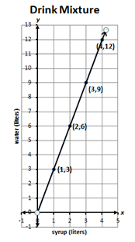
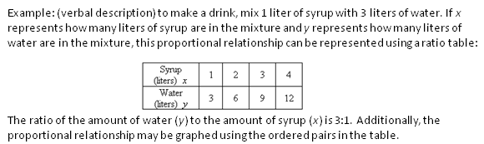
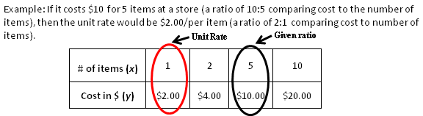
2009 SOL | 2016 SOL
 | 6.12 The student will a) represent a proportional relationship between two quantities, including those arising from practical situations; b) determine the unit rate of a proportional relationship and use it to find a missing value in a ratio table; c) determine whether a proportional relationship exists between two quantities; and d) make connections between and among representations of a proportional relationship between two quantities using verbal descriptions, ratio tables, and graphs.
New
Revisions:
Represent proportional relationships between 2 quantities; determine the unit rate; complete ratio tables; determine if a proportional relationship exits; make connections among different representations
6.12b - Unit rates are limited to positive values
Examples added in the US
Notes:
SOL 6.12 was added to better prepare students for success in Algebra I. Students should be able to make connections between the numeric concepts of ratio and proportion and the algebraic relationships that exist within a set of equivalent ratios.
In 6.12a, students will represent proportional relationships between 2 quantities using a table of equivalent ratios.
In 6.12b students will determine the unit rate of a proportional relationship from a table of values or a verbal description. Unit rates are limited to positive values. See the example on the screen.
6.12c students will determine if a proportional relationship exists between 2 quantities.
And in 6.12d students will make connections between and among representations (such as a verbal description, a ratio table, or a graph) of a proportional relationship between 2 quantities.
Teachers are encouraged to review the US column in the curriculum frameworks for definitions, examples, and explanations regarding this standard and the EKS bullets.

Slide 36
2009 SOL | 2016 SOL
6.18 The student will solve one-step linear equations in one variable involving whole number coefficients and positive rational solutions. | 6.13 The student will solve one-step linear equations in one variable, including practical problems that require the solution of a one-step linear equation in one variable.
Revisions:
Solve practical problems with one-step linear equations
Coefficients are limited to integers and unit fractions
Numeric terms are limited to integers
Apply properties of real numbers and properties of equality
EKS – Write verbal expressions and sentences as algebraic expressions and sentences and vice versa
New
Notes:
SOL 6.18 is now 6.13 in the 2016 standards.
Students are expected to represent and solve one-step equations and to solve practical problems that require the solution to a 1 step equation. Coefficients are limited to integers and unit fractions. Numeric terms are limited to integers.
Students are expected to apply the properties of real numbers when solving equations. This is a shift from the 2009 standards in that the focus is not to identify a specific property being used, but correctly apply the properties to solve equations. It is appropriate for teachers and students to use the names of the properties when being applied, but this should not be a focus of assessment.
New to grade 6 – students are expected to write verbal expressions and sentences as algebraic expressions and sentences and vice versa which is a new EKS bullet for 6.13.

Slide 37
2009 SOL | 2016 SOL
6.19 The student will investigate and recognize a) the identity properties for addition and multiplication; b) the multiplicative property of zero; and c) the inverse property for multiplication. [Included in EKS and US for 6.6, 6.13, and 6.14]
Revisions:
Moved to 6.6, 6.13 and 6.14 Understanding the Standard
The focus is not to identify a specific property being used, but correctly apply the properties.
Notes:
SOL 6.19 was included in the new 6.6, 6.13 and 6.14.
As stated previously in this presentation - Students are expected to apply the properties of real numbers when simplifying expressions and solving equations and inequalities. This is a shift from the 2009 standards in that the focus is not to identify a specific property being used, but correctly apply the properties to simplify expressions and solve equations.

Slide 38
2009 SOL | 2016 SOL
6.20 The student will graph inequalities on a number line. | 6.14 The student will a) represent a practical situation with a linear inequality in one variable; and b) solve one-step linear inequalities in one variable, involving addition or subtraction, and graph the solution on a number line.
Revisions:
6.14b - Apply properties of real numbers and properties of equality/inequality
6.14b - Solve one-step linear inequalities in one variable involving addition and subtraction
6.14b - Numeric terms are limited to integers
6.14a, b - Identify a numerical value that is a part of the solution set of a given inequality
Notes:
6.20 is now 6.14
In SOL 6.14b students are expected to solve one-step linear inequalities in one variable, involving addition and subtraction where the numeric terms are limited to integers.
In grade 7, students will solve one- and two-step inequalities including practical problems where coefficients and numeric terms are rational.
Students are expected to identify a value that is part of the solution set of the inequality.
Note: Students are expected to apply the properties of real numbers and properties of inequality when solving inequalities. This is a shift from the 2009 standards in that the focus is not to identify a specific property being used, but correctly apply the properties to simplify expressions and solve equations and inequalities.

Slide 39
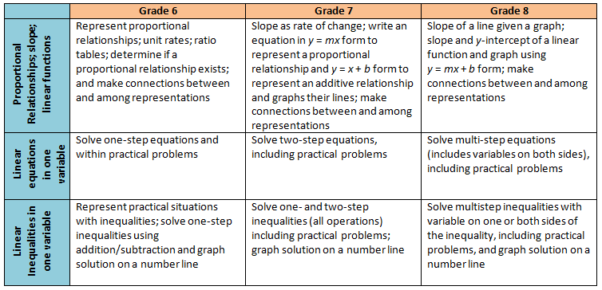
Middle School Revisions Leading to Algebra I
Notes:
The 2016 Mathematics standards include a shift in the development of the concept of linear functions beginning in grade 6. The new standards will recognize the relationship between proportional relationships and linear functions.
In grade 6 students will represent a proportional relationship using tables and identify the unit rate (leading to the concept of slope) in a proportional relationship.
In grade 7 students learn to write the equation of a proportional relationship in y = mx form and contrast that relationship with a simple additive relationship of the form y = x + b and graph each of these types of functions, first as the slope changes in the proportional relationship, and then separately as the y-intercept changes in an additive relationship.
In grade 8, students then put these two transformational approaches together to explore linear functions in y = mx + b form. Students will be expected to build the concepts through graphing and tables and will not be expected to use the slope formula.
In Algebra I, students will then take a deeper dive into slope (including exposure to the slope formula), other forms of linear functions such as point-slope and standard form, and undefined slope. Knowing this progression and the intended development of these concepts in middle school will be helpful for teachers in Algebra I.
The chart on this slide provides a summary of this progression, along with the progression of solving equations and inequalities. The progression for equations and inequalities has very few revisions, thus Algebra I teachers can expect students to have prior knowledge similar to what they are currently exposed to in middle school.

Slide 40
Questions?
Please contact us!
Mathematics@doe.virginia.gov
Notes:
This concludes the presentation on the 2016 Grade 6 Mathematics Standards of Learning. You are encouraged to refer to the curriculum framework where additional information can be found.
Should you have any questions, feel free to contact the Mathematics Team at the email address shown on the screen.

