Slide 1
2016 Mathematics Standards of Learning
Grade 5
Overview of Revisions - 2009 to 2016
Referenced documents available at VDOE Mathematics 2016
Notes:
Welcome to the Grade 5 overview of revisions to the Mathematics Standards of Learning from 2009 to 2016.
It would be very helpful to have a copy of the Grade 5 – Crosswalk (Summary of Revisions) and a copy of the 2016 Grade 5 Curriculum Framework to reference during this presentation.

Slide 2
Purpose
Overview of the 2016 Mathematics Standards of Learning and the Curriculum Framework
Highlight information included in the Essential Knowledge and Skills and the Understanding the Standard sections of the Curriculum Framework
Notes:
The purpose of this presentation is to provide an overview of the revisions and to highlight information included in the Essential Knowledge and Skills and Understanding the Standards sections of the Curriculum Framework. This presentation serves as a brief overview and is not a comprehensive list of all revisions. The Curriculum Framework should be referenced for additional information regarding the 2016 standards.

Slide 3
Agenda
Implementation Timeline
Resources Currently Available
Crosswalk (Summary of Revisions)
Standards and Curriculum Frameworks
Comparison of 2009 to 2016 Standards
Number and Number Sense
Computation and Estimation
Measurement and Geometry
Probability and Statistics
Patterns, Functions, and Algebra
Notes:
The implementation timeline will be shared followed by a brief overview of the Crosswalk and Curriculum Frameworks, and lastly a side by side comparison, by strand, of the 2009 standards to the new 2016 (two thousand sixteen) standards.

Slide 4
Implementation Timeline
2016-2017 School Year – Curriculum Development VDOE staff provides a summary of the revisions to assist school divisions in incorporating the new standards into local written curricula for inclusion in the taught curricula during the 2017-2018 school year.
2017-2018 School Year – Crossover Year 2009 Mathematics Standards of Learning and 2016 Mathematics Standards of Learning are included in the written and taught curricula. Spring 2018 Standards of Learning assessments measure the 2009 Mathematics Standards of Learning and include field test items measuring the 2016 Mathematics Standards of Learning.
2018-2019 School Year – Full-Implementation Year Written and taught curricula reflect the 2016 Mathematics Standards of Learning. Standards of Learning assessments measure the 2016 Mathematics Standards of Learning.
Notes:
During the (two thousand sixteen/two thousand seventeen) 2016-2017 school year – school divisions should begin incorporating the new standards into local curricula to be taught during the 2017-2018 school year.
During the Crossover Year both the 2009 and 2016 standards should be taught. During the Spring 2018 assessments will measure the 2009 standards and will include field test items measuring the 2016 standards.
Full implementation of the 2016 standards will occur in the 2018-2019 school year.

Slide 5
2016 SOL Revisions –
Improve the vertical progression of mathematics content
Ensure developmental appropriateness of student expectations
Increase support for teachers in mathematics content (including definitions, explanations, examples, and instructional connections)
Clarify expectations for teaching and learning
Improve precision and consistency in mathematical vocabulary and format
Ensure proficiency of elementary students in computational skills
Notes:
The revisions focus on improving vertical progression of the content, ensuring developmental appropriateness, increasing support for teachers (including definitions, explanations, examples, and instructional connections), clarifying expectations both for teacers and for student learning, improving precision and consistency in mathematical vocabulary and format, and better ensuring computational fluency at the elementary level.

Slide 6
Changes to the Curriculum Framework
Reduction of columns from 3 to 2
Understanding the Standard (US) – information that supports mathematics content knowledge
Essential Knowledge and Skills (EKS) – information that provides expectations for student learning
Indicators of SOL sub-bullet added to each bullet within the Essential Knowledge and Skills
Objectives measured without a calculator on state assessments are indicated with an asterisk *
Notes:
The Curriculum Framework will have a somewhat different look for K-8. The reduction in the number of columns from 3 to 2 was made in order to provide consistency in format to other disciplines and consistency within mathematics K-12. The Understanding the Standard column has information that supports mathematical content knowledge and provides background information for teachers. The Essential Knowledge and Skills column provides the expectations for learning and assessment.
Corresponding EKS bullets and SOL bullets are indicated with the same letter. An example is provided on the next slide.
Teachers are encouraged to read both the Essential Knowledge and Skills and the Understanding the Standard columns of the Framework.
SOL with asterisks indicate objectives that are measured without a calculator on state assessments.

Slide 7
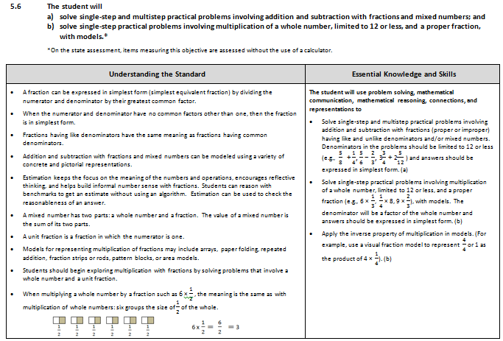
Notes:
This is a page from the grade 5 Curriculum Framework. It is very important that teachers spend time exploring the new Curriculum Frameworks as they contain edits made to the Understanding the Standard section including clarity in definitions and explanations.
In some standards, examples have been included such as the ones shown on the screen.
In addition, where appropriate, corresponding EKS bullets and SOL bullets are indicated with the same letter. It is important to note that during any given lesson, multiple EKS bullets may be represented.

Slide 8
Overview of Revisions in Grade 5
2009 |  | 2016
Strand | # of Standards | # of Standards | Strand
Number and Number Sense | 3 | 3 | Number and Number Sense
Computation and Estimation | 4 | 4 | Computation and Estimation
Measurement | 4 | 7 | Measurement and Geometry
Geometry | 2
Probability and Statistics | 3 | 3 | Probability and Statistics
Patterns, Functions, and Algebra | 3 | 2 | Patterns, Functions, and Algebra
Total | 19 | 19 | Total
Notes:
In Grade 5 the number of standards remains the same as in 2009 although some changes have taken place. These changes and specific revisions will be addressed in greater detail later in this presentation. Note that the strands of measurement and geometry have been combined and now represent one strand titled “measurement and geometry.”

Slide 9
Mathematics Process Goals for Students
“The content of the mathematics standards is intended to support the five process goals for students” - 2009 and 2016 Mathematics Standards of Learning
Mathematical Understanding
Problem Solving
Connections
Communication
Representations
Reasoning
Notes:
In the next several slides, we will take a look at revisions to the Curriculum Framework document.
The mathematical process goals, found listed in the Introduction, continue to play an instrumental role in the teaching and learning of mathematics with understanding.
We encourage educators to review information included in the introduction of the 2016 Curriculum Frameworks.

Slide 10
Standards of Learning Curriculum Frameworks
Introduction includes:
Mathematical Process Goals for Students
Instructional Technology
Computational Fluency
Algebra Readiness
Equity
New
Notes:
Four additional sections have been included in the introduction to the Curriculum Frameworks -- Instructional Technology, Computational Fluency, Algebra Readiness, and Equity.
The content of each section addresses the impact on student learning and instruction. We encourage educators to review these sections of the introduction.

Slide 11
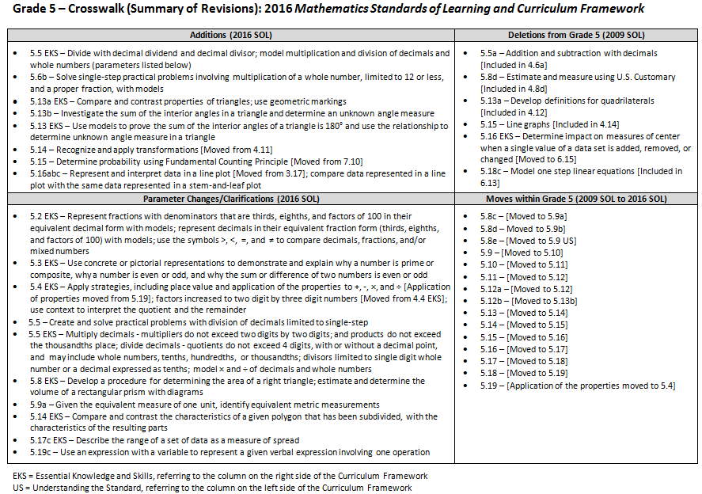
2016
2009
Notes:
This is a snapshot of the Grade 5 Crosswalk and Summary of Revisions page one. Notice there are four quadrants representing the additions, deletions, parameter changes or clarifications, and any moves within the Grade 5 standards.
The upper left quadrant represents the additions, the standards referenced are the 2016 numbers. Moves from other grade levels are indicated within brackets. The upper right quadrant identifies deletions from the 2009 standards and indications of where that content was moved.
The bottom left quadrant indicates parameter changes or clarifications. For example in 5.3 – students will use concrete or pictorial representations to demonstrate and explain why a number is prime or composite, even or odd, and why the sum or difference of two numbers is even or odd. In the bottom right quadrant, moves within a grade level are indicated with the first number being the 2009 SOL number and the number in the brackets representing the 2016 number.

Slide 12
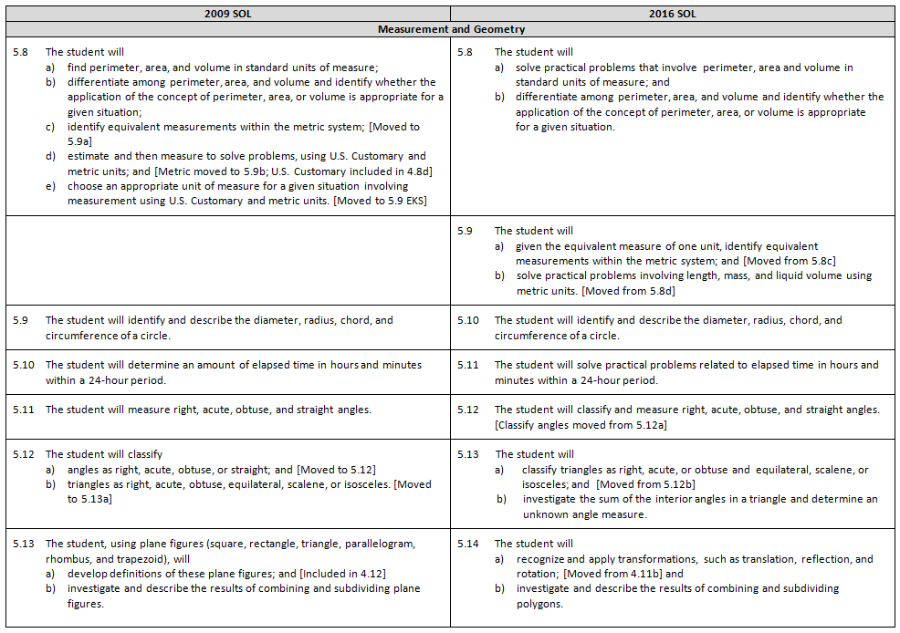
Notes:
On the remaining pages of the crosswalk, a side by side comparison of the 2009 and 2016 standards can be found. An attempt was made to keep the standards in numerical order for both columns.
When deleted content was moved or already found in another grade, it is indicated in brackets.
Empty boxes on the left typically indicate that the 2016 standard is new to that grade level. For example, standard 5.9 is a new standard; however, the content was part of the 2009 5.8 standard and is therefore not new content to grade 5.
Empty boxes on the right indicate that that content has either been deleted or moved.

Slide 13
Number and Number Sense
Notes:
We’ll now dig deeper into the crosswalk and Curriculum Framework by taking a look at the Number and Number Sense strand.

Slide 14
2009 SOL | 2016 SOL
5.1 The student, given a decimal through thousandths, will round to the nearest whole number, tenth, or hundredth. | 5.1 The student, given a decimal through thousandths, will round to the nearest whole number, tenth, or hundredth.
Revisions:
No change
Notes:
No changes were made to SOL 5.1; however, additional information has been added to the Understanding the Standard section of the Curriculum Framework.

Slide 15
2009 SOL | 2016 SOL
5.2 The student will a) recognize and name fractions in their equivalent decimal form and vice versa;* and b) compare and order fractions and decimals in a given set from least to greatest and greatest to least.* | 5.2 The student will a) represent and identify equivalencies among fractions and decimals, with and without models;* and b) compare and order fractions, mixed numbers, and/or decimals, in a given set, from least to greatest and greatest to least.*
Revisions:
5.2a – Represent and identify equivalences among fractions and decimals, with and without models
5.2a EKS – Represent fractions limited to denominators that are thirds, eighths, and factors of 100 in their equivalent decimal form with concrete or pictorial models
5.2a EKS – Represent decimals in their equivalent fraction form limited to thirds, eighths, and factors of 100 with models
5.2b EKS – Use the symbols >, <, =, and ≠ to compare decimals, fractions, and/or mixed numbers
*On the state assessment, items measuring this objective are assessed without the use of a calculator.
Notes:
For SOL 5.2 there have been several parameter and/or clarification changes. In SOL 5.2a, students will represent and identify equivalencies among fractions and decimals, WITH and WITHOUT models. The EKS spells out that students will represent fractions limited to denominators that are thirds, eighths and factors of 100 in their equivalent decimal form with concrete or pictorial models.
Representation of decimals in their equivalent fraction form will be limited to thirds, eighths, and factors of 100 WITH models. NOTE the EKS states that students will continue to identify equivalent relationships between decimals and fractions without models.
For SOL 5.2b when comparing and ordering, it has been made clear that fractions should include proper, improper and mixed numbers. As indicated in the EKS bullet, students will also use symbols to compare decimals, fractions and mixed numbers.
Please refer to the Essential Knowledge and Skills section of the Curriculum Framework for additional information regarding parameter changes.

Slide 16
2009 SOL | 2016 SOL
5.3 The student will a) identify and describe the characteristics of prime and composite numbers; and b) identify and describe the characteristics of even and odd numbers. | 5.3 The student will a) identify and describe the characteristics of prime and composite numbers; and b) identify and describe the characteristics of even and odd numbers.
Revisions:
5.3a EKS – Use concrete or pictorial representations to demonstrate and explain why a number is prime or composite
5.3b EKS – Use concrete or pictorial representations to demonstrate and explain why a number is even or odd
5.3b EKS – Use concrete or pictorial representations to demonstrate and explain why the sum or difference of two numbers is even or odd
Notes:
While SOL 5.3 remains the same, several edits have been made to bullets found in the Essential Knowledge and Skills. New expectations include the use of concrete or pictorial representations to demonstrate and explain why a number is prime or composite; why a number is even or odd; and why the sum or difference of two numbers is even or odd.

Slide 17
Computation and Estimation
Notes:
We will now take a look at the Computation and Estimation Strand.

Slide 18
2009 SOL | 2016 SOL
5.4 The student will create and solve single-step and multistep practical problems involving addition, subtraction, multiplication, and division with and without remainders of whole numbers.* | 5.4 The student will create and solve single-step and multistep practical problems involving addition, subtraction, multiplication, and division of whole numbers.
Revisions:
5.4 EKS – Apply strategies, including place value and application of the properties to +, -, ×, and ÷ [Application of properties moved from 5.19]
5.4 EKS – Factors increased to two digit by three digit numbers [Moved from 4.4 EKS]
5.4 EKS – Use context of practical problems to interpret the quotient and the remainder
Notes:
Parameter changes have been made to the Essential Knowledge and Skills bullets for 5.4.
Students will apply strategies, including the use of place value and the properties of multiplication and/or addition, to solve practical problems that involve addition, subtraction, multiplication, and division. This is a shift from the 2009 standards in that the focus is not to identify a specific property being used, but to correctly apply properties. It is, however, appropriate for teachers and students to use the names of the properties when being applied, but this should not be a focus of assessment. Teachers may reference the Understanding the Standard section of the Curriculum Framework for additional information.
Other parameter changes include: when determining the products of two whole numbers, the factors will be limited to two digits by three digits and will utilize the context of a practical problem to assist in interpreting the quotient and the remainder.
Please refer to the Understanding the Standard section of the Curriculum Framework for several teacher resources: 1) a chart that provides examples of the variety of problem types related to multiplication and division that grade 5 students should have experiences solving; and 2) a chart that provides examples of types of practical problems in which students must interpret the quotient and remainder based upon the context provided.

Slide 19
2009 SOL | 2016 SOL
5.5 The student will a) find the sum, difference, product, and quotient of two numbers expressed as decimals through thousandths (divisors with only one nonzero digit);* [Addition and subtraction of decimals included in 4.6] and b) create and solve single-step and multistep practical problems involving decimals.* | 5.5 The student will a) estimate and determine the product and quotient of two numbers involving decimals;* and b) create and solve single-step and multistep practical problems involving addition, subtraction, and multiplication of decimals, and create and solve single-step practical problems involving division of decimals.
Revisions:
5.5a – Addition and subtraction with decimals removed [Included in 4.6a]
5.5a EKS – Multiply decimals - factors do not exceed two digits and products do not exceed the thousandths place
5.5a EKS – Divide with decimal dividend and decimal divisor; model multiplication and division of decimals and whole numbers ; divide decimals - quotients do not exceed 4 digits, with or without a decimal point, and may include whole numbers, tenths, hundredths, or thousandths; divisors limited to single digit whole number or a decimal expressed as tenths; model × and ÷ of decimals and whole numbers
5.5b – Create and solve practical problems with division of decimals limited to single-step
*On the state assessment, items measuring this objective are assessed without the use of a calculator.
Notes:
For SOL 5.5a addition and subtraction of decimals has been removed from grade 5 as it is included in grade 4. A new EKS bullet states that students will use multiple representations to model multiplication and division of decimals and whole numbers.
When estimating and determining the product of two numbers involving decimals, the factors do not exceed two digits, and the products do not exceed the thousandths place. Examples could include 1.8 (one and eight tenths) multiplied by 5 or 2.3 (two and three tenths) multiplied by 4.5 (four and five tenths).
When estimating and determining the quotient of two numbers involving decimals,
quotients do not exceed 4 digits, with or without a decimal point,
quotients may include whole numbers, tenths, hundredths, or thousandths;
divisors limited to single digit whole number or a decimal expressed as tenths; and
no more than one additional zero will need to be annexed.
Division with decimal examples are included in the Understanding the Standard section of the Curriculum Framework.
In SOL 5.5b, creating and solving practical problems involving division of decimals is limited to single-step.

Slide 20
2009 SOL | 2016 SOL
5.6 The student will solve single-step and multistep practical problems involving addition and subtraction with fractions and mixed numbers and express answers in simplest form. * [Express in simplest form included in EKS] | 5.6 The student will solve single-step and multistep practical problems involving addition and subtraction with fractions and mixed numbers; and solve single-step practical problems involving multiplication of a whole number, limited to 12 or less, and a proper fraction, with models.*
New
Revisions:
5.6b – Solve single-step practical problems involving multiplication of a whole number, limited to 12 or less, and a proper fraction, with models
5.6b EKS – Apply the inverse property of multiplication in models
*On the state assessment, items measuring this objective are assessed without the use of a calculator.
Notes:
SOL 5.6 is now 5.6a.
SOL 5.6b is new content for grade 5 students. Students will solve single-step practical problems involving multiplication of a whole number, limited to 12 or less, and a proper fraction, with models. A new bullet found in the EKS states that students will apply the inverse property of multiplication; for example students will use a visual fraction model to represent four-fourths or one as the product of four and one fourth.
Please refer to the Essential Knowledge and Skills bullets and the Understanding the Standards section of the Curriculum Framework for additional information and examples.

Slide 21
2009 SOL | 2016 SOL
5.7 The student will evaluate whole number numerical expressions, using the order of operations limited to parentheses, addition, subtraction, multiplication, and division.* | 5.7 The student will simplify whole number numerical expressions using the order of operations.*
Revisions:
No significant change
*On the state assessment, items measuring this objective are assessed without the use of a calculator.
Notes:
There is no significant change to SOL 5.7. Note, however, that the limiters were moved to the Essential Knowledge and Skills section of the Framework.

Slide 22
MEASUREMENT AND GEOMETRY
Notes:
We will now take a look at the Measurement and Geometry strand.

Slide 23
2009 SOL | 2016 SOL
5.8 The student will a) find perimeter, area, and volume in standard units of measure; b) differentiate among perimeter, area, and volume and identify whether the application of the concept of perimeter, area, or volume is appropriate for a given situation; c) identify equivalent measurements within the metric system; [Moved to 5.9a] d) estimate and then measure to solve problems, using U.S. Customary and metric units; and [Metric moved to 5.9b; U.S. Customary included in 4.8d] e) choose an appropriate unit of measure for a given situation involving measurement using U.S. Customary and metric units. [Moved to 5.9 EKS] | 5.8 The student will a) solve practical problems that involve perimeter, area and volume in standard units of measure; and b) differentiate among perimeter, area, and volume and identify whether the application of the concept of perimeter, area, or volume is appropriate for a given situation.
Revisions:
5.8a EKS – Develop a procedure for determining the area of a right triangle; estimate and determine the volume of a rectangular prism with diagrams
5.8d – Estimate and measure using U.S. Customary [Included in 4.8d]
Notes:
A number of changes were made to the measurement standards in grade 5.
For SOL 5.8a, it has been clarified that students will solve practical problems related to perimeter, area and volume.
In the 2009 SOL 5.8c identifying equivalent measurements within the metric system has been moved to 5.9a and SOL 5.8d estimating and measuring using U.S. Customary units has been removed as it is already included in grade 4. Note that estimating and measuring to solve problems has been moved to 5.9b.
Additions to the Essential Knowledge and Skills for 5.8a include developing a procedure for determining the area of a right triangle and estimating and determining the volume of a rectangular prism with diagrams, when the length, width, and height are given, using whole number measurements.
Please refer to the Curriculum Framework for additional information and examples related to SOL 5.8a and 5.8b.

Slide 24
2009 SOL | 2016 SOL
 | 5.9 The student will a) given the equivalent measure of one unit, identify equivalent measurements within the metric system; and [Moved from 5.8c] b) solve practical problems involving length, mass, and liquid volume using metric units. [Moved from 5.8d]
Revisions:
5.9a – Given the equivalent measure of one unit, identify equivalent metric measurements
Notes:
As shared on the previous slide, the new SOL 5.9a and b were moved from 5.8c and d. Some changes in the Essential Knowledge and Skills have occurred.
Parameter changes were made to 5.9a as it relates to identifying equivalent measurements within the metric system - students will now be given the equivalent measure of one unit, when determining equivalencies related to the measure of length, mass, and liquid volume between units within the metric system.
See additional parameter information included in the Essential Knowledge and Skills section of the Curriculum Framework and examples provided in the Understanding the Standard section of the Framework.

Slide 25
2009 SOL | 2016 SOL
5.9 The student will identify and describe the diameter, radius, chord, and circumference of a circle. | 5.10 The student will identify and describe the diameter, radius, chord, and circumference of a circle.
Revisions:
5.10 EKS – Investigate (as well as describe) the relationship between diameter and radius; diameter and chord; radius and circumference; and diameter and circumference
Notes:
5.9 is now 5.10.
A minor edit was made to the EKS bullet stating that students will ‘investigate’ as well as describe the relationship between diameter and radius; diameter and chord; radius and circumference; and diameter and circumference.

Slide 26
2009 SOL | 2016 SOL
5.10 The student will determine an amount of elapsed time in hours and minutes within a 24-hour period. | 5.11 The student will solve practical problems related to elapsed time in hours and minutes within a 24-hour period.
Revisions:
No significant change
Notes:
SOL 5.10 is now 5.11.
No change was made to this standard; however, clarification has been provided in the Essential Knowledge and Skills section of the Framework that students will solve practical problems related to elapsed time in which they would determine one of the following: time that has elapsed, the ending time, or the beginning time.

Slide 27
2009 SOL | 2016 SOL
5.11 The student will measure right, acute, obtuse, and straight angles. 5.12 The student will classify a) angles as right, acute, obtuse, or straight; and [Moved to 5.12] b) triangles as right, acute, obtuse, equilateral, scalene, or isosceles. [Moved to 5.13a] | 5.12 The student will classify and measure right, acute, obtuse, and straight angles. [Classify angles moved from 5.12a]
Revisions:
5.11 and 5.12a – Combined
Notes:
SOL 5.11 and SOL 5.12a were combined to form the new SOL 5.12.

Slide 28
2009 SOL | 2016 SOL
5.12 The student will classify a) angles as right, acute, obtuse, or straight; and [Moved to 5.12] b) triangles as right, acute, obtuse, equilateral, scalene, or isosceles. [Moved to 5.13a] | 5.13 The student will a) classify triangles as right, acute, or obtuse and equilateral, scalene, or isosceles; and [Moved from 5.12b] investigate the sum of the interior angles in a triangle and determine an unknown angle measure.
New
Revisions:
5.13a EKS – Compare and contrast properties of triangles; use geometric markings
5.13b – Investigate the sum of the interior angles in a triangle and determine an unknown angle measure
5.13 EKS – Use models to prove the sum of the interior angles of a triangle is 180° and use the relationship to determine unknown angle measure in a triangle
5.13a – Develop definitions for quadrilaterals [Included in 4.12]
Notes:
5.12b has been moved to 5.13a.
New EKS bullets for 5.13a state that students will compare and contrast properties of triangles and identify congruent sides and right angles using geometric markings to denote properties of triangles.
SOL 5.13b is new to grade 5; students will investigate the sum of the interior angles in a triangle and determine an unknown measure.
The related EKS bullet states that students will use models to prove the sum of the interior angles of a triangle is 180° and use the relationship to determine unknown angle measures in a triangle.
Please refer to the Understanding the Standard section of the Curriculum Framework for additional information and examples.

Slide 29
2009 SOL | 2016 SOL
5.13 The student, using plane figures (square, rectangle, triangle, parallelogram, rhombus, and trapezoid), will a) develop definitions of these plane figures; and [Included in 4.12] b) investigate and describe the results of combining and subdividing plane figures. | 5.14 The student will a) recognize and apply transformations, such as translation, reflection, and rotation; [Moved from 4.11b] and investigate and describe the results of combining and subdividing polygons.
Revisions:
5.14 – Recognize and apply transformations [Moved from 4.11]
5.14b EKS – Compare and contrast the characteristics of a given polygon that has been subdivided with the characteristics of the resulting parts
Notes:
SOL 5.13 is now 5.14.
SOL 5.13a – Specifically developing definitions for quadrilaterals is included in SOL 4.12.
The new SOL 5.14a – recognizing and applying transformations was moved from SOL 4.11.
A new EKS bullet related to 5.14b states that students will compare and contrast the characteristics of a given polygon that has been subdivided, with the characteristics of the resulting parts.

Slide 30
PROBABILITY AND STATISTICS
Notes:
We will now take a look at the Probability and Statistics strand.

Slide 31
2009 SOL | 2016 SOL
5.14 The student will make predictions and determine the probability of an outcome by constructing a sample space. | 5.15 The student will determine the probability of an outcome by constructing a sample space or using the Fundamental (Basic) Counting Principle.
Revisions:
5.15 – Determine probability using Fundamental Counting Principle [Moved from 7.10]
5.15 – Line graphs [Included in 4.14]
Notes:
SOL 5.14 is now 5.15.
An understanding of the Fundamental Counting Principle has been added to the expectations for this standard. The new related EKS bullet states, students will determine the number of possible outcomes by using the Fundamental Counting Principle. Please refer to the Understanding the Standard section of the Curriculum Framework for additional information and examples.

Slide 32
2009 SOL | 2016 SOL
5.15 The student, given a problem situation, will collect, organize, and interpret data in a variety of forms, using stem-and-leaf plots and line graphs. | 5.16 The student, given a practical problem, will represent data in line plots and stem-and-leaf plots; interpret data represented in line plots and stem-and-leaf plots; and compare data represented in a line plot with the same data represented in a stem-and-leaf plot.
New
Revisions:
5.16ab – Represent and interpret data in a line plot [Moved from 3.17]
5.16c – Compare data represented in a line plot with the same data represented in a stem-and-leaf plot
5.15 EKS – Determine impact on measures of center when a single value of a data set is added, removed, or changed [Moved to 6.15]
Notes:
SOL 5.15 is now 5.16.
Collecting, organizing and interpreting data using line graphs is included in 4.14 and has therefore been removed from grade 5.
Representing and interpreting data in line plots was moved from grade 3. Line plots will be limited to no more than 30 data points.
In addition, 5.16c is new to grade 5. Students will compare data represented in a line plot with the same data represented in a stem-and-leaf plot. Comparing different types of representations of the same data provides student opportunity to learn how different graphs show different things about the same data.
Note that the former 5.15 EKS bullet which read: “Determine the impact on measures of center when a value of a data set is added, removed, or changed” has been moved to grade 6.

Slide 33
2009 SOL | 2016 SOL
5.16 The student will a) describe mean, median, and mode as measures of center; b) describe mean as fair share; c) find the mean, median, mode, and range of a set of data; and d) describe the range of a set of data as a measure of variation. | 5.17 The student, given a practical context, will describe mean, median, and mode as measures of center; describe mean as fair share; describe the range of a set of data as a measure of spread; and [Reordered] determine the mean, median, mode, and range of a set of data.
Revisions:
5.17c EKS – Describe the range of a set of data as a measure of spread
Notes:
SOL 5.16 is now 5.17.
Several edits were made to the wording and organization of SOL 5.17. Note the change to 5.17c that students will describe the range of a set of data as a measure of spread.

Slide 34
PATTERNS, FUNCTIONS, AND ALGEBRA
Notes:
Let’s take a look at Patterns, Functions and Algebra.

Slide 35
2009 SOL | 2016 SOL
5.17 The student will describe the relationship found in a number pattern and express the relationship. | 5.18 The student will identify, describe, create, express, and extend number patterns found in objects, pictures, numbers, and tables.
Revisions:
5.18 – Identify, create and extend patterns using concrete materials, number lines, tables, or pictures
5.18 New EKS – Solve practical problems that involve identifying, describing, and extending single-operation input and output rules
5.18 New EKS – Identify the rule in a single-operation numerical pattern found in a list or table
Notes:
SOL 5.17 is now 5.18.
Identify, create and extend patterns using concrete materials, number lines, tables, or pictures has been added to this standard and the related EKS bullets.
In addition, two new EKS bullets were added to this standard. Students will now:
solve practical problems that involve identifying, describing, and extending single-operation input and output rules (limited to addition, subtraction and multiplication of whole numbers; addition and subtraction of fractions, with denominators of 12 or less; and addition and subtraction of decimals expressed in tenths or hundredths); and
will identify the rule in a single-operation numerical pattern found in a list or table (limited to addition, subtraction and multiplication of whole numbers; addition and subtraction of fractions, with denominators of 12 or less; and addition and subtraction of decimals expressed in tenths or hundredths).
Additional information, including examples, can be found in the Curriculum Framework.

Slide 36
2009 SOL | 2016 SOL
5.18 The student will a) investigate and describe the concept of variable; b) write an open sentence to represent a given mathematical relationship, using a variable; c) model one-step linear equations in one variable, using addition and subtraction; and [Included in 6.13] d) create a problem situation based on a given open sentence, using a single variable. | 5.19 The student will a) investigate and describe the concept of variable; b) write an equation to represent a given mathematical relationship, using a variable; c) use an expression with a variable to represent a given verbal expression involving one operation; and d) create a problem situation based on a given equation, using a single variable and one operation.
Revisions:
5.18c – Model one step linear equations [Included in 6.13]
5.19c – Use an expression with a variable to represent a given verbal expression involving one operation
Notes:
SOL 5.18a, b and d are now 5.19a, b and d.
Note that the 2009 5.18c standard - modeling one step linear equations has been removed from grade 5. It remains in grade 6.
The 2016 5.19c is new to grade 5 - students will use an expression with a variable to represent a given verbal expression. This will be limited to one operation.
Note that the term ‘open sentence’ has been replaced throughout this standard with ‘equation.’

Slide 37
2009 SOL | 2016 SOL
5.19 The student will investigate and recognize the distributive property of multiplication over addition. [Application of properties moved to 5.4 EKS]
Revisions:
5.19 – Application of properties has been moved to SOL 5.4 EKS.
Notes:
SOL 5.19 The application of properties has been moved to the Essential Knowledge and Skills bullet found in SOL 5.4.

Slide 38
Questions?
Please contact the
VDOE Mathematics Team
Mathematics@doe.virginia.gov
Notes:
This concludes the presentation on the 2016 Standards of Learning for Grade 5. You are encouraged to reference the Curriculum Framework for additional information and examples.
Should you have any questions, feel free to contact a member of the Mathematics Team at the email address shown on the screen.

