Slide 1

2016 Mathematics
Standards of Learning
Grade 4
Overview of Revisions - 2009 to 2016
Referenced documents available at VDOE Mathematics 2016
Notes:
Welcome to the Grade 4 overview of revisions to the Mathematics Standards of Learning from 2009 to 2016.
It would be helpful to have a copy of the Grade 4 – Crosswalk (Summary of Revisions) and a copy of the 2016 Grade 4 Curriculum Framework to reference during this presentation.

Slide 2
Purpose
Overview of the 2016 Mathematics Standards of Learning and the Curriculum Framework
Highlight information included in the Essential Knowledge and Skills and the Understanding the Standard sections of the Curriculum Framework
Notes:
The purpose of this presentation is to provide an overview of the revisions and to highlight information included in the Essential Knowledge and Skills and Understanding the Standards sections of the Curriculum Framework. This presentation serves as a brief overview and is not a comprehensive list of all revisions. The Curriculum Framework should be referenced for additional information regarding the 2016 standards.

Slide 3
Agenda
Implementation Timeline
Resources Currently Available
  Crosswalk (Summary of Revisions)
  Standards and Curriculum Frameworks
Comparison of 2009 to 2016 Standards
  Number and Number Sense
  Computation and Estimation
  Measurement and Geometry
  Probability and Statistics
  Patterns, Functions, and Algebra
Notes:
The implementation timeline will be shared followed by a brief overview of the Crosswalk and Curriculum Frameworks, and lastly a side by side comparison, by strand, of the 2009 standards to the new 2016 (two thousand sixteen) standards.

Slide 4
Implementation Timeline
2016-2017 School Year – Curriculum Development VDOE staff provides a summary of the revisions to assist school divisions in incorporating the new standards into local written curricula for inclusion in the taught curricula during the 2017-2018 school year.
2017-2018 School Year – Crossover Year 2009 Mathematics Standards of Learning and 2016 Mathematics Standards of Learning are included in the written and taught curricula. Spring 2018 Standards of Learning assessments measure the 2009 Mathematics Standards of Learning and include field test items measuring the 2016 Mathematics Standards of Learning.
2018-2019 School Year – Full-Implementation Year Written and taught curricula reflect the 2016 Mathematics Standards of Learning. Standards of Learning assessments measure the 2016 Mathematics Standards of Learning.
Notes:
During the (two thousand sixteen/two thousand seventeen) 2016-2017 school year – school divisions should begin incorporating the new standards into local curricula to be taught during the 2017-2018 school year.
During the Crossover Year -- both the 2009 and 2016 standards should be taught. The Spring 2018 assessments will measure the 2009 standards and include field test items measuring the 2016 standards.
Full implementation of the 2016 standards will occur in the 2018-2019 school year.

Slide 5
2016 SOL Revisions –
Improve the vertical progression of mathematics content
Ensure developmental appropriateness of student expectations
Increase support for teachers in mathematics content (including definitions, explanations, examples, and instructional connections)
Clarify expectations for teaching and learning
Improve precision and consistency in mathematical vocabulary and format
Ensure proficiency of elementary students in computational skills
Notes:
The revisions focus on improving vertical progression of the content, ensuring developmental appropriateness, increasing support for teachers (including definitions, explanations, examples, and instructional connections), clarifying expectations both for teaching and for student learning, improving precision and consistency in mathematical vocabulary and format, and better ensuring computational fluency at the elementary level.

Slide 6
Changes to the Curriculum Framework
Reduction of columns from 3 to 2
  Understanding the Standard (US) – information that supports mathematics content knowledge
  Essential Knowledge and Skills (EKS) – information that provides expectations for student learning
Indicators of SOL sub-bullet added to each bullet within the Essential Knowledge and Skills
Objectives measured without a calculator on state assessments are indicated with an asterisk *
Notes:
The Curriculum Framework will have a somewhat different look for K-8. The reduction in the number of columns from 3 to 2 was made in order to provide consistency in format to other disciplines and consistency within mathematics K-12. The Understanding the Standard column has information that supports mathematical content knowledge and provides background information for teachers. The Essential Knowledge and Skills column provides the expectations for learning and assessment.
Corresponding EKS bullets and SOL bullets are indicated with the same letter. An example is provided on the next slide.
Teachers are encouraged to read both the Essential Knowledge and Skills and the Understanding the Standard columns of the Framework.
SOL with an asterisk indicate objectives that are measured without a calculator on state assessments.

Slide 7
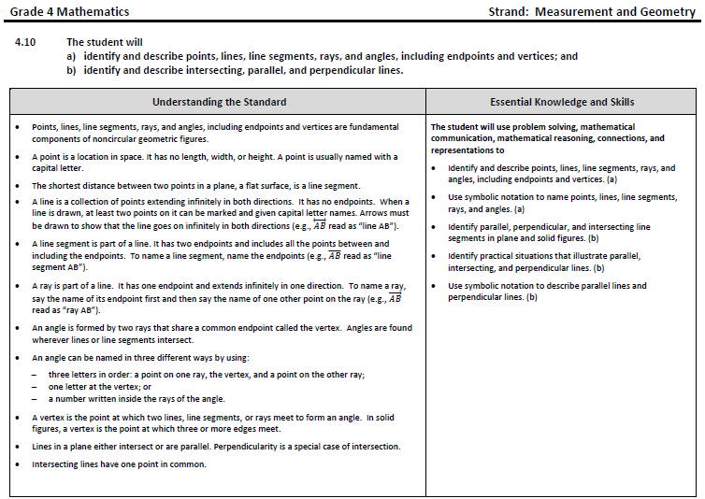
Notes:
This is a page from the grade 4 Curriculum Framework. It is very important that teachers spend time exploring the new Curriculum Frameworks as they contain edits made to the Understanding the Standard section including providing clarity and consistency in definitions and explanations. In some standards, examples have been included such as the ones shown on the screen.
In addition, where appropriate, corresponding EKS bullets and SOL bullets are indicated with the same letter. It is important to note that during any given lesson, multiple EKS bullets may be represented.

Slide 8
Overview of Revisions in Grade 4
2009 |  | 2016
Strand | # of Standards | # of Standards | Strand
Number and Number Sense | 3 | 3 | Number and Number Sense
Computation and Estimation | 2 | 3 | Computation and Estimation
Measurement | 4 | 6 | Measurement and Geometry
Geometry | 3
Probability and Statistics | 2 | 2 | Probability and Statistics
Patterns, Functions, and Algebra | 2 | 2 | Patterns, Functions, and Algebra
Total | 16 | 16 | Total
Notes:
In Grade 4 the number of standards remains the same as in 2009 although some changes have taken place. These changes and specific revisions will be addressed in greater detail later in this presentation. Note that the strands of measurement and geometry have been combined and now represent one strand titled “measurement and geometry.”

Slide 9
Mathematics Process Goals for Students
“The content of the mathematics standards is intended to support the five process goals for students”
- 2009 and 2016 Mathematics Standards of Learning
Mathematical Understanding
Problem Solving
Connections
Communication
Representations
Reasoning
Notes:
In the next several slides, we will take a look at revisions to the Curriculum Framework document.
The mathematical process goals, found listed in the Introduction, continue to play an instrumental role in the teaching and learning of mathematics with understanding.
We encourage educators to review information included in the introduction of the 2016 Curriculum Frameworks.

Slide 10
Standards of Learning Curriculum Frameworks
Introduction includes:
  Mathematical Process Goals for Students
  Instructional Technology
  Computational Fluency
  Algebra Readiness
  Equity
New
Notes:
Four additional sections have been included in the introduction to the Curriculum Frameworks -- Instructional Technology, Computational Fluency, Algebra Readiness, and Equity.
The content of each section addresses the impact on students’ learning and instruction. We encourage educators to review these sections of the introduction.

Slide 11
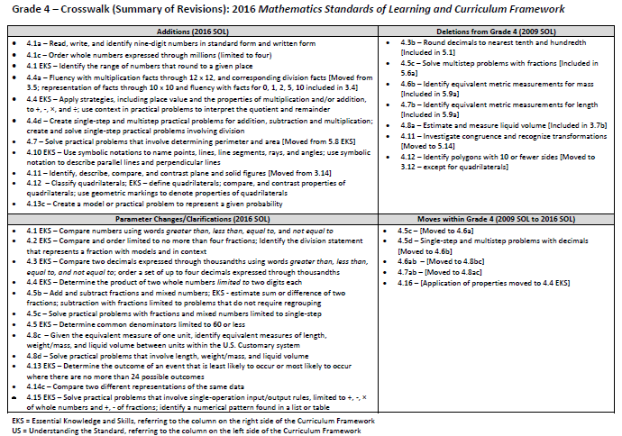
2016
2009
Notes:
This is a snapshot of the Grade 4 Crosswalk and Summary of Revisions page one. Notice there are four quadrants representing the additions, deletions, parameter changes or clarifications, and any moves within the Grade 4 standards.
The upper left quadrant represents the additions, the standards referenced are the 2016 numbers. Moves from other grade levels are indicated within brackets. The upper right quadrant identifies deletions from the 2009 standards and indications of where that content was moved.
The bottom left quadrant indicates parameter changes or clarifications. For example in 4.5c – solving practical problems with fractions and mixed numbers is now limited to single-step problems. In the bottom right quadrant, moves within a grade level are indicated with the first number being the 2009 SOL number and the second number in the brackets representing the 2016 number.

Slide 12
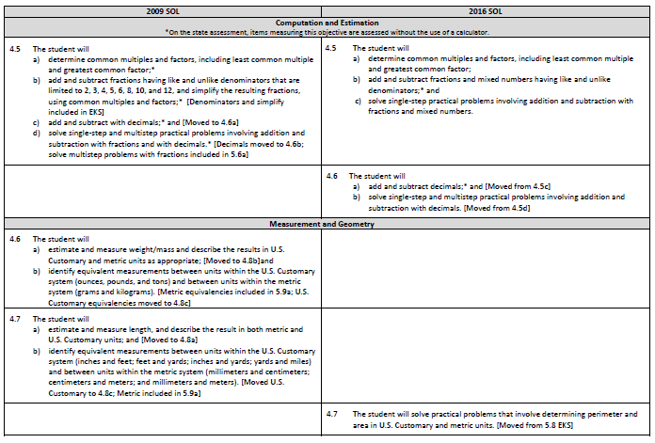
Notes:
On page 2 and the remaining pages of the crosswalk, a side by side comparison of the 2009 and 2016 standards can be found. An attempt was made to keep the standards in numerical order for both columns.
When deleted content was moved or already found in another grade level, it is indicated in brackets.
Empty boxes on the left typically indicate that the 2016 standard is new to that grade level. For example, standard 4.6 is a new standard; however, the content was part of the 2009 4.5 standard and is therefore not new content to grade 4.
Empty boxes on the right indicate that that content has either been deleted or moved. For example see the information in brackets for SOLs 4.6 and 4.7.

Slide 13
Number and Number Sense
Notes:
We’ll now dig deeper into the crosswalk and Curriculum Framework by taking a look at the Number and Number Sense strand.

Slide 14
2009 SOL | 2016 SOL
4.1 The student will a) identify orally and in writing the place value for each digit in a whole number expressed through millions; b) compare two whole numbers expressed through millions, using symbols (>, <, or = ); and [Symbols included in EKS] c) round whole numbers expressed through millions to the nearest thousand, ten thousand, and hundred thousand. | 4.1 The student will a) read, write, and identify the place and value of each digit in a nine-digit whole number; b) compare and order whole numbers expressed through millions; and c) round whole numbers expressed through millions to the nearest thousand, ten thousand, and hundred thousand.
Revisions:
4.1a – Read, write, and identify nine-digit numbers in standard form and written form
4.1b – Order whole numbers expressed through millions (limited to four)
4.1 EKS – Compare numbers using words greater than, less than, equal to, and not equal to
4.1 EKS – Identify the range of numbers that round to a given place
Notes:
In 4.1 clarification has been made that students will read, write and identify the place and value of each digit in a nine-digit whole number (meaning through the millions period).
In 4.1b ordering no more than four whole numbers expressed through millions has been added . Comparing numbers using words has been added to the EKS. The comparing symbols have been removed from the standard but continue to appear in the EKS bullet.
While SOL 4.1c remains the same, a new EKS bullet had been added that states students will identify the range of numbers that round to a given thousand, ten thousand, and hundred thousand.

Slide 15
2009 SOL | 2016 SOL
4.2 The student will a) compare and order fractions and mixed numbers; b) represent equivalent fractions; and c) identify the division statement that represents a fraction. | 4.2 The student will a) compare and order fractions and mixed numbers, with and without models;* b) represent equivalent fractions;* and c) identify the division statement that represents a fraction, with models and in context.
Revisions:
4.2 EKS – Compare and order limited to no more than four fractions; identify the division statement that represents a fraction with models and in context
*On the state assessment, items measuring this objective are assessed without the use of a calculator.
Notes:
In SOL 4.2 parameter changes include limiting the ordering of fractions and mixed numbers to no more than four. When referring to fractions both proper and improper are included as indicated in the EKS.
The EKS bullet which states that students will identify the division statement that represents a fraction now specifies that will be done with models and in context. For example, students will be able to recognize that $\frac{3}{5}$ means the same as 3 divided by 5 or that$\frac{3}{5}$ represents the amount of muffins each of five children will receive when sharing 3 muffins equally.

Slide 16
2009 SOL | 2016 SOL
4.3 The student will a) read, write, represent, and identify decimals expressed through thousandths; b) round decimals to the nearest whole number, tenth, and hundredth; [Rounding to tenth and hundredth included in 5.1] c) compare and order decimals; and d) given a model, write the decimal and fraction equivalents. | 4.3 The student will a) read, write, represent, and identify decimals expressed through thousandths; b) round decimals to the nearest whole number; [Round to tenth and hundredth included in 5.1] c) compare and order decimals; and d) given a model, write the decimal and fraction equivalents.*
Revisions:
4.3b – Round decimals limited to nearest whole number
4.3c EKS – Compare two decimals expressed through thousandths using words greater than, less than, equal to, and not equal to; order a set of up to four decimals expressed through thousandths
*On the state assessment, items measuring this objective are assessed without the use of a calculator.
Notes:
In 4.3b rounding decimals is now limited to rounding to the nearest whole number. Rounding to the nearest tenth and hundredth remains in SOL 5.1.
Clarification has been provided in EKS bullets that students will compare decimals expressed through thousandths using symbols AND words and will order up to up to four decimals, expressed through thousandths.

Slide 17
Computation and Estimation
Notes:
We will now take a look at the Computation and Estimation Strand.

Slide 18
2009 SOL | 2016 SOL
4.4 The student will a) estimate sums, differences, products, and quotients of whole numbers;* b) add, subtract, and multiply whole numbers;* c) divide whole numbers, finding quotients with and without remainders;* and d) solve single-step and multistep addition, subtraction, and multiplication problems with whole numbers.* | 4.4 The student will a) demonstrate fluency with multiplication facts through 12 x 12, and the corresponding division facts;* [Moved from 3.5] b) estimate and determine sums, differences, and products of whole numbers;* c) estimate and determine quotients of whole numbers, with and without remainders;* and create and solve single-step and multistep practical problems involving addition, subtraction, and multiplication, and single-step practical problems involving division with whole numbers.
New
Revisions:
4.4a – Fluency with multiplication facts through 12 x 12, and corresponding division facts [Moved from 3.5]; representation of facts through 10 x 10 and fluency with facts for 0, 1, 2, 5, 10 included in 3.4
4.4b EKS – Determine the product of two whole numbers limited to two digits each
4.4b EKS – Apply strategies, including place value and the properties of multiplication and/or addition, to add, subtract, multiply and divide
4.4d – Create single-step and multistep practical problems for addition, subtraction, and multiplication; create and solve single-step practical problems involving division
4.4d EKS – Use context in practical problems to interpret the quotient and remainder
*On the state assessment, items measuring this objective are assessed without the use of a calculator.
Notes:
The contents of SOL 4.4a – demonstrate fluency with multiplication facts through 12 x 12, and the corresponding division facts is new to grade 4. Demonstrating fluency of facts in grade 3 is now limited to facts for 0, 1, 2, 5 and 10. It is important to note that grade three students will continue to represent and use multiplication facts through 10 x 10 to create and solve practical problems that involve multiplication and division. It is recommended that fourth grade teachers collaborate with their third grade colleagues around instructional strategies focused on developing fluency.
Parameter changes were made to the EKS bullets for 4.4b -- when determining the products of two whole numbers both factors will be limited to two digits or fewer. In addition, students will apply strategies including the use of place value and the properties of multiplication and/or addition, to add, subtract, multiply and divide. This is a shift from the 2009 standards in that the focus is not to identify a specific property being used, but correctly apply the properties. It is, however, appropriate for teachers and students to use the names of the properties when being applied, but this should not be a focus of assessment. Teachers may reference the Understanding the Standard section of the Framework for additional information.
Additions to SOL 4.4d include creating single-step and multistep practical problems for addition, subtraction and multiplication AND creating and solving single-step practical problems involving division. In the EKS for 4.4d , students are expected to utilize the context as a tool for interpreting the quotient and remainder in division problems.
Please refer to the Understanding the Standard section of the Framework for additional teacher resources: 1) a chart that provides examples of the variety of problem types related to multiplication and division that grade 4 students should have experiences solving; and 2) a chart that provides examples of types of practical problems in which students must interpret the quotient and remainder based upon the context provided.

Slide 19
2009 SOL | 2016 SOL
4.5 The student will a) determine common multiples and factors, including least common multiple and greatest common factor;* b) add and subtract fractions having like and unlike denominators that are limited to 2, 3, 4, 5, 6, 8, 10, and 12, and simplify the resulting fractions, using common multiples and factors;* [Denominators and simplify included in EKS] c) add and subtract with decimals;* and [Moved to 4.6a] d) solve single-step and multistep practical problems involving addition and subtraction with fractions and with decimals.* [Decimals moved to 4.6b; solve multistep problems with fractions included in 5.6a] | 4.5 The student will a) determine common multiples and factors, including least common multiple and greatest common factor; b) add and subtract fractions and mixed numbers having like and unlike denominators;* and c) solve single-step practical problems involving addition and subtraction with fractions and mixed numbers. 4.6 The student will add and subtract decimals;* and [Moved from 4.5c] solve single-step and multistep practical problems involving addition and subtraction with decimals. [Moved from 4.5d]
Revisions:
4.5b – Includes proper and improper fractions, and mixed numbers
4.5 EKS – Estimate the sum or difference of two fractions; subtraction with fractions limited to problems that do not require regrouping; determining common denominators for fractions, common denominators should not exceed 60
4.5c – Solve practical problems with fractions and mixed numbers limited to single-step
4.5c (2009) – Add and subtract with decimals [Moved to 4.6a]
4.5d (2009) – Solving practical addition and subtraction problems involving decimals [Moved to 4.6b]
*On the state assessment, items measuring this objective are assessed without the use of a calculator.
Notes:
For SOL 4.5b – Students will continue to add and subtract fractions – clarification however has been made that this includes proper and improper fractions as well as mixed numbers; new EKS bullets and clarifications for 4.5b have also been added – students will estimate the sum or difference of two fractions limited to problems that do not require regrouping. In addition, when determining common denominators for fractions, common denominators should not exceed 60.
In SOL 4.5c, solving practical problems with fractions and mixed numbers is now limited to single-step. Note that solving multistep practical problems involving fractions is already included in SOL 5.6.
SOL 4.5c (2009) adding and subtracting decimals has been moved to 4.6a and SOL 4.5d (2009) solving practical addition and subtraction problems involving decimals has moved to 4.6b.
Please refer to the Curriculum Framework for additional details related to these standards.

Slide 20
MEASUREMENT AND GEOMETRY
Notes:
We will now take a look at the Measurement and Geometry strand.

Slide 21
2009 SOL | 2016 SOL
4.6 The student will a) estimate and measure weight/mass and describe the results in U.S. Customary and metric units as appropriate; [Moved to 4.8b]and b) identify equivalent measurements between units within the U.S. Customary system (ounces, pounds, and tons) and between units within the metric system (grams and kilograms). [Metric equivalencies included in 5.9a; U.S. Customary equivalencies moved to 4.8c]
Revisions:
4.6 – Moved to SOL 4.8
4.6b – Identify equivalent metric measurements for mass [Included in 5.9a]
Notes:
SOL 4.6a has been moved to SOL 4.8b.
In SOL 4.6b identification of equivalent U.S. Customary measurements has been moved to 4.8c while the identification of equivalent metric measurements has been removed from grade 4 as it is already included in SOL 5.9a.
Additional information regarding the new SOL4.8 will be provided later in this presentation.

Slide 22
2009 SOL | 2016 SOL
4.7 The student will a) estimate and measure length, and describe the result in both metric and U.S. Customary units; and [Moved to 4.8a] b) identify equivalent measurements between units within the U.S. Customary system (inches and feet; feet and yards; inches and yards; yards and miles) and between units within the metric system (millimeters and centimeters; centimeters and meters; and millimeters and meters). [Moved U.S. Customary to 4.8c; metric included in 5.9a]
Revisions:
4.7ab – Moved to SOL 4.8
4.7b – Identifying equivalent measurements between units within the metric system removed [Included in 5.9a]
Notes:
SOL 4.7a has been moved to SOL 4.8a.
4.7b - identifying equivalent measurements between units within the metric system has been removed from grade 4. This content remains in grade 5.
Additional information regarding the new SOL4.8 will be provided later in this presentation.

Slide 23
2009 SOL | 2016 SOL
 | 4.7 The student will solve practical problems that involve determining perimeter and area in U.S. Customary and metric units. [Moved from 5.8 EKS]
New
Revisions:
4.7 – Solve practical problems that involve determining perimeter and area [Moved from 5.8 EKS]
Notes:
SOL 4.7 is new content for grade 4: students will solve practical problems that involve determining perimeter and area in U.S. Customary and metric units.

Slide 24
2009 SOL | 2016 SOL
4.8 The student will a) estimate and measure liquid volume and describe the results in U.S. Customary units; and [Included in 3.7b] b) identify equivalent measurements between units within the U.S. Customary system (cups, pints, quarts, and gallons). | 4.8 The student will estimate and measure length and describe the result in U.S. Customary and metric units; [Moved from 4.7a] estimate and measure weight/mass and describe the results in U.S. Customary and metric units [Moved from 4.6a]; given the equivalent measure of one unit, identify equivalent measures of length, weight/mass, and liquid volume between units within the U.S. Customary system; and solve practical problems that involve length, weight/mass, and liquid volume in U.S. Customary units.
New
Revisions:
4.8a – Estimate and measure liquid volume [Included in 3.7b]
4.8c – Given the equivalent measure of one unit, identify equivalent measures of length, weight/mass, and liquid volume between units within the U.S. Customary system
4.8d – Solve practical problems that involve length, weight/mass, and liquid volume
Notes:
The 2009 version of SOL 4.8a – Estimate and measure liquid volume has been removed as it is already included in grade 3.
The 2016 version of 4.8a was moved from 4.7a (2009).
A new parameter for 4.8c has been added - students will now be given the equivalent measure of one unit, when determining equivalencies related to measures of length, weight/mass, and liquid volume between units within the U.S. Customary system. Additional information and examples are provided in the Understanding the Standard section of the Curriculum Framework.
SOL 4.8d is new content for grade 4 - students will solve practical problems that involve length, weight/mass, and liquid volume in U.S. Customary units.

Slide 25
2009 SOL | 2016 SOL
4.9 The student will determine elapsed time in hours and minutes within a 12-hour period. | 4.9 The student will solve practical problems related to elapsed time in hours and minutes within a 12-hour period.
Revisions:
No significant change
Notes:
In 4.9 there are no significant changes; however, clarification was made in the EKS that students would solve practical problems in which they would determine one of the following: time that has elapsed, the ending time, or the beginning time.

Slide 26
2009 SOL | 2016 SOL
4.10 The student will a) identify and describe representations of points, lines, line segments, rays, and angles, including endpoints and vertices; and b) identify representations of lines that illustrate intersection, parallelism, and perpendicularity. | 4.10 The student will a) identify and describe points, lines, line segments, rays, and angles, including endpoints and vertices; and b) identify and describe intersecting, parallel, and perpendicular lines.
Revisions:
4.10 EKS – Use symbolic notations to name points, lines, line segments, rays, and angles
4.10 EKS – Identify parallel, perpendicular, and intersecting line segments in plane and solid figures
4.10 EKS – Use symbolic notation to describe parallel lines and perpendicular lines
Notes:
Three new EKS bullets were added to SOL 4.10 for clarification. Students will now use symbolic notations to name points, lines, line segments, rays, and angles; they will identify parallel, perpendicular, and intersecting line segments in plane and solid figures; and will use symbolic notation to describe parallel lines and perpendicular lines.
Please refer to the Understanding the Standards section of the Framework for additional information and examples.

Slide 27
2009 SOL | 2016 SOL
4.11 The student will a) investigate congruence of plane figures after geometric transformations, such as reflection, translation, and rotation, using mirrors, paper folding, and tracing; and b) recognize the images of figures resulting from geometric transformations, such as translation, reflection, and rotation. [Moved to 5.14]
Revisions:
4.11 Investigate congruence and recognize transformations [Moved to 5.14]
Notes:
SOL 4.11 was moved to grade 5.

Slide 28
2009 SOL | 2016 SOL
 | 4.11 The student will identify, describe, compare, and contrast plane and solid figures according to their characteristics (number of angles, vertices, edges, and the number and shape of faces), using concrete models and pictorial representations. [Moved from 3.14]
New
Revisions:
4.11 – Identify, describe, compare, and contrast plane and solid figures [Moved from 3.14]
Notes:
SOL 4.11 is new to grade four – Students will identify concrete models and pictorial representations of solid figures; describe solid figures according to their characteristics; and compare and contrast solid figures. Additional information can be found in the Curriculum Framework.

Slide 29
2009 SOL | 2016 SOL
4.12 The student will a) define polygon; and b) identify polygons with 10 or fewer sides. [All polygons excepts quadrilaterals moved to 3.12] | 4.12 The student will classify quadrilaterals as a parallelograms, rectangles, squares, rhombi, and/or trapezoids.
Revisions:
4.12ab (2009) – Define polygons and identify polygons with 10 or fewer sides [Moved to 3.12 – except for quadrilaterals]
4.12 (2016) – Classify quadrilaterals; EKS – define quadrilaterals; compare, and contrast properties of quadrilaterals; use geometric markings to denote properties of quadrilaterals
Notes:
SOL 4.12 has been moved to grade 3 (except for the classification of quadrilaterals). Third grade will name a four-sided figure as a quadrilateral whereas grade 4 will delve deeper into classifying quadrilaterals by developing definitions and identifying properties of quadrilaterals; compare, and contrast properties of quadrilaterals; and will use geometric markings to denote properties of quadrilaterals. Additional information and examples can be found in the Curriculum Framework.

Slide 30
PROBABILITY AND STATISTICS
Notes:
We will now take a look at the Probability and Statistics strand.

Slide 31
2009 SOL | 2016 SOL
4.13 The student will a) predict the likelihood of an outcome of a simple event; and b) represent probability as a number between 0 and 1, inclusive. | 4.13 The student will determine the likelihood of an outcome of a simple event; represent probability as a number between 0 and 1, inclusive; and create a model or practical problem to represent a given probability.
New
Revisions:
4.13c – Create a model or practical problem to represent a given probability
Notes:
4.13c is new content for grade 4 students – Students will create a model or practical problem to represent a given probability. Please refer to the Understanding the Standard section of the Curriculum Framework for additional information and examples.

Slide 32
2009 SOL | 2016 SOL
4.14 The student will collect, organize, display, and interpret data from a variety of graphs. | 4.14 The student will collect, organize, and represent data in bar graphs and line graphs; interpret data represented in bar graphs and line graphs; and compare two different representations of the same data (e.g., a set of data displayed on a chart and a bar graph, a chart and a line graph, or a pictograph and a bar graph).
New
Revisions:
4.14c – Compare two different representations of the same data
4.14b EKS – Interpret data by making inferences from line and bar graphs
Notes:
4.14c is new content to grade 4 – Students will compare two different representations of the same data. For example, they will compare a set of data displayed on a chart and a bar graph, a chart and a line graph, or a pictograph and a bar graph. Comparing different types of representations of the same data provides students an opportunity to learn how different graphs show different things about the same data.
There is also a new EKS bullet for 4.14b that states that students will interpret data by making inferences from line and bar graphs.
Additional information and examples have been included in the Understanding the Standard section of the Curriculum Framework.

Slide 33
PATTERNS, FUNCTIONS, AND ALGEBRA
Notes:
Let’s take a look at Patterns, Functions and Algebra.

Slide 34
2009 SOL | 2016 SOL
4.15 The student will recognize, create, and extend numerical and geometric patterns. | 4.15 The student will identify, describe, create, and extend patterns found in objects, pictures, numbers, and tables.
Revisions:
4.15 EKS – Solve practical problems that involve single-operation input/output rules, limited to addition, subtraction, and multiplication of whole numbers and addition and subtraction of fractions
4.15 EKS – Identify the rule in a single-operation numerical pattern found in a list or table limited to addition, subtraction, and multiplication of whole numbers
Notes:
In SOL 4.15 clarification can be found in wording throughout the standard and the EKS bullets. There are two EKS bullets that represent new expectations related to this standard.
Students will solve practical problems that involve identifying, describing, and extending single-operation input and output rules, limited to addition, subtraction, and multiplication of whole numbers and addition and subtraction of fractions with like denominators of 12 or less.
AND
Students will identify the rule in a single-operation numerical pattern found in a list or table, limited to addition, subtraction, and multiplication of whole numbers.
Please refer to the Understanding the Standard section of the Curriculum Framework for additional information and examples.

Slide 35
2009 SOL | 2016 SOL
4.16 The student will a) recognize and demonstrate the meaning of equality in an equation; and b) investigate and describe the associative property for addition and multiplication. [Application of properties moved to 4.4 EKS] | 4.16 The student will recognize and demonstrate the meaning of equality in an equation.
Revisions:
4.16 – Application of properties moved to 4.4 EKS
4.16 EKS – Identify and use the appropriate symbol to distinguish between expressions that are equal and expressions that are not equal
Notes:
4.16b The application of properties has moved to 4.4 EKS.
A new EKS bullet for 4.16 states that students will identify and use the appropriate symbol to distinguish between expressions that are equal and expressions that are not equal, using addition, subtraction, multiplication, and division.

Slide 36
Questions?
Please contact the
VDOE Mathematics Team
Mathematics@doe.virginia.gov
Notes:
This concludes the presentation on the 2016 Standards of Learning for Grade 4. You are encouraged to reference the Curriculum Framework for additional information.
Should you have any questions, feel free to contact a member of the Mathematics Team at the email address shown on the screen.

