Slide 1
2016 Mathematics Standards of Learning
Grade 3
Overview of Revisions - 2009 to 2016
Referenced documents available at VDOE Mathematics 2016
Notes:
Welcome to the Grade 3 overview of revisions to the Mathematics Standards of Learning from 2009 to 2016.
It would be helpful to have a copy of the Grade 3 – Crosswalk (Summary of Revisions) and a copy of the 2016 Grade 3 Curriculum Framework to reference during this presentation.

Slide 2
Purpose
Overview of the 2016 Mathematics Standards of Learning and the Curriculum Framework
Highlight information included in the Essential Knowledge and Skills and the Understanding the Standard sections of the Curriculum Framework
Notes:
The purpose of this presentation is to provide an overview of the revisions and to highlight information included in the Essential Knowledge and Skills and the Understanding the Standards sections of the Curriculum Framework. This presentation serves as a brief overview and is not a comprehensive list of all revisions. The Curriculum Framework should be referenced for additional information regarding the 2016 standards.

Slide 3
Agenda
Implementation Timeline
Resources Currently Available
Crosswalk (Summary of Revisions)
Standards and Curriculum Frameworks
Comparison of 2009 to 2016 Standards
Number and Number Sense
Computation and Estimation
Measurement and Geometry
Probability and Statistics
Patterns, Functions, and Algebra
Notes:
The implementation timeline will be shared followed by a brief overview of the Crosswalk and Curriculum Frameworks, and lastly a side by side comparison, by strand, of the 2009 standards to the new 2016 (two thousand sixteen) standards.

Slide 4
Implementation Timeline
2016-2017 School Year – Curriculum Development VDOE staff provides a summary of the revisions to assist school divisions in incorporating the new standards into local written curricula for inclusion in the taught curricula during the 2017-2018 school year.
2017-2018 School Year – Crossover Year 2009 Mathematics Standards of Learning and 2016 Mathematics Standards of Learning are included in the written and taught curricula. Spring 2018 Standards of Learning assessments measure the 2009 Mathematics Standards of Learning and include field test items measuring the 2016 Mathematics Standards of Learning.
2018-2019 School Year – Full-Implementation Year Written and taught curricula reflect the 2016 Mathematics Standards of Learning. Standards of Learning assessments measure the 2016 Mathematics Standards of Learning.
Notes:
During the 2016-2017 (two thousand sixteen/two thousand seventeen) school year – school divisions should begin incorporating the new standards into local curricula to be taught during the 2017-2018 school year.
During the Crossover Year -- both the 2009 and 2016 standards should be taught. During the Spring 2018, assessments will measure the 2009 standards and will include field test items measuring the 2016 standards.
Full implementation of the 2016 standards will occur in the 2018-2019 school year.

Slide 5
2016 SOL Revisions –
Improve the vertical progression of mathematics content
Ensure developmental appropriateness of student expectations
Increase support for teachers in mathematics content (including definitions, explanations, examples, and instructional connections)
Clarify expectations for teaching and learning
Improve precision and consistency in mathematical vocabulary and format
Ensure proficiency of elementary students in computational skills
Notes:
The revisions focus on improving vertical progression of the content, ensuring developmental appropriateness, increasing support for teachers (including definitions, explanations, examples, and instructional connections), clarifying expectations both for teaching and for student learning, improving precision and consistency in mathematical vocabulary and format, and better ensuring computational fluency at the elementary level.

Slide 6
Changes to the Curriculum Framework
Reduction of columns from 3 to 2
Understanding the Standard (US) – information that supports mathematics content knowledge
Essential Knowledge and Skills (EKS) – information that provides expectations for student learning
Indicators of SOL sub-bullet added to each bullet within the Essential Knowledge and Skills
Notes:
The Curriculum Framework will have a somewhat different look for K-8. The reduction in the number of columns from 3 to 2 was made in order to provide consistency in format to other disciplines and consistency within mathematics K-12. The Understanding the Standard column has information that supports mathematical content knowledge and provides background information for teachers. The Essential Knowledge and Skills column provides the expectations for learning and assessment.
Corresponding EKS bullets and SOL bullets are indicated with the same letter. An example is provided on the next slide.
Teachers are encouraged to read both the Essential Knowledge and Skills section and the Understanding the Standard section.

Slide 7
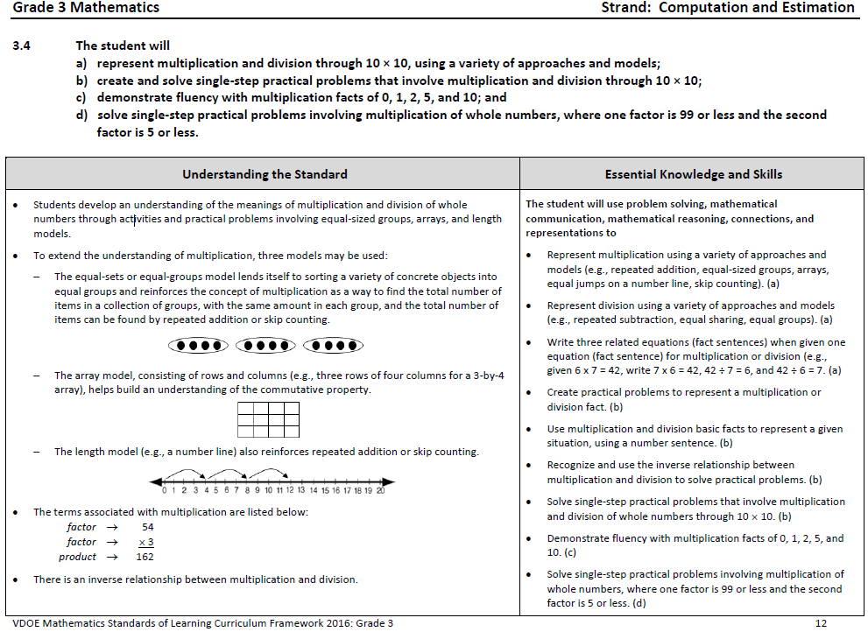
Notes:
This is a page from the grade 3 Curriculum Framework. It is very important that teachers spend time exploring the new Curriculum Frameworks as they contain edits made to the Understanding the Standard section including clarity in definitions and explanations. In some standards, examples have been included such as the ones shown on the screen.
In addition, where appropriate, corresponding EKS bullets and SOL bullets are indicated with the same letter. It is important to note that during any given lesson, multiple EKS bullets may be represented.

Slide 8
Overview of Revisions in Grade 3
2009 |  | 2016
Strand | # of Standards | # of Standards | Strand
Number and Number Sense | 3 | 2 | Number and Number Sense
Computation and Estimation | 4 | 3 | Computation and Estimation
Measurement | 5 | 8 | Measurement and Geometry
Geometry | 4
Probability and Statistics | 2 | 2 | Probability and Statistics
Patterns, Functions, and Algebra | 2 | 2 | Patterns, Functions, and Algebra
Total | 20 | 17 | Total
Notes:
In Grade 3 there was a reduction from 20 to 17 standards. This is a result of: consolidation of related concepts and skills, a reduction of repetition, an improvement in the developmental progression, and/or deletion of content.
The revisions made to Grade 3 will be addressed in greater detail later in this presentation. Note that the strands of measurement and geometry have been combined and now represent one strand titled “measurement and geometry.”

Slide 9
Mathematics Process Goals for Students
“The content of the mathematics standards is intended to support the five process goals for students” - 2009 and 2016 Mathematics Standards of Learning
Mathematical Understanding
Problem Solving
Connections
Communication
Representations
Reasoning
Notes:
In the next several slides, we will take a look at revisions to the Curriculum Framework document.
The mathematical process goals, found listed in the Introduction, continue to play an instrumental role in the teaching and learning of mathematics with understanding.
We encourage educators to review information included in the introduction of the 2016 Curriculum Frameworks.

Slide 10
Standards of Learning Curriculum Frameworks
Introduction includes:
Mathematical Process Goals for Students
Instructional Technology
Computational Fluency
Algebra Readiness
Equity
New
Notes:
Four additional sections have been included in the introduction to the Curriculum Framework -- Instructional Technology, Computational Fluency, Algebra Readiness, and Equity.
The content of each section addresses the impact on students’ learning and instruction. We encourage educators to review these sections of the introduction.

Slide 11
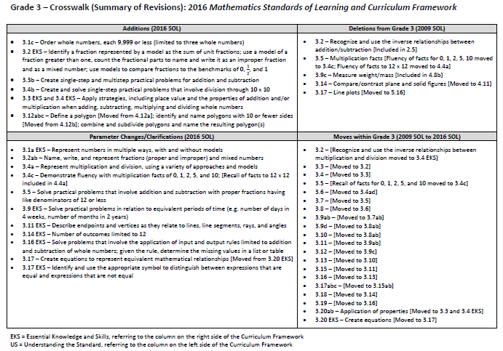
2016
2009
Notes:
This is a snapshot of the Grade 3 Crosswalk and Summary of Revisions page one.
Notice there are four quadrants representing the additions, deletions, parameter changes or clarifications, and any moves within the Grade 3 standards.
The upper left quadrant represents the additions, the standards referenced are the 2016 numbers. Moves from other grade levels are indicated within brackets.
The upper right quadrant identifies deletions from the 2009 standards and indications of where that content was moved.
The bottom left quadrant indicates parameter changes or clarifications.
For example in 3.2ab clarity has been provided in that grade 3 students will work with fractions that include proper, improper and mixed numbers.
In the bottom right quadrant, moves within a grade level are indicated with the first number being the 2009 SOL number and the number in the brackets representing the 2016 number.

Slide 12
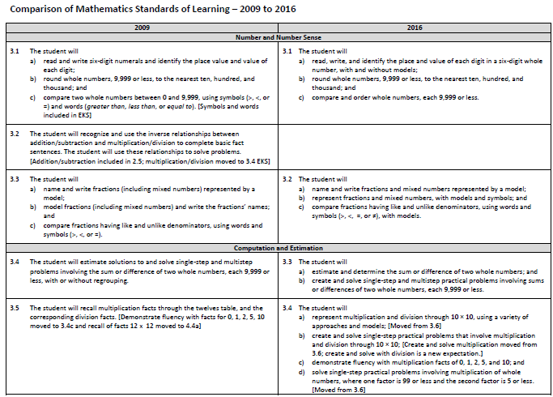
Notes:
On page 2 and the remaining pages of the crosswalk, a side by side comparison of the 2009 and 2016 standards can be found.
When deleted content was moved or already found in another grade, it is indicated in brackets.
Empty boxes on the right indicate that that content has either been deleted or moved.
For example in 2009 SOL 3.2 – Students are already recognizing and using inverse relationships between addition and subtraction in grade 2 so that has been removed from grade 3. Recognizing and using inverse relationships between multiplication and division are now found in the EKS bullets for 3.4.
Empty boxes on the left typically indicate that the 2016 standard is new to that grade level.

Slide 13
Number and Number Sense
Notes:
We’ll now dig deeper into the crosswalk and Curriculum Framework by taking a look at the Number and Number Sense strand.

Slide 14
2009 SOL | 2016 SOL
3.1 The student will a) read and write six-digit numerals and identify the place value and value of each digit; b) round whole numbers, 9,999 or less, to the nearest ten, hundred, and thousand; and c) compare two whole numbers between 0 and 9,999, using symbols (>, <, or =) and words (greater than, less than, or equal to). [Symbols and words included in EKS] | 3.1 The student will a) read, write, and identify the place and value of each digit in a six-digit whole number, with and without models; b) round whole numbers, 9,999 or less, to the nearest ten, hundred, and thousand; and compare and order whole numbers, each 9,999 or less.
Revisions:
3.1a EKS - Represent numbers in multiple ways, with and without models
3.1c New - Ordering numbers (limited to three whole numbers each 9,999 or less)
3.1c – Use of symbols and words moved to EKS
Notes:
Clarification has been provided in the EKS for 3.1a stating that numbers should be represented in multiple ways, with and without models.
In 3.1c ordering numbers is an addition to grade 3. As stated in the EKS, this will be limited to no more than three whole numbers.
The use of symbols and words to compare numbers in 3.1c has been moved to the EKS.

Slide 15
2009 SOL | 2016 SOL
3.2 The student will recognize and use the inverse relationships between addition/subtraction and multiplication/division to complete basic fact sentences. The student will use these relationships to solve problems. [Addition/subtraction included in 2.5; multiplication/division moved to 3.4 EKS]
Revisions:
Recognizing and using inverse relationships between multiplication and division are now located in 3.4 EKS
Recognizing and using inverse relationships between addition and subtraction removed
Notes:
SOL 3.2 is no longer a stand-alone SOL in grade three.
Recognizing and using inverse relationships between multiplication and division are now located in the EKS bullets aligned with 3.4.
Recognizing and using inverse relationships between addition and subtraction is included in grade 2 and has therefore been removed from grade 3.

Slide 16
2009 SOL | 2016 SOL
3.3 The student will name and write fractions (including mixed numbers) represented by a model; model fractions (including mixed numbers) and write the fractions’ names; and compare fractions having like and unlike denominators, using words and symbols (>, <, or =). | 3.2 The student will a) name and write fractions and mixed numbers represented by a model; b) represent fractions and mixed numbers, with models and symbols; and c) compare fractions having like and unlike denominators, using words and symbols (>, <, =, or ≠), with models.
Revisions:
3.2 New EKS – Identify a fraction represented by a model as the sum of unit fractions; use a model of a fraction greater than one to count the fractional parts to name and write it as an improper fraction
3.2ab – Clarification - fractions include proper, improper, and mixed numbers
Notes:
3.3 is now 3.2
There are new EKS bullets associated with 3.2b. They include identifying a fraction represented by a model as the sum of unit fractions AND use a model for a fraction greater than one, count the fractional parts to name and write it as an improper fraction.
EKS bullets aligning to 3.2a and b provide clarification that fractions refer to proper, improper, and mixed numbers.
Please refer to the Understanding the Standards Section for more information.

Slide 17
Computation and Estimation
Notes:
We will now take a look at the Computation and Estimation Strand.

Slide 18
2009 SOL | 2016 SOL
3.4 The student will estimate solutions to and solve single-step and multistep problems involving the sum or difference of two whole numbers, each 9,999 or less, with or without regrouping. | 3.3 The student will estimate and determine the sum or difference of two whole numbers; and create and solve single-step and multistep practical problems involving sums or differences of two whole numbers, each 9,999 or less.
Revisions:
3.3b – Create single-step and multistep practical problems for addition and subtraction
3.3 EKS – Apply strategies, including place value and the properties of addition, when adding and subtracting whole numbers
Notes:
3.4 is now 3.3
3.3b The creation of single-step and multistep problems has been added for addition and subtraction.
A new EKS bullet has been added for 3.3 with the expectation that students will apply strategies, including the use of place value and the properties of addition, to add and subtract. This is a shift from the 2009 standards in that the focus is not to identify a specific property being used, but to correctly apply the properties. It is, however, appropriate for teachers and students to use the names of the properties when being applied, but this should not be a focus of assessment.
Please refer to the Understanding the Standard section of the Framework for additional teacher resources including additional information regarding the properties and a chart that provides examples of the variety of problem types related to addition and subtraction that students in grade 3 should have experiences solving.

Slide 19
2009 SOL | 2016 SOL
3.5 The student will recall multiplication facts through the twelves table, and the corresponding division facts. [Demonstrate fluency with facts for 0, 1, 2, 5, 10 moved to 3.4c and recall of facts 12 x 12 moved to 4.4a] 3.6 The student will represent multiplication and division, using area, set, and number line models, and create and solve problems that involve multiplication of two whole numbers, one factor 99 or less and the second factor 5 or less. [Moved to 3.4a and 3.4d] | 3.4 The student will represent multiplication and division through 10 × 10, using a variety of approaches and models; [Moved from 3.6] create and solve single-step practical problems that involve multiplication and division through 10 × 10; [Create and solve multiplication moved from 3.6; create and solve with division is a new expectation.] demonstrate fluency with multiplication facts of 0, 1, 2, 5, and 10; and solve single-step practical problems involving multiplication of whole numbers, where one factor is 99 or less and the second factor is 5 or less. [Moved from 3.6]
Revisions:
3.4a – Represent multiplication and division, using a variety of approaches and models
3.4b – New - Create and solve single-step practical problems that involve division
3.4 EKS – Apply strategies, including place value and the properties of addition and/or multiplication when multiplying and dividing whole numbers
3.4c – Demonstrate fluency limited to multiplication facts of 0, 1, 2, 5, and 10; Recall of facts to 12 x 12 moved to 4.4a
Notes:
SOL 3.5 and 3.6 have now been combined into 3.4.
SOL 3.4a, representing multiplication and division are not new to grade 3; however, the use of a variety of approaches and models has been added. Examples of models can be found in the Understanding the Standard section of the Framework.
In SOL 3.4b, creating and solving single-step practical problems involving division is new to grade 3.
A new EKS bullet states that students will apply strategies including the use of place value and the properties of multiplication and/or addition, to multiply and divide whole numbers. Again, this is a shift from the 2009 standards in that the focus is not to identify a specific property, but to correctly apply the properties. It is, however, appropriate for teachers and students to use the names of the properties when being applied, but this should not be a focus of assessment. Teachers may reference the Understanding the Standard section of the Framework for additional information.
In looking at SOL 3.4c – While demonstrating fluency for multiplication in grade 3 is now limited to facts for 0, 1, 2, 5 and 10, students are still to represent and use multiplication facts through 10 x 10 to create and solve practical problems that involve multiplication and division. They are still learning the facts through 10, but demonstrating fluency is now shared between grade three and grade four.
Additional information and resources related to SOL 3.4 can be found in the Curriculum Framework.

Slide 20
2009 SOL | 2016 SOL
3.7 The student will add and subtract proper fractions having like denominators of 12 or less. | 3.5 The student will solve practical problems that involve addition and subtraction with proper fractions having like denominators of 12 or less.
Revisions:
3.5 – Clarification - solve practical problems that involve addition and subtraction with proper fractions having like denominators of 12 or less
Notes:
3.7 is now 3.5
Clarification has been provided that students will solve practical problems that involve addition and subtraction with proper fractions.

Slide 21
MEASUREMENT AND GEOMETRY
Notes:
Moving on to Measurement and Geometry --

Slide 22
2009 SOL | 2016 SOL
3.8 The student will determine, by counting, the value of a collection of bills and coins whose total value is $5.00 or less, compare the value of the bills and coins, and make change. | 3.6 The student will determine the value of a collection of bills and coins whose total value is $5.00 or less; compare the value of two sets of coins or two sets of coins and bills; and make change from $5.00 or less.
Revisions:
Skills represented in separate 3.6 bullets a, b, c
Notes:
3.8 is now 3.6 with the skills being represented in separate bullets.

Slide 23
2009 SOL | 2016 SOL
3.9 The student will estimate and use U.S. Customary and metric units to measure a) length to the nearest inch, inch, foot, yard, centimeter, and meter; b) liquid volume in cups, pints, quarts, gallons, and liters; c) weight/mass in ounces, pounds, grams, and kilograms; [Included in 4.8b] and d) area and perimeter. [Moved to 3.8ab] | 3.7 The student will estimate and use U.S. Customary and metric units to measure a) length to the nearest $\frac{1}{2}$ inch, inch, foot, yard, centimeter, and meter; and b) liquid volume in cups, pints, quarts, gallons, and liters.
Revisions:
3.9c – Measure weight/mass [Included in 4.8b]
3.9d – Moved to 3.8ab
Notes:
3.9ab is now 3.7ab.
3.9c which included measuring weight and mass are included in 4.8b and have been removed from grade 3.
3.9d has been moved to 3.8ab.

Slide 24
2009 SOL | 2016 SOL
3.10 The student will a) measure the distance around a polygon in order to determine perimeter; and b) count the number of square units needed to cover a given surface in order to determine area. [Moved to 3.8b] | 3.8 The student will estimate and [Estimate moved from 3.9d EKS] a) measure the distance around a polygon in order to determine its perimeter using U.S. Customary and metric units [Using U.S. Customary and metric units moved from 3.9d EKS]; and b) count the number of square units needed to cover a given surface in order to determine its area.
Revisions:
3.8a – Estimate and use U.S. Customary and metric units [Moved from 3.9d EKS]
Notes:
3.10 is now 3.8.
3.8a – Estimating and using U.S. Customary and metric units to measure were moved from the EKS of 3.9d.

Slide 25
2009 SOL | 2016 SOL
3.11 The student will a) tell time to the nearest minute, using analog and digital clocks; and determine elapsed time in one-hour increments over a 12-hour period. 3.12 The student will identify equivalent periods of time, including relationships among days, months, and years, as well as minutes and hours. [Moved to 3.9c] | 3.9 The student will a) tell time to the nearest minute, using analog and digital clocks; b) solve practical problems related to elapsed time in one-hour increments within a 12-hour period; and identify equivalent periods of time and solve practical problems related to equivalent periods of time. [Moved from 3.12]
Revisions:
3.9c EKS – Clarification - solve practical problems in relation to equivalent periods of time (e.g. number of days in 4 weeks, number of months in 2 years)
Notes:
3.11ab is now 3.9ab and 3.12 is now 3.9c.
In the EKS for 3.9c clarification has been provided that students will solve practical problems in relation to equivalent periods of time (e.g. number of days in 4 weeks, number of months in 2 years).

Slide 26
2009 SOL | 2016 SOL
3.13 The student will read temperature to the nearest degree from a Celsius thermometer and a Fahrenheit thermometer. Real thermometers and physical models of thermometers will be used. | 3.10 The student will read temperature to the nearest degree.
Revisions:
Types of thermometers included in EKS
Notes:
3.13 is now 3.10 with no significant change; the types of thermometers are now included in the EKS.

Slide 27
2009 SOL | 2016 SOL
3.14 The student will identify, describe, compare, and contrast characteristics of plane and solid geometric figures (circle, square, rectangle, triangle, cube, rectangular prism, square pyramid, sphere, cone, and cylinder) by identifying relevant characteristics, including the number of angles, vertices, and edges, and the number and shape of faces, using concrete models. [Moved to 4.11]
Revisions:
3.14 – Moved to 4.11
Notes:
SOL 3.14 was moved to 4.11 and is no longer included in grade 3.

Slide 28
2009 SOL | 2016 SOL
3.15 The student will identify and draw representations of points, line segments, rays, angles, and lines. | 3.11 The student will identify and draw representations of points, lines, line segments, rays, and angles.
Revisions:
3.11 EKS – Clarification - describe endpoints and vertices as they relate to lines, line segments, rays, and angles
Notes:
3.15 is now 3.11
Clarification has been provided in the EKS for 3.11 – students will describe endpoints and vertices as they relate to lines, line segments, rays, and angles.

Slide 29
2009 SOL | 2016 SOL
 | 3.12 The student will define polygon; [Moved from 4.12a] identify and name polygons with 10 or fewer sides; and [Moved from 4.12b] combine and subdivide polygons with three or four sides and name the resulting polygon(s).
New
Revisions:
3.12a – Define a polygon [Moved from 4.12a]
3.12b – Identify and name polygons with 10 or fewer sides [Moved from 4.12b]
3.12c – Combine and subdivide polygons with three or four sides and name resulting polygon(s)
Notes:
3.12 is NEW content to grade 3.
In 3.12 a and b students will define a polygon as well as identify and name polygons with 10 or fewer sides; both of these expectations were moved from 4.12.
Note that classification of quadrilaterals remains in grade 4. See the EKS bullets for 3.12b for a list of polygons that students will identify and name in grade 3.
In 3.12c students will work with composing and decomposing shapes. This will include combining polygons with three or four sides and then naming the resulting polygon AND subdividing polygons with three or four sides and then naming the resulting polygons.

Slide 30
2009 SOL | 2016 SOL
3.16 The student will identify and describe congruent and noncongruent plane figures. | 3.13 The student will identify and describe congruent and noncongruent figures.
Revisions:
No significant change
Notes:
3.16 is now 3.13

Slide 31
PROBABILITY AND STATISTICS
Notes:
We will now move on to Probability and Statistics.

Slide 32
2009 SOL | 2016 SOL
3.17 The student will a) collect and organize data, using observations, measurements, surveys, or experiments; [Process included in 3.15 EKS] b) construct a line plot, a picture graph, or a bar graph to represent the data; and [Line plot moved to 5.16; construct graphs moved to 3.15a] c) read and interpret the data represented in line plots, bar graphs, and picture graphs and write a sentence analyzing the data. [Line plots moved to 5.16; interpret bar graphs and picture graphs moved to 3.15b]
Revisions:
3.17abc – Collecting data, constructing and interpreting picture graphs and bar graphs moved to 3.15ab
Line plots moved to 5.16
Notes:
SOL 3.17abc – Collecting data, constructing and interpreting picture graphs and bar graphs has moved to 3.15a and b.
Line plots have been removed from grade 3 and have moved to 5.16.

Slide 33
2009 SOL | 2016 SOL
3.18 The student will investigate and describe the concept of probability as chance and list possible results of a given situation. | 3.14 The student will investigate and describe the concept of probability as a measurement of chance and list possible outcomes for a single event.
Revisions:
3.14 EKS – Number of outcomes limited to 12
Notes:
SOL 3.18 is now 3.14
Parameter changes to the EKS include limiting the number of outcomes to 12 for a single event.
Additional information can be found the in Curriculum Framework.

Slide 34
2009 SOL | 2016 SOL
 | 3.15 The student will a) collect, organize, and represent data in pictographs or bar graphs; and read and interpret the data represented in pictographs and bar graphs. [Moved from 3.17abc]
Revisions:
3.15ab – Moved from 3.17abc
Notes:
3.15ab was moved from the former 3.17abc as discussed previously. Please refer to the EKS bullets of the Curriculum Framework for additional details.

Slide 35
PATTERNS, FUNCTIONS, AND ALGEBRA
Notes:
We’ll now take a look at Patterns, Functions, and Algebra.

Slide 36
2009 SOL | 2016 SOL
3.19 The student will recognize and describe a variety of patterns formed using numbers, tables, and pictures, and extend the patterns, using the same or different forms. | 3.16 The student will identify, describe, create, and extend patterns found in objects, pictures, numbers, and tables.
Revisions:
3.16 New EKS – Solve problems that involve the application of input and output rules (limited to addition and subtraction of whole numbers)
3.16 New EKS – Given the rule, determine the missing values in a list or table (rules limited to addition and subtraction of whole numbers)
Notes:
3.19 is now 3.16
Additional EKS bullets have been added to 3.16
Solve problems that involve the application of input and output rules limited to addition and subtraction of whole numbers AND
Given the rule, determine the missing values in a list or table (rules have been limited to addition and subtraction of whole numbers).

Slide 37
2009 SOL | 2016 SOL
3.20 The student will a) investigate the identity and the commutative properties for addition and multiplication; and b) identify examples of the identity and commutative properties for addition and multiplication. [Use of properties moved to 3.4 EKS and 3.5 EKS] | 3.17 The student will create equations to represent equivalent mathematical relationships. [Moved from 3.20 EKS]
Revisions:
Identification of properties removed; application of properties moved to 3.4 EKS and 3.5 EKS
Notes:
The new 3.17 was moved from the former 3.20 EKS.
Note that while the identification or naming of properties has been removed, emphasis continues to be placed on the application of properties, which can be found in 3.4 EKS and 3.5 EKS.

Slide 38
Questions?
Please contact the
VDOE Mathematics Team
Mathematics@doe.virginia.gov
Notes:
This concludes the presentation on the 2016 Grade 3 Mathematics Standards of Learning revisions. You are encouraged to refer to the Curriculum Frameworks where additional information can be found.
Should you have any questions, feel free to contact a member of the Mathematics Team at the email shown on the screen.

