Slide 1
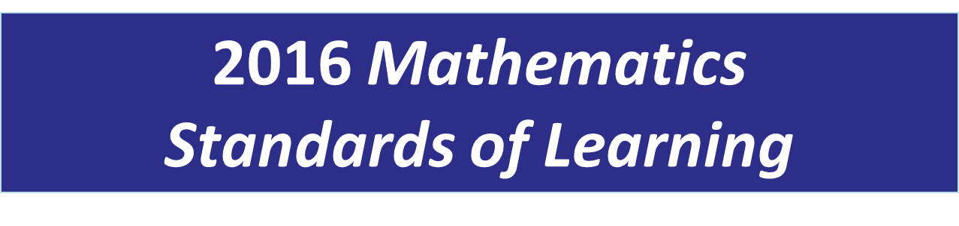

Grade 2
Overview of Revisions from 2009 to 2016
Notes:
Welcome to the Grade Two Overview of Revisions to the Mathematics Standards of Learning from 2009 to 2016.
It would be helpful to have a copy of the Grade 2 – Crosswalk (Summary of Revisions) and a copy of the 2016 Grade 2 Curriculum Framework to reference during this presentation.

Slide 2
Purpose
Overview of the 2016 Mathematics Standards of Learning and the Curriculum Framework
Highlight information included in the Essential Knowledge and Skills and the Understanding the Standard sections of the Curriculum Framework
Notes:
Our purpose is to provide an overview of the changes and to highlight information included in the essential knowledge and skills and understanding the standards sections of the Curriculum Framework.

Slide 3
Agenda
Implementation Timeline
Resources Currently Available
  Crosswalk (Summary of Revisions)
  Standards and Curriculum Frameworks
Comparison of 2009 to 2016 Standards
  Number and Number Sense
  Computation and Estimation
  Measurement and Geometry
  Probability and Statistics
  Patterns, Functions, and Algebra
Notes:
The implementation timeline will be shared followed by an introduction to the Crosswalk (Summary of Revisions) and the Curriculum Framework documents.
Then a detailed review of the Crosswalk comparing the 2009 standards to the newly adopted 2016 standards will be provided.

Slide 4
Implementation Timeline
2016-2017 School Year – Curriculum Development VDOE staff provides a summary of the revisions to assist school divisions in incorporating the new standards into local written curricula for inclusion in the taught curricula during the 2017-2018 school year.
2017-2018 School Year – Crossover Year 2009 Mathematics Standards of Learning and 2016 Mathematics Standards of Learning are included in the written and taught curricula. Spring 2018 Standards of Learning assessments measure the 2009 Mathematics Standards of Learning and include field test items measuring the 2016 Mathematics Standards of Learning.
2018-2019 School Year – Full-Implementation Year Written and taught curricula reflect the 2016 Mathematics Standards of Learning. Standards of Learning assessments measure the 2016 Mathematics Standards of Learning.
Notes:
During the (two thousand sixteen/two thousand seventeen) 2016-2017 school year – school divisions should begin incorporating the new standards into local curricula to be taught during the 2017-2018 school year.
During the Crossover Year 2017-2018 -- both the 2009 and 2016 standards should be taught. During the Spring 2018 assessments will measure the 2009 standards and will include field test items measuring the 2016 standards.
Full implementation of the 2016 standards will occur in the 2018-2019 school year.

Slide 5
2016 SOL Revisions –
Improve the vertical progression of mathematics content
Ensure developmental appropriateness of student expectations
Increase support for teachers in mathematics content (including definitions, explanations, examples, and instructional connections)
Clarify expectations for teaching and learning
Improve precision and consistency in mathematical vocabulary and format
Ensure proficiency of elementary students in computational skills
Notes:
The revisions focus on improving vertical progression of the content, ensuring developmental appropriateness, increasing support for teachers (including definitions, explanations, examples, and instructional connections), clarifying expectations both for teaching and for student learning, improving precision and consistency in mathematical vocabulary and format, and better ensuring computational fluency at the elementary level.

Slide 6
Changes to the Curriculum Framework
Reduction of columns from 3 to 2
  Understanding the Standard (US) – information that supports mathematics content knowledge
  Essential Knowledge and Skills (EKS) – information that provides expectations for student learning
Indicators of SOL sub-bullet added to each bullet within the Essential Knowledge and Skills
Notes:
The Curriculum Framework will have a somewhat different look for K-8. The reduction in the number of columns from 3 to 2 was made in order to provide consistency in format to other disciplines and consistency within mathematics K-12. The Understanding the Standard column has information that supports mathematical content knowledge and provides background information for teachers. The Essential Knowledge and Skills column provides the expectations for learning and assessment.
Corresponding EKS bullets and SOL bullets are indicated with the same letter. An example will be provided on the next screen.
Teachers are encouraged to read both the Essential Knowledge and Skills and the Understanding the Standard columns.

Slide 7
Support for Teachers
Significant additions to the Understanding the Standard column including
  Definitions
  Explanations
  Examples
  Instructional connections
Improvements in precision, clarity, and consistency in language K-12
Notes:
Additional support for teachers was added to the Understanding the Standard column in the Curriculum Frameworks to include definitions, explanations, as well as many examples and some instructional connections. These edits result in better precision, greater clarity, and consistency in language across K-12.

Slide 8
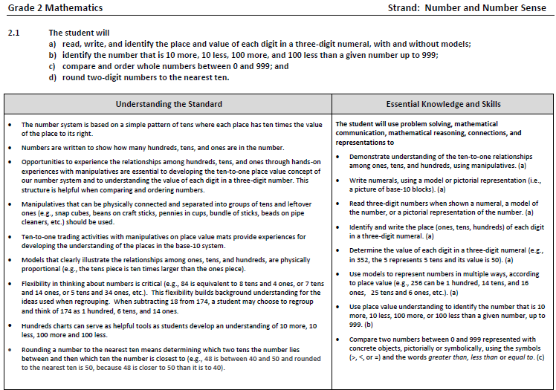
Notes:
This is a page from the Grade Two Curriculum Framework. It is very important that teachers spend time exploring the new Curriculum Frameworks.
For standards containing multiple bullets, a letter has been added to the end of each EKS bullet to indicate which standard it most closely corresponds with. It should be noted that during any given lesson, multiple EKS bullets may be represented.
In most standards examples, definitions and clarifying statements have been added to the Understanding the Standard or EKS sections of the framework such as those indicated here.

Slide 9
Overview of Revisions in Grade 2
2009 |  | 2016
Strand | # of Standards | # of Standards | Strand
Number and Number Sense | 4 | 4 | Number and Number Sense
Computation and Estimation | 5 | 2 | Computation and Estimation
Measurement | 5 | 7 | Measurement and Geometry
Geometry | 2
Probability and Statistics | 3 | 2 | Probability and Statistics
Patterns, Functions, and Algebra | 3 | 2 | Patterns, Functions, and Algebra
Total | 22 | 17 | Total
Notes:
There was an overall reduction in the number of standards from 285 to 259 in K-12; specifically in Grade Two there was a reduction from 22 to 17 standards. This is a result of -- consolidation of related concepts and skills; a reduction of repetition, an improvement in the developmental progression, and/or deletion of content.
The changes occurring in Grade Two will be addressed in greater detail later in this presentation. Note that the strands of measurement and geometry have been combined and now represent one strand titled “measurement and geometry.”

Slide 10
Mathematics Process Goals for Students
“The content of the mathematics standards is intended to support the five process goals for students”
- 2009 and 2016 Mathematics Standards of Learning
Mathematical Understanding
Problem Solving
Connections
Communication
Representations
Reasoning
Notes:
In the next several slides, we will take a quick look at changes to the Curriculum Framework document.
It is important to note that the mathematical process goals for students continue to be emphasized throughout the 2016 standards. The content of the mathematics standards is intended to support the following five goals for students: becoming mathematical problem solvers, communicating mathematically, reasoning mathematically, making mathematical connections, and using mathematical representations to model and interpret practical situations.

Slide 11
Standards of Learning Curriculum Frameworks
Introduction includes:
  Mathematical Process Goals for Students
  Instructional Technology
  Computational Fluency
  Algebra Readiness
  Equity
New
Notes:
Four additional sections have been included in the introduction to the Curriculum Framework -- Instructional Technology, Computational Fluency, Algebra Readiness, and Equity.
The content of each section addresses the impact on students’ learning and instruction. We encourage educators to review these sections of the introduction.

Slide 12
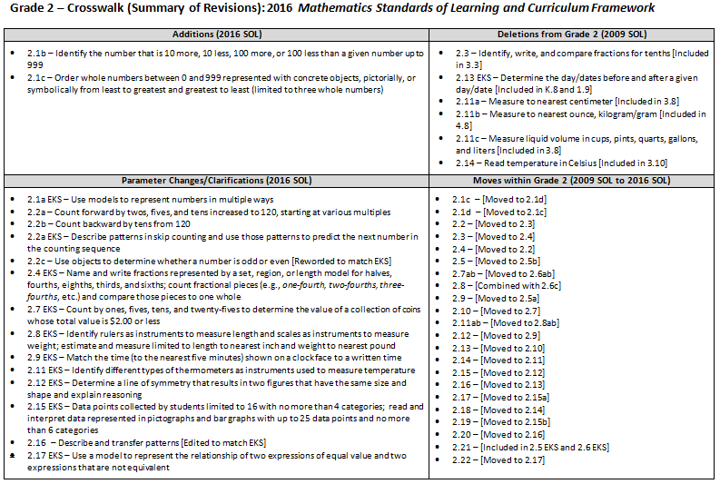
2009
2016
Notes:
This is a snapshot of the Grade 2 Crosswalk and Summary of Revisions page one. There are four quadrants – additions, deletions, parameter changes or clarifications, and moves within the standards.
The upper left quadrant represents the additions, the standards referenced are the 2016 numbers.
The upper right quadrant identifies deletions from the 2009 standards and indicates where content was moved.
The bottom left quadrant indicates parameter changes (for example in 2.2a – counting forward by twos, fives, and tens increased to 120). Note that skip-counting in grade one increased to 110.
In the bottom right quadrant, moves within a grade level are indicated with the first number being the 2009 Standard number and the number in the brackets representing the 2016 number.

Slide 13
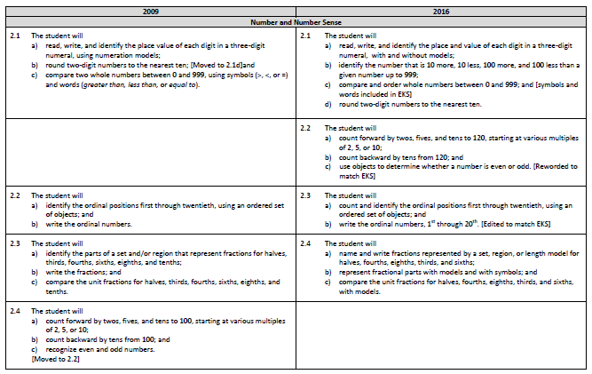
Notes:
On page 2 and the remaining pages of the crosswalk, a side by side comparison of the 2009 and 2016 standards can be found. There was an attempt to keep the standards in numerical order for both columns.
When deleted content was moved, it is indicated in brackets. See the examples shown on the screen.
Empty boxes on the left indicate that the 2016 standard is either new to that grade level or has been moved from within the grade level, as can be seen here the new 2016 SOL 2.2 was moved from the 2009 SOL 2.4.
Empty boxes on the right indicate that that content has either been deleted or moved.

Slide 14
Number and Number Sense
Notes:
We’ll now dig deeper into the crosswalk and Curriculum Framework by taking a look at the Number and Number Sense strand.

Slide 15
2009 SOL | 2016 SOL
2.1 The student will a) read, write, and identify the place value of each digit in a three-digit numeral, using numeration models; b) round two-digit numbers to the nearest ten; [Moved to 2.1d] and c) compare two whole numbers between 0 and 999, using symbols (>, <, or =) and words (greater than, less than, or equal to). | 2.1 The student will read, write, and identify the place and value of each digit in a three-digit numeral, with and without models; identify the number that is 10 more, 10 less, 100 more, and 100 less than a given number up to 999; compare and order whole numbers between 0 and 999; and [symbols and words included in EKS] round two-digit numbers to the nearest ten.
New
Revisions:
2.1a EKS – Use models to represent numbers in multiple ways, according to place value
2.1b – Identify the number that is 10 more, 10 less, 100 more, or 100 less than a given number up to 999
2.1c – Order whole numbers between 0 and 999 represented with concrete objects, pictorially, or symbolically from least to greatest and greatest to least (limited to three whole numbers)
Notes:
The revisions made to SOL 2.1 are intended to strengthen students’ understanding of place value.
Clarification has been added to the EKS for SOL 2.1a that students should use models to represent numbers in multiple ways (for instance, representing 256 not only as 2 hundreds 5 tens and 6 ones but also recognizing that 256 can be represented as 1 hundred, 14 tens, and 16 ones, or 25 tens and 6 ones).
The 2016 version of SOL2.1b is NEW to grade two– Students will now identify the number that is 10 more, 10 less, 100 more, or 100 less than a given number up to 999.
SOL 2.1c now includes ordering three whole numbers between 0 and 999 represented with concrete objects, pictorially, or symbolically from least to greatest and greatest to least.

Slide 16
2009 SOL | 2016 SOL
 | 2.2 The student will a) count forward by twos, fives, and tens to 120, starting at various multiples of 2, 5, or 10; b) count backward by tens from 120; and use objects to determine whether a number is even or odd. [Reworded to match EKS] [Moved from 2.4]
Revisions:
2.2a – Count forward by twos, fives, and tens increased to 120, starting at various multiples
2.2a EKS – Describe patterns in skip counting and use those patterns to predict the next number in the counting sequence
2.2b – Count backward by tens from 120
2.2c – Use objects to determine whether a number is odd or even [Reworded to match EKS]
Notes:
SOL 2.2 was moved from the 2009 SOL 2.4.
In SOL 2.2a - counting forward by twos, fives, and tens has increased to 120 and includes starting at any multiple of 2, 5, or 10 with and without manipulatives.
A new EKS bullet for 2.2a states that students will describe patterns in skip counting and use those patterns to predict the next number in the counting sequence. This was previously a part of the Essential Understanding Column of the 2009 standards document.
For SOL 2.2b students will now count backward by tens from 120.
Revisions to the wording for SOL 2.2c state that students should use objects to determine whether a number is odd or even. This edit now matches the EKS bullet from 2009 and is not new content for grade two students.

Slide 17
2009 SOL | 2016 SOL
2.2 The student will a) identify the ordinal positions first through twentieth, using an ordered set of objects; and b) write the ordinal numbers. | 2.3 The student will a) count and identify the ordinal positions first through twentieth, using an ordered set of objects; and b) write the ordinal numbers, 1st through 20th. [Edited to match EKS]
Revisions:
2.3 – Identify, write, and compare fractions for tenths [Included in 3.3]
Notes:
SOL 2.2 is now SOL 2.3. Edits made to the SOL were solely edits to wording that bring into alignment the wording of the EKS bullets and the standard.

Slide 18
2009 SOL | 2016 SOL
2.3 The student will a) identify the parts of a set and/or region that represent fractions for halves, thirds, fourths, sixths, eighths, and tenths; b) write the fractions; and c) compare the unit fractions for halves, thirds, fourths, sixths, eighths, and tenths. | 2.4 The student will a) name and write fractions represented by a set, region, or length model for halves, fourths, eighths, thirds, and sixths; b) represent fractional parts with models and with symbols; and c) compare the unit fractions for halves, fourths, eighths, thirds, and sixths, with models.
Revisions:
2.4 EKS – Name and write fractions represented by a set, region, or length model for halves, fourths, eighths, thirds, and sixths
2.4 EKS – Count fractional pieces (e.g., one-fourth, two-fourths, three-fourths, etc.) and compare those pieces to one whole
Notes:
SOL 2.3 is now SOL 2.4; SOL 2.3b (writing fractions) is now included in SOL 2.4a with naming and writing fractions.
Several parameter changes were made to SOL 2.4 with unit fractions for tenths being removed. They are included in Grade three.
EKS bullets for SOL 2.4 clarify that students will name and write fractions represented by a set, a region, or a length model for halves, fourths, eighths, thirds, and sixths.
In addition, they should have experiences using same-size fraction pieces, from region/area models or length/measurement models, count the pieces (for example, one-fourth, two-fourths, three-fourths, etc.) and compare those pieces to one whole (for example, four-fourths will make one whole or one-fourth is less than a whole). These experiences will help to further support students understanding that four-fourths makes one whole and prepares them for the extended study of fractions in later grades.

Slide 19
2009 SOL | 2016 SOL
2.4 The student will a) count forward by twos, fives, and tens to 100, starting at various multiples of 2, 5, or 10; b) count backward by tens from 100; and c) recognize even and odd numbers. [Moved to 2.2]
Revisions:
Moved to 2.2
Notes:
SOL 2.4 was moved to SOL 2.2 as previously shared.

Slide 20
Computation and Estimation
Notes:
We will now take a look at the Computation and Estimation Strand.

Slide 21
2009 SOL | 2016 SOL
2.5 The student will recall addition facts with sums to 20 or less and the corresponding subtraction facts. 2.9 The student will recognize and describe the related facts that represent and describe the inverse relationship between addition and subtraction. . [Moved to 2.5 EKS] | 2.5 The student will recognize and use the relationships between addition and subtraction to solve single-step practical problems, with whole numbers to 20; and [Moved from 2.9] demonstrate fluency with addition and subtraction within 20.
Revisions:
2.5 and 2.9 from 2009 have been combined to form the new 2.5
No significant change
Notes:
SOL 2.5 and SOL 2.9 have been combined to form the new SOL 2.5. No significant change has been made to the content of this standard.
However, significant revisions and additions have been included in the Understanding the Standard section of the framework. For example: computational fluency has been defined as the ability to think flexibly in order to choose appropriate strategies to solve problems accurately and efficiently. In addition, information has been provided regarding experiences students should have related to the properties of addition as strategies for solving addition and subtraction problems.
Please refer to the Curriculum Framework for additional information and examples related to this standard.

Slide 22
2009 SOL | 2016 SOL
2.6 The student, given two whole numbers whose sum is 99 or less, will estimate the sum; and find the sum, using various methods of calculation. 2.7 The student, given two whole numbers, each of which is 99 or less, will estimate the difference; and [Moved to 2.6a] find the difference, using various methods of calculation. [Moved to 2.6b] 2.8 The student will create and solve one- and two-step addition and subtraction problems, using data from simple tables, picture graphs, and bar graphs. [Moved to 2.6c] 2.21 The student will solve problems by completing numerical sentences involving the basic facts for addition and subtraction. The student will create story problems, using the numerical sentences. [Moved to EKS 2.5/2.6] | 2.6 The student will estimate sum and differences; [Differences moved from 2.7a] determine sums and differences, using various methods; and [Differences moved from 2.7b] create and solve single-step and two-step practical problems involving addition and subtraction. [Moved from 2.8 and 2.21]
Revisions:
2.6, 2.7 and 2.8 from 2009 have been combined
No significant changes in content
Problem type examples chart included in Understanding the Standard section of Framework
Notes:
SOL 2.6, 2.7, 2.8, and 2.21 from 2009 have been combined to form the new SOL 2.6a, b and c.
Based on the extensive research on addition and subtraction problem types, a problem type chart has been included in the Understanding the Standard section of the Framework. It is important that second graders experience an array of problems types in order to deepen their understanding of addition and subtraction and the relationship between the two.
Clarification has been made that students will create and solve one and two-step practical problems. Two-step problems could include only addition, only subtraction, or both addition and subtraction.

Slide 23
2009 SOL | 2016 SOL
2.9 The student will recognize and describe the related facts that represent and describe the inverse relationship between addition and subtraction. [Moved to 2.5 EKS]
Revisions:
Moved to 2.5 EKS
Notes:
SOL 2.9 was moved to the Essential Knowledge and Skills for SOL 2.5, as previously shared.

Slide 24
MEASUREMENT AND GEOMETRY
Notes:
We will now take a look at the Measurement and Geometry strand.

Slide 25
2009 SOL | 2016 SOL
2.10 The student will a) count and compare a collection of pennies, nickels, dimes, and quarters whose total value is $2.00 or less; and b) correctly use the cent symbol (¢), dollar symbol ($), and decimal point (.). | 2.7 The student will a) count and compare a collection of pennies, nickels, dimes, and quarters whose total value is $2.00 or less; and b) use the cent symbol (¢), dollar symbol ($), and decimal point (.) to write a value of money.
Revisions:
2.7a EKS – Count by ones, fives, tens, and twenty-fives to determine the value of a collection of coins whose total value is $2.00 or less
Notes:
SOL 2.10 is now SOL 2.7.
A new EKS bullet for SOL 2.7a was moved from Grade One SOL 1.7 – Students will count by ones, fives, tens, and twenty-fives to determine the value of a collection of coins whose total value is $2.00 or less.

Slide 26
2009 SOL | 2016 SOL
2.11 The student will estimate and measure a) length to the nearest centimeter and inch; [Centimeters included in 3.8] b) weight/mass of objects in pounds/ounces and kilograms/grams, using a scale; and [Ounces, kilograms/grams included in 4.8] liquid volume in cups, pints, quarts, gallons, and liters. [Included in 3.8] | 2.8 The student will estimate and measure length to the nearest inch; and weight to the nearest pound.
Revisions:
Removal of measurement to nearest centimeter and nearest ounce, kilogram/gram
Removal of measurement of liquid volume in cups, pints, quarts, gallons, and liters
2.8 EKS – Identify a ruler as an instrument to measure length
Notes:
Select content from the 2009 SOL 2.11 have been removed from Grade Two.
Estimate and measure to the nearest centimeter, to the nearest ounce, and to the nearest kilogram/gram; and estimate and measure liquid volume have all been removed from Grade 2. This content remain in the grade levels and the 2016 standards as indicated on the screen.
New EKS bullets (moved from K.8) clarify that students will identify rulers as instruments to measure length and scales as instruments to measure weight.
Note: Students at this age often struggle to understand the difference between weight and mass; therefore, the term weight will be used at this level.

Slide 27
2009 SOL | 2016 SOL
2.12 The student will tell and write time to the nearest five minutes, using analog and digital clocks. | 2.9 The student will tell time and write time to the nearest five minutes, using analog and digital clocks.
Revisions:
2.9 EKS – Match the time (to the nearest five minutes) shown on a clock face to a written time
Notes:
SOL 2.12 is now SOL 2.9.
Clarification has been made with a new EKS bullet for SOL 2.9 that states students will also match the time (to the nearest five minutes) shown on a clock face to a written time.

Slide 28
2009 SOL | 2016 SOL
2.13 The student will a) determine past and future days of the week; and b) identify specific days and dates on a given calendar. | 2.10 The student will a) determine past and future days of the week; and b) identify specific days and dates on a given calendar.
Revisions:
2.13EKS – Determine days/dates before and after a given day/date removed [Included in K.8 and 1.9]
Notes:
SOL 2.13 is now SOL 2.10.
The 2009 EKS bullet from SOL 2.13 which read determine the days/dates before and after a given day/date has been removed. It remains in K.8 and 1.9.

Slide 29
2009 SOL | 2016 SOL
2.14 The student will read the temperature on a Celsius and/or Fahrenheit thermometer to the nearest 10 degrees. [Temperature in Fahrenheit included in EKS; temperature in Celsius included in 3.10] | 2.11 The student will read temperature to the nearest 10 degrees.
Revisions:
Reading temperature in Celsius removed [Included in 3.10]
2.11 EKS – Identify different types of thermometers as instruments used to measure temperature
Notes:
SOL 2.14 is now SOL 2.11
Students in Grade Two will read temperature in Fahrenheit to the nearest 10 degrees. Reading temperature in Celsius has been removed from Grade Two. This content remains in Grade Three.
A new EKS bullet (moved from K.8) has been added stating that students will identify different types of thermometers as instruments used to measure temperature.

Slide 30
2009 SOL | 2016 SOL
2.15 The student will a) draw a line of symmetry in a figure; and b) identify and create figures with at least one line of symmetry. | 2.12 The student will a) draw a line of symmetry in a figure; and b) identify and create figures with at least one line of symmetry.
Revisions:
2.12 EKS – Determine a line of symmetry that results in two figures that have the same size and shape and explain reasoning
Notes:
SOL 2.15 is now SOL 2.12.
Clarification has been made in the EKS that students will determine a line of symmetry that results in two figures that have the same size and shape and explain their reasoning.

Slide 31
2009 SOL | 2016 SOL
2.16 The student will identify, describe, compare, and contrast plane and solid geometric figures (circle/sphere, square/cube, and rectangle/rectangular prism). | 2.13 The student will identify, describe, compare, and contrast plane and solid figures (circles/spheres, squares/cubes, and rectangles/rectangular prisms).
Revisions:
No significant change
Notes:
SOL 2.16 is now SOL 2.13.
No significant changes have been made to the content of this standard.

Slide 32
PROBABILITY AND STATISTICS
Notes:
We will now take a look at the Probability and Statistics strand.

Slide 33
2009 SOL | 2016 SOL
 | 2.14 The student will use data from probability experiments to predict outcomes when the experiment is repeated. [Moved from 2.18]
Revisions:
No significant change
Notes:
SOL 2.14 was moved from the 2009 SOL 2.18.
No significant change was made to the content of this standard.

Slide 34
2009 SOL | 2016 SOL
2.17 The student will use data from experiments to construct picture graphs, pictographs, and bar graphs. | 2.15 The student will collect, organize, and represent data in pictographs and bar graphs; and read and interpret data represented in pictographs and bar graphs. [Moved from 2.19]
Revisions:
2.15 EKS – Data points collected by students limited to 16 with no more than 4 categories
2.15 EKS – Read and interpret data represented in pictographs and bar graphs with up to 25 data points and no more than 6 categories
Notes:
SOL 2.17 is now represented in SOL 2.15a.
The new 2.15b was moved from the 2009 standard 2.19.
Parameter clarifications have been made in the Essential Knowledge and Skills bullets:
When student are collecting data, the number of data points they collect should be limited to no more than16 representing no more than 4 categories; however, for data already represented in pictographs and bar graphs students should be able to read and interpret up to 25 data points with no more than 6 categories. An example might be when the class as a whole, or the teacher, has collected data around how students travel to school – the data points would exceed 16 but would likely not exceed 25.
Additional information and examples of the types of questions students should be able to answer regarding data represented in pictographs and bar graphs has been included in the Curriculum Framework.

Slide 35
2009 SOL | 2016 SOL
2.18 The student will use data from experiments to predict outcomes when the experiment is repeated. [Moved to 2.14]
Revisions:
Moved to 2.14
Notes:
SOL2.18 moved to 2.14 as previously mentioned.

Slide 36
2009 SOL | 2016 SOL
2.19 The student will analyze data displayed in picture graphs, pictographs, and bar graphs. [Moved to 2.15b]
Revisions:
Moved to 2.15b
Notes:
As stated previously, SOL 2.19 has been moved to 2.15b.

Slide 37
PATTERNS, FUNCTIONS, AND ALGEBRA
Notes:
Let’s now take a look at Patterns, Functions, and Algebra.

Slide 38
2009 SOL | 2016 SOL
2.20 The student will identify, create, and extend a wide variety of patterns. | 2.16 The student will identify, describe, create, extend, and transfer patterns found in objects, pictures, and numbers.
Revisions:
2.16 – Describe and transfer patterns [Edited to match EKS]
Notes:
SOL 2.20 is now 2.16.
The words describe and transfer were added to the SOL to bring it in alignment with the existing EKS bullets.
Additional EKS bullets have been added that elaborate on describing patterns. First, students are to describe the core of a repeating patterns as the part of the sequence that repeats; and students are to describe how a given growing pattern is changing.

Slide 39
2009 SOL | 2016 SOL
2.21 The student will solve problems by completing numerical sentences involving the basic facts for addition and subtraction. The student will create story problems, using the numerical sentences. [Moved in 2.5 EKS and 2.6 EKS]
Revisions:
Moved in 2.5 EKS and 2.6 EKS
Notes:
SOL2.21 is now included in EKS bullets for SOL 2.5 and 2.6

Slide 40
2009 SOL | 2016 SOL
2.22 The student will demonstrate an understanding of equality by recognizing that the symbol = in an equation indicates equivalent quantities and the symbol ≠ indicates that quantities are not equivalent. | 2.17 The student will demonstrate an understanding of equality through the use of the equal symbol and the use of the not equal symbol.
Revisions:
2.17 EKS – Use a model to represent the relationship of two expressions of equal value and two expressions that are not equivalent
Notes:
SOL 2.22 is now SOL 2.17
Slight modifications have been made to the wording found within EKS bullets.
In addition, a new EKS bullet has been added stating that students will use a model to represent the relationship of two expressions of equal value and two expressions that are not equivalent. An example would be a student modeling two expressions where both are equivalent to 12 such as:
a train consisting of 6 red cubes and 6 blue cubes (representing 6 + 6); and
another train consisting of 8 green cubes and 4 white cubes (representing 8 + 4).

Slide 41
Questions?
Please contact the
VDOE Mathematics Team
Mathematics@doe.virginia.gov
Notes:
This concludes the presentation of the 2016 Grade 2 Mathematics Standards of Learning revisions. You are encouraged to refer to the Curriculum Frameworks where additional information can be found.
Should you have any questions, feel free to contact a member of the Mathematics Team at the email shown on the screen.

