Slide 1

2016 Mathematics
Standards of Learning
Geometry
Overview of Changes from 2009 to 2016
Related documents available on VDOE Mathematics 2016 webpage
Notes:
Welcome to the Geometry overview of revisions to the Mathematics Standards of Learning from 2009 to 2016. It would be helpful to have a copy of the Geometry – Crosswalk (Summary of Revisions), and a copy of the 2016 Geometry Curriculum Framework to reference during this presentation. These documents are available electronically on the VDOE Mathematics 2016 webpage under Standards of Learning and Testing.

Slide 2
Purpose
Overview of the 2016 Mathematics Standards of Learning and the Curriculum Framework
Highlight information included in the Essential Knowledge and Skills and the Understanding the Standard sections of the Curriculum Framework
Notes:
The purpose of this presentation is to provide an overview of the revisions and to highlight information included in the Essential Knowledge and Skills and Understanding the Standard sections of the curriculum framework. This presentation is a brief overview of revisions and not a comprehensive list of all revisions. Teachers are encouraged to thoroughly review the 2016 Curriculum Framework to obtain a comprehensive understanding of the revisions.

Slide 3
Agenda
Overview and Implementation Timeline
Resources Currently Available
  Crosswalk (Summary of Revisions)
  Standards and Curriculum Frameworks
Comparison of 2009 to 2016 Standards
  Reasoning, Lines, and Transformations
  Triangles
  Polygons and Circles
  Three-Dimensional Figures
Notes:
The implementation timeline will be shared followed by a brief overview of the Crosswalk document and Curriculum Frameworks, and lastly a side by side comparison of the 2009 standards to the new 2016 (two thousand sixteen) standards.

Slide 4
Implementation Timeline
2016-2017 School Year – Curriculum Development VDOE staff provides a summary of the revisions to assist school divisions in incorporating the new standards into local written curricula for inclusion in the taught curricula during the 2017-2018 school year.
2017-2018 School Year – Crossover Year 2009 Mathematics Standards of Learning and 2016 Mathematics Standards of Learning are included in the written and taught curricula. Spring 2018 Standards of Learning assessments measure the 2009 Mathematics Standards of Learning and include field test items measuring the 2016 Mathematics Standards of Learning.
2018-2019 School Year – Full-Implementation Year Written and taught curricula reflect the 2016 Mathematics Standards of Learning. Standards of Learning assessments measure the 2016 Mathematics Standards of Learning.
Notes:
During the 2016-2017 school year, school divisions should begin incorporating the new standards into local curricula.
During the 2017-2018 school year, both the 2009 and 2016 standards should be included during instruction. The Spring 2018 assessments will measure the 2009 standards and include field test items measuring the 2016 standards.
Full implementation of the new standards will occur during the 2018-2019 School Year. Written and taught curriculum will reflect the 2016 Mathematics Standards of Learning, and the SOL assessments will measure the 2016 Mathematics Standards during this full implementation year.

Slide 5
2016 SOL Revisions
Improve the vertical progression of mathematics content
Ensure developmental appropriateness of student expectations
Increase support for teachers in mathematics content
Clarify expectations for teaching and learning
Improve precision and consistency in mathematical language and format
Ensure proficiency of elementary students in computational skills
Notes:
The revisions focus on several things – improving vertical progression of the content, ensuring developmental appropriateness, increasing support for teachers, clarifying expectations for both teaching and for student learning, improving precision and consistency in mathematical vocabulary and format, and to better ensure computational fluency at the elementary level.

Slide 6
Support for Teachers
Significant additions to the Understanding the Standard column including
  Definitions
  Explanations
  Examples
  Instructional connections
Improvements in precision, clarity, and consistency in language K-12
Indicators of SOL sub-bullet added to each bullet within the Essential Knowledge and Skills
Notes:
Additional support was added to the Understanding the Standard (or US) column in the 2016 Mathematics Curriculum Frameworks to provide background information for teachers to include definitions, explanations, examples, and statements that help to make instructional connections between content. These changes result in better precision, greater clarity and consistency in language across the K-12 Curriculum Frameworks. In the Essential Knowledge and Skills (or EKS) section of the frameworks, expectations for learning and assessment are provided.
Corresponding EKS bullets and SOL bullets are indicated with the same letter. An example is provided on the next slide.
Teachers are encouraged to read both the Understanding the Standard (US) and Essential Knowledge and Skills (EKS) columns of the Curriculum Framework.

Slide 7
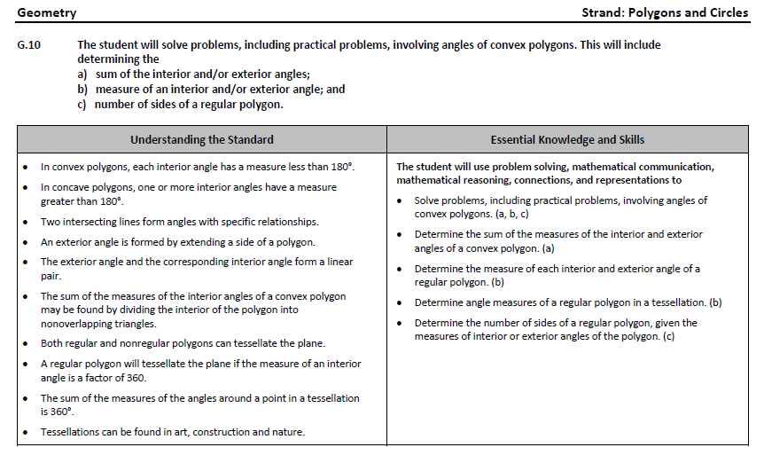
Notes:
This is a page from the Geometry curriculum framework. It is very important that teachers spend time exploring the new curriculum framework. This slide contains examples of edits (CLICK) made to the Understanding the Standard section that provide clarity in definitions and explanations. In some standards, examples have also been included.
In addition, where appropriate, (CLICK) corresponding EKS bullets and SOL bullets are indicated with the same letter.

Slide 8
Overview of Changes
Reporting Category | # of Standards (2009) | # of Standards (2016)
Reasoning, Lines, and Transformations | 4 | 4
Triangles | 4 | 4
Polygons and Circles | 4 | 4
Three-Dimensional Figures | 2 | 2
Total | 14 | 14
Notes:
There was an overall reduction in the number of mathematics standards spanning K-12. This is a result of consolidation of related concepts and skills, a reduction of repetition, an improvement of the developmental progression, and/or deletion of content.
In Geometry, there was no change in the number of standards in the 2016 compared to the 2009 standards.

Slide 9
Mathematics Process Goals for Students
“The content of the mathematics standards is intended to support the five process goals for students”
- 2009 and 2016 Mathematics Standards of Learning
Mathematical Understanding
Problem Solving
Connections
Communication
Representations
Reasoning
Notes:
The mathematical process goals continue to play an instrumental role in the teaching and learning of mathematics with understanding.
We encourage educators to review these sections included in the introduction of the 2016 curriculum frameworks.

Slide 10
Standards of Learning Curriculum Frameworks
Introduction includes:
  Mathematical Process Goals for Students
  Instructional Technology
  Computational Fluency
  Algebra Readiness
  Equity
New
Notes:
Four additional sections have been included in the introduction to the 2016 Curriculum Framework -- Instructional Technology, Computational Fluency, Algebra Readiness, and Equity. The content of each section addresses the impact on students’ learning and instruction. Educators are encouraged to review these sections included in the introduction.

Slide 11
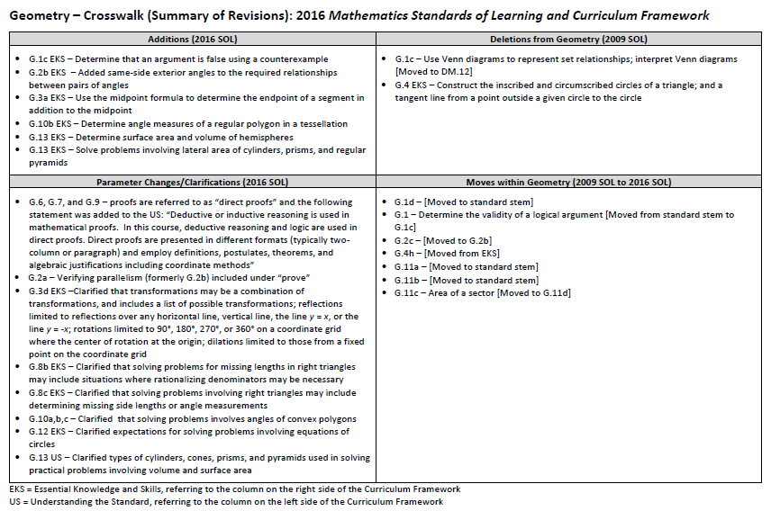
2009
2016
2009
2016
Notes:
This is a snapshot of the Geometry Crosswalk and Summary of Revisions page one. There are four quadrants – (CLICK) additions, (CLICK) deletions, (CLICK) parameter changes or clarifications, and (CLICK) moves within the Geometry course itself.
The upper left quadrant (CLICK) includes additions to the 2016 standards. The standards referenced (CLICK) are the 2016 numbers and may include additions (CLICK) to the Essential Knowledge and Skills (EKS) as well as the standards themselves.
The upper right quadrant (CLICK) includes deletions from the 2009 standards (CLICK) and may indicate where that content was moved using the 2016 standard number (CLICK).
The bottom left quadrant (CLICK) indicates parameter changes (for example G.8b Essential Knowledge and Skills (EKS) (CLICK) – solving problems for missing lengths in right triangles may include situations where rationalizing the denominator may be necessary.
In the bottom right quadrant (CLICK), moves within a grade level are indicated with the first number (CLICK) being the 2009 standard number and the second number in the brackets representing the 2016 standard number.

Slide 12
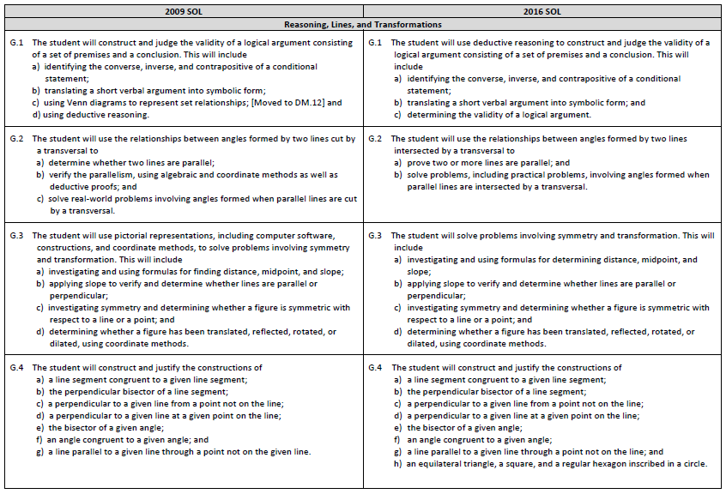
Notes:
On page 2 and the remaining pages of the Crosswalk, a side by side comparison of the 2009 standards (CLICK) and 2016 standards (CLICK) can be found. For comparison purposes, the standards are in numerical order for both columns. The standards are divided into strands, with the title of each indicated. (CLICK) When deleted content was moved or already found in another grade or course, it is indicated in brackets. For example, content from the 2009 SOL G.1c is now included in Discrete Mathematics (CLICK).

Slide 13
REASONING, LINES, AND TRANSFORMATIONS
Notes:
We will begin reviewing the revisions to the Geometry standards by looking at the Reasoning, Lines, and Transformations strand, which includes SOL G.1, G.2, G.3, and G.4.

Slide 14
2009 SOL | 2016 SOL
G.1 The student will construct and judge the validity of a logical argument consisting of a set of premises and a conclusion. This will include a) identifying the converse, inverse, and contrapositive of a conditional statement; b) translating a short verbal argument into symbolic form; c) using Venn diagrams to represent set relationships; [Moved to DM.12] and d) using deductive reasoning. | G.1 The student will use deductive reasoning to construct and judge the validity of a logical argument consisting of a set of premises and a conclusion. This will include a) identifying the converse, inverse, and contrapositive of a conditional statement; b) translating a short verbal argument into symbolic form; and c) determining the validity of a logical argument.
Revisions:
2009 SOL G.1c – Use of Venn diagrams to represent set relationships and interpreting Venn diagrams was moved to Discrete Mathematics (SOL DM.12)
Determine the validity of a logical argument was moved from standard stem of 2009 SOL G.1 to 2016 SOL G.1c
Using deductive reasoning was moved from the 2009 SOL G.1d to the stem of the 2016 SOL G.1
SOL G.1c EKS - Determine that an argument is false using a counterexample is now included
Notes:
SOL G.1 is now divided into three parts versus four. (CLICK) The 2009 standard G.1c - using Venn diagrams to represent set relationships is no longer included in the 2016 Geometry standards and is now included in the Discrete Mathematics standards. The portion of the 2009 standard stem related to judging the validity of a logical argument has been moved to G.1c. in the 2016 standards. Using deductive reasoning is now included in the stem of the 2016 G.1 standard versus part d of the 2009 standard. An addition to the Essential Knowledge and Skills (EKS) of G.1c is to determine that an argument is false using a counterexample.

Slide 15
2009 SOL | 2016 SOL
G.2 The student will use the relationships between angles formed by two lines cut by a transversal to a) determine whether two lines are parallel; b) verify the parallelism, using algebraic and coordinate methods as well as deductive proofs; and c) solve real-world problems involving angles formed when parallel lines are cut by a transversal.us | G.2 The student will use the relationships between angles formed by two lines intersected by a transversal to a) prove two or more lines are parallel; and b) solve problems, including practical problems, involving angles formed when parallel lines are intersected by a transversal.
Revisions:
2009 SOL G.2c is now SOL G.2b in the 2016 standards
2016 SOL G.2a combines SOL G.2a and SOL G.2b from the 2009 standards
2016 SOL G.2b EKS - Includes same-side exterior angles as a required relationship to be included between pairs of angles
2016 SOL G.2b - Real world problems are now referred to as practical problems in 2016
Notes:
There are now only parts a) and b) to SOL 2016 G.2. In 2016 G.2a, proving two or more lines parallel combines parts a and b from the 2009 standard. In the Essential Knowledge and Skills (EKS) section for G.2b, same-side exterior angles have been added to the required relationships between pairs of angles. Of note, in this standard and across the 2016 K-12 Mathematics Standards of Learning, real-world problems has been replaced by practical problems.

Slide 16
2009 SOL | 2016 SOL
G.3 The student will use pictorial representations, including computer software, constructions, and coordinate methods, to solve problems involving symmetry and transformation. This will include a) investigating and using formulas for finding distance, midpoint, and slope; b) applying slope to verify and determine whether lines are parallel or perpendicular; c) investigating symmetry and determining whether a figure is symmetric with respect to a line or a point; and d) determining whether a figure has been translated, reflected, rotated, or dilated, using coordinate methods. | G.3 The student will solve problems involving symmetry and transformation. This will include a) investigating and using formulas for determining distance, midpoint, and slope; b) applying slope to verify and determine whether lines are parallel or perpendicular; c) investigating symmetry and determining whether a figure is symmetric with respect to a line or a point; and d) determining whether a figure has been translated, reflected, rotated, or dilated, using coordinate methods.
Revisions:
“Use of pictorial representations, including computer software….” wording that was included in the stem of the 2009 G.3 standard is now included in the Understanding the Standard section of the 2016 G.3 standard
SOL G.3a EKS - Includes the use of the midpoint formula to determine the endpoint of a segment in addition to the midpoint
SOL G.3d EKS – Provides clarification that transformations may be a combination of transformations, and a list of possible transformations is included; reflections limited to reflections over any horizontal line, vertical line, the line y = x, or the line y = -x; rotations limited to 90°, 180°, 270°, or 360° on a coordinate grid where the center of rotation at the origin; dilations limited to those from a fixed point on the coordinate grid
Notes:
In SOL G.3, there are still four parts to the standard. A revision in SOL G.3 moves the use of pictorial representations, including computer software from the 2009 stem of the G.3 standard to the Understanding the Standard section of the 2016 G.3 standard. The EKS of G.3a includes using the midpoint formula to determine the endpoint of a segment in addition to determining just the midpoint itself. More clarification is provided in the Essential Knowledge and Skills of SOL G.3d regarding transformations. It is important to note that the 2016 standards for Grade 8 mathematics will no longer include rotations, thus students in subsequent years may not encounter this transformation prior to entering Geometry.

Slide 17
2009 SOL | 2016 SOL
G.4 The student will construct and justify the constructions of a) a line segment congruent to a given line segment; b) the perpendicular bisector of a line segment; c) a perpendicular to a given line from a point not on the line; d) a perpendicular to a given line at a given point on the line; e) the bisector of a given angle; f) an angle congruent to a given angle; and g) a line parallel to a given line through a point not on the given line. | G.4 The student will construct and justify the constructions of a) a line segment congruent to a given line segment; b) the perpendicular bisector of a line segment; c) a perpendicular to a given line from a point not on the line; d) a perpendicular to a given line at a given point on the line; e) the bisector of a given angle; f) an angle congruent to a given angle; g) a line parallel to a given line through a point not on the line; and h) an equilateral triangle, a square, and a regular hexagon inscribed in a circle.
Revisions:
2009 SOL G.4 EKS addressing constructing the inscribed and circumscribed circles of a triangle and constructing a tangent line from a point outside a given circle to the circle are NOT included in 2016 SOL G.4
2009 SOL G.4 EKS of constructing an equilateral triangle, a square, and a regular hexagon inscribed in a circle are now included in SOL G.4h
Notes:
Geometric constructions are addressed in SOL G.4. The EKS of the 2009 version of G.4 had included constructing the inscribed and circumscribed circles of a triangle and constructing a tangent line from a point outside a given circle to the circle, which have been deleted in the 2016 G.4 standard. The 2009 G.4 Essential Knowledge and Skill of constructing an equilateral triangle, a square, and a regular hexagon inscribed in a circle are now in G.4h of the 2016 standard.

Slide 18
TRIANGLES
Notes:
The next strand of the Geometry standards that we will examine is Triangles, which includes SOL G.5, G.6, G.7, and G.8.

Slide 19
2009 SOL | 2016 SOL
G.5 The student, given information concerning the lengths of sides and/or measures of angles in triangles, will a) order the sides by length, given the angle measures; b) order the angles by degree measure, given the side lengths; c) determine whether a triangle exists; and d) determine the range in which the length of the third side must lie. These concepts will be considered in the context of real-world situations. | G.5 The student, given information concerning the lengths of sides and/or measures of angles in triangles, will solve problems, including practical problems. This will include a) ordering the sides by length, given angle measures; b) ordering the angles by degree measure, given side lengths; c) determining whether a triangle exists; and d) determining the range in which the length of the third side must lie.
Revisions:
SOL G.5 - Real world problems are now referred to as practical problems in 2016
Notes:
The most notable change between the 2009 SOL G.5 and the 2016 version is the wording of “solve problems, including practical problems,” included in the stem of the standard, versus the note regarding considering the concepts in the context of real-world situations that was included in the 2009 standard.

Slide 20
2009 SOL | 2016 SOL
G.6 The student, given information in the form of a figure or statement, will prove two triangles are congruent, using algebraic and coordinate methods as well as deductive proofs. | G.6 The student, given information in the form of a figure or statement, will prove two triangles are congruent.
Revisions:
Wording from 2009 SOL G.6 standard regarding using algebraic and coordinate methods as well as deductive proofs is now included in the Understanding the Standard section of the 2016 SOL G.6.
In 2016 SOL G.6, G.7, and G.9 proofs are referred to as “direct proofs” and the following statement was added to the Understanding the Standard section: “Deductive or inductive reasoning is used in mathematical proofs. In this course, deductive reasoning and logic are used in direct proofs. Direct proofs are presented in different formats (typically two-column or paragraph) and employ definitions, postulates, theorems, and algebraic justifications including coordinate methods”
Notes:
The wording from 2009 G.6 regarding using algebraic and coordinate methods as well as deductive proofs is now included in the Understanding the Standard section of the 2016 G.6 standard. In 2016 SOLs G.6, G.7 and G.9 proofs are referred to as “direct proofs” and the following statement was added to the Understanding the Standard section: “Deductive or inductive reasoning is used in mathematical proofs. In this course, deductive reasoning and logic are used in direct proofs. Direct proofs are presented in different formats (typically two-column or paragraph) and employ definitions, postulates, theorems, and algebraic justifications including coordinate methods” The Understanding the Standard section of 2016 SOL G.6 now include statements for teachers that connect geometric constructions to congruent triangles. For example,
“Triangle congruency can be explored using geometric constructions such as an angle congruent to a given angle or a line segment congruent to a given line segment.” Deeper understanding of both constructions and congruency can be achieved when students explore the connection between the concepts in SOL G.4 and other SOL.

Slide 21
2009 SOL | 2016 SOL
G.7 The student, given information in the form of a figure or statement, will prove two triangles are similar, using algebraic and coordinate methods as well as deductive proofs. | G.7 The student, given information in the form of a figure or statement, will prove two triangles are similar.
Revisions:
Wording from 2009 SOL G.7 regarding using algebraic and coordinate methods as well as deductive proofs is now included in the Understanding the Standard section of 2016 SOL G.7.
In 2016 SOL G.6, G.7, and G.9 proofs are referred to as “direct proofs” and the following statement was added to the Understanding the Standard section: “Deductive or inductive reasoning is used in mathematical proofs. In this course, deductive reasoning and logic are used in direct proofs. Direct proofs are presented in different formats (typically two-column or paragraph) and employ definitions, postulates, theorems, and algebraic justifications including coordinate methods”
Notes:
As in the previous SOL, the wording from 2009 G.7 regarding using algebraic and coordinate methods as well as deductive proofs is now included in the Understanding the Standard section of the 2016 G.7 standard. In 2016 SOLs G.6, G.7 and G.9 proofs are referred to as “direct proofs” and the following statement was added to the Understanding the Standard section: “Deductive or inductive reasoning is used in mathematical proofs. In this course, deductive reasoning and logic are used in direct proofs. Direct proofs are presented in different formats (typically two-column or paragraph) and employ definitions, postulates, theorems, and algebraic justifications including coordinate methods.”

Slide 22
2009 SOL | 2016 SOL
G.8 The student will solve real-world problems involving right triangles by using the Pythagorean Theorem and its converse, properties of special right triangles, and right triangle trigonometry. | G.8 The student will solve problems, including practical problems, involving right triangles. This will include applying a) the Pythagorean Theorem and its converse; b) properties of special right triangles; and c) trigonometric ratios.
Revisions:
SOL G.8b EKS – Clarified that solving problems for missing lengths in right triangles may include situations where rationalizing denominators may be necessary
SOL G.8c EKS – Clarified that solving problems involving right triangles may include determining missing side lengths or angle measurements
SOL G.8 - Real world problems are now referred to as practical problems in 2016
Notes:
The 2016 G.8 standard has been subdivided into three parts a, b, and c. Again, “real-world problems” as addressed in the stem of the 2009 SOL G.8 are referenced as “practical problems” in the stem of the 2016 G.8 standard. In the 2016 standard of the Essential Knowledge and Skills column, solving problems for missing lengths in right triangles may include situations where rationalizing denominators may be necessary. The progression of radical expressions from the middle school to high school standards have been revised and it may benefit Geometry teachers to be aware of the revisions addressing radicals, especially in Algebra I and Algebra II. The 2016 G.8c Essential Knowledge and Skills now clarifies that solving problems involving right triangles may include determining the missing side lengths or missing angle measurements.

Slide 23
POLYGONS and CIRCLES
Notes:
The Polygons and Circles strand of the Geometry Standards of Learning includes only SOL G.9 through G.12. We will now examine the revisions included in this strand.

Slide 24
2009 SOL | 2016 SOL
G.9 The student will verify characteristics of quadrilaterals and use properties of quadrilaterals to solve real-world problems. | G.9 The student will verify and use properties of quadrilaterals to solve problems, including practical problems.
Revisions:
SOL G.9 - Students will verify and use properties quadrilaterals; the term “properties” vs. characteristics is used in 2016
SOL G.9 - Real world problems are now referred to as practical problems in 2016
In 2016 SOL G.6, G.7, and G.9 proofs are referred to as “direct proofs” and the following statement was added to the Understanding the Standard section: “Deductive or inductive reasoning is used in mathematical proofs. In this course, deductive reasoning and logic are used in direct proofs; direct proofs are presented in different formats (typically two-column or paragraph) and employ definitions, postulates, theorems, and algebraic justifications including coordinate methods”
SOL G.9 EKS - To prove properties of angles for a quadrilateral inscribed in a circle moved to the Understanding the Standard section of 2016 G.11
Notes:
SOL G.9 has a few revisions that alter wording, such as the use of the word “properties” in the standard versus “characteristics” from the 2009 standard. We again see the use of the wording “practical problems” in the 2016 standard versus “real-world problems.” In 2016 SOLs G.6, G.7, and G.9 proofs are referred to as “direct proofs” and the following statement was added to the Understanding the Standard section: “Deductive or inductive reasoning is used in mathematical proofs. In this course, deductive reasoning and logic are used in direct proofs. Direct proofs are presented in different formats (typically two-column or paragraph) and employ definitions, postulates, theorems, and algebraic justifications including coordinate methods” The Essential Knowledge and Skill from the 2009 standard to prove properties of angles for a quadrilateral inscribed in a circle has been moved to the Understanding the Standard section of 2016 G.11. The Understanding the Standard portion of the 2016 G.9 standard includes definitions and properties of quadrilaterals.

Slide 25
2009 SOL | 2016 SOL
G.10 The student will solve real-world problems involving angles of polygons. | G.10 The student will solve problems, including practical problems, involving angles of convex polygons. This will include determining the a) sum of the interior and/or exterior angles; b) measure of an interior and/or exterior angle; and c) number of sides of a regular polygon.
Revisions:
G.10b EKS - Includes determining angle measures of a regular polygon in a tessellation
SOL G.10 clarifies that solving problems involves angles of convex polygons
SOL G.10 - Real world problems are now referred to as practical problems in 2016
Notes:
The 2016 SOL G.10 now has three parts a – c . The Essential Knowledge and Skills (EKS) of G.10b has the addition of determining angle measures of a regular polygon in a tessellation. The 2016 G.10 standard clarifies that solving problems will involve the angles of convex polygons.

Slide 26
2009 SOL | 2016 SOL
G.11 The student will use angles, arcs, chords, tangents, and secants to a) investigate, verify, and apply properties of circles; b) solve real-world problems involving properties of circles; and c) find arc lengths and areas of sectors in circles. | G.11 The student will solve problems, including practical problems, by applying properties of circles. This will include determining a) angle measures formed by intersecting chords, secants, and/or tangents; b) lengths of segments formed by intersecting chords, secants, and/or tangents; c) arc length; and d) area of a sector.
Revisions:
2009 SOL G.11a (investigate, verify, and apply properties of circles) was moved to the standard stem of 2016 SOL G.11
2009 SOL G.11b (solve real-world problems involving properties of circles) was moved to the standard stem of 2016 SOL G.11
2009 SOL G.11c (area of a sector ) was moved to 2016 SOL G.11d
SOL G.11 - Real world problems are now referred to as practical problems in 2016
Notes:
The 2016 standard G.11 now has four parts instead of three. 2009 G.11a and G.11b are now included in the standard stem of 2016 G.11 standard. In addition, area of a sector, which was included in 2009 G.11 part c is now part d of the 2016 standard. Parts a and b of the 2016 G.11 standard now provide more specific details than previously included in the 2009 G.11 standard.

Slide 27
2009 SOL | 2016 SOL
G.12 The student, given the coordinates of the center of a circle and a point on the circle, will write the equation of the circle. | G.12 The student will solve problems involving equations of circles.
Revisions:
SOL G.12 EKS - Clarifies expectations for solving problems involving equations of circles
Notes:
The 2016 SOL G.12 Essential Knowledge and Skills now provides more clarification regarding the expectations for solving problems involving equations of circles compared to that of the 2009 standard.

Slide 28
THREE-DIMENSIONAL FIGURES
Notes:
The Three-Dimensional Figures strand in the 2016 Geometry Standards of Learning includes two standards, G.13 and G.14.

Slide 29
2009 SOL | 2016 SOL
G.13 The student will use formulas for surface area and volume of three-dimensional objects to solve real-world problems. | G.13 The student will use surface area and volume of three-dimensional objects to solve practical problems.
Revisions:
SOL G.13 EKS - Includes determining the surface area and volume of hemispheres
SOL G.13 EKS – Includes solving problems involving the lateral area of cylinders, prisms, and regular pyramids
The Understanding the Standard portion of the 2016 SOL G.13 clarifies the types of cylinders, cones, prisms, and pyramids used in solving practical problems involving volume and surface area
Notes:
The Essential Knowledge and Skills of the 2016 SOL G.13 now includes determining the surface area and volume of hemispheres and solving problems that involve the lateral area of cylinders, prisms, and regular pyramids. The Understanding the Standard portion of the 2016 G.13 standard now clarifies the types of cylinders, cones, prisms, and pyramids used in solving practical problems involving volume and surface area.

Slide 30
2009 SOL | 2016 SOL
G.14 The student will use similar geometric objects in two- or three-dimensions to a) compare ratios between side lengths, perimeters, areas, and volumes; b) determine how changes in one or more dimensions of an object affect area and/or volume of the object; c) determine how changes in area and/or volume of an object affect one or more dimensions of the object; and d) solve real-world problems about similar geometric objects. | G.14 The student will apply the concepts of similarity to two- or three-dimensional geometric figures. This will include a) comparing ratios between lengths, perimeters, areas, and volumes of similar figures; b) determining how changes in one or more dimensions of a figure affect area and/or volume of the figure; c) determining how changes in area and/or volume of a figure affect one or more dimensions of the figure; and d) solving problems, including practical problems, about similar geometric figures.
Revisions:
Geometric “objects” from 2009 SOL G.14 are now referred to as geometric “figures” in the 2016 G.14 standard
Notes:
The most significant revision to G.14 in the 2016 is the reference to geometric figures, which is a change from geometric objects which was used in the 2009 standard.

Slide 31
Questions?
Please contact the
VDOE Mathematics Team
Mathematics@doe.virginia.gov
Notes:
This concludes the presentation on the 2016 Standards of Learning for Geometry. As mentioned at the beginning of this presentation, teachers are encouraged to refer to the curriculum framework where additional information can be found.
Should you have any questions, feel free to contact a member of the Mathematics Team at Mathematics@doe.virginia.gov.

