Slide 1
Student Behavior and Administrative Response Collection (SBAR)
Regional Centers
April 25, 2022
Notes:
Welcome to the Student Behavior and Administrative Response Collection for Regional Centers.

Slide 2

Webinar Participation
Please type your questions in the Q&A box found at the bottom of your screen.
This presentation will be available to participants via the Tuesday Telegram and will be posted to the VDOE website

Slide 3
Agenda
Data Governance and Background
SBAR File Submission Process
Compile the File Information
Create the Tab Delimited Text File
Submission and Verification
Timeline and Contact Information
Questions
Notes:
We are gathering information to complete your SBAR submission file. A handful of regional programs have already submitted their Preliminary file; however, the process will also be needed for EOY SBAR submission.

Slide 4
Data Governance and Background

Slide 5
Student Behavior and Administrative Response Collection (SBAR)
Required by the Code of Virginia (§22.1-279.3:1) and used to satisfy federal assurances for ESSA, the Gun-Free Schools Act of 1994, and the Individuals with Disabilities Education Act (IDEA)
  Replaced the Discipline, Crime, and Violence Collection (DCV) in 2021-2022
SBAR enables reporting of all administrative responses (behavioral interventions, instructional supports, and disciplinary sanctions) to student behaviors that occurred
  On school property, a school bus, or at a school-sponsored activity
  OR, occurred in the community with in charges filed and an administrative response from the school that resulted in the student being alternatively placed
Allows VDOE to identify inequities in disciplinary outcomes, exclusionary practices, and school safety issues

Slide 6
Student Behavior and Administrative Response Collection (SBAR) cont.
SBAR Data collected twice a year
  Preliminary SBAR (February 1st through mid-March)
    Collection will be retired after 2022-2023
    This is not required of regional programs at this time, but submission is encouraged
  End of Year (EOY) SBAR (July 1st through August)
    Required

Slide 7
SBAR File Submission Process

Slide 8
SBAR File Submission Process
Option 1: Responsible Division staff send regional program data for their students to a designated division that submits the regional program file for all
Regional Program Staff (New Adventures/987)
987’s File
VDOE
Division Staff (Fiscal Agent, Supervisory Division, or another participating division for Regional Program)
Option 2: Regional Program staff submits data directly to VDOE
987’s File
Regional Program Staff (New Adventures/987)
VDOE
Notes:
When regional programs submit SBAR files to VDOE, there are two options for submission and these are equally appropriate data reporting models. Depending on how your program operates with local school divisions, size of your program, etc, one model may work better for you. The end result of either of these models is that VDOE will receive a data file where the regional program is the reporting entity. It can be staff from the regional program that submits the file or designated staff from one school division that submits the file.

Slide 9
Option 1: Designated Responsible Division Submits SBAR Data for Regional Center
  Download the Data File Template (formally the Header File) Excel document located on SBAR’s webpage, https://www.doe.virginia.gov/info_management/data_collection/sbar/index.shtml
  Enter the required data for all events, student behaviors, administrative responses and victims
  Complete the spreadsheet using the proper codes and format for each record type
Notes:
The regional program will designate a responsible division staff to submit SBAR data on behalf of the regional program.

Slide 10
Option 1: Designated Responsible Division Submits SBAR Data for Regional Center
  Send spreadsheet via SSWS Dropbox to division data collection manager
  Division data collection manager will contact regional program with any data errors for correction
  Regional Center Director will Complete the Local Approval and Verification process
Notes:
The regional program can work with the designated division determine the best way to transfer SBAR data. VDOE just requires that the data is complete and the transfer is secure (PII is protected).

Slide 11
Option: 2 Regional Centers upload their own data
  Download the Data File Template (formally the Header File) Excel document located on SBAR’s webpage, https://www.doe.virginia.gov/info_management/data_collection/sbar/index.shtml
  Enter the required data for all events, student behaviors, administrative responses and victims
  Complete the spreadsheet using the proper codes and format for each record type
  Convert the spreadsheet to a tab delimited text (.txt) file
Notes:
The regional program staff submits data directly to VDOE.

Slide 12
Option 2: Regional Centers upload their own data Cont.
  Within SSWS, upload the txt file
  Uploaded files will go through a process of edit checks. Check SSWS for Pass/Fail notifications
    A list of errors will be available for unsuccessful files
    Troubleshoot errors
    Resubmit file until all fatal errors are resolved
  Complete the Local Approval and Verification process

Slide 13
Compile the File Information

Slide 14
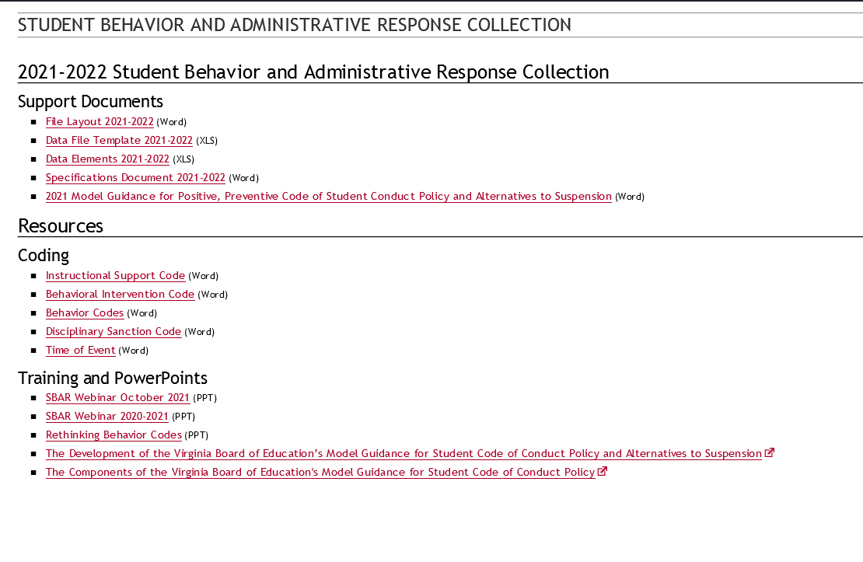
SBAR Webpage and Resources
https://www.doe.virginia.gov/info_management/data_collection/sbar/index.shtml
Notes:
Our SBAR Webpage and Resources contain links to information on the current file layout, the header file, data elements, specification document, behavior, instructional support, behavior intervention and , disciplinary sanction codes. There are also additional Training and PowerPoint slides for guidance. These documents go hand and hand they can assist you with completing your SBAR data file and answer questions.

Slide 15
Diagram of SBAR Connected Records
D Record: Student 1 Behavior 1
Response 1
C Record: Student 1 Behavior 1
D Record: Student 1 Behavior 1 Response 2
B Record: Event
C Record: Student 1 Behavior 2
D Record: Student 1 Behavior 2 Response 1
C Record: Student 2
Behavior 1
D Record: Student 2 Behavior 1 Response 1
E Record: Victims
(dependent on behavior code)
Notes:
The SBAR data consists of Events (B Records), Student Behaviors (C Records), Administrative Responses (D Records) and Victims (E Records). This diagram shows how each of the records are connected

Slide 16
SBAR Excel Data File Template
Download the “Data File Template.xls” from the SBAR webpage, https://www.doe.virginia.gov/info_management/data_collection/sbar/index.shtml
  This file contains a worksheet with column headers for each SBAR record type (referenced on the previous slide)
  Use this file to compile each section of the SBAR file to be sent to a responsible division collection manager or submit directly to VDOE

Slide 17
Example with Scenario
Reagan was caught spray-painting graffiti outside the school during lunch. She was removed from her classes for the remainder of the day. Later she was assigned 3 days of ISS.
Record Type | Local Event ID | Event Division | Event School | Date of Event | Time of Event | Location of Event | Firearms Confiscated | Weapons Confiscated
B | 3 | 987 | 9999 | 8/5/2021 | 1 | 3 | 0 | 0
Record Type | Local Event ID | State Testing ID | Behavior Code | Unknown Offender Code | Enrolled Division | Enrolled School | Aggravating Circumstances | Law Enforcement Flag | Notified of Charges Filed Flag | Notified of Conviction Flag
C | 3 | 1019998888 | BSO14 |  | 99 | 999 | N | N | N | N
Record Type | Local Event ID | State Testing ID | Behavior Code | Behavioral Intervention Code | Instructional Support Code | Disciplinary Sanction Code | Days Sanctioned | Alternate Placement Educational Agency | Alternate Placement School
D | 3 | 1019998888 | BSO14 |  |  | CR | .50
D | 3 | 1019998888 | BSO14 |  | 6 | ISS | 3
Record Type | Local Event ID | Student Victims | Staff Victims | Other Adult Victims | Other/Unknown Victims | Indeterminate Victims Flag | Filler | Filler | Filler | Filler
E | 1090 | 0 | 0 | 0 | 0 | N
Notes:
The data entered must tell the story about the event, the student’s behavior during the event, and the administrator’s response to that behavior. The data must also reveal if there were any victims involved.

Slide 18
Create the Tab Delimited Text File
Notes:
SBAR data is made of many scenarios and stories. Once all data has been collected, a tab delimited file has to be created.

Slide 19
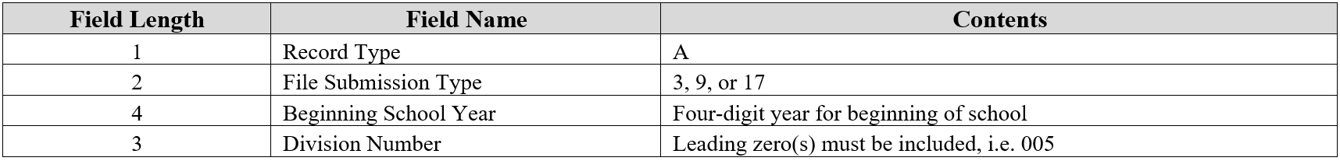
The Header and A Record Data Elements
03 - End of Year
09 - Pre-submission
17 - Preliminary
The Header
SenderID=987
CreateDate=04/25/2022
CreateTime=09:02:18
EMAIL=john.doe.@email.com
~~
DATATYPE=SBAR
~
A172021987
The A Record
Notes:
The header record consists of record type A, file submission type, beginning school year, and regional program or school division number. The A record is 10 digits long and indicates information about the data collection.
A means A record
17 means Preliminary SBAR.
The current school year is 2021
And the last three numbers represent your regional program number or division number which will be the same number as the sender id.

Slide 20
Creating Tab Delimited File
Open a blank Word document
Select all data from the very first Record Type B to the very last filler (everything in blue); the 4 fillers at the end of each row are necessary to complete each B record
Do Not include the column headers
Notes:
Open a blank Word document
Select everything in blue.

Slide 21
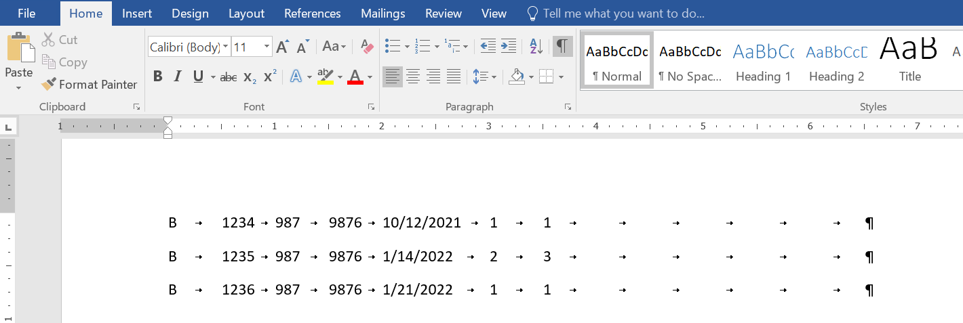

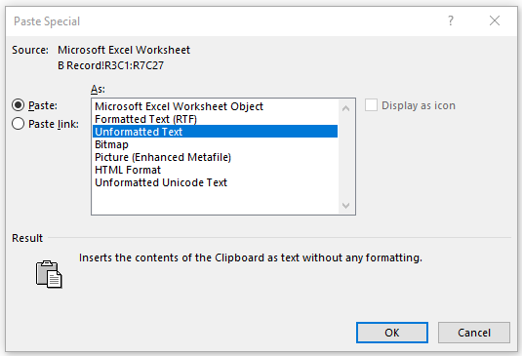
Creating Tab Delimited File Cont.
Select Paste
  Select Paste Special
  Select Unformatted Text
  Select Okay
Turn on hide/show character to see the tabs which represent the empty fields for the required elements (circled in red)
Make sure that there are NO extra lines or spaces in between the rows of data
Repeat the process for C Records
Notes:
Go to your Word document
select paste
select paste special
select unformatted text
and select okay
If this process is not followed, the data will not format correctly.

Slide 22
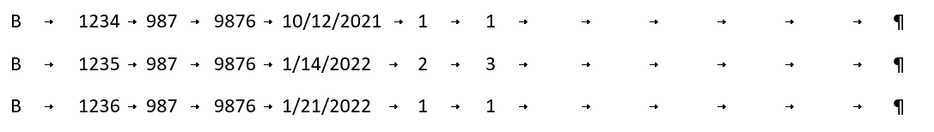
Creating Tab Delimited File
B Record Data Elements
Record Type B
Local Event ID
Event Division
Event School
Date of Event
Time of Event
Location of Event
Firearms Confiscated
Weapons Confiscated
Filler
Filler
Filler
Filler
When the Hide/Show character is selected, the tabs in each null fields become visible. Although not every field has a data value, each record contain the same number of fields, and each field represents a required data element to complete the B Record.
Notes:
Each record type have specific data elements and a specific number of fields which make up a record. As you can see, the B Record contains 9 data elements and 4 fillers; this means that each B Record in your data file must include 13 fields. If they do not, then you will receive a fatal error.
Although not every field has a data value, the hide/show character allows you to verify that each of the 13 fields represented in the data element have been accounted.

Slide 23
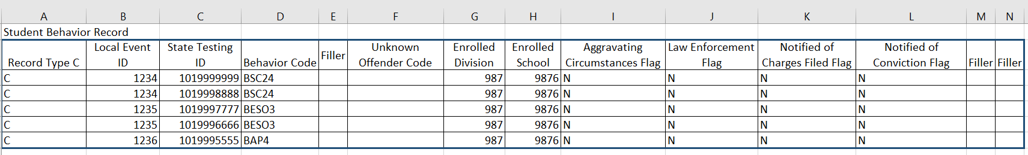
Creating Tab Delimited File
Select all data from the very first C Record Type to the very last filler (everything in blue); the 2 fillers at the end of each row are necessary to complete each C record
Do Not include the column headers
Paste C Record data underneath the B Records
Notes:
Select everything in blue.

Slide 24
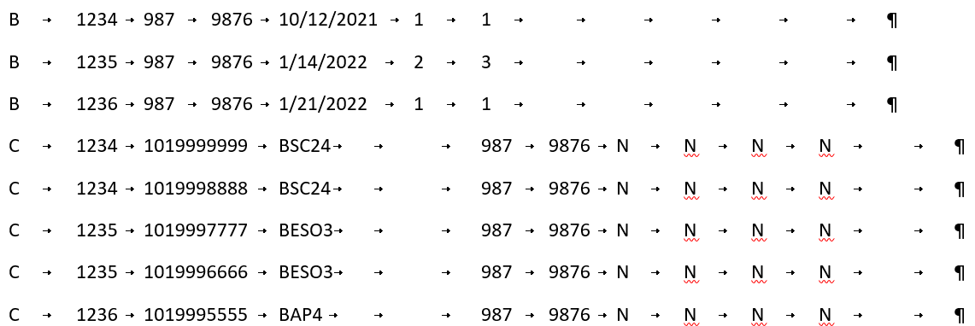
Creating Tab Delimited File
Repeat the process for D and E Records
Notes:
Go to your Word document
Position your cursor directly under the B Records
select paste
select paste special
select unformatted text
and select okay
Repeat the process for D and E Records

Slide 25
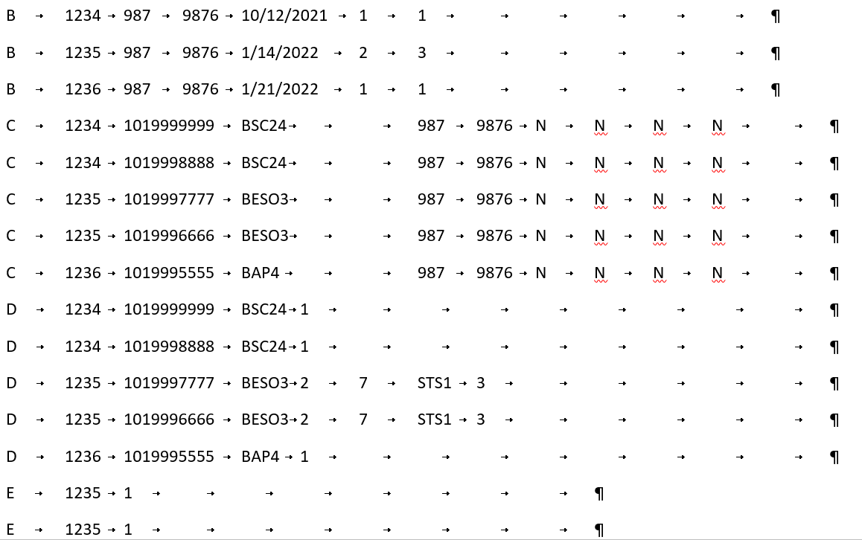
Creating Tab Delimited File
Here is a look at all of the data collected in the B, C, D and E Records
Add the A Record and position it above the first B Record
Notes:
Add Header and A Record and a record count at the bottom. The record count includes the A record, B records, C records, D records and E records. Do not include the header in your count

Slide 26
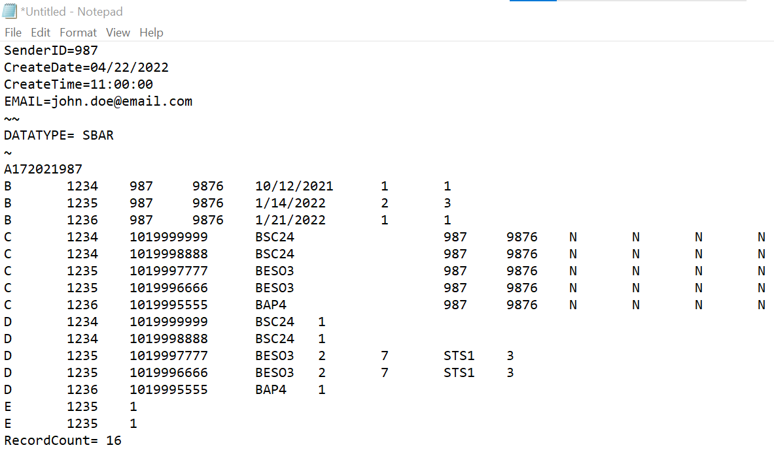
Creating Tab Delimited File Cont.
Open Notepad
Select file contents starting with SenderID and ending with the last paragraph mark in the last record
Paste file contents into Notepad.
Save File (Save As .txt file)
  File name should not include any spaces within the name
Notes:
Here is the completed data file.
Open Notepad
Select all file contents starting with the header and ending with the record count
Paste all file contents into Notepad
Name the file. The file name should not have any spaces within the name
And Save File As a Text Document (.txt)

Slide 27
Submission and Verification
Notes:
Now that that the SBAR tab delimited file has been created, it is time to send it to VDOE.

Slide 28
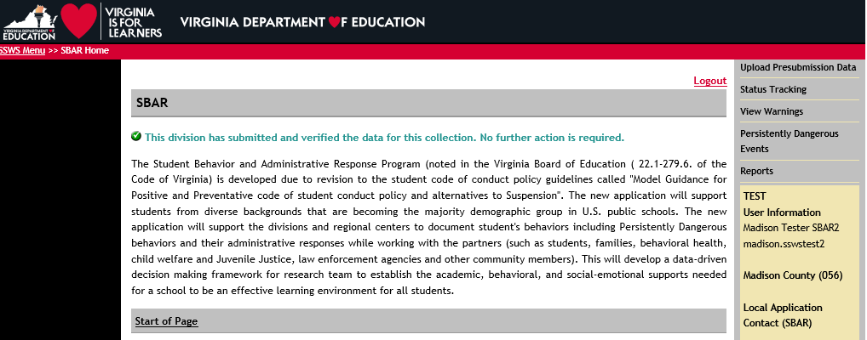
Notes:
Log into SSWS
Select the Student Behavior and Administrative Response (SBAR) link
Select your regional center
Select Upload SBAR Data file.
If the Preliminary window is open, this will say “Upload Preliminary Data”.
If the EOY window is open, it will say “Upload End of Year Data”.

Slide 29
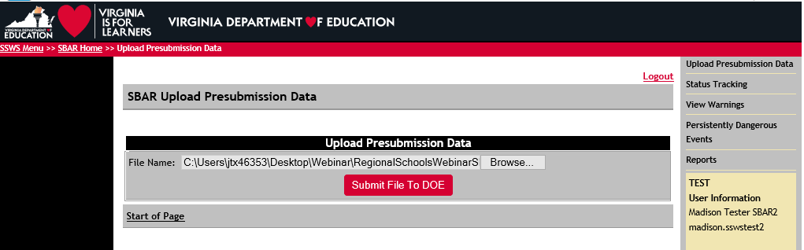
Select the Browse button to get your data file
Select the Submit File to DOE
C:\Users\Desktop\Webinar\vdoesbarfile_04-25-2022.txt
Once DOE has received your data file, an email message will be sent regarding the status of your file submission.
Notes:
Select the Browse button and navigate to your file
Select your data file
Select the Submit File To DOE button
And once DOE has received your SBAR file, an email message will be sent regarding the statues of your file submission.

Slide 30
Verification Report
Notes:
Check with your SSWS Account Manager for access to the Reports selection.

Slide 31
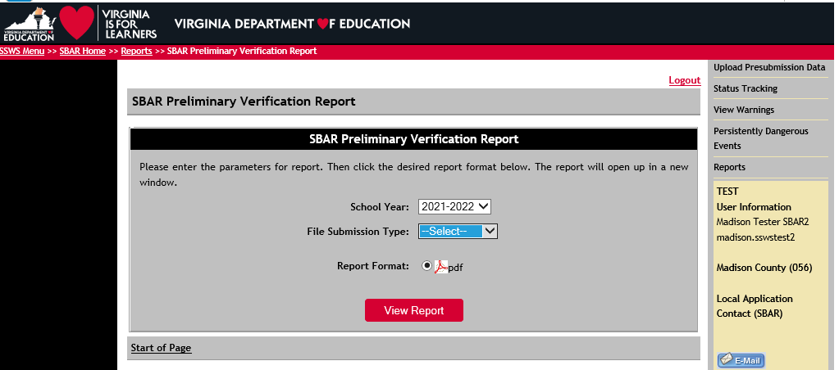
Select Reports
SBAR Preliminary Verification Report
Notes:
To review your verification report, select reports from the menu.
Select SBAR Preliminary Verification Report.
Select the school year
Select File Submission Type; there will be an option between End of Year and Preliminary
Select View Report

Slide 32
Data Submission and Verification Flow
Upload Data
Resolve All Issues
Review Verification Report
Submit for Local Approval
Local SBAR Data Approver
Submit for Verification
SBAR data goes to Director
Notes:
SBAR Data Submission and Verification Flow is pretty much the same process as VDOE’s other data collections. If the data file is rejected at any point within the submission and verification flow, the process must start over again by correcting the questionable data, uploading the new file, and troubleshooting all errors.

Slide 33
Timeline and Contact Information

Slide 34
SBAR 2021-2022 Timeline
Regional Schools and Division-level data gathering is ongoing July 1, 2021 - June 30, 2022
Preliminary (past due)
  Currently accepting Preliminary SBAR data from Regional Programs
  Optional but encouraged
Other Important Dates:
  April 25 - Regional Schools Training Webinar
  July 1 - EOY SBAR Window Opens (planned)
  Aug 26 - EOY SBAR Final Signatures Due
Notes:
It is highly recommended that regional programs submit data on a monthly or quarterly basis. This ongoing process allows for review of the data and edits for the point of time of the submission.

Slide 35
Internal Help for your Division
Assistance with file layouts and uploading files in SSWS
  SBAR Collection contact
Assistance with access to the SBAR application in SSWS
  SSWS Account Manager
  SSWS back-up Account Manager
Assistance with setting up local approvers
  SSWS Account Manager
  SSWS back-up Account Manager
Assistance with setting up Superintendent Data Collection Approval (SDCA) account for Superintendent
  SSWS Account Manager
  SSWS back-up Account Manager
Notes:
If you need help, your local co-workers can assist you.

Slide 36
Contact Information
Student Behavior And Administrative Response Collection web site:
https://www.doe.virginia.gov/info_management/data_collection/sbar/index.shtml
Patricia Mealy, Data Specialist, Office of Data Services
Email: patricia.mealy@doe.virginia.gov or
resultshelp@doe.virginia.gov
Rebecca Kahila, School Safety and Discipline Specialist, Office of Student Services
Email: rebecca.kahila@doe.virginia.gov

Slide 37
Thank You
For Your Time and Attention
Notes:
Thank you.

