Slide 1
SBAR: Rethinking Behavior Codes
December 16, 2020

Slide 2

Webinar Participation
Please type your questions in the Q&A box found at the bottom of your screen.
This presentation will be available on the Student Behavior and Administrative Response webpage and Tuesday Telegram

Slide 3
Agenda
Model Guidance for Positive and Preventative Code of Student Conduct
Behavior Categories and Responding to Behavior
Local Authorization Code
Tentative timeline
Questions

Slide 4
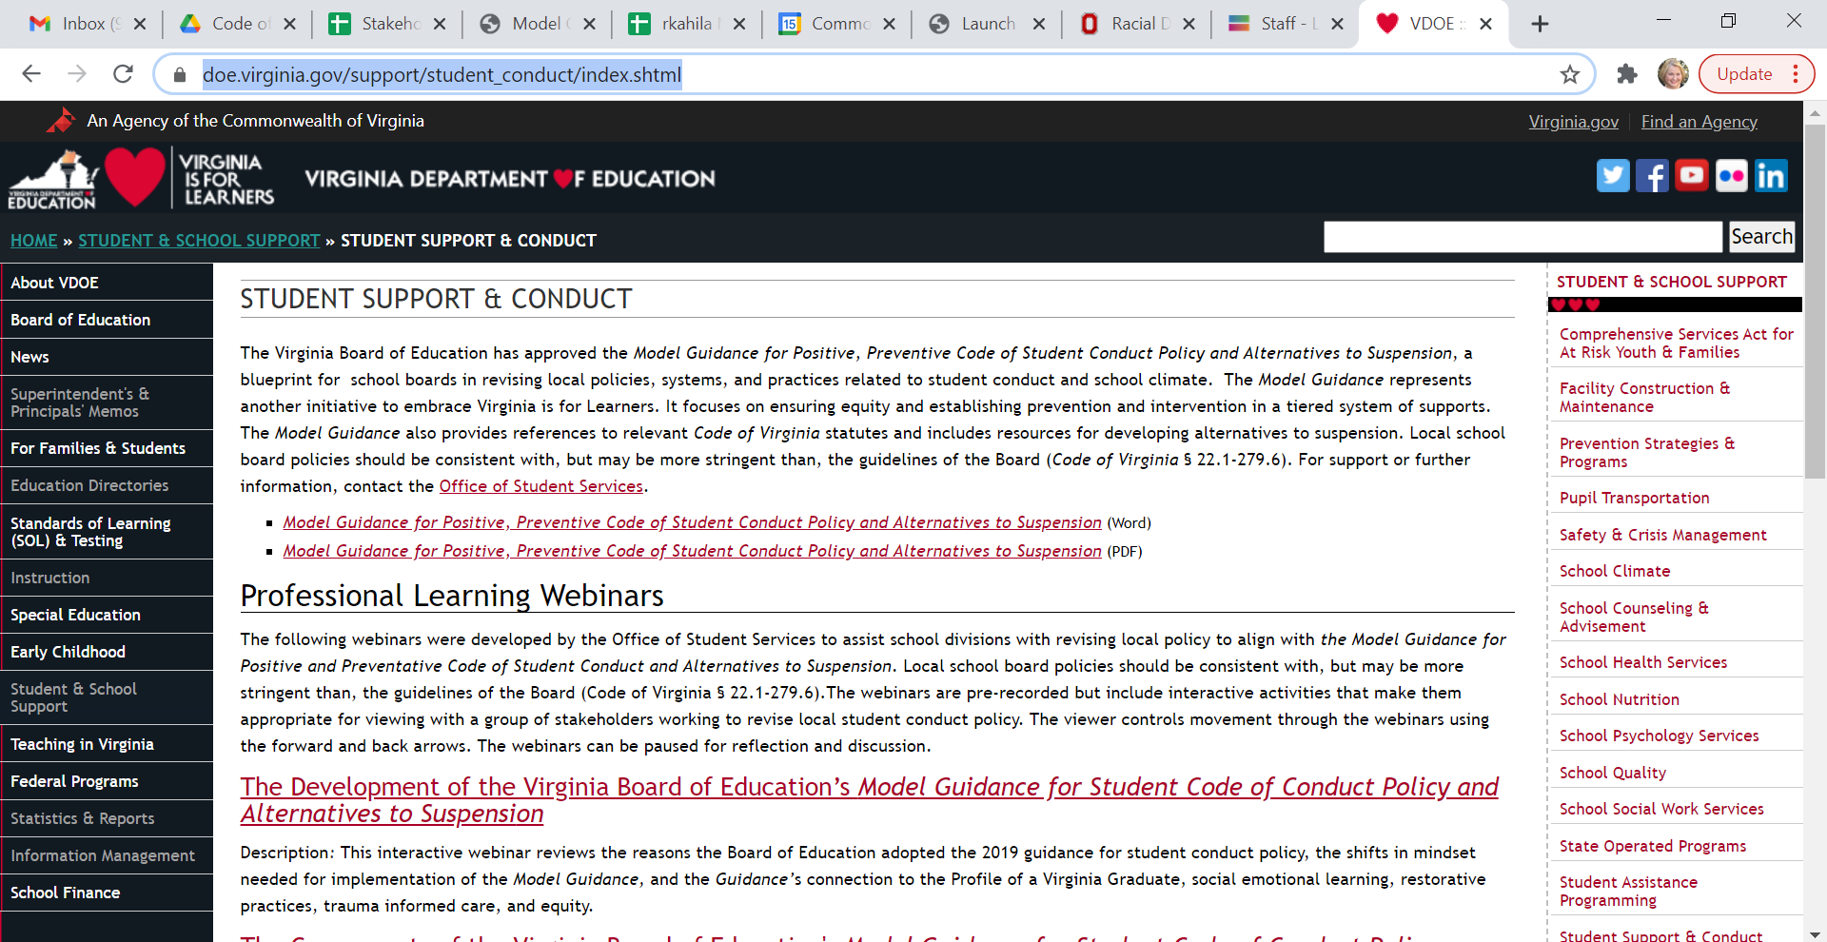
https://www.doe.virginia.gov/support/student_conduct/index.shtml

Slide 5
Assess social emotional development.
Behavior is communication.
Understand the message.
Behavior has cultural context.
Know the story.
Behavior is developmental.
Behavior is learned.
TEACH.
Notes:
Shifting our mindset to focus on prevention requires that we agree upon and understand that behavior is communication –Healthy adults have learned to use words to communicate their needs and feelings most of the time, but students are still learning how to communicate their needs and feelings verbally. So, it is the job of the adults in schools to understand the message that a student is communicating through behavior. Behavior is also learned in a cultural context. What one culture teaches as respectful behavior may be considered disrespectful in another setting. To understand their behavior, we must know the story and see the behavior through their cultural context rather than our own. Behavior is developmental. Science tells us that the human brain does not fully develop decision making skills until our early to mid 20’s. Yet, we sometimes assume that student behavior is a product of decision making when often it is not We must know our students’ stories. Behavior is learned and sometimes has to be unlearned to adapt to a school environment. That is why in schools we must teach the behaviors we want to see in a school setting. These ideas lie at the foundation of the Model Guidance and are directly connected to Virginia Tiered Systems of Support and Positive behavioral interventions and supports.

Slide 6
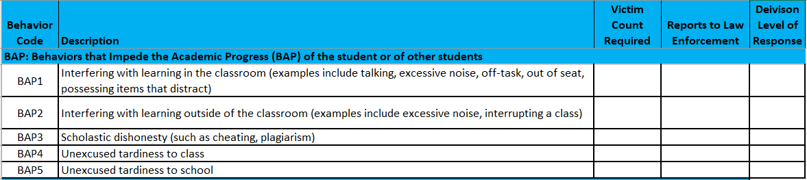
Behavior Descriptors
Notes:
The behavior descriptors in the Model Guidance will replace the DCV codes that we have all grown so accustomed to using. Some school divisions have already updated their student conduct policies to reflect the descriptors, some are in process. By 2021-2022, all school divisions will use the behavior descriptors from the Model Guidance which describe student behavior without bias and criminalization, encourage administrators to ask what harm was caused and what caused the behavior. What is the student communicating? They re-focus administrative responses to behavior to being prescriptive in regard to the student’s social emotional development and they give the student the opportunity to understand the behaviors impact on the community and to repair the harm caused.

Slide 7

Behavior Categories: What harm was caused?
Behaviors that impede Academic Progress (BAP)
Behaviors related to School Operations (BSO)
Relationship Behaviors (RB)
Behaviors that present a Safety Concern (BSC)
Behaviors that Endanger Self or Others(BESO)
Behaviors that are Persistently Dangerous (BPD)
Notes:
Behavior affects the community. Understanding that effect is a step in restoration and healing for the community and for the person who caused the harm. To shift the mindset from criminal language to developmental approaches, these behavior categories were created. They generate a conversation for understanding the behavior for students and for adults. They begin the restorative conversation about what harm was caused and lead to determining what social emotional learning skill the student may need to develop. The categories are
Behaviors that impede Academic Progress (BAP)
Behaviors related to School Operations (BSO)
Relationship Behaviors (RB)
Behaviors that present a Safety Concern (BSC)
Behaviors that endanger Self or Others(BSO)

Slide 8
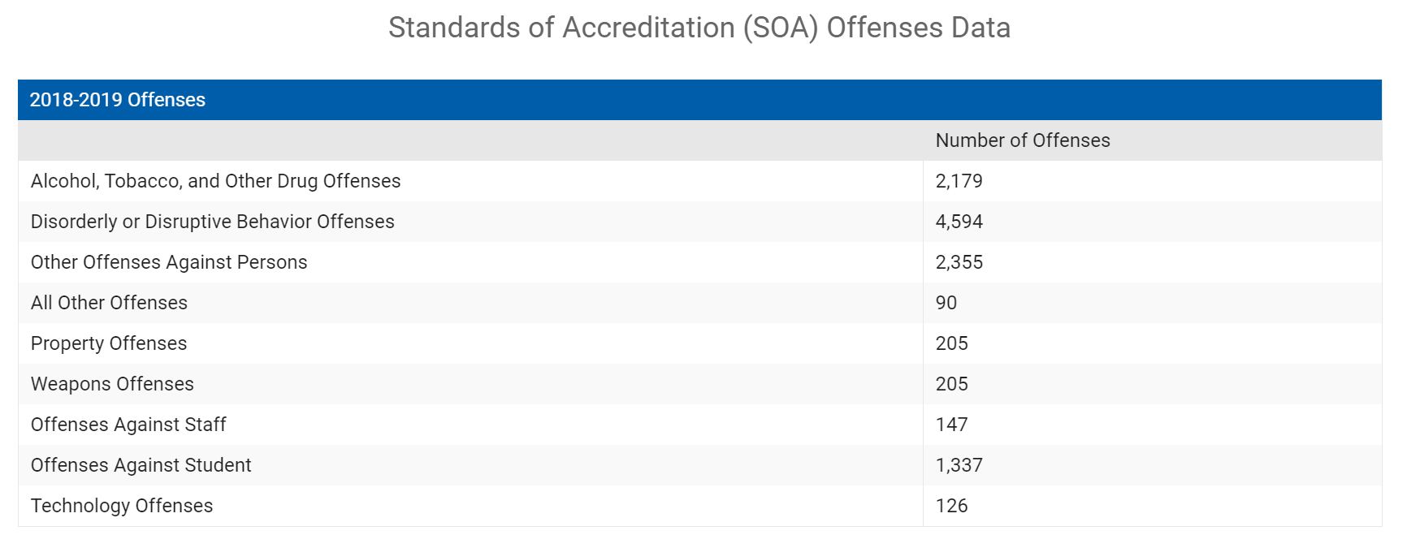
School Quality Profiles
Notes:
State Reporting – If there is no exclusion, does it need to be reported? Each event can have multiple responses: 3 kinds This is a way for school divisions to report what they are doing to support students, not just exclude them.

Slide 9
Behavior Categories and Response

Slide 10

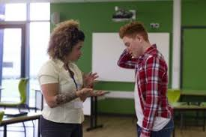
Behavior as Communication
https://www.edutopia.org/discussion/how-talk-problem-student-without-them-tuning-you-out
Notes:
Teacher on left telling student they are being defiant, disrespectful, & disruptive.
Teacher on right explaining the impact of the students behavior and centered conversation around students success.
What message do each of these send?

Slide 11

Behavior as Communication
https://extension.umn.edu/parent-school-partnerships/eight-p-philosophy-effective-school-family-partnerships
Notes:
Teachers and administrators are communicating in the same way. Conversation centered on student success and not student punishment.

Slide 12
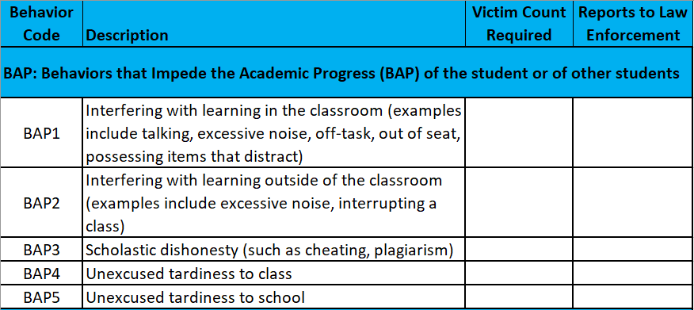
Category BAP

Slide 13
BAP Scenario
David repeatedly interrupts the teacher while he is talking. David does not raise his hand and is talking loudly during an independent practice.
What harm is done?
BAP1- Interfering with learning in the classroom.
Notes:
Poll: What level of response would this behavior get in your division on the first event? What sanction, instructional support, and behavioral interventions are in that level?

Slide 14
Create Your Division’s Leveled Responses
5 levels with exclusion limits
Include Sanctions, Instructional Supports, and Behavior Interventions

Slide 15
Leveled Administrative Responses pages 36-38
Level | Instructional Supports | Behavioral Supports | Sanctions
1 |  |  | *Class Removal or ISS for no more than 2 days
2 |  |  | *Class Removal or ISS for up to 3 days
3 |  |  | *ISS of 3 to 5 days; STS for 1-3 PK-3 and 1 -5 days 4-12
4 |  |  | *STS of 1- 3 days for PK-3; 4-10 days for 6-12 students or LTS for 11 to 45 days per local policy
5 |  |  | *LTS, AG, Expulsion
Notes:
Which resources will be deployed at each level. Pages 36 to 38.

Slide 16
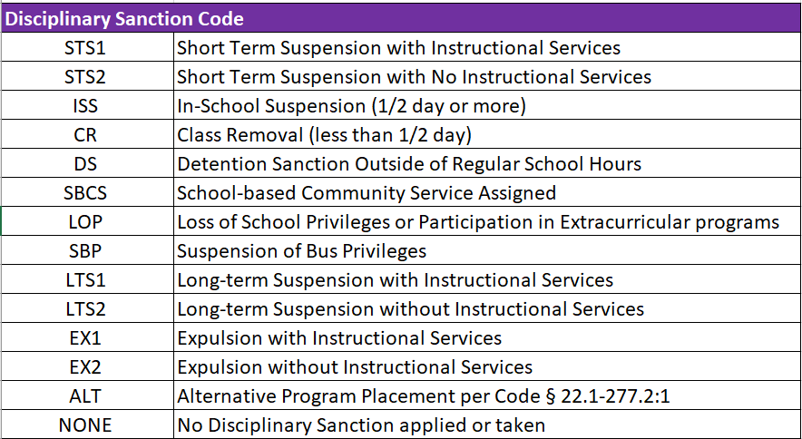
Disciplinary Sanction Code

Slide 17
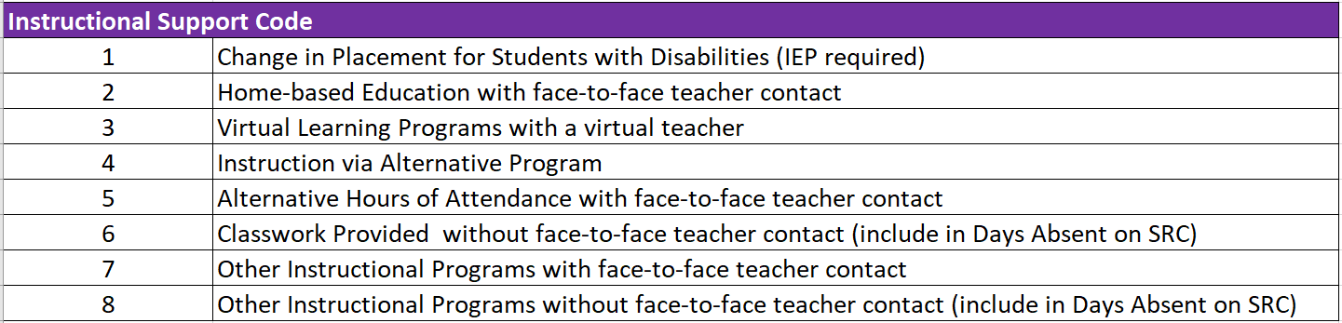
Instructional Support Code
Any instructional support provided to the student

Slide 18
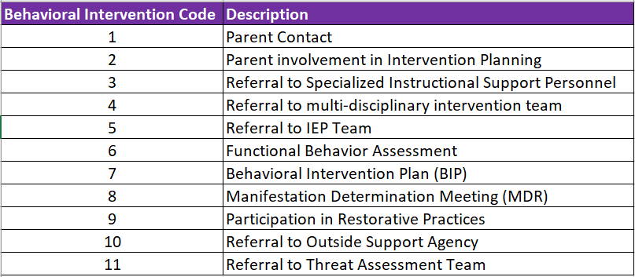
Behavioral Intervention Code
Specific intervention that addresses the specific student behavior

Slide 19
POLL
Event: David repeatedly interrupts the teacher while he is talking. David does not raise his hand and is talking loudly during an independent practice.
What level of response would this behavior get in your division on the first event reported to the administration assuming the teacher has taken steps to change the behavior?
What sanction, instructional support, and behavioral interventions are in that level?
Notes:
Use chat

Slide 20
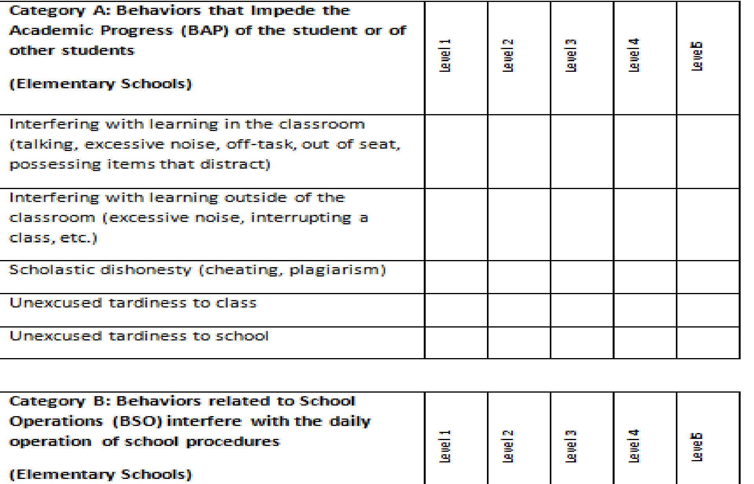
School divisions create levels of response and determine the level of response to each behavior
49
Notes:
X’s in your boxes

Slide 21
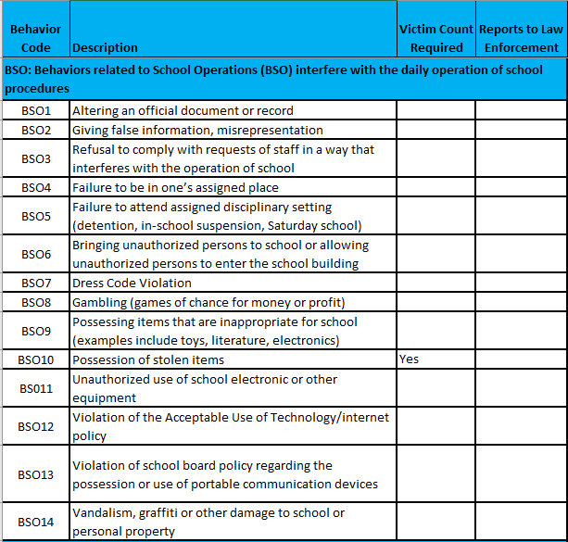
Category BSO
Notes:
I will probably just click over to the spreadsheet here.

Slide 22
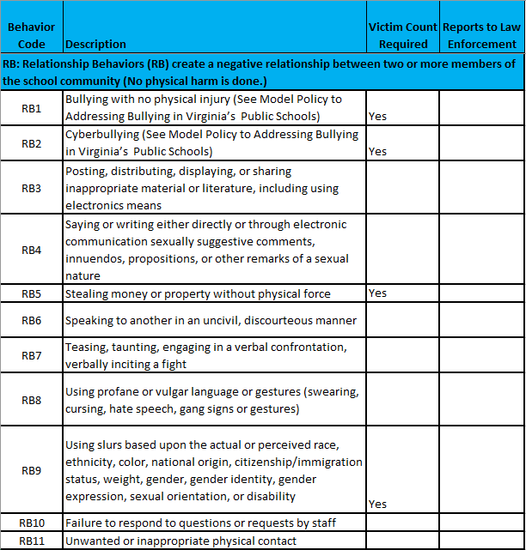
Category RB

Slide 23
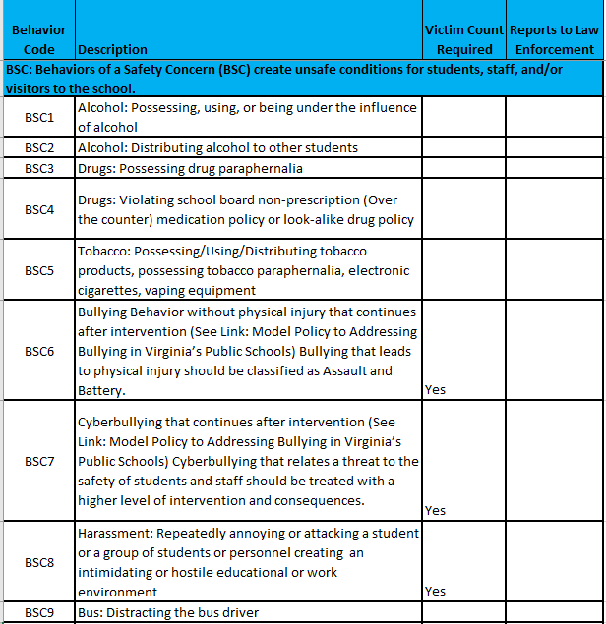
Category BSC

Slide 24
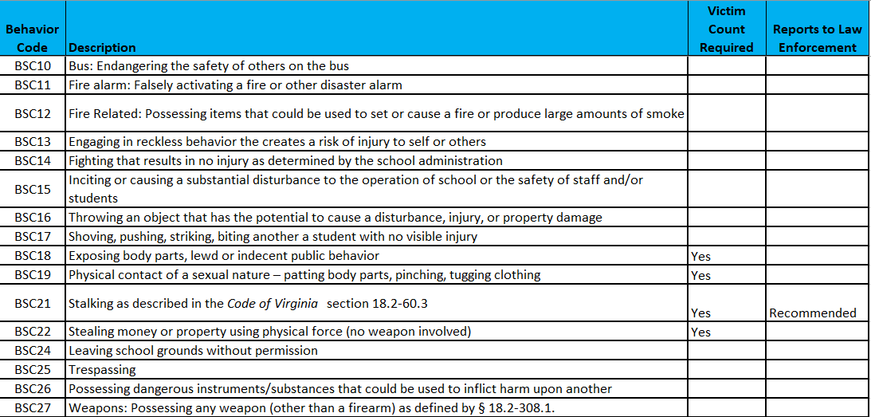
Category BSC

Slide 25
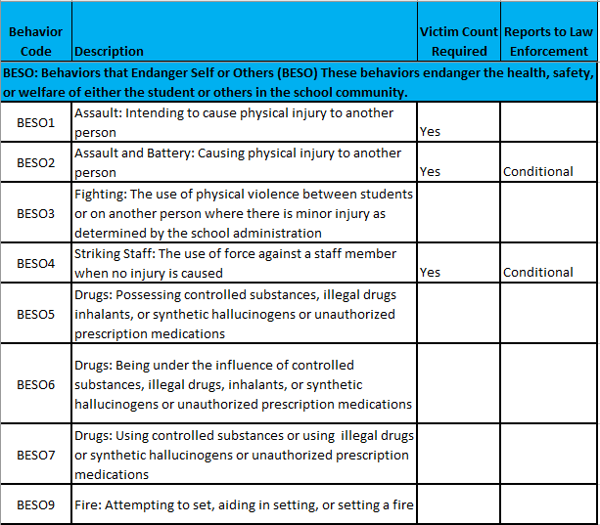
Category BESO

Slide 26
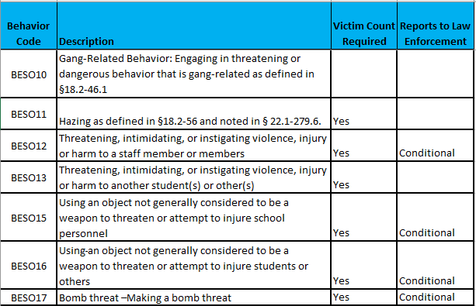
Category BESO

Slide 27
BESO Scenario
Kelsey arrived at school high one morning.
What harm was caused?
BESO6- Being under the influence of controlled substances, illegal drugs, inhalants, or synthetic hallucinogens or unauthorized prescription medications
Notes:
We are concerned for Kelsey and her safety. This tells us to look in BESO category.

Slide 28
POLL
Event: Kelsey arrived at school high one morning
What level of response would this behavior get in your division on the first event reported to the administration assuming the teacher has taken steps to change the behavior?
What sanction, instructional support, and behavioral interventions are in that level?
Notes:
Use chat

Slide 29
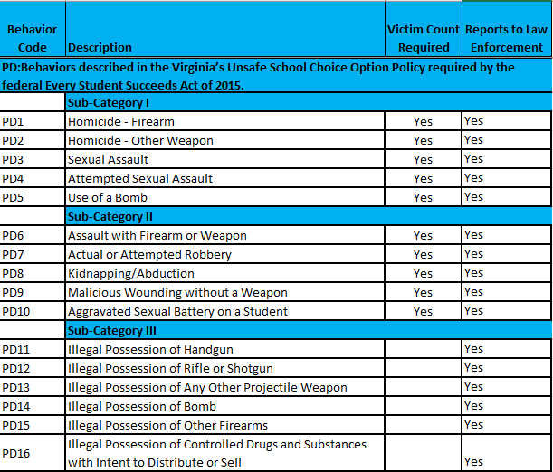
Category BPD
Notes:
Add explanation of victim reporting here to explain why there is just one behavior descriptor not two.

Slide 30
Obtaining a Local Authorization Behavior Code

Slide 31
Local Authorization Code/Other Explanation
Established process for obtaining a Local Authorization Code for any behavior not identified in the existing behavior codes
This is to track behaviors that need codes, to prevent having too many codes, and to ensure accurate reporting
Notes:
Example: Cutting Class, Tardy to class, Use examples

Slide 32
Obtaining a Local Authorization Code
Ask “What harm was caused?”
  This will aid in selecting a behavior category.
Call or email us directly
This code will be stored for one year with LEA permissions.
We will review before the next school year.

Slide 33
Responding to Behavior
Notes:
Look at responses with same lens framed around student success, not punishment!

Slide 34
Example of SBAR Reporting
D Record: Student 1 Behavior 1
Response 1
C Record: Student 1 Behavior 1
D Record: Student 1 Behavior 1 Response 2
A Record
B Record: Event
C Record: Student 1 Behavior 2
D Record: Student 1 Behavior 2 Response 1
C Record: Student 2
Behavior 1
D Record: Student 2 Behavior 1 Response 1
E Record: Victims
Notes:
Remind them where this fits in SBAR reporting

Slide 35
Keeping the Conversation Going
How can I relay this information to the right people?
What resources could assist you?
Notes:
I want to stop a minute and talk about how important it is to consider staff training. This information is not just helpful for data personelle!

Slide 36
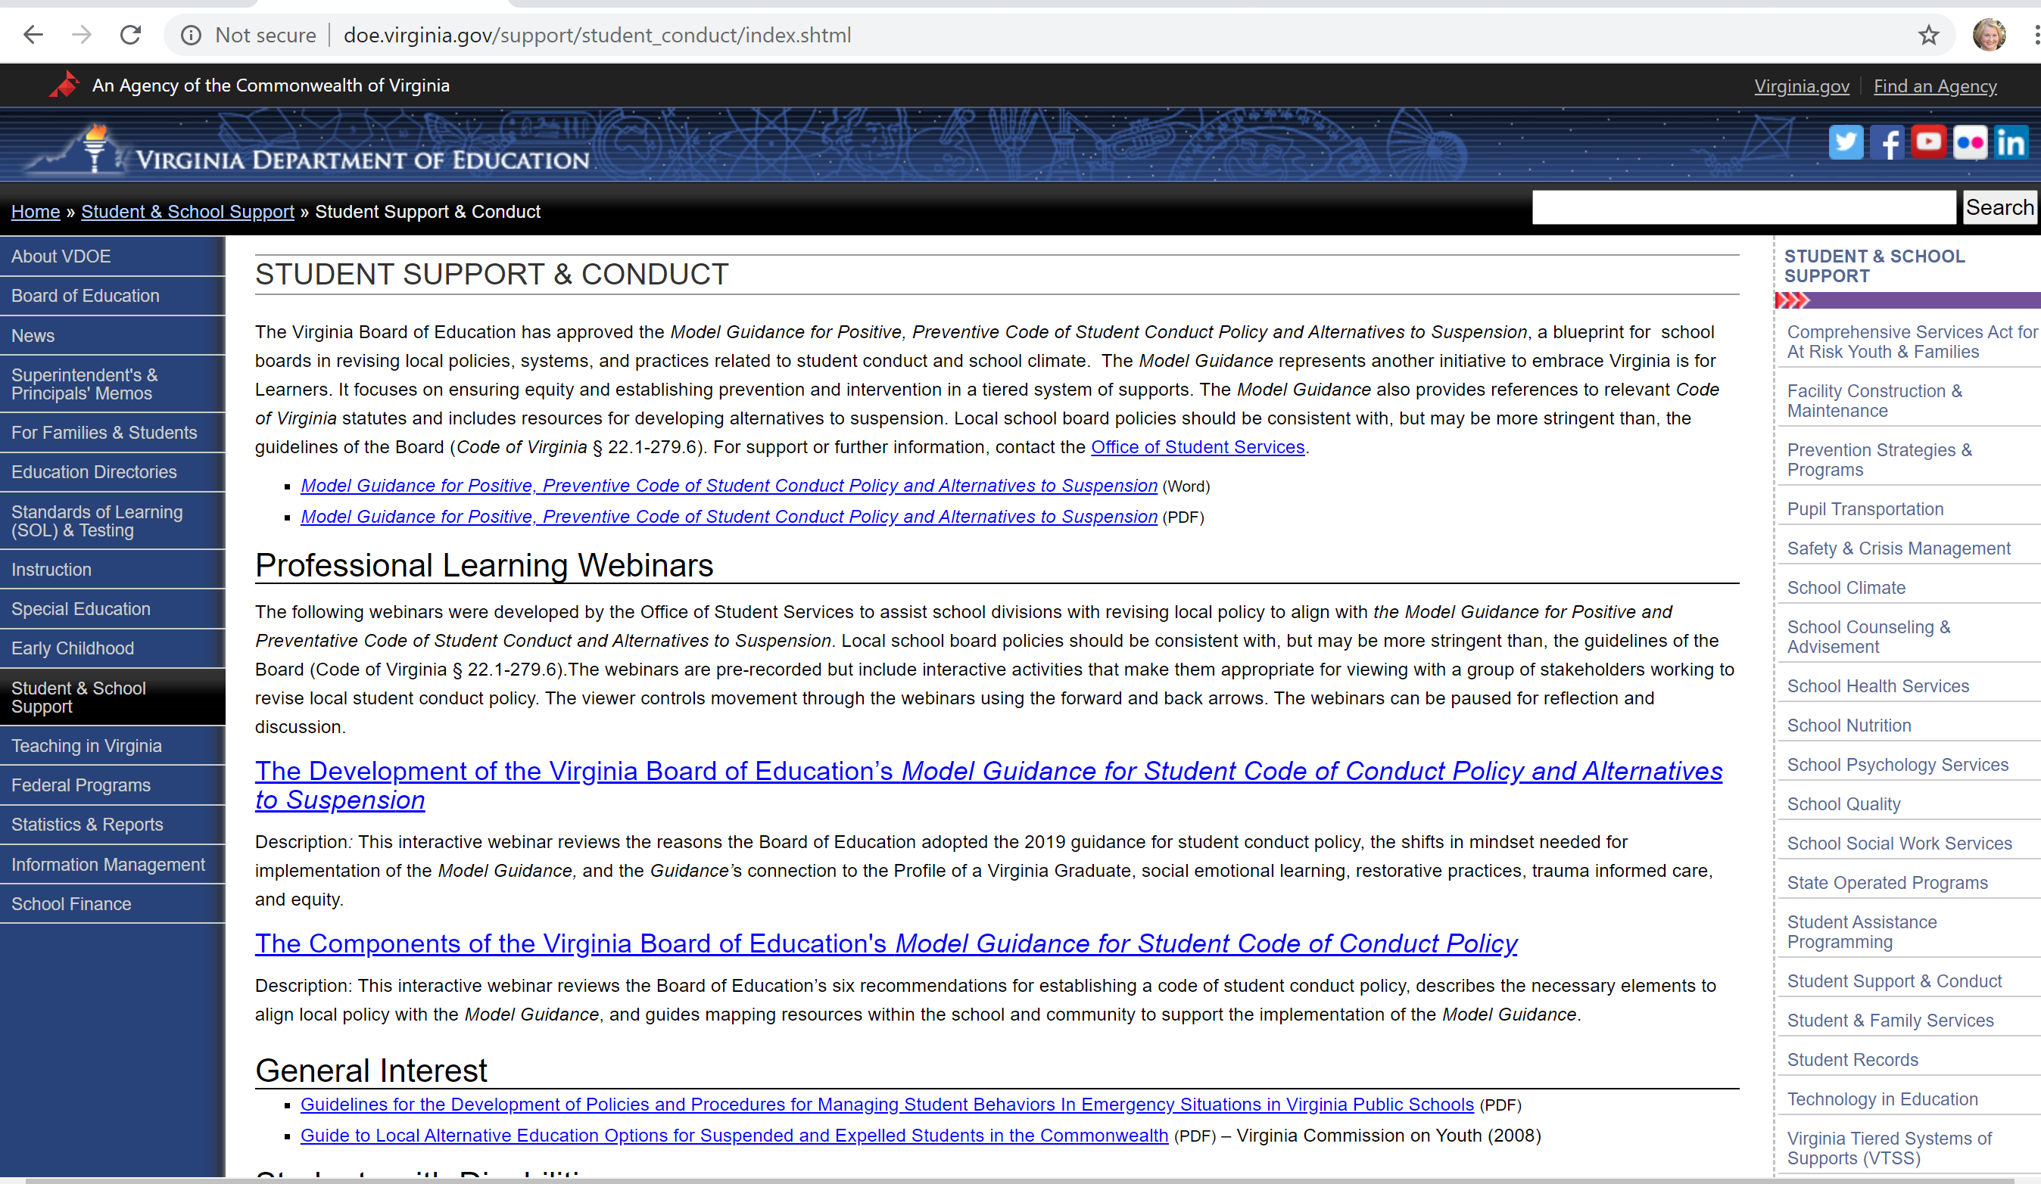

Slide 37
Tentative Timeline
2020-2021 School Year-Divisions implementing new Model Guidance (ongoing at LEA level)
2020-2021 – Quarterly Webinars
July 16, 2021 – Final DCV submission closes.
October 1, 2021 – Web form opens for reporting Persistently Dangerous Events
October 1, 2021* – February 1, 2022*- Pre-submission to SBAR is open.
March 1, 2022* – Preliminary SBAR submission due
July 31, 2022 – End of Year SBAR submission due
Fall 2022- SBAR Build-a-Table will be available
*Date subject to slight change

Slide 38
Contact Information
E-Mail:
  ResultsHelp@doe.virginia.gov
  Brittney.Kanard@doe.Virginia.gov
  Rebecca.Kahila@doe.Virginia.gov
  Susan.M.Williams@doe.virginia.gov
Phone:
  (804) 225-3909

