Slide 1
2016 Mathematics Standards of Learning
Algebra II
Overview of Changes from 2009 to 2016
Related documents available on VDOE Mathematics 2016 webpage
Notes:
Welcome to the Algebra II overview of revisions to the Mathematics Standards of Learning from 2009 to 2016. It would be helpful to have a copy of the Algebra II – Crosswalk (Summary of Revisions), and a copy of the 2016 Algebra II Curriculum Framework to reference during this presentation. These documents are available electronically on the VDOE Mathematics 2016 webpage under Standards of Learning and Testing.

Slide 2
Purpose
Overview of the 2016 Mathematics Standards of Learning and the Curriculum Framework
Highlight information included in the Essential Knowledge and Skills and the Understanding the Standard sections of the Curriculum Framework
Notes:
The purpose of this presentation is to provide an overview of the revisions and to highlight information included in the Essential Knowledge and Skills and the Understanding the Standard sections of the Curriculum Framework. This presentation is a brief overview of revisions and is not a comprehensive list of all revisions. Teachers are encouraged to thoroughly review the 2016 Curriculum Framework to obtain a comprehensive understanding of the revisions.

Slide 3
Agenda
Overview and Implementation Timeline
Resources Currently Available
Crosswalk (Summary of Revisions)
Standards and Curriculum Frameworks
Comparison of 2009 to 2016 Standards
Expressions and Operations
Equations and Inequalities
Functions
Statistics
Notes:
The implementation timeline will be shared followed by a brief overview of the Crosswalk document and Curriculum Frameworks, and lastly a side by side comparison of the 2009 standards to the new 2016 (two thousand sixteen) standards.

Slide 4
Implementation Timeline
2016-2017 School Year – Curriculum Development VDOE staff provides a summary of the revisions to assist school divisions in incorporating the new standards into local written curricula for inclusion in the taught curricula during the 2017-2018 school year.
2017-2018 School Year – Crossover Year 2009 Mathematics Standards of Learning and 2016 Mathematics Standards of Learning are included in the written and taught curricula. Spring 2018 Standards of Learning assessments measure the 2009 Mathematics Standards of Learning and include field test items measuring the 2016 Mathematics Standards of Learning.
2018-2019 School Year – Full-Implementation Year Written and taught curricula reflect the 2016 Mathematics Standards of Learning. Standards of Learning assessments measure the 2016 Mathematics Standards of Learning.
Notes:
During the 2016-2017 school year, school divisions should begin incorporating the new standards into local curricula.
During the 2017-2018 school year, both the 2009 and the 2016 standards should be included during instruction. The Spring 2018 assessments will measure the 2009 standards and include field test items measuring the 2016 standards.
Full implementation of the new standards will occur during the 2018-2019 School Year. Written and taught curriculum will reflect the 2016 Mathematics Standards of Learning, and the SOL assessments will measure the 2016 Mathematics Standards during this full implementation year.

Slide 5
2016 SOL Revisions
Improve the vertical progression of mathematics content
Ensure developmental appropriateness of student expectations
Increase support for teachers in mathematics content
Clarify expectations for teaching and learning
Improve precision and consistency in mathematical language and format
Ensure proficiency of elementary students in computational skills
Notes:
The revisions focused on several things – improving vertical progression of the content, ensuring developmental appropriateness, increasing support for teachers, clarifying expectations both for teaching and for student learning, improving precision and consistency in mathematical vocabulary and format, and to better ensure computational fluency at the elementary level.

Slide 6
Support for Teachers
Significant additions to the Understanding the Standard column including
Definitions
Explanations
Examples
Instructional connections
Improvements in precision, clarity, and consistency in language K-12
Indicators of SOL sub-bullet added to each bullet within the Essential Knowledge and Skills
Notes:
Additional support was added to the Understanding the Standard (or US) column in the 2016 Mathematics Curriculum Frameworks to provide background information for teachers to include definitions, explanations, examples, and statements that help to make instructional connections between content. These changes result in better precision, greater clarity and consistency in language across the K-12 Curriculum Frameworks. In the Essential Knowledge and Skills (or EKS) section of the frameworks, expectations for learning and assessment are provided.
Corresponding Essential Knowledge and Skills (EKS) bullets and SOL bullets are indicated with the same letter. An example is provided on the next slide.
Teachers are encouraged to read both the Understanding the Standard (US) and Essential Knowledge and Skills (EKS) columns.

Slide 7
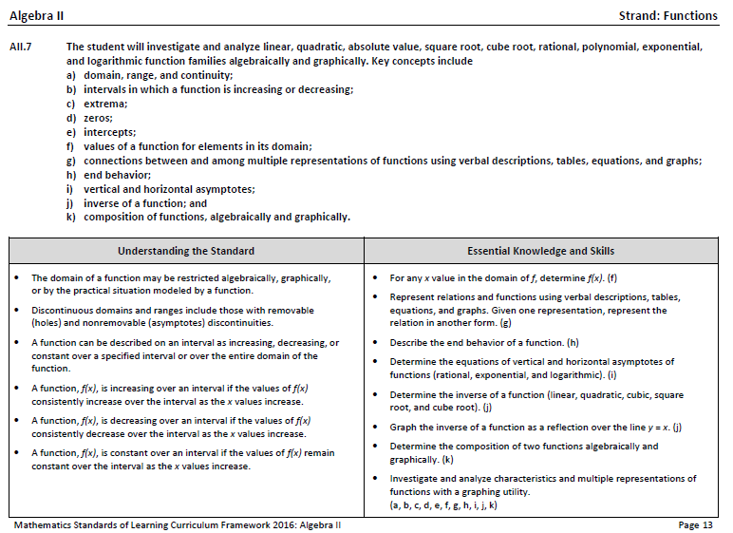
Notes:
This is a page from the Algebra II Curriculum Framework. It is very important that teachers spend time exploring the new Curriculum Framework. This slide contains examples of edits (CLICK) made to the Understanding the Standard section that provide clarity in definitions and explanations. In some standards, examples have also been included.
In addition, where appropriate, (CLICK) corresponding Essential Knowledge and Skills (EKS) bullets and SOL bullets are indicated with the same letter.

Slide 8
Overview of Changes
Reporting Category | # of Standards (2009) | # of Standards (2016)
Expressions and Operations | 3 | 2
Equations and Inequalities | 2 | 2
Functions | 3 | 4
Statistics | 4 | 4
Total | 12 | 12
Notes:
There was an overall reduction in the number of mathematics standards spanning K-12. This is a result of consolidation of related concepts and skills, a reduction of repetition, an improvement of the developmental progression, and/or deletion of content.
In Algebra II, while one SOL was moved from the Expressions and Operations strand to the Functions strand, there was no change in the number of standards in the 2016 compared to the 2009 standards.

Slide 9
Mathematics Process Goals for Students
“The content of the mathematics standards is intended to support the five process goals for students” - 2009 and 2016 Mathematics Standards of Learning
Mathematical Understanding
Problem Solving
Connections
Communication
Representations
Reasoning
Notes:
The mathematical process goals continue to play an instrumental role in the teaching and learning of mathematics with understanding.
We encourage educators to review these sections included in the introduction of the 2016 curriculum frameworks.

Slide 10
Standards of Learning Curriculum Frameworks
Introduction includes:
Mathematical Process Goals for Students
Instructional Technology
Computational Fluency
Algebra Readiness
Equity
New
Notes:
Four additional sections have been included in the introduction to the 2016 Curriculum Framework -- Instructional Technology, Computational Fluency, Algebra Readiness, and Equity. The content of each section addresses the impact on students’ learning and instruction. Educators are encouraged to review these sections included in the introduction.

Slide 11
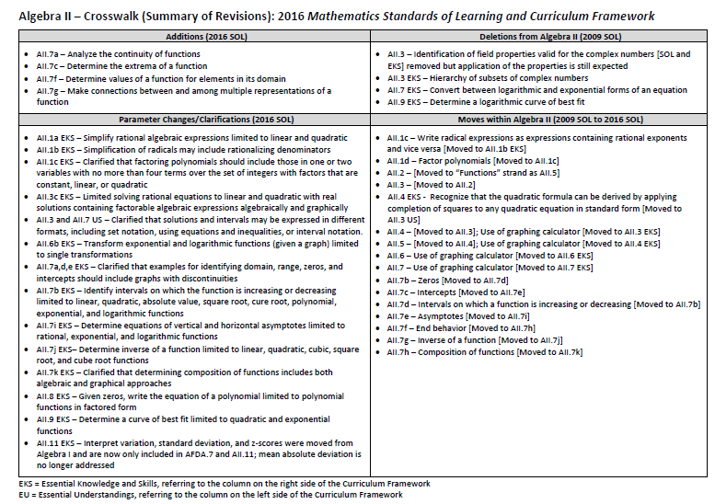
2009
2009
2016
Notes:
This is the snapshot of the Algebra II Crosswalk and Summary of Revisions page one. There are four quadrants – (CLICK) additions, (CLICK) deletions, (CLICK) parameter changes or clarifications, and (CLICK) moves within the standards themselves.
The upper left quadrant (CLICK) includes additions to the 2016 standards. The standards referenced (CLICK) are the 2016 numbers and may include additions (CLICK) to the Essential Knowledge and Skills (EKS) as well as the standard.
The upper right quadrant (CLICK) identifies deletions from the 2009 standards (CLICK).
The bottom left quadrant (CLICK) indicates parameter changes (for example AII.7k EKS (CLICK) – clarifies that determining the composition of functions includes both algebraic and graphical approaches.
In the bottom right quadrant (CLICK), moves within a grade level are indicated with the first number (CLICK) being the 2009 number and the second number in the brackets representing the 2016 number.

Slide 12
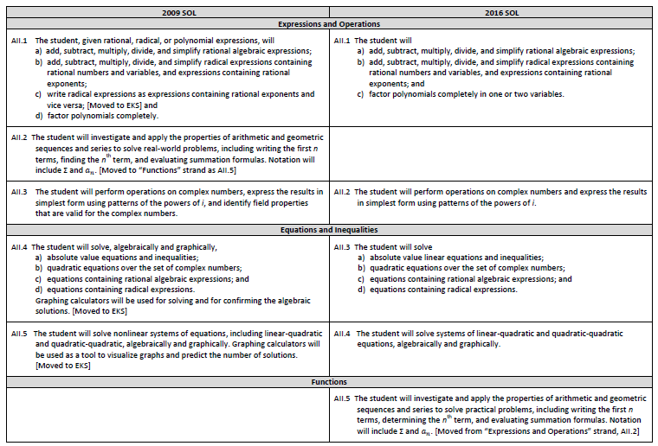
Notes:
On page 2 and the remaining pages of the Crosswalk, a side by side comparison of the 2009 standards (CLICK) and 2016 standards (CLICK) can be found. For comparison purposes, the standards are in numerical order for both columns. The standards are divided into strands, with the title of each indicated. (CLICK) When deleted content was moved or already found in another grade or course, it is indicated in brackets. For example, the AII.1c in the 2009 SOL is now included in Essential Knowledge and Skills (CLICK). If a 2009 standard has been deleted or moved, there will be a blank cell in the 2016 column. For example AII.2c was moved to the function strand and is now AII.5.

Slide 13
EXPRESSIONS and OPERATIONS
Notes:
We will begin reviewing the revisions to the Algebra II standards by looking at the Expressions and Operations strand, which includes SOL AII.1 and AII.2.

Slide 14
2009 SOL | 2016 SOL
AII.1 The student, given rational, radical, or polynomial expressions, will a) add, subtract, multiply, divide, and simplify rational algebraic expressions; b) add, subtract, multiply, divide, and simplify radical expressions containing rational numbers and variables, and expressions containing rational exponents; c) write radical expressions as expressions containing rational exponents and vice versa; [Moved to EKS] and d) factor polynomials completely. | AII.1 The student will a) add, subtract, multiply, divide, and simplify rational algebraic expressions; b) add, subtract, multiply, divide, and simplify radical expressions containing rational numbers and variables, and expressions containing rational exponents; and c) factor polynomials completely in one or two variables.
Revisions:
Write radical expressions as expressions containing rational exponents and vice versa from the 2009 SOL AII.1c moved to SOL AII.1b EKS
SOL AII.1a EKS - Simplifying rational expressions are limited to linear and quadratic expressions
SOL AII.1b EKS - Simplification of radical expressions may include rationalizing denominators
SOL AII.1c EKS - Clarification included that factoring polynomials should include those in one or two variables with no more than four terms over the set of integers with factors that are constant, linear or quadratic
Notes:
SOL AII.1 is now divided into three parts versus four, (CLICK) with AII.1c from 2009 moved to the Essential Knowledge and Skills (EKS) of AII.1b. Simplifying rational expressions in the 2016 SOL AII.1a Essential Knowledge and Skills (EKS) is now limited to linear and quadratic expressions. Simplification of radical expressions in Algebra II may now include rationalizing the denominator in the 2016 standards. Additional clarification was added to 2016 SOL AII.1c that factoring polynomials should include those in one or two variables with no more than four terms over the set of integers. Factors will be constant, linear, or quadratic.

Slide 15
2009 SOL | 2016 SOL
AII.2 The student will investigate and apply the properties of arithmetic and geometric sequences and series to solve real-world problems, including writing the first n terms, finding the nth term, and evaluating summation formulas. Notation will include ∑ and $a_{n}$. [Moved to “Functions” strand as AII.5]
Revisions:
2009 SOL AII.2 was moved to the “Functions” strand in the 2016 standards as AII.5
Notes:
2009 SOL AII.2 was moved to the “Functions” strand as AII.5 in the 2016 standards. We will discuss this standard later in the presentation.

Slide 16
2009 SOL | 2016 SOL
AII.3 The student will perform operations on complex numbers, express the results in simplest form using patterns of the powers of i, and identify field properties that are valid for the complex numbers. | AII.2 The student will perform operations on complex numbers and express the results in simplest form using patterns of the powers of i.
Revisions:
The identification of field properties valid for the complex numbers that was included in the 2009 SOL AII.3 SOL and Essential Knowledge and Skills section was removed, but application of the properties is still expected
2009 SOL AII.3 Essential Knowledge and Skill of placing numbers in a hierarchy of subsets of the complex numbers is no longer included in the 2016 SOL AII.2
Notes:
2009 SOL AII.3 is now AII.2 in the 2016 standards. Identification of field properties valid for the complex numbers previously included in the 2009 SOL AII.3 is no longer included in the 2016 standard, however students will be expected to apply these properties when performing operations with complex numbers. This is a K-12 Mathematics global shift from the 2009 standards in that the focus is not to identify a specific property being used, but correctly apply the properties to simplify expressions and solve equations. In addition, the Essential Knowledge and Skill from 2009 of placing numbers in a hierarchy of subsets of the complex number system is no longer included in the 2016 AII.2 standard. It is expected that instruction will include a discussion of the hierarchy of the complex number system when developing the concept of the imaginary unit, however this will not be a focus of assessment in Algebra II.

Slide 17
EQUATIONS and Inequalities
Notes:
The next strand of the 2016 Algebra II standards that we will examine is Equations and Inequalities, which includes SOL AII.3 and AII.4.

Slide 18
2009 SOL | 2016 SOL
AII.4 The student will solve, algebraically and graphically, a) absolute value equations and inequalities; b) quadratic equations over the set of complex numbers; c) equations containing rational algebraic expressions; and d) equations containing radical expressions. Graphing calculators will be used for solving and for confirming the algebraic solutions. [Moved to EKS] | AII.3 The student will solve a) absolute value linear equations and inequalities; b) quadratic equations over the set of complex numbers; c) equations containing rational algebraic expressions; and d) equations containing radical expressions.
Revisions:
SOL AII.3c EKS - Limits solving rational equations to linear and quadratic with real solutions containing factorable algebraic expressions algebraically and graphically
SOL AII.3 Understanding the Standard - Clarified that solutions and intervals may be expressed in different formats, including set notation, using equations and inequalities, or interval notation
SOL AII.3 Understanding the Standard - Includes recognizing that the quadratic formula can be derived by applying completion of squares to any quadratic equation in standard form; this was moved from 2009 SOL AII.5 Essential Knowledge and Skills
Notes:
2009 SOL AII.4 is now SOL AII.3 in the 2016 standards. In the Essential Knowledge and Skills (EKS) of 2016 SOL AII.3, solving rational equations is limited to those containing factorable algebraic expressions that are linear or quadratic. Students will be expected to solve rational equations with real solutions both algebraically and graphically. The 2016 Understanding the Standard section of SOL AII.3 includes expressing solution sets in different formats including set notation, using equations or inequalities, and interval notation. In addition, recognizing that the quadratic formula can be derived by applying completion of squares to any quadratic equation in standard form has been moved from SOL AII.5 Essential Knowledge and Skills (EKS) to the Understanding the Standard section of SOL AII.3.

Slide 19
2009 SOL | 2016 SOL
AII.5 The student will solve nonlinear systems of equations, including linear-quadratic and quadratic-quadratic, algebraically and graphically. Graphing calculators will be used as a tool to visualize graphs and predict the number of solutions. [Moved to EKS] | AII.4 The student will solve systems of linear-quadratic and quadratic-quadratic equations, algebraically and graphically.
Revisions:
The phrase about graphing calculators included in 2009 SOL AII.5 was moved to the Essential Knowledge and Skills section of the 2016 SOL AII.4 and refers to “graphing utilities”
2009 SOL AII.5 EKS to recognize that the quadratic formula can be derived by applying completion of squares to any quadratic equation in standard form moved to 2016 SOL AII.3 Understanding the Standard section
Notes:
2009 SOL AII.5 is now SOL AII.4 in the 2016 standards. The phrase referring to the use of graphing calculators in 2009 SOL AII.5 is now included in the Essential Knowledge and Skills section of SOL AII.4 and expands to the use of graphing utilities. The Essential Knowledge and Skill that students will recognize that the quadratic formula can be derived by applying completion of squares to any quadratic equation in standard form is now included in the Understanding the Standard section of SOL AII.3, as previously discussed.

Slide 20
FUNCTIONS
Notes:
The Functions strand of the 2016 Algebra II Standards of Learning includes standards AII.5 through AII.8. We will now examine the revisions included in this strand.

Slide 21
2009 SOL | 2016 SOL
 | AII.5 The student will investigate and apply the properties of arithmetic and geometric sequences and series to solve practical problems, including writing the first n terms, determining the nth term, and evaluating summation formulas. Notation will include ∑ and $a_{n}$. [Moved from “Expressions and Operations” strand, AII.2]
Revisions:
Real-world problems are now referred to as practical problems in the 2016 standards
Notes:
2016 SOL AII.5 is the first standard in the Functions strand of the Algebra II standards. This was previously SOL AII.2 in the 2009 standards formerly located in the Expressions and Operations strand. There are very few revisions to this standard. It is notable to mention that “real-world” problems as referenced in the 2009 K-12 Mathematics standards are now globally referred to as “practical” problems in the 2016 standards.

Slide 22
2009 SOL | 2016 SOL
AII.6 The student will recognize the general shape of function (absolute value, square root, cube root, rational, polynomial, exponential, and logarithmic) families and will convert between graphic and symbolic forms of functions. A transformational approach to graphing will be employed. Graphing calculators will be used as a tool to investigate the shapes and behaviors of these functions. [Moved to EKS] | AII.6 For absolute value, square root, cube root, rational, polynomial, exponential, and logarithmic functions, the student will recognize the general shape of function families; and use knowledge of transformations to convert between equations and the corresponding graph of functions.
Revisions:
The phrase about graphing calculators included in 2009 SOL AII.6 was moved to the Essential Knowledge and Skills section of the 2016 SOL AII.6 and refers to “graphing utilities”
SOL AII.6b EKS - Transforming exponential and logarithmic functions (given a graph) is now limited to single transformations
Notes:
The 2009 SOL AII.6 now appears with two parts in 2016 SOL AII.6. The phrase referring to the use of graphing calculators in the 2009 AII.6 is now included in the Essential Knowledge and Skills (EKS) section of 2016 SOL AII.6 and expands to the use of graphing utilities. The Essential Knowledge and Skill (EKS) in 2016 SOL AII.6b limits transformations of exponential and logarithmic functions to a single transformation when asked to identify the transformation given a graph of the function.

Slide 23
2009 SOL | 2016 SOL
AII.7 The student will investigate and analyze functions algebraically and graphically. Key concepts include a) domain and range, including limited and discontinuous domains and ranges; b) zeros; c) x- and y-intercepts; d) intervals in which a function is increasing or decreasing; e) asymptotes; f) end behavior; g) inverse of a function; and h) composition of multiple functions. Graphing calculators will be used as a tool to assist in investigation of functions. [Moved to EKS] | AII.7 The student will investigate and analyze linear, quadratic, absolute value, square root, cube root, rational, polynomial, exponential, and logarithmic function families algebraically and graphically. Key concepts include domain, range, and continuity; intervals in which a function is increasing or decreasing; extrema; zeros; intercepts; values of a function for elements in its domain; connections between and among multiple representations of functions using verbal descriptions, tables, equations, and graphs; end behavior; vertical and horizontal asymptotes; inverse of a function; and composition of functions algebraically and graphically.
Revisions:
The phrase about graphing calculators included in 2009 SOL AII.7 was moved to the Essential Knowledge and Skills section of the 2016 SOL AII.7 and refers to “graphing utilities”
SOL AII.7 - Analyze the continuity of functions added to SOL AII.7a; determine the extrema of a function added as SOL AII. 7c; determine values of a function for elements in its domain added as SOL AII.7f; and make connections between and among multiple representations of a function added as SOL AII.7g
SOL AII.7a,d,e EKS - Clarification provided that examples for identifying domain, range, zeros, and intercepts should include graphs with discontinuities
SOL AII.7b EKS - Identify intervals on which the function is increasing or decreasing limited to linear, quadratic, absolute value, square root, cure root, polynomial, exponential, and logarithmic functions
Notes:
There are numerous revisions to mention regarding 2016 SOL AII.7, thus we will look at some on this slide and continue on the next slide as well. The graphing calculator phrase from the 2009 standard is now in the Essential Knowledge and Skills of the 2016 standard and references “graphing utilities.” There are several additions to the 2016 SOL AII.7: analyze continuity of a function included in part (a); determine extrema of a function (which includes both absolute and relative extrema) are included as part (c); determine values of a function for elements in its domain, while a skill most likely addressed in most Algebra II classroom instruction, is now deliberately included as part (f); and making connection between among different representations of a function (verbal descriptions, tables, equations, and graphs) is added as part (g). In addition to these additions, several parameter changes are included in this standard. In the Essential Knowledge and Skills for 2016 SOL AII.7a, d and e, examples with discontinuities should be included when identifying domain, range, zeros, and intercepts of a function. In the Essential Knowledge and Skills for AII.7b, the functions for which students will identify increasing/decreasing intervals are specified.

Slide 24
2009 SOL | 2016 SOL
AII.7 The student will investigate and analyze functions algebraically and graphically. Key concepts include a) domain and range, including limited and discontinuous domains and ranges; b) zeros; c) x- and y-intercepts; d) intervals in which a function is increasing or decreasing; e) asymptotes; f) end behavior; g) inverse of a function; and h) composition of multiple functions. Graphing calculators will be used as a tool to assist in investigation of functions. [Moved to EKS] | AII.7 The student will investigate and analyze linear, quadratic, absolute value, square root, cube root, rational, polynomial, exponential, and logarithmic function families algebraically and graphically. Key concepts include domain, range, and continuity; intervals in which a function is increasing or decreasing; extrema; zeros; intercepts; values of a function for elements in its domain; connections between and among multiple representations of functions using verbal descriptions, tables, equations, and graphs; end behavior; vertical and horizontal asymptotes; inverse of a function; and composition of functions algebraically and graphically.
Revisions (con’t):
SOL AII.7i EKS - Determine equations of vertical and horizontal asymptotes limited to rational, exponential, and logarithmic functions
SOL AII.7j EKS - Determine inverse of a function limited to linear, quadratic, cubic, square root, and cube root functions
SOL AII.7k EKS - Clarified that determining composition of functions includes both algebraic and graphical approaches
2009 SOL AII.7 EKS to convert between logarithmic and exponential forms of an equation is no longer included in 2016 SOL AII.7
Notes:
Additional revisions to 2016 SOL AII.7 are indicated in this slide. In the Essential Knowledge and Skills of SOL AII.7i the type of functions for which students will determine vertical and horizontal asymptotes are specified. In the Essential Knowledge and Skills SOL AII.7j, the types of functions for which students will determine inverses are specified. In the Essential Knowledge and Skills of SOL AII.7k, clarification is provided that students will need to be able to determine composition of functions using both algebraic and graphical approaches. A deletion from the 2009 AII.7 standard that does not appear in the 2016 standards is converting between logarithmic and exponential forms of an equation. While many local curricula may choose to include this topic as part of instruction, it will no longer be a focus of assessment in the 2016 standards.

Slide 25
2009 SOL | 2016 SOL
AII.8 The student will investigate and describe the relationships among solutions of an equation, zeros of a function, x-intercepts of a graph, and factors of a polynomial expression. | AII.8 The student will investigate and describe the relationships among solutions of an equation, zeros of a function, x-intercepts of a graph, and factors of a polynomial expression.
Revisions:
SOL AII.8 EKS - If students are given the zeros of a polynomial function and asked to write the equation of the polynomial function, the equation will be limited to defining the polynomial function in factored form
Notes:
2016 SOL AII.8 has few revisions compared to the 2009 standard. One change is a limitation in the Essential Knowledge and Skills that if student are asked to define a polynomial function given its zeros, the polynomial function equation will be limited to factored form. While students benefit from expanding algebraic functions from factored to expanded form, this algebraic skill is not a focus of SOL AII.8

Slide 26
STATISTICS
Notes:
The Statistics strand in the 2016 Algebra II Standards of Learning includes four standards, AII.9 through AII.12. We will now examine the revisions to this final strand of the Algebra II standards.

Slide 27
2009 SOL | 2016 SOL
AII.9 The student will collect and analyze data, determine the equation of the curve of best fit, make predictions, and solve real-world problems, using mathematical models. Mathematical models will include polynomial, exponential, and logarithmic functions. | AII.9 The student will collect and analyze data, determine the equation of the curve of best fit in order to make predictions, and solve practical problems, using mathematical models of quadratic and exponential functions.
Revisions:
SOL 2016 AII.9 no longer includes logarithmic functions when finding the curve of best fit
Real world problems are now referred to as practical problems in 2016
Notes:
The 2016 SOL AII.9 now includes only quadratic and exponential functions, and no longer includes the expectation of using logarithmic models. A focus of the 2016 AII.9 standard should be to examine the reasonableness of a mathematical model, especially within the context of the data being analyzed.

Slide 28
2009 SOL | 2016 SOL
AII.10 The student will identify, create, and solve real-world problems involving inverse variation, joint variation, and a combination of direct and inverse variations. | AII.10 The student will represent, create, and solve problems, including practical problems, involving inverse variation, joint variation, and a combination of direct and inverse variations.
Revisions:
Real world problems are now referred to as practical problems in 2016
Notes:
There are no significant changes to SOL AII.10 in the 2016 standard. The change in referring to real-world versus practical problems is noted in the wording of the standard.

Slide 29
2009 SOL | 2016 SOL
AII.11 The student will identify properties of a normal distribution and apply those properties to determine probabilities associated with areas under the standard normal curve. | AII.11 The student will identify and describe properties of a normal distribution; interpret and compare z-scores for normally distributed data; and apply properties of normal distributions to determine probabilities associated with areas under the standard normal curve.
Revisions:
SOL AII.11 EKS – includes interpret variation, standard deviation, and z-scores [moved from Algebra I]
Mean absolute deviation is no longer addressed in the 2016 Mathematics Standards of Learning
Notes:
The 2016 SOL AII.11 is now divided into three parts. In Algebra I, SOL A.9 was moved to be included in SOL AII.11. Students will be expected to interpret variation, standard deviation and z-scores in Algebra II and will no longer be expected to have this prior knowledge from Algebra I. Analyzing mean absolute deviation is no longer addressed in the 2016 Mathematics Standards of Learning. One important instructional shift in this standard can be found in the first bullet of the Understanding the Standard section of AII.11, and states “the focus of this standard is on the interpretation of descriptive statistics, z-scores, probabilities, and their relationship to the normal curve in the context of a data set.” While we do want students exploring and using the formulas associated with these concepts, the bigger idea of interpretation of the statistics associated with data that is normally distributed should be gleaned from this standard.

Slide 30
2009 SOL | 2016 SOL
AII.12 The student will compute and distinguish between permutations and combinations and use technology for applications. | AII.12 The student will compute and distinguish between permutations and combinations.
Revisions:
The phrase about technology included in 2009 SOL AII.12 was moved to the Essential Knowledge and Skills section of the 2016 standard and refers to “graphing utilities”
Notes:
There are no notable changes between the 2009 SOL AII.12 and the 2016 standard. The phrase about technology in the 2009 standard has been moved to the Essential Knowledge and Skills section of the 2016 standard. Real-world problems are referred to as practical problems, as is the global difference across K-12 math standards.

Slide 31
Questions?
Please contact the
VDOE Mathematics Team
Mathematics@doe.virginia.gov
Notes:
This concludes the presentation on the 2016 Standards of Learning for Algebra II. As mentioned at the beginning of this presentation, teachers are encouraged to refer to the curriculum framework where additional information can be found.
Should you have any questions, feel free to contact a member of the Mathematics Team at Mathematics@doe.virginia.gov.

