Slide 1
Status Report on COVID-19 Impacts on PreK-12 Education in Virginia
Presented on January 28, 2021
Holly Coy, Assistant Superintendent for Policy, Equity, and Communications
Michael Bolling, Assistant Superintendent of Learning and Innovation

Slide 2
Introduction and Overview
State COVID Guidance for Schools
  Evolution of state guidance
  Highlights from the January 2021 School Reopening Guidance
  Other applicable requirements
Operational Impacts and Instructional Delivery
  Operational and enrollment impacts
  Changes in instructional delivery
  Details from First Periodic Report (November 2020)
Academic Outcomes and Supports
  PALS and VKRP results
  Highlights from the First Periodic Report (November 2020)
Looking Ahead
  Addressing learning loss and mental health of students
  New infusion of federal funding

Slide 3
State COVID Guidance for Schools

Slide 4
Evolving Guidance From VDOE and VDH
In June 2020, the Governor released Phase Guidance for Virginia’s Schools, which provided a phased approach for bringing students back to school for in person instruction, following the statewide closure ordered in March by Governor Northam.
In October 2020, the Virginia Department of Health issued Interim Guidance for Virginia Schools, which incorporated CDC Indicators for Decision making (released in September).
In January 2021, Interim Guidance for Reopening PreK-12 Schools was issued to consolidate and replace the previously issued guidance and support school divisions as they plan for reopenings in 2021. Key updates include a 5 step decision making framework, and a new decision matrix for local divisions to use.

Slide 5
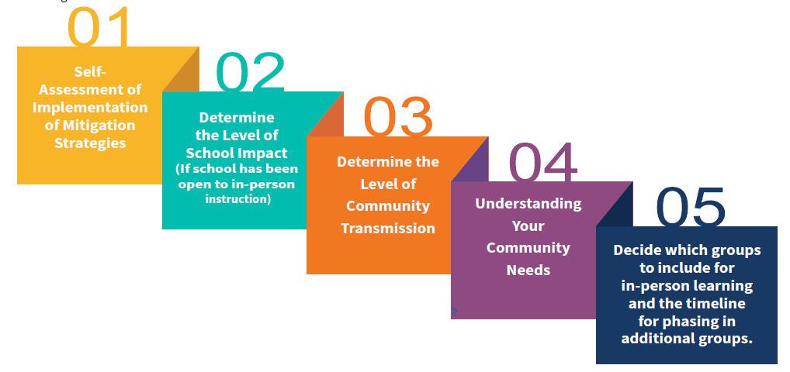
5 Steps to Guide School Reopening Decisions

Slide 6
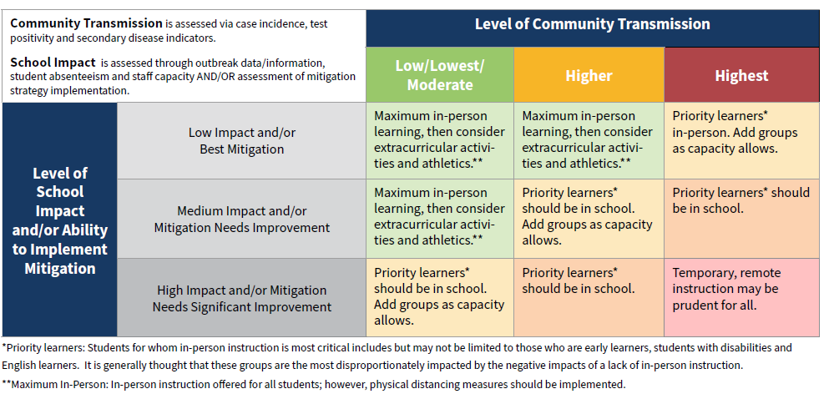
Decision Matrix

Slide 7
Other Applicable State Policies
Executive Orders
Some apply to schools, such as EO72, requiring the use of face coverings and restricting social gathering group sizes.
Department of Labor and Industry Emergency Standards
Health and safety measures and COVID reporting requirements, applicable to certain employers, including schools.
Orders of the State Health Commissioner
Required submission of health plans by school divisions before reopening in Phase II or Phase III.
Vaccine Distribution Policy
School staff are included in the definition of essential workers in Phase 1B.

Slide 8
Waivers and Relief Measures
Regulatory language may be waived by the agency head, with concurrence from the Secretary, under EO51 issued by Governor Northam in March 2020.
Statutory and budgetary language waivers, by the Superintendent of Public Instruction with concurrence from the Secretary, for the 2020-2021 school year and FY21 are permitted per language in the Appropriation Act.
All waivers and relief measures issued to date are posted on the VDOE website.

Slide 9
Questions?

Slide 10
Operational Impacts and Instructional Delivery
Notes:
VDOE Map is housed online at: https://www.doe.virginia.gov/support/health_medical/office/reopen-status.shtml

Slide 11
Operational Impacts
Fall Membership (September 30, 2020)
September 30, 2020 PreK-12 enrollment was 45,327 students lower than the state total from September 30, 2019.
Enrollment declines were most acute in preschool (approx. 6,400) and kindergarten (approx. 12,000)
Preschool drops were 4 times larger among children from economically-disadvantaged families and were larger among Black and Hispanic children as compared to white and Asian children.

Slide 12
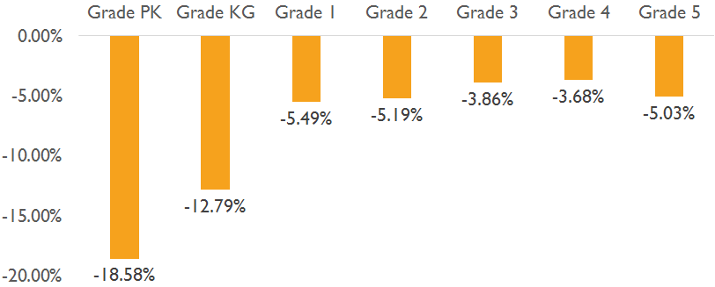
2020 Enrollment Declines in Young Learners
Changes in Enrollment between 2019-2020 and 2020-2021 School Years

Slide 13
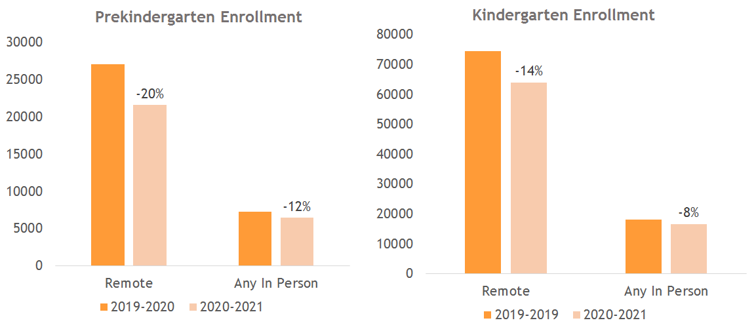
Modality Impact on Enrollment Declines
Enrollment dropped more in divisions that offered no in-person option.

Slide 14
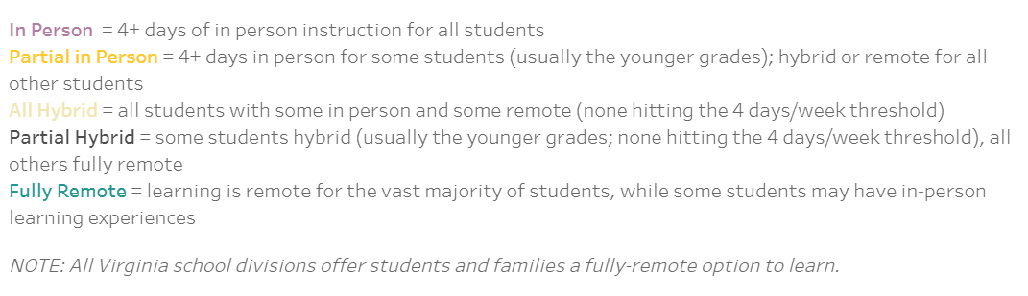
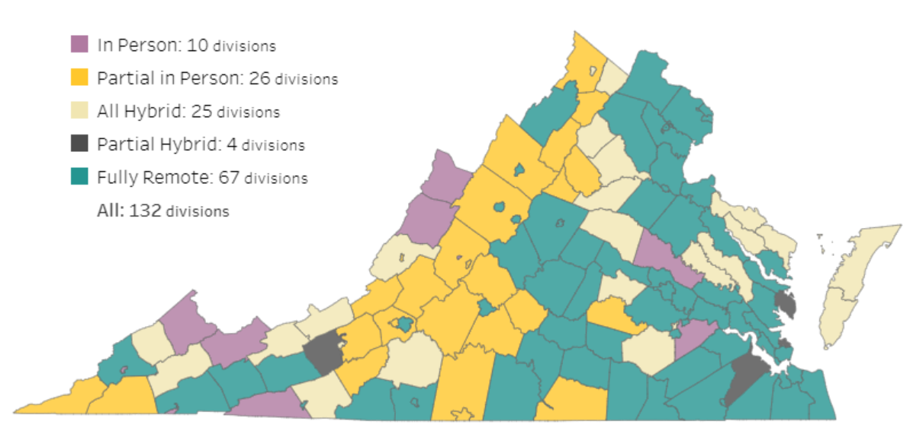
Heatmap of Instructional Modalities
Notes:
The next few slides describe the frequency of varied instructional modalities in Virginia. This slide provides definitions for each. While In person, fully remote, and Hybrid are somewhat self explanatory, there are divisions with partial in person and partial hybrid approaches. These approaches describe divisions that have differences in modalities depending on the grade level or group.

Slide 15
September 8, 2020
Notes:
Since the year started, trend to more in person; Fully remote was at 50%, now closer to 30%

Slide 16
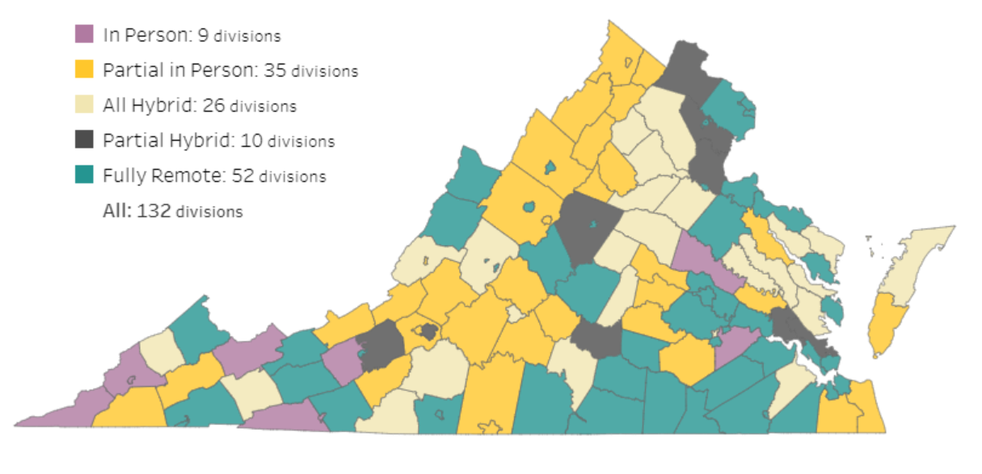
December 12, 2020

Slide 17
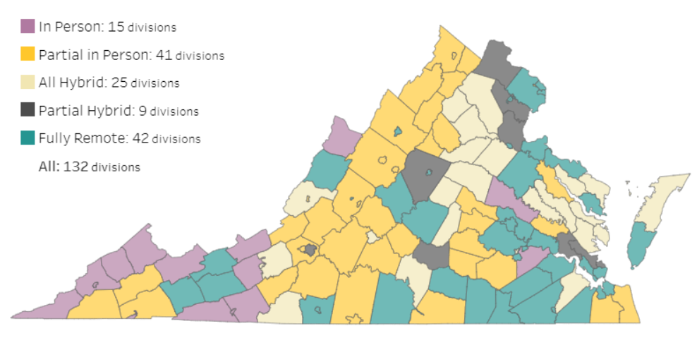
January 26, 2020

Slide 18
Instructional Modalities
 | September 8, 2020 |  | January 26, 2021
Type of Learning | # Divisions | % Divisions | # Divisions | % Divisions
Fully Remote | 68 | 51.5% | 42 | 31.8%
Partial Hybrid | 5 | 3.8% | 9 | 6.8%
All Hybrid | 24 | 18.2% | 25 | 18.9%
Partial In Person | 25 | 18.9% | 41 | 31.1%
In Person | 10 | 7.6% | 15 | 11.4%
Grand Total | 132 | 100.0% | 132 | 100.0%

Slide 19
Intro to the Periodic Report
First submission - November 2020
Required for consideration of 180/990 waiver in spring 2021
132 school division responses (100%)
Data collection included
  Instructional delivery
  Academic outcomes
  Division challenges
  Assessment strategies
  Supports for students

Slide 20
Instructional Delivery

Slide 21
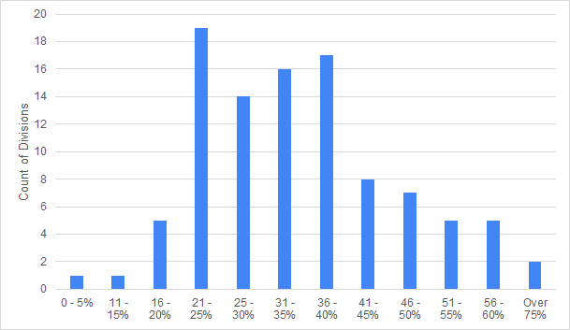
Parents Opting for Remote Learning
Percentage of parents opting for fully remote instruction in divisions offering in-person or hybrid instruction only
VDOE November 2020, n = 100
Notes:
Note that 100 school divisions responded as those offering some in-person/hybrid. The majority of school divisions’ percentage of parents/guardians opting for remote instruction is between 20-40% (66/100).

Slide 22
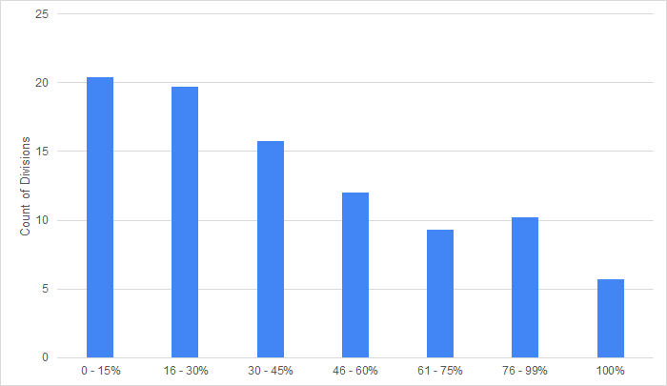
Synchronous Learning
Number of divisions reporting average percent of weekly instructional time that is synchronous for students learning remotely
VDOE November 2020, n = 132
Notes:
Percent of weekly SYNCHRONOUS instructional time for students learning remotely varies among school divisions
Over 40 school divisions have over half of instructional time synchronous for remotely learning students
If needed….this information was collected by grade level, therefore use of averages was necessary for summary reporting.

Slide 23
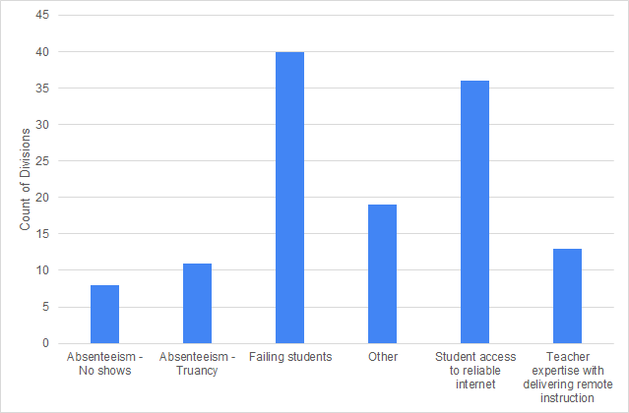
Remote Learning Challenges
Greatest challenge with remote learning,
as reported by school divisions
VDOE November 2020, n = 130
Notes:
Failing students and access to reliable internet

Slide 24
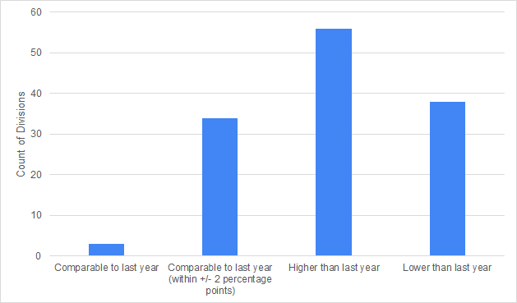
Absenteeism Rates
Comparison of absenteeism to last year,
as reported by school divisions
VDOE November 2020, n = 130
Notes:
Over 50 school divisions reporting absenteeism higher than last year. Note that there are varied approaches to collecting absenteeism data in remote settings.

Slide 25
Questions?

Slide 26
Academic Outcomes and Supports

Slide 27
Phonological Awareness Literacy Screening (PALS) Data
The Early Intervention Reading Initiative (EIRI) provides and requires the use of a screening assessment for all students Kindergarten through Grade 3.
The goal of EIRI is to reduce the number of students with reading problems through early diagnosis and immediate intervention.
PALS-K and PALS 1-3 are screening tools used by 99% of school divisions in Virginia.
The PALS K-3 screening tools identify students at-risk in early reading and this guides the allocation of EIRI funding to support early intervention.
Students falling below the PALS benchmark are identified as being at high-risk for third-grade reading failure, in the absence of intervention.

Slide 28
Phonological Awareness Literacy Screening (PALS) Data
PALS-PreK is an early childhood assessment, not a formal screening measure. Localities that participate in the Virginia Preschool Initiative (VPI) are required to use the PALS-PreK assessment as a tool for supporting young children’s literacy development.
In Fall of 2020, all grades (K-3) were required to conduct screening related to EIRI.
  A flexible testing window and a remote administration option for PALS were made available to support screening.
  55.7% of kindergarten and first-grade PALS data were collected through remote administration methods.
Notes:
No differences in use of remote/in person across economic disadvantaged and not disadvantaged.
69.4% of PALS data on Black kindergarten and first students were collected through remote administration methods.
67.3% of PALS data on Hispanic kindergarten and first grade students were collected through remote administration methods.
75% of PALS data on EL kindergarten and first grade students were collected through remote administration methods.
41% of PALS data on White kindergarten and first grade students were collected through remote administration methods.

Slide 29
Phonological Awareness Literacy Screening (PALS) Data
State trends are similar across remote and in-person administration methods. Validity analyses by the PALS Office at UVA show the assessment functions similarly across remote and in-person modes of administration.
Use of the remote testing administration method varied by division and by geography, with more rural school divisions using primarily in-person administration methods.
PALS informs teachers’ instruction by providing them with explicit information about their students’ knowledge of literacy. School leaders and teachers are using the data to implement research-based, effective instruction and intervention plans to support student success.

Slide 30
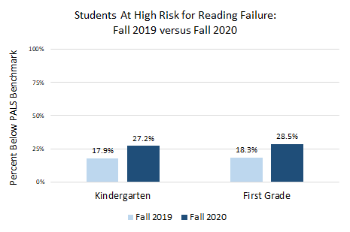
PALS Fall 2020 - Key Findings
PALS data show significantly more kindergarten and first grade students starting the school year at high risk for reading failure compared to last year.
McGinty, A.S., Gray, A., Herring, W., Soland, J., & Partee, A. (2021). Examining early reading skills in the wake of COVID-19: Virginia Fall 2020 state-wide screening findings and implications. Research Brief of the PALS Office at the University of Virginia, Charlottesville.
Notes:
Note that the percentage of K and 1 students identified as at high risk for reading failure compared to last year increased by approximately 10% in each grade level.

Slide 31
PALS Fall 2020 - Key Findings
The increase in kindergarten and first grade students starting the school year at high risk for reading failure was largest among students who are Black, Hispanic, economically disadvantaged and English learners (EL).
McGinty, A.S., Gray, A., Herring, W., Soland, J., & Partee, A. (2021). Examining early reading skills in the wake of COVID-19: Virginia Fall 2020 state-wide screening findings and implications. Research Brief of the PALS Office at the University of Virginia, Charlottesville.

Slide 32
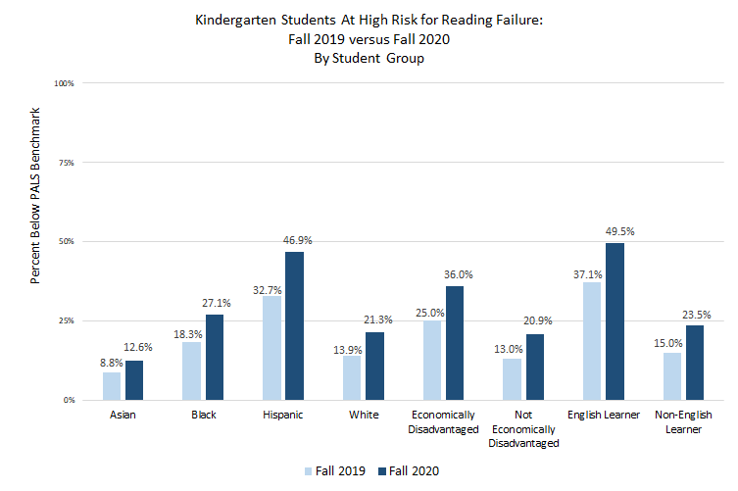
McGinty, A.S., Gray, A., Herring, W., Soland, J., & Partee, A. (2021). Examining early reading skills in the wake of COVID-19: Virginia Fall 2020 state-wide screening findings and implications. Research Brief of the PALS Office at the University of Virginia, Charlottesville.

Slide 33
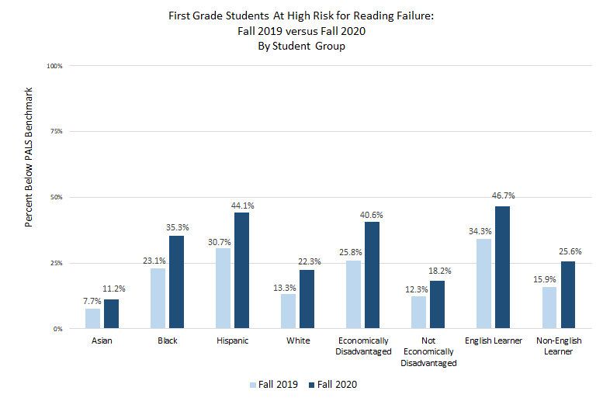
McGinty, A.S., Gray, A., Herring, W., Soland, J., & Partee, A. (2021). Examining early reading skills in the wake of COVID-19: Virginia Fall 2020 state-wide screening findings and implications. Research Brief of the PALS Office at the University of Virginia, Charlottesville.

Slide 34
VKRP Data on Student Well-Being
Kindergarten teachers are concerned about their students’ social-emotional well-being.
VKRP is only statewide assessment of student social-emotional skills with items added this year to assess each K student’s well-being
Teachers reported to be significantly concerned about the well-being of 8,497 students (11% of students who were assessed)
  Teachers expressed significant concerns for 27% of children with disabilities
66% of teachers reported to be significantly concerned about at least 1 student
26% of teachers reported being significantly concerned for 3 or more of the K students in their classroom
“I am concerned not only about (student’s) social, emotional state, but the well-being of all of her classmates. Virtually learning [means]...they are not able to see each other on camera. This affects friendships from being formed and students getting to interact with each other.”

Slide 35
Academic Achievement (first marking period)
Of 93 school divisions that had completed their analyses of academic achievement levels as of November, in
PreK-Grade 2
  68 divisions report that over 50% of their students are at or above expected levels in reading
  56 divisions report that over 50% of their students are at or above expected levels in mathematics
Grade 3-Grade 5
  63 divisions report that over 50% of their students are at or above expected levels in reading
  57 divisions report that over 50% of their students are at or above expected levels in mathematics

Slide 36
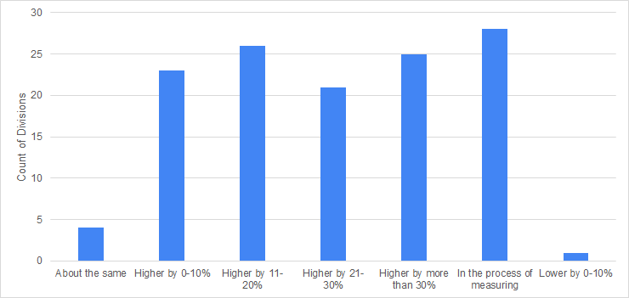
Comparison of Failure Percentages
Percentage of MIDDLE SCHOOL students failing two or more classes at the end of marking period one in 2020, compared to last year
VDOE November 2020, n = 128
Notes:
While a number of divisions were still measuring the comparison, the VAST majority of school divisions are seeing a high percentage of students failing two or more classes compared to last year in both middle and high school.

Slide 37
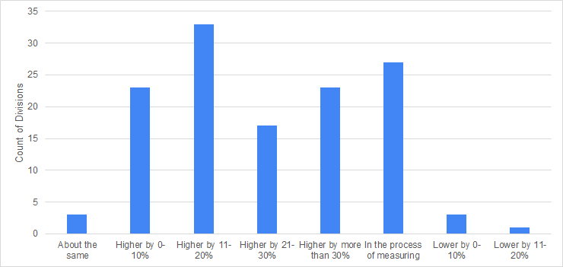
Comparison of Failure Percentages
Percentage of HIGH SCHOOL students failing two or more classes at the end of marking period one in 2020, compared to last year
VDOE November 2020, n = 130

Slide 38
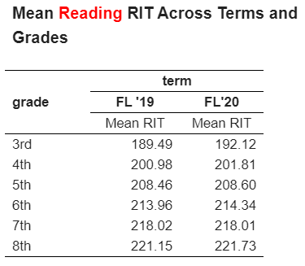
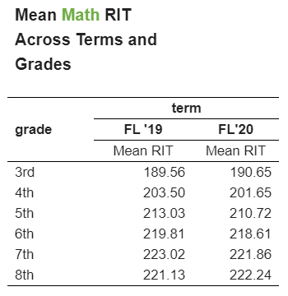
NWEA MAP Assessment - Virginia
“...initial findings reveal students stayed relatively the same in reading, whereas math indicated substantially more learning loss.”
Notes:
57 school divisions

Slide 39
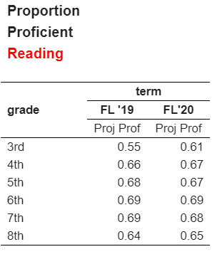
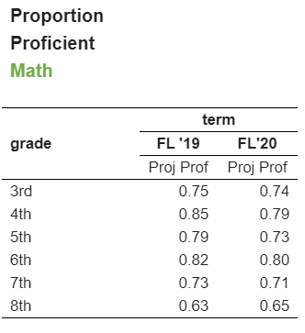
NWEA MAP Assessment - Virginia

Slide 40
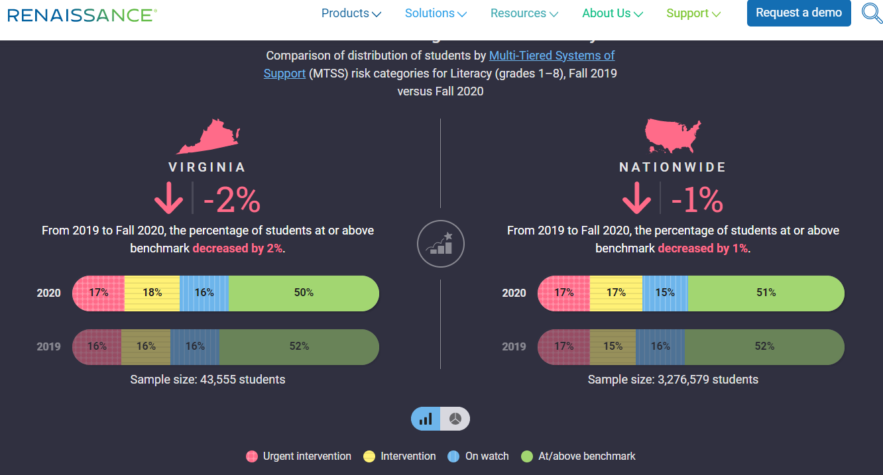
Renaissance Learning STAR Reading
Notes:
Fall 2020 test records contain students in a variety of learning environments (in-school, remote, or hybrid).
Some students MAY have been receiving support from a parent, guardian, or caregiver who may not have differentiated the assessment from an instructional activity.
There is a lack of complete demographic information on students.
We do not know how much instruction students had been exposed to before they took Star Assessments this fall.
Participation in this year is lower than in previous years.

Slide 41
Professional Development
School divisions have provided tremendous support to teachers, staff, and the parents/guardians. The vast majority of school divisions provided professional development in:
virtual instruction including (class management, building courses, instructional and assessment techniques, tech tools for engagement, creating instructional videos);
accessing high-quality instructional resources in virtual settings;
supporting social emotional health and well-being;
communication and feedback expectations and procedures in remote settings;
structuring the remote learning environment; and
parent/guardian use of learning management system/student information system.

Slide 42
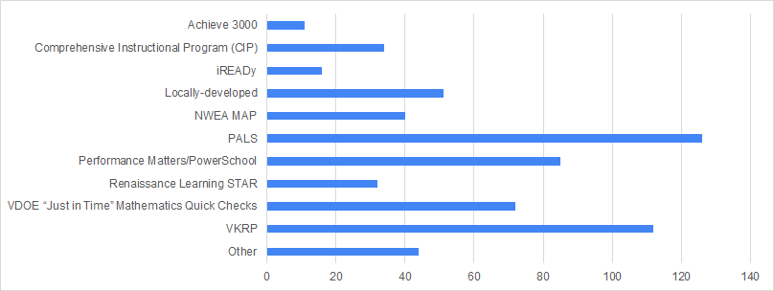
Diagnostic Assessments Administered
Frequency of assessments administered
VDOE November 2020, n = 132

Slide 43
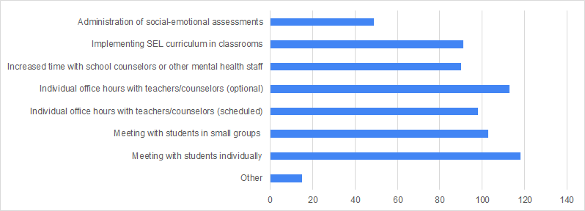
Social-Emotional Supports Provided
Frequency of supports provided to support social-emotional learning and health
VDOE November 2020, n = 132

Slide 44
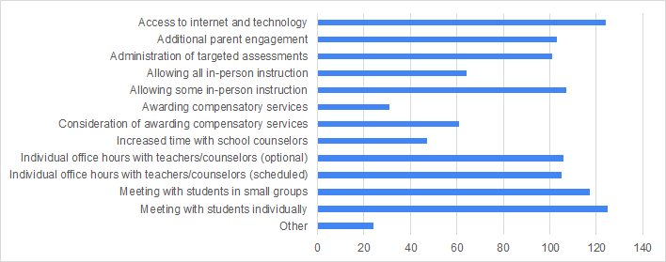
Supports Provided for Students with Disabilities
Frequency of supports provided to students with disabilities
VDOE November 2020, n = 132

Slide 45
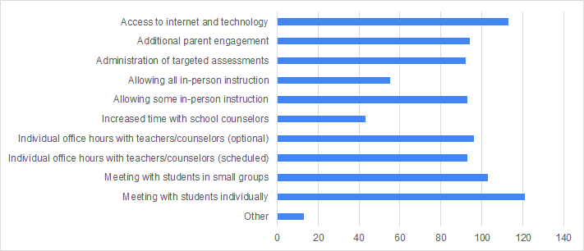
Supports Provided to English Learners
Frequency of supports provided to English learners
VDOE November 2020, n = 132

Slide 46
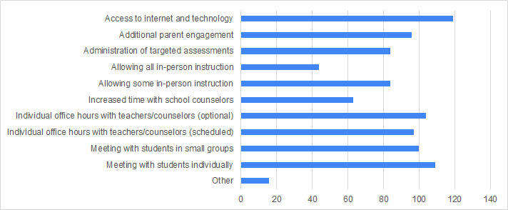
Supports Provided to Economically Disadvantaged Students
Frequency of supports provided to economically disadvantaged students
VDOE November 2020, n = 132

Slide 47
Questions?

Slide 48
Looking Ahead

Slide 49
Looking Ahead
Continued support for in-person learning, particularly for our most impacted students, with appropriate health mitigation strategies.
Remediate & Recover effort led by the VDOE, may include a workgroup with stakeholders, to provide best practices and support to local divisions
Second Periodic Report to be deployed in February
SOL assessments will yield much more granular and comparative data on academic impacts
VKRP Spring assessment will provide insight into impact on young learners
Significant new infusion of federal funding:
-$939M to divisions via Title 1 allocation formula
-Of that $93M for the state, $5M for administration
-$30M in Governor’s discretionary fund
-$47M for non-public schools
-Priority areas include addressing learning loss and supporting student mental health and social-emotional
well being

