Slide 1
Virginia Mathematics Pathways Initiative (VMPI)
Board of Education Report - January 28, 2021
Tina Mazzacane – VDOE Mathematics Coordinator

Slide 2



Virginia Mathematics Pathways Initiative

Slide 3
Somewhere in the United States…..
A recent high school graduate excitedly starts her first semester in college. While she passed advanced mathematics courses in her senior year of high school, her university informs her she is not “college ready” in mathematics.
Another student is steered away from advanced mathematics courses by her counselor based on that counselor’s perceptions about her race or family background.
And somewhere, a recent university graduate, having successfully navigated the transition into and through college mathematics, finds that what he learned in his math courses did not prepare him with the quantitative skills he needs for his future..
A high school student decides not to take any mathematics courses beyond those required for graduation because nothing in his experience has helped him see how math is relevant to his future.
Still another student wants to take additional mathematics courses but cannot – because his school does not offer them.

Slide 4




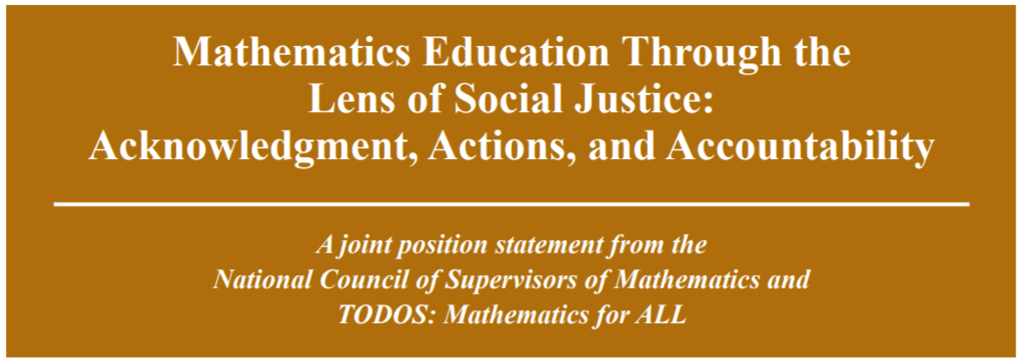


National Landscape in Mathematics Education

Slide 5
National Council of Teachers of Mathematics and Catalyzing Change
"All stakeholders must examine beliefs about who is capable of doing and understanding mathematics, disrupt existing inequitable practices and catalyze change toward creating a just, equitable and inclusive system..”
Catalyzing Change in Early Childhood and Elementary Mathematics, Catalyzing Change in Middle School Mathematics , NCTM, 2020

Slide 6
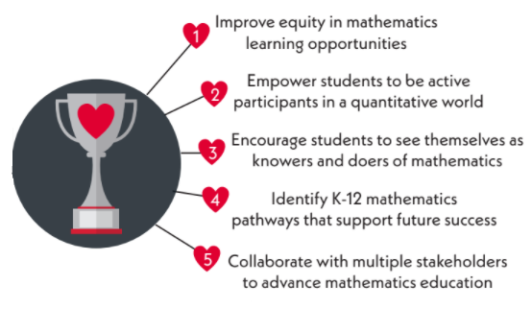

VMPI Project Goals

Slide 7
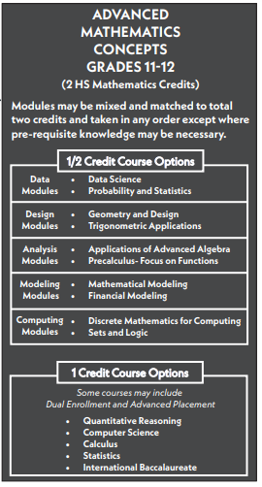
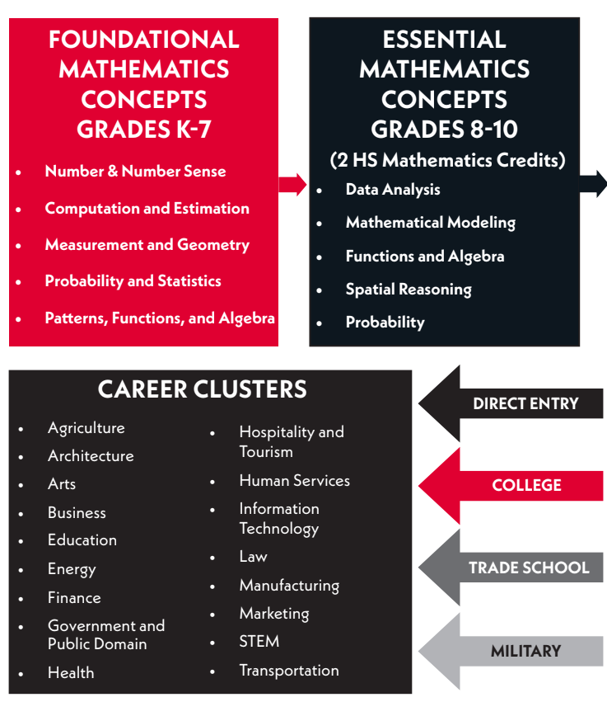
Follow the “Math Path”

Slide 8
VMPI – Phases of Work
Phase | School Year | Action Steps
Phase I | 2019-2020 | Develop Drafts - Math Pathways, Essential Concepts, Advanced Math Courses
Phase II | 2020-2021 | Stakeholder Feedback; Revise drafts; Develop Advanced Math Courses
Phase III | 2021-2022 | 2016 Math SOL Review; Essential Concepts SOL; Develop Advanced Math Courses; Develop Advanced Math Resources; Create Professional Learning Plan
Phase IV | 2022-2023 | 2016 Math SOL Review Committees; Pilot Advanced Math Courses; Develop Resources; Professional Learning Opportunities
Phase V | 2023-2024 | Seek BOE Approval 2023 Math SOL; Pilot Advanced Math Courses; Develop Resources; Professional Learning Opportunities
Phase VI | 2024-2025 | Crosswalk Year – 2023 Math SOL; Pilot Advanced Math Courses; Develop Resources; Professional Learning Opportunities
Phase VII | 2025-2026 | Implementation Year – 2023 Math SOL; Implementation Grades 8 and 9 Essential Concepts Standards; Develop Resources; Professional Learning
Phase VIII | 2026-2027 | Implementation Grade 10 Essential Concepts Standards; SOA Graduation Requirements; Develop Resources; Professional Learning Opportunities

Slide 9
Stakeholder Groups
K-12 Division-Level Staff
  administrators;
  mathematics leaders;
  counselors;
  teachers;
  special educators;
  gifted education
Higher Education Faculty and Administrators
Students - current and graduated
State and national mathematics organizations; and
Virginia business and industry representatives.

Slide 10

Stakeholder Feedback:
What Excites You About VMPI?

Slide 11
Important Considerations –
Responding to Stakeholder Feedback
Shifting from Acceleration to Deeper Learning through Differentiated Instruction
Supporting Access to Rigorous Coursework
Providing Equity in Readiness and Access
Teacher Preparation, Licensure, and Teacher Shortages
Assessment

Slide 12
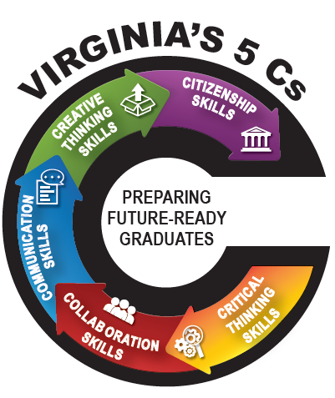
Enhancing Mathematics for ALL Students

Slide 13

Questions or Feedback?

