Slide 1
Overview of Supports Provided to Local School Divisions by the Office of School Quality
Virginia Board of Education Work Session
October 19, 2022
Dr. Aurelia Ortiz, Director
Office of School Quality
Notes:
Overview of the Supports Provided to Local School Divisions by the Office of School Quality
Dr. Aurelia Ortiz, Director, Office of School Quality

Slide 2
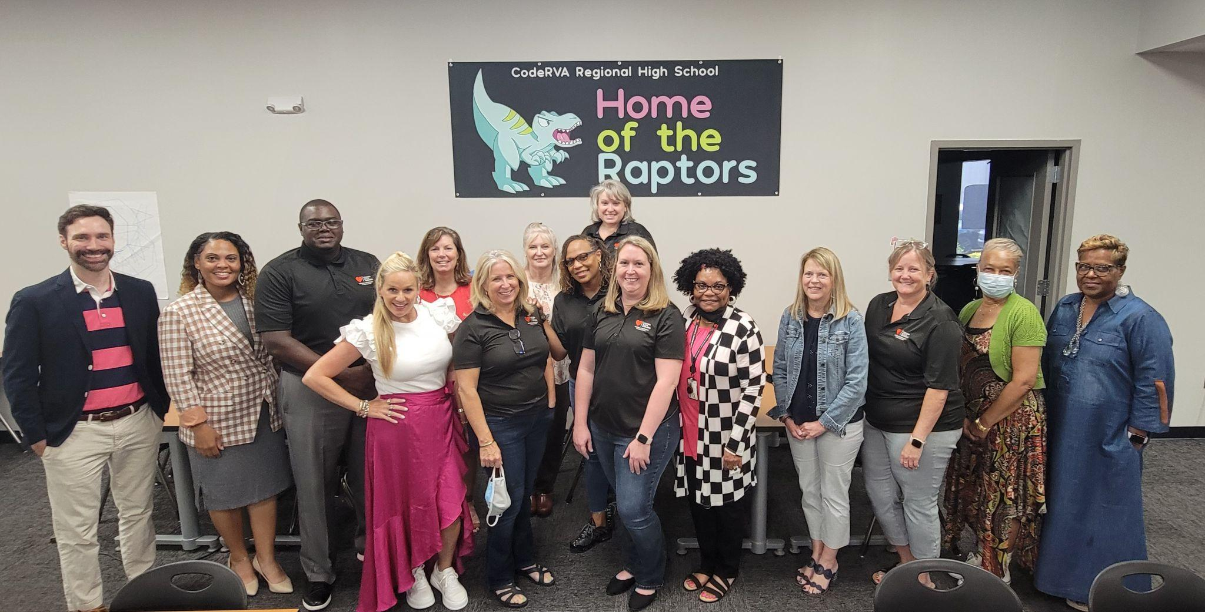
Office Of School Quality Staff:
Director (1)
Associate Director (1)
Coordinators:
Standards of Accreditation (1)
Federal, Vacant position (1)
Data (new) (1)
Implementation and Communication (1)
Special Projects(1)
Specialists:
School Quality Specialists (7)
School Quality Consultants (10)

Slide 3
Office of School Quality Mission
Mission: To advance learning outcomes by supporting schools and divisions in the continuous improvement process that complies with state and federal guidelines.

Slide 4
Background
Beginning in 2000, the Virginia Board of Education (Board) required schools, that have not achieved the expected benchmarks as measured by the Virginia Standards of Learning (SOL) content-area assessments, to undergo academic reviews to determine contributing factors impacting student achievement.
The Office of School Improvement was created in 2001 within the VDOE to work closely with low-performing schools to implement best practices and conduct academic reviews to analyze a variety of qualitative and quantitative data.
Former Governor Mark Warner augmented the Board’s academic review process with his Partnership for Achieving Successful Schools (PASS) initiative which paired Title I schools, subject to sanctions under the federal No Child Left Behind Act, with similar schools that were meeting state and federal standards. The initiative also identified community and private sector partners to provide resources and opportunities for students and teachers.

Slide 5
Office of School Quality - Support Model
Since its inception, the OSQ has continued to provide a seamless system of support to local school division staff as they implement the Standards of Learning to ensure students graduate with college- and career-ready skills. In recent years, the OSQ has been repurposed to serve as a resource for all schools and divisions across the eight Superintendent’s Regions in the areas of curriculum alignment, instructional leadership, continuous improvement planning, and data analysis.
Services provided by the OSQ are aligned with state and federal accountability requirements as promulgated in the Regulations Establishing Standards for Accrediting Public Schools in Virginia (SOA) and the Elementary and Secondary Education Act of 1965, as amended by the Every Student Succeeds Act of 2015 (ESSA). Examples include:
School-level academic reviews
Division-level academic reviews
Continuous school improvement planning (State and Federal)
School improvement grant (SIG) administration
Instructional Leadership professional development
Principals in Action and Teachers in Action initiatives
Capacity-building Through Coaching Initiative

Slide 6
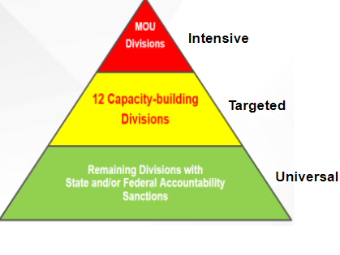
Office of School Quality -
Tiers of Support
A differentiated system of support has been developed through collaboration among various offices within the Virginia Department of Education (VDOE) as well as a multitude of educational partners.
Local capacity is built with targeted and differentiated supports and interventions determined by diagnostic reviews of student performance and local practices.

Slide 7
Tiers of Support Services
Memorandum of Understanding (MOU) Divisions | Corrective Action Plan (CAP) meetings, off-cycle support meetings, artifact review, essential action monitoring, technical assistance, Teacher-in-Action workshops, Professional Learning Network, early registration to events offered by the OSQ, collaboration across the agency to support respective division’s CAP(s), Virginia Transformational Leaders Academy (VTLA)
Capacity-building Divisions | Divisions with a high ratio of schools receiving Level 3 school quality indicators received targeted support regarding division-level systems and processes for aligning the written, taught, and assessed curriculum.
Universal Model | Virginia’s Continuous Improvement Process (VaCSIP) includes four modules 1- Understand the Continuous Improvement Process, 2 - Conduct a Comprehensive Needs Assessment, 3 - Develop a Comprehensive School Improvement Plan, 4 - Monitor for Implementation and Impact; School Improvement Summit; Monthly Webinars focused on school improvement, leadership development, Canvas Continuous Improvement Course; Principal Leader Conference - Virtual; Quality Quick Takes Monthly Newsletter; Quality Time office hours, Transformational Leadership Superintendent Academy, Attendance Works, Engagement Program, SISEP (Literacy), High Leverage Practices Collaborative Learning Cohort (CLC), Principal Leader Conference, K-5 Literacy Leaders, Chronic Absenteeism Collaborative Learning Cohort, Return to Learn Principal Cohort, Science collaboration Schools identified for support and improvement per ESSA

Slide 8
How Divisions enter in an MOU
The Standards of Quality (SOQ) require local school boards to maintain fully accredited schools and implement processes for corrective actions and improvement planning.
§ 22.1-253.13:3. Standard 3. Accreditation, other standards, assessments, and releases from state regulations.
… Each local school board shall maintain schools that are fully accredited pursuant to the standards for accreditation as prescribed by the Board of Education. Each local school board shall report the accreditation status of all schools in the local school division annually in public session.
The Board shall establish a review process to assist any school that does not meet the standards established by the Board. The relevant school board shall report the results of such review and any annual progress reports in public session and shall implement any actions identified through such review and utilize them for improvement planning.
… When the Board determines through its review process that the failure of schools within a division to meet the standards established by the Board is related to division-level failure to implement the Standards of Quality or other division-level action or inaction, the Board may require a division-level academic review. After the conduct of such review and within the time specified by the Board of Education, each school board shall enter into a memorandum of understanding with the Board and shall subsequently submit to the Board for approval a corrective action plan, consistent with criteria established by the Board setting forth specific actions and a schedule designed to ensure that schools within its school division meet the standards established by the Board. If the Board determines that the proposed corrective action plan is not sufficient to enable all schools within the division to meet the standards established by the Board, the Board may return the plan to the local school board with directions to submit an amended plan pursuant to Board guidance. Such corrective action plans shall be part of the relevant school division's comprehensive plan pursuant to § 22.1-253.13:6.

Slide 9
MOU Process
The division-level review focuses on the following categories: Academics and Student Success, Leadership and Governance, Operations and Support Services, and Human Resource Leadership.
A review team including representatives from various offices within the VDOE conduct a desk audit and an onsite review of systems and processes influencing student achievement.
During the onsite review, the review team collaborates with the LEA staff to analyze artifacts for each area of review to determine the level of implementation (Full, Functional, Limited, or No Implementation) (Not Started, Plan, Initial Implementation, Full Implementation, or Operational) of various components using a scoring rubric. In addition, interviews are conducted with the school board chairperson and vice-chairperson to gain perspective regarding school board governance.
These data sources are used to identify division-level areas of strength and improvement. All of the information is analyzed by the OSQ staff to identify patterns and trends to clearly define areas for improvement.
Once this information is compiled, the division superintendent is presented with a Report of Findings containing essential actions to be integrated into a corrective action plan (CAP).
The Virginia Board of Education and the local school board enter into a Memorandum of Understanding (MOU) indicating the responsibilities of the local educational agency and the Virginia Department of Education to develop systems and processes for improving student outcomes.

Slide 10
Name of Division | MOU Approved by the Virginia Board of Education (VBOE) | Number of Superintendents since Approval of MOU | Date of Release from the MOU
Lee County | April 15, 2004 | 1 | November 29, 2006
Sussex County | December 9, 2004 September 17, 2009 (MOU updated) February 27, 2014 (MOU updated) | 3 | September 27, 2017
Petersburg City | April 21, 2004 November 20, 2006 (MOU updated) November 17, 2009 (MOU updated) October 24, 2013 (MOU updated) April 28, 2016 (MOU updated) | 6 | TBD
Franklin City | March 27, 2014 | 3 | November 2018
Richmond City | April 4, 2005 (first MOU) | 1 | February 28, 2007
 | July 27, 2017 (second MOU) | 2 | TBD
Greensville County | March 22, 2018 | 2 | TBD
Danville City | June 18, 2020 | 2 | TBD
Prince Edward County | June 18, 2020 | 1 | TBD

Slide 11
SOA Required Actions
Academic Review
Monitoring Process
Schools with Level Two School Quality Indicators in Academic Achievement English, math, and/or science and Schools with any Level Three School Quality Indicators:
The school-level academic review is designed to help schools identify and analyze instructional and organizational factors affecting student achievement. The focus of the review process is on the systems, processes, and practices that are being implemented at the school level.
Schools with Level Three School Quality Indicators must complete a corrective action plan which is a combination of the academic review report and updated Comprehensive School Improvement Plan with the findings from the academic review.
Schools with Level 2 School Quality Indicators division and school staff monitor progress of school quality indicator improvement.
Schools with Level 3 School Quality Indicators division, school staff, and the department monitor progress of school quality indicator improvement.
Fall Division Monitoring:
Engage in collaborative conversations with division leadership about the systems and processes they utilize to support the continuous school improvement process with a focus on data, comprehensive school improvement plan monitoring, and resources.
Spring School Level Monitoring:
Engage in a collaborative conversation with school principals about the implementation of the comprehensive school improvement, impact towards SMART goals, action steps completed and next steps.
Notes:
Standards of Accreditation focus on requirements for schools based on performance levels. This slide reflects the current process for monitoring and academic review. Additional supports and monitoring required for schools with level 3 SQI
Academic Review hasn’t been done since the beginning of the 2019-2020 school year
I’d suggest adding here in the talking points how monitoring was previously done, and then in 2020-2021 we did virtual school visits, and in 2021-2022 we did virtual school monitoring visits twice with schools with Level 3 indicators and three times with CSI schools.

Slide 12
Academic Review Process
The Standards of Accreditation (8VAC20-131-400) requires schools not meeting minimum state accountability standards to undergo an academic review and develop a multi-year school improvement plan.
The academic review is designed to help schools identify and analyze instructional and organizational factors affecting student achievement and school engagement. Review activities may be conducted by the VDOE or under its guidance and emphasize the systems, processes, and practices that are being implemented at the school- and division-levels. Specifically, information is gathered that relates to the following areas of review:
Academic Achievement Tools | Student Engagement and Outcome Tools
Instructional Leadership Classroom Evaluation Climate and Culture Professional Development Data Analysis Master Schedule Assessment | Social Emotional Support Resource Management Chronic Absenteeism Graduation and Dropout College, Career, and Civic Readiness

Slide 13
Academic Review Process
The areas of review are grounded on research-based practices found to be effective in improving student achievement. Within each of these areas, indicators reflecting effective practices have been identified for review.
The VDOE and/or the LEA team collect(s) and analyze(s) artifacts demonstrating the school’s status in implementing these practices.
At the conclusion of the academic review, a Report of Findings is completed to describe the areas of strength, areas for improvement, and essential actions to include in the multi-year school improvement plan which is monitored by OSQ staff and used as the basis for the provision of customized professional development.

Slide 14
School and Division Responsibilities
All Divisions and Schools
Regardless of Accreditation Status
School and its division: complete comprehensive needs assessment (CNA) and comprehensive school improvement plan (CSIP).
Level One School Quality Indicators (SQI)
School and its division: Monitor and evaluate implementation of evidence-based essential actions and strategies and monitor progress on SQI.
School and its division:
Reexamine and amend the CNA; revise CSIP, as needed.
Monitor and evaluate implementation of evidence-based essential actions and strategies, focusing on fidelity.
If no progress on SQI after two years, identify areas for improvement and revise CSIP accordingly.
Additional requirements, if any of the academic achievement indicators for all students in English, mathematics, and/or science is at Level Two:
Follow VDOE guidance for conducting an academic review (AR) and completing an AR report.
Revise CSIP to align/incorporate essential actions from the AR report.
Submit Division Superintendent Certification to verify requirements have been met.
Level Two School Quality Indicators (SQI)
Level Three School Quality Indicators (SQI)
School and its division in consultation with VDOE:
Reexamine and amend the CNA; conduct an academic review (AR) and complete the AR report.
Revise CSIP to align/incorporate essential actions from the AR report.
To meet corrective action plan requirements, submit the AR report and revised CSIP to the VDOE.
Meet regularly with VDOE to monitor and evaluate implementation of evidence-based essential actions and provide evidence of progress on SQI.

Slide 15
Schools Supported by the Office of School Quality
School Year | Accountability Year | Schools with Level 2 School Quality Indicators in Academic Achievement English, mathematics, and/or science | Schools with any Level 3 School Quality Indicators
2021-2022 | 2022-2023 | 129 | 329
2020-2021 | Waived | 69 | 192
2019-2020 | Waived | 69 | 192
2018-2019 | 2019-2020 | 69 | 192
*During 2019-2021 due to accreditation being waived, schools were not required to conduct an Academic Review.
**For Accreditation Year 2022-2023 Chronic Absenteeism was waived and are not included in the data for 2022-2023.
***During 20-2022, our schools support touched 64 divisions; for the 22-2023 school year, our support has expanded to 111.

Slide 16
Federally Identified Schools
School Year | Identification Year | Comprehensive Support and Improvement (CSI) | Targeted Support and Improvement (TSI) | Additional Targeted Support and Improvement (ATSI)
2021-2022 | 2022-2023 | 52 | 6 | 55
2019-2021 | Waived | 39 | 10 | 38
2018-2019 | 2019-2020 | 39 | 10 | 38

Slide 17
Efficacy and Metrics
Foci based on JLARC report, feedback from the field and leadership:
Tailored and timely support, and multiple tiers of support;
Increased collaboration across VDOE departments and offices;
Promotion of data usage to support continuous improvement; and
Capacity building through coaching to co-construct/support division improvement efforts.
Intended Outcomes
System Improvements and Sustainability
Closing Performance and Opportunity Gaps
Student Growth and Success
Teacher and Leadership Retention
Effective Leadership and Governance
Creation of Coaching Culture

Slide 18
National Center on Education
Education systems are not simply collections of independently effective parts and pieces. Effective systems, by definition, are parts and pieces that work in harmony with one another, each one reinforcing and supporting the functioning of the other parts and pieces, and all of them together contributing to the system’s high performance.

