Slide 1
NAEP 101​
Mark Schneider
Director, IES
US Department of Education

Slide 2

What is NAEP?
The National Assessment of Education Progress – also known as the "Nation's Report Card“– has several components:
“Main NAEP”
  Reading and math grades 4 and 8 every two years (pandemic caused 1 year delay from 2021 to 2022).
    National and state-by-state results
    Large urban districts under the TUDA program.
      There are NO Virginia cities or counties represented.
  Reading and math at 12th grade – only national and every 4 years.
There are also other subject specific tests – only national and grade coverage varies.
  Science assessment
  Writing
  Various social sciences (economics, history, civics) are tested periodically
Long Term Trends
  Continuous trend lines going back to the 1990s
  Based on 9-, 13-, and 15-year-old students – not based on grade levels.

Slide 3
When NAEP results are reported, they are reported as
Scale scores (e.g., 250, 300, Etc.)
Achievement levels based on scale score cut points: below basic, basic, proficient, and advanced.
Results are also reported by different racial, ethnic, free- and reduced-price lunch status, disability and English Language Learners, enabling analysis of achievement gaps.
A key feature is trend analysis going back to the 1990s and gaining in detail since 2002.

Slide 4
Most useful for states are the comparisons that are possible because NAEP is a common yardstick that states can compare themselves to the nation and other states.

Slide 5
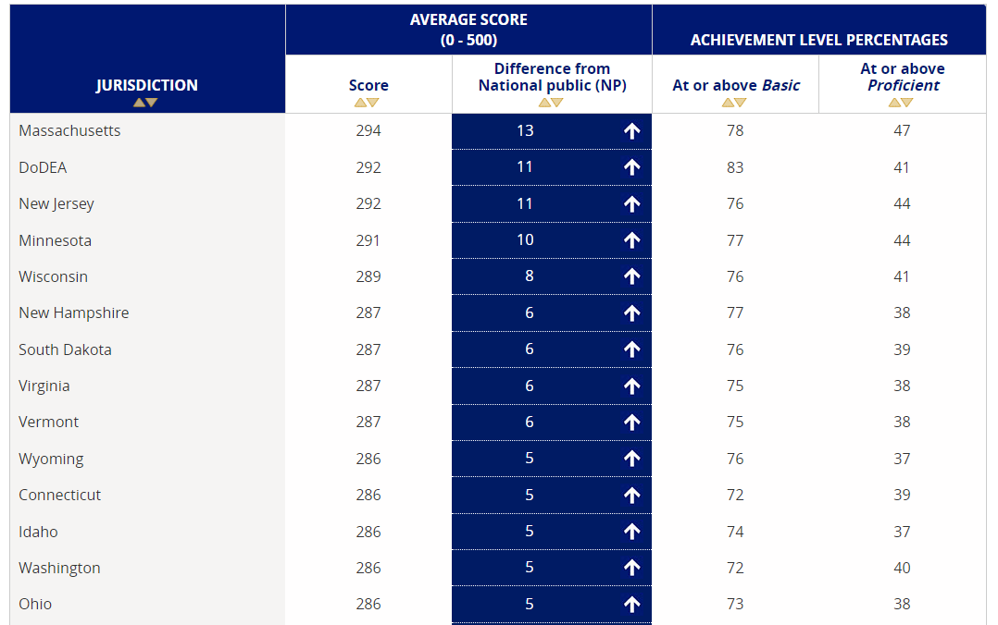
State comparison chart.
2019 Grade 8 Math

Slide 6
State snapshot reports are another useful tool
(each subject-grade combination is reported separately)

Slide 7
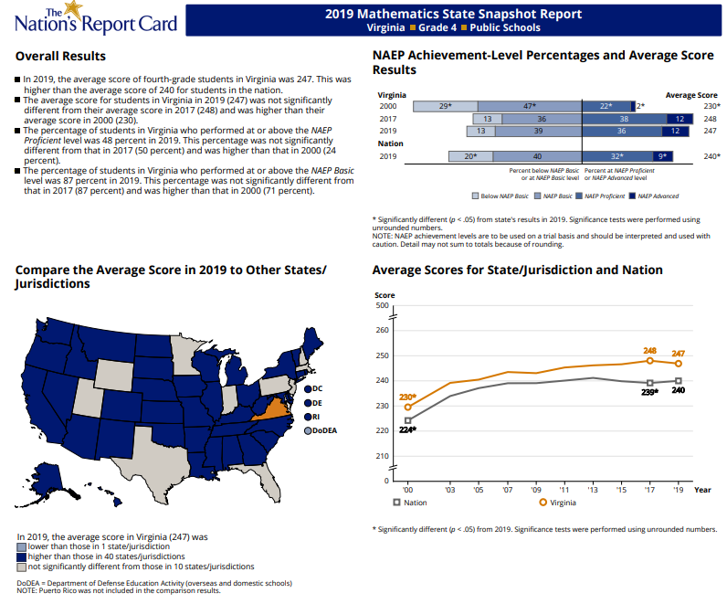
Virginia State Grade 8 Math Snapshot

Slide 8
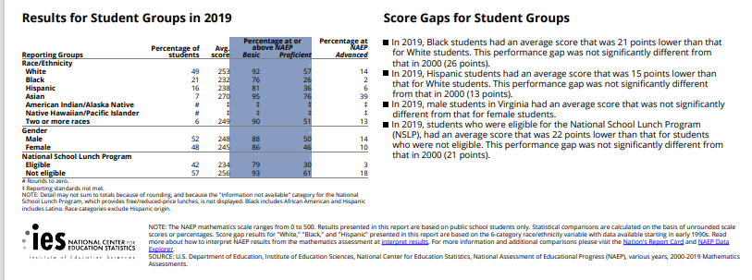
Performance Gaps for Students in Virgina: Grade 8 Math
Percent Below Basic
White | Black | His-panic | Asian | Two or More Races | National
8 | 24 | 9 | 5 | 10 | 20
Percent at Proficient or above
White | Black | Hispanic | Asian | Two or More Races | National
57 | 26 | 36 | 76 | 51 | 41

Slide 9
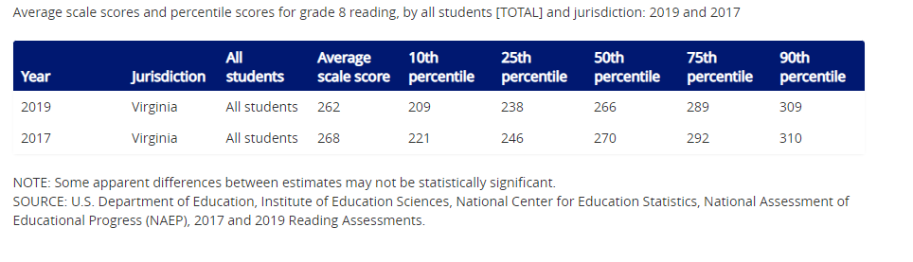
Declining scores are common and often concentrated at the lowest performing students

Slide 10
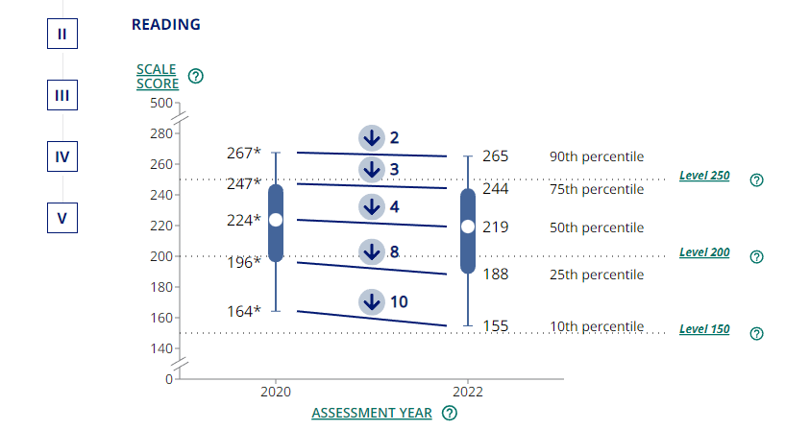
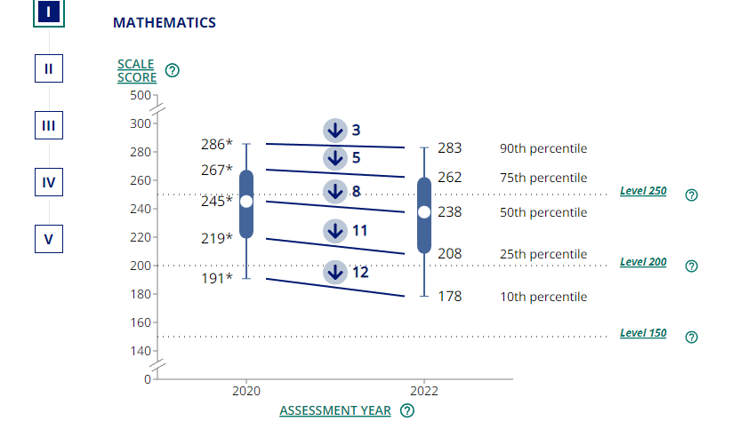
Declines are bigger among lower performing students: Example 2022 Long Term Trend of a national sample of 9-year-old students

Slide 11
October 24: NAEP Day
Test was administered between late January and early April 2022
>200,000 students in >5000 schools at each of grades 4 and 8
Grade 4 and 8 Math and Reading
We can expect:
  Based on past scores, including Long Term Trends, significant declines across the board
  Expect a "horse race" comparing changing scores across states
  Declines among already struggling students:
    Bottom of the distribution
    Racial and ethnic minorities
    Students with special needs

Slide 12
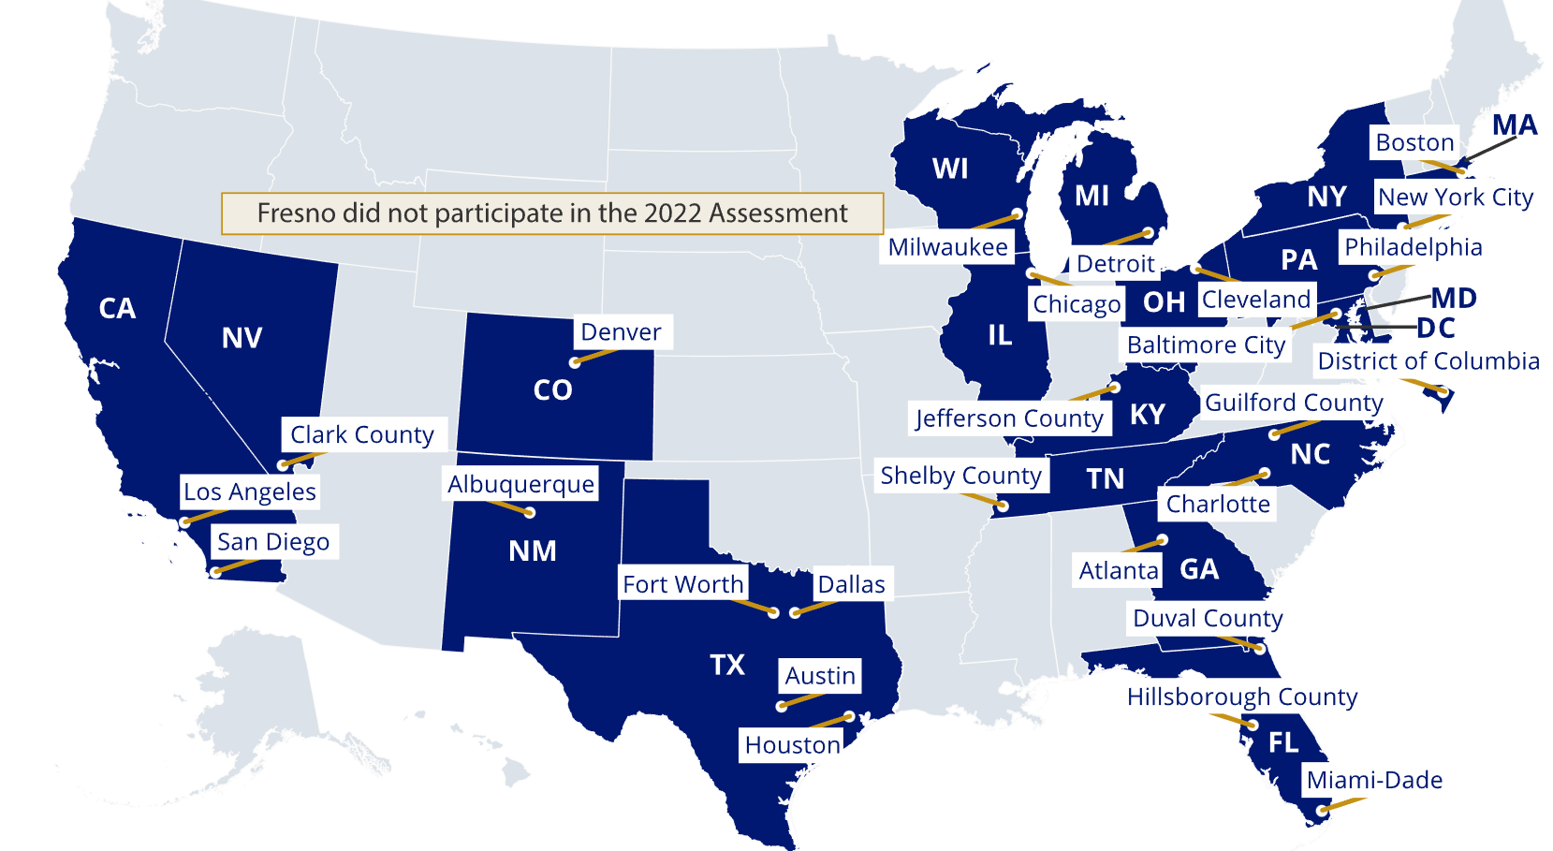
NAEP 2022 will also have TUDA scores
  A "horse race" comparing changing scores across states​
Where are VA counties/cities?

Slide 13
Questions?
Mark.Schneider@ed.gov

