Slide 1

Virginia’s Early Childhood Advisory Committee (ECAC)
September 29, 2022

Slide 2
Agenda
Update on VQB5 Practice Years
Update on Licensing Regulations and Workgroup
Update on Improvements to the Child Care Subsidy Program
Update on Preschool Development Grant Birth-to-Five Opportunity
Update on Virginia Child Care Provider Survey Opportunity
Notes:
Kris

Slide 3
Update on VQB5 Practice Years

Slide 4
VQB5: Unified Measurement and Improvement
In response to state law, the Virginia Board of Education has established a unified measurement and improvement system, called VQB5, for all publicly-funded birth-to-five early childhood programs.
The Virginia Department of Education (VDOE) worked with multiple stakeholders and communities to develop the new system.
This new system includes 2 Practice Years through local and regional community networks.
By fall 2023, all publicly-funded programs, including VPI and Early Childhood Special Education, will be required to participate in VQB5.
Notes:
Erin
278 out of 533 (52.2%) public schools receive ECSE funds

Slide 5
Unified Measurement and Improvement
Virginia’s early childhood system must ensure that all children have access to quality teaching and learning experiences that meet their unique needs.
Working together, through VQB5, we:
UNIFY around shared and equitable expectations for quality.
MEASURE and strengthen teacher-child interactions and curriculum use in all publicly-funded birth-to-five programs.
IMPROVE supports for educators, prioritizing those who need it most.
Notes:
Erin

Slide 6
VQB5 Timeline
Practice years allow programs the chance to practice collecting information and receiving supportive feedback, and targeted supports for interactions and curriculum. They also enable state and local leaders to gather information to inform future guidelines and procedures.
VQB5 Practice Year 1 (Completed in June 2022 1500+ sites)
Participation through PDG communities (about 85% of the state)
Practice Year 1 ratings will be shared with site leaders on Oct.3rd
2021-2022
VQB5 Practice Year 2 (2600+ sites completed registration)
Participation available through Ready Regions to 100% of programs
Practice Year 2 ratings shared with site leaders in fall of 2023
2022-2023
VQB5 Year 1
All publicly funded programs required to participate
Quality Ratings from Year 1 publicly shared in the fall 2024
2023-2024
Notes:
KRIS

Slide 7
Measuring Quality
VQB5 measures the quality of infant, toddler and preschool teaching and learning based on two nationally-recognized quality indicators.
Interactions | Curriculum
Measure teacher-child interactions and instruction in a developmentally-appropriate way using the Classroom Assessment Scoring System (CLASS) | Measure the use of approved curricula that are aligned with Virginia’s Early Learning and Development Standards
Research shows that stimulating and supportive interactions between teachers and children and effective use of quality curricula promote children’s holistic learning and development, resulting in improved school readiness.
Details can be found on the Quality Measurement and Improvement (VQB5) website
Notes:
KRIS

Slide 8
Continuous Quality Improvement
PREPARE
Leaders and educators understand what is being measured and why
RECOGNIZE, REFLECT AND ADJUST
Leaders and educators use data to recognize growth, reflect on what works and make adjustments to address challenges and gaps
MEASURE AND IMPROVE
All infant, toddler and preschool classrooms are observed and consistent information is collected to understand the experience of all children
SUPPORT
Leaders and educators receive professional development that addresses their unique classrooms
GIVE FEEDBACK
Leaders provide educators with individualized feedback on their classroom’s strengths and opportunities for growth

Slide 9
Using VQB5 Data to Target Support
Here are ways that VDOE and partners are prioritizing programs for improvement supports based on their unique needs:
Ready Regions are using regional data to collaborate with existing improvement partners to ensure there are professional development options available to VQB5 programs.
Classrooms with lower scores on CLASS observations are being prioritized for coaching supports.
Sites who are not yet using an approved curriculum are prioritized for STREAMin3 enrollment and coaching.
Improvement partners are prioritizing VQB5 sites for trainings and technical assistance on CLASS and curriculum.

Slide 10
VQB5 Practice Year 1 Summary

Slide 11
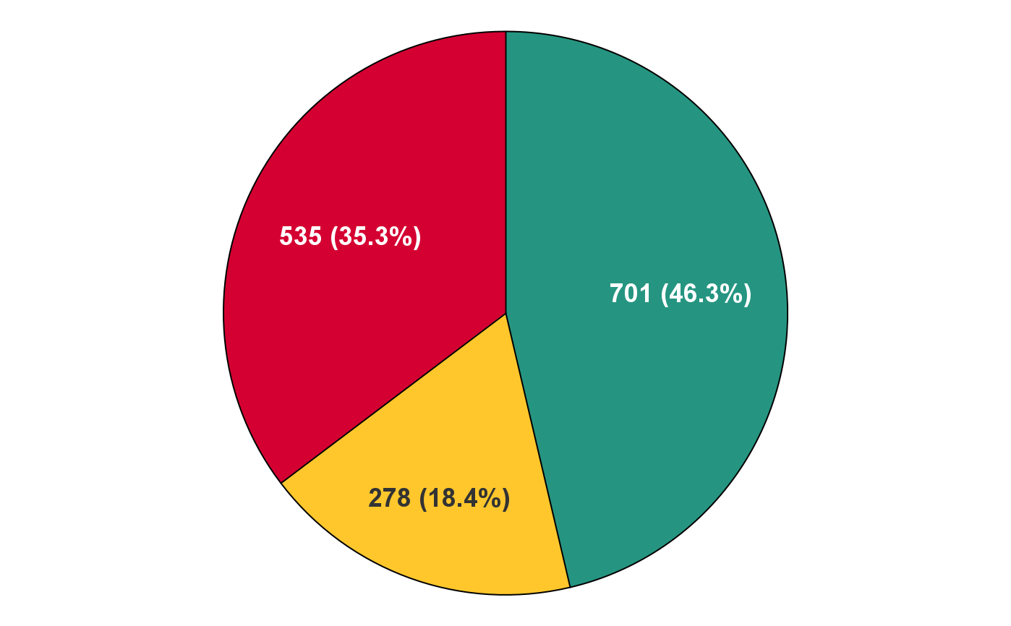
Practice Year 1 Participation (2021-2022)
The 1,514 participating sites represented all types of early childhood settings and will receive their results on October 3. More than 90% were publicly-funded.
Public Schools
Centers
Family Day Homes

Slide 12
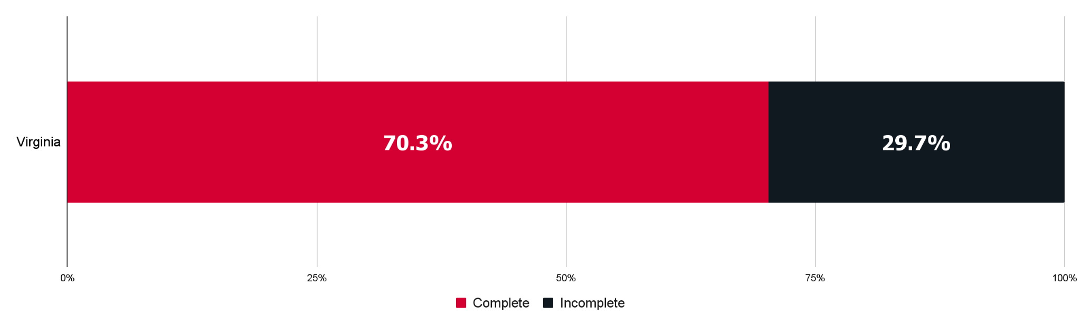
Practice Year 1: Percent of Sites Receiving a Complete Rating
Many Practice Year 1 sites were able to complete the required activities, however there were some challenges related to completion of local CLASS observations.
1,064 sites
450 sites
Over the summer, VDOE gathered information about why sites were unable to complete required observations and is using this information to inform the development of future guidelines and procedures to ensure more sites are able to successfully complete all requirements.

Slide 13
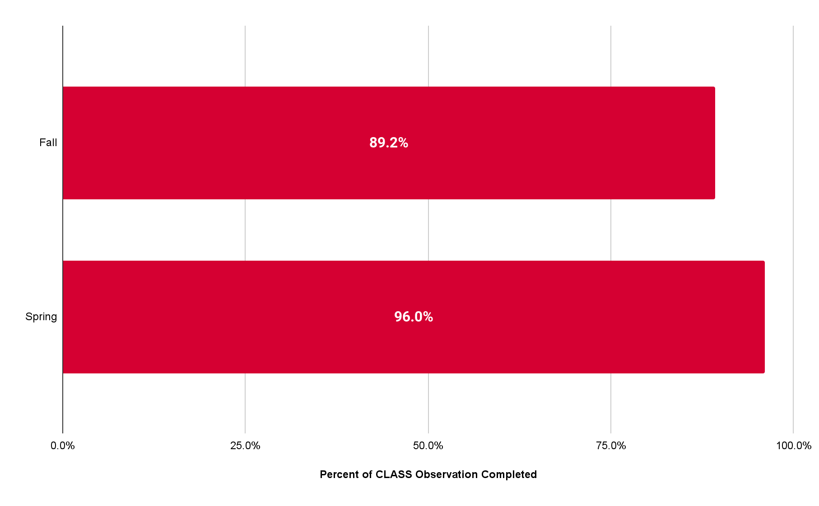
Practice Year 1: CLASS Observations from Fall to Spring
Classroom observation rates improved in the spring of Practice Year 1.
Notes:
important note: this is the number of OBSERVATIONS, not # of classrooms that had an observation. Some classes had 2-3 observations. It won't match classroom age breakouts for that reason, and because of FDHs using different tools than what they listed classrooms as in LB5, some #s wont match too.

Slide 14
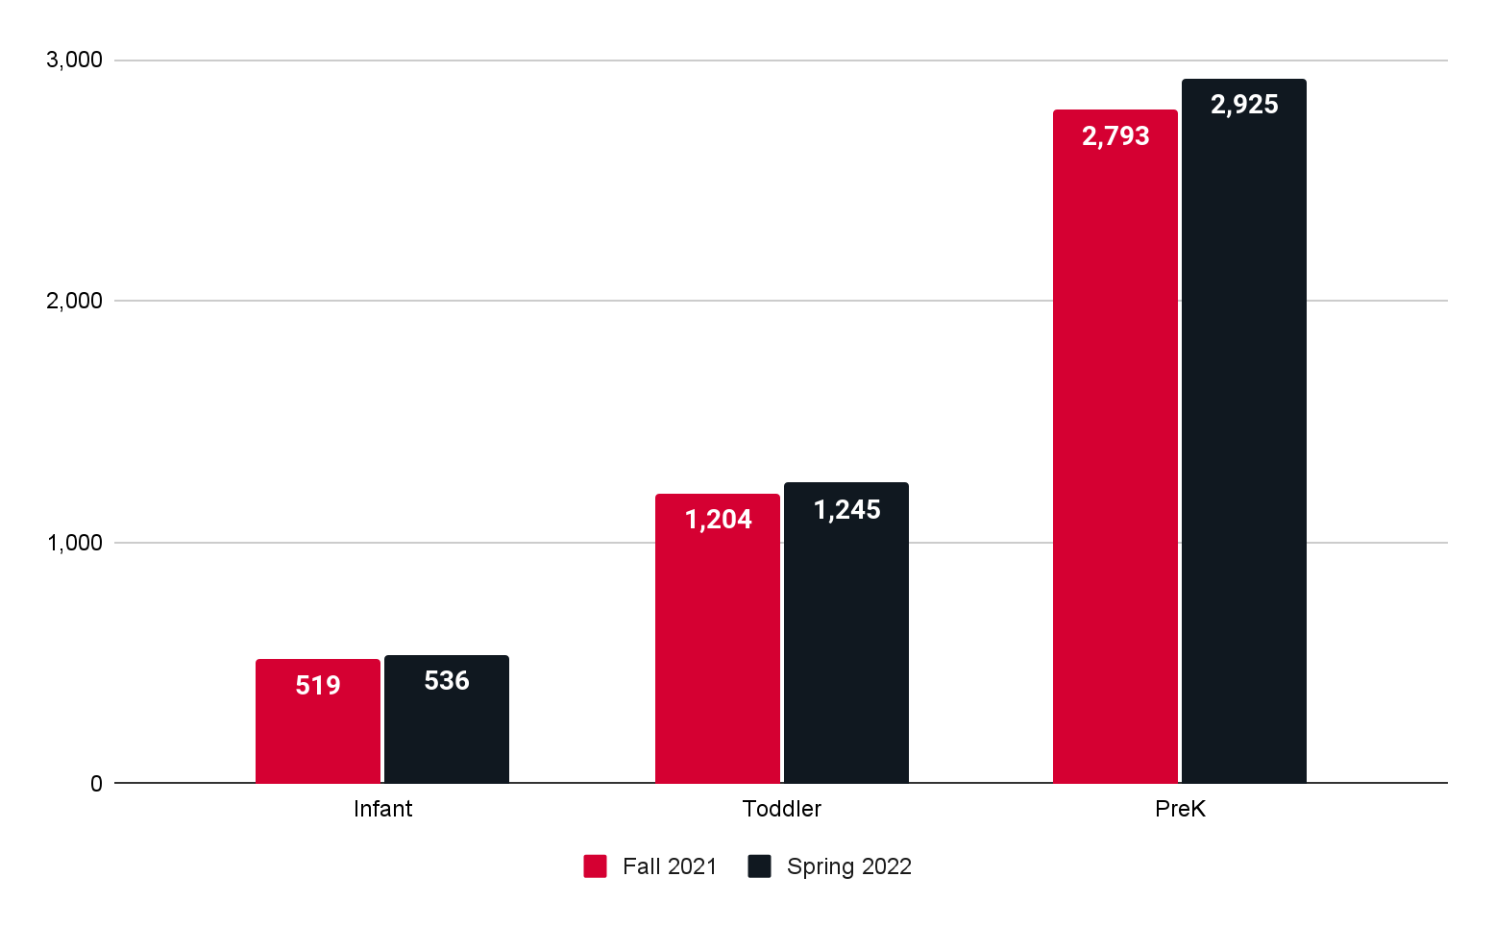
Practice Year 1: Number of CLASS Observations from Fall to Spring by Age
Classroom observation rates were higher in the spring, across all age levels.

Slide 15
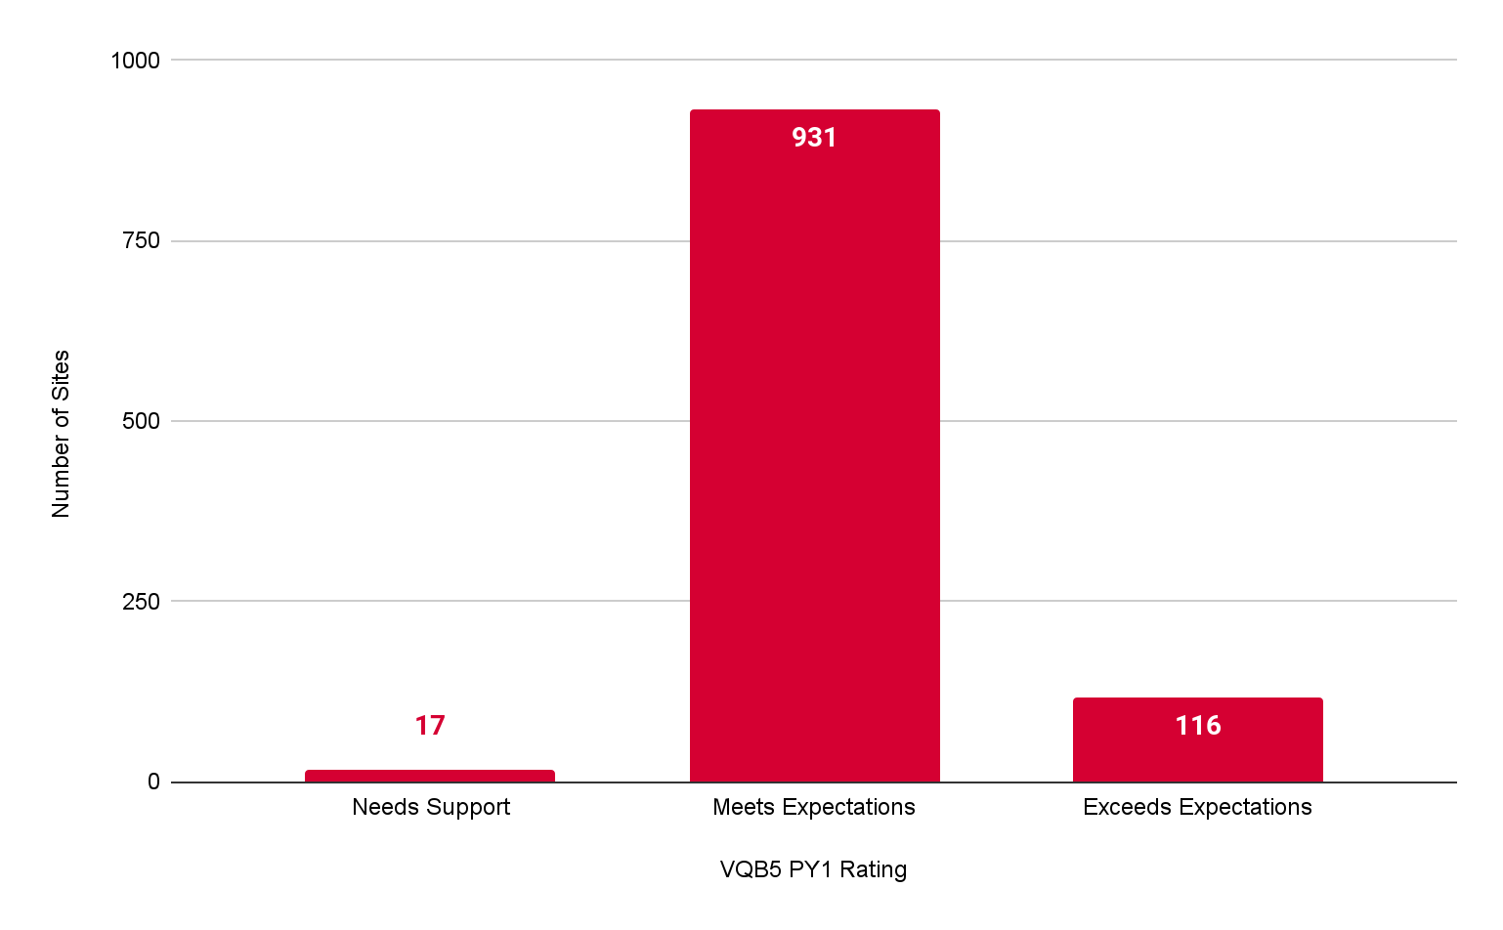
Overall Practice Year 1 VQB5 Ratings
During Practice Year 1, the majority of sites met or exceeded practice year expectations.
87.5%
1.6%
10.9%

Slide 16
Next Steps: Sharing Practice Year 1 Results
The 1500+ sites who participated in VQB5 will be able to access their results via their LinkB5 accounts on October 3.
Every primary site administrator will receive an email from VDOE with instructions on how to access their Practice Year 1 results.
Site administrators will log in to LinkB5 to access and download a letter from the VDOE that contains their Practice Year 1 rating.
  ONLY site administrators will have access to this report.
The Practice Year 1 email and results letter will also include additional resources for next steps:
  VDOE Practice Rating User Guide; VQB5 Coaching Services Flyer; and Strengthening Quality Toolkit
Following this private dissemination, sites can share rating information with their Ready Region and improvement partners to support improvement.

Slide 17
VQB5 Practice Year 2

Slide 18
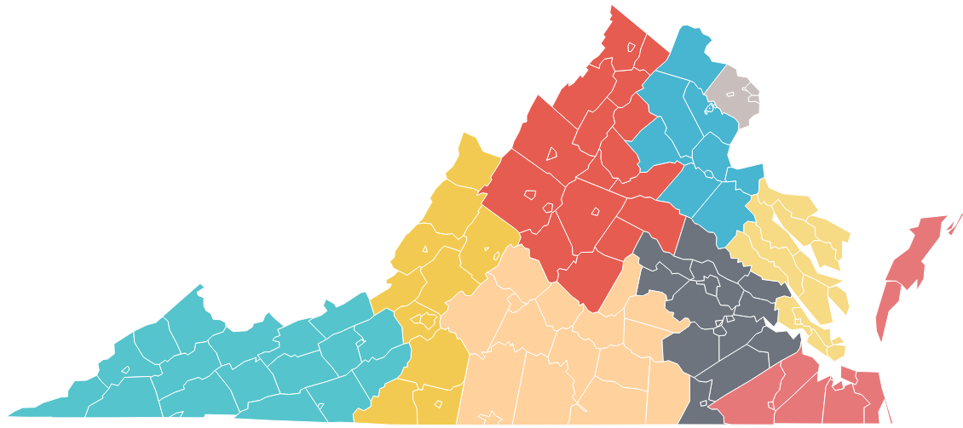
VQB5 Practice Year 2 (2022-2023)
Here are the key overall points:
Required activities and expectations are the same for Practice Year 2.
We are on track for having nearly double the number of classrooms participating.
Ready Regions (not PDG Community Networks) are coordinating the implementation at the community level.
As of July 2022…
VQB5 Coordinated statewide through READY REGIONS

Slide 19
Practice Year 2 Enhancements
The enhancements, endorsed by ECAC and approved by the BOE, help ensure more children have access to quality teaching and learning experiences that meet their unique needs.
1
PARTICIPATION
Increase Participation of Publicly Funded programs
2
CLASS OBSERVATIONS
Ensure educators receive consistent observations and supportive feedback
3
CURRICULUM
Increase support for accessing and using quality curriculum
4
IMPROVEMENT SUPPORT
Prioritize VQB5 participants for Improvement Supports
5
PRACTICE RATINGS
Pilot a Site Level Quality Profile
6
LINKB5
Improve LinkB5 user experience
7
APPEAL PROCESS
Develop a structured process to address unique situations

Slide 20
VQB5 Activities Timeline (2022-2023)
All programs that completed registration by Sept. 16th, 2022 will complete the following activities during Practice Year 2.
Summer 2022 | Fall 2022 | Winter 2023 | Spring 2023
Program registration and preparation for fall CLASS observations (Registration closed 9/16/22) | Local CLASS observations and curriculum use information for every classroom entered in LinkB5. | Programs use information from fall to engage in professional development based on program and classroom needs. | Local CLASS observations and curriculum use information updated (if needed) for every classroom entered in LinkB5.
Reflect and Prepare
Measurement, Feedback and Support for Every Classroom
Every site will also have at least one external observation between Oct-June, as a secondary method to gather information, support local observers, and provide additional feedback.

Slide 21
Update on Licensing Regulations

Slide 22
Status of Pending Regulatory Action
This section provides an update on the regulatory action initiated for General Procedures and Information for Licensure (8VAC20-821)
A regulatory action to repeal the current 8VAC20-820 and create a new 8VAC20-821 with background check requirements for child care providers merged into the new regulation was accepted by the Board on first review on September 15, 2022.
The Board members will review the materials presented in depth and the Board members will vote on the regulatory action on final review.
If the Board approves, the regulation will move to the ‘proposed’ stage in the regulatory process.

Slide 23
Next Steps
If the Board approves, the proposed regulation will continue in the review process ending with a review by the Governor’s office. If approved by the Governor, the proposed regulatory text and a document explaining the basis, purpose, substance and issues of the regulatory action will be posted to the Virginia Regulatory Town Hall and a 60 day public comment period will open.
VDOE will make changes to the proposed regulation based on comments received during the public comment period.
A final regulation will be prepared for approval.

Slide 24
Health and Safety Regulation Workgroup Update
Here is a progress update on the comprehensive review of Standards for Licensed Child Day Centers (8VAC20-780) which will repeal the current regulation and establish a new regulation (8VAC20-781).
The workgroup has worked over the last eight months to review the standards.
As of September 27, 2022, the workgroup has concluded the first review of the standards.
The Office of Child Care Health and Safety will revise standards based on feedback and recommendations from the group. Follow-up meetings will occur to review final draft recommendations.
The final draft will be presented to ECAC members at the December meeting.
The next step is to prepare and submit the NOIRA for Board approval. VDOE is in the planning phase of this next step.

Slide 25
Update on Improvements to the Child Care Subsidy Program

Slide 26
Overview
This section summarizes the Child Care Subsidy Program policy changes to make quality child care more accessible to Virginia’s families and providers.
Three Key Principles for Public Investments in Early Childhood Care and Education in Virginia
Virginia’s New Cost Estimation Model and Revisions to Provider Rates
Revisions to Parent Copayments

Slide 27
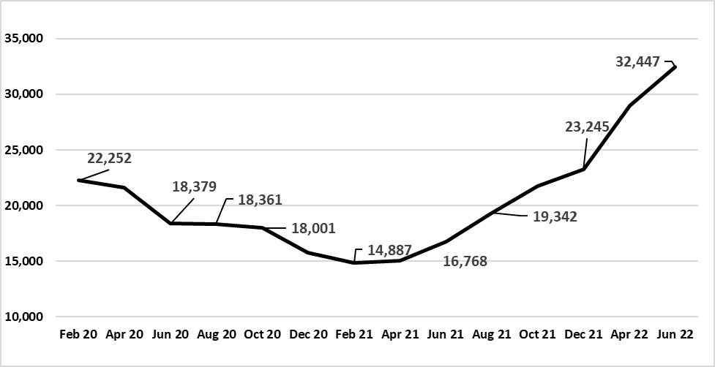
Virginia is Serving More Children and Families in the Child Care Subsidy Program than Ever
Enrollment Feb. 2020 - June 2022
VDOE aspires to serve 35,000 children this year and 38,000 children in CCSP next year.
Notes:
Alex

Slide 28
Update on Child Care Funding Efforts
VDOE is implementing two key changes to the Child Care Subsidy Program policy that will 1) fund child care programs to meet quality expectations and 2) make public child care more accessible and affordable for parents by:
Using the of results the cost estimation model to determine the “true cost” to deliver quality care and education with competitive compensation, and set payment rates based on a percentage of these costs.
Restructuring parent copayments in the Child Care Subsidy Program (CCSP) to reduce financial burdens for families and promote consistency with other publicly-funded programs.

Slide 29
Reminder: Key Principles
1. Our unique public-private system should offer true choice for families. | 2. Rates should reflect higher quality expectations. | 3. Educator compensation should be competitive.
Eligible families have different preferences and should be able to choose based on what is best for their child; not be limited because of affordability. The public school day is free for all families. The ECE equivalent should be free for eligible families to the greatest extent feasible. Families living in poverty should not have payment obligations. | All publicly-funded programs have same quality expectations under VQB5. Public payment rates should reflect the supports educators need to foster strong teacher-child relationships and implement effective curricula. All providers should have access to payment rates that support continuous quality improvement. | Compensation for early childhood educators should attract and help retain competent professionals. Compensation for publicly-funded early childhood programs should be pegged to public teacher salaries and should include benefits. Wages/salaries at publicly-funded programs should generally be reflective of competency, education levels and experience, noting that all educators will be a part of VQB5.
Notes:
Whenever possible, the framework for setting per-child payment rates and parent cost-sharing obligations should be consistent across the public-private system.

Slide 30
Virginia’s Cost Estimation Model
A New Approach to Setting Provider Payment Rates

Slide 31
Funding Providers to Meet VQB5 Expectations
VDOE is using a new model to set payment rates that looks at different program elements and cost drivers, namely educator compensation, to assess the “true cost” of providing child care.
Starting October 1, payment rates will better support providers to meet quality expectations in VQB5.
  This accounts for higher staff compensation, benefits, and opportunities for performance bonuses not just for programs achieving high quality levels, but for all programs in the subsidy system.
  CCSP Vendors (Level 1 and Level 2) will be paid for up to 15 days of planned closure for holidays, vacations, and professional development or planning time.
Notes:
Alex
Federal law requires states to model the costs associated with meeting higher levels of quality, as defined by the state quality rating and improvement system. Many states use this information to established tiered reimbursement rates based on levels of quality. These types of scales give providers access to higher payment rates once higher levels of quality have been achieved.
We think that approach is fundamentally flawed. If we are going to establish expectations for quality, VDOE believes that we should fund programs to achieve those expectations. So we will establish payment rates based on modeled costs to meet expectations in VQB5, accounting for competitive compensation, benefits, and continuous quality supports for all programs in subsidy.
VDOE will use the cost estimation model to phase in:
Phase I: Set Regional payment rates in the Child Care Subsidy Program based on a percentage of estimated costs.
Phase II: Set voluntary wage scale to encourage programs to increase wages over time.
Phase III: Additional supports for continuous quality improvement based on VDOE’s evaluation during the final VQB5 practice year.
Extent to which we continue to raise rates - compensation and planning time - lead with emphasis on comp. Will wait to see what the data show
Increase the number of days providers may be paid for planned closure, holidays, vacations, and professional development or planning time. This now applies to both Level 1 and Level 2 providers.
Added Juneteenth to list of paid holidays (counts toward the 15 total days)
Added: “Family day home providers in the Child Care Subsidy program may be paid for up to three sick days to care for themselves or a family member.”

Slide 32
Key Assumptions in VDOE’s Model
Here are the key assumptions:
The model generates separate estimates for child day centers and family day homes, and account for differences in program size and auspice.
The model accounts for geographic variations in wages and other operating costs. Localities will be organized regionally into Ready Regions.
Licensing standards serve as the baseline for the cost of meeting basic health and safety standards, including age-based group sizes and teacher-child ratios.
Costs at increasing levels of quality under VQB5 reflect competitive compensation and supports for educators.
The model assumes a certain level of enrollment efficiency, or the number of children enrolled relative to capacity.

Slide 33
Payment Rate Structure (Effective Oct. 1)
Centers: Proposed rates are set at 75% of cost estimation model results for Level 2 programs. (The rate differential between Level 1 and Level 2 centers is eliminated to account for the similarity in health and safety requirements between licensing and subsidy vendor regulations).
Family Day Homes: Rates are set at graduated percentages of cost for each age group: 94% for infants, 82% for toddlers, 76% for preschool, and 70% for school age.
  Modeled cost for Level 1 and Level 2 Family Day Homes.
  Accounting for a mixed-age setting used in the cost model, Family Day Home programs would receive about 80% of the total cost of quality model results.
All: Part-day rates are 70 percent of full-day rates.
All: Locality payment rates either increase or are held harmless. No locality will experience a reduction in payment rates.
Rates are on ChildCareVA.com
Notes:
Using the default age distribution used in the cost model (2 infants, 4 toddlers, 3 preschool, 3 school age) the program would receive about 80% of the total cost of quality total

Slide 34
Local Impacts: Centers
 |  | Licensed Centers |  | License-Exempt Centers
 |  | Number of localities experiencing increase (out of 133) | Average daily rate increase if > $0 | Number of localities experiencing increase (out of 133) | Average daily rate increase if > $0
Full-day | Infant | 132 (99%) | $31 | 133 (100%) | $36
 | Toddler | 129 (97%) | $25 | 132 (99%) | $29
 | Preschool | 115 (86%) | $13 | 126 (95%) | $15
 | School-Age | 92 (69%) | $5 | 111 (83%) | $7
Part-day | Infant | 132 (99%) | $22 | 133 (100%) | $25
 | Toddler | 129 (97%) | $17 | 132 (99%) | $20
 | Preschool | 116 (97%) | $9 | 126 (95%) | $11
 | School-Age | 79 (59%) | $4 | 114 (86%) | $5
Notes:
Alex

Slide 35
Local Impacts: Family Day Homes (August update)
 |  | Licensed Family Day Homes |  | License-Exempt Family Day Homes
 |  | Number of localities experiencing increase (out of 133) | Average daily rate increase if > $0 | Number of localities experiencing increase (out of 133) | Average daily rate increase if > $0
Full-day | Infant | 133 (100%) | $24 | 133 (100%) | $21
 | Toddler | 132 (99%) | $20 | 129 (97%) | $18
 | Preschool | 132 (99%) | $18 | 129 (97%) | $16
 | School-Age | 131 (98%) | $17 | 129 (97%) | $14
Part-day | Infant | 133 (100%) | $17 | 133 (100%) | $15
 | Toddler | 132 (99%) | $14 | 132 (99%) | $13
 | Preschool | 132 (99%) | $13 | 129 (97%) | $12
 | School-Age | 129 (97%) | $9 | 129 (97%) | $11
Notes:
Alex
All rates, by region, are in appendix and by locality on Child Care VA

Slide 36
What Does the Change in Payment Rates Mean…
For families? | For child care providers? | For Virginia?
The state will cover a greater share of costs for providers in the Child Care Subsidy Program, allowing more providers to serve publicly-funded families. Families will have more options when selecting a provider. Families will be able to choose the option that best meets their needs and preferences. | Payment rates will be commensurate with expectations for delivering quality as measured by VQB5, primarily by accounting for competitive compensation. Providers that serve a large share of publicly- funded children will have sufficient public resources and will be encouraged to increase educator compensation over time. | Virginia will have a consistent method for per-child payment rates in public programs, promoting coordination and choice across the system. Our public-private system ECCE system will better prepare children for kindergarten, resulting in more children coming to school with the key literacy, math, and social-emotional skills needed to succeed. Virginia will establish a national model for a public-private parent choice system.

Slide 37
Revisions to Parent Copayment Scale
Making Child Care Assistance More Accessible to Families

Slide 38
Federal Requirements for Family Copayments
Federal law requires most families in the CCSP to pay a copayment.
VDOE has the authority to waive copayments for families in poverty, homeless families, children in child protective services/foster care, and “other priority populations” as identified by the state.
Copayments must reflect a sliding fee scale based on income.
Copayments can be a flat rate or a percentage of family income. They cannot be based on prices charged by providers.

Slide 39
Priorities for Virginia’s Copayment Scale
Virginia’s priorities are rooted in the 3 key principles for investment.
Families at or below the poverty line should not have a copayment obligation.
Copayments should be simple and straightforward.
Copayments should mirror cost obligations in other publicly-funded programs, to the extent possible.

Slide 40
New Copayment Structure
Here’s how Virginia will restructure copayments:
Copayment rates will be established per day and per child receiving assistance (up to three children).
Daily payment rates will start at $0 for families with incomes below the poverty guidelines, and increase as a family’s income increases.
Maximum total fees for monthly family copayments will not exceed 7% of family income.
Copayments will be paid to providers on a monthly basis.

Slide 41
New Copayment Scale
Here are the new copayment amounts, effective January 1, 2023:
*If a family adds a child during their eligibility period, their case will be reassessed to determine if an additional per-child copayment will apply.
Income Range | Family Copayment Amount
0% - 100% FPG | $0
101% - 200% FPG | $60 Monthly Fee per Child*
201% - 300% FPG | $120 Monthly Fee per Child*
301% and above FPG | $180 Monthly Fee per Child*

Slide 42
Example: Impact on Families
Example: The Johnson family of three has a household income of $34,500 annually, or $2,875 monthly, roughly 150% FPG. The Johnson family has preschooler and a 5th grader in the CCSP.
The preschooler (Child 1) is authorized for care 5 days per week all year.
The 5th grader (Child 2) is authorized for care 3 days per week during the school year (9 months) and 5 days per week during the summer (3 months)
Monthly copay for child 1 | Monthly copay for child 2 | Monthly Total Family Copay | Copay under current scale
$60 | $60 | $120 | $201.25

Slide 43
What Does the Change in Copayments Mean…
For families? | For child care providers? | For Virginia?
Family copayment burdens will be significantly reduced, allowing more families to access child care assistance. Families will have more choices among publicly-funded programs that meet their needs. More families will be able to access full-day, full-year experiences for their preschool-age children. | Family copayments will be affordable, minimizing the likelihood that families will struggle to make monthly payments. Coupled with higher payment rates, fewer families will owe providers tuition beyond the copayment and state payment. | More families will have access to stable, quality child care, supporting parental employment and maximum workforce participation and productivity. Our public-private system ECCE system will better prepare children for kindergarten, resulting in more children coming to school with the key literacy, math, and social-emotional skills needed to succeed. Virginia will establish a national model for a public-private parent choice system.
Notes:
And again, here are the outcomes we hope to see based on the revisions to the copayment scale. Most importantly for families, copayment burdens will be significantly reduced, which eliminate cost as a barrier to participate in the subsidy program. This will also give more families more options for programs and providers that meet their needs, and can open the door to full-day, full-year experiences for more families.

Slide 44
Other Changes to Child Care Subsidy
New state budget language also directs VDOE to increase access and ensure choice across the public-private system after July 1 by:
Removing the 72 month limit for time that families may participate
Supporting parents to pursue work;
Paying based on enrollment: all vendors receive 36 absences per child;
Paying for additional planned days of closure (up to 15 days, all levels)
Juneteenth is now a paid holiday;
Setting 85% of State Median Income as threshold for families with young children; and
Eliminating the waitlist for child care subsidy.

Slide 45
What’s Next?

Slide 46
Timeline for Implementation
The new rates for the Child Care Subsidy Program (CCSP) will go into effect on October 1, 2022.
September 28, 2022: End of Town Hall public comment period. Policy changes to CCSP Guidance Manual take effect Sep. 29.
September - October: baseline child care provider survey
October 1, 2022: New provider payment rates go into effect
  Vendors should expect to see the increased payments reflected in their November 1 payment.
November (approx.): Vendor Agreements reissued
January 1, 2023: New copayment scale goes into effect

Slide 47
Update on Preschool Development Grant Birth-Five Opportunity

Slide 48
New Grant Opportunity for Virginia
Virginia will likely apply for a Preschool Development Grant Birth-to-Five (PDG B-5) Planning Grant.
Virginia has received a PDB B-5 planning grant and 3-year renewal grant.
Funds support needs assessment, strategic planning, family engagement, quality improvement, and/or workforce compensation and supports.
PDG B-5 encourages collaboration among programs as well as a mixed delivery system that includes child care and family child care providers, Head Start, state pre-kindergarten, and home visiting.
Eligible states can receive up to $4 million for 1 year. 27 states are competing for ~10 awards.
Application is due on November 7, 2022.

Slide 49
Update on Virginia Child Care Provider Survey Opportunity

Slide 50
Provider Survey is Open through October 7th
The Virginia Department of Education wants to learn more about your experiences leading your early childhood site.
All respondents will receive a $25 Walmart gift card after completing the survey!
Our partners at the University of Virginia (UVA) have sent emails with your survey link.
  If you can’t find the email, but would like to take the survey, please email the UVA team at see-partnerships@virginia.edu.
The survey is voluntary and confidential. It asks about your site’s enrollment, staffing, and experiences with the Child Care Subsidy Program. It will never be used to evaluate you or your site.
This survey will help us to understand how to:
  Improve child care providers’ experiences with the Child Care Subsidy Program (CCSP)
  Improve families’ access to child care

Slide 51
Appendices

Slide 52
Appendix A: VQB5 Practice Years

Slide 53
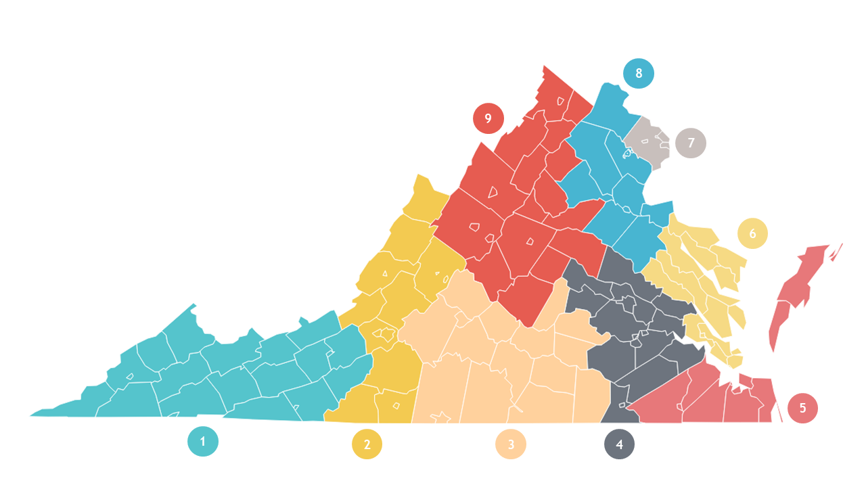
A1: VQB5 Ready Regions Coordination
The following organizations lead the Ready Regions work for VQB5:
RR 1 | Southwest | United Way of Southwest Virginia
RR 2 | West | United Way of Roanoke Valley
RR 3 | Southside | Center for Early Success
RR 4 | Central | Thrive Birth to Five
RR 5 | Southeastern | Minus 9 to 5, EVMS
RR 6 | Chesapeake Bay | Smart Beginnings Virginia Peninsula
RR 7 | Capital Area | Fairfax County Office for Children
RR 8 | North Central | Smart Beginnings Rappahannock Area
RR 9 | Blue Ridge | United Way of Greater Charlottesville
**See Ready Regions Contact List for County/City Breakdown
Notes:
Erin

Slide 54
A2: VQB5 Practice Year Ratings
Practice Year ratings are calculated at the end of the school year (i.e. in the summer) using the following point system. Practice Year 2 ratings will be shared privately with site-administrators in the fall of 2023 for information only.
Interactions Points (700 total points) | Average of all local CLASS scores from the fall and the spring (all classrooms at a site*) x 100
Curriculum Points (100 total points) | Programs using an approved curriculum in at least one classroom, by May 31st, will receive 100 points added to their score
Total Points | Interactions Points + Curriculum Points = Total Points
Practice Year 2 Ratings | Exceeds Practice Year Expectations = 700 - 800 points Meets Practice Year Expectations = 400 - 699 points Needs Support = 100 - 399 points
Sites with practice ratings will be provided with Professional Development options in response to their practice rating results. Programs that fall into the “Needs Support” category within the practice years will be a priority for improvement support.
Notes:
KRIS

Slide 55
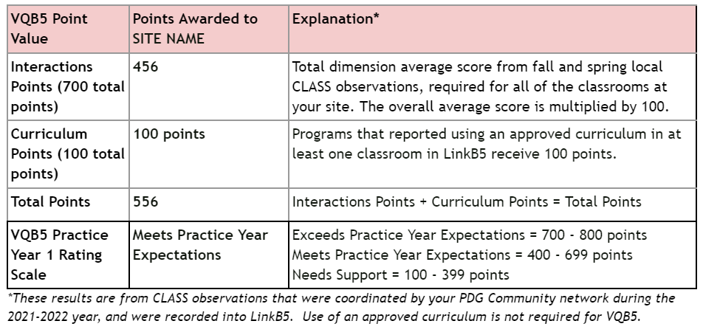
A3: PY1 Results - Sample Complete Rating

Slide 56
Appendix C: Background on Family Copayments in the Child Care Subsidy Program

Slide 57
C1. Child Care Subsidy Copayments and Rates
The Child Care Subsidy Program (CCSP) pays a portion of child care tuition for eligible families, up to the Maximum Reimbursement Rate (MRR), less the family copayment.
Copayments are currently set based on a percentage of families’ incomes. Families with any countable income owe copayments, unless they are on TANF.
Currently, the MRR is set based on a percentile of the prevailing market rate--the prices charged by child care providers in each locality.

Slide 58
C2. How are Family Copayments Set?
Federal law requires most families in the CCSP to contribute to the cost of child care by paying a copayment.
Copayments are based on family size and income, and may consider other factors, such as the number of children in care or whether care is full- or part-time.
Copayments may be based a share of income or a flat dollar amount. They may not be based on the cost of care.
The federal Office of Child Care recommends that copayments not exceed 7 percent of family income.
Note: States may permit child care providers to charge families the difference between the MRR and their tuition rates.

Slide 59
C3. Current Copayment Rates Limit Access
Poverty threshold | Annual income for a family of 4 | Copayment obligation (% of income) | Annual copayment obligation (in dollars)
100% | $27,750 | 5% | $1,388
125% | $34,688 | 6% | $2,081
150% | $41,625 | 7% | $2,914
160% | $44,400 | 8% | $3,552
185% | $51,338 | 9% | $4,620
250% | $69,375 | 10% | $6,938
300% | $83,250 | 10% | $8,325
85% SMI | $88,954 | 10% | $8,895
Notes about current copayment structure in Virginia:
Copayments are based on a percent of monthly income and assessed on a monthly basis.
Copayments are not differentiated for full vs. part-time care.
Families pay one copayment, regardless of the number of children in care.

Slide 60
Appendix D: Background on Maximum Reimbursement Rates in the Child Care Subsidy Program

Slide 61
D1. How do States Determine Maximum Reimbursement Rates?
States set payment rates in their child care assistance programs using one of the following methods:
A market rate survey, which is a study of the fees that child care programs charge based on the program type (center or family day home), age group, unit of care, and geography; or
An approved alternative methodology that estimates the cost of operating a child care program versus the prices programs charge families.
Notes:
Statistically valid and reliable MRS:
• Include the full priced child care market
• Contain complete and current data
• Represent geographic variation
• Use rigorous data collection procedures
• Analyze data in a manner that captures market differences

Slide 62
D2: Regional Daily Rates (Centers)*
 | Full-Day |  |  |  | Part-Day
 | Infant | Toddler | Preschool | School-Age | Infant | Toddler | Preschool | School-Age
Region 1 | $63.00 | $55.00 | $39.00 | $27.00 | $45.00 | $39.00 | $28.00 | $19.00
Region 2 | $67.00 | $58.00 | $41.00 | $29.00 | $47.00 | $41.00 | $29.00 | $21.00
Region 3 | $64.00 | $56.00 | $39.00 | $28.00 | $45.00 | $40.00 | $28.00 | $20.00
Region 4 | $69.00 | $60.00 | $42.00 | $30.00 | $49.00 | $42.00 | $30.00 | $21.00
Region 5 | $71.00 | $61.00 | $42.00 | $30.00 | $50.00 | $43.00 | $30.00 | $21.00
Region 6 | $68.00 | $59.00 | $41.00 | $30.00 | $48.00 | $42.00 | $29.00 | $21.00
Region 7 | $94.00 | $81.00 | $55.00 | $39.00 | $66.00 | $57.00 | $39.00 | $28.00
Region 8 | $83.00 | $72.00 | $50.00 | $35.00 | $59.00 | $51.00 | $35.00 | $25.00
Region 9 | $70.00 | $61.00 | $42.00 | $30.00 | $49.00 | $43.00 | $30.00 | $21.00
Note: If the identified regional payment rate is lower than the current MRR, local rates will be held harmless.
Additional details regarding Family Day Home rates are available in the appendices.

Slide 63
D3: Regional Daily Rates (Licensed FDH)*
 | Full-Day |  |  |  | Part-Day
 | Infant | Toddler | Preschool | School-Age | Infant | Toddler | Preschool | School-Age
Region 1 | $ 50.00 | $ 43.00 | $ 40.00 | $ 37.00 | $ 35.00 | $ 31.00 | $ 28.00 | $ 26.00
Region 2 | $ 53.00 | $ 46.00 | $ 43.00 | $ 39.00 | $ 38.00 | $ 33.00 | $ 31.00 | $ 28.00
Region 3 | $ 51.00 | $ 44.00 | $ 41.00 | $ 38.00 | $ 36.00 | $ 31.00 | $ 29.00 | $ 27.00
Region 4 | $ 55.00 | $ 48.00 | $ 44.00 | $ 41.00 | $ 39.00 | $ 34.00 | $ 31.00 | $ 29.00
Region 5 | $ 55.00 | $ 48.00 | $ 45.00 | $ 41.00 | $ 39.00 | $ 34.00 | $ 32.00 | $ 29.00
Region 6 | $ 54.00 | $ 47.00 | $ 43.00 | $ 40.00 | $ 38.00 | $ 33.00 | $ 31.00 | $ 28.00
Region 7 | $ 75.00 | $ 66.00 | $ 61.00 | $ 56.00 | $ 53.00 | $ 47.00 | $ 43.00 | $ 40.00
Region 8 | $ 66.00 | $ 57.00 | $ 53.00 | $ 49.00 | $ 47.00 | $ 40.00 | $ 38.00 | $ 35.00
Region 9 | $ 55.00 | $ 48.00 | $ 45.00 | $ 41.00 | $ 39.00 | $ 34.00 | $ 32.00 | $ 29.00
Note: If the identified regional payment rate is lower than the current MRR, local rates will be held harmless.

Slide 64
D4: Regional Daily Rates (Unlicensed FDH)*
 | Full-Day |  |  |  | Part-Day
 | Infant | Toddler | Preschool | School-Age | Infant | Toddler | Preschool | School-Age
Region 1 | $ 44.00 | $ 39.00 | $ 36.00 | $ 33.00 | $ 31.00 | $ 28.00 | $ 26.00 | $ 24.00
Region 2 | $ 47.00 | $ 41.00 | $ 38.00 | $ 35.00 | $ 33.00 | $ 29.00 | $ 27.00 | $ 25.00
Region 3 | $ 45.00 | $ 39.00 | $ 37.00 | $ 34.00 | $ 32.00 | $ 28.00 | $ 26.00 | $ 24.00
Region 4 | $ 49.00 | $ 43.00 | $ 40.00 | $ 36.00 | $ 35.00 | $ 31.00 | $ 28.00 | $ 26.00
Region 5 | $ 50.00 | $ 43.00 | $ 40.00 | $ 37.00 | $ 35.00 | $ 31.00 | $ 28.00 | $ 26.00
Region 6 | $ 48.00 | $ 42.00 | $ 39.00 | $ 35.00 | $ 34.00 | $ 30.00 | $ 28.00 | $ 25.00
Region 7 | $ 58.00 | $ 50.00 | $ 47.00 | $ 43.00 | $ 41.00 | $ 35.00 | $ 33.00 | $ 31.00
Region 8 | $ 50.00 | $ 43.00 | $ 40.00 | $ 37.00 | $ 35.00 | $ 31.00 | $ 28.00 | $ 26.00
Region 9 | $ 50.00 | $ 43.00 | $ 40.00 | $ 37.00 | $ 35.00 | $ 31.00 | $ 28.00 | $ 26.00
Note: If the identified regional payment rate is lower than the current MRR, local rates will be held harmless.

Slide 65
D5: Notes Regarding Payment Rates
Shifting the basic principles and methodology for setting payment rates is an exciting opportunity in Virginia. It is also important to note what the new methodology does NOT do:
Set new or additional requirements associated with higher payment rates.
Require providers to change wages when new rates go into effect.
Cap earnings for any program.
Require programs to increase costs for private pay families.
  Vendors will be paid the MRR for their locality. If the MRR is higher than the rate a program charges the general public, the Vendor will still be paid the MRR. If a Vendor prefers to receive a lower rate than the MRR, the Vendor may contact VDSS.

Slide 66
We are experiencing technical difficulties.
The livestream will return momentarily.

