Slide 1

VDOE Modifying & Building
Desmos Activities
Welcome!
We’ll start at 7 pm ET.
Friendly reminder: participants are muted upon entry
Resources: bit.ly/VDOEdesmos10-14

Slide 2
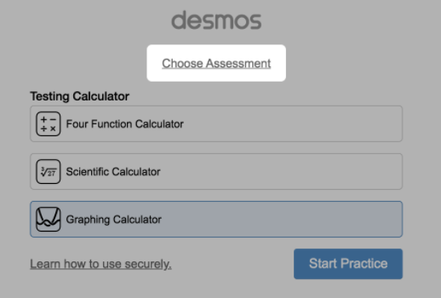
Desmos Virginia Calculators (1 of 2)
VDOE Desmos Calculator Webpage – links to Virginia versions of Desmos calculators
  Virginia Desmos Four-Function Calculator
  Virginia Desmos Scientific Calculator
  Virginia Desmos Graphing Calculator
  Desmos Virginia Calculator – handout (PDF)
Desmos Virginia Calculator Apps –
available in app stores for iOS devices

Slide 3
Desmos Virginia Calculators (2 of 2)
The Desmos Virginia Graphing Calculator has been updated to include some additional features. This updated calculator will be available beginning with the Fall 2020 Test Administration.
  The updated version of the Desmos Virginia Graphing Calculator will be in all versions of End-of-Course test forms assessing the 2016 Mathematics Standards of Learning.
No update was made to the Desmos Virginia Scientific Calculator or to the Desmos Virginia Four- Function Calculator.

Slide 4
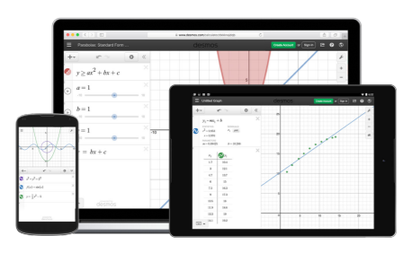
VDOE Mathematics Resources
VDOE Desmos Activities Log – updated in 2019
Just in Time Mathematics Quick Checks – now available K – Algebra I; Geometry and Algebra II Quick Checks are in development

Slide 5
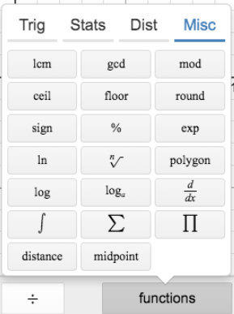
Desmos Virginia Graphing Calculator
Distance and midpoint (geometry functions) will now be enabled on the keypad in the Functions-Miscellaneous tab.
For additional information regarding these updates, view the Desmos Virginia Information document.

Slide 6
Asking Questions
During the presentation, you may have a question that others may also like to hear about.
We prefer you to type your question in the QA box so it doesn’t get lost in the Chat Room chatter.
This will be moderated by the Hosts.
Resources: bit.ly/VDOEdesmos10-14

Slide 7
About Me
Current Classroom Teacher (13 years)
Started Using Desmos 2012
Desmos Teaching Fellow 2015
Desmos Certified Presenter 2017
Resources: bit.ly/VDOEdesmos10-14

Slide 8
Agenda
Introductions
Copy and Edit Activities
Build Custom Activities
Computation Layer
Resources: bit.ly/VDOEdesmos10-14

Slide 9
Desmos Guide to Building Great (Digital) Math Activities
Variety of verbs
Informal before formal
Connect representations
Promote mathematical conversations
Opportunities to be right and wrong in different and interesting ways
Delay feedback for reflection
Blog post
Resources: bit.ly/VDOEdesmos10-14

Slide 10
Copy and Edit Activities
Find an Activity
Make Edits
Copy Screens
Save
Collect
Collaborate
Resources: bit.ly/VDOEdesmos10-14

Slide 11
Build Activities
Getting Started
Adding Components
Preview
Publish
Resources: bit.ly/VDOEdesmos10-14

Slide 12
Computation Layer
Documentation
Examples
Resources
bit.ly/DesmosCL
cl.desmos.com
Resources: bit.ly/VDOEdesmos10-14

Slide 13
Resources and Q & A
Resources: bit.ly/VDOEdesmos10-14

Slide 14
VDOE Mathematics Contact Information
Tina.Mazzacane@doe.virginia.gov
Kristin.Williams@doe.virginia.gov
vdoe.mathematics@doe.virginia.gov
student_assessment@doe.virginia.gov
Survey: bit.ly/PDDesmos

Slide 15

Thank you!
Nolan Doyle
Desmos Fellow
Resources: bit.ly/VDOEdesmos10-14

