Slide 1
VDOE 2018 Algebra Readiness (AR) Institute
October 30, 2018 – Fredericksburg
October 31, 2018 – Williamsburg
November 6, 2018 – Charlottesville
November 7, 2018 - Radford
VDOE Team:
Tina Mazzacane, Mathematics Coordinator
Kristin Hope, Mathematics and Special Education Specialist
Michael Traylor, Assessment Specialist
Algebra Readiness Committee Representatives:
Michele Giglio, Henrico County Public Schools
Dr. Brendon Albon, Amherst County Public Schools

Slide 2
VDOE AR Session Agenda
Welcome and Introductions
Introduction to Algebra Readiness Initiative
Mathematics Vertical Articulation Activity
MVAT and AR Resource Showcase
Using Student Score Reports and Data – Grade 7
Interpreting Student Score Reports and Data – Grade 6
Dynamic MVAT Tool Application/AR Resources Identification
Components of Effective AR Programs
Mathematics SOL Practice Items and Desmos
Reflection and Closure
Notes:
Tina

Slide 3
1. Introduction to Algebra Readiness Initiative
Notes:
Tina

Slide 4
Algebra Readiness Initiative (ARI)
Standards of Quality (Sec. 22.1-253.13:1(D)13)
Local school divisions shall provide algebra readiness intervention services to students in grades six through nine who are at risk of failing the Algebra I end-of-course test, as demonstrated by their individual performance on any diagnostic test that has been approved by the Department of Education. Local school divisions shall report the results of the diagnostic tests to the Department of Education on an annual basis, at a time to be determined by the Superintendent of Public Instruction. Each student who receives algebra readiness intervention services will be assessed again at the end of that school year. Funds appropriated for prevention, intervention, and remediation; summer school remediation; at-risk; or algebra readiness intervention services may be used to meet the requirements of this subdivision.
Notes:
The Algebra Readiness Initiative began in 2002 and is a lottery funded program in which local school divisions agree to match state funds for the purpose of providing intervention services to students in grades 6 – 9.

Slide 5
Data Collection: SOQ Compliance
School divisions will use the following criteria when providing Algebra Readiness Initiative (ARI) intervention services to individual students:
Determine the student's knowledge and skills of the Mathematics SOL for grades 3 through 8 and Algebra I.
Support the following five mathematical process goals for students found in the SOL: 1) Becoming Mathematical Problem Solvers; 2) Communicating Mathematically; 3) Reasoning Mathematically; 4) Making Mathematical Connections; and 5) Making Mathematical Representations.
Notes:
Since school divisions must agree to match the funding amount, the criteria for use of the funds must be certified through the SOQ Compliance report completed by every school division, typically completed in August through the SSWS system.

Slide 6
Data Collection: SOQ Compliance
Identify mathematics content strengths and challenges, and indicate the level of performance where intervention may be necessary to be successful in each of the following categories:
Grades 3 through 8:
1) Number and Number Sense;
2) Computation and Estimation;
3) Measurement and Geometry;
4) Probability and Statistics; and
5) Patterns, Functions, and Algebra
Algebra I
1) Expressions and Operations;
2) Equations and Inequalities;
3) Functions; and
4) Statistics.
Notes:
Schools also certify that they will use diagnostic tools to help identify areas of content strength and challenge for students in order to focus intervention efforts.

Slide 7
Virginia ARI Annual Report
To receive SOL Algebra Readiness Initiative Payments, the school division certifies that it will:
Offer an intervention program to targeted students;
Utilize diagnostic methods to assess students at the beginning and at the end of that school year;
Submit a report to the Virginia Department of Education by August 1 outlining the methods used for diagnosing individual student mathematics content strengths and challenges, remediation efforts used, the number of students who received ARI services, and the number of students demonstrating improvement during the 2017-2018 school year; and
Match these funds based on the composite index of local ability-to-pay.
Notes:
(Handout – 2018-2019 ARI Annual Report)
Policy dictates that school divisions must report their efforts in remediating students using this funding to the Virginia Department of Education. An annual report is to be submitted by August 1 (at the end of the school year). The report includes:
Division contact information
Division diagnostic method information (SOL results, locally developed pre- and post-assessments, or locally-selected pre- and post-assessments)
Additional information – if using a locally-selected assessment
Students served using ARI funding to include (number of students receiving intervention and number demonstrating improvement)
Type of AR intervention – small group push-in or pull-out; additional remediation during or afterschool, or other types of remediation
Mathematics Teacher Specialist funding

Slide 8
Algebra Readiness Initiative Division Contact
Name ___________________
Title ___________________
Email ___________________
Who is designated in your school division?
Notes:
Through the SOQ compliance process, an AR representative contact is designated by each division. Sometimes that person may be a testing representative or assistant superintendent who is not directly responsible for implementing remediation. Be sure to find out who is designated in your school division. The invitations for these AR Institutes were sent to those names designated for the current school year. Encourage your superintendent to change the designee, if you feel that there is another person who should be listed as the contact.

Slide 9
ARI – Two Major Components
Provides mathematics intervention resources and services to students in grades six through nine who are at risk of failing the Algebra I end-of-course test.
Diagnostic assessment designed to guide instructional decisions for students that may need intervention services
Targeted intervention services for students
Algebra Readiness Initiative (FAQ) #1
Notes:
Handout – ARI FAQ
There is a list of Frequently Asked Questions available on the VDOE website. The first FAQ is: What is the Algebra Readiness Initiative?
We have already established the purpose of the AR Initiative based on policy. The ARI consists of two major components:
A diagnostic assessment to guide instructional decisions
Targeted intervention services

Slide 10
Identifying At-Risk Students
The school division determines which students should be targeted for diagnostic testing and then subsequently for intervention services. The identified group may include:
students in grades 6-9 at risk of failing the Algebra I end-of-course test;
students not successful in previous intervention programs;
students who performed below average in their previous year's mathematics program;
students identified by teachers through formal and informal assessment; and/or
students who did not pass their previous mathematics standards of learning assessment.
Algebra Readiness Initiative (FAQ) #2
Notes:
Handout – ARI FAQ
The second FAQ is: Who determines which students are at risk?
Algebra Readiness intervention services should target:
Students in grades 6-9 at risk of failing the Algebra I EOCT
Students not successful in previous intervention programs
Students who performed below average in previous year’s mathematics program
Students identified through formal or informal assessment
Students who did not pass their previous mathematics SOL assessment
Ideally, school divisions will use several criteria to identify students who would benefit from remediation

Slide 11
Approved AR Diagnostic Tests
Locally-designed or locally selected diagnostic tests must:
Assess students’ knowledge and skills of Mathematics SOL in grades 3-8 and Algebra I
Support the five mathematics process goals
Identify content strengths and challenges, and indicate levels of performance where intervention may be necessary in the mathematics content strands of grades 3-8 and Algebra I
Algebra Readiness Initiative (FAQ) #3
Notes:
Handout – ARI FAQ
The third FAQ is: What diagnostic tests are approved by the VDOE for ARI?
Locally designed or locally selected tests must
Assess mathematics knowledge and skills of mathematics SOL grades 3 – 8 and Algebra I
Support the five mathematics process goals
Identify individual student content strengths and challenges

Slide 12
Using SOL Assessments as Diagnostic Tools
School divisions also have the option of using student results from Virginia Mathematics Standards of Learning Assessments as a pre-assessment in conjunction with classroom formative assessments to identify areas of individual student focus for remediation.
The end-of-year grade level or Algebra I Mathematics Standards of Learning Assessment results can then serve as the post-assessment.
Algebra Readiness Initiative (FAQ) #3
Notes:
Handout – ARI FAQ
The third FAQ is: What diagnostic tests are approved by the VDOE for ARI?
School divisions also have the option of using student results from the previous year’s Virginia Mathematics SOL assessment as a tool for pre-assessment. The end-of-year grade level or Algebra I Mathematics SOL assessment would then be the post-assessment. For example, the grade 5 mathematics SOL assessment results could be used to diagnose an incoming grade 6 student. The grade 6 SOL assessment results could then be used as the post-assessment.

Slide 13
AR Intervention
The school division determines and designs the local intervention service model
Intervention Program Requirements:
The intervention services should provide 2½ hours of instruction per week in addition to regular classroom instruction.
The intervention service should be provided on a student/teacher ratio of 10 to 1.
A pre- and post-assessment must be administered to students that participate in the intervention program.
Algebra Readiness Initiative (FAQ) #4 & 5
Notes:
Handout – ARI FAQ
The fourth and fifth FAQs are: Who determines the intervention service model? and What are the requirements of an intervention program?
The school divisions determines the model for intervention, however there are some requirements that must be met:
Intervention should include 2 ½ hours of additional instruction beyond regular classroom instruction
Should be provided on a student/teacher ratio of 10 to 1
A pre- and post-assessment must be administered to each student served

Slide 14
AR Intervention
Intervention Program Requirements (cont.):
Local school division determines and designs the local intervention model.
Students targeted to participate in the intervention program will include those who did not pass the appropriate diagnostic test.
The intervention services can be provided by classroom teachers, paraprofessionals, or part-time tutors who have the appropriate mathematical understanding and pedagogical knowledge to implement an effective remediation program.
Algebra Readiness Initiative (FAQ) #5
Notes:
Handout – ARI FAQ
The fourth and fifth FAQs are: Who determines the intervention service model? and What are the requirements of an intervention program?
The local division determines and designs the intervention model
Targeted students are those who do not pass the appropriate diagnostic test (or show significant content challenges based on the diagnostic tool used)
Intervention can be provided by classroom teachers, paraprofessionals, or part-time tutors with content/pedagogical knowledge needed to lead a successful intervention program

Slide 15
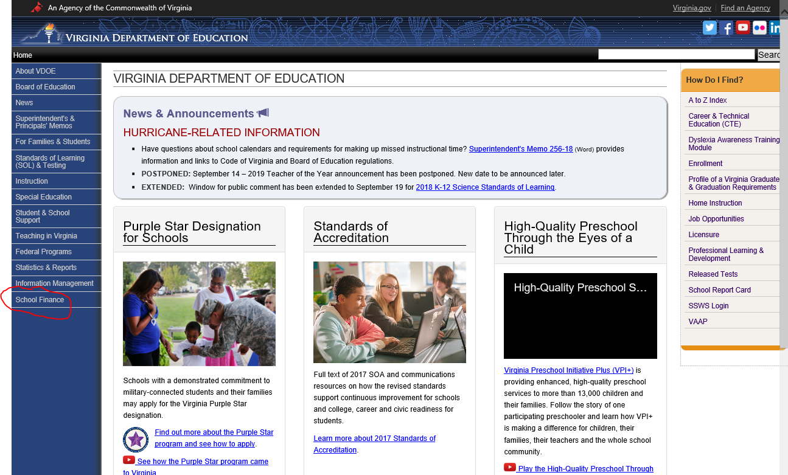
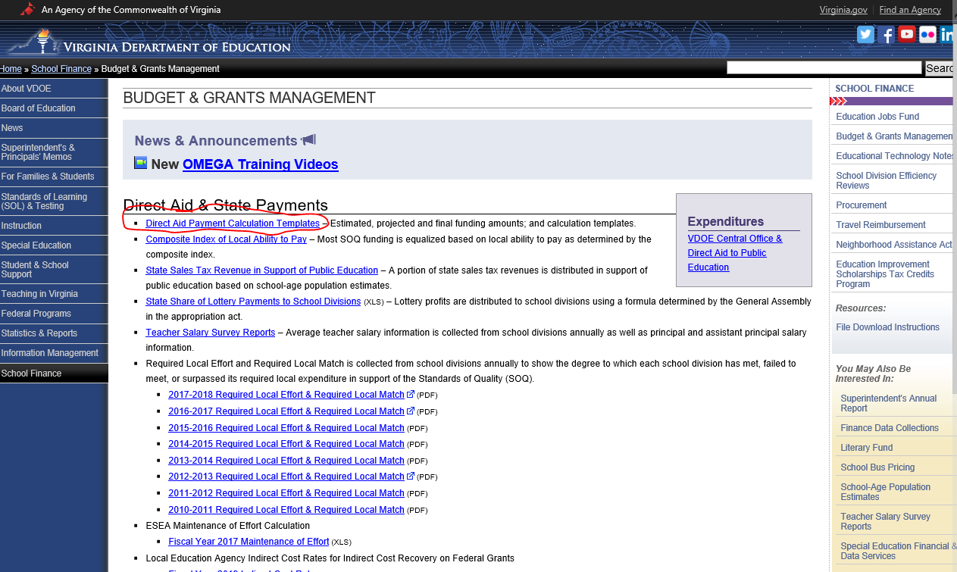
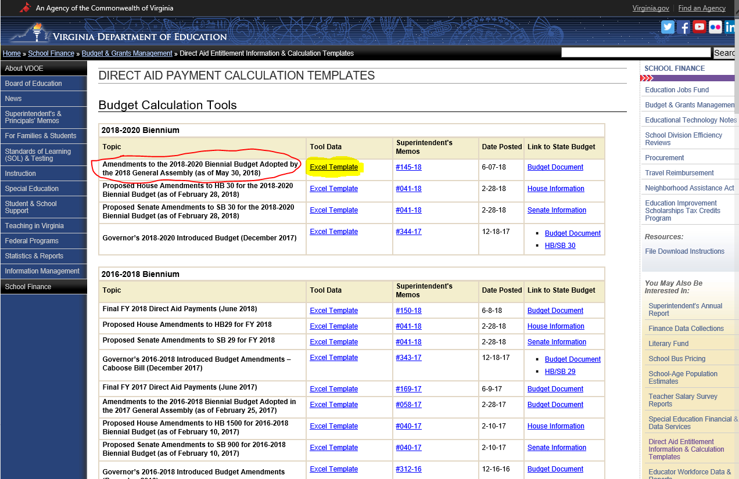
VDOE Website - ARI Local Funding Amounts
Notes:
Handout – ARI FAQ
The sixth FAQ is: What funds are available to school divisions for ARI?
As mentioned earlier, ARI is a lottery funded program in which localities match state funds. School division funding is based on the estimated number of student requiring intervention and the composite index of local ability to pay. The estimated number of students is determined by multiplying the projected number of 7th and 8th grade students in each school INTERNET AND WALK PARTICIPANTS THROUGH SCREENS) division (fall membership) by the percent that qualify for the federal free lunch program.
We will briefly review how to determine the amount of funding for your school division using the VDOE website.
(PULL UP VDOE WEBSITE AND WALK PARTICIPANTS THROUGH THE SCREENS)

Slide 16
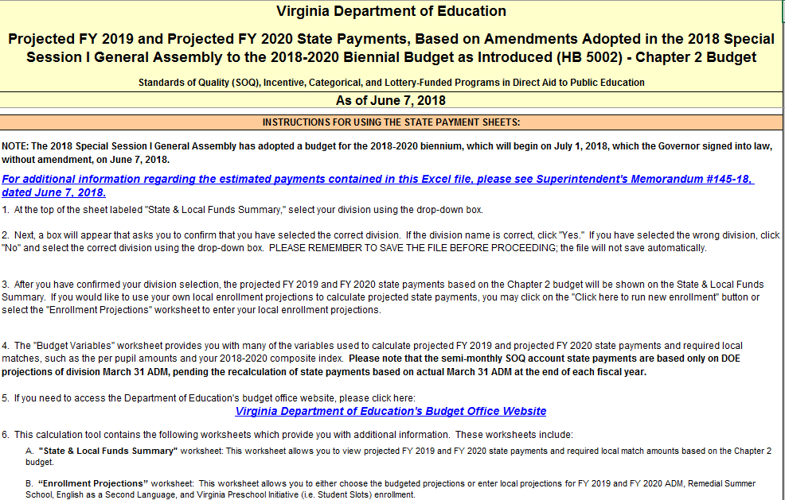
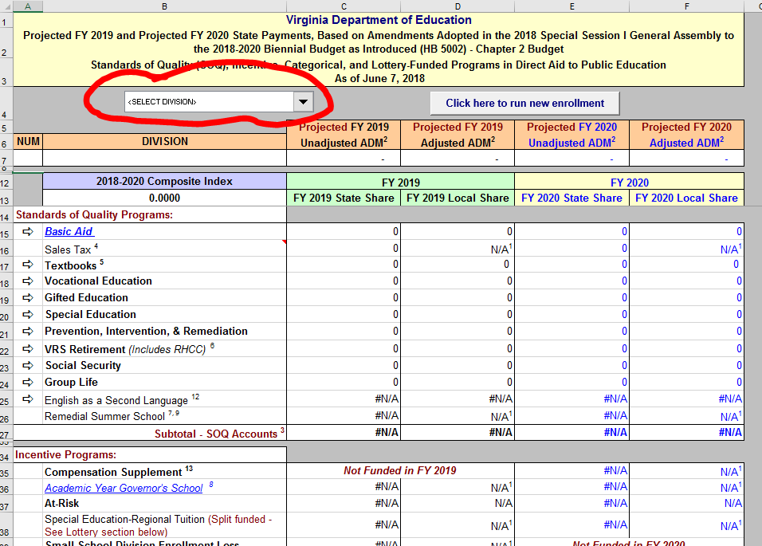
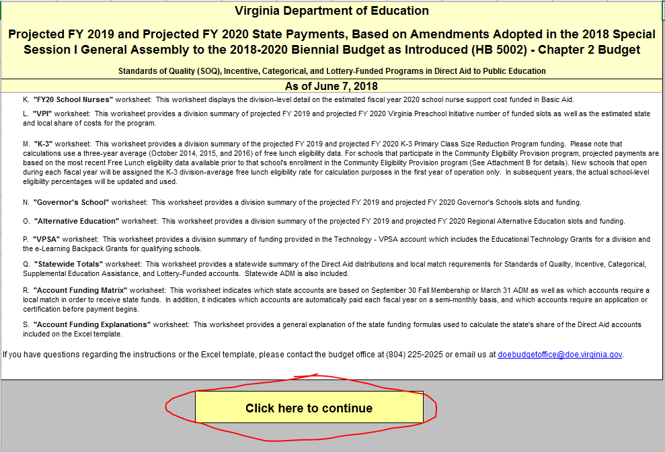
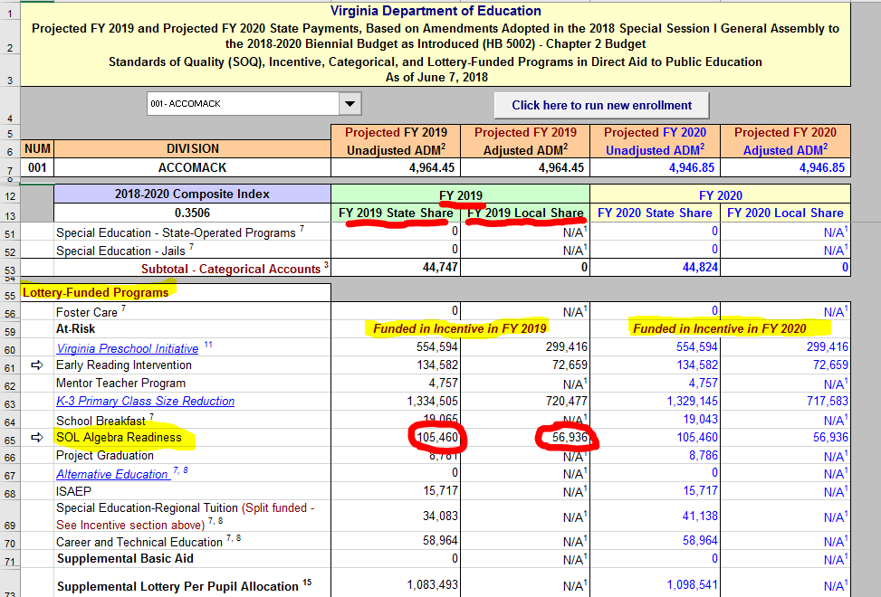
Budget Template (ARI ) - Excel
Sample Only!
Notes:
Handout – ARI FAQ
The sixth FAQ is: What funds are available to school divisions for ARI?
Excel Document pages

Slide 17
ARI Funding - Purchases
Intervention and remediation services (teachers, paraprofessionals, tutors)
Student transportation to/from services
Other costs associated with providing intervention services
Salary to employ mathematics teacher specialists (effective 2011)
ARI funding carryover is not guaranteed.
Algebra Readiness Initiative (FAQ) #7 & 8
Notes:
Handout – ARI FAQ
The seventh and eighth FAQs are: What can ARI funds purchase? and If ARI funds are not completely used, can funding be carried over to the following year?
ARI funding can be used for the following:
Intervention and remediation services
Student transportation to/from services
Other costs associated with providing intervention services (e.g., copies, materials, etc.)
Salary of a mathematics teacher specialist
Funding carryover is not guaranteed and, if granted, is typically announced by Superintendent’s Memo.

Slide 18
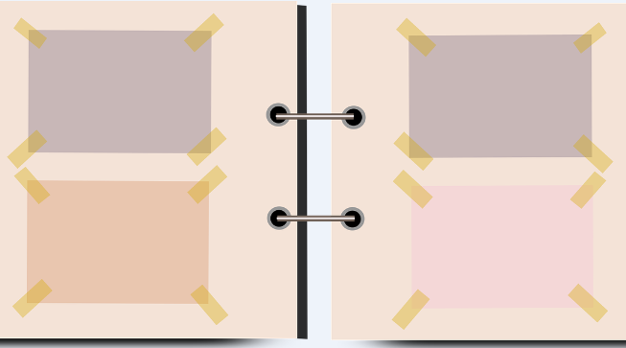
ARI - Using Multiple Data Points
Mathematics SOL Assessments
Mathematics Diagnostic Assessments
Classroom Summative Assessments
Classroom Formative Assessments & Observations
Notes:
Identifying and then monitoring students who will benefit from AR intervention should include multiple data points

Slide 19
Mathematics Vertical Articulation Activity

Slide 20
Vertical Strand Progression Sort Activity
Patterns, Functions, and Algebra -Equality/Solving Equations
Computation and Estimation- Practical Applications – Rational numbers and Proportional Reasoning
Number and Number Sense - Rational Numbers – Compare and Order
Notes:
Pass out envelope sorts. Each table should have at least one envelope per strand (PFA, CE, NNS).
Ask participants to work in pairs/groups of three to organize the objectives in each envelope in sequential order.
Show a completed MVAT for each topic so participants can check their work.

Slide 21
Patterns, Functions, and Algebra Sort Key
SOL | EQUALITY/SOLVING EQUATIONS
1.15 | demonstrate an understanding of equality through the use of the equal symbol
2.17 | demonstrate an understanding of equality through the use of the equal symbol = and the use of the not equal symbol ≠
3.17 | create equations to represent equivalent mathematical relationships
4.16 | recognize and demonstrate the meaning of equality in an equation
5.19b | write an equation to represent a given mathematical relationship, using a variable
5.19d | create a problem situation based on a given equation, using a single variable
6.13 | solve one-step linear equations in one variable, including practical problems
7.12 | solve two-step linear equations in one variable, including practical problems
8.17 | solve multistep linear equations in one variable with the variable on one and both sides of the equation, including practical problems
A.4a | solve multistep linear equations in one variable algebraically
A.4b | solve quadratic equations in one variable algebraically
A.4c | solve literal equations for a specified variable
A.4d | solve systems of two linear equations in two variables algebraically and graphically
A.4e | solve practical problems involving equations and systems of equations
AII.3a | solve absolute value linear equations
AII.3b | solve algebraically and graphically, quadratic equations over the set of complex numbers
AII.3c | solve algebraically and graphically, equations containing rational algebraic expressions
AII.3d | solve algebraically and graphically, equations containing radical expressions
AII.4 | solve systems of linear-quadratic and quadratic-quadratic equations, algebraically and graphically
Notes:
After participants have completed the sort, ask them to check their answers with the next three slides

Slide 22
Computation and Estimation Sort Key
SOL | Practical Applications – Rational Numbers and Proportional Reasoning
3.5 | solve practical problems that involve addition and subtraction with proper fractions having like denominators of 12 or less
4.5c | solve single-step practical problems involving addition and subtraction with fractions and mixed numbers
4.6b | solve single-step and multistep practical problems involving addition and subtraction with decimals
5.4 | create and solve single-step and multistep practical problems involving addition, subtraction, multiplication, and division of whole numbers
5.5b | create and solve single-step and multistep practical problems involving addition, subtraction, and multiplication of decimals, and create and solve single-step practical problems involving division of decimals
5.6a | solve single-step and multistep practical problems involving addition and subtraction with fractions and mixed numbers
5.6b | solve single-step practical problems involving multiplication of a whole number, limited to 12 or less, and a proper fraction, with models*
6.5b | solve single-step and multistep practical problems involving addition, subtraction, multiplication, and division of fractions and mixed numbers
6.5c | solve multistep practical problems involving addition, subtraction, multiplication, and division of decimals
6.6b | solve practical problems involving operations with integers
7.2 | solve practical problems involving operations with rational numbers
7.3 | solve single-step and multistep practical problems, using proportional reasoning
8.4 | solve practical problems involving consumer applications

Slide 23
Number and Number Sense Sort Key
SOL | Rational Numbers - Compare and Order
K.2a | given no more than three sets, each set containing 10 or fewer concrete objects, will compare and describe one set as having more, fewer, or the same number of objects as other sets
K.2b | given no more than three sets, each set containing 10 or fewer concrete objects, will compare and order sets from least to greatest
1.2b | compare two numbers between 0 and 100 represented pictorially or with concrete objects, using the words greater than, less than or equal to
1.2c | order three or fewer sets from least to greatest and greatest to least
2.1c | compare and order whole numbers between 0 and 999
2.4c | compare the unit fractions for halves, fourths, eighths, thirds, and sixths, with models
3.1c | compare and order whole numbers, each 9,999 or less
3.2c | compare fractions having like and unlike denominators, using words and symbols (<, >, =, or $≠$), with models
4.1b | compare and order whole numbers expressed through millions
4.2a | compare and order fractions and mixed numbers, with and without models*
4.3c | compare and order decimals
5.2b | compare and order fractions, mixed numbers, and/or decimals, in a given set, from least to greatest and greatest to least*
6.2b | compare and order positive rational numbers*
6.3b | order and compare integers
7.1b | compare and numbers greater than zero written in scientific notation*
7.1c | compare and order rational numbers*
8.1 | compare and order real numbers

Slide 24
Vertical Strand Progression Activity Debrief
Purpose of sort activity
Importance of vertical alignment and “mapping back”
Notes:
After participants have checked their sorts, facilitate a whole group discussion about the purpose of the sort:
1. What did you notice as you were sequencing the objectives?
2. Did you think this task was difficult? Why or why not?
3. What does it mean when we talk about vertical alignment?
4. Why is it important to “map back” with objectives? (unfinished learning)
5. When would this be helpful? Give some specific situations

Slide 25
3. Mathematics Vertical Articulation Tool (MVAT) Overview

Slide 26
Mathematics Vertical Articulation Tool (MVAT)
Purpose: provides support in identifying concepts aligned to the 2016 Mathematics Standards of Learning (SOL) that articulate across mathematics grade levels or courses
Possible Uses:
Classroom Instructional Planning
Individual Student Remediation Planning
Notes:
Purpose and possible uses of MVAT

Slide 27
Mathematics Vertical Articulation Tool (MVAT) Static Formats
STATIC = Available in Word and PDF
Strand Versions (K – Algebra II)
Number and Number Sense
Computation and Estimation
Measurement and Geometry
Probability and Statistics
Patterns, Functions, and Algebra
Comprehensive Version (K – Algebra II)
Include all five strands in legal size document
Notes:
Static formats of MVAT are documents in Word and PDF
We are providing copies of NNS, MG, and PFA versions of MVAT Strand Versions
And a copy of the Comprehensive Version

Slide 28
Mathematics Vertical Articulation Tool (MVAT) Dynamic Formats
DYNAMIC = Customized by inputting student data
Dynamic Versions – tested grade levels
Grade 3 SOL Dynamic MVAT
Grade 4 SOL Dynamic MVAT
Algebra I SOL Dynamic MVAT
We will review the Dynamic version of MVAT soon!
Notes:
Dynamic versions were created in conjunction with Appalachia Regional Comprehensive Center (ARCC) and will be reviewed later in the session today

Slide 29
MVAT Strand Versions - Structure
Strands (NNS, CE, MG, PS, PFA)
Strand Concepts – macro concepts of K – Algebra II content
Standard Descriptors – short descriptions of the standards included in each Strand Concept
Associated Standards – standard numbers that are aligned to each standard descriptor
Notes:
Structure of MVAT Strand versions

Slide 30
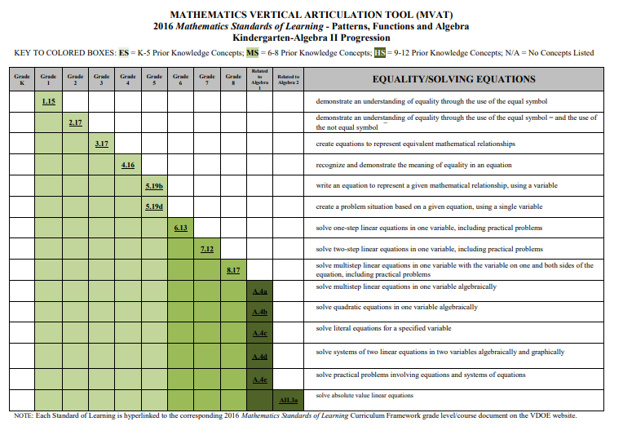
MVAT – Strand Versions
Notes:
HANDOUT – Provide Static Strand Versions of MVAT for NNS, CE, MG, PS and PFA (table copies)
Review static version of PFA together
Note:
Divided into Strand Concepts
SOL #s linked to Curriculum Framework Documents (must be online for links to work) – left side (Grade 8 – Algebra II in most strands)
Description of standard
Vertical Alignment indicated by colors (lighter to darker colors moves from lower to higher grade levels)

Slide 31
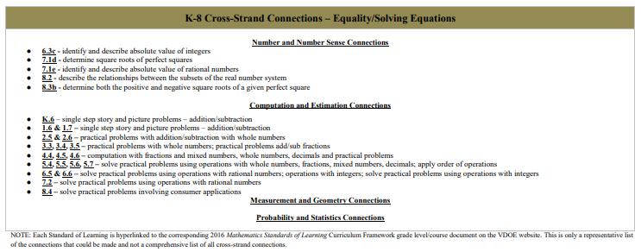
MVAT – Cross-Strand Connections
Notes:
HANDOUT – Static Strand Version PFA
Cross-Strand Connections are noted, when applicable, in the documents
SOL #’s are hyperlinked
Not a comprehensive list of all connections

Slide 32
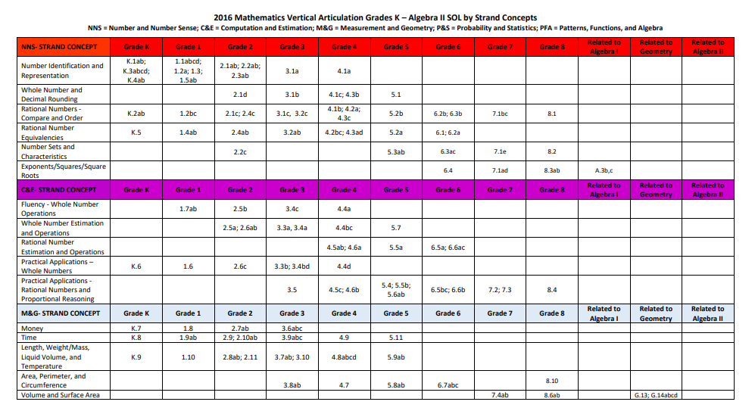
MVAT – Comprehensive Version K – Algebra II
Notes:
HANDOUT – MVAT Static Comprehensive Version
The comprehensive version includes SOL #s only (no SOL descriptors)
Legal size paper (front/back)
Corresponds to MVAT Static Strand Versions

Slide 33
Resources – Turn and Talk
How might the MVAT support instructional planning in your school division?
What steps might be needed to support teachers in using these tools?
Notes:
Purpose and possible uses of MVAT

Slide 34
4. VDOE AR Resource Showcase

Slide 35
Data Previously Obtained from Algebra Readiness Diagnostic Test (ARDT)
Reported student areas of content strength and weakness based on strand
Pinpointed SOL focus content from grades 3 – 8
Included strand tests to use during remediation
Notes:
The ARDT is no longer used so other means of diagnosing student strengths/weaknesses is now needed. The ARDT report pinpointed strands/standards for which students may need further instruction. Strand tests allowed for another look at student understanding after remediation.

Slide 36
Algebra Readiness Curriculum Companion
Targets SOL concepts – grades 5 – 8
Aligned to 2009 SOL
Remediation lessons designed for use during ARI Remediation
Notes:
The Curriculum Companion was a resource for teachers to support remediation based on 2009 SOL.

Slide 37
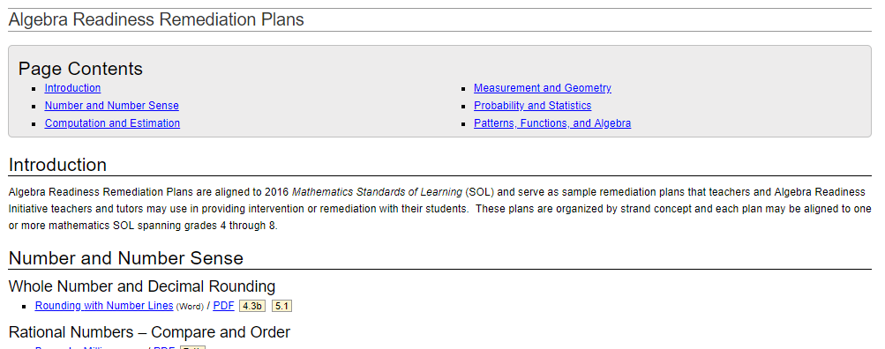
VDOE Remediation Plans
MVAT helps to identify unfinished learning that will guide the intervention plan.
Remediation plans that align with unfinished learning can be used as a resource.
Aligned to 2016 Mathematics SOL
Notes:
Discuss with participants that once they have analyzed a particular student’s score report and they have used the MVAT to target unfinished learning , they will use that information to help guide the focus of the intervention plan. Remediation plans can be found that align with the objectives on the MVAT, and can be one of the resources utilized to support Algebra Readiness. Other resources are intended to be used beyond those provided online.
(Click on a few of the remediation plans found on the website to show participants examples)

Slide 38
VDOE Remediation Plan Structure
Remediation Plan Summary
Common Errors and Misconceptions
Introductory Activity
Plan for Instruction
Pulling It All Together (Reflection)
Ancillary Activities/Handouts
Notes:
The committee created remediation plans that all use the same structure:
Summary of the content addressed (some plans vertically articulate across grades)
Common errors and misconceptions
Introductory (launch) activity
Plan for instruction (teacher instructions intended to guide classroom activity and dialogue)
Pulling It All Together – reflection activity for students to summarize learning
Ancillary documents may include handouts, activity pages, matching cards, games, etc.

Slide 39
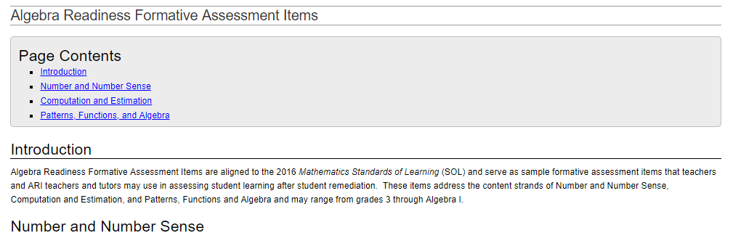
VDOE Formative Assessment Items
Assess proficiency related to unfinished learning after remediation or intervention
Primarily Target Grades 5 – Algebra I
May be used to target areas where additional remediation may be needed
Can be used to drive instructional decisions
Aligned to 2016 Mathematics SOL
Notes:
Formative assessments can be found for each objective in the areas of Computation and Estimation, Number and Number Sense, and Patterns, Functions, and Algebra. Administering formative assessments that align with unfinished learning can be used to target more specific areas related to that objective and aid in instructional and remediation efforts for the intervention plan.

Slide 40
Sample VDOE AR Resources
Remediation Plans:
Solving Equations Using Algebra Tiles – SOL 6.13 and 7.12
Solving Two-Step and Multi-Step Equations – SOL 7.12 and 8.17
Formative Assessments:
SOL 7.12
Notes:
Participants will be provided copies of two remediation plans and a formative assessment item set as samples to review. Allow participants time to review each remediation plan and the formative assessment items. Ask participants “what do you notice?” Be sure to point out the focus in the remediation plans on common errors and misconceptions, reflection, and emphasis on student discourse. Formative items include other types of items beyond just MC.

Slide 41
5. Student Score Reports and Data

Slide 42
Student Score Reports and Data Topics
Student Detail by Question Report availability
Student performance data contained in the report
A closer look at a Student Detail by Question (SDBQ) Report
Cautions when using SDBQ data

Slide 43
Defining the SDBQ Report
Provides a description (item descriptor) of each operational test item, with the SOL identification, level of difficulty, and whether the student’s response was correct or incorrect.
Organized by reporting category according to the test blueprint.
Provided at the student level by school.
SDBQ is the most granular data available from VDOE on SOL assessments.
Notes:
In summary, the SDBQ report provides an item descriptor for each test item, the level of difficulty of the test item, and whether the item was answered correctly or incorrectly. The reporting categories and number of test items in each reporting category are organized according to the test blueprint for that grade level. The SDBQ report is provided to school personnel at the student level by school and it is the most granular piece of data available from the VDOE on SOL assessments.

Slide 44
SDBQ Availability
On Demand SDBQ
Available for non-writing tests completed online and paper.
Updated immediately upon scoring online test attempts (as long as the test is not alerted).
Available for print as a PDF by individual student or multiple students.
Notes:
On demand SDBQ reports are available for non-writing tests and updated immediately upon scoring for online tests. Paper test reports are available once they have been scored. Reports can be printed as a PDF for multiple students or individually. A helpful feature is the ability to create a report for scaled scores below 400.

Slide 45
SDBQ Availability
Published Reports SDBQ
Online and paper test attempts are included.
Scheduled refresh cycle
All students file - weekly by Monday morning until the administration is closed.
All tests completed by 3:00 p.m. the previous Friday.
Available as a PDF at the school level.
Notes:
Published reports for online and paper tests are available on a weekly basis on Monday mornings until the close of the administration window, provided the test was completed by 3 pm the previous Friday. These reports are available as a PDF but only at the school level.

Slide 46
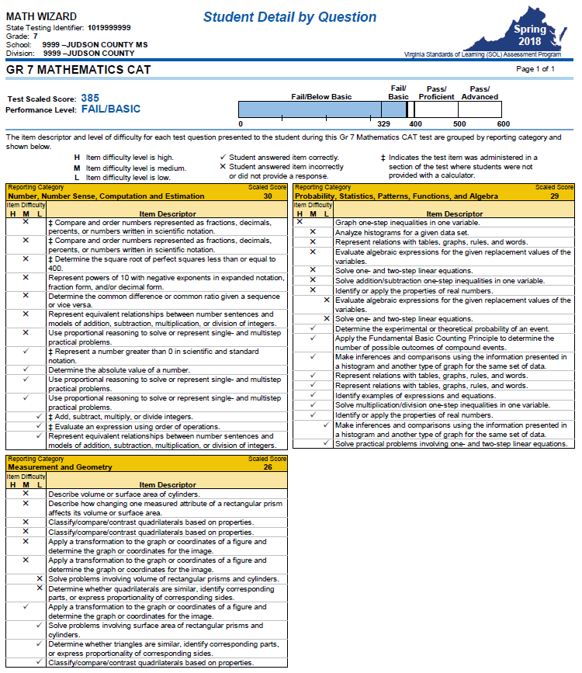
2018 Spring SDBQ Report
Test Scaled Score
Performance Level
Reporting Categories
(RC)
RC Scaled Score
H, M, L test item
difficulty
Incorrect/Correct
responses
Item descriptions
Notes:
HANDOUT – Grade 7 Sample SDBQ Report (Math Wizard)
Here is what was provided in the SDBQ report for Math Wizard during the Spring 2018 administration. Explain what teachers/administrators have to do in order to identify a corresponding SOL for each item descriptor within the reporting categories. The next few slides will explain the components of the SDBQ report shown here.
Turn and talk – how are SDBQ reports currently used in your school division?

Slide 47
SDBQ Report Header - On Demand Report
Student Name and Report Title
Student and Test Specific Information
Test Administration
Overall Performance Level and Test Scaled Score
Notes:
highlight
-student name an report title
-student and test specific information
-overall performance level and test scaled score

Slide 48
SDBQ Report Header - Published Reports
Student Specific Information
Report Title
Test Administration
SDBQ screenshot
Test Name, Overall Test Scaled Score, and Performance Level
Notes:
highlight
-student specific information
-report title
-test administration
-test name, overall test scaled score, and performance level

Slide 49
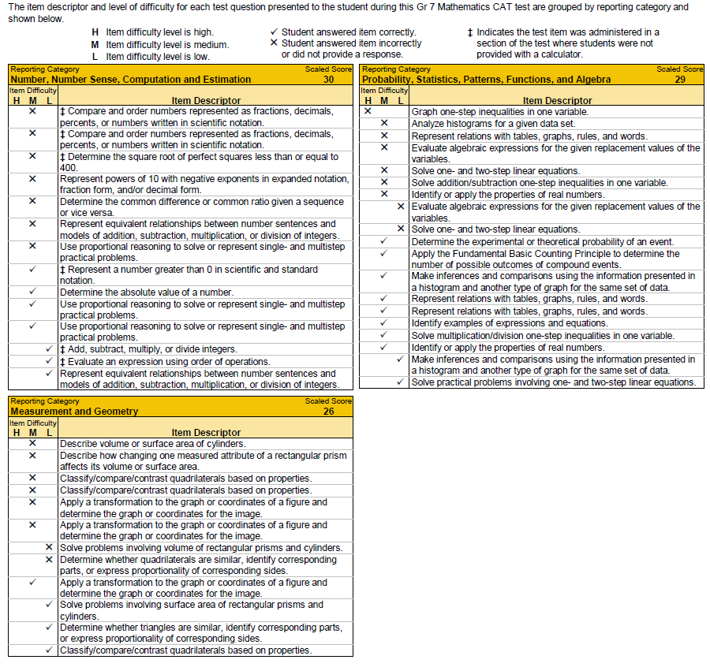
SDBQ Report – Grade 7 Math CAT
Legend
Reporting Category
Notes:
Participants will have a copy of this SDBQ report with DRAFT spelled across the page. They will use their copy throughout the presentation.
Every SDBQ report contains a legend for item difficultly, items answered correctly/incorrectly, and test items where a student was not provided a calculator. The non-calculator items occur in the first portion of the test (Gr 4 – 7).
The name of each reporting category is also listed on every report.

Slide 50
SDBQ Report – Grade 7 Math CAT
Legend
Reporting Category Scaled Score
Notes:
The reporting scaled score is listed as well by reporting category.

Slide 51
SDBQ Review Reporting Category Scaled Scores
Intended to provide an ESTIMATE of potential strengths and weaknesses related to the SOL assessed within that reporting category. A reporting category score of > 40 may represent a strength while a score of < 30 may suggest an area where additional instruction is needed.
May provide an indication of where the student may need additional support.
Degree to which reporting category scaled score information is useful differs by student.
Notes:
The scaled score is intended to provide an indication of a student’s proficiency. It may provide potential strengths and weaknesses related to the SOL assessed within the reporting category. Typically, a scaled score number greater than or equal to 40 may represent a strength while a score less than 30 may suggest a content area(s) where additional instruction is needed.
Reporting category scaled scores are NOT assigned a passing or failing performance. i.e. A scaled score of 30 for each reporting category does not ensure that the overall student performance equates to a passing score.

Slide 52
SDBQ Review Reporting Category Scaled Scores
Are more important than a raw score because they provide some indication of proficiency. The scaled score provides an established level of achievement, whereas the raw score provides only a count of correct answers.
Reporting category scaled scores are not used to assign “passing” or “failing” performance levels for a reporting category.
Notes:
The difference between a scaled score and a raw score is that the scaled score provides an established level of achievement, whereas the raw score provides a count of correct answers. As mentioned before, it may provide an indication of where the student may need additional support.
The reporting category scaled score does provide useful information but the degree of this information differs by student.

Slide 53
SDBQ Report – Grade 7 Math CAT
Item Difficulty Level
Notes:
The test item difficulty for each descriptor is displayed in the left most column of each reporting category and is denoted as H, M, or L.

Slide 54
Test Item Difficulty Level
Based on actual student performance on the test item
Determined using the data from field testing the items
Within each level of item difficulty there is a range of items.
For example, there are some low level items that are less difficult than other low level items.
Notes:
Test item difficulties are determined using the data from field testing the item. They are based on actual student performance on the test item (field test items). As new items get developed each year, they are first field tested before they become operational items for assessing students. During this process, the test item difficulty is based on the student performance at the time of field testing. As new content is introduced, item difficulty does not always reflect the true difficulty of the item. If new content was not taught, cross-over year (2018 spring administration), then the test item difficulty may not be a true reflection of the actual difficulty.
Within each level H, M, and L of item difficulty there exist a range of items. This means that within the range of low level items, there are some low level items that are less difficult than other low level items.

Slide 55
SDBQ Report – Grade 7 Math CAT
Item Descriptors
Notes:
The item descriptors provide a brief description of the content being assessed by a test item.

Slide 56
SDBQ Item Descriptors
SDBQ item descriptors are:
A brief description of the content being assessed by a test item.
A brief description of the skill/process being assessed by a test item, including but not limited to:
Justify, Identify, Determine, Interpret, and Construct.
For Example:
Item descriptor = “Solve a linear inequality.”
Content = Knowledge of linear inequalities
Skill/Process = Solve
Notes:
Provide a brief description of content and skill/process being assessed by the test item. In the example provided here: The item descriptor is brief: “Solve a linear inequality.”
What is the content being assessed? What is the skill/process being assessed?
Two questions to ponder: What is the benefit of having this information? How will it help you make decisions regarding additional support?

Slide 57
SDBQ Item Descriptors
SDBQ item descriptors are NOT:
An indicator of item difficulty or rigor.
The actual item with the corresponding answer choices in the order they appeared on the SOL assessment.
Correlated to a single test item; the same descriptor may be used for different items.
Notes:
The item descriptor itself is not an indicator of difficulty or rigor. The item descriptors listed within each reporting category is not the actual order that the items were presented to the student. Lastly, item descriptors are not correlated to a single test item. The item descriptor can be used for many different items.

Slide 58
SDBQ Report – Grade 7 Math CAT
Sort order for Item Descriptors within a Reporting Category:
All items answered incorrectly; starting from the highest level of difficulty to the lowest level of difficulty.
All items answered correctly; starting from the highest level of difficulty to the lowest level of difficulty.
Student Responses
If a student does not answer an item, the respective item descriptor will be marked incorrect.
Notes:
The order of the item descriptors in each reporting category are always listed by incorrect answers first followed by correct answers and by the test item difficulty. Look at the Patterns, Functions, and Algebra reporting category on the screen. Notice the H, M, L descent of the items answered incorrectly, followed by the items answered correctly.

Slide 59
SDBQ Review Reporting Category Scaled Score
Let’s take a closer look at this Gr 7 Mathematics CAT example for MATH WIZARD…
Grade 7 Mathematics (2009 SOL) CAT
Notes:
When we look at the reporting scaled score comparison, our first thought might be…….

Slide 60
SDBQ Analysis
In the next few slides, we will analyze an example of SDBQ for Gr 7 Mathematics CAT.
When analyzing this data, we will focus on two major areas:
Content
Skill/Process

Slide 61
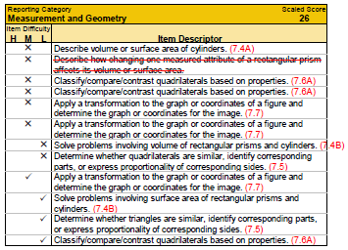
2018 Spring SDBQ Report
Content Concerns
Volume/surface area (7.4 A, B)
Similarity (7.5)
Properties of quads (7.6 A)
Transformations (7.7)
Notes:
This slide depicts the actual content concerns of the SOL assessed for this student. I have outlined the actual content assessed in each of the test items that the student answered incorrectly.

Slide 62
SDBQ Analysis Skill/Process Concerns – Measurement and Geometry
Skill/Process Concerns
Apply = 2 of 3 incorrect
Classify/Compare/Contrast =
2 of 3 incorrect
Describe = 1 of 1 incorrect
Determine = 1 of 2 incorrect
Solve = 1 of 2 incorrect
Notes:
Mike
This slide depicts all of the skills involved with each of the test items assessed. (Apply, Classify, Compare, Contrast, Describe, Determine, and Solve) The color coding visually assists you in identifying each of the required skills assessed for this particular student. For Apply: the ratio 2 of 3 indicates that the student answered 2 of the 3 test items incorrectly when assessed to apply the knowledge of transformations.

Slide 63
SDBQ Analysis Measurement and Geometry Content and Skill/Process Concerns
Content Concerns
Skill/Process Concerns
Volume/Surface Area
(7.4 A, B)
Similarity (7.5)
Properties of quads (7.6 A)
Transformations (7.7)
Describe and Solve
Determine and Identify
Classify/Compare/Contrast
Apply
Notes:
This slide marries content and skills to assist in what to concentrate on and at what level of thinking might be required for this student to be successful. For example, describe the volume or surface area. An example might be to describe the meaning of covering a box with wrapping paper. For solve: What is the volume of a given cylinder? Was it with or without a picture displayed, was it a practical problem?
Refer to the curriculum framework for clarification of the standard, essential skills, and understandings.

Slide 64
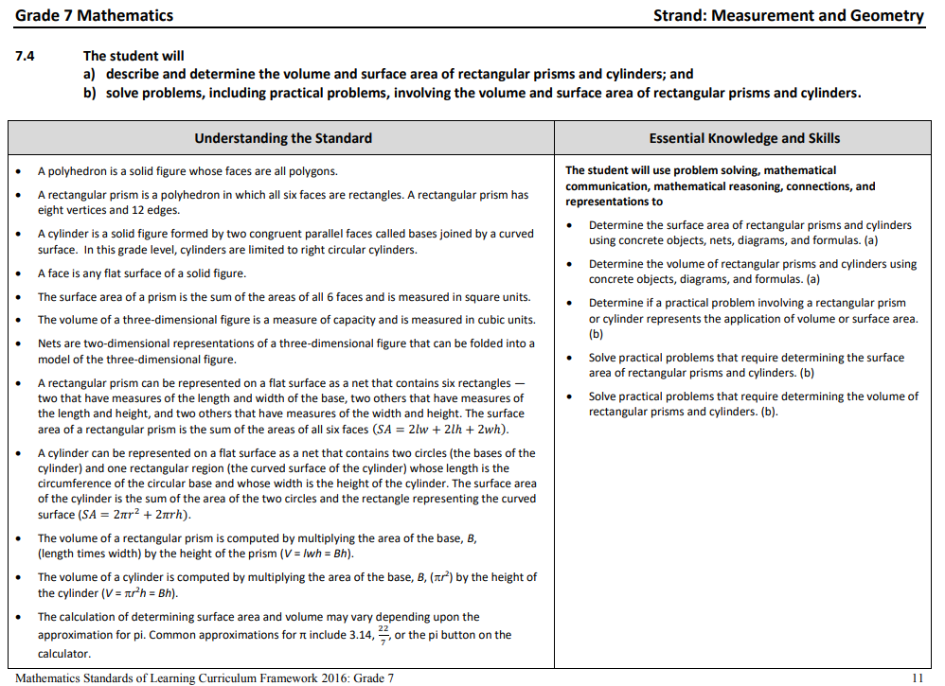
2016 Curriculum Framework
Notes:
From the 2016 Standards of Learning Curriculum Framework
Note: the EKS for 7.4 A states determine the surface area and/or volume. But, the standard assesses describing and determining the surface area and/or volume. Always consider both the standard and the EKS. For EKS 7.4B, the focus is on solving problems, including practical problems, involving volume and surface area.

Slide 65
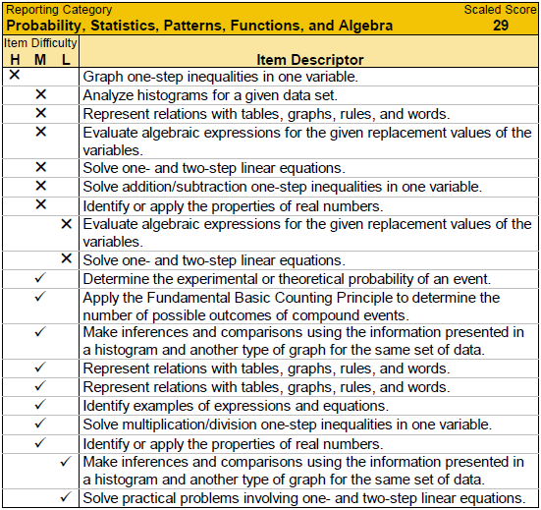
SDBQ Analysis Content Concerns – Patterns, Functions, and Algebra
Content Concerns
Two-step linear equations (7.12)
Algebraic expressions (7.11)
One- and two-step inequalities (7.13)
Notes:
This slide depicts the actual content concerns of the SOL assessed for this student. I have outlined the actual content assessed in each of the test items that the student answered incorrectly and correctly.

Slide 66
SDBQ Analysis Skill/Process Concerns – Patterns, Functions, and Algebra (PFA)
Skill/Process Concerns
Apply = 0 of 1 incorrect
Identify = 1 of 3 incorrect
Represent/Determine =
1 of 4 incorrect
Evaluate = 2 of 2 incorrect
Inference/Compare =
0 of 2 incorrect
Solve = 3 of 5 incorrect
Analyze = 1 of 1 incorrect
Graph = 1 of 1 incorrect
Notes:
This slide depicts all of the skills involved with each of the test items assessed. (Apply, Identify, Represent/Determine, Evaluate, Infer, Analyze, Graph, and Solve) The color coding either visually assists you or distracts you…(LOL) in identifying each of the required skills assessed for this particular student. For solve: the ratio 3 of 5 indicates that the student answered 3 of the 5 test items incorrectly when assessed to solve linear equations and inequalites.

Slide 67
SDBQ Analysis PFA Content and Skill/Process Concerns
Content Concerns
Skill/Process Concerns
Solve
Evaluate and Identify
Graph and Solve
Two-step linear equations
(7.12)
Algebraic expressions (7.11)
One- and two-step inequalities
(7.13)
Notes:
This slide marries content and skills to assist in what to concentrate on and at what level of thinking might be required for this student to be successful. For example, evaluate an algebraic expression. An example might be to evaluate an algebraic expression given replacement values. For identify: Identify an algebraic expression using concrete materials or pictorial representations
Refer to the curriculum framework for clarification of the standard, essential skills, and understandings.

Slide 68
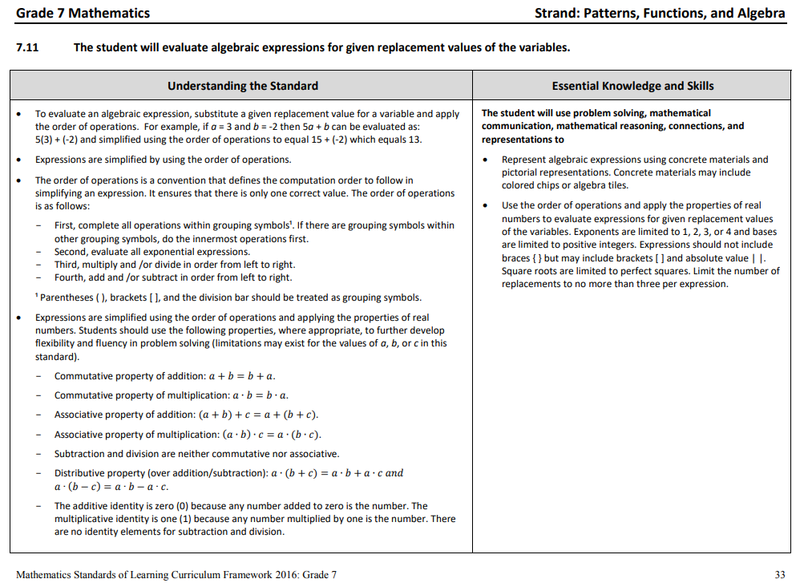
2016 Curriculum Framework
Limit the number of replacements to no more than three per expression. Other parameters include exponents, bases, and grouping symbols used.
Notes:
From the 2016 Standards of Learning Curriculum Framework
Note: the EKS for 7.11 states evaluate algebraic expressions for given replacement values of the variables. The EKS portion speaks of representing algebraic expressions using concrete objects and pictorial representations and evaluating expressions using replacement values (no more than three replacements) . Always consider both the standard and the EKS.

Slide 69
SDBQ Analysis Reporting Category
Reporting Categories are consistent across different forms of the same test.
Refer back to standards and curriculum framework for details to apply to on-going and SOL test remediation.
How was the content taught prior to the SOL assessment?
How will the content be taught during remediation?

Slide 70
SDBQ Analysis Content Concerns – Gr 7 Mathematics CAT
This student’s performance on items with identical item descriptors is inconsistent.
Why might this occur?
Level of item difficulty
Higher order thinking skills
Multistep vs. single-step
Language load
Visuals (graphs, pictures)
Notes:
Recall, we talked about how an item descriptor is NOT correlated to a single test item; the same descriptor may be used for different items. Notice from this student’s SDBQ report there were three instances where identical item descriptors occurred and the inconsistency within those three instances. You might wonder why this might occur.
Typically, it is the level of difficulty associated with the test item itself. Remember, there is a range of difficulty within each of the H, M, and L levels. These items may also differ by required level of thinking, multistep vs. single-step problem, reading load, and graphs/pictures or lack there of. Consider if instruction is only focuses on surface level learning or allows for deeper student thinking.

Slide 71
5. Networking with Padlet

Slide 72
6. Unfinished Learning/ Grade 6 Score Report

Slide 73
Grade 6 Sample Score Report
Analyze the overall score report
Review the scaled scores for each reporting category
What observations can you make about the data represented in the report?
What inferences can be made, if any?
Notes:
HANDOUT – Grade 6 blank score report (front/back)
Think about the information Mike reviewed this morning regarding score reports. Analyze the grade 6 score report and use post-it notes to write down observations or inferences that you can make. Work with a shoulder partner if needed.

Slide 74
SDBQ Review Reporting Category Scaled Score
Let’s take a closer look at this Gr 6 Mathematics CAT example
Notes:
HANDOUT – Grade 6 blank score report (front/back)
When we look at the reporting scaled score comparison (pg. 1), which reporting categories might become our focus for this student? Why?
(Click to show red arrows)
Anything below a scaled score of 30 indicates that the student may benefit from additional instruction in the concepts included in this strand

Slide 75
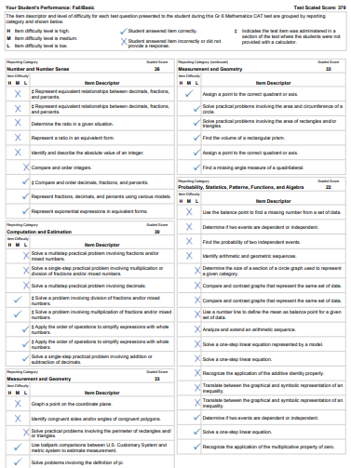
TASK
What areas of content and what skills should the focus of support be for this student?
Notes:
HANDOUT – Grade 6 blank score report (front/back)
Pair with a colleague or someone at your table. Using page 2 of this report, determine what additional support this student should receive in the targeted content strands (NNS and PFA). for which this student may need to receive remediation. (10 minutes) Talk at your tables and make some notes on the report regarding your analysis.

Slide 76
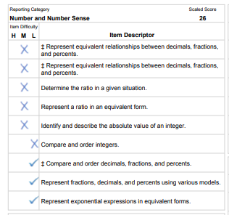
SDBQ Analysis Content Concerns – Number and Number Sense
Content Concerns
Equivalent relationships – fractions, decimals, percents (2 of 2 incorrect)
Ratios
(2 of 2 incorrect)
Integers – Compare and Order; Absolute Value (2 of 2 incorrect)
Notes:
HANDOUT – Grade 6 blank score report (front/back)
This slide depicts the content concerns of the SOL assessed for this student based on the items answered incorrectly. Comparing and ordering integers was grouped with absolute value of integers. Note that under the 2016 mathematics standards of learning, students in grade 6 during the 2017-2018 school year should have received instruction in operations with integers, which was not assessed. Therefore, additional remediation may be needed, as the student may have difficulty in CE if there are issues with comparing and ordering and absolute value in NNS.

Slide 77
SDBQ Analysis Skill/Process Concerns – Number and Number Sense
Skill/Process Concerns
Represent = 3 of 5 incorrect
Determine = 1 of 1 incorrect
Identify and Describe = 1 of 1 incorrect
Compare and Order = 1 of 2 incorrect
Notes:
HANDOUT – Grade 6 blank score report (front/back)
This slide depicts all of the skills involved with each of the test items assessed. (Represent, Determine, Identify and Describe, Compare and Order) The color coding visually assists you in identifying each of the required skills assessed for this particular student. For Represent: the ratio 3 of 5 indicates that the student answered 3 of the 5 test items incorrectly when assessed to apply the knowledge of transformations.

Slide 78
SDBQ Analysis Number and Number Sense Content and Skill/Process Concerns
Content Concerns
Skill/Process Concerns
Equivalent relationships – fractions, decimals, percents
Ratios
Integers
Represent
Determine
Identify and describe
Notes:
HANDOUT – Grade 6 blank score report (front/back)
This slide marries content and skills to assist in what to concentrate on and at what level of thinking might be required for this student to be successful. For example, equivalent relationships between fractions, decimals and percents includes represent. How are rational number being represented? Are students provided opportunities move from concrete-representational-abstract?
Refer to the curriculum framework for clarification of the standard, essential skills, and understandings.

Slide 79
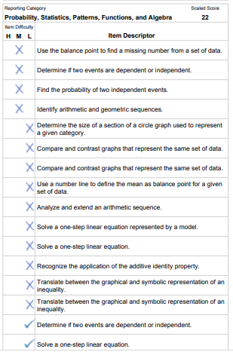
SDBQ Analysis Content Concerns – Probability, Statistics, and Patterns, Functions, and Algebra
Content Concerns
Balance Point = 2 of 2 incorrect
Independent and Dependent Events =
2 of 3 incorrect
Arithmetic and Geometric Sequences =
2 of 2 incorrect
Representations of Data in Graphs =
3 of 3 incorrect
Linear Equations = 2 out of 3 incorrect
Linear Inequalities = 2 out of 2 incorrect
Properties = 1 out of 2 incorrect
Notes:
HANDOUT – Grade 6 blank score report (front/back)
The previous slide for content identified the areas of concern. This slide visually displays content concerns. The color coding assists you in quickly identifying the different content areas and whether those content areas were answered correctly or incorrectly. Again, for “balance point”, the 2 of 2 ratio represents that this student answered 2 of the 2 items incorrectly. There appear to be several area of content concerns.

Slide 80
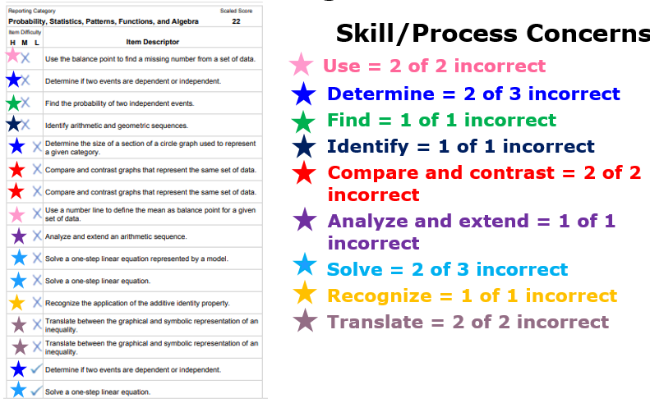
SDBQ Analysis Skill/Process Concerns – Probability, Statistics, and Patterns, Functions, and Algebra
Notes:
HANDOUT – Grade 6 blank score report (front/back)
This slide depicts all of the skills involved with each of the test items assessed. (Use, Determine, Find, Identify, Compare and Contrast, Analyze and Extend, Solve, Recognize, Translate) The color coding visually assists you in identifying each of the required skills assessed for this particular student. For Use: the ratio 2 of 2 indicates that the student answered 2 of the 2 test items incorrectly when assessed to use the balance point.

Slide 81
SDBQ Analysis Probability, Statistics, and Patterns, Functions and Algebra Content and Skill/Process Concerns
Content Concerns
Skill/Process Concerns
Linear Equations
Linear Inequalities
Representations of Data
Solve
Translate
Compare and contrast
Notes:
HANDOUT – Grade 6 blank score report (front/back)
This slide marries content and skills to assist in what to concentrate on and at what level of thinking might be required for this student to be successful. For example, solve linear equations. An example might be to solve a linear equation by using the addition property of equality. Since application of properties is now part of solving equations, perhaps a student cannot apply the properties correctly. For compare and contrast: What types of representations of data were used? One of the items specifies circle graphs, but the others do not specify. One change in the 2016 Standards of Learning is that graphical representations of data are more specifically specified in each grade level versus any graph learned in previous grade levels.
Refer to the curriculum framework for clarification of the standard, essential skills, and understandings.

Slide 82
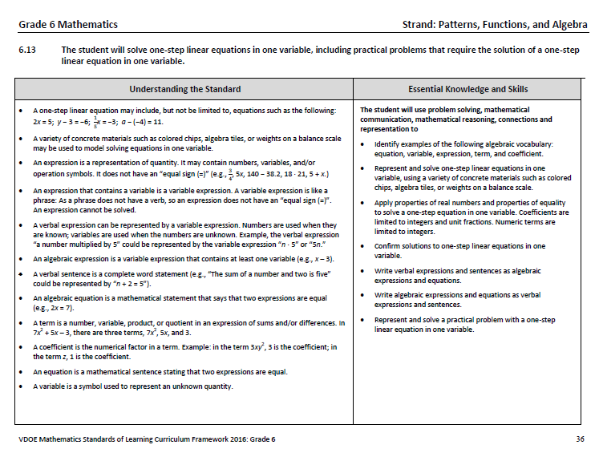
2016 Curriculum Framework
Notes:
HANDOUT – Grade 6 blank score report (front/back)
Discuss how solving one-step linear equations could involve addition and subtraction (operations with Integers) or multiplication and division. The application of the properties of equality are also included as are solving using concrete materials.

Slide 83
7. Cross-walking the Grade 6 Report

Slide 84
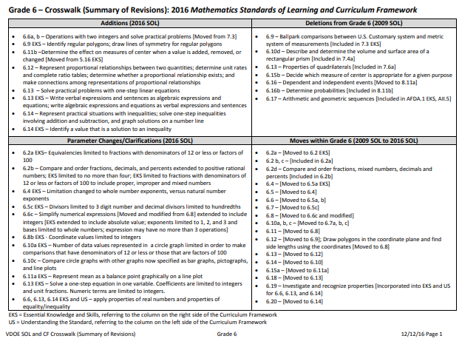
Crosswalk Document
Notes:
HANDOUT – Grade 6 Crosswalk
Discuss how to read the first page of the crosswalk

Slide 85
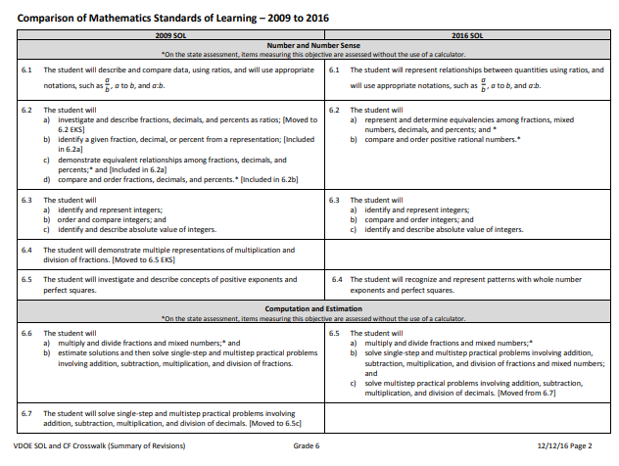
Crosswalk Document
Notes:
HANDOUT – Grade 6 Crosswalk
Discuss how to the remaining pages of the Crosswalk show a side by side comparison of the 2009 and 2016 standards

Slide 86
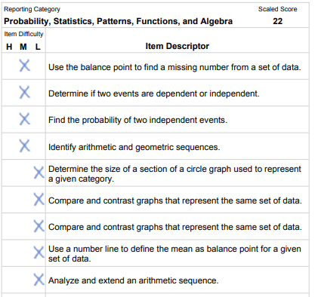
Grade 6 Sample Score Report – Crosswalked 2009 to 2016 SOL
2009 | 2016
6.15a 6.11a
6.16a None
6.16b None
6.17 None
6.14a 6.10a
6.14c 6.10c
6.14c 6.10c
6.15a 6.11a
6.17 None
Notes:
HANDOUTS – Grade 6 Score Report – page 2; Grade 6 Crosswalk
Walk through one reporting category together to show 2009 to 2016 crosswalk.

Slide 87
Grade 6 Sample Score Report – Crosswalking 2009 to 2016 SOL
Crosswalk the remaining Prob/Stat and PFA Reporting Category
When finished compare your standards with those provided on the annotated score report
Notes:
HANDOUTS – Grade 6 Score Report – page 2; Grade 6 Crosswalk

Slide 88
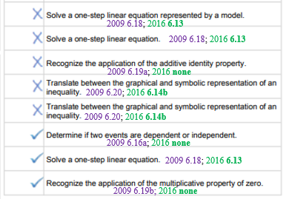
Grade 6 Sample Score Report – Cross-walked 2009 to 2016 SOL
Notes:
HANDOUTS – Grade 6 Score Report – annotated with 2009 and 2016 SOL; Grade 6 Crosswalk
Review PFA crosswalk together
.

Slide 89
SDBQ Analysis Reporting Category
Refer back to standards and curriculum framework for details to apply to on-going and SOL test remediation.
How was the content taught prior to the SOL assessment?
How will the content be taught during remediation?

Slide 90
Analysis:
Notes:
Recall, we talked about how an item descriptor is NOT correlated to a single test item; the same descriptor may be used for different items. Notice from this student’s SDBQ report there were three instances where identical item descriptors occurred and the inconsistency within those three instances. You might wonder why this might occur.
Typically, it is the level of difficulty associated with the test item itself. Remember, there is a range of difficulty within each of the H, M, and L levels. These items may also differ by required level of thinking, multistep vs. single-step problem, reading load, and graphs/pictures or lack there of.

Slide 91
8. MVAT Tool Application/ AR Resource Identification

Slide 92
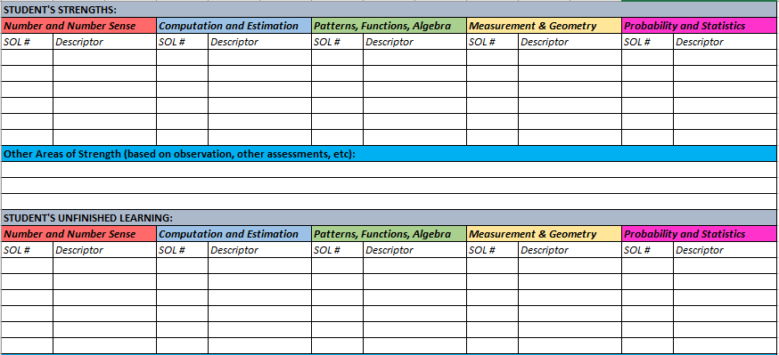
2016 TASK
For the Number and Number Sense and Patterns, Functions, and Algebra strands, list student areas of strength and unfinished learning?
Notes:
HANDOUT – Grade 6 blank score report (front/back)
Pair with a colleague or someone at your table. Using page 2 of this report, determine what additional support this student should receive in the targeted content strands (NNS and PFA). for which this student may need to receive remediation. (10 minutes) Talk at your tables and make some notes on the report regarding your analysis.

Slide 93
Planning for Remediation – VDOE Resources
Use either the strand or comprehensive MVAT to map backward to find possible areas of unfinished learning for the following two item descriptors:
Notes:
Use either the strand or comprehensive MVAT to map back areas of unfinished learning

Slide 94
Planning for Remediation – VDOE Resources
Notes:
Use areas of student strength and weakness to identify a plan for remediation

Slide 95
Planning for Remediation – VDOE Resources
What AR Remediation Plans and Formative Assessment Items would you recommend be utilized with this student?
Notes:
Use areas of student strength and weakness to identify a plan for remediation

Slide 96
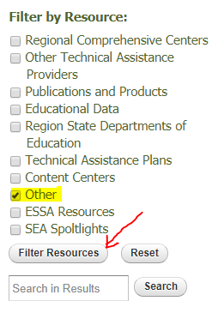
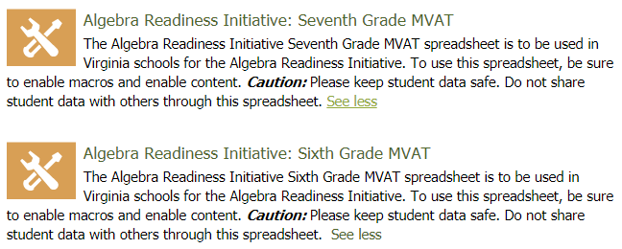
MVAT Tool – Dynamic Version
Go to the ARCC website (ARCC)
Select Resources, and check Other and click Filter Resources.
Notes:
Use Grade 6 score report to generate a student report using the dynamic version of the MVAT
https://www.arccta.org/content/algebra-readiness-initiative-sixth-grade-mvat
https://www.arccta.org/content/algebra-readiness-initiative-seventh-grade-mvat

Slide 97
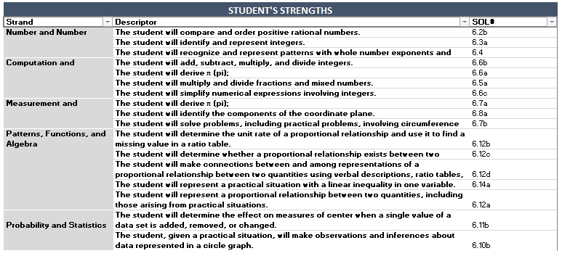
Student Strengths - Report
Notes:
Tina, Kristin, ARCC Representative
Use Grade 6 score report to generate a student report using the dynamic version of the MVAT tool

Slide 98
Student Unfinished Learning - Report
Notes:
Tina, Kristin, ARCC Representative
Use Grade 6 score report to generate a student report using the dynamic version of the MVAT tool

Slide 99
9. AR Program Structures

Slide 100
Brainstorm – Structures of Effective AR School Programs
How are students identified?
When is intervention provided?
How is student progress measured?
Who provides intervention services?
What instructional resources are used during intervention?
How is the intervention time structured?
Notes:
Small group table brainstorm; Round robin to share as whole group and create lists on poster paper

Slide 101
Effective ARI Program Components
How are students identified?
Multiple measures are used (screeners, benchmark assessments, classroom assessments, previous SOL data)
When is intervention provided?
Time is built into the regular school day schedule
Afterschool tutoring with transportation (and snacks ☺)
How is student progress measured?
Formative assessment results are tracked regularly
Pre- and post-assessment results
Notes:
Review list created formed by combining characteristics of programs from across the state

Slide 102
ARI Program Exemplars
Who provides intervention services?
Mathematics teachers at the school
Retired mathematics teachers
What instructional resources are used during intervention?
Instruction that promotes student discourse and problem solving
Mathematics SOL aligned activities that engage learners
How is the intervention time structured?
Remediation bells/blocks that parallel daily instruction
Notes:
Review list created formed by combining characteristics of programs from across the state

Slide 103
Padlet - Large Group Share-Out
What challenges could limit the effectiveness of the AR program? What are some solutions to those challenges?
What strategies might be used to motivate students?
How can parents/community be involved in Algebra Readiness Initiative?
Notes:
Three groups of three – round robin

Slide 104
10. TestNav Practice Items and Desmos

Slide 105
Desmos Online Calculators
Spring 2019
Mathematics Standards of Learning tests (assessing the 2016 Mathematics SOL) administered online will include access to an online calculator from Desmos within TestNav 8
Students may use Desmos and one of the hand-held calculators on the List of Approved Calculators
2018-2019 School Year – Transition period for school division staff and students to become more familiar with Desmos

Slide 106
Desmos Online Calculators
2019-2020 School Year – Students taking the Mathematics SOL tests administered online expected to use only the Virginia Desmos online calculator
Mathematics Practice Items in TestNav –2016 items include Virginia Desmos online
calculator where applicable
Superintendent’s Memo 144-18

Slide 107
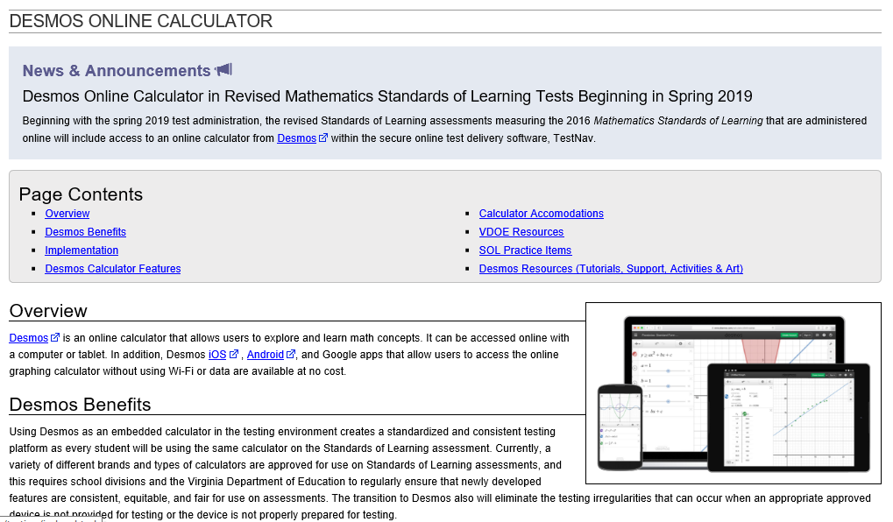
Desmos Online Calculators

Slide 108
Desmos Online Calculators
Desmos Tutorials and Learning Hub
Desmos Classroom Activities
Student Classroom Hub
Desmos Art

Slide 109
Reflection/Closure

Slide 110
Reflection ARI Institute Take-Aways
What am I taking back to my division?
What additional support is needed?

Slide 111
Thank you!!!!!!
Algebra Readiness Development Committee
Brendon Albon, Amherst County Public Schools
Michele Giglio, Henrico County Public Schools
Mary Hardesty, Virginia Beach City Public Schools
Alfreda Jernigan, Norfolk City Public Schools
Amy Jones, Hanover County Public Schools
Jennifer Mason, Henrico County Public Schools
Kelly Pocta, Hanover County Public Schools
Ashley Rea, Fredericksburg City Public Schools
Kathleen Stoebe, Stafford County Public Schools
Elaine Smetts, Stafford County Public Schools
Carol Walsh, Middlesex County Public Schools
Lois Williams, Retired VDOE staff

Slide 112
Questions??
Mathematics@doe.virginia.gov
Student_Assessment@doe.virginia.gov

